Slide 2
INTERVENTION SCHOOL UPDATE
Dr. Wanda H. Legrand, Deputy Superintendent for Academics
Aleesia Johnson, Innovation Officer
June 7, 2017

Slide 3
overview
updates provided by school
Arlington Community High School
George Washington Community High School
John Marshall Community High School
Kindezi Academy at Joyce Kilmer School 69
Data Dashboard Summary
Goal Updates
Next Steps
1
2
3

Slide 4
ARLINGTON COMMUNITY HIGH SCHOOL

Slide 5
data dashboard summary
graduation rate
Graduation Rate 2014-15*
40.5%
Graduation Rate 2015-16
74.5%
Graduation Rate Goal 2016-17
77.5%
Predicted Graduation Rate 2017
81.5%
*Operated by EdPower

Slide 6
graduation goal update
improving the graduation rate
Strategies Utilized This Year:
Graduation Coach
Satellite Programs that provided smaller settings
Twilight Program
Student progress monitoring
Student mentors
Parent meetings

Slide 7
next steps
1
Proactive Support
2
Freshman Academy
3
Advisory Program
Create an Advisory Program that educates students on credits, college & career readiness, and social/emotional support in order to assist them with graduating in four years.

Slide 8
data dashboard summary
honors & AP course participation
Honors Courses
2015-16 Data | 2016-17 Data | 2017-18 Goal
13% | 22% | 23%
AP Courses
2015-16 Data | 2016-17 Data | 2017-18 Goal
8% | 10% | 13%

Slide 9
honors & AP course update
increasing the number of students
Strategies Utilized This Year:
Teacher professional development
Formal and Informal assessments
AP Reviews and Boot Camps
AP Parent Nights

Slide 10
next steps
1
College Board AP Potential
2
Increased honors courses for AP preparation
3
AP strategies professional development
4
Parent education

Slide 11
data dashboard summary
scholarship dollars
Scholarship Dollars 2015-16
$1,063,250.00
Scholarship Goal for 2016–2017
$1,275,900.00
Projected Scholarship Dollars 2016-17
$1,428,840.00

Slide 12
scholarship goal update
increasing scholarship dollars
Strategies Utilized This Year:
Dual credit and advanced placement (AP)
Advisory
Targeted senior meetings
Scholarship events

Slide 13
next steps
1
Additional dual-credit and AP courses
2
Pathways
3
Targeted Advisory Program
4
Exposure for students in Grades 9–11

Slide 14
GEORGE WASHINGTON
COMMUNITY HIGH SCHOOL

Slide 15
data dashboard summary
graduation rate
Graduation Rate 2014-15
55%
Graduation Rate 2015-16
65%
Graduation Rate Goal 2016-17
67%
Predicted Graduation Rate 2016-17
64%

Slide 16
graduation goal update
improving the graduation rate
Strategies Utilized This Year:
Block Schedule
Graduation Coach
Advisory Program
Satellite Program with smaller setting
Twilight Program
Student progress monitoring
Targeted parent meetings

Slide 17
next steps
1
Student progress monitoring for underclassmen
2
Grant funds to support initiatives that are working

Slide 18
data dashboard summary
honors & AP course participation
Honors Courses
2015-16 Data | 2016-17 Data | 2017-18 Goal
17% | 31% | 32%
AP Courses
2015-16 Data | 2016-17 Data | 2017-18 Goal
11% | 15% | 24%

Slide 19
honors & AP course update
reducing the number of students not passing
Strategies Utilized This Year:
Teacher professional development
Formal and Informal assessments
College tutors
AP review sessions
AP Parent Nights

Slide 20
next steps
1
College Board AP Potential
2
Increased honors courses for AP preparation
3
School-wide writing initiative
4
AP strategies professional development
5
Parent education

Slide 21
data dashboard summary
scholarship dollars
Scholarship Dollars 2014-15
$723,150.00
Scholarship Dollars 2015-16
$950,514.00
Scholarship Goal for 2016–2017
$1,140,616.00
Projected Scholarship Dollars 2016-17
$2,126,078.00

Slide 22
scholarship goal update
increasing scholarship dollars
Strategies Utilized This Year:
Advisory
Targeted senior meetings
Student mentors
Scholarship events
Recognized as Indiana Top 100 FAFSA School

Slide 23
next steps
1
Additional dual-credit courses
2
Differentiated advisory for underclassmen

Slide 24

JOHN MARSHALL
COMMUNITY HIGH SCHOOL

Slide 25
data dashboard summary
graduation rate
Graduation Rate December 2014-15
72.7%
Graduation Rate December 2015-16
63%
Graduation Rate Goal 2015-16
70%
Predicted Graduation Rate 2016-17
55%

Slide 26
graduation goal update
improving the graduation rate
Strategies Utilized This Year:
Graduation Coach
Twilight School
Student progress monitoring
Parent meetings

Slide 27
next steps
1
Progress monitoring for underclassmen
2
Freshman Academy
3
Advisory Program

Slide 28
data dashboard summary
honors & AP course participation
Honors Courses
2015-16 Data | 2016-17 Data | 2017-18 Goal
16% | 26% | NA
AP courses
2015-16 Data | 2016-17 Data | 2017-18 Goal
12% | 15% | NA

Slide 29
honors & AP course update
reducing the number of students not passing
Strategies Utilized This Year:
Teacher professional development
Formal and Informal assessments
Tutoring

Slide 30
next steps
1
Utilization of AP Potential
2
Increased honors courses for AP preparation
3
AP strategies professional development
4
Parent Education Nights

Slide 31
data dashboard summary
scholarship dollars
Scholarship Dollars 2014-15
$673,714.00
Scholarship Dollars 2015-16
$1,009,400.00
Scholarship Goal for 2016–2017
$1,211,280.00
Projected Scholarship Dollars 2016-17
$1,024,900.00

Slide 32
scholarship goal update
increasing scholarship dollars
Strategies Utilized This Year:
Advisory
Targeted senior meetings
Scholarship events

Slide 33
next steps
1
Additional dual-credit and AP courses
2
Create Pathways
3
Advisory
4
Expose current students in Grades 9–11 to scholarship opportunities

Slide 34
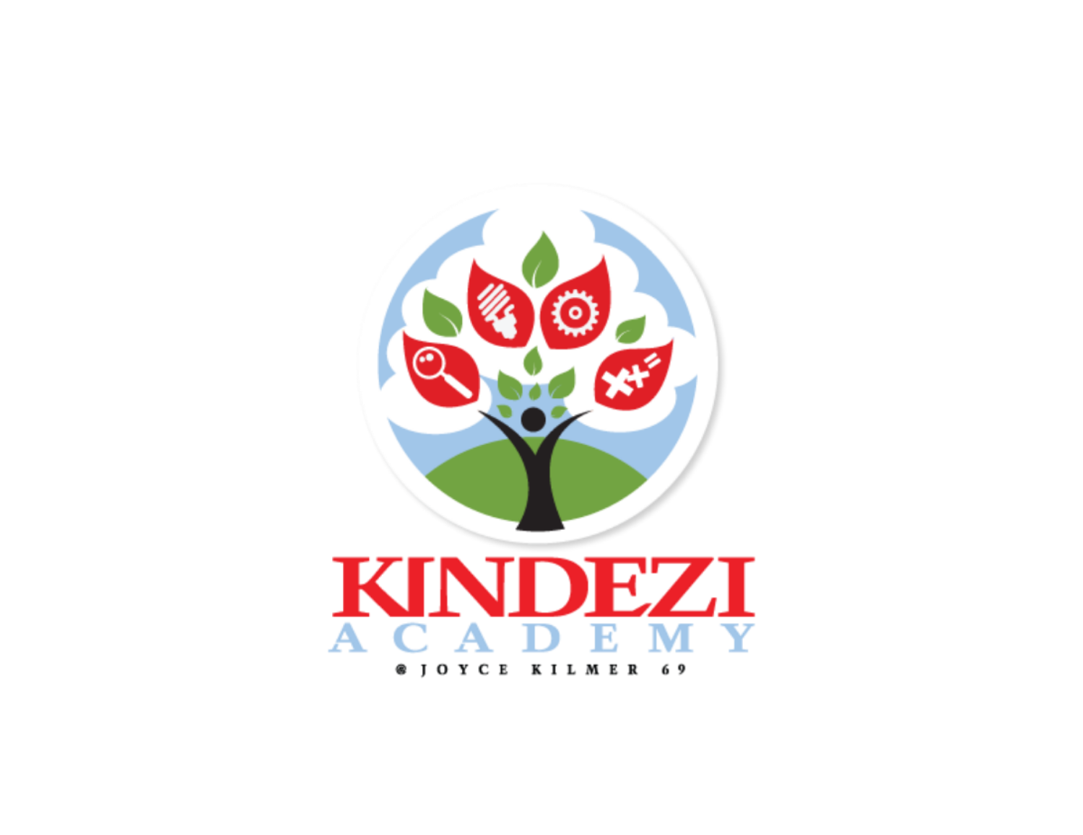
KINDEZI ACADEMY
AT JOYCE KILMER SCHOOL 69

Slide 35
enrollment
Beginning of Year | Mid-Year | End of Year
329 | 385 | +56

Slide 36
year-to-date updates
academic goals
State Assessment | 2015-16 Performance | 2016-17 Goal
ISTEP+ ELA | 28.2% | 39%
ISTEP+ MATH | 20.3% | 31%
I-READ 3 | 58.7% | 64%
Academic Growth
  Increase average reading growth by 1.6 years for each student

Slide 37
reading performance
as measured by IRLA (Independent Reading Level Assessment)
Grade Level | Beginning of Year Average Reading Level | Mid-Year Average Reading Level | Difference
K | PK | 0.4 | 0.4
1 | 0.1 | 0.8 | 0.7
2 | 1.0 | 1.3 | 0.3
3 | 1.9 | 2.4 | 0.5
4 | 2.0 | 2.7 | 0.7
5 | 2.3 | 3.0 | 0.7
6 | 3.3 | 3.9 | 0.6

Slide 38
math performance
as measured by NWEA Measures of Academic Progress
Grade Level | Fall RIT Norm | Beginning of Year | Mid-Year | Difference
K | 140.0 | 127.7 | 134.6 | 6.9
1 | 162.4 | 149.9 | 156.7 | 6.8
2 | 176.9 | 160.3 | 169.0 | 8.8
3 | 190.4 | 175.2 | 185.1 | 10
4 | 201.9 | 191.2 | 195.9 | 4.7
5 | 211.4 | 199.2 | 204.1 | 4.9
6 | 217.6 | 205.3 | 211.3 | 6.0

Slide 39
next steps
Areas of Strength
Opportunities for Growth
A comprehensive reading curriculum, through American Reading Company, provides a research-based, 12-step Response to Intervention school transformation model
Providing professional development in differentiation of literacy instruction
Increasing use of data-driven instructional practices
Led to accelerated transformation of literacy instruction practices and positively impacted student culture around reading

