Slide 1
Hoosier Academy Virtual Charter Review
May 10, 2017

Slide 2
HAVC Enrollment Trend

Slide 3
HAVC Enrollment By Grade Span

Slide 4
Cohort “Unknowns” & Expulsions by Year
School Year | Students Categorized as Unknown in Grad Cohort | Expulsions
13-14 | 52/223 (23%) | 490
14-15 | 99/401 (25%) | 109
15-16 | 131/538 (24%) | 247

Slide 5
Graduation Rate and Non-Waiver Rate
16.36%
22.7%

Slide 6
Mobility Patterns
New students by year with the number returning in years following.

Slide 7
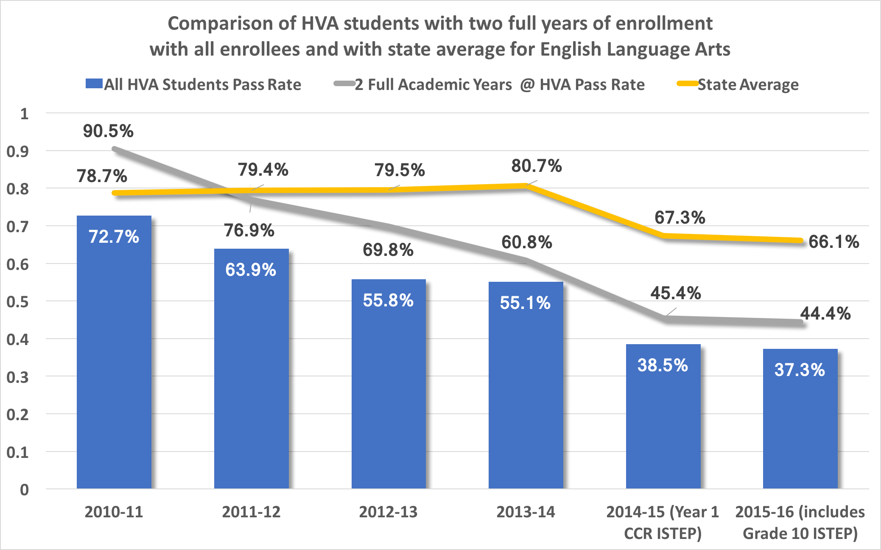

Slide 8
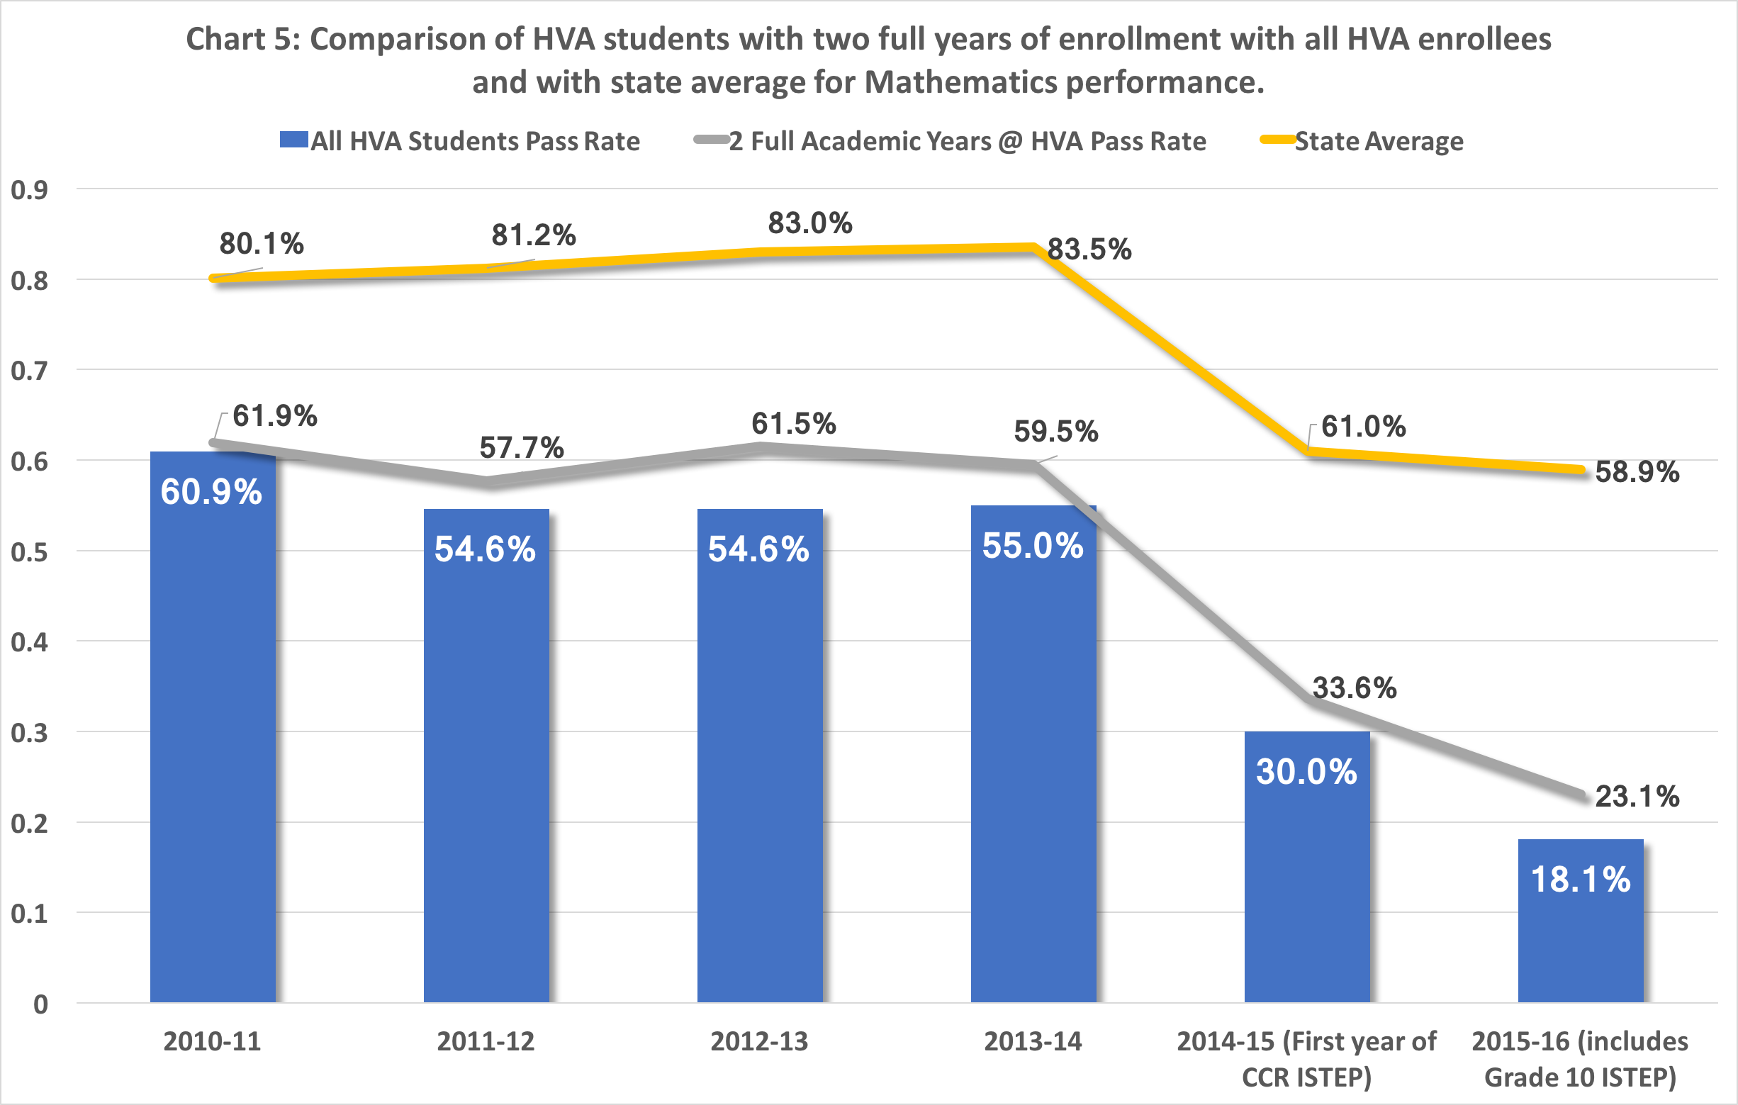

Slide 9
Student Growth & ISTEP Participation
15-16 School Year | ELA | Math
Growth | Bottom 3% | Bottom 2%
Participation Grades 3-8 | 90.3% | 92.2%
Participation Grade 10 | 87.3% | 85.6%

Slide 10
Source of New Enrollment 15-16
15-16 School Year | % of New Enrollment
Students not reported in an Indiana school prior to enrolling at HAVC | 17%
Indiana Connections Academy | 2.5%
Hoosier Academy | 1.7%
Indiana Virtual School | .9%
Indiana Cyber Charter School | .8%
No other school accounted for more than .5% of HVA’s new enrollment in 15-16.

Slide 11
School Visit
April 28 & May 1, 2017
Stakeholder Meetings
Parents
Teachers
Support Staff
Administrators
Board Members
Observation of Teaching

Slide 12
Summary of Key Challenges
Highly fluid school enrollment.
Alignment of K-12.com curriculum with the Indiana Academic Standards.
Extensive flexibility afforded by the HAVC program/structure and the resulting uneven engagement of students with the academic program being offered.
Sustained leadership and consistency of vision.
Pending status of the school with regard to the renewal of the charter.
Newness of this model of schooling & lack of understanding of enrollees regarding family commitment (time and effort) necessary to be successful.

Slide 13
Why do Families Choose HAVC?
Best educational choice for their student.
Flexibility the school afforded families and students who had struggled to succeed in other contexts.
Academic rating of the school not the principle factor in parent choice.
Students from every Indiana county.
Notes:
This flexibility appears to be a partial explanation for the popularity of the school in terms of the high enrollment numbers but also represents a key challenge for the organization in terms of fluid enrollment and flexible expectations around participation and engagement. The flexibility Hoosier Virtual Academy provides to its families represents an opportunity cost for the school when those investments do not result in genuine engagement in the academic enterprise by subscribing families or in sustained enrollment.

Slide 14
Leadership & Governance
Leadership change has been positive.
Charter authorizer not wanting to “lean in” too much.
Board looking for metrics to measure success.

Slide 15
Instructional Program & Curriculum
Alignment of K-12.com curriculum to Indiana Academic Standards – students don’t benefit from work done in this area if they don’t attend class or watch recorded class sessions.
Families do not always understand what they are agreeing to do when they sign up.
Critical role of the learning coach (often a parent or grandparent).
Family Academic Success Team – key intervention in place to track and address problems of engagement.

Slide 16
Student Performance
Consistent downward trend in proficiency
Very low growth
Despite the trends in the aggregate, there are exceptions to these performance patterns.
Students with needs
Academic acceleration needs
Medical needs
Social needs
Schedule needs

Slide 17
School Culture
Monthly events
Trying to make the state seem small
Opportunities for engagement beyond traditional academics
Science Fair
Art Competition
Prom
Support for parents

Slide 18
Improvement Efforts
Teacher development through Focused Leadership Academy.
Implementation of FAST team.
Plans for additional teacher leadership.
Adjustments to expectations regarding participation in live lessons.
Renewed efforts to onboard families no matter when they enroll.
Planned addition of office hours before & after the school day.
Addition of peer teaching observations.

Slide 19
Summary
Professional staff supportive of administration’s direction and vision.
Lack of intervention and support by authorizer.
Low performance on proficiency in Math and ELA (20 points or more below state average).
Low performance on growth (bottom 2-3 %).
Low participation in ISTEP+ assessment (85-92%).
Low grad rate (21.7%) Non-waiver grad rate 16.36%.
Extensive effort expended to address mobility and lack of engagement.
$23,515,000 annual expenses reported in 2016.

