Slide 1
Glenwood Leadership Academy
May 2017

Slide 2
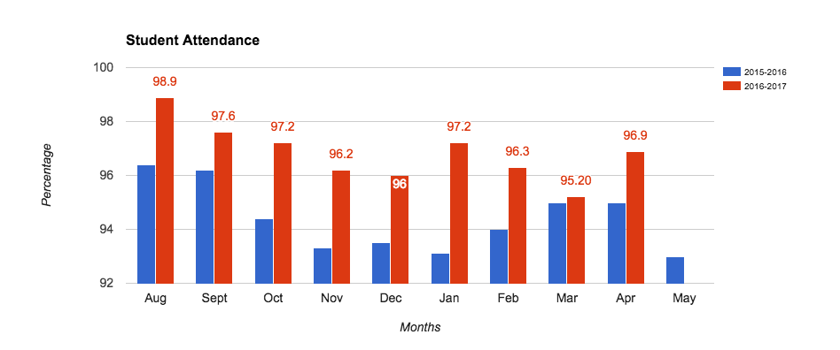
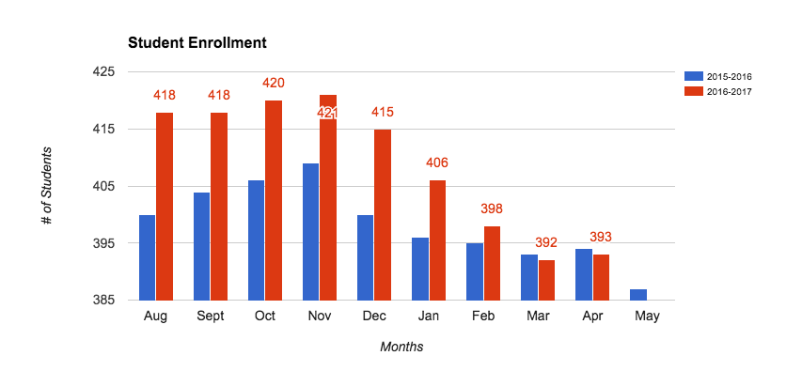
Data Dashboard Summary - Student Attendance, Enrollment

Slide 3
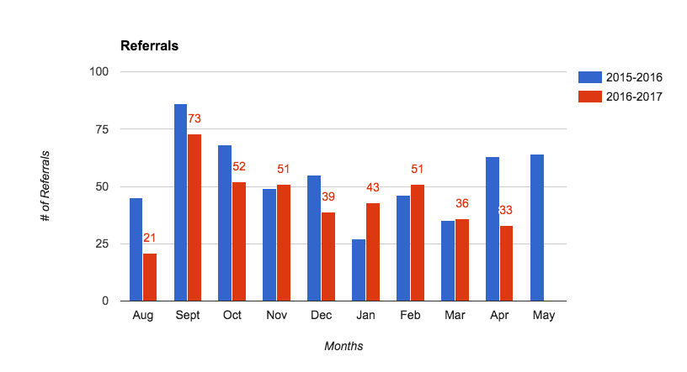
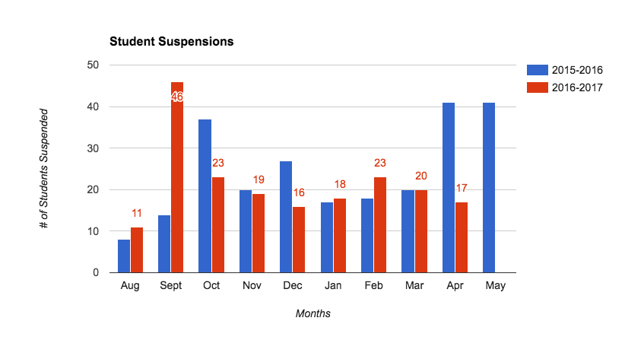
Data Dashboard Summary - Behavior
Improved difference of
19
referrals per day!

Slide 4
Data Dashboard Summary - ELA Student Performance (First Year NWEA)
Highlight: Spring IREAD pass rates improved 9%

Slide 5
Data Dashboard Summary - Math Student Performance (First Year NWEA)

Slide 6
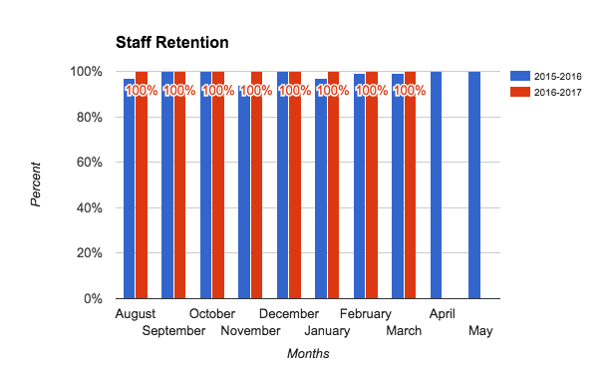
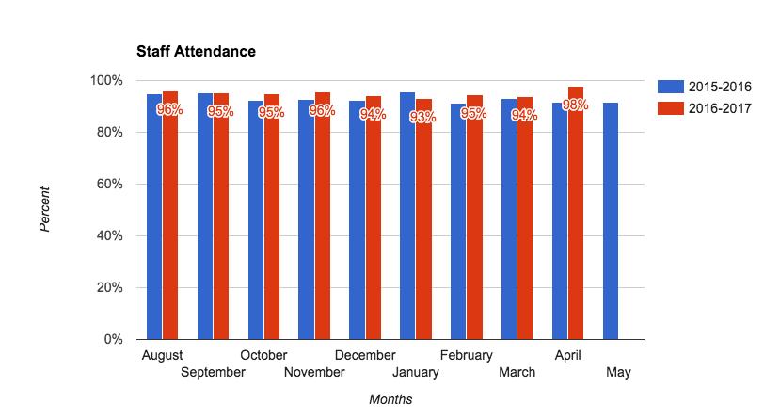
Data Dashboard Summary - Staff Retention, Staff Attendance

Slide 7
Data Dashboard Summary - Professional Development
Session 1
Session 2
Session 3
Monitoring
for Learning
Core Instruction
Core Instruction: Round 2

Slide 8
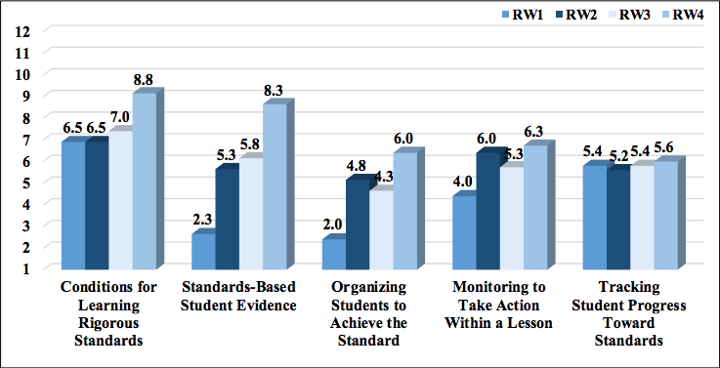
Goal Update - Effective turnaround school leadership

Slide 9
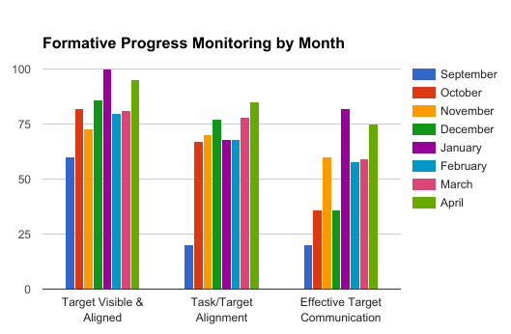
Goal Update - Effective Instruction that meets the needs of all students and is aligned with state standards
Goal: 100% of Glenwood teachers: 1) have daily visible learning targets that are specific and aligned to standards, 2) have learning tasks aligned to learning targets, 3) effectively communicate the learning target to students.
Intervention: Learning Sciences International professional development followed by tight cycles of formative and summative monitoring that drive individual teacher support.

Slide 10
Goal Update - Using data to differentiate instruction and provide interventions
Goal: NWEA data utilized in all grades K-8 to drive Tier I small group instruction for remediation, enrichment and Tier II interventions.
Intervention: NWEA and intervention training paired with cyclical teacher training and support provided by district data coach and school-based instructional coaches.

Slide 11
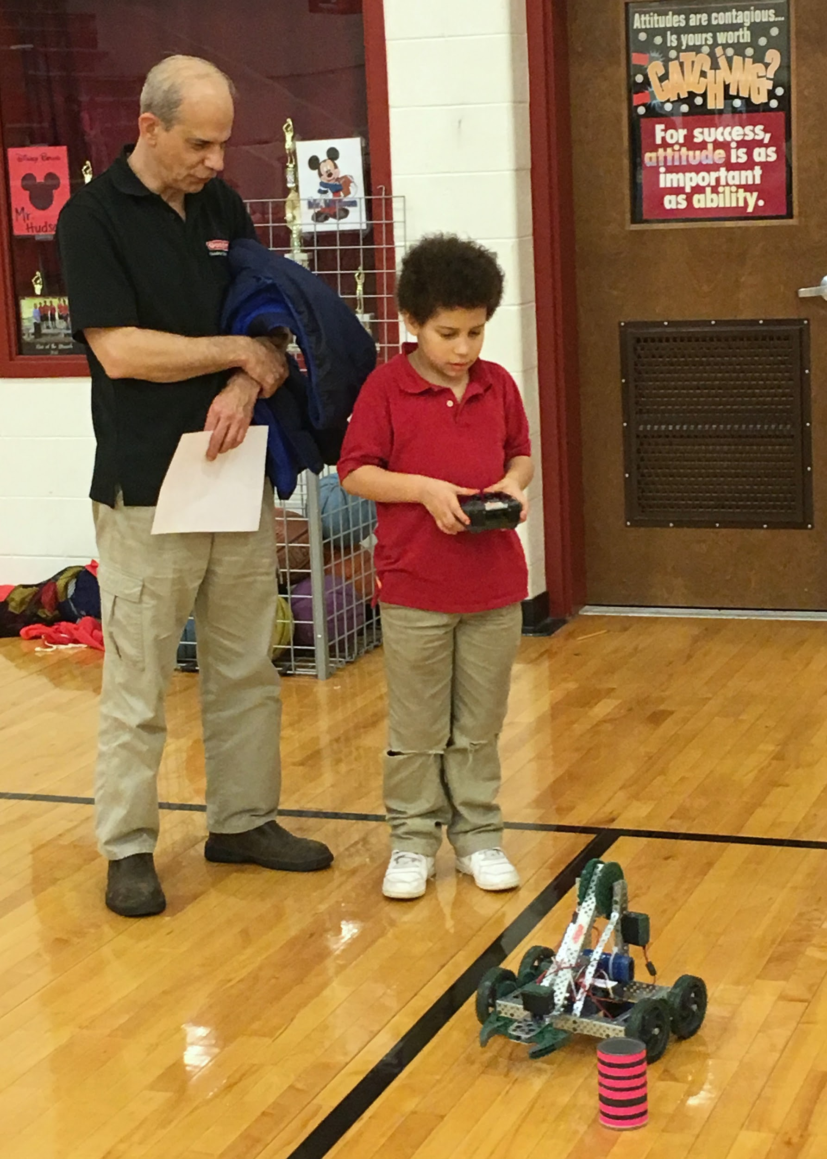
Community and Stakeholder Input and Engagement

Slide 12
Next Steps

