Slide 1
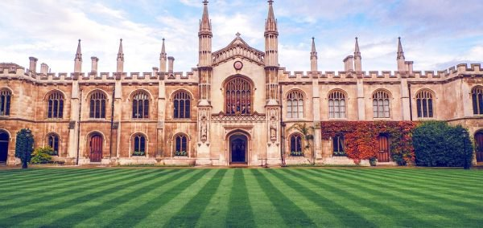
Welcome to the Cambridge Pathway: An Innovative Approach to Education
Prepared for the Indiana State Board of Education
Keith Lucey
Senior Schools Manager
December 2018

Slide 2
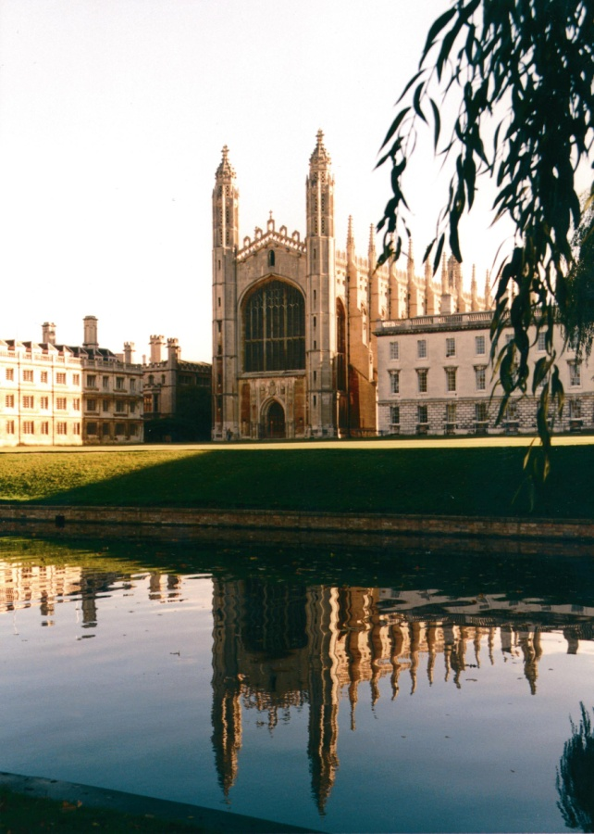
Cambridge International Assessment
part of the University of Cambridge –a non-profit renowned worldwide for excellence in education
World’s largest provider of international education for over 150 years
The only education provider part of a top university, ranked #5 worldwide in 2017
Working with over 10,000 schools, 170 countries & 40 governments
Notes:
Cambridge International Examinations is part of the University of Cambridge, which celebrated its 800th anniversary last year.
Cambridge International Examinations is also part of Cambridge Assessment – founded over 150 years ago. Today, Cambridge Assessment is an organisation of 1500 people, and Cambridge International Examinations is a vital part of its international educational expertise and assessment research. Our sister organisations within Cambridge Assessment are OCR (Oxford Cambridge and RSA) which offers qualifications for schools here in the UK and Cambridge English Language Assessment, which provides exams testing English language skills among speakers of other language. Research is at the heart of everything we do - the reliability of our assessment comes from our evidence-based and research-led approach to all developments. And so of course we have our own assessment research division, the largest research capability of its kind.
Because we belong to the University of Cambridge, we are a charitable foundation. We invest any return from our activities into education and research.
Cambridge International Examinations is the world’s largest provider of international education for 5-19 year olds.

Slide 3

Problems facing schools
Today, because of rapid economic and social change, schools have to prepare students for jobs that have not yet been created, technologies that have not yet been invented and problems that we don't yet know will arise.
Andreas Schleicher - Directorate of Education Organisation for Economic Co-operation and Development (OECD)
Notes:
Cambridge Assessment International Education (Cambridge International for short) is part of the Cambridge Assessment Group, a not-for profit department of the University of Cambridge. We are proud to be part of one of the oldest and greatest universities in the world - renowned worldwide for excellence in education.
The Cambridge Assessment Group operates and manages the University’s three exam boards:
Cambridge Assessment International Education- the world’s largest provider of international education programmes and qualifications for 5 to 19 year olds
Oxford Cambridge and RSA Examinations (OCR for short) - a leading UK awarding body, committed to providing qualifications that engage learners of all ages at school, college, in work or through part-time learning programmes to achieve their full potential
Cambridge Assessment English – provider of the world’s leading range of certificates for learners of English.

Slide 4
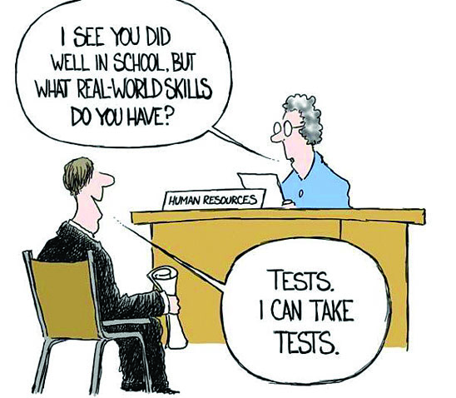
Schools need curriculum that is:
What are we teaching our students?
Rigorous and engaging, creating interactive learning environments that challenge students and prepare them for the future
Aligned to a set of performance based assessments where students demonstrate mastery
Designed to enable success of all students regardless of background or socio-economic status
Prepares them to adapt to a forever changing world
Notes:
If found it needs to be aligned with the coming assessment and professional development which is a difficult and costly proposition in the best of circumstances.

Slide 5
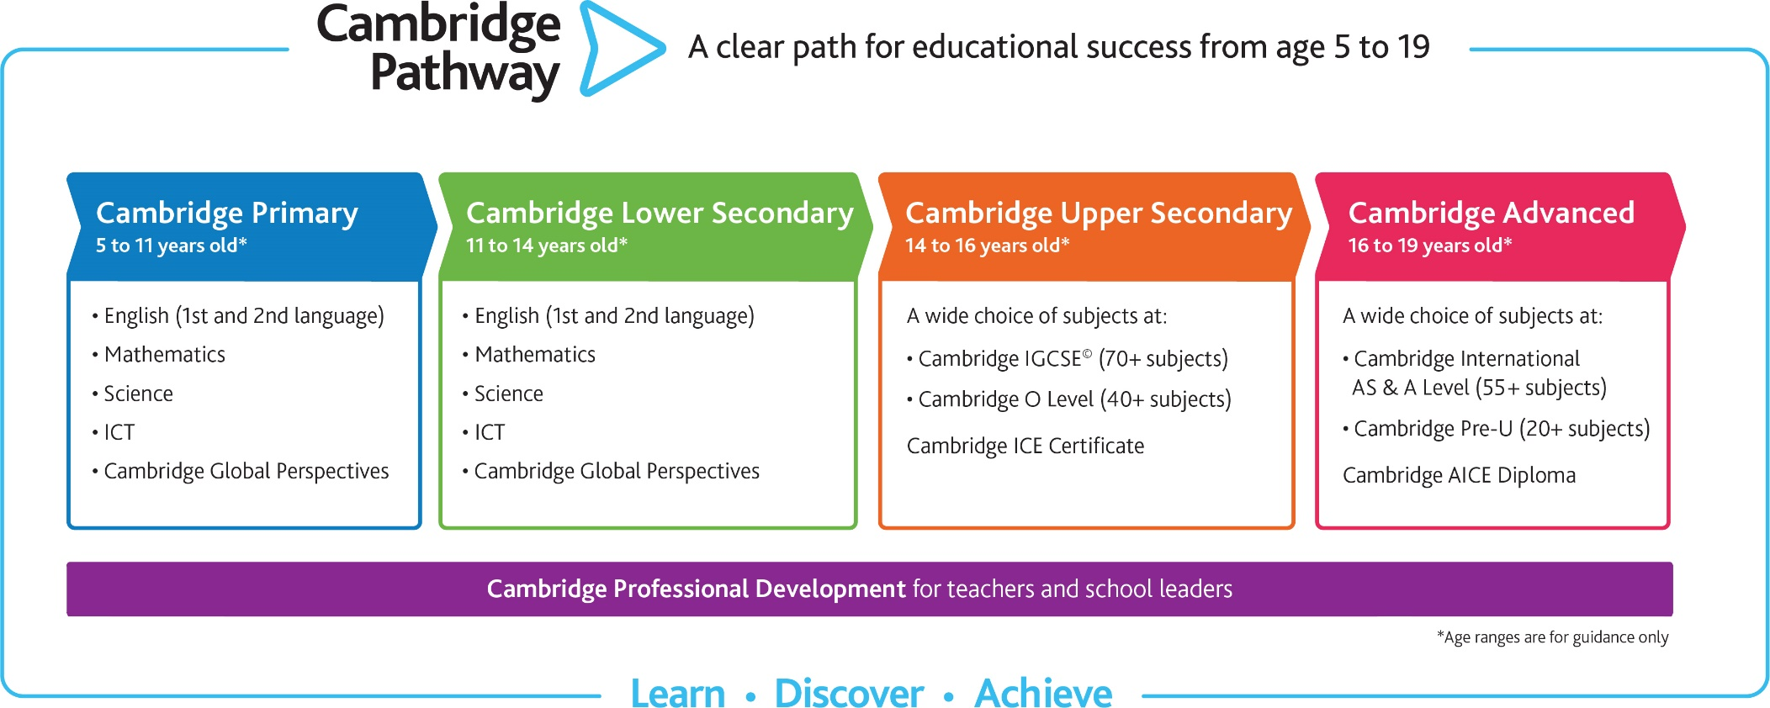
Cambridge Pathway
Flexibility for a Changing World
Notes:
Cambridge Pathway
Our Cambridge Pathway gives students a clear path for educational success from age 5 to 19.
Its wide range of subjects and flexibility gives schools the chance to shape the curriculum so that it is exciting and relevant for their own students.
Cambridge Pathway students have the chance to acquire the knowledge and skills they need to achieve at school, university and beyond.
The four stages lead seamlessly from primary to secondary and pre-university years. Each stage builds on the students’ development from the previous one, but can also be offered separately.

Slide 6
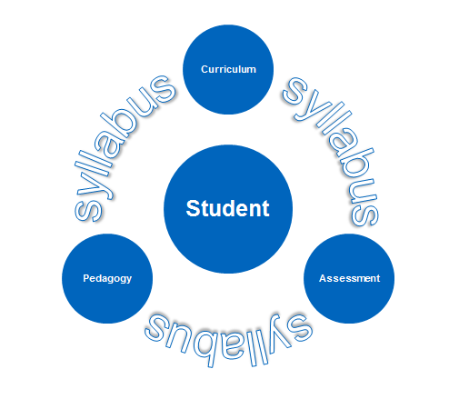
Why Cambridge a Education?
Backwards design
A Learner-Centered Approach
Our backwards designed model provides learners with the foundation to achieve high levels of academic and personal learning. Together with schools, we aim to develop learners and teachers who are:
Confident
Responsible
Reflective
Innovative
Engaged
Notes:
Confident in working with information and ideas – their own and of others
Responsible for themselves, responsive to and respectful of others
Reflective as learners, developing their ability to learn
Innovative and equipped for new and future challenges
Engaged intellectually and socially, and ready to make a difference

Slide 7
Cambridge International represented in 34 states , representing large public school districts in 19 states…
Districts Include but are not limited to….
District | State
Mobile | Alabama
Christina | Delaware
Miami Dade | Florida
Palm Beach | Florida
Broward | Florida
Collier | Florida
Orange | Florida
Clayton | Georgia
Jefferson | Kentucky
Charlotte Mecklenburg | North Carolina
Corinth | Mississippi
Passaic | New Jersey
New York | New York
Pittsburgh/Penn Hills | Pennsylvania
Aiken | South Carolina
Metro Nashville | Tennessee
Lake Washington | Washington
Pending Registrations
Active Districts

Slide 8

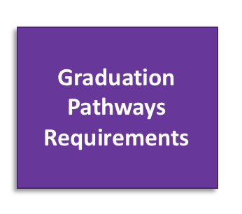
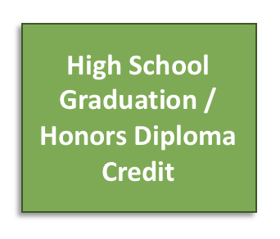

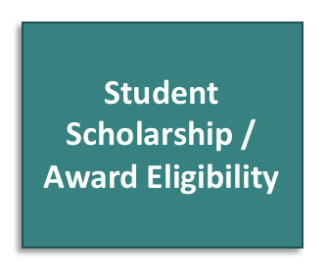

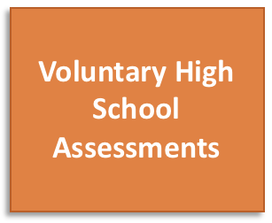
State of Indiana Policy Environment
“Expanding Graduation Pathways Options”
On March 21, 2018, Indiana Governor Holcomb signed House Enrolled Act 1420 into law. The law expands existing policy around advanced coursework (AP, IB, and Dual Credit), to now include Cambridge International courses and examinations. Specifically, the bill supports Indiana teachers and students by allowing Cambridge International to be used for:

Slide 9
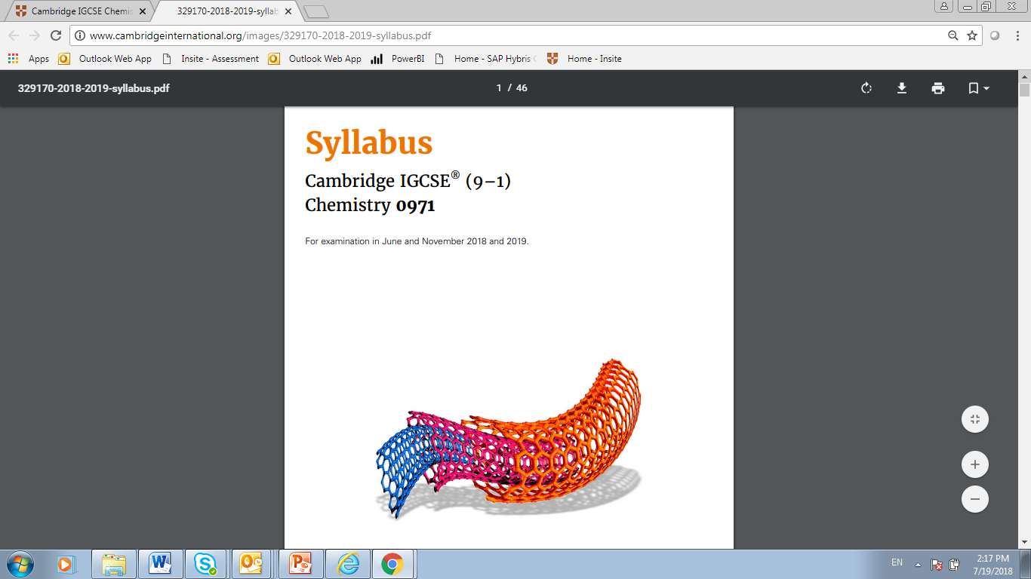
Cambridge Upper Secondary (IGCSE)
(IGCSE: International General Certificate of Secondary Education )
Typically used in grades 9 & 10
Over 70 subjects, including 30 languages
Develops learner knowledge, understanding and skills
International in outlook with local relevance
Accepted for admission at many four year and 2 year junior and community colleges
Excellent foundation for advanced programs such as Cambridge International, IB or AP
15
Notes:
Cambridge IGCSE is the world’s most popular qualification for 14 to 16 year olds. It celebrated it’s 25th anniversary on 2010.
The curriculum offers a variety of routes for learners with a wide range of abilities, including those whose first language is not English.
It develops learner knowledge, understanding and skills in:
subject content
applying knowledge and understanding to familiar and new situations
intellectual enquiry
flexibility and responsiveness to change
working and communicating in English
influencing outcomes
cultural awareness.
The syllabuses are international in outlook, but retain a local relevance. They have been created specifically for an international student body with content to suit a wide variety of schools and avoid cultural bias.
Schools worldwide have been, and continue to be, involved in the development of Cambridge IGCSE, so we are confident it represents the best possible international education for 14 to 16 year olds. The content, the structure and the administrative support mean Cambridge IGCSE answers the needs of more and more schools worldwide.

Slide 10
IGCSE
Cambridge Upper Secondary
Choose from over 70 subjects, in almost any combination. We update the syllabuses each year.
IGCSE Subjects
Accounting Agriculture Arabic Art and Design Biology Business Studies Chemistry Child Development Chinese Co-ordinated Sciences Combined Science Computer Studies Design and Technology Development Studies Drama Economics | English (First Language) English (Second Language) English Literature Environmental Management Food and Nutrition French Geography German Greek Hindi History Information Technology | Italian Japanese Latin Mathematics International Mathematics Mathematics (Additional) Music Physical Education Physics Religious Studies Sociology Spanish Travel and Tourism
Notes:
Cambridge English - Develop the ability to communicate clearly, accurately and effectively.
Cambridge First and Foreign Languages - Helps students understand and respond to what they read and hear
Cambridge IGCSE Mathematics - An essential subject for all learners, syllabuses encourage the development of mathematical knowledge as a key life skill.
Cambridge Sciences – emphasizes theory and real life applications, impact of research on individuals and society and development of practical skills.
Cambridge Arts & Humanities – Enables students to develop deeper insights. Provides a wider perspective on social issues and cultures around the globe
Cambridge Business, Vocational and Technical subjects – theory and real world applications

Slide 11
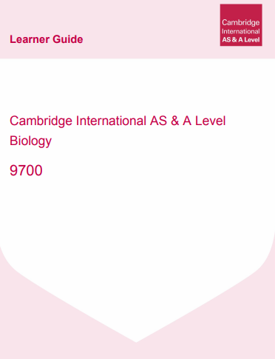
Cambridge Advanced:
AS and A-Levels (also known as “AICE” )
  College level courses and exams typically used in grades 10 – 12 in high schools
  Gives students the opportunity for a deep dive in a wide choice of subjects
  Over 55 subjects offered
  Focus on developing the skills and knowledge required for university study in higher education around the world
  Culminates in University credit and/or Advanced Placement
  Developed in collaboration with the best higher education institutions
“Students who have studied Cambridge International AS & A Levels have a real depth of understanding of the subject matter.”
- Stuart Schmill, Dean of Admissions, Massachusetts Institute of Technology (MIT), USA
18

Slide 12
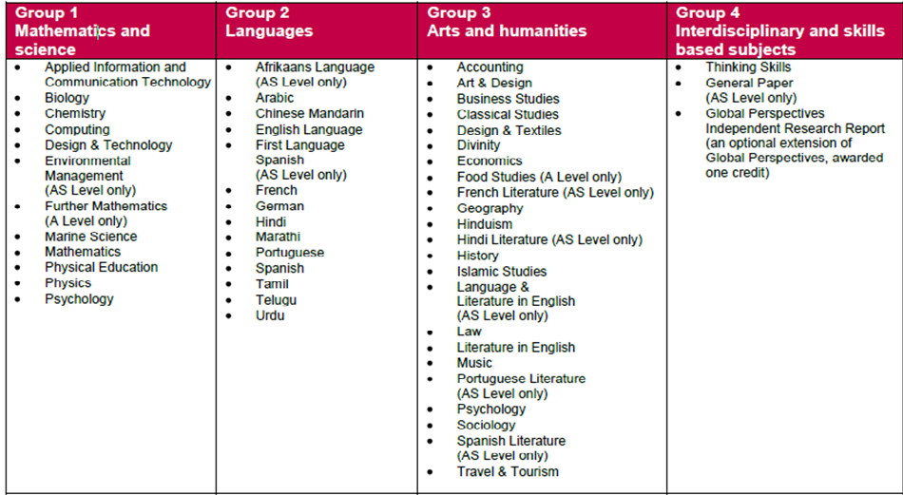
Cambridge International Advanced Subsidiary (AS) and Advanced (A) Levels
Cambridge A/AS Subject Groupings
Notes:
Other subjects to note : Classical Studies; Travel and Tourism; General Paper – a Writing exam that requires student to read about issues cross curricular in nature e.g. genetics research and the ethics of designer babies and present the various views in writing in addition to stating and supporting their own opinion

Slide 13
National US higher education colleagues advising Cambridge International
Phillip Ballinger | Associate Vice Provost for Enrollment | University of Washington
John Barnhill | Assistant Vice President for Academic Affairs, | Florida State University
Doug Christiansen | Vice Provost for University Enrollment Affairs, Dean of Admissions and Financial Aid, | Vanderbilt University
Barbara Gill | Associate Vice President for Enrollment Management, | University of Maryland
Christoph Guttentag | Dean of Undergraduate Admissions, | Duke University
Kent Hopkins | Vice President for Enrollment Services, | Arizona State University
Jerry Lucido | Executive Director, and Associate Dean of Strategic Enrollment Services, | University of Southern California
Jessica Marinaccio | Dean of Undergraduate Admissions and Financial Aid | Columbia University
Yolanda Copeland - Morgan | Vice Provost for Enrollment | University of California at Los Angeles
Logan Powell | Dean of Admission | Brown University
Stu Schmill | Dean of Undergraduate Admissions and Student Financial Services | Massachusetts Institute of Technology
Yvonne Romero da Silva | Vice President for Enrollment | Rice University
Greg Roberts | Dean of Undergraduate Admissions | University of Virginia
23

Slide 14
Western regional US higher education colleagues advising Cambridge International
Andrew Hamilton | Associate Dean for Student Success | University of Houston
Carlos Jimenez | Director of Admissions | Colorado College
Colleen Newman | Director of Admissions | University of Colorado - Boulder
Jim Rawlins | Assistant Vice President/Director of Admission | University of Oregon
Kasey Urquidez | Vice President, Enrollment Management & Student Affairs Advancement and Dean, Undergraduate Admissions | University of Arizona
Melissa Pizzo | Dean for Admission and Financial Aid Services | Arizona State University
Mike Devlin | Associate Dean and Director of Admission at Stanford | Stanford University
Robert Mundy | Dean of Admissions | University of Notre Dame
Rose Rojas | District Director, Center for Curriculum and Transfer Articulation | Maricopa Community College
Wade Bird | Assistant Director of International Admissions | Seattle University
23

Slide 15
Impact on a School

Slide 16
Kentucky: Neighboring example of potential impact
Fairdale High School, Fairdale, KY
College & Career Readiness Percent Target
Adopted
Cambridge
Note: over last 3 years witnessed a
3 point increase in ACT scores taken off state corrective action
Fairdale Population:
61% White, 22% Black,14% Hispanic
Low Income % = 64%
Notes:
Began in 2012

Slide 17
North Carolina: Middle School EOC Science with improved state Test Results…Cambridge very closely aligns with state standards…
 | 2015 - 16 Science | 2016 - 17 Science | 2017-18 Science
Sixth Grade | 49.45% | 59.20% | 77.30%
Seventh Grade | 41.18% | 80.00% | 87.60%
Eighth Grade | N/A | 53.70% | 58.20%
Middle School Proficiency | 45.3% | 61.2% | 74.36%
Report produced by Rolando Parkins MILA

Slide 18
Learn more!
Getting in touch with Cambridge is easy
Keith Lucey
Senior School Development Manager/ Northeast
Call: 917-522-2143
Email: keith.lucey@cambridgeinternational.org

