Slide 1
Assessment Update

Slide 2
Test Window Updates
ISTEP+ Grades 3-8, 10
  April 16-May 4
ISTEP+ ECAs
  April 23-May 25
ISTAR
  April 16-May 18

Slide 3
ISTEP+ Part 2 – Week 1 Call Center Volumes
Contact Method | Day | Spring 2018 | Spring 2017
Phone | Monday | 302 | 526
 | Tuesday | 355 | 677
 | Wednesday | 269 | 564
 | Thursday | 213 | 396
 | Friday | 161 | 274
 | Week Total | 1,300 | 2,437
Web/Email | Week Total | 43 | 99

Slide 4
ISTEP+ Part 2 – Week 2 Call Center Volumes
Contact Method | Day | Spring 2018 | Spring 2017
Phone | Monday | 161 | 287
 | Tuesday | 179 | 276
 | Wednesday | 141 | 240
 | Thursday | 106 | 182
 | Friday | 85 | 109
 | Week Total | 672 | 1,094
Web/Email | Week Total | 35 | 54

Slide 5
ISTEP+ Part 2 – Top Call Drivers
Category | Number of Calls
Testing – Student Test Issues/Questions | 753
PearsonAccess^{next} – Session Management | 608
TestNav – Error Codes | 576
Testing – Accommodations | 136
Questions Referred to IDOE | 113
Paper-Pencil Testing Questions | 102

Slide 6
ISTEP+ Part 1 Testing Volumes by Mode
Subject | Paper – Completed | Online – Completed | Total - Completed
ELA | 215,294 | 396,299 | 611,593
MATH | 220,131 | 409,933 | 630,064
SCIENCE | 83,819 | 163,902 | 247,721
SOC STUDIES | 55,594 | 113,250 | 168,844
Total | 574,838 | 1,083,384 | 1,658,222

Slide 7
ISTEP+ Part 2 Testing Status – through April 27
Subject | Paper – Assigned | Online – Not Started | Online – In Progress | Online - Completed
ELA | 34,292 | 14,327 | 42,684 | 537,245
MATH | 34,937 | 13,952 | 33,164 | 565,089
SCIENCE | 16,473 | 19,571 | 53,958 | 172,214
SOC STUDIES | 8,368 | 5,983 | 31,011 | 125,774
Total | 94,070 | 53,833 | 160,817 | 1,400,322

Slide 8
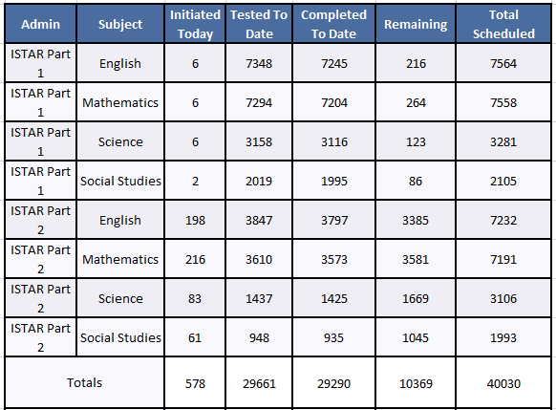
ISTAR Parts 1 & 2 Administration 2018
Test Administration Window
Part 2: April 16 – May 18, 2018
Cumulative Testing Data
April 16 – April 27, 2018

Slide 9
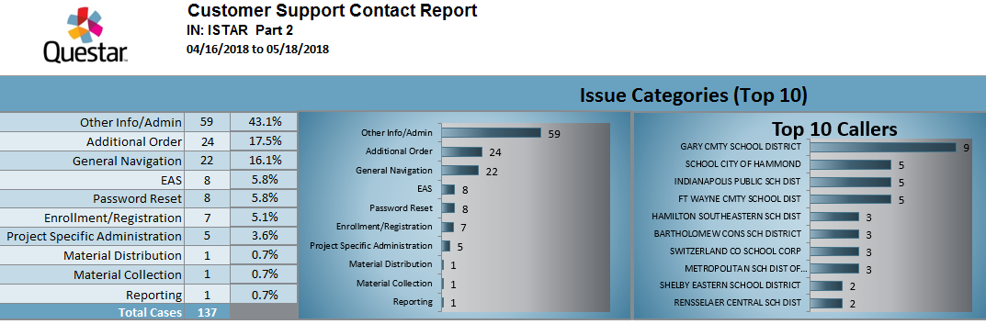
ISTAR Parts 1 & 2 Administration 2018
Cumulative Customer Support Contact Report
April 16 – April 27, 2018

Slide 10
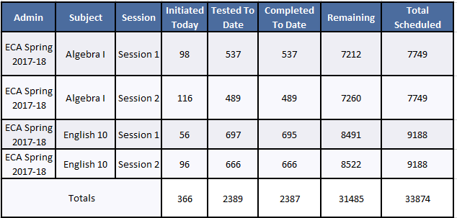
ISTEP+ ECA Spring Administration 2018
Test Administration Window
April 23 – May 25, 2018
Cumulative Testing Data
April 23 – April 27, 2018

Slide 11
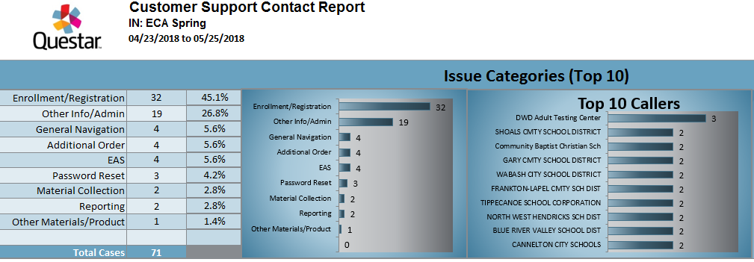
ISTEP+ ECA Spring Administration 2018
Cumulative Customer Support Contact Report
April 23 – April 27, 2018

Slide 12
ILEARN Resources Release: May 15, 2018
Blueprints
Item and Passage Specifications
Released Items
  Sample Items (at least 10 per grade and content area)
  Student Tools and Supports
Technology Resources and Specifications
Accessibility and Accommodations Guidance
Assessment Literacy Resources
  Educator Brochure
  Assessment Development Infographic
  Understanding Indiana’s New Assessment System Webinar (May-June)
  Computer Adaptive Tests Webinar (May-June)
Notes:
On May 15, 2018, Assessment will deploy an updated website for ILEARN which will feature the resources listed on the slide.
Supporting resources:
Videos and Infographics explaining blueprints and item specifications
User guides walking through the released items and student tools/supports
Released Items are provided in testing platform. Tutorials will be available that model answering different item types.
Technology Resources: AIR’s network diagnostic tool simulates a given number of concurrent testers on a school’s network to provide information regarding network performance
We will also have an assessment literacy webpage up on this date.

Slide 13

ILEARN Webinars
Interactive sessions with educators!
Registration Link: https://form.jotform.com/81066155039960

