Slide 1
Assessment Update

Slide 2
Updates
Spring Pretest Workshops initiate this month
  ISTEP+ 3-8 and 10, ECAs and IREAD-3
WIDA Assessment Window
  January 8-February 23, 2018
ISTAR Part 1
  January 15-February 16, 2018
ILEARN Contract Execution

Slide 3


Slide 4
Applying Lessons Learned from Current Programs
Delivery Platform
Content Development
Accessibility
Reporting
AIR’s platform has successfully delivered over 70 million online adaptive tests over the course of 10 years with no significant technical issues.
ILEARN will incorporate universal design practices along with student supports such as glossaries, dictionaries, translations, and accessible calculators, enabling all students to successfully access and interact with test content.
Schools and teachers will receive more precise data from computer-adaptive tests. Preliminary data will be provided 12 days after testing, and final data will be released by July 1*
IDOE will license quality and rigorous item banks. Educators will conduct an item audit with IDOE to identify items aligned to IN standards. Any additional items needed to ensure alignment will be pulled from the current IN pool or developed.
*After year 1 due to standard setting

Slide 5
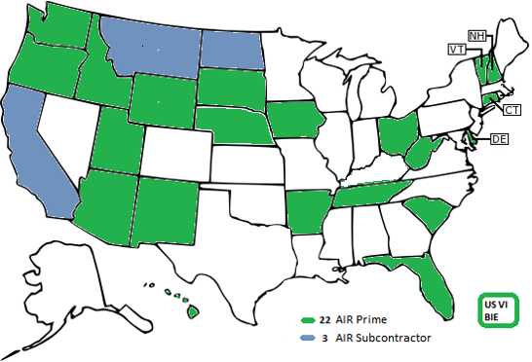
AIR Assessment
Not-for-profit
Statewide assessments
Online adaptive testing
General Education, Alternate, English Proficiency Assessments
Notes:
AIR currently serves as a prime contractor in 22 states and as a subcontractor in 3 states with their delivery platform.

Slide 6
ILEARN: Understanding the New Assessment
Computer Adaptive
Math and ELA
Unique student experience that always meets the blueprint
Assesses Grades 3-8
Math (Grades 3-8)
English/Language Arts (Grades 3-8)
Additional Student Supports and Accommodations
Translations
Glossaries
Adapts on difficulty, not across grade levels unless content aligns at multiple grade levels
Science
(Grades 4 and 6)
Social Studies
(Grade 5)
Spell Check
Accessible Calculator
American Sign Language
Improved Testing Times
Single testing window at the end of the year
Improved Reporting Structures
Decreased test length (average 2 hours shorter total at each grade level)
Untimed sessions
Individual student results in 12 days*
Final results by
July 1*
More detailed student reports for computer adaptive tests
Revised cut scores and proficiency levels (by educator committee)
Custom-built for IN standards
Rich Text Tools
Intuitive Graphing Interfaces
Includes open-ended items for all content areas
Embedded Dictionary/Thesaurus
*These times will begin in 2020 due to setting cut scores in Summer 2019. Final reporting will be available Aug 15 for 2019.

Slide 7
ILEARN: Reducing Burden for Schools
Elimination of TL Data Collection
  Students will be automatically loaded into TIDE (the test administration system) from the Department’s systems.
  Regular feeds will keep registration up-to-date at all times.
“Sessionless” Testing
  Student test sessions are automatically generated during log-in based on a code provided by the teacher, reducing the burden of prior setup.
Streamlined Technology Setup
  AIR systems require the installation of a single secure browser with no caching server, reducing time required for technology setup.
  System check tools automate infrastructure trials.
Single Test Window
  A single testing window at the end of the school year requires only one preparation rather than two.

Slide 8
ILEARN: Educator Involvement & Next Steps
Standard Setting Determine cut scores for
each proficiency category.
We are building ILEARN from the ground up, and educators are involved in every step!
Scoring Score open-ended items for field test (calibrate the
scoring through range finding) and operational data.
Data Review Review statistical data from field test items to
determine if the items can be used operationally.
Item Development Develop new items to ensure the assessment
of the breadth and depth of Indiana standards.
Item Audit Review items from licensed banks to
determine alignment with Indiana Standards.
Specifications Determine how each standard should be measured (e.g.,
evidence statements, item types, cognitive complexity, etc.)
Blueprints Create test parameters that define essential content from
the standards and appropriate proportions of the standards.
IN Academic Standards Define the knowledge and skills students should
achieve at each grade level for each content area.

