Slide 1
Assessment Update

Slide 2
Current Administrations

Slide 3
Current Spring Administrations
ISTEP+ Part Two Window: completed successfully on May 5
  Over 1.5 M test sections completed online
  Reviewing feedback from survey to document lessons to learn for 2017-18 administration
ISTAR Part Two Window: April 10-May 19
  Standard Setting in June
  Recruitment completed
ECAs: April 24-May 26
IREAD-3 Preliminary Results for Phase 1 and 2 posted early

Slide 4
Current Spring Administrations: IREAD-3
Results will be posted as preliminary on Compass May 12 and the embargo removed.

Slide 5
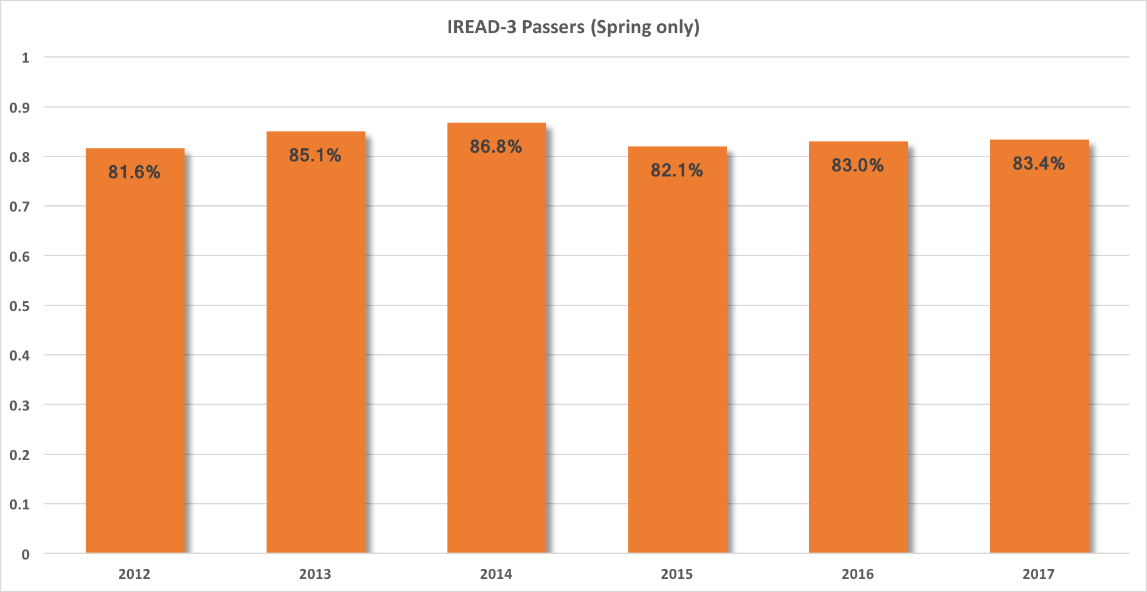
Annual Spring IREAD-3 Comparison

Slide 6
Current Spring Administrations: ISTEP+
Date | Activity
5/19/17 | Parent Portal Claim Codes are available
6/16/17 | *OnDemand Reports Preliminary (Proficiency, Pass/Did Not Pass/Undetermined) are available Applied Skills Response Images are available on Parent Portal
6/19/17 – 6/23/17 | Undetermined Status Resolution Window is open
6/19/17 – 7/7/17 | Request for Rescore Window is open
7/31/17 | Corporation and School Student Data Files (Contains the student demographic information, scale scores and proficiency level) are available PDF Copies of Individual Student Reports are available
8/16/17 | Paper Copies of Individual Student Reports and labels are delivered to corporations Summary Reports
Reporting Timelines
  Spring ISTEP+

Slide 7
ISTAR Standard Setting
June 19-21
  ELA and Science
June 26-28
  Mathematics and Social Studies
Formalizing PLDs with educators to inform process
Soliciting feedback on proficiency levels
  Developing proficiency
  Meeting proficiency
  Exceeding proficiency

Slide 8
1003 Considerations

Slide 9
Proposed Assessment Plan
(Computer Adaptive and/or Fixed Form)
Grade | English/Language Arts | Mathematics | Science | Social Studies
3 | ILEARN | ILEARN
4 | ILEARN | ILEARN | ILEARN
5 | ILEARN | ILEARN |  | ILEARN
6 | ILEARN | ILEARN | ILEARN
7 | ILEARN | ILEARN
8 | ILEARN | ILEARN or Alg I ECA
9 |  | Alg I ECA (only students in Alg I)
10 | Eng 10 ECA | Alg I ECA (only students in Alg I) | Biology ECA
11 |  | College Entrance Exam (only students who completed Alg I in MS)
12 |  |  |  | US Government

Slide 10
Considerations:
Growth and performance for Grades 3-8 are required by ESSA and the current process for calculating growth continues under the proposed plan.
Students taking Algebra I in MS will no longer be required to “double test”, but will still take an appropriate, more rigorous, assessment in HS, just like all other students.

Slide 11
Concerns:
In order to move from ISTEP+ given only at Grade 10 to ECAs given starting in 2018-19, we will have one subset of high school students who will not have an accountability assessment available.
Hint: English is not an issue since the English 10 ECA will still be given to all Grade 10 English students.

Slide 12
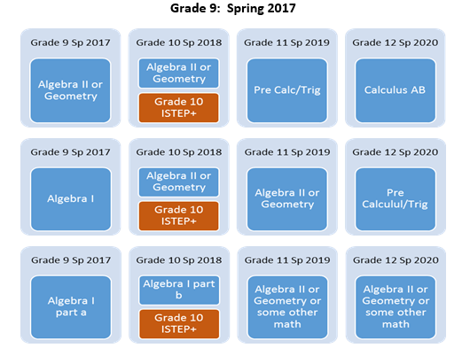
Current Math Accountability Tests:
Spring 2017
(not inclusive of all pathways)

Slide 13
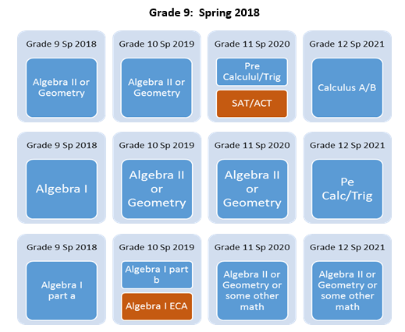
Math Accountability Tests:
Spring 2018
(not inclusive of all pathways)

Slide 14
Proposed Solution:
Given that the Grade 10 Mathematics ISTEP+ test is comprised of content from Algebra I and Grade 8, allow students completing Algebra I in Grade 9 in 2018 to take the Grade 10 math portion for Accountability purposes.

Slide 15
RFP Development
RFP Draft 1 Review (Group 1)
April 10, 2017 - April 21, 2017
Grades 3-8: Jennifer Stargel, Mary Williams
RFP Draft 2 Review (Group 2)
May 8, 2017 - May 12, 2017
Assessment Implementation Advisory Group
RFP Draft 3 Review (Group 3)
May 22, 2017 - May 31, 2017
State Board of Education
(All grades) Cynthia Roach
Technial Advisory Committee
RFP Draft 3 Development
(based on feedback from Group 2)
May 15, 2017 - May 19, 2017
RFP Draft 3 Revision/Finalize RFP
(based on feedback from Group 3)
June 1, 2017 - June 22, 2017
Simple Revisions: (Grades 3-8) Graham Collins
Simple Revisions: (Grades 3-8) Graham Collins
RFP Draft 1 Development
April 3, 2017 - April 7, 2017
Charity Flores, Randi Rieman-Johns, Sholonda Trice, Graham Collins, Adam Mastrucci, Karen Stein
(All grades) John Keller, Jeff Milkey
RFP Draft 2 Development
(based on feedback from Group 1)
April 24, 2017 - May 5, 2017
Simple Revisions: (Grades 3-8) Graham Collins
Simple Revisions: (Grade 10) Adam Mastrucci
Major Revisions: RFP Committee - Charity Flores, Mike Moore (Legal), John Keller (IT), and Lee Ann Kwiatkowski, Sholonda Trice
Simple Revisions: (Grade 10) Adam Mastrucci
Major Revisions: RFP Committee - Charity Flores, Mike Moore (Legal), John Keller (IT), and Lee Ann Kwiatkowski, Sholonda Trice
Simple Revisions: (Grade 10) Adam Mastrucci
Major Revisions: RFP Committee - Charity Flores, Mike Moore (Legal), John Keller (IT), and Lee Ann Kwiatkowski, Sholonda Trice
Grade 10: Erin Thompson, Joe Staten

Slide 16
TAC Recommendations

Slide 17
Recommendations from TAC
IREAD-3 Cut Score validation
  Routine assessment process to ensure cut score throughout administrations as standards are implemented
  Scheduled for summer workshop
  Significant changes are not anticipated
  Maintains validity for future administrations
Science Assessment Development
  Ensures alignment to 2016 standards
  Blueprint and specifications development in May
  Field test in 2018
  Operational in 2019
Coretests Technical Documentation

Slide 18
Indiana CORE Assessment Background
Spring 2010: Rules for Educator Preparation and Accountability (REPA) revised teacher licensing structure
Summer – Fall 2010: IDOE contracted with the Evaluation Systems group of Pearson to develop Educator Standards to support REPA
Spring 2011: IDOE selected Evaluation Systems group of Pearson to develop and administer the Indiana CORE Assessments for Educator Licensure

Slide 19
Assessments in Program
Core Academic Skills Assessment (CASA)
  One means of demonstrating basic skills competency
  Reading, Mathematics, & Writing
Pedagogy Assessments:
  Based on School Setting Developmental Standard
  Early Childhood Education (P–3)
  Elementary Education (K–6)
  Secondary Education (5–12)
  P–12 Education
Content Area Assessments
  Based on Indiana content area educator standards
  Over 50 licensing areas

Slide 20
TAC Engagement
The Technical Advisory Committee (TAC) met in April
  Reviewed development process
  Technical documentation for assessments

Slide 21
TAC Engagement
Technical Defensibility
Validity Claim
  Indiana CORE assessment scores are valid measures of knowledge and skills needed for an entry-level educator in Indiana schools or entry into Indiana educator preparation programs
Evidence to Support Claim:
    Test Development Activities
    Scoring
    Reliability
    Passing Standards
Notes:
Validity simply refers to the degree of which evidence supports the intended claim on test score interpretations and uses. In other words, a validity claim answers the question, “does the test measure what is was intended to measure?”
The Indiana CORE Assessments for Educator Licensure were developed to assess the basic skills competency required for entry into Indiana educator preparation programs and developmental (pedagogy) and content area knowledge and skills required for an entry-level educator in Indiana classrooms.
Evaluation Systems, in collaboration with the IDOE, presented a summary of the validity evidence to the TAC on or before its April meeting to support the technical aspects of the program.
The IN TAC discussed the available evidence on (1) test development, (2) scoring procedures, (3) reliability, and (4) how the passing standards were adopted. Evidence supports:
test items measure the knowledge and skills delineated in the REPA standards. Each assessment blueprint is aligned with the REPA standards, and Content Advisory Committees (CAC) comprised by IN Educators established the relevance of the assessments content for entry-level teaching;
rules and procedures for scoring candidates’ responses on Indiana Core assessments are technically defensible;
Indiana Core assessment scores are dependable (reliable) measures of candidates’ test performance;
pass/did not pass cut scores were developed with a technically sound standard setting process. Its implementation yielded challenging but attainable passing standards.

Slide 22
Next Steps
The TAC supported the technical defensibility of the CORE program and did not indicate any significant concerns
The TAC will review additional next steps at the August meeting to contribute to the technical documentation:
    Recommendations for continued periodic review of performance data;
    Recommendations for further adherence to industry standards

Slide 23
IREAD-3 Considerations

Slide 24
How is the pass rate for IREAD calculated?
Number of students that pass in either administration (best attempt) Number of students enrolled in grade 3 taking IREAD-3 for the first time during Spring and Summer administrations in a given year (less ISTAR test takers and students with Medical Necessity Exceptions) | = Overall pass percentage rate for school

Slide 25
Have passing rates on IREAD-3 held steady over the years?
(Spring and Summer)
Notes:
Yes—there has been a total variance of less than 4% over the five years of IREAD administration for which we are reporting data.

Slide 26
What is a good cause exemption (GCE)?
A Good Cause Exemption allows a student to be exempted from the consequences of not passing (i.e., having to retake the test or having to be retained in 3rd grade reading). The conditions that result in exemptions are enumerated below:
Students who have previously been retained twice.
Students with disabilities whose Case Conference Committee has determined that promotion is appropriate.
English Learners whose Individual Learning Planning (ILP) committee has determined that promotion is appropriate.

Slide 27
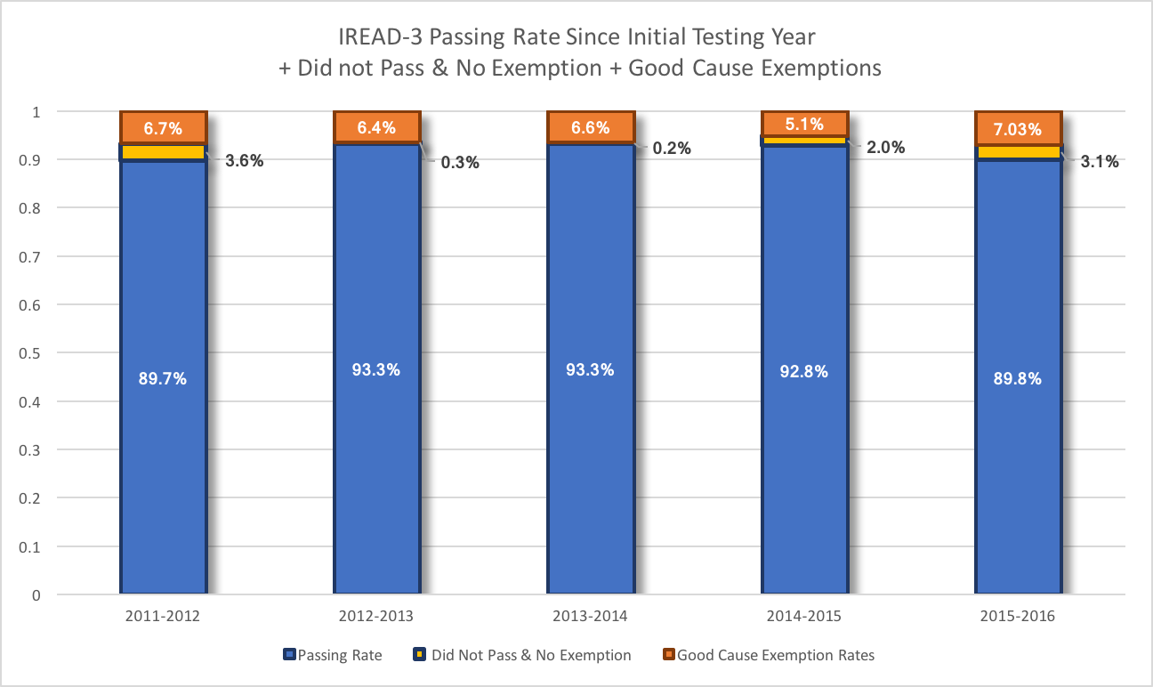
What % of students qualified as GCE each year?
Notes:
Over the five years of the IREAD results currently available approximately 5-7% of 3rd graders are given a good cause exemption.

Slide 28
Approach for Addressing Instructional Needs of Non-Passers
Retain student in 3rd grade as appropriate.
Any 3rd graders unable to pass IREAD-3 initially or during the summer be retained for 3rd grade reading during their 4th grade year as appropriate.
Going forward:
  DOE schedules IREAD-3 assessment for any 4th grader without a passing score on IREAD-3 (and having no exemption).
  DOE creates a cohort list displaying students who passed, did not pass or meet a GCE for schools and corporations to confirm instructional and assessment next steps for students.

