Slide 1

CTE Update
Stefany Deckard
State Director of CTE

Slide 2
Perkins State Plan

Slide 3
Timeline
2006
Perkins Act authorized
2014-2018
No significant revisions to State Plan
2007-2008
State transition Plan submitted
2009-2013
Five-year State Plan submitted
Notes:
2013-2018: Technical changes were made.
2014: Updated budget format, included the use of Reserve funds;
2015: Indiana reorganized 16 clusters into 12 clusters; includes pathway panels in the development and implementation of programs of study, postsecondary institutions identified in development of articulation agreements; addition of TransferIN.net as additional website to find CTE information; update on use of leadership funds to support teacher recruitment and retention, teacher training programs and WBL courses
2016: No changes
2017: Clarification on targeted use of Reserve funds (rural districts), clarifying SBOE gave authority to IDOE to administer Perkins
2018: No revisions at this time, but indicate State Plan Review Committee will review and determine changes for FY2019-20 as a result of new legislation and policy

Slide 4
Perkins State Plan Requirements
States must annually submit the following items:
  Request to Extend the State Plan
    Cover letter, signed by State Official
  Revisions to the State Plan, if any
  Updated Budget
    Use FY 2017 allocations for planning purposes
  State Proposed Performance Levels
    Final Agreed-Upon Adjusted Performance Levels (FAUPL) Negotiation
States must submit by April 23, 2018

Slide 5

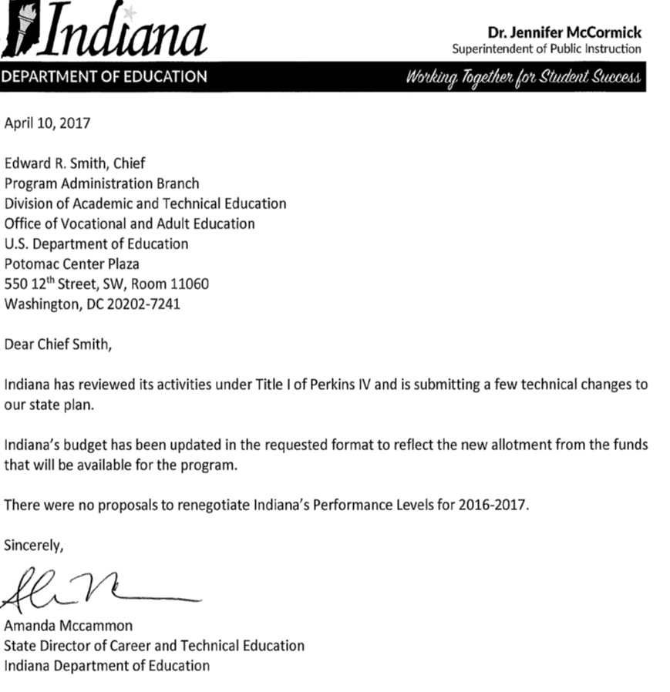
Perkins State Plan
Extension
Request to Extend State Plan
  Cover letter signed by State Official
  (2017 Example)

Slide 6
Perkins State Plan Requirements
States must annually submit the following items:
  Request to Extend the State Plan
    Cover letter, signed by State Official
  Revisions to the State Plan, if any
    None at this time
  Updated Budget
    Use FY 2017 allocations for planning purposes
  State Proposed Performance Levels
    Final Agreed-Upon Adjusted Performance Levels (FAUPL)Negotiation
States must submit by April 23, 2018

Slide 7
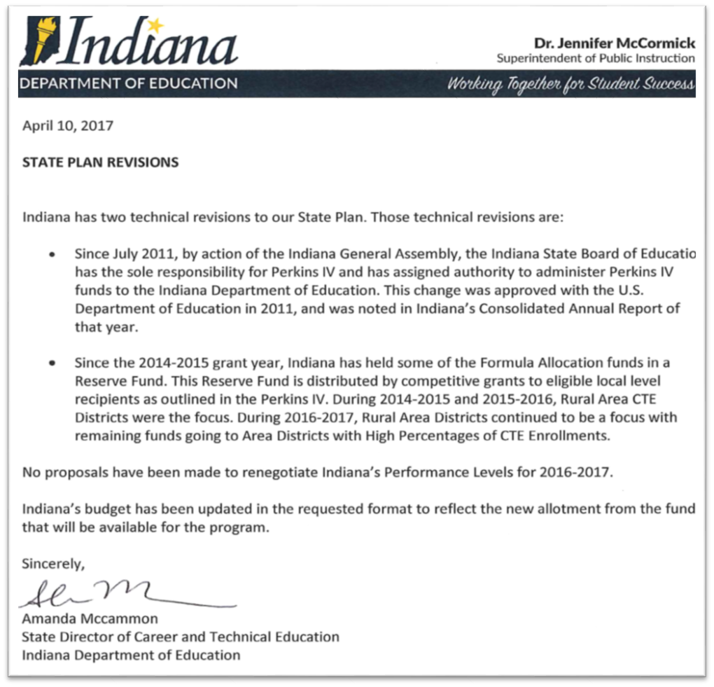
Perkins State Plan Revisions
Revisions to State Plan
  Letter identifying where changes occur in State Plan
  (2017 Example)
  2018: Indicate that a State Plan Review committee will be formed to determine necessary and applicable changes.
Notes:
2017: Clarification on targeted use of Reserve funds (rural districts), clarifying SBOE gave authority to IDOE to administer Perkins

Slide 8
Perkins State Plan Requirements
States must annually submit the following items:
  Request to Extend the State Plan
    Cover letter, signed by State Official
  Revisions to the State Plan, if any
    None at this time
  Updated Budget
    Use FY 2017 allocations for planning purposes
  State Proposed Performance Levels
    Final Agreed-Upon Adjusted Performance Levels (FAUPL)Negotiation
States must submit by April 23, 2018

Slide 9
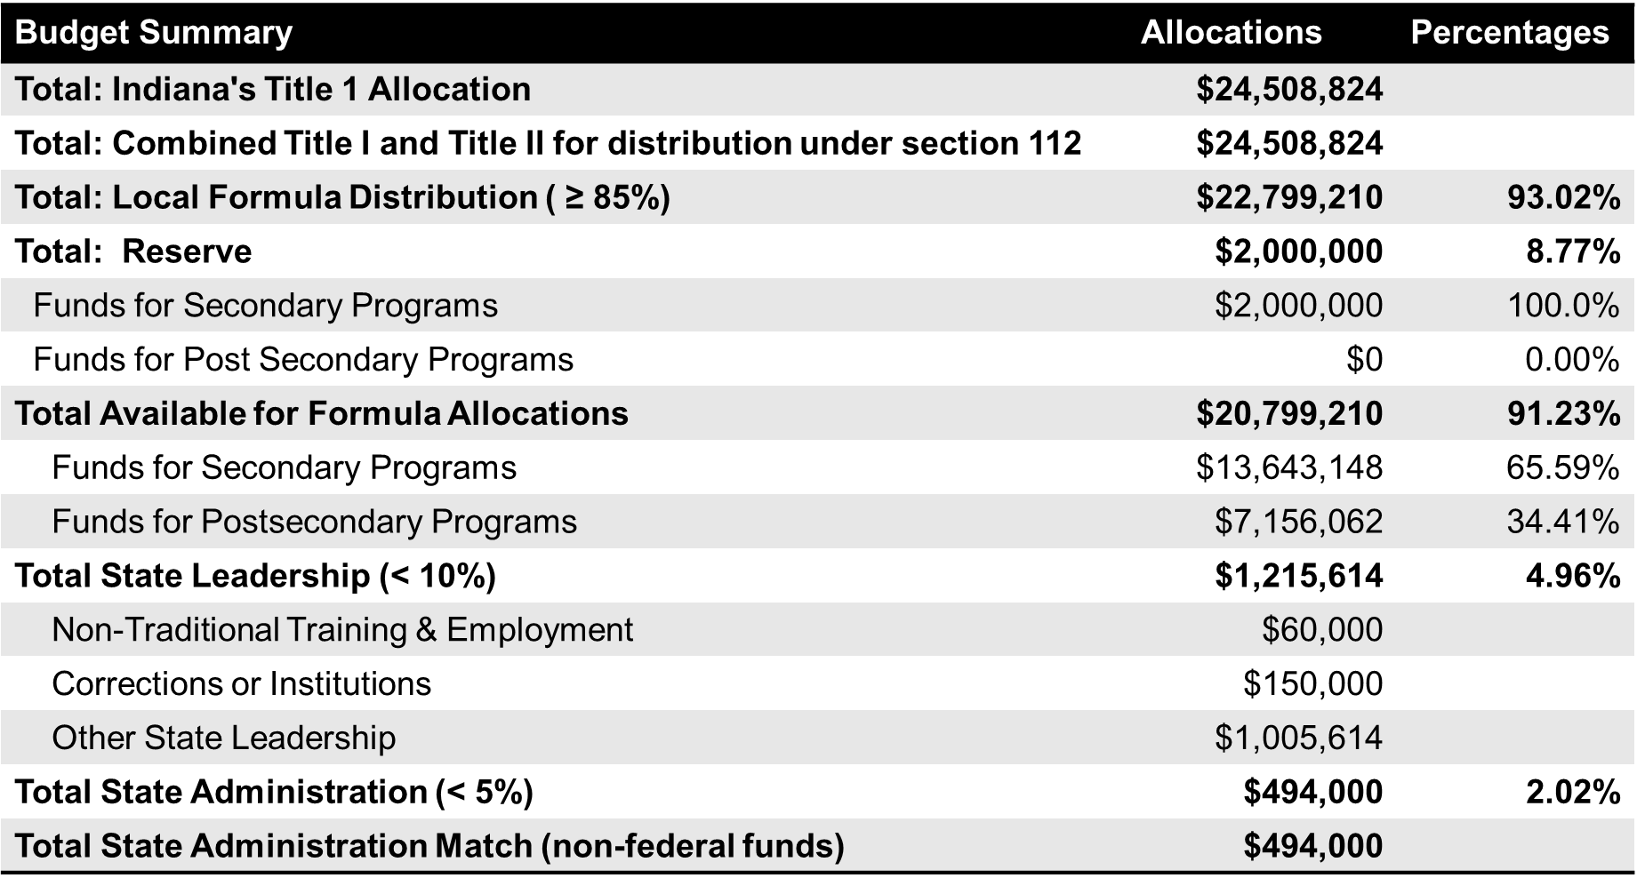

Slide 10
Perkins State Plan Requirements
States must annually submit the following items:
  Request to Extend the State Plan,
    Cover letter, signed by State Official
  Revisions to the State Plan, if any
    None at this time
  Updated Budget
    Use FY 2017 allocations for planning purposes
  State Proposed Performance Levels
    Final Agreed-Upon Adjusted Performance Levels (FAUPL) negotiation
States must submit by April 23, 2018

Slide 11
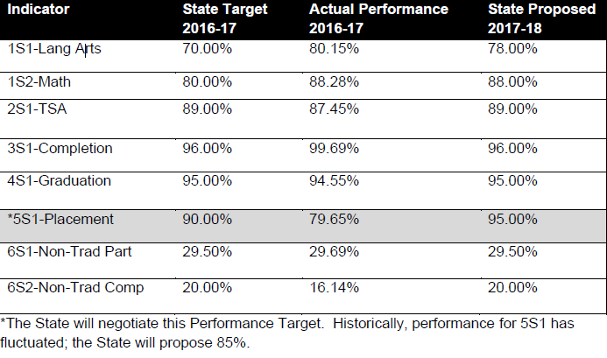
Perkins State Plan Performance Levels

Slide 12
Perkins State Plan Requirements
Recommendations:
  Make no significant revisions to the State Plan before April 23, 2018
  Schedule a full review of the State Plan June-August 2018
  Submit the proposed budget (2017 allocation)
  Accept all proposed levels of performance except 5S1 (Placement)
    Negotiate 5S1 target

Slide 13
Perkins State Plan Requirements
  Schedule a full review of the State Plan June-August 2018
    Review Committee Members:
      Secondary CTE Directors and teachers
      Postsecondary CTE faculty
      Business and Industry Stakeholders
      State agencies, DWD, CHE
      State Board of Education members
      Others, as recommended
      Purpose of Committee:
        Ensure the State Plan adequately reflects the state’s goals and objectives
        Ensure the State Plan is aligned to state statute and rule
        Examine Program Administration changes
          Replace SWIC with Governor’s Cabinet
        Determine local plan changes, if any
        Review key definitions (size, scope, quality, concentrator, completer) and impact
        Financial consequences for failure to meet performance indicator targets

Slide 14
Perkins Monitoring

Slide 15
Spring Monitoring Visits
Six (6) onsite visits will occur April through May 2018:
Career Center | Location
AK Smith Career Center | Michigan City
South Bend Community School Corporation | South Bend
Heartland Career Center | Wabash
New Castle Career Center | New Castle
Central Nine Career Center | Greenwood
Walker Career Center | Indianapolis

Slide 16
Perkins Activities

Slide 17
Perkins Activities
ACTIVITY | DEADLINE
Review and approve Program Improvement Plans | April 13
Review and approve CTE Summer Expansion Grant | April 13
Release FY2018 Perkins Local Plan Application | April 17
Review and Notify Teachers in Industry program Applicants | April 27
Perkins Monitoring Visits | April - May
Approve Local Plan Applications, issue grant award | June 1
State Plan Review Committee Convenes | June 1- August
Review State Leadership contracts, including CTSO contracts | Ongoing

Slide 18
Program Improvement Plans
Three (3) districts met ALL Performance Indicators
  Porter County, Impact Institute, McKenzie Career Center
Eleven (11) ACTEDs met or exceeded on at least 7 of 8 indicators
Twenty-three (23) of the ACTEDs met or exceeded on at least 6 of 8 indicators
Five (5) of the ACTEDs met or exceeded on three (3) or less indicators
Notes:
Federal Indicators

Slide 19
Perkins CTE Summer Expansion Grants
Purpose: Provide extended CTE summer opportunities aligned to high-wage/high-demand occupations
Perkins Eligible Recipients: CTE Districts
Applications Received: 37
Grant award amounts based on formula allocation
Notes:
Total statewide amount made available through Perkins leadership funds: 765K

Slide 20
Teachers and Counselors in Industry Project
Summer internship project for Indiana teachers and counselors
  Applies Work Based Learning principles
  Provides opportunities to meet and work with other CTE teachers
  Builds stronger partnerships with local businesses and industries
  Offers valuable experience and knowledge about local companies
  Expands program partnerships
Notes:
Purpose: to gain valuable industry knowledge while completing an internship with a partnering business or industry.

Slide 21
CTE Concentrators

Slide 22
2016-2017 State Totals
Pathway Enrollment | Pathway Concentrator | Pathway Completers
240,037 | 28,560 | 15,439
An Indiana student who begins a CTE pathway by taking one of the required courses in the Pathway. | An Indiana student who has earned at least six (6) credits in CTE pathway courses in a state- approved College and Career Pathway. | An Indiana student who is a CTE Concentrator and who has taken the state-specified pathway assessment in a state approved College and Career Pathway.
Notes:
Concentrator
A CTE CONCENTRATOR - An Indiana student who has earned at least six (6) credits in CTE pathway courses in a state- approved College and Career Pathway.
Completer
CTE COMPLETER - A CTE Completer is a CTE Concentrator who has taken the state-specified pathway assessment in a state approved College and Career Pathway.

Slide 23
CTE Pathway Enrollment > Concentrator > Completer
Top 10 Programs by Pathway Enrollment | Enrolled 2016-17 | Concentrators 2016-2017 | Completed Pathway 2016-2017
Elkhart Area Career Center | 16,066 | 1,584 | 821
Area 31 Career Programs | 14,538 | 1,584 | 966
J. Everett Light Career Center | 12,839 | 1,249 | 492
Central Nine Career Center | 11,996 | 1,300 | 992
FWCS Career Academy @ Anthis | 10,843 | 1,150 | 588
Prosser Career Education Center | 9,120 | 1,560 | 451
Area Career Center of Hammond | 8,828 | 885 | 440
Southern Indiana Career & Tech. Center | 8,654 | 1,051 | 663
Porter Co. Career & Tech Education | 7,256 | 1,072 | 656
Wildcat Creek Career Coop | 7,152 | 513 | 255
* See supplementary handout for full list of career centers.
Top Ten
Top Ten

Slide 24
Locally Created Concentrator Pathways
Five (5) Concentrator Pathway applications submitted since March 2018
  All submitted by current CTE Directors
  Pathway Areas:
    PC Support
    Computer Programming
    Industrial Mechanics
    Graphic Imaging Technology
    Entrepreneurship/Sports & Entertainment Marketing
    Addition of Agribusiness course in all Agriculture pathways
DWD, CHE and SBOE staff will review applications

Slide 25
CTE Teacher Assignment Code Additions

Slide 26
CTE Assignment Code Additions
Link to Memo
  Input provided from education stakeholders including CTE districts (IACTED), business/industry stakeholders, CTE content specialists/leadership, and licensing content specialists/leadership,
  Responsive to the flexibility requests from the field, pertaining to needs based on graduation pathways
  Highlights:
    Alternative licensing options
      Computer Science
      Preparing for College & Careers
      Introductory courses
      WBL courses

Slide 27
Thank you

