Slide 1


Indiana Academic Standards Evaluation Status Update
March 12, 2014
Evaluation Team Leaders:
Molly Chamberlin, Ph.D., CECI
Danielle Shockey, IDOE
STATE BOARD OF EDUCATION

Slide 2
Today’s Update
HEA 1427 Requirements
Project Plan Overview and Status Update
FAQ on Comments Received To Date
Questions

Slide 3
HEA 1427 Requires SBOE To Adopt “College and Career Readiness Standards”
State Board of Education required to perform a “comprehensive evaluation of the common core standards”
State Board of Education required to “adopt college and career readiness educational standards” by July 1, 2014.
“The educational standards must meet national and international benchmarks for college and career readiness standards and be aligned with postsecondary educational expectations. The state board shall implement educational standards that use the common core standards as the base model for academic standards to the extent necessary to comply with federal standards to receive a flexibility waiver under 20 U.S.C. 7861.”

Slide 4
Legislative Study Committee, OMB Fiscal Impact Report, Impact Upon Schools Provided Additional Parameters
6 members of Legislative Study Committee issued the following guidance:
  Utilize the highest standards in the United States
  Prepare Hoosier students for college and career success
  Obtain a waiver from No Child Left Behind
  Maintain Indiana’s sovereignty and independence from the federal government
  Effective testing to match our rigorous standards.
OMB Fiscal Impact report, submitted by September 1, 2013, concluded the cost to Indiana would increase if adoption of standards and selection of an assessment were delayed and urged standards adoption well before the July 1 deadline.
Other factors: balanced calendar/ early August start dates; teachers need sufficient time to consider transitions in curriculum maps and if necessary develop new lessons plans

Slide 5
Today’s Update
HEA 1427 Requirements
Project Plan Overview and Status Update
FAQ on Comments Received To Date
Questions

Slide 6
Evaluation Project Plan Overview: 2014
Task | 3 - 9 Feb | 10 - 16 Feb | 17 - 23 Feb | 24 Feb - 2 Mar | 3 - 9 Mar | 10 - 16 Mar | 17 - 23 Mar | 24 - 30 Mar | 31 Mar - 6 Apr | 7 - 13 Apr
Orientation & Training | 3 FEB
EVAL. PAN.: Individual eval. | 4 - 11 FEB
EVAL. PAN.: On-site Reconcil. |  | 13 - 14 FEB
Public eReview of Draft |  |  | 19 FEB - 12 MAR
Public Hearings |  |  |  | 24 - 26 FEB
National Expert Reviews |  |  | 20 - 28 FEB |  |  | 14 - 21 MAR
Articulation |  |  |  |  | 3 - 24 MAR
EVAL. PAN.: Individual Review |  |  |  |  |  | 14 - 18 MAR
EVAL. PAN.: On-site Reconcil. |  |  |  |  |  |  | 19 - 20 MAR
CCR PAN.: Individual Review |  |  |  |  |  |  | 20 - 24 MAR
CCR PAN.: On-site Reconcil. |  |  |  |  |  |  |  | 24 MAR
Architecture |  |  |  |  |  | 14-26 MAR
Final Review |  |  |  |  |  |  |  | 25-30 MAR
Ed Roundtable Review/Update |  |  | 20 FEB |  |  |  |  |  | 31 MAR
SBOE Meeting | 6 FEB |  |  |  |  | 12 MAR |  |  |  | 9 APR

Slide 7
Phase I: Evaluation – Completed February 19
Consulting, facilitation and orientation: Sujie Shin, Assistant Director of the Center on Standards and Assessment Implementation at WestEd
Math and English/Language Arts Evaluation Panel evaluations
  Evaluated multiple sets of standards on own merit
    Math: IAS 2000, IAS 2009, CCSS, NCTM
    E/LA: IAS 2006, CCSS, NCTE.
  Panels divided into groups of four: Math (K-5, 6-12) and ELA (K-5, 6-12)
  On-site “blind” consensus evaluation process Feb. 13-14
  Other standards used during on-site evaluation: Massachusetts 2010 (Dr. Sandra Stotsky)
  Each team either: (1) selected one of the existing written standards, (2) combined language from two or more versions to achieve maximum clarity, or (3) wrote their own standard.

Slide 8
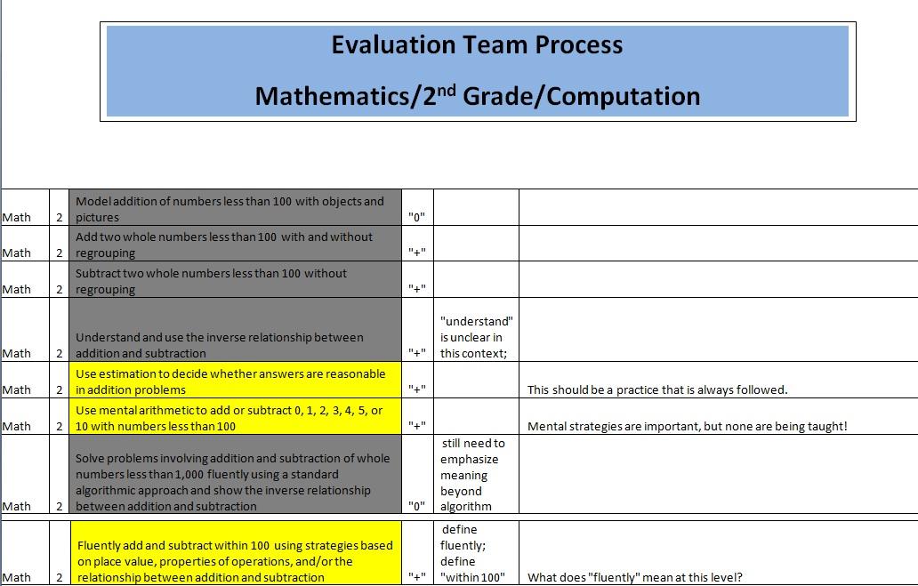

Slide 9
Phase I: Public Comment Period –
In Process Through March 12
Draft standards posted 2/19
  “Raw ingredients” - no articulation or architecture yet conducted; math standards not placed in courses.
Public hearings in Sellersburg, Indianapolis, Plymouth 2/24-2/26
Approximately 100 individuals in total testified
10 of 11 Board members attended at least one hearing
Content specialists, evaluation panel members, SBOE and IDOE staff also attended all three hearings
Invitations sent to the following local and national experts to provide input on 2/19 version of draft standards:
  Dr. Sandra Stotsky (University of Arkansas) – in discussion until 3/3 – declined to participate
  Dr. James Milgram (Stanford University) – will review second draft of standards
  Dr. James Davis (IU Bloomington) – declined to review due to lack of standards expertise; possibly on CCR panel
  Dr. Shauna Findlay (Indiana ASCD) – completed review
  Ms. Janet Rummel (Indiana Network of Independent Schools) – completed review
  Ms. Kathleen Porter-Magee (Fordham Institute) – completed review
Over 600 comments submitted through online portal (open through March 12th)

Slide 10
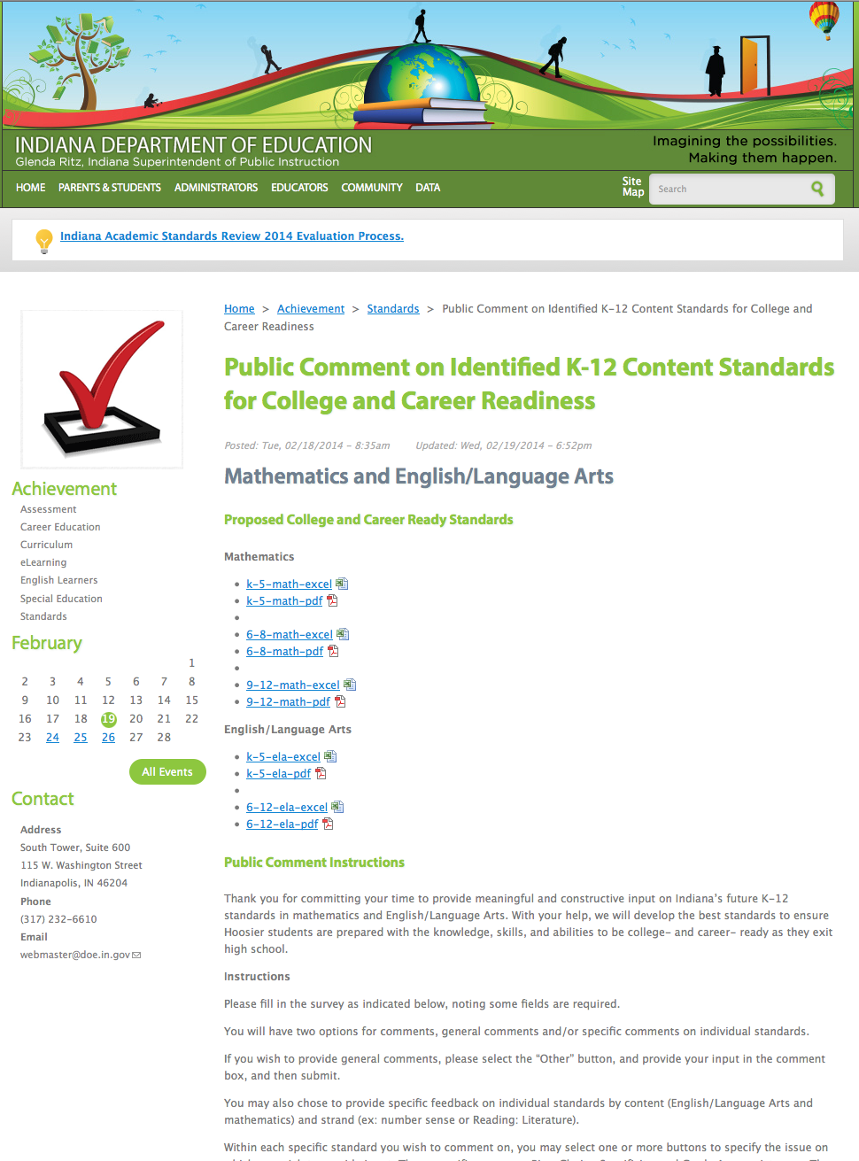

Slide 11
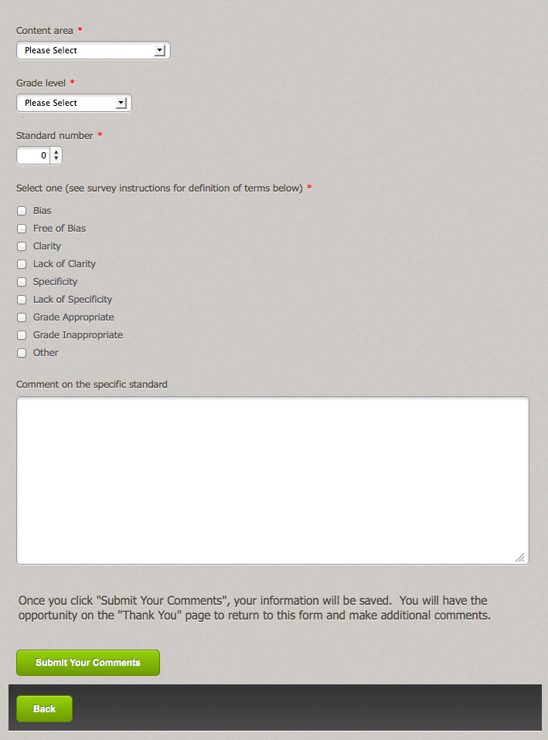

Slide 12
Phase II: Articulation – In Process Through March 19
By Grade Level & Content Strand
Articulation Step 1:
  -Appropriate balance for depths of knowledge (DOK) represented: Recall, Skill/Concept, Strategic Thinking, Extended Thinking
  -Balance for Skill Acquisition: Introductory Skill, Practice Skill, Mastery of Skill
  -Alignment in both DOK and Skill Acquisition to grade levels above and below
Articulation Step 2: Remove any redundancy and make edits for like skills that can be integrated into one standard
Articulation Step 3: Incorporation of any outstanding public comments and recommendation from technical teams & advisory teams.
Articulation Step 4: Reconvene evaluation panels for final review

Slide 13
Phase II: National Expert Input – through March 24
Invitations sent to the following national experts to provide input on the next iteration of draft standards:
  Dr. Sandra Stotsky (University of Arkansas) – declined to review
  Dr. James Milgram (Stanford University) – will review second draft of standards – requested extension to March 24
  Dr. Terrence Moore (Hillsdale College) - TBD
  Dr. Michael Cohen (Achieve) – in negotiation, TBD
  Professor Hung-Hsi Wu (UC Berkeley) – will review second draft of standards
  Ms. Sujie Shin (WestEd)—recommendation TBD

Slide 14
Phase III: Architecture – In Process Through April 1
Architecture
National expert to assist in the architecture work
Identify and articulate guiding principles
Identify layout of document and components to include, e.g., goals of standards, overview of organization of standards, glossary, companion documents including examples
Identify whether/how anchor and process standards are incorporated, as well as literacy standards

Slide 15
Final Approval, Federal Waiver Update
FINAL APPROVAL STEPS
LSA working on fiscal impact report required by statute
  OMB report indicated the implementation cost differential between a consortium developed test and customized test is minimal. However, Indiana would have to invest, in addition to the budget appropriation for assessment of 30M approximately $9M-10.5M to develop a customized assessment.
March Education Roundtable and April SBOE Meetings
USDOE to approve of process by which standards deemed “CCR”

Slide 16
Today’s Update
HEA 1427 Requirements
Project Plan Overview and Status Update
FAQ on Comments Received To Date
Questions

Slide 17
Team Qualifications and Perceived Bias
Comment | Analysis
Evaluation panel members unqualified | Evaluation teams were made up of classroom teachers, curriculum coaches, administrators, and school district staff with over 447 years of combined experience in English/Language Arts and Mathematics, as well as subject matter experts with earned doctorates in Mathematics, Mathematics Education, Rhetoric and Composition, Language Education, Curriculum and Instruction, and Elementary Education, representing various Indiana institutions of higher education.
Evaluation panel members biased toward Common Core | While several members of the evaluation team may have worked on PARCC teams, or may have testified against the Common Core pause, that does not make them biased toward the Common Core. Many educators were against the Common Core pause, due to real and perceived disruptions in education. Those who served on PARCC teams were selected not because of any Common Core bias, but because of their subject matter expertise, content knowledge, and expert reputations—the same reasons they were selected to serve on College and Career Ready or Advisory panels. The evaluation panel teams were selected from previously-identified technical, advisory, and CCR teams. Those teams were created using a variety of methods, including working to ensure that all types of school districts were represented; reaching out to other state agencies and entities for recommendations; and identifying subject matter experts.

Slide 18
Speed of Process, Lack of Coherence in 2/19 Draft
Comment | Analysis
Process too rushed | The process of standards review of evaluation began back in August, when IDOE organized technical teams (to review the current academic standards and Indiana “danglers”), as well as the Advisory and College and Career Readiness teams, to review the work of the technical team. Following the State Board resolution of December 20th, evaluation panels were created using the pre-existing teams, and the work to evaluate multiple sets of standards began right away. The state must have a sense of urgency to release the new College and Career Ready standards to schools before the summer begins, so that schools may begin planning for transition to implementation in 2014-2015, and the state may begin plans to adopt its college and career ready assessment in 2015-2016 (with piloting in 2014-2015 by continued use of CoreLink).
Draft standards posted 2/19 not articulated, lacking architecture | This was done by design, in order to maximize transparency and public input into the standards process. Indiana is one of the first early adopter Common Core states that is attempting to substantially revise its standards. The teams felt it important that the public be permitted to weigh in on the “raw ingredients” of the standards—the skills identified by the experts as skills necessary to ensure that students are college and career ready. The team is in the process of working through standards articulation, incorporating public comment, as well as standards architecture, further incorporating public comment.

Slide 19
Educator Concerns About Impact on Students, Schools
Comment | Analysis
Teachers frustrated and concerned about changing standards, impact upon student outcomes, schools | IDOE and the State Board will work diligently to provide transition support that will minimize the impact of the change in standards (much like is done every time standards change). The professional development will include crosswalks from previous standards to new standards; guidance documents; and other materials to help teachers transition to the new standards.
9-12 Math standards provided by strand, not by course | IDOE Mathematics content experts are working on separating the 9-12 Math standards into courses. After articulation, the 9-12 Math standards will appear by course, as opposed to strand.

Slide 20
Today’s Update
HEA 1427 Requirements
Project Plan Overview and Status Update
FAQ on Comments Received To Date
Questions

