Slide 1
Indianapolis Turnaround Academies Review
State Board of Education Presentation
02/05/2014

Slide 2
Presentation Agenda
Agenda:
  About Pensarus
  Project Background
  Approach
  High-Level Findings
2

Slide 3

I. About Pensarus, LLC
Facts About Pensarus:
Founded in 2008
Based in Washington, DC
Mission: Improve organizational performance by blending business and education “bests”
Thoughtful educational change and innovation
Clients include:
  Federal, state, and local educational agencies
  Schools – private/public/charter
  Non-profits
  Mission-driven for-profits
3

Slide 4
II. Background on the Project
An Independent Audit of Turnaround Academies:
Obtain a neutral, 3rd party opinion
Evaluate current operating conditions
Address Core Question 4 and best practices
Why Pensarus:
Existing approach to comprehensively reviewing schools
Tools and knowledgeable consultants to conduct the reviews
Research bases that address educational best practices, change, and innovation
Experience with turnaround schools, charter schools, and urban districts
Experience with middle and high school levels
Experience with school diversity and special needs
4

Slide 5
III. Approach - Priorities
Office of Education Innovation Performance Framework
Core Question 1: Is the educational program a success?
Core Question 2: Is the organization in sound fiscal health?
Core Question 3: Is the organization effective and well-run?
Core Question 4:
Is the school providing the appropriate conditions for success?
Pensarus reviewed 11 indicators under OEI’s Core Question 4 to evaluate operating conditions:
4.1 | 4.2 | 4.3 | 4.4 | 4.5 | 4.6 | 4.7 | 4.8 & 4.9 | 4.10 | 4.11
Curriculum | Pedagogy | College & Career Readiness | Assessment | HR & Management | Mission | Climate | Parent Engagement | SPED | ELL
Developed Implemented CRP | ELA Math CRP | College Career CRP | Data RtI | PLCs CRP Research | Leadership Core Values OD | Discipline Culture CRP | Parent/Family/ Community Engagement Satisfaction | RtI
*Also referencing US Department of Education’s WWC Practice Guide Recommendations and Mass Insight Framework for School Turnaround
5

Slide 6

III. Approach - Process
Grounded theory review process (~8weeks):
Initial document requests
Initiation meetings
Site visits (~2.5days) included:
  Leadership interviews
  Team interviews
  Class observations
  General observations
  File reviews
  Artifact collection
Focus groups
Surveys
Synthesis and report compilation
*In each area, reviewers aimed for 3 data points (i.e. survey + documentation + interview)
**Timing, access to data and documentation, and confidentiality concerns presented some constraint
6

Slide 7
IV. Overall Findings - Commonalities
Numerous positive developments:
Legitimate curricula
Data-driven decision making
Addressing individual student needs
Communicating with parents, families, and the community
Human resource management
Professional development
And areas for continued development:
Pedagogy and classroom practices
Application of research-based practices
Strategy across departments based on data
Regular course corrections
Leveraging extended school year/summer school
7

Slide 8
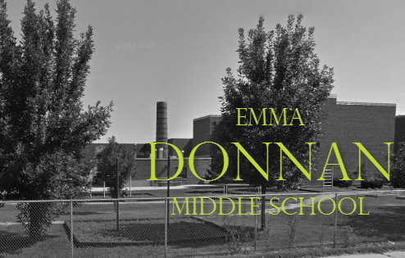
IV. Overall Findings - Donnan
Positive developments:
School leadership – vision and structure
Human resource management – teambuilding
Assessment and data-driven decision making
Addressing individual student needs
Culture and climate – including college/ career readiness and positive behavior
Areas for continued development:
Pedagogy and classroom practices
Ensuring procedures for special needs
Mission refinement/community outreach
Application of research-based practices
Schoolwide planning with data
Leveraging ESY/summer school
Vision Teamwork
Structure
8

Slide 9
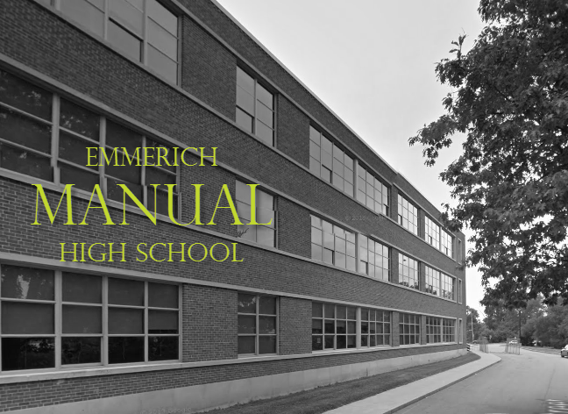
IV. Overall Findings - Manual
Positive developments:
Research-based practices – leadership
Assessment and data-driven decision making
College and career readiness programming
Human resource management
Parent, family, community engagement
Culture and climate – including behavior
Areas for continued development:
Mission refinement and teambuilding
Pedagogy and classroom practices
Diversity and culturally responsive pedagogy
Schoolwide planning with data
Culture, tightening implementation
Leveraging ESY/summer school
Opportunity
Talent
Inspiration
9

Slide 10
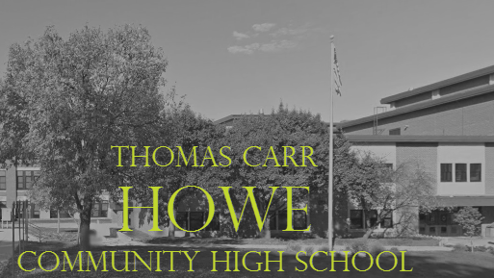
IV. Overall Findings - Howe
Positive developments:
Assessment and data-driven decision making
Diversity and inclusion
Community engagement
Positive and energetic climate
Areas for continued development:
Mission refinement
Leadership and teambuilding
Culture and discipline – implementation
Pedagogy and classroom practices
College and career readiness programming
Ensuring family satisfaction
Schoolwide planning with data
Addressing special needs
Leveraging ESY/summer programs
Inclusive
Community
Ideas
10

Slide 11
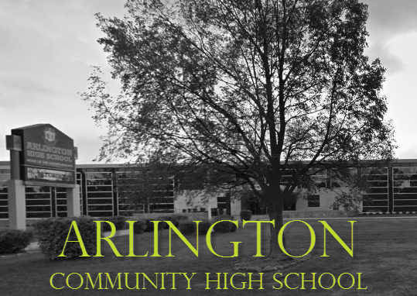
IV. Overall Findings - Arlington
Positive developments:
Curriculum and related practices
Assessment and data-driven decision making
Staff and faculty diversity
Disciplined work environment
Areas for continued development:
Mission refinement and teambuilding
Positive culture and discipline practices
College and career readiness offerings
Pedagogy and classroom practices
Ensuring family satisfaction
Addressing English language learners
Schoolwide planning with data
Leveraging ESY/summer school
Focus
Structure
Philosophy
11

Slide 12

END
Contact us at: info@pensarus.com
Visit us online at: www.pensarus.com
12

