Slide 1
Monthly Uploads
Chase Lenon, CPA CFE CGFM
Director of Audit Services

Slide 2
Contact Information
Phone: 317-232-2512
Email: Schools.Townships@sboa.in.gov
Website: https://www.in.gov/sboa/4449.htm

Slide 3
Monthly Uploads
State Examiner Directive 2018-1
https://www.in.gov/sboa/files/Directive%202018-1.pdf
More efficient and less costly audits.
Proactively identify problems.
Notes:
The State Examiner Directive 2018-1 was released on July 30th 2018. This directive…
This will allow us to do as much of the audit work as possible remotely which will result in efficiencies and reduced audit costs for you. It is our intent to use the monthly information to more effectively plan our engagements. Additionally, we are required to conduct a risk assessment to plan the priorities of our engagements and the information requested will allow us to more efficiently conduct that risk assessment to better prioritize our engagements. Finally, with monitoring information monthly, we plan to provide better service to you, in which we can identify more quickly when you might need our assistance and we can provide that assistance more timely.

Slide 4
Dates of Submission
Monthly – by the 15th of each month
45 days to submit information (January information in March).
1st month required: January 2019
Annual Uploads – After Fiscal Year-end
By August 29th

Slide 5
Monthly Upload Requirements
Bank reconcilements
Approved board minutes – N/A for ECAs
Funds ledger, summarizing total receipts, disbursements, and balances by fund

Slide 6
Upload Resources
Manual Records template
https://www.in.gov/sboa/files/Manual%20Record%20Template.xlsx
Website section “Gateway Upload Application”
https://www.in.gov/sboa/4445.htm
Notes:
Open template and explain. We accept pictures, scans etc… In the future we will try to work toward having file that are machine readable, so please be aware any changes in the future…..

Slide 7
Annual Upload Requirements
Year-end bank statement
Year-end outstanding check list
Year-end investment statements
Detail of receipt activity – N/A for manual records
Detail of disbursement activity – N/A for manual records
Current year salary resolution
Annual vendor history report – N/A ECAs
Notes:
If anywhere you identify we are asking for the same thing twice or multiple times, please let us know. We do not want to create more work for you and any suggestions to this portal are welcome.

Slide 8
Frequently Asked Questions
Future changes
Machine Readable format
Direct Requests
Repercussions
Multiple Files
Notes:
Direct request probably going to be expanded in the future. Talking about ability to provide items in advance to us for items you know we are going to ask for.
Repercussions: may hinder the ability to have a timely audit (may sound good…but it isn’t – no time to fix issues, now you have to write a CAP), audit comment that may require corrective action plan, possibly posting noncompliant units on our webpage for public…

Slide 9
Gateway https://gateway.ifionline.org/

Slide 10
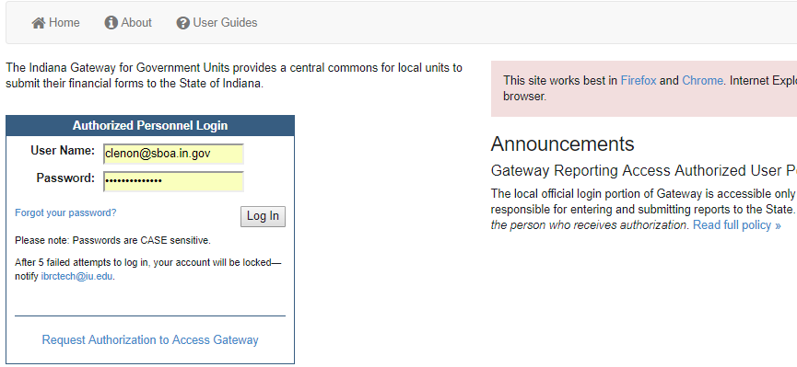
Login Screen

Slide 11
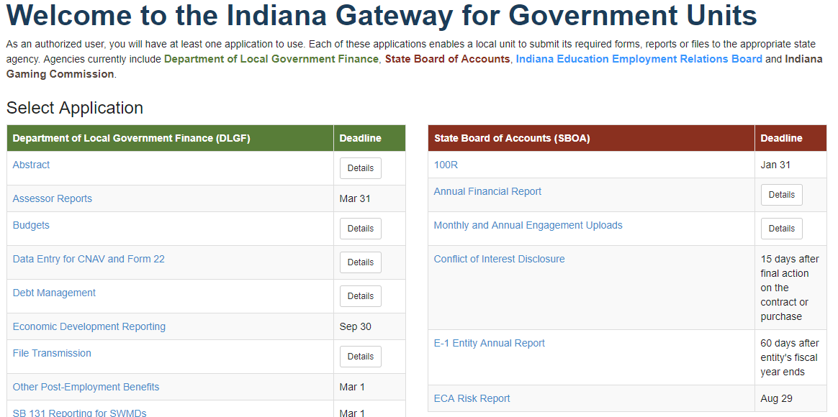

Slide 12
Gateway
gateway@sboa.in.gov
Submitter – ECA or Corporation Treasurer
Editor – Complete Delegation form
http://www.in.gov/sboa/files/DelegationForm.pdf
Notes:
The ECA or corporation treasurer can be given access to submit the uploads and anyone else in the organization would need to complete the delegation form linked here.

Slide 13
Gateway
https://gateway.ifionline.org/
User Guide: https://gateway.ifionline.org/userguides/engagementguide
Notes:
OPEN Gateway and go over how to login, how to upload (in depth, create a file and navigate to it).
Questions?

Slide 14
Monthly Upload Questions?

Slide 15
Monthly and Annual Uploads
Engagement Strategies
Same group doing remote audits responsible for monitoring and requirements for uploads.
EngagementStrategies@sboa.in.gov

Slide 16
ECA Audits
SBOA plan
ECA with receipts greater than $1,000,000 will be examined during the school
corporation audit by the assigned field examiners
For 2016 Report 76 ECAs
ECA with receipts between $1,000,000 - $100,000 will be examined by a centralized compliance process
For 2016 Report 682 ECAs
Will be done on a 4 year rotation coinciding with the School Corporation audit
ECA with receipts less than $100,000 and not having a specific risk identified will have Centralized review process
Approximately 10% of total statewide ECA activity
Notes:
For any ECA records prior to 6/30/15

Slide 17
Staff Funds
Our prior audit position disallowed staff funds to be
accounted for in the extracurricular records. We have
recently revised our opinion and we will not take exception to
an extracurricular account established for staff funds.
This change in position does not affect our position on outside organizations, such as booster groups, parent teacher organizations etc.… There should not be any outside organizations’ funds accounted for in the extracurricular records.
IC 20-41-1-7 states in part: "The treasurer has charge of the custody and disbursement of any funds . . . incurred in conducting any athletic, social, or other school function (other than functions conducted solely by any organization of parents and teachers) . . ."
Notes:
First bullet
-staff funds such as ‘jean days’, staff vending machine proceeds, or other funds that are received for the purpose of supporting staff purchases.
-2nd bullet – outside organization funds
-3rd just statute

Slide 18
Bonding Requirements
IC 5-4-1-18
“…whose official duties include receiving, processing, depositing, disbursing, or otherwise having access to funds that belong to the federal government, the state, a political subdivision, or another governmental entity” must have a bond of at least $5,000.
The statute does not require the individual to be an employee of the school corporation. So, for example, parents volunteering in the school lunchroom or at an extracurricular sporting event must be bonded if their official volunteer duties include receiving public funds such as lunch money or admission fees assuming they will collect over the de minimis amount.
Notes:
So if anyone other than the ECA Treasurer collects money, this includes parents volunteering in the lunchroom or at a ball game if they collect over $5,000 over the course of the year.

Slide 19
Internal Controls
Internal Controls Standards
Required to be adopted per IC 5-11-1-27
‘Personnel’ required to be trained.
Need to have documented procedures for the next round of audits.
Notes:
Personnel that have access to public funds need to be trained.

Slide 20
New School Chart of Accounts
Effective and on our website
Have you transferred the General Fund to Education?
Have you decided how much you plan to transfer from Education to Operations by March 1st?
Rainy Day Fund
IC 20-40-18-4(b) clarified that Operations fund can be transferred to the RDF.
IC 36-1-8-5.1(h) allows for transfers from the RDF to the Education or Operations Fund.
Notes:
Ask for questions

Slide 21
Fundraisers
In the absence of a local policy, our opinion would be that each fundraising activity needs to be looked at individually to determine if the school corporation is running the activity or if an outside organization is running the activity.
Things to keep in mind would be that if school employees are participating in the fundraising activity on school time, then the fundraiser activity should be accounted for in the school records or you run the risk of ghost employment issues.
Notes:
We have not found any statutes that address who has control over fundraising activities. Therefore, we would not take exception to the local school board passing required procedures if the fundraising activity uses school property or is associated with a school event.

Slide 22
Fundraisers
Governmental units which conduct fund raising events should have the express permission of the governing body for conducting the fundraiser as well as procedures in place concerning the internal controls and the responsibility of employees or officials.
School Board would also need to approve/accept donations to be received.

Slide 23
Donations
Cash donations that are extra-curricular in nature may be accounted for in the Extra-Curricular Account.
Any School Corporation donations shall be accounted for in the School Corporation records.
Notes:
I put cash in the first point because property has to be accepted by the board and be in the school’s name

Slide 24
Donations
We will not take exception to club/organizations donating money to an outside organization based on a majority vote of its members.
Documentation must be retained to provide approval of a majority of the members.
The warrant/check should be written to an organization and not an individual.
Notes:
Majority vote,
Need documentation of vote – can be class representatives etc…
Write checks to organizations! Talk about fundraiser for child with burned house

Slide 25
Two Types of Medicaid Reimbursements for Schools
Individualized Education Programs (IEP)
Reimbursements of medical services to students
If the school provides the services with their staff the school is a vendor and the expenditures would not have to be shown on the SEFA
If the School uses a contractor to provide the services, the expenditures should appear on the SEFA
Medicaid Administrative Claiming (MAC)
For expenses incurred by the schools for assisting students in obtaining Medicaid coverage
Services for these reimbursements are required to be completed by the school staff
These payments are 100% Federal dollars and should always be reported on the SEFA
Notes:
We have two fund ranges for Medicaid funds 3250-3259 is the state range and 6460-6469 is the federal range. The MAC specifically are federal funds and should go into that last range.

Slide 26
Website Overview
https://www.in.gov/sboa/4449.htm
Notes:
Go over website – talk about the searching ability, CAPs, etc…

