Slide 1

2014 Clerk-Treasurer’s Conference
Dan Jones
Budget Div. Asst. Dir., DLGF
June 2014

Slide 2

Topics
Preparing for 2015 Budget
Gateway
Problem Areas
  Most Common Reasons for Budget Problems
  1782 Requirement: How to use it
New for 2015 (Legislation)
  Online Advertising
  Protected Taxes
  OPEB

Slide 3
Preparing for 2015 Budget
Review Y-T-D revenues and expenditures
  Find where you are over or below projections
Count your pay periods
Review the Budget Manuals and Instructions
Review the Budget Calendar & other memo’s
Plan dates for budget hearing and adoption meetings
Go to Summer Budget Workshops with your DLGF field representatives

Slide 4
Preparing for 2015 Budget
Budget Workshops
  Scheduled early July through mid August
  Materials to bring:
    June 30 cash & investment balances
    Y-T-D expense and revenues
    Encumbrances carried over from last year
    Debt schedules & debt service worksheet
    Dates for public hearing and adoption meeting
    Current Year Financial Worksheet (completed in Gateway)
    Completed budget form 1; Form 22 (from auditor)
    Contact information

Slide 5
Important Dates
June 30 – First 6 months fund balances available
Aug 1 - Auditor certifies CNAV
Sep 2 - Budgets, rates and levies to county council for budget recommendation*
Sep 13 - Last day for 1st publication of budget notice and submit to DLGF for web page*
Sep 20 - Last day for 2nd publication*
Oct 1 - Last day for council to make budget recommendation*
Oct 24 - Last possible day for public hearing*

Slide 6
Important Dates
Oct 31 - Last possible day for 10 or more taxpayers to object to proposed budget, rates, or levies
Nov 3 - Last possible day to adopt the 2015 budget, tax rates and levies*
Dec 16 - Last day to submit additional appropriation requests to DLGF
Feb 16 - Last day for DLGF to certify budgets, tax rates, and tax levies
* Noncompliance results in continued (frozen) budgets, tax rates and tax levies. See Budget Calendar memo for complete list.

Slide 7
Gateway
  All budgets are prepared and submitted using Gateway
  On-line advertising in Gateway is required for 2015 budgets. (Last year for newspaper ads.)
  DLGF will continue to make improvements to make the Gateway experience more productive
  Log-In: https://gateway.ifionline.org/login.aspx
  A discussion of Gateway upgrades, User Guides, Training Materials and any relevant memo’s can be found at: http://www.in.gov/dlgf/9105.htm

Slide 8
2015 Gateway Enhancements
  Existing funds, departments, and structure has been carried over from 2014 to 2015
  Most line items on Form 1 have been carried over from 2014 to 2015 (except capital outlays).
  Copy all amounts on Form 4B from published column to adopted column with a single mouse click
  County Council Review Worksheet now displays the due date and submission status on Unit Main Menu

Slide 9
Problem Areas

Slide 10
Most Common Reasons for Budget Denials
Error with Budget Advertisement
  Not advertised by deadline (and online for 2015)
  Not advertised at least 10 days before meeting
  Did not allow 7 days between public notices
  1st publication must be before September 14
  2nd publication must be before September 21
  Did not allow 10 days between public hearing and adoption meeting.
  DO NOT COUNT DAY OF PUBLICATION

Slide 11
Most Common Problems
Errors with Budget
  Budget hearing or adoption meeting not held on date advertised
    Last possible day for public hearing is Oct 24th
    Last possible day to adopt budget is Nov. 3rd
  Rescheduled meetings and revised notices can be published if done timely but rarely ever successful.
  Budget not submitted to county council for non-binding recommendation by deadline (Sept 2nd)

Slide 12
Most Common Problems
Error(s) with Budget Advertisement:
  Publication does not include all funds;
  Publication has incorrect amounts or zeroes;
  Publication must include amount of excessive levy appeals (if any) in both the appeal column and included in the total amount of the levy for that fund
  Remember
  1st Notice must be AT LEAST 10 days before public hearing, 2nd Notice at least 3 days before hearing
  Public hearing must be at least 10 days before adoption meeting

Slide 13
More Common Problems
Fiscal body does not have a quorum at adoption meeting.
  Action: Postpone action on the budget to a new date and time specified during the advertised meeting.
No budget amounts in Gateway “Adopted” budget columns. Amounts are only in the “Published” column.
  Action: Copy amounts to the Adopted column and have fiscal body sign Form 4. Remember the deadlines.
Council did not sign Form 4 at adoption meeting.
  Action: Schedule a special meeting of the fiscal body giving at least 48 hours notice and re-adopt budget and sign form(s).

Slide 14
More Common Problems
  DLGF cannot approve an appropriation or debt service levy for debt not reported in Gateway (IC 5-1-18-7)
  Required Reports to be filed with the Board of Accounts before budget is certified:
      Annual Financial Report (IC 6-1.1-17-16.2)
      Personnel Report (5-11-13-1)
        Includes an indication if unit provides a health plan, pension & other benefits to full and part-time employees
      Anti-nepotism Policy Statement (IC 36-1-20.2)

Slide 15
The 1782 Requirement
1782 Notice:
What is it?
  After the DLGF has processed an annual budget, tax rates, and levies, they are required to notify the political subdivision of the actions taken. IC 6-1.1-17-16
What should you do with it?
  Review the 1782 and compare the budget amounts, tax levies and rates to those adopted by the fiscal body. You may send a request to the DLGF in writing to make an adjustment or correction to amounts on the Notice.

Slide 16
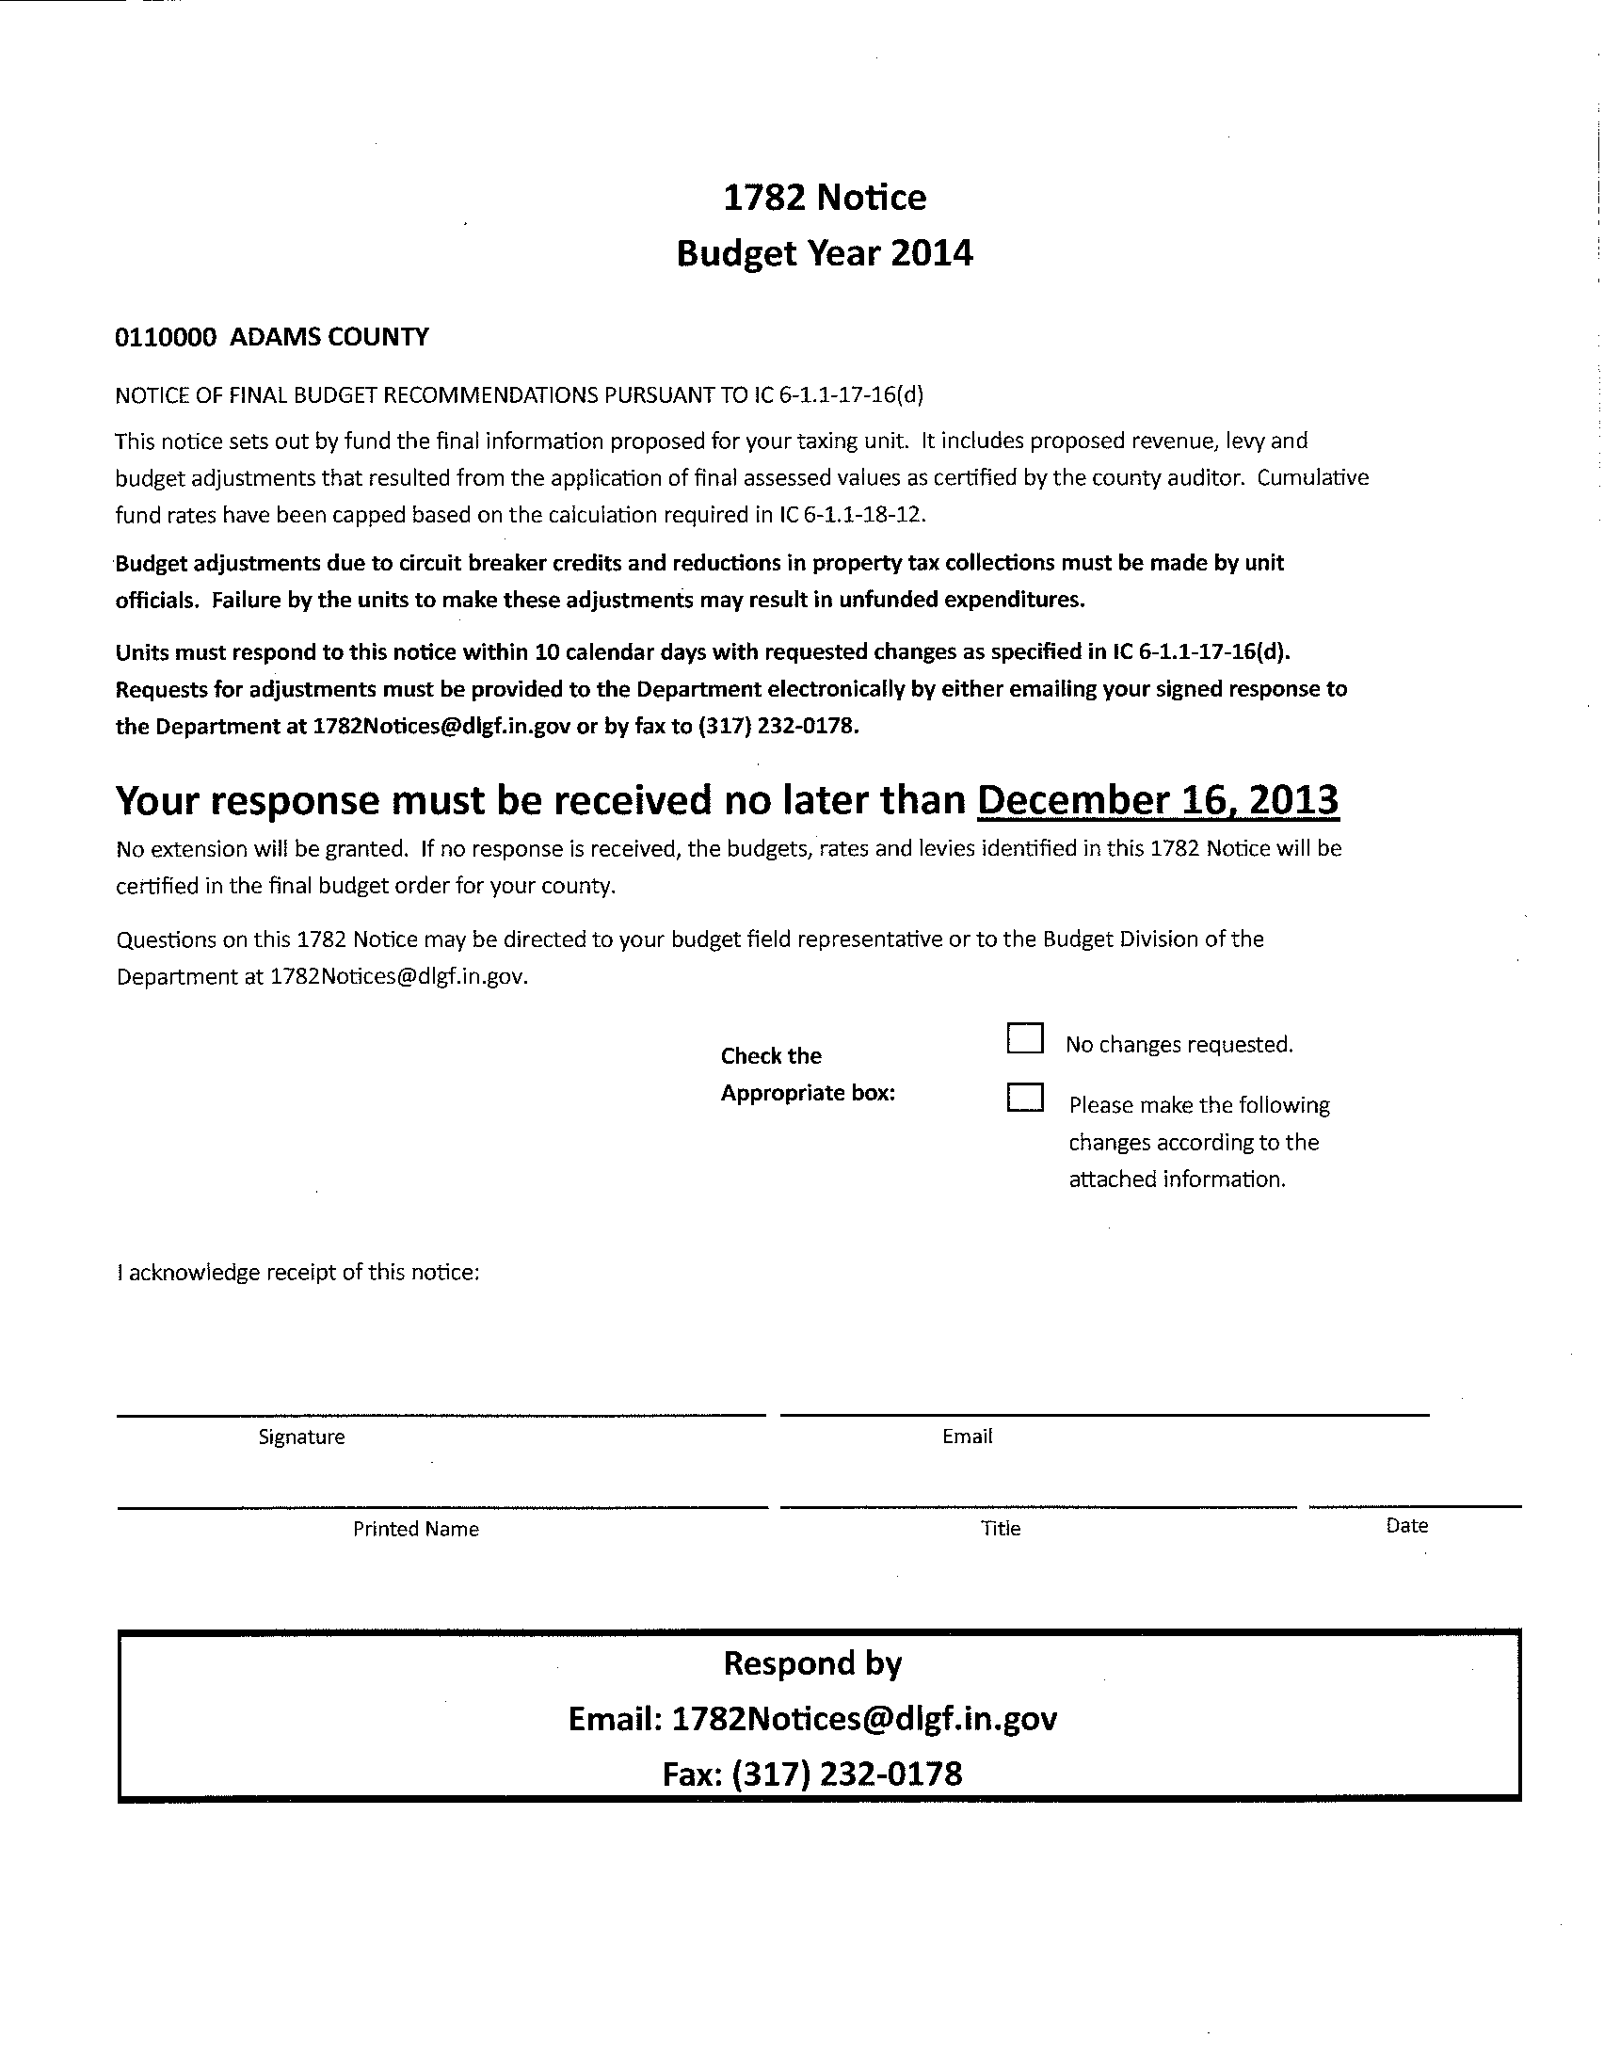
The 1782 Requirement
1782 Notice:
  Contains instructions
  for responding
  _ Box to check for
  indicating changes
  _ Signature lines
  _ Email address for
  sending response

Slide 17
The 1782 Requirement
1782 Notice Notes Report:
Messages describing DLGF actions:
  Budget Approved for Displayed Amount
  Lesser of Unit adopted or prior year budget because not properly advertised
  Lesser of Unit adopted or prior year budget because not properly appropriated
  Budget has been reduced due to advertising constraints
  Budget has been decreased because projected revenues are insufficient to fund the adopted budget
  Tax rate reduced due to increased assessed value

Slide 18
The 1782 Requirement
1782 Notice:
Check the assessed value on the Notice.
Compare the assessed value on the Notice to the Auditor’s Certificate.
  Is the tax levy on the 1782 Notice similar to the levy adopted by your fiscal body? How does the tax rate compare to the adopted rate?
  Compare to the tax rates, tax levies, and the appropriations to those advertised.

Slide 19
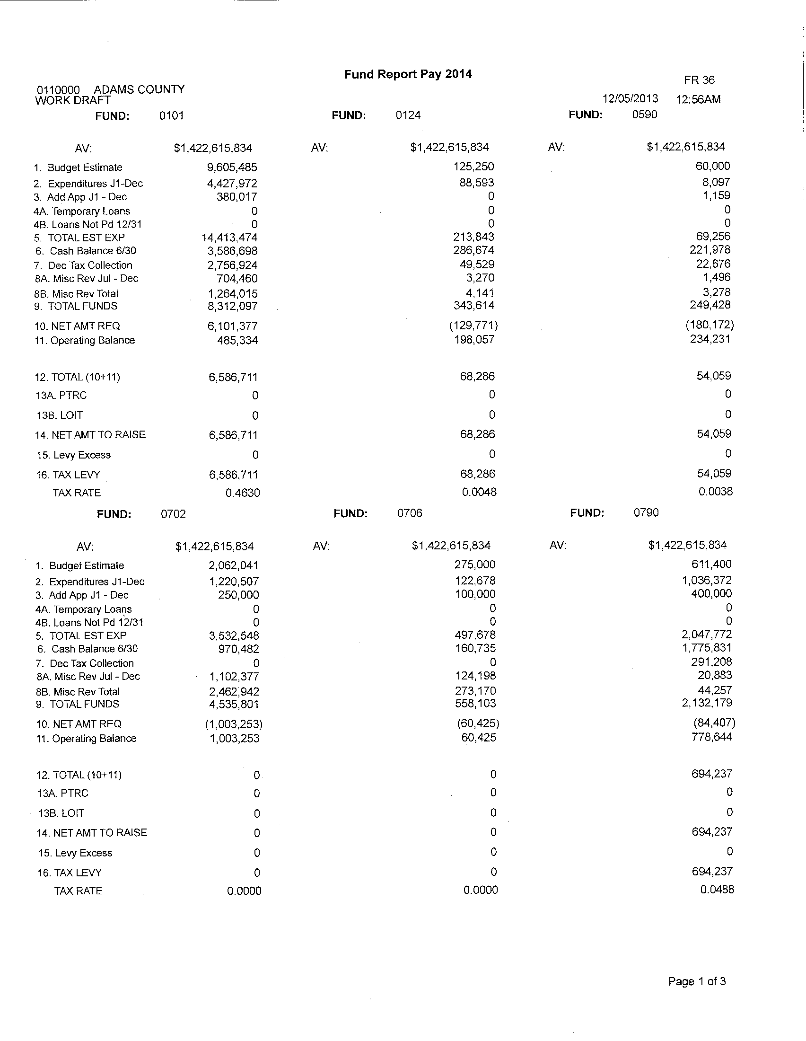
The 1782 Requirement
1782 Notice:
  Fund Report
  - Shows all property
  tax supported funds
  Shows property
  Tax levy and rate
  Calculates ending
  fund balance

Slide 20
The 1782 Requirement
How to read 1782 Notice Fund Report:
  Line 1 is the proposed budget for the ensuing year
  Line 2 is the remaining appropriations for reminder of the current year. Passing an ordinance or resolution to reduce this amount increases available funding for next years budget.
  Line 8a is the estimated misc. revenues for the 2nd half of the current year. Does this amounts need to be adjusted?
  Line 8b is estimated misc. revenues for the budget year. Do you agree with this amount?

Slide 21
The 1782 Requirement
How to respond to the 1782 Notice:
  Line 11 is the estimated available balance at the end of the budget cycle. If this amount is zero, line 1 is maximum amount that can be funded.
  Line 16 is the property tax levy for the following year. This should be relatively close to the amount approved by the fiscal body. If it is not, try to understand why it’s different.
  Line 17 is the property tax rate for the budget year. This should be close to the rate approved by the fiscal body and close to last years rate.

Slide 22
The 1782 Requirement
How to respond to the 1782 Notice:
  After you receive the 1782, you may request changes by responding in writing within 10 days of receiving the notice. Send your response to the email address on the Notice. You may need to provide documentation to support your request.
  This is your last opportunity to make corrections to budget, tax rates, or tax levies for the budget.

Slide 23
Transfers
Two Types of Transfers:
  Transfer of Appropriations or transfer of Funds:
  1. Transfer of appropriations (budget) from one line-item to another within the same fund.
  - Requires fiscal body approval if the transfer crosses major classification of appropriation,
  - Requires approval of DLGF only if it changes the total amount appropriated to the fund.
  2. Transfer of budget from one department to another;
    - This requires an ordinance or resolution increasing and decreasing the budgets in both departments.

Slide 24
Transfers
Two Types of Transfers:
  Transfer of funds:
  1. Transfer of money from one fund to another
  - Requires fiscal body approval of ordinance or resolution allowing the transfer.
  - Does not require approval of DLGF. However, DLGF approval is required when appropriated (certain funds).
  - Very few transfer of funds allowed under Indiana Code

Slide 25
Transfers
Rainy Day Fund Transfers:
  Transfer to rainy day fund:
  - Requires fiscal body approval of ordinance or resolution allowing the transfer (IC 36-1-8-5.1).
  - Transfer does not require approval of DLGF. However, DLGF approval is required when appropriated.
  - Transfer is limited to 10% of total annual budget for that fiscal year.
  - Transfer cannot be made from a debt service fund.

Slide 26
Transfers
Rainy Day Fund Transfers:
  Transfer from rainy day fund:
  - A county, city, or town may at any time, by ordinance or resolution, transfer to:
  1. It’s general fund, or
  2. Any other appropriated funds of the county, city, or town, money that has been deposited into the rainy day fund.
  See IC 36-1-8-5.1

Slide 27
New for 2015
Protected taxes effective for 2014 levies
  Protected taxes were enacted in 2013 but postponed until 2014.
  Protected taxes are property tax levies exempt from circuit breaker credits: voter approved referendum funds and debt service funds.
  Those funds will receive tax distributions first and revenues lost to circuit breaker credits are allocated to other property tax supported funds.

Slide 28
Protected Taxes: Example
201 4(Not protected) | Levy | Circuit Breaker Credits | Percent of Levy Lost to Circuit Breakers
General | 615,638 | 187,733 | 30.49%
Park | 147,913 | 45,105 | 30.49%
MVH | 156,208 | 47,634 | 30.49%
Bond #1 | 91,246 | 27,824 | 30.49%
Bond #2 | 24,885 | 7,589 | 30.49%
2014 (Protected)
General | 615,638 | 211,288 | 34.32%
Park | 147,913 | 50,764 | 34.32%
MVH | 156,208 | 53,610 | 34.32%
Bond #1 | 91,246 | 175 | 0.19%
Bond #2 | 24,885 | 48 | 0.19%

Slide 29
New for 2015
Units have the ability to reallocate circuit breaker credits among “unprotected” taxes.
  DLGF will calculate the minimum amount of circuit breaker required for each fund.
    This is needed to keep Over 65 circuit breaker with each appropriate fund and to control allocations of circuit breaker credits within the appropriate taxing districts
  DLGF is creating a form to complete and submit to the DLGF legal division to show how you would like the circuit breaker credits allocated.
  Legal will issue a certification approving the reallocation of credits.

Slide 30
New for 2015
On-line budget Advertisements in addition to newspaper public notices.
  Form 3 in Gateway has been modified to notify taxpayers of this new on-line feature.
County advertises to taxpayers the internet address where they may request copies of the political subdivisions budget information.
2014 is the last year for newspaper advertisement (for 2015 budgets).
New maximum fund balances allowed for debt service funds.

Slide 31
LEGISLATION
Please note that this presentation is intended to be informative but it is not a substitute for reading the law.

Slide 32
Legislation
SEA 1 – State and Local Taxation-
  Effective July 1, 2015 - Allows a county income tax council to adopt an exemption for business personal property for property with acquisition cost less than $20,000.
  Sec. 9, effective July 1, 2014, amends IC 6-3-2-1 to lower the corporate income tax by 0.25% each year from 2016 through 2021.

Slide 33
Legislation
SEA 106 – Transparency
  Requires the DLGF to develop indicators of fiscal health for political subdivisions and post on Gateway beginning in 2015.
SEA 118 – Redevelopment Commissions
  Sec 1, effective July 1, 2014, amends IC 36-7-14-0.5. Defines “obligations” as bonds, notes, warrants, leases, or other instruments under which money is borrowed. Defines public funds as fees, payments, tax receipts, and funds coming into possession of a redevelopment commission.

Slide 34
Legislation
SEA 118 – Redevelopment Commissions
  Section 2, effective July 1, 2014 amending IC 36-7-14-2.5 prohibiting a redevelopment commission from entering into an obligation without approval by ordinance or resolution by the legislative body of the unit. The approving ordinance must include the maximum amount of the obligation, maximum interest rate, and any provisions for redemption before maturity, provisions for capitalized interest, and maximum term of the obligation. There is an exception for acquiring real property financed for three years or less or a cost less than $5M.

Slide 35
Legislation
SEA 118 – Redevelopment Commissions
  Section 3, effective July 1, 2014 amending IC 36-7-14-3 bringing a redevelopment commission under the oversight of the legislative body including review of the annual budget. Commission is now subject to same laws, rules, and ordinances as other units and subject to audit by board of accounts, covered by public meeting laws and public records laws. The fiscal officer of the unit is now the fiscal officer of the commission. Treasurer shall report annually to the fiscal body before July 1.

Slide 36
Legislation
SEA 118 – Redevelopment Commissions
  Sec. 5, effective July 1, 2014 amends IC 36-7-14-12.2 by removing the power of eminent domain from redevelopment commissions. The legislative body must adopt a resolution specifying the public purpose of bonds, use of the proceeds, maximum principal amount, term of the bonds (not to exceed 25 years), any provision for redemption before maturity and provision for payment of capitalized interest.

Slide 37
Legislation
SEA 118 – Redevelopment Commissions
  Section 14, effective July 1. 2014, amends IC 36-7-14-25.2 requiring the legislative body to approve by ordinance or resolution the maximum annual lease rental, maximum interest rates and provisions for paying capitalized interest rates and provisions for redemption before maturity.
  Section 18, effective July 1, 2014 amends IC 36-7-14-39 so that commissions determine before July 15th of each year if the captured AV in an allocation area exceeds 200% of the AV required for debt service payments and appropriate uses (IC 36-7-14-39).

Slide 38
Legislation
SEA 118 – Redevelopment Commissions
  Section 18 (continued) states the commission shall submit to the legislative body its determination of the excess and its proposal to allocate assessed value to the respective taxing units.
  Section 23, effective July 1, 2014 amends IC 36-7-14.5-9 requires the board to meet to elect officers immediately after January 15. The board may elect an assistant secretary-treasurer. Before July 1, the secretary-treasurer shall annually report to the fiscal body .

Slide 39
Legislation
SEA 367- Various Tax Matters
  Section 1, effective July 1, 2014 amends IC 5-13-6-3 to require a county auditor rather than the county treasurer to make advance distributions of taxes collected to units that have requested tax advances in writing to the treasurer.
  Section 37, effective upon passage, amends IC 8-22-3-11 reestablishing the maximum property tax rates airport authorities may charge.
SEA 420- Property Assessment Dates
  Changes for property assessment purposes the assessment and valuation date to January 1. (in 2016)

Slide 40
Legislation
SEA – 420
  Changes exemption filing deadline to April 1 (in 2016).
  Changes deadline for meeting to fix the budget for fiscal year schools to April 1.
HEA – 1062 Local Government Finance
  Section 1, effective upon passage, specifies the requirements for a school to be eligible and qualifying to finance debt.
  Section 2, effective upon passage, amends IC 6-1.1-17-22 setting the maximum balance in a debt service fund at 15% of the budget estimate for debt originally incurred after June 30, 2014 ; plus

Slide 41
Legislation
HEA – 1062 Local Government Finance (Continued):
  Fifty percent (50%) of the budget estimate for the debt service fund for the ensuing year for debt originally incurred before July, 1, 2014.
    If debt is refinanced, the date the refinanced debt was originally incurred, and not the date of the refinancing is closed, is the date to be used.
    Property taxes allowed for an operating balance may not be construed as an increase to make up for a reduction due to circuit breaker credits.
    Schools are allowed to allocate credits proportionately if credits are at least 10% of transportation fund levy.

Slide 42
Legislation
HEA – 1266 Local Government Finance Issues:
  Sections 1 and 2, effective July 1, 2014 amends IC 5-3-1-2 sunseting provisions where notices of budget estimates were valid even though they contained errors at the fault of the newspaper. That exception now expires on January 1, 2015.
  Section 3 through 18 make changes to dates public utilities are to file statements of value and property descriptions and changes deadlines to file property deductions to January 5 of the succeeding year.

Slide 43
Legislation
HEA – 1266 Local Government Finance Issues:
  Section 20, effective July 1, 2014, amends IC 6-1.1-17-3 requiring units to publish the budget notice as required under IC 5-3-1 (1st time before September 14 and 2nd time before September 21) AND to submit the information to the DLGF’s Gateway before September 14 and at least 10 days before the public hearing. The DLGF shall review ONLY the submission to Gateway for compliance.
    For 2015 and 2016 taxes payable, each county shall publish the Internet address where the information is available through which taxpayers may request copies of information.

Slide 44
Legislation
HEA – 1266 Local Government Finance Issues:
  Section 20 (Continued) Counties may seek reimbursement from political subdivisions for the cost of this notice.
  Budgets and tax levies will be continued for units that do not publish their budget and it is not submitted to Gateway in the prescribed manner.
  Notices that are published and submitted timely but contain an error, unit may request permission to submit amended information not later than seven days before the public hearing. Acknowledgment of the correction shall be posted on Gateway and communicated to the county fiscal body.

Slide 45
Legislation
HEA – 1266 Local Government Finance Issues:
  Section 21, effective July 1, 2014, amends IC 6-1.1-17-16(i) requiring the DLGF to increase a political subdivision’s tax levy that exceeds the amount originally advertised or adopted if:
    The increase is in writing by the officers of the political subdivision
    The requested increase is published on the DLGF’s advertising Internet web site and is published by the political subdivision according to a notice provided by the DLGF and,
    Notice is given to the county fiscal body of the error and the department’s correction.
    If the DLGF increases a certified levy beyond the amount advertised or adopted under this subsection, it shall unless the DLGF finds extenuating circumstances , reduce the certified levy by the lesser of five percent (5%) or one hundred thousand ($100,000).

Slide 46
Legislation
HEA – 1266 Local Government Finance Issues:
  Section 24, effective July 1, 2014, amends IC 36-1-8-17.5 deleting references to OPEB or “Other Post Retirement Benefits” and deletes requirement to report obligations to the DLGF by February 1.
  Replaces OPEB with the requirement to report to the DLGF in a manner specified by the DLGF “information and data on its retiree benefits and expenditures by March 1 of each year.”

Slide 47
Legislation
HEA – 1266 Local Government Finance Issues:
  Section 25, effective July 1, 2014, amends IC 36-4-7-6
  Replaces “his” with “the department heads” and “he” with “the department head”.
  Section 27, effective July 1, 2014, amending IC 36-8-19-8 to allow a fire protection territory to maintain a reasonable balance not to exceed 120% of the budgeted expenses.

Slide 48
Key Dates for RDC’s
After Jan 15 Board meets to elect officers
By Mar 15 Redevelopment Commissioners or designees shall file a report with unit’s executive setting out activities of preceding year
Before July 1 Treasurer shall report annually to the fiscal body of the unit
Before July 15 Commissioners determine, if any, excess assessed value needed for debt service
Before Aug 1 Commissioners report to fiscal body
Before Oct 1 Fiscal body shall compile reports received for all TIF districts and submit a comprehensive report to DLGF

Slide 49
Miscellaneous
Library Capital Project Fund plans must be approved by the Library Board before May 15th.
Fiscal body approves or rejects CPF plan before August 1.
Transfers to a Rainy Day Fund from a Debt Service Fund are NOT allowed.
Watch for Budget Calendar and other memo’s to be posted on DLGF web site soon.
Circuit Breaker Credit reports are now online.
Fiscal Dashboard in 2015.

Slide 50
Title
Questions?

Slide 51
Contact the Department
Courtney Schaafsma, Director of the DLGF Budget Division
  Telephone 317-234-3937
  E-mail: cschaafsma@dlgf.in.gov
Dan Jones, Asst. Dir. of the DLGF Budget Div.
  Telephone: 317.232.0651
  Fax: 317.232.8779
  E-mail: djones@dlgf.in.gov
Web site: www.in.gov/dlgf
  “Contact Us”: www.in.gov/dlgf/2338.htm.

