Slide 1

UNDERSTANDING
OPIOID USE DISORDER
Stigma Reduction Campaign
Notes:
The Opioid Crisis has had a devastating impact on the entire state of Indiana.
Many people who struggle with opioid dependency face a wide range of stigmas that are preventing them from seeking treatment. We don’t want them to become an opioid overdose statistic.

Slide 2
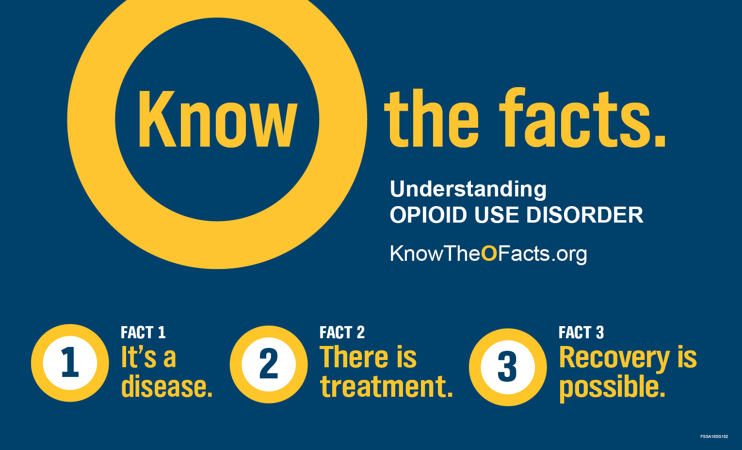
#KnowTheOFacts

Slide 3
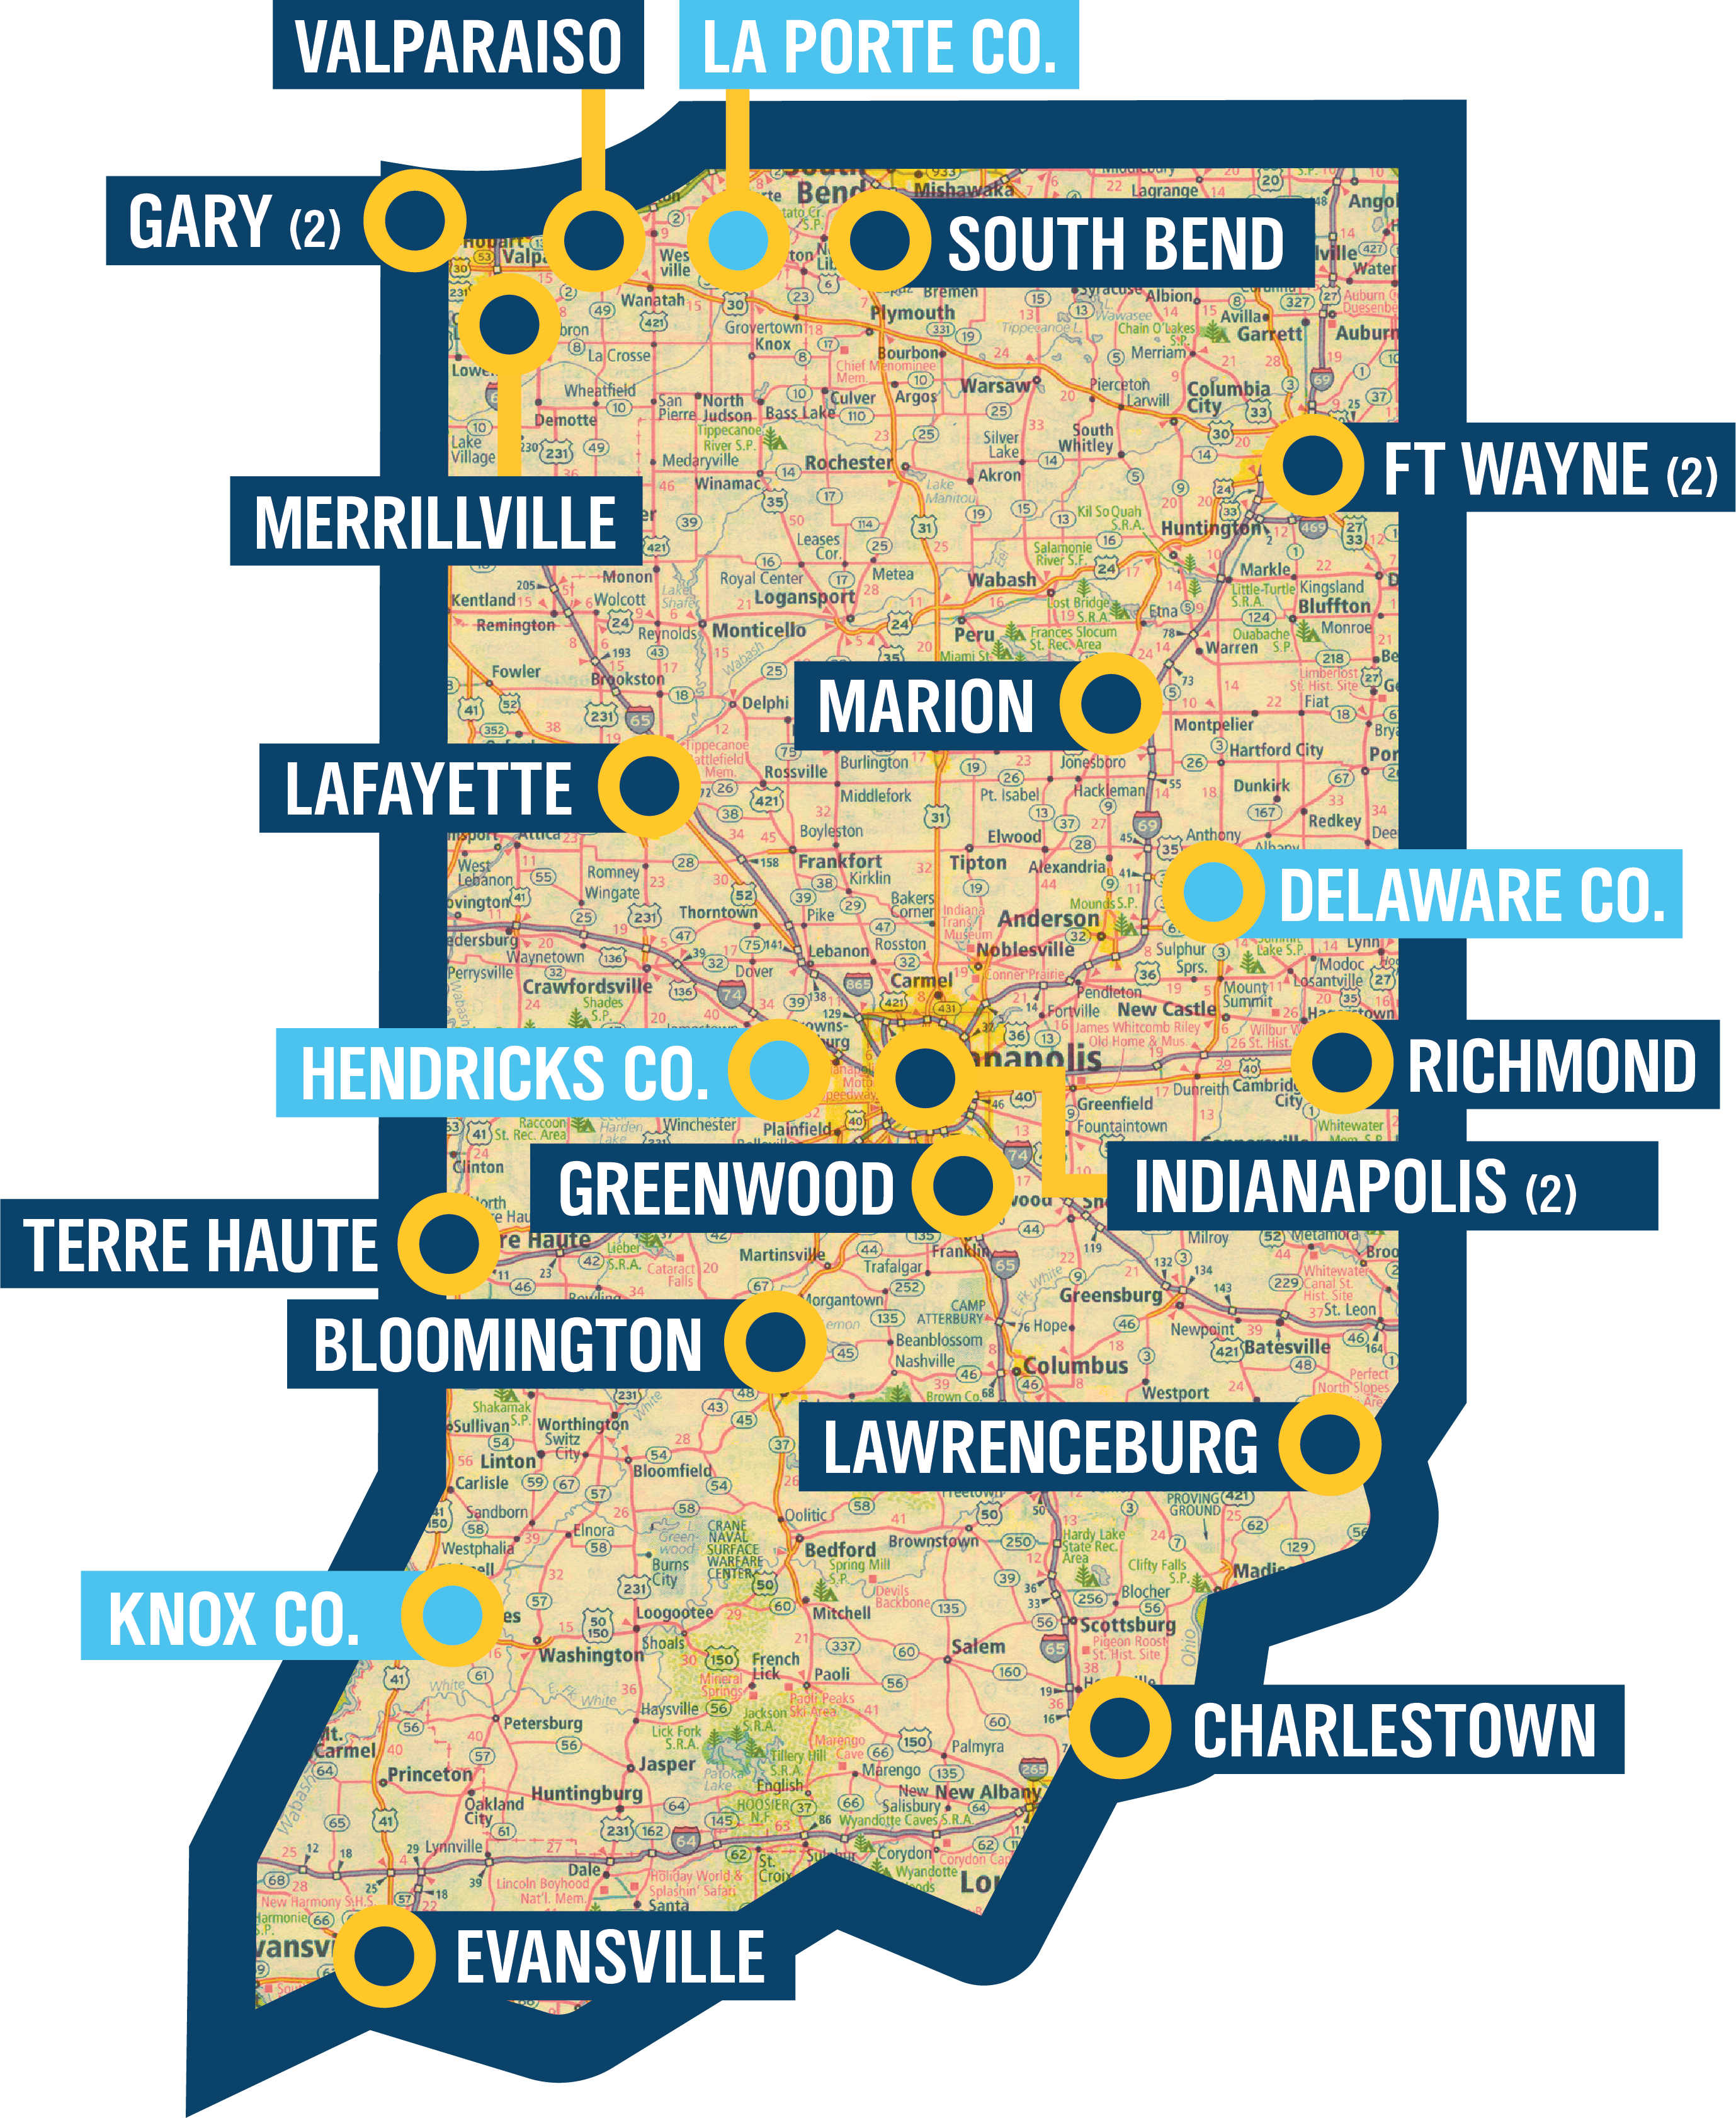
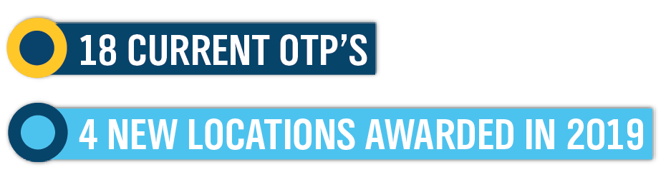
Opioid
Treatment
Programs in Indiana
4 additional locations to be awarded in 2019
#KnowTheOFacts
Notes:
Currently Indiana has 18 Opioid Treatment Programs (OTPs)
5 new locations were awarded for 2019
4 additional new locations to be awarded in 2019

Slide 4
What can you do to reduce the stigma?
#KnowTheOFacts
Notes:
So, what can you do to reduce the stigma around Opioid Use Disorder?
Language is powerful – especially when talking about addictions.
Stigmatizing language perpetuates negative perceptions around Opioid Use Disorder.
By using “Person First” language – we focus on the person NOT the disorder.

Slide 5
Language matters
SAY THIS NOT THIS
Person with Opioid Use Disorder | Addict, user, druggie, junkie, abuser
Disease | Drug habit
Person living in recovery | Ex-addict
Person arrested for a drug violation | Drug offender
Substance dependent | Hooked
#KnowTheOFacts
Notes:
For example, we should say This instead of …

Slide 6
Language matters
SAY THIS NOT THIS
Medication is a treatment tool | Medication is a crutch
Had a setback | Relapsed
Maintained recovery; substance-free | Stayed clean
Sources: Office of National Drug Control Policy, Changing the Language of Addiction., 01/09/17.
National Council for Behavioral Health, Language Matters, September 2015.
#KnowTheOFacts

Slide 7
UNDERSTANDING
OPIOID USE DISORDER
www.IN.gov/recovery
©2017

