Slide 2
Topics Covered
Indiana State CSR & DEA Registration
Administering and Dispensing VS. Prescribing
Inventory Control & Required Record Keeping
INSPECT Reporting & Querying
State Laws Impacting Veterinarians

Slide 3
Indiana Controlled Substance Registration (CSR)
An Indiana Controlled Substance Registration (CSR) is required for each practitioner who intends to prescribe, administer or dispense controlled substances.
An additional, separate CSR is required for each practice address at which a practitioner physically possesses controlled substances to administer or dispense.
A separate registration is NOT required for each place where a Practitioner merely prescribes controlled substances.
A CSR must be issued prior to a practitioner applying for a DEA registration. A personal DEA is not required if the practitioner is only dispensing controlled substances and does not administer or prescribe.

Slide 4
Drug Enforcement Administration
Practitioners may apply for the Drug Enforcement Administration (DEA) registration after their Indiana CSR is issued by going to their website (http://www.deadiversion.usdoj.gov/)
If you have further questions, you may contact the DEA at (317) 226-7977.

Slide 5
Administering and Dispensing
vs.
Prescribing

Slide 6
Legal Definitions
Practitioner: Physician, dentist, veterinarian, podiatrist, nurse practitioner, pharmacist, hospital, or other institution or individual licensed, registered, or otherwise permitted to distribute, dispense, conduct research with respect to, or administer a controlled substance in the course of professional practice.
Administering: The direct application of a drug to the body of a person by injection, inhalation, ingestion, or any other means.
Dispensing: The preparation, packaging, labeling, record keeping, and transfer of a prescription drug to a patient or an intermediary, who is responsible for administration of the drug.
Prescribing: A person licensed by law to prescribe drugs provides a written order, or an order transmitted by other means of communication, containing instructions for preparation and dispensing to the Pharmacist along with the mode of administration for the patient.

Slide 7
Administering & Dispensing Controlled Substances
The use of one DEA number by all practice Veterinarians is permitted for ordering, administering and dispensing controlled medications.
A personal DEA must be obtained by a Veterinarian before prescribing a controlled drug.
CFR 1301.22(b)

Slide 8
Prescribing Controlled Substances
An individual DEA registration is required for each Veterinarian who prescribes controlled medication.
Medications are prescribed when
a veterinarian issues a written order to a patient to be filled at a third party pharmacy, or an order is transmitted by other means of communication directly to a third party pharmacy on a patient’s behalf.

Slide 9
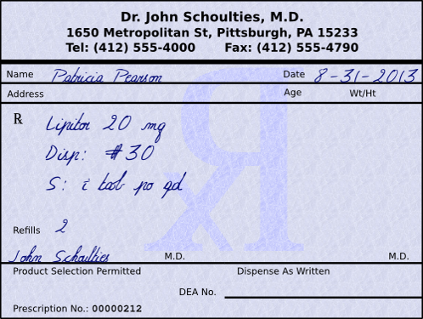
Required Prescription Information
A prescription for a controlled substance must include the following information:
- Date of issue
- Patient's name and address
- Practitioner's name, address, DEA
- Drug name
- Drug strength
- Dosage form
- Quantity prescribed
- Directions for use
- Number of refills (if any) authorized
- Manual signature of prescriber
MS0222212

Slide 10
Inventory Control
&
Record Keeping

Slide 11
DEA: Persons Required to Keep Records & File Reports
The DEA registrant who orders controlled substances to be used in the facility is the person held responsible for keeping controlled substance records. 21 CFR 1304.03(a)
Records must be kept for two years
21 CFR 1304.21(a)
Records must be stored at the registered location
21 CFR 1304.21(b)

Slide 12
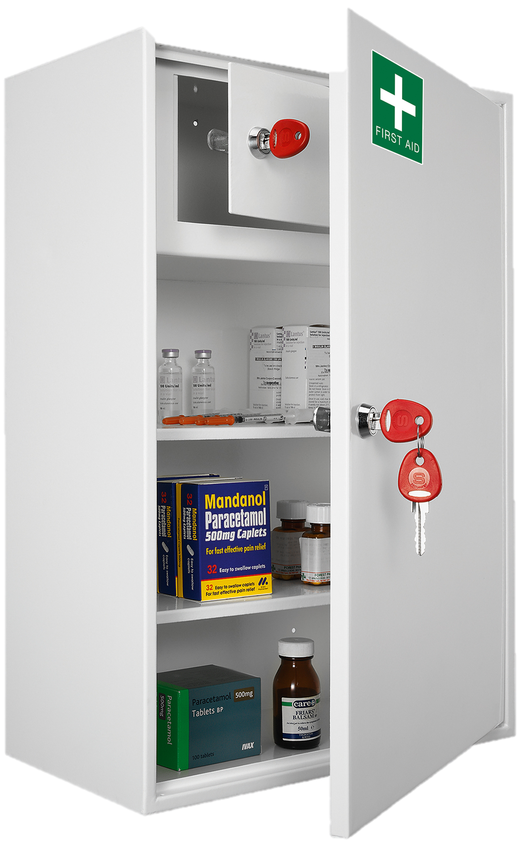
DEA: Controlled Substance Secure Storage Guidelines
The DEA registrant must store all Schedule II controlled substances and all copies of DEA Form 222* (the form used for ordering Schedule I and II controlled substances) in a substantially constructed, securely locked cabinet and must immediately report to the DEA any change in a copy (or copies) of the form’s status (used/unused, lost, stolen)

Slide 13
DEA: Record Keeping by Schedule
Records for Controlled Substances Received
Schedule II controlled substances must be logged on a separate sheet
Schedules III-V may be logged together.

Slide 14
DEA: Inventory Records
Each Inventory must contain the following information:
Whether the inventory was taken at the beginning or close of business.
Names of controlled substances.
Each finished form of the substances (e.g., 100 milligram tablet).
The number of dosage units of each finished form in the commercial container (e.g., 100 tablet bottle).
The number of commercial containers of each finished form (e.g., four 100 tablet bottles).
Disposition of the controlled substances.
It is important to note that inventory requirements extend to controlled substance samples provided to practitioners by pharmaceutical companies.

Slide 15
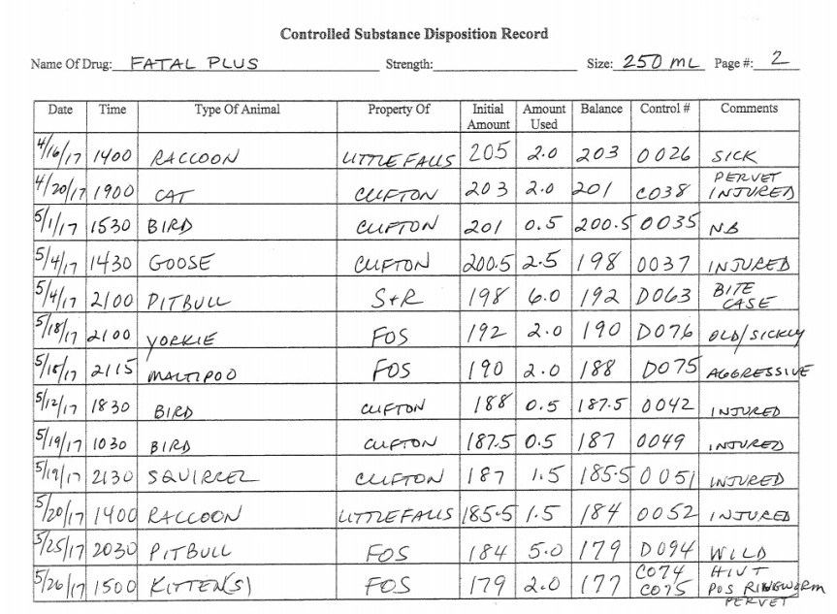
Inventory Records Example

Slide 16
INSPECT Reporting
&
Querying

Slide 17
INSPECT’s Technology Systems
1) PMP Clearinghouse
- PMP Clearinghouse is a portal used by pharmacists and
dispensing practitioners for reporting controlled substance
dispensations to State PDMPs. Dispensing facilities should have
only one Clearinghouse account. Multiple users may be added.
Only the organization dispensing a medication to the patient will report to Clearinghouse. Prescriptions (written, electronic, oral) filled at a pharmacy should be reported to INSPECT by the pharmacy.
2) PMP AWARxE
- PMP AWARxE is Indiana’s Prescription Drug monitoring platform,
which collects dispensation data from the clearinghouse and stores
the information in a format that is available to healthcare
practitioners for the purpose of viewing their patient’s controlled
substance prescription history. Each practitioner with prescriptive
authority should have their own account.

Slide 18
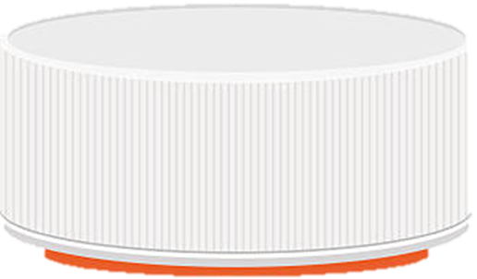
How Does it Work?
Patient
Info
Pharmacy
Info
Rx
Rx
History
Prescriber
Info
Payment
Type
INSPECT
Rx Report
Controlled Substance Dispensation is Reported
INTERNET
PMP Clearinghouse
PMP
AWARxE

Slide 19
What, When & Where to Report
Indiana requires all dispensers to report controlled substance dispensations to the Indiana PMP via the PMP Clearinghouse
What: Schedule II ‐ V controlled substances and gabapentin
(anything greater than a 72 hour supply).
When: At least within twenty‐four (24) hours (or next business day)
from the date that the drug is dispensed.
Where: Indiana PMP Clearinghouse.
To register for a data submitter account for PMP AWARXE, visit https://pmpclearinghouse.net

Slide 20
Registering for a Data Submitter Account in PMP Clearinghouse
Perform the following steps to create a data submitter account:
To request a data submitter account for PMP AWARXE, the user must go to https://pmpclearinghouse.net and click the “Create Account” link in the center of the screen.
The screen displayed requires the user to enter their current, valid email address, and a password. This email address will act as your username when logging into the system. The password must contain at least 8 characters, including 1 capital letter, 1 lower case letter, and 1 special character (such as !, @, #, $).

Slide 21
What Information is Collected
by INSPECT?
A. The patient's name.
B. The patient's identification number. If someone other than patient is picking
up medication, the patient representative’s identification number under
AIR05: Pick-up/Drop-off Person
C. The patient's date of birth.
D. The national drug code (NDC) number of the controlled substance dispensed.
E. The date the controlled substance is dispensed.
F. The quantity of the controlled substance dispensed.
G. The number of days of supply dispensed.
H. The dispenser's United States Drug Enforcement Agency (DEA) registration
number.
I. The prescriber's United States Drug Enforcement Agency (DEA) registration
number.
J. Patient address information, including city, state and zip code.

Slide 22
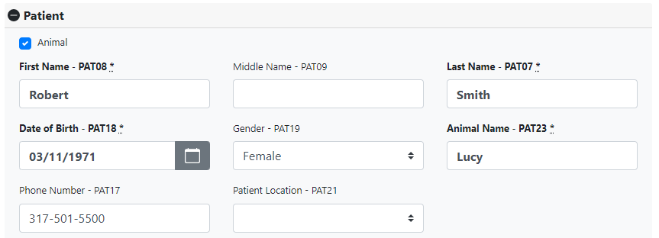
How to Report Dispensations for Animals
First Name - PAT08: First Name of the Pet Owner (if 2 owners, select 1 as the primary)
Last Name - PAT07: Last Name of the Pet Owner
Date of Birth - PAT18: Pet Owner’s Date of Birth
Animal Name - PAT23: First Name of the Pet
Example

Slide 23
How to Report Dispensations for Animals Owned by the Humane Society
First Name: Humane
Last Name: Society
DOB: 01/01/2000
Animal Name: First Name of Animal. If no name has been assigned, enter
Animal Shelter in the Animal Name Field (PAT23 *)
Example

Slide 24
How to Query INSPECT for Pet Records
Query the pet owner’s First name, last name and DOB.
Animal Dispensations reported correctly (as described in previous slide) will merge
into the owner’s INSPECT report.
Prescriptions for animals will be marked with the symbol of a dog.

Slide 25
State Laws Impacting Veterinarians

Slide 26
INSPECT Registration & Query Requirements
IC 25-26-24-20 A practitioner who is permitted to distribute, dispense, prescribe, or administer ephedrine, pseudoephedrine, or a controlled substance must have an active INSPECT account registration (effective Jan. 1, 2019).
To register for an INSPECT account and perform patient prescription history requests, visit our registration page online at: indiana.pmpaware.net
IC 25-26-24-19 A practitioner who is permitted to distribute, dispense, prescribe, or administer a controlled substance must query a patient’s INSPECT record each time before issuing a prescription for an opioid or benzodiazepine (effective Jan. 1, 2021)
All Indiana practitioners with authority to issue a controlled substance prescription
must be registered for an INSPECT account by January 1, 2019
Patient queries can be completed in AWARxE, through the PMP Gateway
integration within an EMR, or via a registered prescriber delegate.
Notes:
Practitioners who have an active Indiana Controlled Substance Registration (CSR) and valid DEA License must be registered for an INSPECT account.

Slide 27
Opioid Prescribing & Opioid Abuse Continuing Education Requirements
IC 35-48-3-3.5: A practitioner who is licensed by a board under IC 25-1-9 and applies for registration or reregistration under this chapter must have completed two (2) hours of continuing education during the previous two (2) years addressing the topic of opioid prescribing and opioid abuse. Continuing education requirements expire July 1, 2025.
Effective: July 1, 2019.
*Requirements and approved CE organizations can be found at PLA.IN.GOV
Notes:
Practitioners who have an active Indiana Controlled Substance Registration (CSR) and valid DEA License must be registered for an INSPECT account.

Slide 28
Veterinarians Are Not Required to Prescribe Electronically
Indiana’s mandatory electronic prescribing law applies to dentists, physicians, advanced practice registered nurses, optometrists, physician assistants, and podiatrists.
Veterinarians are exempt from electronic prescribing of controlled substances under IC 25-1-9.3-7
Notes:
Practitioners who have an active Indiana Controlled Substance Registration (CSR) and valid DEA License must be registered for an INSPECT account.

Slide 29
Questions?
Kara Slusser
Director of INSPECT
kslusser@pla.in.gov
For technical assistance, contact support: (844) 446-4767 or inspect@pla.in.gov

