Slide 1

The New 3Rs: The Rules of Rulemaking and Readoptions
State Ethics Commission Seminar
November 20, 2025
Lynn Tyler
General Counsel
Office of Management and Budget

Slide 2
Agenda
Sources of Rules
Statutes – Regular rulemaking
Statutes – Readoption
Financial Management Circulars
Other Resources
Top 10 Comments

Slide 3
Disclaimers
I’m from OMB and the focus is on issues that come up most often in the OMB and SBA review and approval process.
The focus will be on the fundamentals, “blocking and tackling.” Discussion of advanced issues is welcome during the question and answer period.
Any opinions expressed are mine alone.

Slide 4
Statutes – Regular Rulemaking
IC 4-22-2-19.5 Standards for rules
Sec. 19.5. (a) To the extent possible, a rule adopted under this article or IC 13-14-9 shall comply with the following:
(1) Minimize the expenses to:
(A) regulated entities that are required to comply with the rule;
(B) persons who pay taxes or pay fees for government services affected by the rule; and
(C) consumers of products and services of regulated entities affected by the rule.
(2) Achieve the regulatory goal in the least restrictive manner.
(3) Avoid duplicating standards found in state or federal laws.
(4) Be written for ease of comprehension.
(5) Have practicable enforcement.
(b) Subsection (a) does not apply to a rule that must be adopted in a certain form to comply with federal law.

Slide 5
Statutes - Regular
IC 4-22-2-19.6 Adoption of a rule that includes a fee, fine, or civil penalty; requirements; effect of nonconformity
Sec. 19.6. (a) A rule adopted under this article or IC 13-14-9 that includes a fee, fine, or civil penalty must comply with this section. Subsections (b), (c), and (d) do not apply to a rule that must be adopted in a certain form to comply with federal law.
(b) For each fee, fine, or civil penalty imposed by an agency that is not set as a specific amount in a state law, a rule must describe the circumstances for which the agency will assess a fee, fine, or civil penalty and set forth the amount of the fee, fine, or civil penalty:
(1) as a specific dollar amount;
(2) under a formula by which a specific dollar amount can be reasonably calculated by persons regulated or otherwise affected by the rule; or
(3) as a range of potential dollar amounts, stating the factors that the agency will utilize to set a specific dollar amount in an individual case with sufficient certainty that a review of an agency action under IC 4-21.5 or comparable process can evaluate whether the amount was reasonable.
A rule concerning fines or civil penalties does not prohibit an agency to enter into a settlement agreement with a person against whom a fine or civil penalty is being assessed to determine the fine or civil penalty to be paid for a violation.
(c) The amount of a fee must be reasonably based on the amount necessary to carry out the purposes for which the fee is imposed.

Slide 6
Statutes - Regular
IC 4-22-2-22.7 Regulatory analysis for proposed rules
Sec. 22.7. (a) Before complying with section 22.8, 37.1, or 37.2 of this chapter, an agency shall conduct a regulatory analysis for the proposed rule that complies with the requirements of this section.
(b) The office of management and budget shall set standards for the criteria, analytical method, treatment technology, economic, fiscal, and other background data to be used by an agency in the regulatory analysis. The regulatory analysis must be submitted in a form that can be easily loaded into commonly used business analysis software and published in the Indiana Register using the format jointly developed by the publisher, the office of management and budget, and the budget agency. The office of management and budget may provide more stringent requirements for rules with fiscal impacts and costs above a threshold amount determined by the office of management and budget.
.

Slide 7
Statutes - Regular
IC 4-22-2-22.7 Regulatory analysis for proposed rules (cont’d)
(c) At a minimum, the regulatory analysis must include findings and any supporting data, studies, or analyses prepared for a rule that demonstrate compliance with the following:
(1) The cost benefit requirements in IC 4-3-22-13.
(2) Each of the standards in section 19.5 of this chapter.
(3) If applicable, the requirements for fees, fines, and civil penalties in section 19.6 of this chapter.
(4) The annual economic impact on small businesses statement required under IC 4-22-2.1-5.
(5) If applicable, the information required under IC 13-14-9-4.
(6) A determination whether the combined implementation and compliance costs of a proposed rule are at least one million dollars ($1,000,000) for businesses, units, and individuals over any two (2) year period.
(7) Any requirement under any other law to conduct an analysis of the cost, benefits, economic impact, or fiscal impact of a rule, if applicable.
.

Slide 8
Statutes - Regular
IC 4-3-22-1 Legislative findings
Sec. 1. The state will benefit from devoting adequate resources to do the following:
***
(9) Ascertain whether the burdens imposed by laws and rules are justified by their benefits using a rigorous cost benefit analysis.
.

Slide 9
Statutes - Regular
IC 4-22-2-22.7 Regulatory analysis for proposed rules
(d) The regulatory analysis must include a statement justifying any requirement or cost that is:
(1) imposed on a regulated entity under the rule; and
(2) not expressly required by:
(A) the statute authorizing the agency to adopt the rule; or
(B) any other state or federal law.
The statement required under this subsection must include a reference to any data, studies, or analyses relied upon by the agency in determining that the imposition of the requirement or cost is necessary.
(e) Except as provided in subsection (f), if the implementation and compliance costs of a proposed rule are expected to exceed the threshold set forth in subsection (c)(6), the publisher may not publish the proposed rule until the budget committee has reviewed the rule.

Slide 10
Statutes - Readoption
IC 4-22-2.6-1 Dates for expiration; exceptions
Sec. 1. (a) Except as provided in this section and section 10 of this chapter, a rule adopted under IC 4-22-2-23 through IC 4-22-2-36 expires January 1 of the fifth year after the year in which the rule takes effect, unless the rule expires or is repealed on an earlier date. Except for an amendment made under IC 4-22-2-38, the expiration date of a rule under this section is extended each time that a rule:
(1) amending under IC 4-22-2-23 through IC 4-22-2-36;
(2) continuing under IC 4-22-2.3-10; or
(3) readopting;
an unexpired rule takes effect. The rule, as amended or readopted, expires on January 1 of the fifth year after the year in which the amendment or readoption takes effect.

Slide 11
Statutes - Readoption
IC 4-22-2.6-1 Dates for expiration; exceptions
(b) If the latest version of a rule became effective:
(1) in calendar year 2017, the rule expires not later than January 1, 2024;
(2) in calendar year 2018, the rule expires not later than January 1, 2025;
(3) in calendar year 2019, the rule expires not later than January 1, 2026; or
(4) in calendar year 2020, the rule expires not later than January 1, 2027.
(c) If the latest version of a rule became effective before January 1, 2017, and:
(1) the rule was adopted by an agency established under IC 13 [IDEM], the rule expires not later than January 1, 2025;
(2) the rule was adopted by an agency established under IC 16 [Health], the rule expires not later than January 1, 2026; or
(3) the rule was adopted by an agency not described in subdivision (1) or (2), the rule expires not later than January 1, 2027.

Slide 12
Statutes - Readoption
IC 4-22-2.6-2 Procedure for readoption
Sec. 2. An agency that has rulemaking authority may readopt a rule in anticipation of a rule's expiration under section 1 of this chapter. To readopt a rule, an agency may readopt the rule either:
(1) without changes in conformity with the procedures in sections 3 through 9 of this chapter; or
(2) with or without changes in conformity with the procedures in IC 4-22-2-23 through IC 4-22-2-36 [regular rulemaking] (as modified by IC 13-14-9, when applicable).

Slide 13
Statutes - Readoption
IC 4-22-2.6-3 Readoption of rule; initial notice; document control number
Sec. 3. (a) Except as provided in subsection (b), if an agency intends to readopt a rule, the agency shall, not later than January 1 of the year preceding the year in which the rule expires under this chapter, provide an initial notice of the intended readoption in an electronic format designated by the publisher.

Slide 14
Statutes - Readoption
IC 4-22-2.6-4 Readoption of rule affecting fees, fines, civil penalties, and small businesses; review required; agency written findings
(b) In the review, the agency shall reexamine previous cost benefit, economic impact, fiscal impact, and regulatory burden statements prepared by the agency for the rule under IC 4-3-22-13, IC 4-22-2-22.7, IC 4-22-2-22.8, IC 4-22-2-28, IC 4-22-2.1-5, or an executive order and revise the statements to reflect any change in circumstances that affect the analysis.

Slide 15
Executive Order 25-17
Paragraph 3 requires writing findings that include, among other things, either:
Any revisions to previously prepared cost benefit, economic impact, fiscal impact, or regulatory burden statements prepared by the agency … if those previously prepared statements were published by the Indiana Register; or
If the rule did not have a previously prepared cost benefit, economic impact, fiscal impact, or regulatory burden statements prepared by the agency … published in the Register, a copy of an updated regulatory burden statement that meets the requirements of Indiana Code § 4-22-2-22.7.

Slide 16
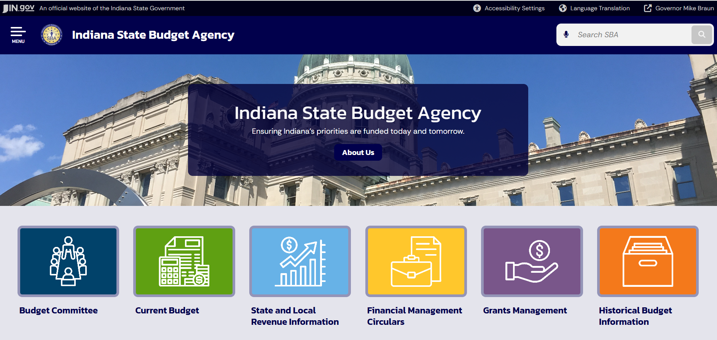
Financial Management Circulars (FMC)

Slide 17
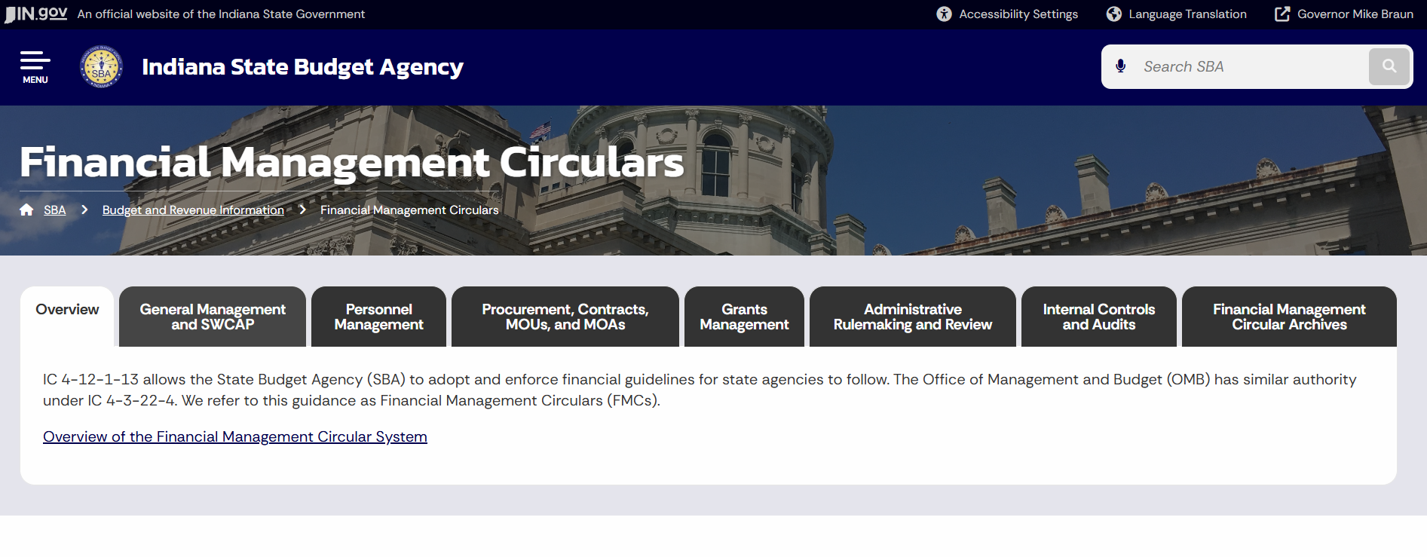
Financial Management Circulars (FMC)

Slide 18
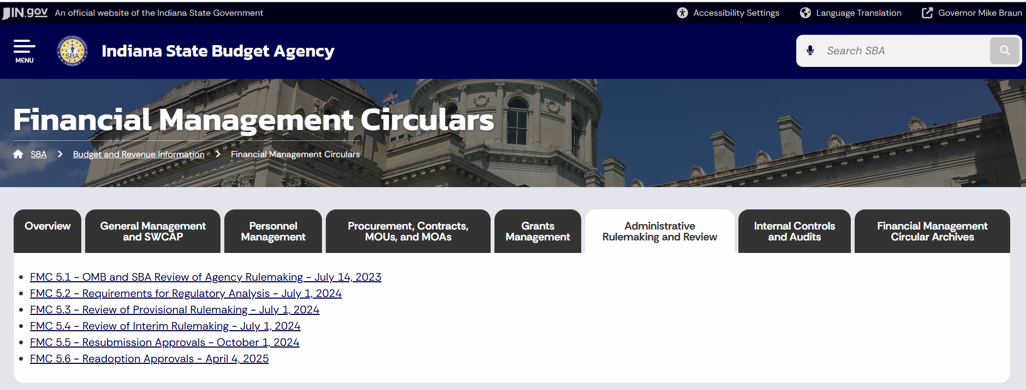
Financial Management Circulars (FMC)

Slide 19
Financial Management Circulars 5.2
Regulatory Analysis Template
Description of Rule: This section should include an overview of the proposed rulemaking, background, and high-level justification. Topics to address include (as applicable):
a. History and Background of the Rule – Explain the genesis for this rulemaking, including what prompted the agency to undertake this rulemaking. For example, is this rulemaking due to an update in state or federal law, court order, audit finding, operational issue or some other factor? When was the last major update to the rule? What process did the agency follow to develop this rule, for example was there a committee, external working groups, model code, etc.?

Slide 20
Financial Management Circular 5.2
Subheadings – Please use them!
Address all of them!
b. Scope of the Rule – Describe at a high-level the scope of the changes in the proposed rule. For example, is the rule simplifying a process, clarifying definitions, aligning the rules with current law, or is it a repeal and replace effort to assist with regulatory compliance and implementation. If it is a repeal and replace, explain why this method was chosen rather than simply amending the existing regulations.

Slide 21
Financial Management Circular 5.2
Subheadings – Please use them!
Address all of them!
c. Statement of Need – Provide a statement explaining the need for the rule and an evaluation of the policy rationale or goal behind the proposed rule, including an explanation as to whether the rule is intended to address 1) a federal or state statutory requirement; 2) a court order; 3) an audit finding, 4) an operational issue, or 5) another factor.

Slide 22
Financial Management Circular 5.2
Subheadings – Please use them!
Address all of them!
II. Fiscal Impact Analysis
This section should include a discussion of the impact of the proposed rulemaking on State and local government expenditures and revenues. Topics to address include (as applicable):
a. Anticipated Effective Date of the Rule
b. Estimated Fiscal Impact on State and Local Government – Does the rule impact expenditures and revenues of State agencies or local government? If so, to the extent possible, quantify the total impact by year.
c. Sources of Expenditures or Revenues Affected by the Rule – If the rule impacts expenditures and revenues of State agencies or local government, indicate (1) which units of government are impacted, (2) which years are impacted, and (3) which funds are impacted (if known). Also indicate which specific provisions in the rule impose the fiscal impact.

Slide 23
Financial Management Circular 5.2
Subheadings – Please use them!
Address all of them!
III. Impacted Parties - This section should identify all parties that may be impacted from the proposed rule and include a specific number or estimated number of such parties.

Slide 24
Financial Management Circular 5.2
Subheadings – Please use them!
Address all of them!
IV. Changes in Proposed Rule - This section should identify all changes from existing regulation. This can be done by creating a list of changes or showing the changes in a table format…. As part of this process, identify all requirements that are being included as part of the proposed rulemaking but are imposed by another source of law.
Also, as part of this process, identify all requirements that are being included as part of the proposed rulemaking that incorporate an existing agency standard that is contained in a non-rule document. For example, these standards can be contained in a policy, manual, handbook, contract, form, application, etc.

Slide 25
Financial Management Circular 5.2
Subheadings – Please use them!
Address all of them!
V. Benefit Analysis - This section should include a discussion of the benefits of the changes made in the proposed rule compared to existing requirements. For each new requirement in the proposed rule, consider the benefits to the general public, regulated community, businesses and other regulated entities, your agency, other state agencies, local partners, individuals, families, and small businesses.
***
If benefits cannot be monetized or quantified, the agency should explain why and include a thorough description of the non-quantifiable benefits as well as a determination whether such benefits will be significant.

Slide 26
Financial Management Circular 5.2
Subheadings – Please use them!
Address all of them!
a. Estimate of Primary and Direct Benefits of the Rule –
b. Estimate of Secondary or Indirect Benefits of the Rule -
c. Estimate of Any Cost Savings to Regulated Industries – Indicate if the proposed rule will provide cost savings individuals and/or businesses. Please note if the savings are from a change in an existing requirement or the imposition of a new requirement.

Slide 27
Financial Management Circular 5.2
Subheadings – Please use them!
Address all of them!
VI. Cost Analysis - This section should include a comprehensive enumeration of the cost imposed by the changes made in the proposed rule compared to existing requirements, including tangible and intangible costs. For each new requirement in the proposed rule, consider the costs to the general public, regulated community, businesses and other regulated entities, your agency, other state agencies, local partners, individuals, families, and small businesses.
If costs cannot be monetized or quantified, the agency should explain why and include a thorough description of the non-quantifiable costs as well as a determination whether such costs will be significant.

Slide 28
Financial Management Circular 5.2
Subheadings – Please use them!
Address all of them!
a. Estimate of Compliance Costs for Regulated Entities – Costs are the burden of complying with the rule…. Consider both direct and indirect costs.... If possible, agencies should monetize the costs by expressing them in numbers.
b. Estimate of Administrative Expenses Imposed by the Rules – To the extent possible, quantify any legal, consulting, reporting, accounting or other administrative expenses imposed by the requirements of the rule. This includes any additional time regulated parties will need to spend to understand the requirements and comply with them through new processes or procedures.
c. The fees, fines, and civil penalties analysis required by IC 4-22-2-19.6 –
d. If the implementation costs of the proposed rule are expected to exceed the threshold set in IC 4-22-2-22.7(c)(6) – Determination whether the combined implementation and compliance costs of the proposed rule are at least one million dollars ($1,000,000) for businesses, units, and individuals over any two (2) year period.

Slide 29
Financial Management Circular 5.2
Subheadings – Please use them!
Address all of them!
VII. Sources of Information - This section should include a discussion of the sources of outside information utilized to calculate the cost and benefits for the rule. Topics to address include (as applicable):
a. Independent Verifications or Studies - Were there any studies that were relied upon in the cost-benefit analysis?
b. Sources Relied Upon in Determining and Calculating Costs and Benefits – Did the agency use any outside sources to calculate costs and benefits?

Slide 30
Financial Management Circular 5.2
Subheadings – Please use them!
Address all of them!
VIII. Regulatory Analysis - Conclude with an aggregated tally of the costs and benefits for each new requirement along with the agency's determination whether the benefits are likely to exceed the costs.

Slide 31
Financial Management Circulars (FMC)

Slide 32
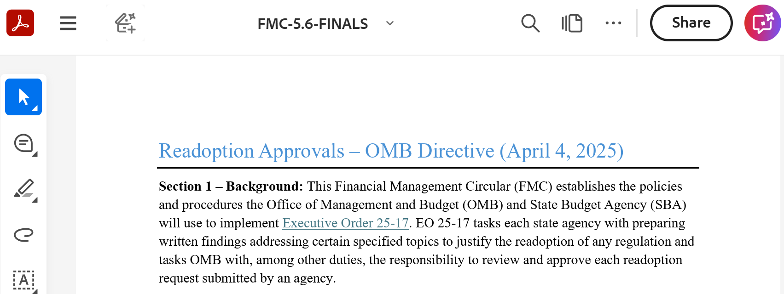
Financial Management Circulars (FMC)

Slide 33
Financial Management Circular 5.6
Given the relatively short timeframe between the deadline for the written findings required by EO 25-17 (first regular business day in July), the time required for OMB and SBA review, and the statutory deadline for publishing the notice of readoption in the Indiana Register (first working day of September), agencies are strongly encouraged to submit their written findings as soon as possible, even in advance of the deadline.
Depending on the volume of readoptions for 2026, we may ask Patrick to adjust the deadline for submitting readoption materials to SBARules@gov.in.gov. Last year it was July 1.

Slide 34
Financial Management Circular 5.6
Section 3 – Required Information: In order to facilitate review of readoption requests, the agency’s request shall include the following information:
a) The written findings required by paragraph 3 of EO 25-17….
b) A copy of the rule to be readopted in Word;
c) A completed Regulatory Readoption Template (see https://www.in.gov/omb/management-circulars/rule-approval-process/readoptionprocess/) and Regulatory Analysis Template (see https://www.in.gov/omb/rule-approvalprocess/regulatory-analysis-template/).
d) With the initial readoption request and at least once a year on the first regular business day in July thereafter, a written plan ….
e) The nature of any comments received from regulated entities or interested parties regarding the proposed rule, if the agency has received such comments;
f) Contact information (name, phone number, and email address) for an agency staff member who can answer substantive questions about the proposed rule and the underlying policy area.

Slide 35
Financial Management Circular 5.6
All the discussion of the Regulatory Analysis in earlier slides applies equally in the readoption context.

Slide 36
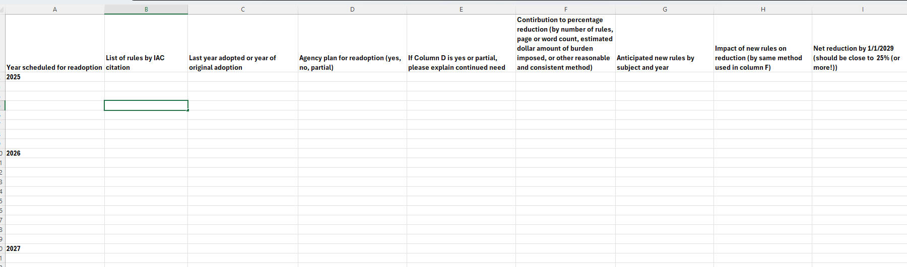
Written Plan

Slide 37
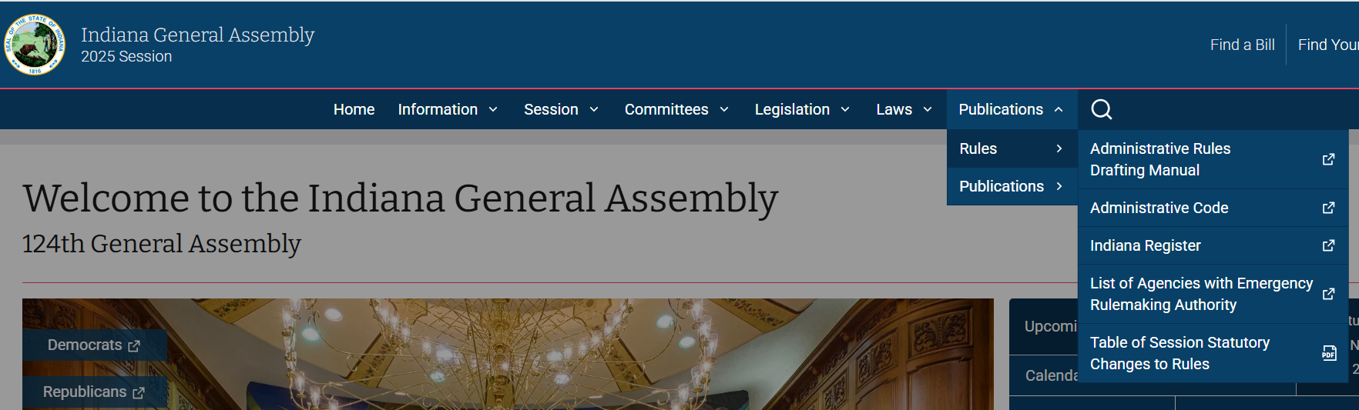

Other Resources

Slide 38
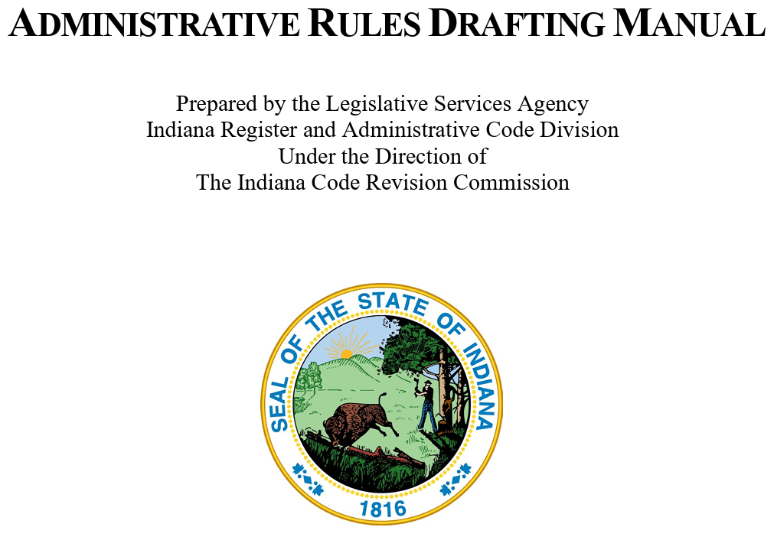
Other Resources

Slide 39
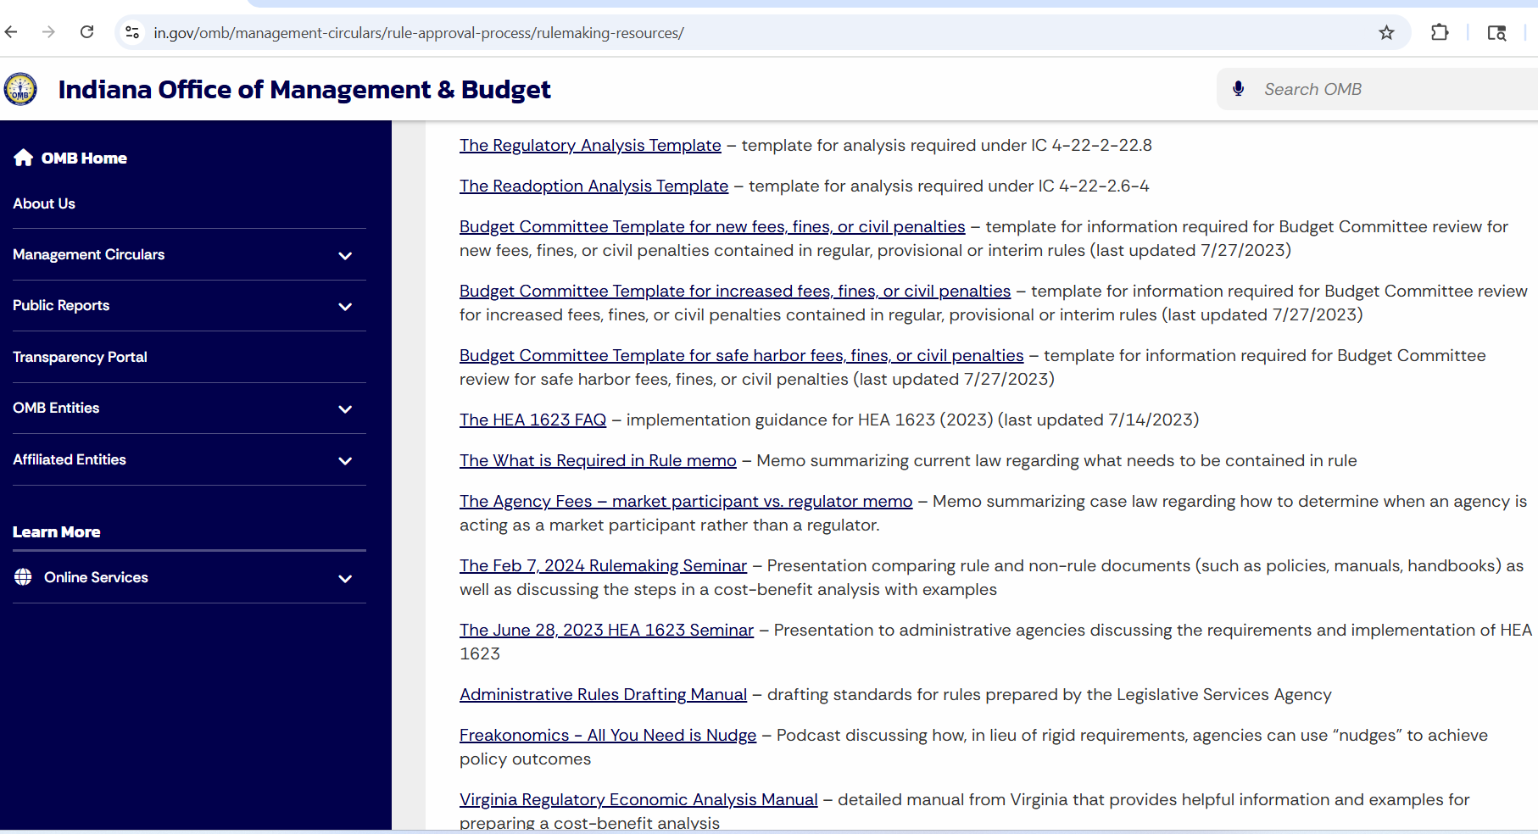

Other Resources

Slide 40

Top Ten OMB/SBA Comments
With apologies to fellow Hoosier David Letterman …

Slide 41
Top Ten OMB/SBA Comments
10. Consider doing a readoption with changes (one proceeding) rather than a readoption followed by an amendment (two proceedings).
9. Please submit a copy of the rule in Word (or a Regulatory Analysis or Readoption Review).
8. Please address this missing section.
7. The compliance costs under IC 4-22-2-22.7(c)(6) are calculated based on all impacted parties, not individually.
6. Costs for state government do not count under IC 4-22-2-22.7(c)(6), only businesses, individuals, and units [of local government].

Slide 42
Top Ten OMB/SBA Comments
5. The Regulatory Analysis should “conclude with an aggregated tally of the costs and benefits for each new requirement along with the agency's determination whether the benefits are likely to exceed the costs.”
4. Please provide an estimated number of impacted parties (or each category of impacted parties).
3. In response to the argument that a readoption does not involve any new benefits or costs because it is a readoption and regulated entities are already in compliance: “Unfortunately, this is not the test. Per IC 4-22-2.6.4(b), ‘[i]n the review, the agency shall reexamine previous cost benefit, economic impact, fiscal impact, and regulatory burden statements prepared by the agency for the rule under IC 4-3-22-13, IC 4-22-2-22.7, IC 4-22-2-22.8, IC 4-22-2-28, IC 4-22-2.1-5, or an executive order and revise the statements to reflect any change in circumstances that affect the analysis.’”

Slide 43
Top Ten OMB/SBA Comments
T1. Per FMC 5.2, please quantify the costs if possible. “If costs cannot be monetized or quantified, the agency should explain why and include a thorough description of the non-quantifiable costs as well as a determination whether such costs will be significant.”
T1. Per FMC 5.2, please quantify the benefits if possible. “If benefits cannot be monetized or quantified, the agency should explain why and include a thorough description of the non-quantifiable benefits as well as a determination whether such benefits will be significant.”

Slide 44
Questions?
Lynn Tyler
lytyler@gov.in.gov
(317) 391-7025

