Slide 1
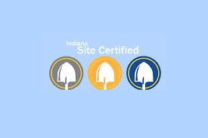

Site Certified Webinar

Slide 2
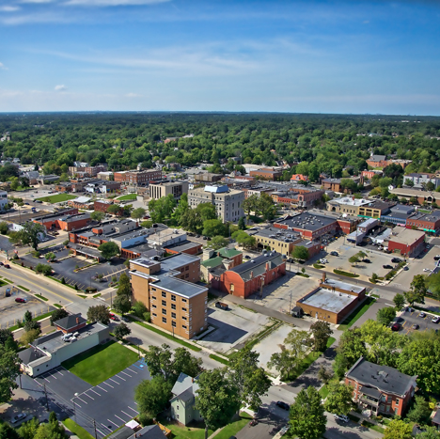
What is the Indiana Site Certified Program?
A statewide initiative by the Indiana Office of Community and Rural Affairs.
Designed to identify, evaluate and certify sites that are ready for economic development
Creates a portfolio of high-quality sites across Indiana to attract new businesses and investment.
This Photo by Unknown Author is licensed under CC BY-NC-ND

Slide 3
What the program does:
Mitigates Risks: Conducts due diligence upfront to identify and address potential site issues.
Markets Your Sites: Promotes certified sites to site selectors and businesses looking to expand or relocate.
Showcases Readiness: Show your community's proactive commitment to economic development.

Slide 4
Why it matters for your community:
Reduces barriers for developers.
Accelerates the site development process.
Increases your competitiveness in attracting jobs and capital.

Slide 5
Why Certify Your Site? The Benefits for Your Community:
Attract More Investment
Certified sites are already approved by OCRA to begin projects, appealing directly to businesses needing quick development.
They signal that a community has done its homework, making it a more attractive place to invest.

Slide 6
Why Certify Your Site? The Benefits for Your Community:
Reduce Risk for Developers
Extensive due diligence conducted through the program identifies and resolves potential issues before a developer commits.
This saves the businesses time and money, making your site a safer bet.

Slide 7
Why Certify Your Site?
The Benefits for Your Community:
Gain a Marketing Advantage
Certified sites are featured in state marketing efforts and databases, increasing their visibility.
The certification acts as a quality seal, enhancing your site's credibility.

Slide 8
Why Certify Your Site?
The Benefits for Your Community:
Streamline Development
With many approvals and studies completed, the path from selection to construction is significantly shortened.
This fast-tracks job creation and economic impact for your community.

Slide 9
Why Certify Your Site?
The Benefits for Your Community:
Demonstrate Preparedness
Achieving certification proves your community's foresight, organization and commitment to supporting business growth.

Slide 10

Understanding the Tier System: Silver, Gold, Prime
The Indiana Site Certified program offers three tiers, each reflecting a different level of due diligence and site readiness. Communities choose a tier based on their site's characteristics and their strategic goals.

Slide 11
Silver Tier
Silver Certification (Entry Level)
Foundational Readiness: Basic due diligence completed.
Demonstrates essential site information is available.
Good for sites just beginning their readiness journey.

Slide 12
Silver Certification: Who it's for
Communities looking to start their site readiness journey.
Sites with strong potential.
less upfront investment in extensive studies:
No Size Limit: Any size site can pursue Silver certification.
Foundational Due Diligence: Focuses on essential site information and initial assessments.
No specific distance requirement to state highways.

Slide 13
What your community can expect to provide
Basic maps (e.g., Aerial, ALTA, Topographical).
Evidence of clear title (50-year search).
A Phase 1 Environmental Assessment.
A Wetland Delineation Report.
Letter of support from Chief Elected Official.
Utility capacity and distance defined.
Benefit: Silver is a great first step to gain recognition and visibility for your promising sites.

Slide 14
Gold Tier
Gold Certification (Elevated Readiness):
Intermediate Due Diligence: More comprehensive studies and stricter criteria.
Indicates a higher level of preparedness, often with specific access and acreage requirements.
A strong signal of an advanced site readiness.

Slide 15
Gold Certification: Who it's for
Communities ready to commit to a higher level of due diligence.
Sites with clear potential for industrial or larger commercial development.
includes all Silver requirements
Minimum 20 Contiguous Acres: The site must be a substantial, unbroken parcel.
Highway Access: MUST be five (5) miles or less from state highway transportation.
More Detailed Studies: Shows greater confidence in site conditions.

Slide 16
What your community can expect to provide
A comprehensive Geotechnical Study/Soil Borings Report.
A Seismic Hazard Map.
Evidence of local zoning that supports the site's intended use.
Desktop Archaeological Investigation.
Utilities that extend to the property line, demonstrating full-service availability.
Benefit: Gold certification positions your site as a serious contender for significant development projects.

Slide 17
Prime Certification
Most Rigorous Due Diligence:
The highest standard of site readiness.
Features strict acreage, access, and often local public entity ownership/control requirements.

Slide 18
Prime Certification: Who it's for
Communities with premium sites targeted for the largest, most critical development projects.
Sites with substantial local government or economic development organization backing.
Key Characteristics (includes all Gold requirements, plus):
Minimum 30 Contiguous Acres: Reserved for large-scale developments.
Premier Highway Access: MUST be two and a half (2.5) miles or less from state highway transportation.
Ownership/Control: Local Unit of Government (LUG), Local Economic Development Organization (LEDO), or Regional Economic Development Organization (REDO) must own the property or have an option agreement.
Most Extensive Due Diligence: Comprehensive vetting, minimizing all potential unknowns.

Slide 19
What your community can expect to provide
A field archaeological investigation (beyond just a desktop review).
Confirmation of no recognized environmental conditions or a fully clear site.
Benefit: Prime certification signifies your site is among the elite, offering unparalleled readiness and confidence to major investors.

Slide 20
The Application Process:
Steps for Your Community
Step 1: Site Identification & Goal Setting:
Identify a potential site in your community.
Discuss with local stakeholders (economic development, planning) to determine which certification tier aligns best with the site's potential and your community's goals.

Slide 21
Step 2: Understand Requirements:
Review the official Indiana Site Certified Program Checklist for your chosen tier. This outlines ALL required documents and criteria
The Site Certified Checklist can be found on our website: OCRA: Indiana Site Certified
Site-Certified-Checklist-and-Glossery.pdf

Slide 22
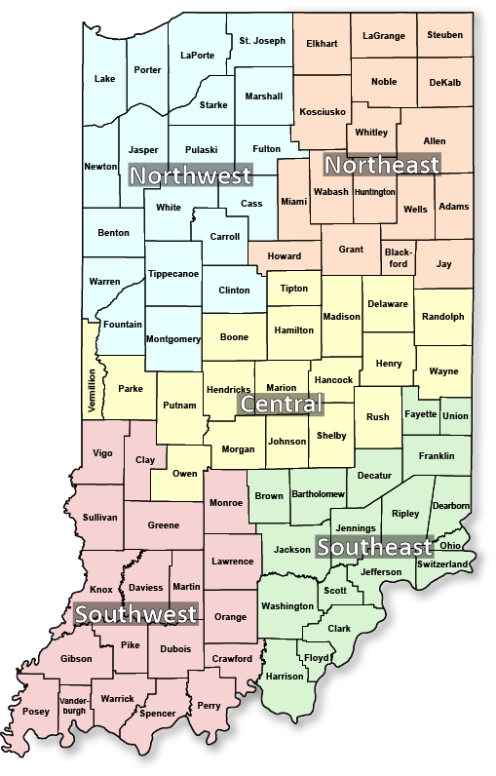
Step 3: Engage Your Community Liaison:
Connect with your designated Community Liaison from OCRA. They are your primary point of contact and will guide you through the process, offering feedback and assistance.
Your CL will also provide login information to our Grants Management System (GMS). This is where the application is housed, documents will be uploaded and applications submitted.
OCRA: Community Liaisons

Slide 23
Step 4: Documentation & Studies:
Begin compiling all necessary documents, maps, letters and commissioning required studies (e.g., environmental, geotechnical) as per your chosen tier's checklist.
Ensure all documents meet dating requirements (your Community Liaison will help clarify these).

Slide 24
Step 5: Application Submission
Submit your complete application package to OCRA through the Grants Management System

Slide 25
Step 6: Review & Feedback Cycle
Your Community Liaison will conduct an initial review, providing feedback on any missing or insufficient items.
Address feedback and resubmit as needed.

Slide 26
Step 7:
Final Review & Certification
Once the Community Liaison’s review is complete, the Program Manager conducts a final assessment.
If all criteria are met, your site receives its official Indiana Site Certified designation!

Slide 27
What Happens After Certification?
Enhanced Marketing & Promotion:
Your site will be featured on state economic development websites and promotional materials.
OCRA and its partners will actively market your certified site to potential developers and site selectors.

Slide 28
Ongoing Site Maintenance:
To maintain certification, you'll need to keep site information up-to-date.
This involves annual updates to confirm the site's status, available utilities and other key details

Slide 29
Showcasing Your Commitment:
Certification serves as a powerful testament to your community's pro-business environment and readiness for economic growth.
Use your certified status in your own local marketing and outreach efforts!

Slide 30
Potential for Future Upgrades:
You can always aim for a higher certification tier as your site matures and further due diligence is completed.
Additional certification would follow a similar process as the initial application but would require the documentation to prove it meets the standards of higher tiers.

Slide 31
Getting Started & Resources
Ready to Certify Your Site?
1. Contact OCRA:
Visit the Indiana Office of Community and Rural Affairs (OCRA) website at www.in.gov/ocra/ for program details and resources.
2. Connect with Your Community Liaison:
Your Liaison is your dedicated guide through this process. Don't hesitate to reach out with questions. Find your Community Liaison at www.in.gov/ocra/about/community-liaisons/
3. Review the Checklist:
The official Document Collection Checklist is your roadmap. Familiarize yourself with the requirements for your target certification level. View the Checklist at www.in.gov/ocra/Indiana-site-certified/
Questions?
We're here to help you succeed! Contact us at site@ocra.in.gov

