Slide 1
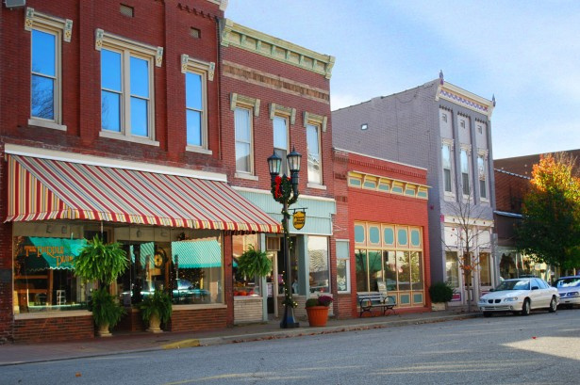



American Rescue Plan Act (ARPA)
An overview of the State and Local Fiscal Recovery Funds (SLFRF)
Presented By
Alexander Taylor, Community and Economic Development Manager
Andrea Kern, Director of Strategic Initiatives

Slide 2
Disclaimer; Housekeeping
Questions: OCRA has inserted several question slides in the presentation, which will allow participants to ask questions in real-time. Additionally, participants may utilize the chat feature for questions.
The webinar recording and slideshow will be readily available to all participants on OCRA’s website.
We will be taking a 5-minute break between sections.
The information provided in this presentation does not, and is not intended to, constitute legal advice; instead, all information, content, and materials available within this presentation are for general informational purposes only. Please consult with your municipal attorney if you have any additional questions or concerns regarding State and Local Fiscal Recovery Funds.
The information provided in this presentation is property of the United States Department of Treasury. All questions, comments, concerns, or inquiries can be submitted to the United States Department of Treasury email at SLFRP@treasury.gov.
The list of eligible activities is meant to be a guide for creating programs and projects. Treasury has left flexibilities within the funding stream on purpose to allow recipients to meet the given needs of their community.
Notes:
Timeline: 12 weeks
Universities lead and facilitate first in-person committee meeting (kick off)
Goal: presenting data; setting expectations for lean prospectus model
Committees are responsible for developing the lean prospectus model and identifying/prioritizing projects. Universities will help facilitate on an as-needed basis
6 weeks after kick-off, the core team member on the Strengthening Local Economies Pathway Committee will have a peer call with the other 3 communities. This peer call will be facilitated by Ivy Tech.
10-11 weeks after kick off, all Pathways committees in each individual community will meet to present their LPMs and projects. At this meeting, all committees will work to prioritize projects across all pathways to inform the SIP. All 4 universities will be on site at each community to facilitate.

Slide 3

Introduction to American Rescue Plan Act and State and Local Fiscal Recovery Funds
PART 1
PART 2
Replacing Lost Sector Revenue
PART 3
Responding to Public Health
Agenda
PART 4
Responding to Economic Distress
PART 5
Providing Premium Pay
PART 6
Water, Sewer and Broadband Infrastructure
PART 7
Compliance and Reporting
02

Slide 4
American Rescue Plan Act
The American Rescue Plan Act of 2021 is designed to facilitate the United States’ recovery from the devastating economic and health effects of the COVID-19 pandemic.
Signed into law on March 11, 2021, the package costs $1.9 trillion, making it one of the largest economic rescue plans in United States history.
High-level goals of the plan include:
  Mount a national vaccination program, contain COVID-19, and safely reopen schools.
  Deliver immediate relief to American families bearing the brunt of the crisis.
  Support communities that are struggling in the wake of COVID-19.

Slide 5
The Coronavirus State and Local Fiscal Recovery Funds (SLFRF)
    Interim Final Rule – The goal of the IFR was to facilitate swift and effective implementation by establishing a framework for determining the types of programs and services that are eligible under the guidelines of the American Rescue Plan Act along with examples of uses that State, Local, and Tribal governments may consider.
    Final Rule – Published on January 7, 2022. The Final Rule provides eligibility criteria and enumerated activities for eligible programs and projects under the funding stream. Final Rule is in full effect as of April 30, 2022.
    The final rule provides these four categories for eligible activities.
        Replacing lost public sector revenue
        Supporting the COVID-19 public health and economic response
        Providing premium pay for eligible workers performing essential work
        Investing in water, sewer, and broadband infrastructure.

Slide 6

Replacing Lost Public Sector Revenue
The final rule offers a standard allowance for revenue loss of $10 million, allowing recipients to select between a standard amount of revenue loss or complete a full revenue loss calculation. Recipients that select the standard allowance may use that amount for government services. SLFRF funding may be used to pay for “government services” in an amount equal to the revenue loss experienced by the recipient due to the Covid-19 public health emergency.
Determining Revenue Loss
1.) Standard Allowance
2.) Calculation
Recipients were required to select an election for lost public sector revenue in the Project and Expenditure Report that
was due on April 30, 2022.
Spending on Government Services
Government services generally include any service traditionally provided by a government, unless Treasury has specifically stated otherwise.
Examples include:
  Construction of Schools
  Construction of Hospitals
  Road Building and Maintenance
  Health Services
  General government administration staff and administrative facility maintenance.
  Environmental Remediation
  Provision of police, fire, and other public safety services (including the purchase of fire trucks and police vehicles)

Slide 7
Public Health and Economic Impact
The final rule clarifies that recipients can use funds for capital expenditures that support an eligible covid-19 public health or economic response.
In addition, the final rule provides an expanded set of households and communities that are presumed to be “impacted” and “disproportionately impacted” by the pandemic, thereby allowing recipients to provide responses to a broad set of households and entities without requiring additional analysis.
The eligible use category to respond to public health and negative economic impacts is organized around the types a recipient may provide and includes several sub-categories:
  Public Health
  Assistance to Households
  Assistance to Small Businesses
  Assistance to Nonprofits
  Aid to impacted industries
  Public Sector Capacity

Slide 8
Determining Eligibility (Public Health and Economic Impact)
Step | Identify COVID-19 Public Health or Economic Impact | Design a Response that addresses or responds to the impact
Analysis | Can identify impact to a specific household, business or nonprofit or to a class of households, businesses, or nonprofits Can also identify disproportionate impacts, or more severe impacts, to a specific beneficiary or a class | Types of responses can include a program, service, or capital expenditure Response should be related and reasonably proportional to the harm Response should also be reasonably designed to benefit impacted individual or class.
Simplifying Presumptions | Final Rule presumes certain populations and classes are impacted and disproportionally impacted | Final Rule provides non-exhaustive list of enumerated eligible uses that respond to pandemic impacts and disproportionate impacts
In general, to identify eligible uses of funds in this category, recipients should:
1.) Identify a Covid-19 public health or economic impact on an individual or class (i.e., group); and
2.) Design a program that responds to that impact.
Responses should be related and reasonably proportional to the harm identified and reasonably designed to benefit those impacted.

Slide 9
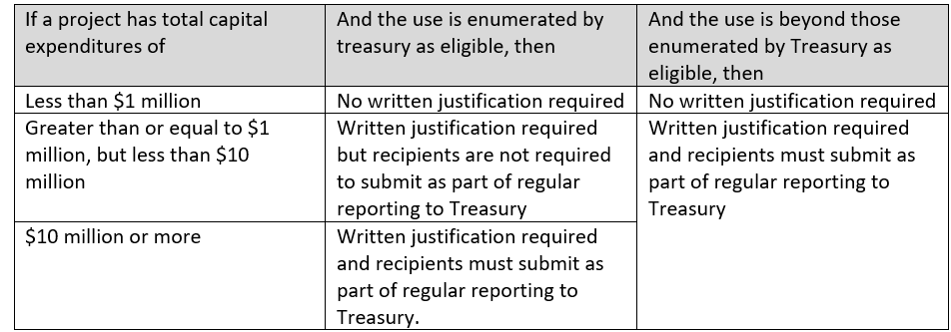
Determining Capital Expenditures
If a recipient wishes to utilize the capital expenditure category, recipients must complete and meet the requirement of a written justification for capital expenditures equal to or greater than $1 million dollars.
If a community wishes to utilize capital expenditures, please review the final rule guidance by Treasury.

Slide 10

Responding to Public Health
Treasury has identified several public health impacts of the pandemic and enumerated uses of funds to respond to impacted populations. Categories of response to the public health crisis include:
  Covid-19 Mitigation and Prevention Numerated Activities;
  Medical Expense Activities;
  Behavioral Health Care, such as mental health treatment, substance abuse treatment, and other behavioral health service activities; and
  Preventing and Responding to Violence

Slide 11
COVID-19 Mitigation and Prevention Enumerated Activities
Vaccination programs, such as vaccine incentives and vaccine sites;
Testing programs, equipment, and sites;
Monitoring, contact tracing & public health surveillance;
Public communication efforts;
Public health data systems;
COVID-19 prevention and treatment equipment, such as ventilators and ambulances;
Medical and PPE / Protective Supplies;
Support for isolation or quarantine;
Ventilation system installation and improvement;
Technical assistance on mitigation and Covid-19 threats to public health and safety;
Transportation to reach vaccination or testing sites, or other prevention and mitigation services for vulnerable populations;
Support for prevention, mitigation, or other services in congregate living facilities, public facilities, and schools;
Medical facilities generally dedicated to Covid-19 treatment and mitigation (emergency rooms);
Temporary medical facilities and other measure to increase COVID-19 treatment facility; and
Emergency operations center & emergency response equipment (emergency response radio systems);
Public telemedicine capabilities for COVID-19 related treatment.

Slide 12
Medical Expense Activities
Treasury has provided a few examples of medical expense activities including:
Unreimbursed expenses for medical care for Covid-19 testing or treatment, such as uncompensated care costs for medical providers or out-of-pocket costs for individuals.
Paid family and medical leave for public employees to enable compliance with covid-19 public health precautions;
Emergency medical response expenses;.
Treatment of long-term symptoms or effects of COVID-19.
Notes:
Timeline: 12 weeks
Universities lead and facilitate first in-person committee meeting (kick off)
Goal: presenting data; setting expectations for lean prospectus model
Committees are responsible for developing the lean prospectus model and identifying/prioritizing projects. Universities will help facilitate on an as-needed basis
6 weeks after kick-off, the core team member on the Strengthening Local Economies Pathway Committee will have a peer call with the other 3 communities. This peer call will be facilitated by Ivy Tech.
10-11 weeks after kick off, all Pathways committees in each individual community will meet to present their LPMs and projects. At this meeting, all committees will work to prioritize projects across all pathways to inform the SIP. All 4 universities will be on site at each community to facilitate.

Slide 13
Behavioral Health Care Activities
Prevention, outpatient treatment, inpatient treatment, crisis care, diversion programs, outreach to individuals not yet engaged in treatment, harm reduction & long-term recovery support.
Enhanced behavioral health needs in Schools.
Services for pregnant women or infants born with neonatal abstinence syndrome.
Support for equitable access to reduce disparities in access to high-quality treatment.
Peer support groups, costs for residence in supportive housing or recovery housing, and the 988 National Suicide Prevention Lifeline or other hotline services.
Expansion of access to evidence-based services for opioid use disorder prevention, treatment, harm reduction, and recovery.
Behavioral health facilities and equipment.

Slide 14
Preventing and Responding to Violence
Referrals to trauma recovery services for victims of crime;
Community violence intervention programs, including:
  Evidence-based practices like focused deterrence, with wraparound services such as behavioral therapy, trauma recovery, job training, education, housing and relocation services, and financial assistance;
In communities experiencing increased gun violence due to the pandemic:
  The creation of law enforcement officer positions focused on advancing community policing;
  The creation of enforcement efforts to reduce gun violence, including prosecution; and
  The development of technology & equipment to support law enforcement policies.

Slide 15
Responding to Economic Distress
The United States Department of Treasury has provided a list of enumerated eligible activities that may be authorized to respond to the negative economic impacts caused by the COVID-19 pandemic.
The United States Department of Treasury separates the activities into several subcategories including:
  Assistance to Households (Disproportionate and Impacted)
  Assistance to Small Businesses (Disproportionate and Impacted)
  Assistance to Nonprofit Organizations (Disproportionate and Impacted)
  Aid to Impacted Industries
  Public Sector Capacity Eligible Uses
  Government Employment and Rehiring of Public Staff
  Effective Service Delivery

Slide 16
Assistance to Households
    Treasury presumes the following households and communities are impacted by the pandemic:
      Low – or moderate –income households or communities;
      Households that experienced unemployment;
      Households that experienced increased food or housing insecurity;
      Households that qualify for the Children’s Health Insurance Program, Childcare Subsidies through the Child Care Development Fund (CCDF) Program, or Medicaid;
      Households that qualify for the National Housing Trust Fund and Home Investment Partnership program; and
      Any student that lost access to in-person instruction for a significant period of time.

Slide 17
Assistance to Households Activities
Food assistance and food banks;
Emergency housing assistance: rental assistance, mortgage assistance, utility assistance, assistance paying delinquent property taxes, counseling and legal aid to prevent eviction and homelessness & emergency programs or services for homeless individuals, including temporary residences for people experiencing homelessness;
Health insurance coverage expansion;
Benefits for surviving family members of individuals who have died from Covid-19;
Assistance to individuals who want and are available to work, including job training, public jobs programs and fairs, support for childcare and transportation to and from a job site or interview, incentives for newly-employed workers, subsidized employment grants to hire underserved workers, assistance to unemployed individuals to start small businesses and development of job and workforce training centers;
Financial services for the unbanked and underbanked;
Burials, home repair & home weatherization;
Programs, devices & equipment for internet access and digital literacy, including subsidies for costs of access;
Cash assistance;
Paid sick, medical, and family leave programs;
Assistance in accessing and applying for public benefits or services;
Childcare and early learning services, home visiting programs, services for child welfare involved families and foster youth and childcare facilities;
Assistance to address the impact of learning loss for K-12 students (high-quality tutoring, differentiated instruction);
Programs or services to support long-term housing security: including development of affordable housing and permanent supportive housing; and
Certain contributions to an unemployment insurance fund.

Slide 18
Disproportionately Impacted Households
Treasury presumes the following households and communities are disproportionately impacted by the pandemic:
  Low-income households and communities
  Households residing in qualified census tracts
  Households that qualify for certain federal benefits
  Households receiving services provided by tribal governments
  Households residing in the U.S. territories or receiving services from those governments

Slide 19
Disproportionately Impacted Households
Treasury recognizes the enumerated projects below, as eligible to respond to disproportionate impacts of the pandemic on households and communities:
  Pay for community health workers to help households access health & social services
  Remediation of lead paint or other lead hazards
  Primary care clinics, hospitals, integration of health services into other settings, and other investments in medical equipment and facilities designed to address health disparities
  Housing vouchers and assistance relocating to neighborhoods with higher economic opportunity
  Investments in neighborhoods to promote improved health outcomes
  Improvements to vacant and abandoned properties, including rehabilitation or maintenance, renovation, removal and remediation of environmental contaminants, demolition or deconstruction, greening, vacant lot cleanup and conversion to affordable housing
  Services to address education disparities, including assistance to high-poverty school districts and educational and evidence-based services to address student academic, social, emotional, and mental needs
  Schools and other education equipment and facilities

Slide 20
Assistance to Small Businesses
Small businesses eligible for assistance are those that experienced negative economic impacts or disproportionate impacts of the pandemic and meet the definition of “small business,” specifically:
  Have no more than 500 employees, or if applicable, the size standard in number of employees established by the Administrator of the Small Business Administration of the industry in which the business concern or organization operate;, and
  Are a small business concern as defined in Section 3 of the Small Business Act (which includes among other requirements, that the business is independently owned and operated and is not dominant in its field of operation.

Slide 21
Impacted Small Businesses
Recipients can identify small business impacted by the pandemic, and measures to respond, in different ways: for example, recipients could consider:
  Decreased revenue or gross receipts
  Financial insecurity
  Increased costs
  Capacity to weather financial hardship
  Challenges covering payroll, rent or mortgage, and other operating costs.
Assistance to small businesses that experienced negative economic impacts includes the following enumerated uses:
  Loans or grants to mitigate financial hardship, such as supporting payroll and benefits, costs to retain employees, and mortgage, rent, utility, or other operating costs
  Technical assistance, counseling, or other services to support business planning.

Slide 22
Disproportionately Impacted Small Businesses
Treasury presumes that the following small businesses are disproportionately impacted by the pandemic:
  Small businesses operating in qualified census tracts
  Small businesses operated by tribal governments
  Small businesses operating in the U.S. territories
Assistance to Disproportionately Impacted Businesses
Assistance to disproportionately impacted business includes the following enumerated uses:
  Rehabilitation of commercial properties, storefront improvements, and façade improvements
  Technical assistance, business incubators & grants for start-up or expansion costs for small businesses
  Support for microbusinesses, including financial, childcare, and transportation costs.
Notes:
Timeline: 12 weeks
Universities lead and facilitate first in-person committee meeting (kick off)
Goal: presenting data; setting expectations for lean prospectus model
Committees are responsible for developing the lean prospectus model and identifying/prioritizing projects. Universities will help facilitate on an as-needed basis
6 weeks after kick-off, the core team member on the Strengthening Local Economies Pathway Committee will have a peer call with the other 3 communities. This peer call will be facilitated by Ivy Tech.
10-11 weeks after kick off, all Pathways committees in each individual community will meet to present their LPMs and projects. At this meeting, all committees will work to prioritize projects across all pathways to inform the SIP. All 4 universities will be on site at each community to facilitate.

Slide 23
Assistance to Nonprofits
  Nonprofits eligible for assistance are those that experienced negative economic impacts or disproportionate impacts of the pandemic and meet the definition of “nonprofit” – specifically those that are a 501 (C)(3) or 501(C)(19) tax-exempt organizations.
  Impacted Nonprofits
  Recipients can identify nonprofits impacted by the pandemic, and measures to respond, in many ways, for example, recipients could consider:
  Decreased revenue
  Financial insecurity
  Increased costs
  Capacity to weather financial hardship
  Challenges covering payroll, rent or mortgage, and other operating costs
  Assistance includes:
  Loans or grants to mitigate financial hardship
  Technical or in-kind assistance or other services that mitigate negative economic impacts of the pandemic

Slide 24
Aid to Impacted Industries
  There are two main ways an industry can be designated as impacted:
    If the industry is in the travel, tourism, or hospitality sectors, the industry is impacted;
    If the industry is outside the travel, tourism, or hospitality sectors, the industry is impacted if:
      The industry experienced at least a percent employment loss from pre-pandemic levels; or
      The industry is experiencing comparable or worse economic impacts as the national tourism, travel, and hospitality standards as of the date of the final rule.
  Treasury recognizes the enumerated projects below as eligible responses to impacted industries:
    Aid to mitigate financial hardship, such as supporting payroll costs, lost pay and benefits for returning employees, support of operations and maintenance of existing equipment and facilities;
    Technical assistance, counseling, or other services to support business planning; and
    Covid-19 mitigation and infection prevention measures.

Slide 25
Public Sector Capacity Eligible Uses
    Recipients may use SLFRF funding to restore and bolster public sector capacity, which supports government’s ability to delivery critical covid-19 services.
      Public Safety Staff (police officers, firefighters, EMS medical responders, etc.)
      Public Health Staff (medical staff, laboratory technicians, medical examiners, etc.)
      Human Services Staff (child, elder, or family care employees, and child welfare services)
      SLFRF funding for payroll and covered benefits for the portion of eligible staff time spent on covid-19 response.

Slide 26
Government Employment and Rehiring Public Staff
SLFRF can be used to support a broader set of uses to restore and support public sector employment.
  Hiring up to pre-pandemic baseline that is adjusted for historic underinvestment in the public sector
  Providing additional funds for employees who experienced pay cuts or were furloughed;
  Avoiding layoffs
  Providing worker retention incentives
  Paying for ancillary administrative costs related to hiring, support, and retention
Costs associated with administering the hiring, support, and retention of the programs above is considered an enumerated activity.

Slide 27
Effective Service Delivery
    SLFRF funding may be used to improve the efficacy of public health and economic programs through tools like program evaluation, data, and outreach, as well as to address administrative needs cause or exacerbated by the pandemic.
      Supporting Program Evaluation, Data, and Outreach (program evaluation and evidence resources, technology infrastructure, community outreach and engagement activities, etc.)
      Addressing Administrative needs (administrative costs for programs responding to the public health emergency, administrative needs caused or exacerbated by the pandemic)

Slide 28
Premium Pay
  SLFRF may be used to provide premium pay for eligible workers performing essential work during the pandemic. Premium pay may be awarded to eligible workers up to $13 per hour. Premium pay must be in addition to wages or renumeration the eligible worker otherwise receives. Premium pay may not exceed $25,000 for any single worker during the program.
  Recipients should undergo the following steps:
    Identify an eligible worker
      Health care, emergency response, sanitation, maintenance, grocery stores, public health, family child care, government workers, waste removal, hotel and commercial lodging staff, dental care, warehousing, etc.
      Verify that the eligible workers performs essential work
        NOT performed by teleworking
        Involves either regular, in person interactions or regular physical handling of items that were handled by the general public during the covid-19 pandemic
  Confirms that the premium pay responds to workers performing essential work during the pandemic

Slide 29
Water and Sewer Infrastructure
State, local and tribal governments have a tremendous need to address the consequences of deferred maintenance in drinking water systems and removal, management, and treatment of sewage and stormwater, along with additional resiliency measures needed to adapt to climate change.
Projects eligible under Environmental Protection Agency’s (EPA) Clean Water State Revolving Funds (CWSRF) include:
  Construction of publicly owned treatment works;
  Projects pursuant to implementation of a nonpoint source pollution management program;
  Decentralized wastewater treatment systems that treat municipal wastewater or domestic sewage;
  Management and treatment of stormwater or subsurface drainage water;
  Water conservation, efficiency, or reuse measures;
  Development and implementation of a conservation and management plan;
  Watershed projects meeting the criteria set forth in the CWA;
  Energy consumption reduction for publicly owned treatment works;
  Reuse of recycling of wastewater, stormwater, or subsurface drainage water; and
  Security of publicly owned treatment works.
Notes:
Timeline: 12 weeks
Universities lead and facilitate first in-person committee meeting (kick off)
Goal: presenting data; setting expectations for lean prospectus model
Committees are responsible for developing the lean prospectus model and identifying/prioritizing projects. Universities will help facilitate on an as-needed basis
6 weeks after kick-off, the core team member on the Strengthening Local Economies Pathway Committee will have a peer call with the other 3 communities. This peer call will be facilitated by Ivy Tech.
10-11 weeks after kick off, all Pathways committees in each individual community will meet to present their LPMs and projects. At this meeting, all committees will work to prioritize projects across all pathways to inform the SIP. All 4 universities will be on site at each community to facilitate.

Slide 30
Drinking Water
Projects eligible under Environmental Protection Agency’s (EPA) Drinking Water State Revolving Funds (DWSRF) include:
  Facilities to improve drinking water quality;
  Transmission and distribution including improvements of water pressure or prevention of contamination in infrastructure and lead service line replacements;
  New sources to replace contaminated drinking water or increase drought resilience, including aquifer storage and recovery system for water storage;
  Green infrastructure, including green roofs, rainwater harvesting collection, permeable pavement;
  Storage of drinking water, such as to prevent contamination or equalize water demands;
  Purchase of water systems and interconnection of systems; and
  New community water systems.

Slide 31
Broadband Infrastructure
    Recipients may pursue investments in broadband infrastructure meeting technical standards detailed below, as well as an expanded set of cybersecurity investments. If a recipient wishes to provide broadband infrastructure, they are to follow the following steps:
      Identify an eligible area for investment – lack of access to reliable high-speed broadband connection, lack of affordable broadband, or lack of reliable service.
      Design a project to meet high-speed technical standards. Recipients are required to design projects that reliably meet or exceed symmetrical 100 Mbps download and upload speeds.
      Require enrollment in a low-income subsidy program. Recipients must require the service provider for a broadband project that provides service to households either:
          Participate in the FCCs affordable connectivity program; OR
          Provide access to a broad-based affordability program to low-income consumers that provides benefits commensurate to ACP.
    SLFRF may be used for modernization of cybersecurity for existing and new broadband infrastructure, regardless of their speed delivery standards. This includes modernization of hardware and software.

Slide 32
Restrictions of Use
  Offset a reduction in net tax revenue
    States and territories may not use this funding to directly or indirectly offset a reduction in net tax revenue resulting from a change in law, regulation, or administrative interpretation beginning on March 3, 2021, through the last day of the fiscal year in which the funds provided have been sent.
    Deposits into Pension Funds
      No recipients except Tribal governments may use this funding to make a deposit into a pension fund.
  Additional Restrictions and Requirements:
    No debt service or replenishing financial services;
    No satisfaction of settlements or judgements; and
    SLFRF funds may NOT be used for a project that conflicts with or contravenes the purpose of the American Rescue Plan Act.

Slide 33
Questions?

Slide 34
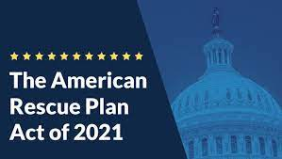
Compliance and Reporting Guidance
Part 1: General Guidance
  Key Principles
  Statutory Eligible Uses
  Treasury’s Final Rule
  Uniform Guidance
  Award Terms and Conditions
Part 2: Reporting Requirements
  Interim Report
  Project and Expenditure Report
  Recovery Plan Performance Report
“Compliance and Reporting Guidance”
Published on June 10, 2022.

Slide 35
Part 1: Key Principles
    Recipients are responsible for ensuring the SLFRF award funds are not used for ineligible purposes, and there is no fraud, waste, or abuse associated with the funding.
    Treasury encourages recipients to use SLFRF funded project to advance shared interests and promote equitable delivery of government benefits and opportunities to underserved communities as outlined in Executive Order 13985.
    Treasury encourages recipients to practice transparency and public accountability for the use of SLFRF funds.

Slide 36
Part 1: Statutory Eligible Uses
The United States Department of Treasury has indicated the following four statutory categories for the use of State and Local Fiscal Recovery Funds (SLFRF).
To respond to the Covid-19 public health emergency or it negative economic impacts;
To respond to workers performing essential work during the COVID-19 public health emergency by providing premium pay to eligible workers of the recipient that are performing such essential work, or by providing grants to eligible employers that have eligible workers who perform essential work;
For the provision of government services, to the extent of the reduction in revenue of such recipient due to the COVID-19 public health emergency, relative to revenues collected in the most recent full fiscal year of the recipient prior to the emergency; or
To make necessary investments in water, sewer, or broadband infrastructure.

Slide 37
Part 1: Treasury’s Final Rule
The Final Rule took effect on April 1, 2022.
Treasury’s Final Rule is divided into several subsections including:
  Eligible and restricted uses of SLFRF Funds
  Eligible Cost Timeframe
  Reporting
  Expenditure Categories
  SLFRF funds may be used to cover eligible costs that your organization incurred during the period that begins on March 3, 2021 and ends on December 31, 2024, as long as, the award funds for the obligations are incurred by December 31, 2024 and expended by December 31, 2026.

Slide 38
Eligible Costs Timeframe
Recipients may, in certain circumstances, use SLFRF award funds for the eligible use categories described in Treasury’s Final Rule for costs incurred prior to March 3, 2021. Specifically:
Public Health and Negative Economic Impacts: Recipients may use SLFRF award funds to provide assistance to households, small businesses and nonprofits to respond to the public health emergency or negative economic impacts of the pandemic, such as rent-mortgage or utility assistance – for costs incurred by the beneficiary prior to March 3, 2021.
Premium Pay: Recipients may provide premium pay retrospectively for work performed at any time prior to March 3, 2021.
Revenue Loss: While calculation of lost revenue is based on the recipient’s revenue in the last full fiscal year prior to the Covid-19 public health emergency, use of funds for government services must be forward looking for costs incurred by the recipient after March 3, 2021.
Investments in Water, Sewer, and Broadband: Recipients may use SLFRF award funds to cover costs incurred for eligible projects planned or started prior to March 3, 2021, provided that the project costs covered by the SLFRF award funds were incurred by the recipient after March 3, 2021.

Slide 39

Part 1: Uniform Administrative Requirements
The State and Local Fiscal Recovery Funds are generally subject to the requirements set forth in the Uniform Guidance.
  Allowable Activities
  Allowable Costs/Cost Principles
  Cash Management
  Eligibility
  Equipment and Real Property Management
  Matching, Level of Efforts, Earmarking
  Period of Performance
  Procurement, Suspension & Debarment
  Program Income
  Reporting
  Subrecipient Monitoring
  Special Tests and Provisions
Notes:
Timeline: 12 weeks
Universities lead and facilitate first in-person committee meeting (kick off)
Goal: presenting data; setting expectations for lean prospectus model
Committees are responsible for developing the lean prospectus model and identifying/prioritizing projects. Universities will help facilitate on an as-needed basis
6 weeks after kick-off, the core team member on the Strengthening Local Economies Pathway Committee will have a peer call with the other 3 communities. This peer call will be facilitated by Ivy Tech.
10-11 weeks after kick off, all Pathways committees in each individual community will meet to present their LPMs and projects. At this meeting, all committees will work to prioritize projects across all pathways to inform the SIP. All 4 universities will be on site at each community to facilitate.

Slide 40
Uniform Administrative Requirements
Allowable Activities
Per 2 CFR Part 200.303, your organization must develop and implement effective internal controls to ensure that funding decisions under the SLFRF award constitute eligible uses of funds, and document determinations.
Allowable Costs / Cost Principles
As outlined in the Uniform Guidance at 2 CFR Part 200, Subpart E regarding cost principles, allowable costs are based on the premise that a recipient is responsible for the effective administration of Federal awards, application of sound management practices, and administration of Federal funds in a manner consistent with the program objectives and terms and conditions of the award.

Slide 41
Allowable Costs / Costs Principles
    SLFRF funds may be, but are not required to be, used along with other funding sources for a given project. Recipients should note that SLFRF funds available under the “revenue loss” eligible use category generally may be used to meet the non-federal cost share or matching requirement of other federal programs.
    ONLY applies to Federal programs that allow the use of SLFRF as match.
    Administrative Costs: Recipients may use funds for administering the SLFRF program, including costs of consultants to support effective management and oversight, including consultation for ensuring compliance with legal, regulatory, and other requirements.
    Direct costs are those that are identified specifically as costs of implementing the SLFRF program objectives, such as contract support, materials, and supplies for a project.
    Indirect costs are general overhead costs of an organization where a portion of such costs are allocable to the SLFRF award such as the cost of facilities or administrative functions like a director’s office.
    Salaries and Expenses: In general, certain employee’s wages, salaries, and covered benefits are an eligible use of SLFRF award funds.

Slide 42
Uniform Guidance Continued
Cash Management
SLFRF payments made to recipients are not subject to the requirements of the Cash Management Improvement Act and Treasury’s implementing regulations at 31CFR Part 205 or 2 CFR 200.305(b)(8)-(9).
Eligibility
Under this program, recipients are responsible for ensuring funds are used for eligible purposes. Generally, recipients must develop and implement policies and procedures, and retain records, to determine and monitor implementation of criteria for determining the eligibility of beneficiaries and/or subrecipients. Your organization will need to maintain procedures for obtaining information evidencing a given beneficiary, subrecipient, or contractor’s eligibility including a valid Sam.gov registration.

Slide 43
Uniform Guidance Continued
  Equipment and Real Property Management: Any purchase of equipment or real property with SLFRF funds must be consistent with the Uniform Guidance at 2 CFR Part 200, Subpart D. Consistent with 2 CFR 200.311 and 2 CFR 200.313, any equipment or real property acquired using SLFRF funds shall vest in the non-Federal entity, consistent with any guidance that Treasury may issue.
  Matching, Level of Effort, Earmarking: There are no matching, level of effort, or earmarking compliance responsibilities associated with the SLFRF award.
  Period of Performance: Your organization should also develop and implement internal controls related to activities occurring outside the period of performance. All funds remain subject to statutory requirements that they must be used for costs incurred by the recipient during the period that begins on March 3, 2021, and ends on December 31, 2024, and that award funds for the financial obligations incurred by December 31, 2024 and must be expended by December 31, 2026. Any funds not used must be returned to Treasury as part of the award closeout process pursuant to 2 CFR 200.344(d).

Slide 44
Procurement, Suspension, and Debarment
Recipients are responsible for ensuring that any procurement using SLFRF funds, or payments under procurement contracts using such funds are consistent with the procurement standards set forth in the Uniform Guidance at 2 CFR 200.317 through 2 CFR 200.327.
The Uniform Guidance establishes in 2 CFR 200.319 that all procurement transactions for property or services must be conducted in a manner providing full and open competition, consistent with standards outlined in 2 CFR 200.320, which allows for non-competitive procurements only in circumstances where at least one of the conditions below is true
    the item is below the micro-purchase threshold;
    the item is only available from a single source;
    the public exigency or emergency will not permit a delay from publicizing a competitive solicitation; or
    after solicitation of a number of sources, competition is determined inadequate.
The Uniform Guidance requires an infrastructure for competitive bidding and contractor oversight, including maintaining written standards of conduct and prohibitions on dealing with suspended or debarred parties.

Slide 45
Uniform Guidance Continued
Program Income: Generally, program income includes, but is not limited to, income from fees for services performed, the use or rental of real or personal property acquired under Federal awards, and principal and interest on loans made with Federal award funds. Program income does not include interest earned on advances of Federal funds, rebates, credits, discounts, or interest on rebates, credits, or discounts. Recipients of SLFRF funds should calculate, document and record the organization’s program income.
Subrecipient Monitoring: SLFRF recipients that are pass-through entities as described under 2 CFR 200.1 are required to manage and monitor their subrecipients to ensure compliance with requirements of the SLFRF award pursuant to 2 CFR 200.332 regarding requirements for pass-through entities.
  First, your organization must clearly identify to the subrecipients: (1) that the award is a subaward of SLFRF funds; (2) any and all compliance requirements for use of SLFRF funds; and (3) any and all reporting requirements of expenditures of SLFRF funds.
  Next, your organization will need to evaluate each subrecipient’s risk of noncompliance based on a set of common factors. These risk assessments may include factors such as prior experience in managing Federal funds, previous audits, personnel and policies or procedures for award execution and oversight. Ongoing monitoring of any given subrecipient should reflect its assessed risk and include monitoring, identification of deficiencies, and follow-up to ensure appropriate remediation.

Slide 46
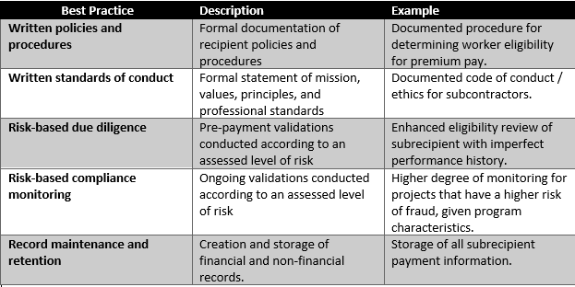
Special Tests and Provisions
  Treasury may issue sub regulatory guidance as well as frequently asked questions.
  Treasury has provided a chart describing some best practices for development of internal controls in Table 1 provided within this slide.

Slide 47
Award Terms and Conditions
The Award Terms and Conditions of the SLFRF financial assistance agreement sets froth the compliance obligations for recipients pursuant to the SLFRF statute, the Uniform Guidance, Treasury’s final rule, and applicable federal laws and regulations. These obligations include the following items in addition to those described above:
          Sam.gov Requirements
          Recordkeeping Requirements
          Single Audit Requirements
          Civil Rights Compliance

Slide 48
Award Terms and Conditions
Sam.gov Requirements: All eligible recipients are also required to have an active registration with the System for Award Management (SAM) www.sam.gov pursuant to 2 CFR Part 25.
Recordkeeping Requirements: Generally, your organization must maintain records and financial documents for five years after all funds have been expended or returned to Treasury, as outlined in paragraph 4.c. of the Award Terms and Conditions. Your organization must agree to provide or make available such records to Treasury upon request.
Single Audit Requirements: Recipients and subrecipients that expend more than $750,000 in Federal awards during their fiscal year will be subject to an audit under the Single Audit Act and its implementing regulation at 2 CFR Part 200, Subpart F regarding audit requirements. Recipients and subrecipients should consult the Federal Audit Clearinghouse to see examples of Single Audit submissions.
Civil Rights Compliance: Recipients of Federal financial assistance from the Treasury are required to meet legal requirements relating to nondiscrimination and nondiscriminatory use of Federal funds. Those requirements include ensuring that the entities receiving Federal financial assistance from the Treasury do not deny benefits or services, or otherwise discriminate on the basis of race, color, national origin, disability, age or sex (including sexual orientation and gender identity).
Notes:
Timeline: 12 weeks
Universities lead and facilitate first in-person committee meeting (kick off)
Goal: presenting data; setting expectations for lean prospectus model
Committees are responsible for developing the lean prospectus model and identifying/prioritizing projects. Universities will help facilitate on an as-needed basis
6 weeks after kick-off, the core team member on the Strengthening Local Economies Pathway Committee will have a peer call with the other 3 communities. This peer call will be facilitated by Ivy Tech.
10-11 weeks after kick off, all Pathways committees in each individual community will meet to present their LPMs and projects. At this meeting, all committees will work to prioritize projects across all pathways to inform the SIP. All 4 universities will be on site at each community to facilitate.

Slide 49
Part 2: Reporting Guidance
  There are three types of reporting requirements for the SLFRF program. The report requirements are approved and documented under OMB PRA number – OMB #1505-0271
  Treasury has identified three types of reports that could be utilized by communities throughout the use of SLFRF funds.
        Interim Report
        Project and Expenditure Report
        Recovery Plan Performance Report

Slide 50
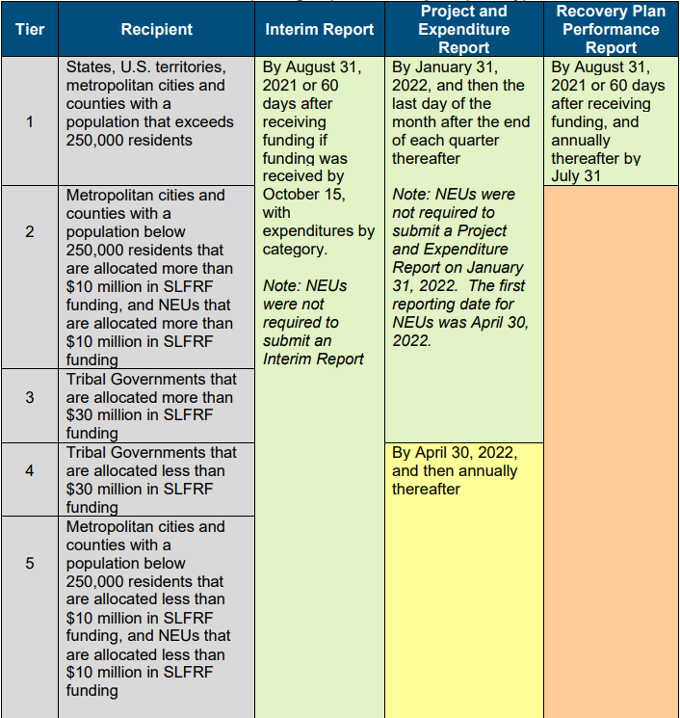
Reporting requirements by recipient type
https://home.treasury.gov/system/files/136/SLFRF-Compliance-and-Reporting-Guidance.pdf

Slide 51
Interim Report
Note: Interim Reports were submitted under the Interim Final Rule. Interim Reports were due to Treasury on Jan. 31, 2022 covering three calendar quarters from March 3, 2021 to Dec. 31, 2021.
Required Programmatic Data: Recipients were required to provide the following information if they had or planned to have expenditures in the following Expenditure Categories:
Revenue Replacement: Include information on base year general revenue, fiscal year end date, growth adjustment used, actual general revenue as of the twelve months ended December 31, 2020, and metropolitan cities and counties with a population below 250,000 residents that are allocated more than $10 million in SLFRF funding and NEUs that are allocated more than $10 million in SLFRF funding.

Slide 52
Project and Expenditure Report
All recipients are required to submit Project and Expenditure Reports
Quarterly Reporting: The following recipients are required to submit quarterly Project and Expenditure Reports: States and U.S. Territories, tribal governments that are allocated more than $30 million in SLFRF funding, metropolitan cities and counties, and metropolitan cities and counties with a population below 250,000 residents that are allocated more than $10 million in SLFRF funding and NEUs that are allocated more than $10 million in SLFRF funding.

Slide 53
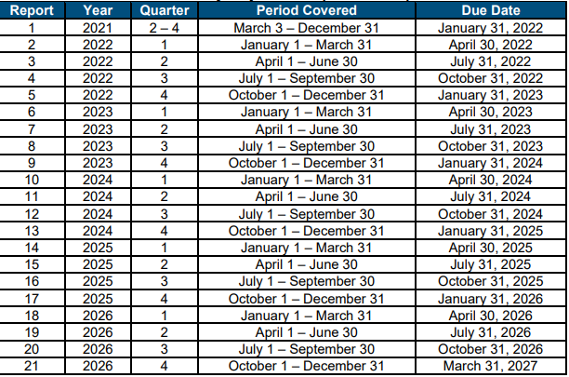
Quarterly Project and Expenditure Report Timeline
https://home.treasury.gov/system/files/136/SLFRF-Compliance-and-Reporting-Guidance.pdf

Slide 54
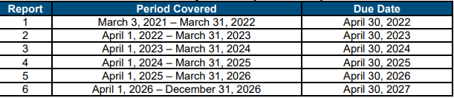
Project and Expenditure Report
    Annual Reporting: The following recipients are required to submit annual Project and Expenditure Reports: tribal governments that are allocated less than $30 million in SLFRF funding and metropolitan cities and counties with a population below 250,000 residents that are allocated less than $10 million in SLFRF funding and NEUs that are allocated less than $10 million in SLFRF funding.
https://home.treasury.gov/system/files/136/SLFRF-Compliance-and-Reporting-Guidance.pdf

Slide 55
Required Information
  The following information will be required in Project and Expenditure Reports for both quarterly and annual reporting:
    Projects
    Obligations and Expenditures
    Project Status
    Program Income
    Adopted Budget
    Project Demographic Distribution
    Subawards, Contracts, Grants, Loans, Transfers and Direct Payments
    Civil Right Compliance
    Ineligible Activities: Tax Offset Provision (States and territories only)
    Required Programmatic Data (other than infrastructure projects)
    Required Programmatic Data for Infrastructure Projects
    NEU Documentation

Slide 56
Required Information
Projects: Provide information on all SLFRF funded projects. For each project, the recipient will be required to enter the project name, identification number (created by the recipient), project expenditure category (see Appendix 1), description, and status of completion. Project descriptions must describe the project in sufficient detail to provide understanding of the major activities that will occur and will be required to be between 50 and 250 words.
Projects should be scoped to align with a single Expenditure Category. For each project, the recipient is asked to select the appropriate Expenditure Category based on the scope of the project.
Obligations and Expenditures: Recipients will be asked to report:
  Current period obligation
  Cumulative obligation
  Current period expenditure
  Cumulative expenditure
Project Status: Recipients will be asked to report on project status each reporting period, in four categories:
  Not started
  Completed less than 50 percent
  Completed 50 percent or more
  Completed
Notes:
Timeline: 12 weeks
Universities lead and facilitate first in-person committee meeting (kick off)
Goal: presenting data; setting expectations for lean prospectus model
Committees are responsible for developing the lean prospectus model and identifying/prioritizing projects. Universities will help facilitate on an as-needed basis
6 weeks after kick-off, the core team member on the Strengthening Local Economies Pathway Committee will have a peer call with the other 3 communities. This peer call will be facilitated by Ivy Tech.
10-11 weeks after kick off, all Pathways committees in each individual community will meet to present their LPMs and projects. At this meeting, all committees will work to prioritize projects across all pathways to inform the SIP. All 4 universities will be on site at each community to facilitate.

Slide 57
Required Information
  Program Income: Recipients should report the program income earned and expended to cover eligible project costs, if applicable.
  Adopted Budget: Each state, territory, and metropolitan city and county with a population that exceeds 250,000 residents will provide the budget adopted for each project by its jurisdiction associated with SLFRF funds.
  Recipients will enter the Adopted Budget based on the information that exists currently in the recipient’s financial system.
  Project Demographic Distribution (applicable to Public Health and Negative Economic Impacts): Recipients will be asked to respond to the following:
  What impacted and/or disproportionally impacted population does this project primarily serve? Please select the population served.
  If this project primarily serves more than one Impacted and/or Disproportionately Impacted population, please select up to two additional populations served.

Slide 58
Required Information
    Subawards, Contracts, Grants, Loans, Transfers and Direct Payments: Each recipient shall also provide detailed obligation and expenditure information for any contracts and grants awarded, loans issued, transfers made to other government entities, and direct payments made by the recipient that are greater than $50,000.
    In general, recipients will be asked to provide the following information for each Contract, Grant, Loan, Transfer or Direct Payment greater than $50,000:
          Subrecipient identifying and demographic information (DUNS/UEI/TIN number and location)
          Award number, date, type, amount, description, payment method (reimbursable or lump sum payment)
          For loans, expiration date (date when loan will be paid in full)
          Primary place of performance
          Related project name and identification numbers
          Period of performance start and end dates
          Quarterly obligation amount and expenditure amount
          Project(s)
          Additional Programmatic Performance Indicators for select Expenditure Categories

Slide 59
Required Information
Additional Programmatic Performance Indicators for select Expenditure Categories
Recipients must also report the names and total compensation of their five most highly compensated executives and their subrecipient’s executives for the preceding completed fiscal year if:
The recipient received 80 percent or more of its annual gross revenues from Federal procurement contracts and Federal financial assistance subject to the Transparency Act, as provided by 2 CFR 170.320 (and subawards), and received $25,000,000 or more in annual gross revenues from Federal procurement contracts (and subcontracts) and Federal financial assistance subject to the Transparency Act
If the information is not otherwise public.

Slide 60
Required Information
Civil Rights Compliance: Treasury will request information on recipients’ compliance with Title VI of the Civil Rights Act of 1964, as applicable, on an annual basis. This information may include a narrative describing the recipient’s compliance with Title VI, along with other questions and assurances.
Required Programmatic Data (other than infrastructure projects):
    Public Health and Negative Economic Impact
    Capital Expenditures
    Use of Evidence
    Household Assistance
    Small Business Economic Assistance
    Assistance to Non-Profits
    Aid to Travel, Tourism, and Hospitality or Other Impacted Industries
    Education Assistance
    Payroll for Public Health and Safety Employees
    Rehiring Public Sector Staff
    Premium Pay
    Revenue Replacement
    For more information on the requirements of each of the above categories, please review the Compliance and Reporting Guidance issued on June 10, 2022 here: https://home.treasury.gov/system/files/136/SLFRF-Compliance-and-Reporting-Guidance.pdf
Notes:
Timeline: 12 weeks
Universities lead and facilitate first in-person committee meeting (kick off)
Goal: presenting data; setting expectations for lean prospectus model
Committees are responsible for developing the lean prospectus model and identifying/prioritizing projects. Universities will help facilitate on an as-needed basis
6 weeks after kick-off, the core team member on the Strengthening Local Economies Pathway Committee will have a peer call with the other 3 communities. This peer call will be facilitated by Ivy Tech.
10-11 weeks after kick off, all Pathways committees in each individual community will meet to present their LPMs and projects. At this meeting, all committees will work to prioritize projects across all pathways to inform the SIP. All 4 universities will be on site at each community to facilitate.

Slide 61
Required Information
  Required Programmatic Data for Infrastructure Projects: For all projects listed under the Water, Sewer and Broadband expenditure categories, more detailed project level information is required.
  All infrastructure projects:
  Projected/actual construction start date;
  Projected/actual initiation of operations date;
  Location; and
  For projects over $10 million (based on expected total cost), a certification that workers are meeting Davis Bacon Requirements or a project employment and local impact report, a certification that a project includes a project labor agreement, whether the project prioritizes local hires, and whether the project has a Community Benefit Agreement, with a description of such Agreement.
Water and Sewer Projects:
  National pollutant discharge elimination system (NPDES) Permit Number;
  Public Water System (PWS) ID number;
  Median Household Income of service area; and
  Lowest Quintile Income for the service area.

Slide 62
Required Information
Broadband Projects:
Confirm that the project is designed to, upon completion, reliably meet or exceed symmetrical 100 Mbps download and upload speeds;
  If the project is not designed to reliably meet or exceed symmetrical 100 Mbps download and upload speeds, explain why not; and
  Confirm that the project is designed to, upon completion meet or exceed 100 Mbps download speed and between at least 20 Mbps and 100 Mbps upload speed and be scalable to a minimum of 100 Mbps downloadd speed and 100 Mbps upload speed; and
Confirm that the service provider for the project has, or will upon completion of the project, either participated in the Federal Communications Commission (FCC)s Affordable Connectivity Program or otherwise provided access to a broad-based affordability program that provides benefits to households.
Detailed Project Information:
Project technology type (Planned / Actual)
Total miles of fiber deployed
Total number of funded locations served (planned/actual)
Speed tiers offered, corresponding non-promotional prices, including associated fees, and data allowance for each speed tier of broadband service (required starting October 2022)

Slide 63
Required Information
Location-by-Location Project Information:
For each location served by a project, the recipient must collect from the subrecipients or contractor and submit the following information to Treasury using a predetermined file format that will be provided by Treasury on the SLFRF website (required starting October 2022):
Latitude / Longitude at the structure where service will be installed
Technology used to offer service at location
Location type (residential, business, community anchor institution)
Speed tier at the location pre-SLFRF investment
  25/3 Mbps or below
  Between 25/3Mbps and 100/20 Mbps
Speed and latency at the location post-SLFRF investment
  Maximum download speed offered
  Maximum download speed delivered
  Maximum upload speed offered
  Maximum upload speed delivered
  Latency

Slide 64
Additional Required Program Data
States, U.S. territories, and metropolitan cities and counties with a population that exceeds 250,000 residents are required to provide additional programmatic data to the U.S. Department of Treasury. This includes:
Use of Evidence
Households Assistance (Long-term housing security and housing support)
Assistance to Unemployed or Underemployed Workers and Community Violence Interventions
Addressing Educational Disparities and Addressing Impacts of Lost Instructional Time
Healthy Childhood Environments
NEU Documentation
Each NEU is also required to provide the following information once its accounts are established in Treasury’s Reporting Portal and prior to the due date for their Project and Expenditure Report (April 30, 2022)
Copy of the signed award terms and conditions agreement (which was signed and submitted to the State as part of the request for funding)
Copy of the signed assurances of compliance with the Title VI of the Civil Rights Act of 1964 (which was signed and submitted to the State as part of the request for funding)
Copy of the actual budget documents validating the top-line budget total provided to the State as part of the request of funding

Slide 65
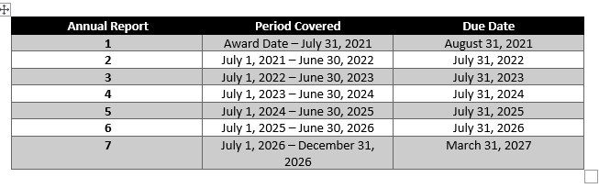
Recovery Plan Performance Report
  Based on the Interim Final Rule and will be updated in future guidance.
  The Recovery Plan Performance Report will include, at a minimum, the following:
  Executive Summary
  Uses of Funds
  Promoting Equitable Outcomes
  Community Engagement
  Labor Practices
  Use of Evidence
  Table of Expenses by Expenditure Category
  Project Inventory
  Performance Report
  Required Performance Indicators and Programmatic Data
  Ineligible Activities

Slide 66
Recovery Plan Performance Report
Executive Summary:
In this section recipients should provide a high-level overview of the jurisdictions intended and actual uses of funding including the jurisdictions strategy, goals, and plan for using Fiscal Recovery Funds to respond to the pandemic and promote economic recovery, key outcome goals, progress to date on those outcomes, and any noteworthy challenges or opportunities.
Uses of Funds
Recipients should describe in further detail the strategy and goals of their jurisdictions SLFRF program. Recipients should describe how their use of funds supports their overall strategy and goals in the following areas:
Public Health
Negative Economic Impacts
Public Health-Negative Economic Impact: Public Sector Capacity
Premium Pay
Water, sewer, and broadband infrastructure
Revenue Replacement

Slide 67
Recovery Plan Performance Report
Promoting Equitable Outcomes:
In this section, recipients should describe, as applicable, their efforts to promote equitable outcomes, including economic and racial equity, and their efforts to design, implement, and measure their SLFRF program and projects with equity in mind.
Beginning in 2022, each annual Recovery Plan must provide an update, using qualitative and quantitative data, on how the recipients’ approach achieved or promoted equitable outcomes or progressed against equity goals during the performance period.
Community Engagement:
In this section, recipients should describe how their jurisdiction’s planned or current use of funds incorporates community engagement strategies including written feedback through surveys, project proposals, and related documents; oral feedback through community meetings, issue-specific listening sessions, stakeholder interviews, focus groups, and additional public engagement; as well as other forms of input, such as steering committees, taskforces, and digital campaigns that capture diverse feedback from the community.

Slide 68
Recovery Plan Performance Report
Labor Practices:
In this section, recipients should describe workforce practices on any infrastructure projects or capital expenditures being pursued. For example, report whether any of the following practices are being utilized: project labor agreements, community benefit agreements, prevailing wage requirements, and local hiring.
Use of Evidence:
In this section, recipients should describe whether and how evidence-based interventions and/or program evaluation are incorporated into their SLFRF program. Recipients may include links to evidence standards, evidence dashboards, evaluation policies, and other public facing tools that are used to track and communicate the use of evidence and evaluation for Fiscal Recovery Funds.

Slide 69
Recovery Plan Performance Report
Performance Report
In this section, recipients should describe how performance management is incorporated into their SLFRF program, including how they are tracking their overarching jurisdictional goals for these funds as well as measuring results for individual projects. Performance indicators should include both output and outcome measures.
While recipients have discretion on the full suite of performance indicators to include, a number of mandatory performance indicators and programmatic data must be included. Below is a list of required data for each Expenditure Category where relevant:
Household Assistance, Long-Term Housing Security, and Housing Support
Assistance to Unemployed or Underemployed Workers and Community Violence Interventions
Addressing Educational Disparities and Addressing Impacts of Lost Instructional Time
Healthy Childhood Environments
Project Inventory
In this section, recipients should list the name and provide a brief description of each SLFRF funded project. For each project, recipients should include the project name, funding amount, identification number, project Expenditure Category, and a description of the project that includes an overview of the main activities of the project., approximate timeline, primary delivery mechanisms and partners, and intended outcomes.
Notes:
Timeline: 12 weeks
Universities lead and facilitate first in-person committee meeting (kick off)
Goal: presenting data; setting expectations for lean prospectus model
Committees are responsible for developing the lean prospectus model and identifying/prioritizing projects. Universities will help facilitate on an as-needed basis
6 weeks after kick-off, the core team member on the Strengthening Local Economies Pathway Committee will have a peer call with the other 3 communities. This peer call will be facilitated by Ivy Tech.
10-11 weeks after kick off, all Pathways committees in each individual community will meet to present their LPMs and projects. At this meeting, all committees will work to prioritize projects across all pathways to inform the SIP. All 4 universities will be on site at each community to facilitate.

Slide 70
NEU Requirements
For NEUs, states and territories should be prepared to report on their information, including the following:
  NEU name, DUNS or UEI number, taxpayer identification number (TIN)
  NEU recipient number ( a unique identification code for each NEU assigned by the State or the territory to the NEU as part of the request for funding)
  NEU Contact information
  NEU authorized representative name and email address
  Initial allocation and subsequent allocations
  Total NEU reference budget
  Amount of the initial and subsequent allocation above 75 percent of the NEUs reference budget which will be returned to Treasury
  Payment amount and date

Slide 71
Questions?

