Slide 1
3rd Quarter 2024 Safety, Reliability, Freight, and Congestion Update
Thursday, December 5th, 2024

Slide 2
Safety
Update
Quarter 3 - 2024

Slide 3
All Collisions NWI

Slide 4
Lake County

Slide 5
LaPorte County

Slide 6
Porter County

Slide 7
Travel Time
Reliability Update
Quarter 3 - 2024

Slide 8
Travel Time Reliability on the Interstates YTD
Q3 of 2023
79.7%
76.6%
89.3%
100.0%
100%
100%
91.7%
85.6%
81.7%
84.8%
81.9%
79.1%
82.1%
75.5%
94.1%
91.3%
Quarter 3

Slide 9
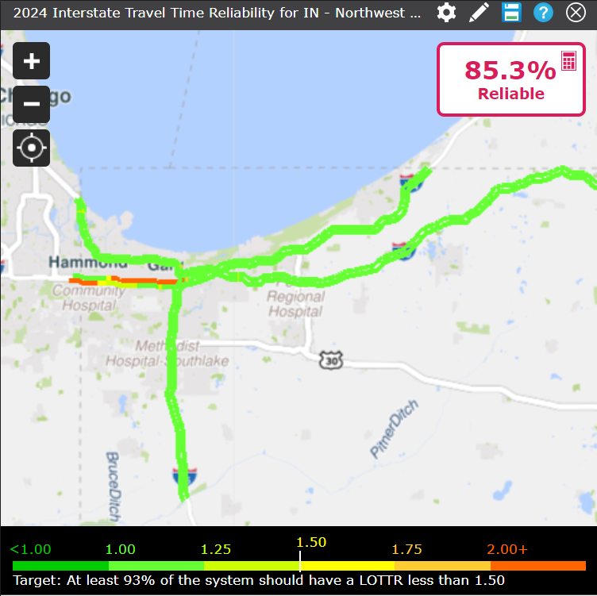
Travel Time Reliability on the Interstates YTD – Q3 2024

Slide 10
Travel Time Reliability on the Non-Interstate NHS YTD Q3 2024
100.0%
98.1%
98.6%
97.9%
96.1%
94.9%
96.4%
96.6%
98.9%
99.8%
98.6%
94.1%
91.3%
Quarter 3

Slide 11
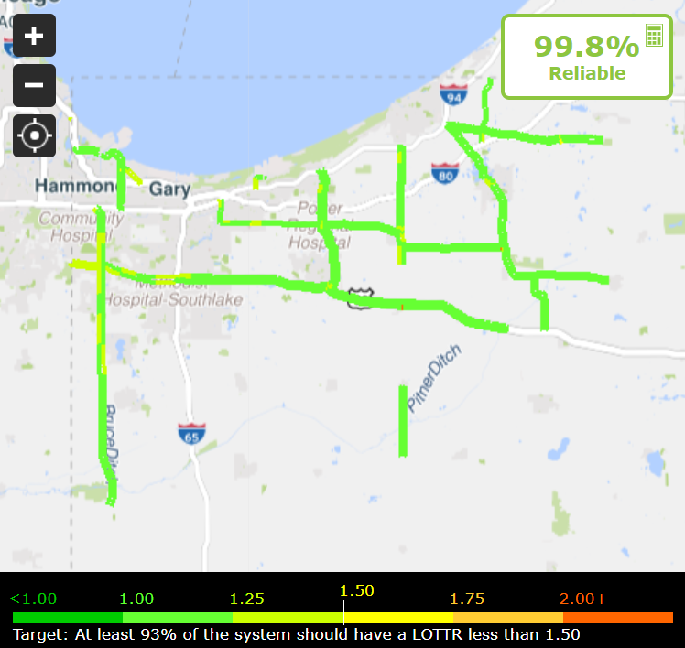
Travel Time Reliability on the Non-Interstate NHS YTD – Q3 2024

Slide 12
Truck Travel Time
Reliability Update
Quarter 3 - 2024

Slide 13
Truck Travel Time Reliability on the Interstates YTD Q3 - 2024
100.0%
1.49
1.23
1.27
1.42
1.42
1.54
1.54
1.72
1.58
1.60
Quarter 3

Slide 14
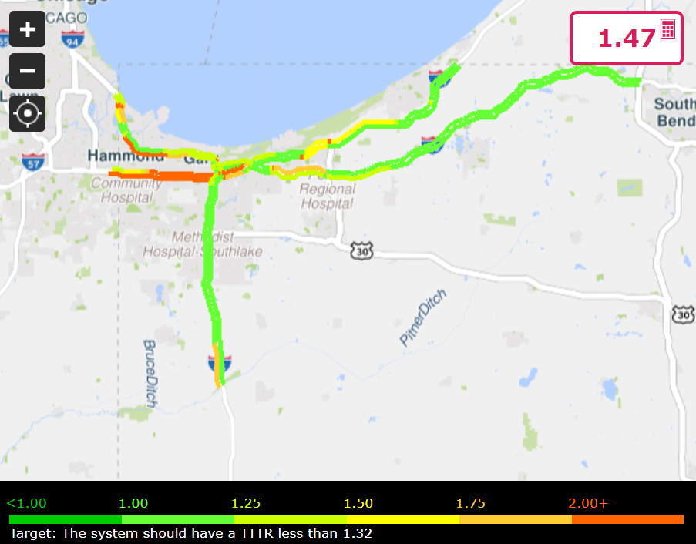
Truck Travel Time Reliability on the Interstates YTD Q3 - 2024

Slide 15
Congestion
Update
Quarter 3 - 2024

Slide 16
Peak-Hour Excessive Delay Per Capita YTD Q3 - 2024
100.0%
0.8h
0.7h
0.8h
1.1h
1.3h
1.0h
1.0h
0.8h
Quarter 3

Slide 17
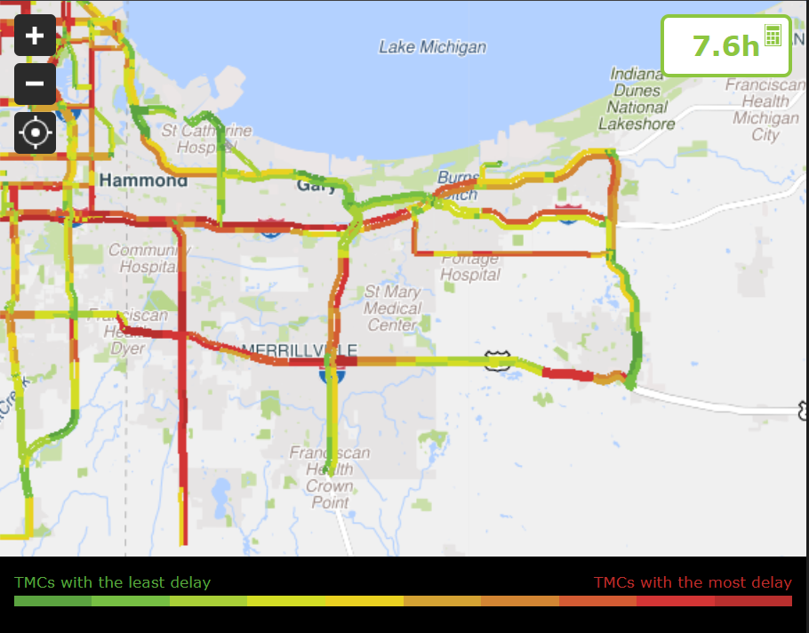
Peak-Hour Excessive Delay Per Capita YTD Q3 - 2024
100.0%
100.0%
100.0%
91.3%

Slide 18
Grace Benninger
gbenninger@nirpc.org
www.nirpc.org

