Slide 1
2024 NOFA Summary
Invest NWI
Northwestern Indiana Regional Planning Commission 2026 - 2030 Transportation Improvement Program Notice of Funds Available

Slide 2
Fiscal Years 2026 through 2030 (2029 & 2030)
Why?
Open from September 10, 2024 to October 18, 2024
$108 M estimated available
$36 M available for Infrastructure projects
$72 M available for Transit
Less funding available this NOFA compared to previous years
Urbanized areas redefined, resulting in a decrease in the populations of urbanized areas
Inflation is still present, but slowing
Many construction items still have long lead times
The program includes two large transformative projects
NIRPC fully programs all funding to demonstrate the need for continued funding
Funding is available under the HSIP, CMAQ, CRP, and PROTECT programs

Slide 3
Applications by Program (not including transit)

Slide 4
Applications by Local Public Agency (not including transit)

Slide 5
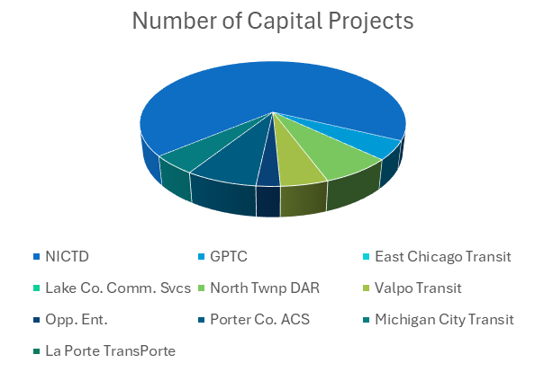
Applications for Transit Capital Projects
Transit Operator | Number of Capital Projects
NICTD | 28
GPTC | 2
East Chicago Transit | 0
Lake Co. Comm. Svcs | 0
North Twnp DAR | 3
Valpo Transit | 2
Opp. Ent. | 1
Porter Co. ACS | 3
Michigan City Transit | 2
La Porte TransPorte | 0

Slide 6
Other Metrics
Average Score
Total PE
Total RW
Total CN
Total CE
53.44
$ 10,084,874
$ 7,845,493
$ 51,922,012
$ 6,873,484

Slide 7
Next Steps
Now through mid-January 2025
Staff will review applications for completeness and scoring
Working Groups (previous Topical Committees) will review projects for recommendation
Will be submitted to Transportation Committee (formerly TPC) with recommendations
Mid-January – February 28, 2025
NIRPC will model its 2026-2030 Program for Air Quality Conformity
March 4, 2025
Transportation Committee meets and votes to recommend list of local project to add to 2026-2030 TIP
March 18 – April 18, 2025
2026-2030 TIP will be put out for Public Comment
May 15, 2025
2026-2030 TIP will be presented to NIRPC Commission for approval
If approved, it will be sent to INDOT and USDOT for approval

Slide 8
Charles Bradsky
cbradsky@nirpc.org
www.nirpc.org

