Slide 1
NIRPC Green Fleet
December 5th, 2024

Slide 2
Our Mission
Clean Cities and Communities advances the nation’s environment, energy security and economic prosperity through collaboration with communities by building partnerships with public and private stakeholders that create equitable deployment of clean transportation solutions for all.
Notes:
The Clean Cities and Communities partnership works toward a unified mission to advance the nation’s environment, energy security and economic prosperity through collaboration with communities by building partnerships with public and private stakeholders that create equitable deployment of clean transportation solutions for all.

Slide 3
About NWI Green Fleet Program
Drive Clean Indiana manages the program for Northwest Indiana Regional Planning Committee (NIRPC).
The goal of the program is to significantly improve the environmental performance of business and government vehicle fleets across each respective MPO’s territory through diesel retrofits and other strategies.
146 Green Fleet Members
Drive Clean Indiana
Notes:
*Must be a DCI member to qualify.

Slide 4
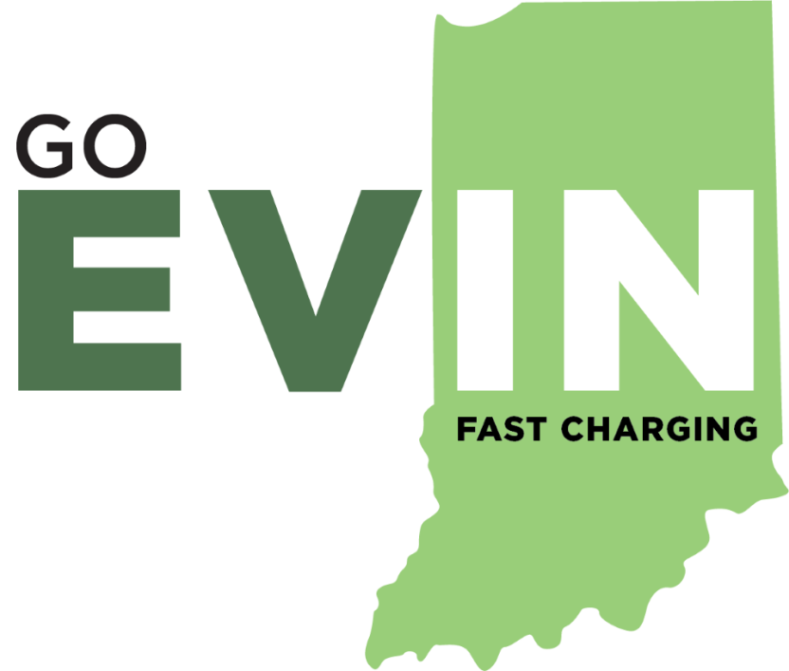
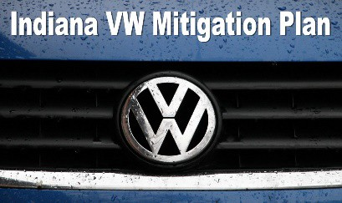
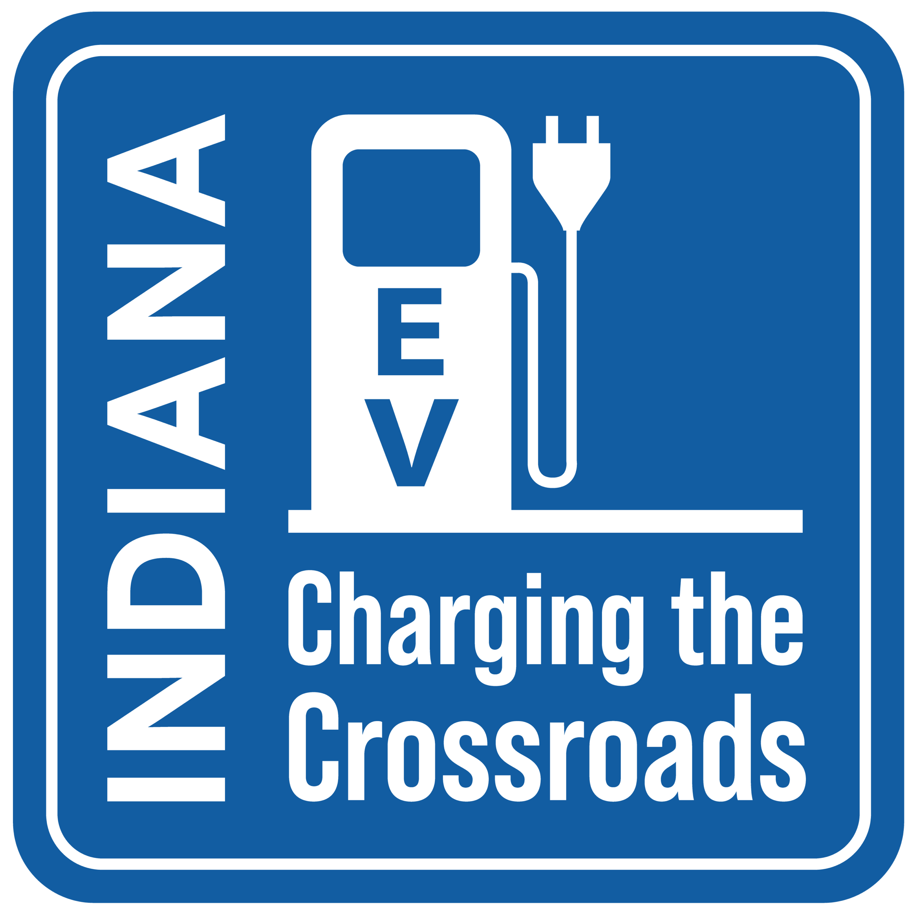
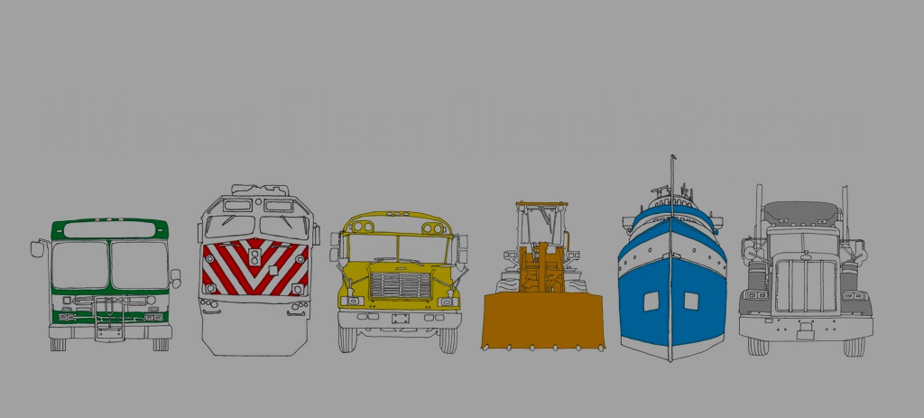
Current Programs and Projects
Indiana Clean School Bus Consortium
Drive Clean Indiana
Notes:
*Must be a DCI member to qualify.

Slide 5
Success in Deployments for 2023/2024
Drive Clean Indiana
Notes:
*Must be a DCI member to qualify.

Slide 6
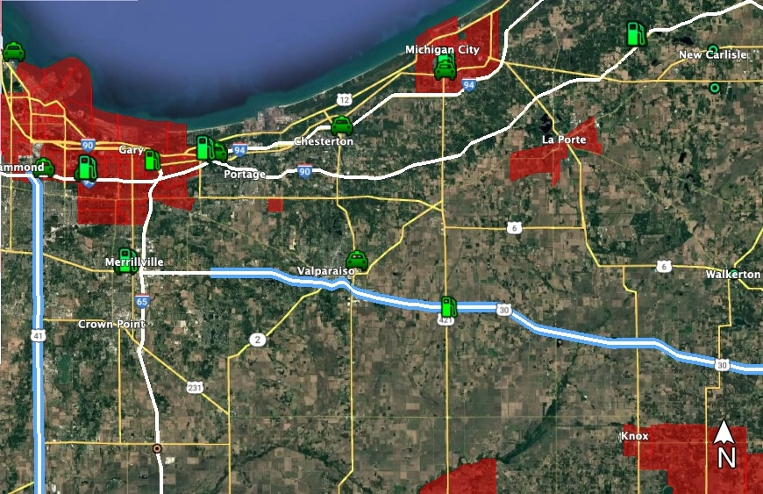
Outstanding Projects
CFI Round 2 (statewide)
$50M Request
$39M Match
124 DCFC/mW Ports
28 Level 2 Ports
Drive Clean Indiana
Notes:
MAP LEGEND
GOEVIN: Closing the Gap Locations
GOEVIN Location (not NEVI compliant)
Electrify America Location
NEVI First Round – Install Fall 2025
MACOG CF1 RD 1 Award (NEVI Compliant)

Slide 7
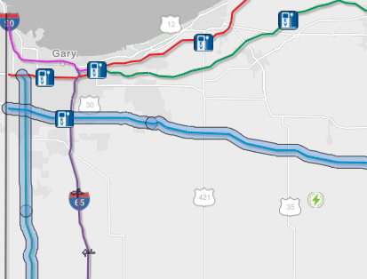
Outstanding Projects
NEVI Round 1
NEVI Round 2
Available Early 2025
80% Funding
Public Alternative Fueling Infrastructure
Drive Clean Indiana
Notes:
*Must be a DCI member to qualify.

Slide 8
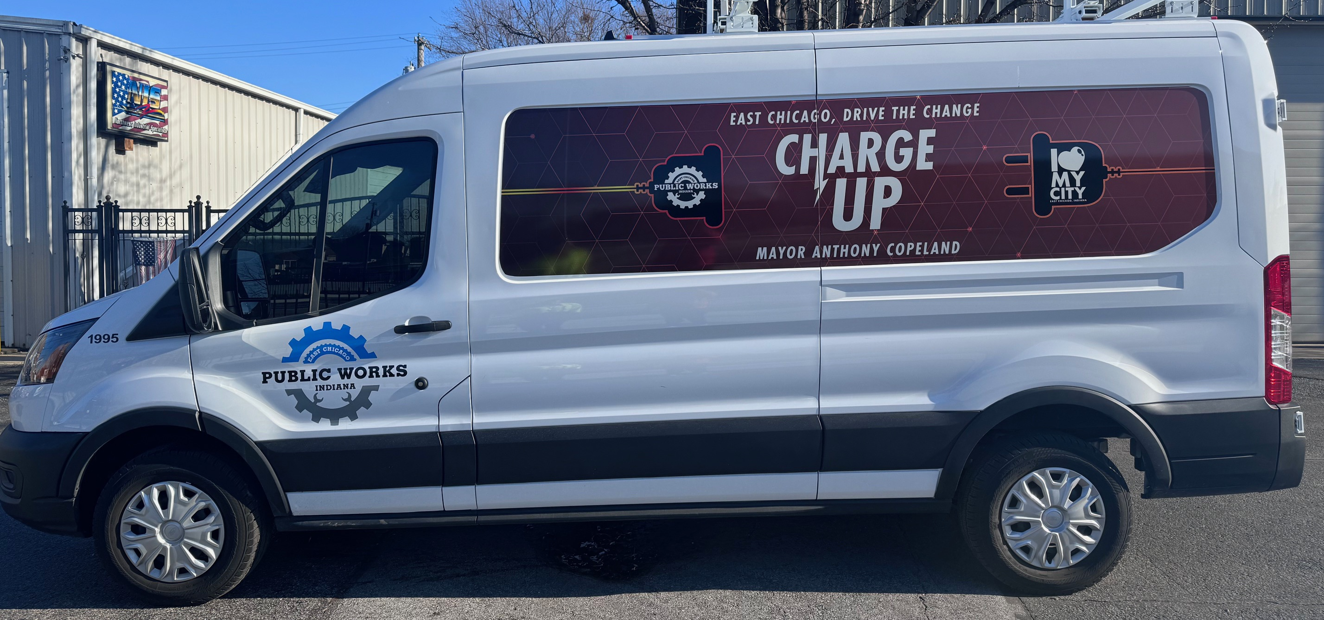
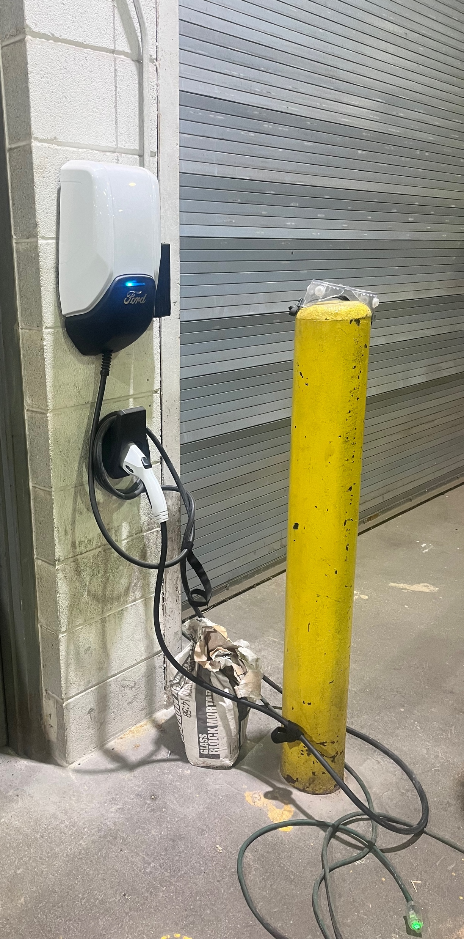
Outstanding Projects
Lake and Porter County ZEV
80 EVs + Level 2 Fleet Chargers
20 Public Level 2 Charging Stations
2022 NIRPC NOFA
Awarded: $2,982,400
Local Match: $1,577,600
City of Lake Station
Drive Clean Indiana
Notes:
*Must be a DCI member to qualify.

Slide 9
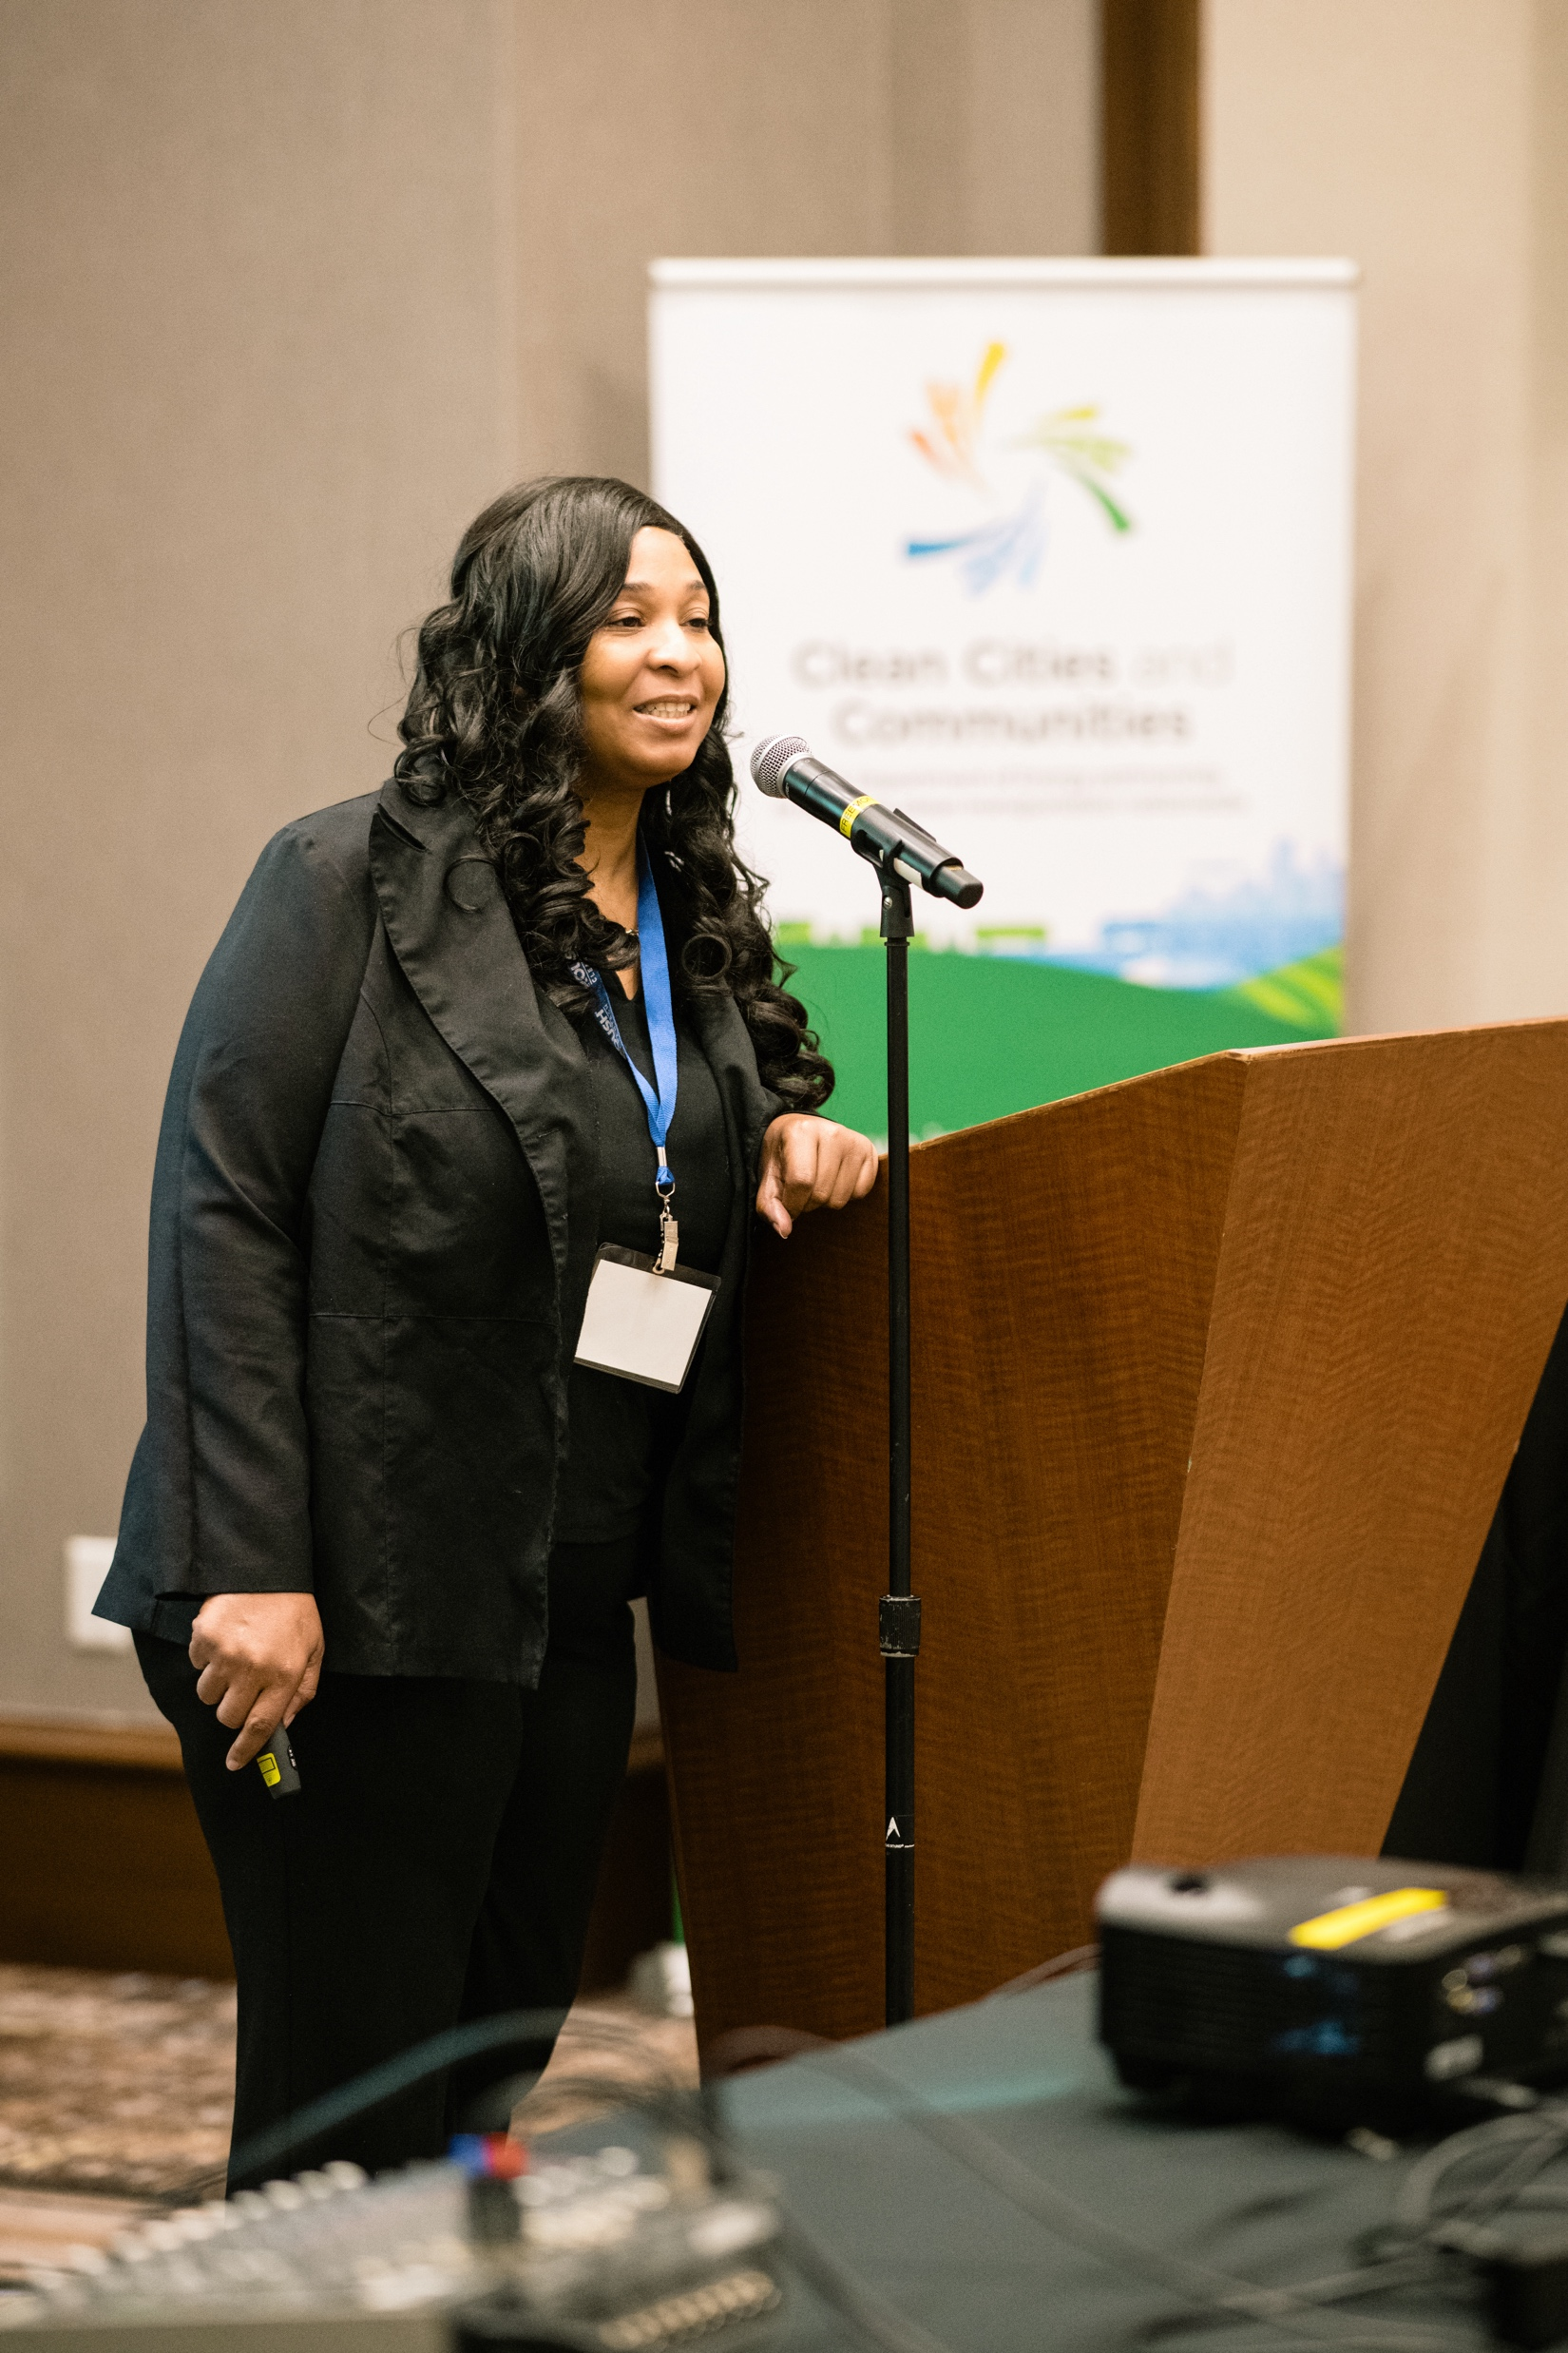
Outstanding Projects
Community Change Grant
$40M Project Requests
Improve Building Efficiencies
Decarbonization
Work Force Training/Development
Collaboration
Apprenticeship Program
Electric Infrastructure Deployment
Lake, LaPorte, and Porter County Focus
Drive Clean Indiana
Notes:
*Must be a DCI member to qualify.

Slide 10
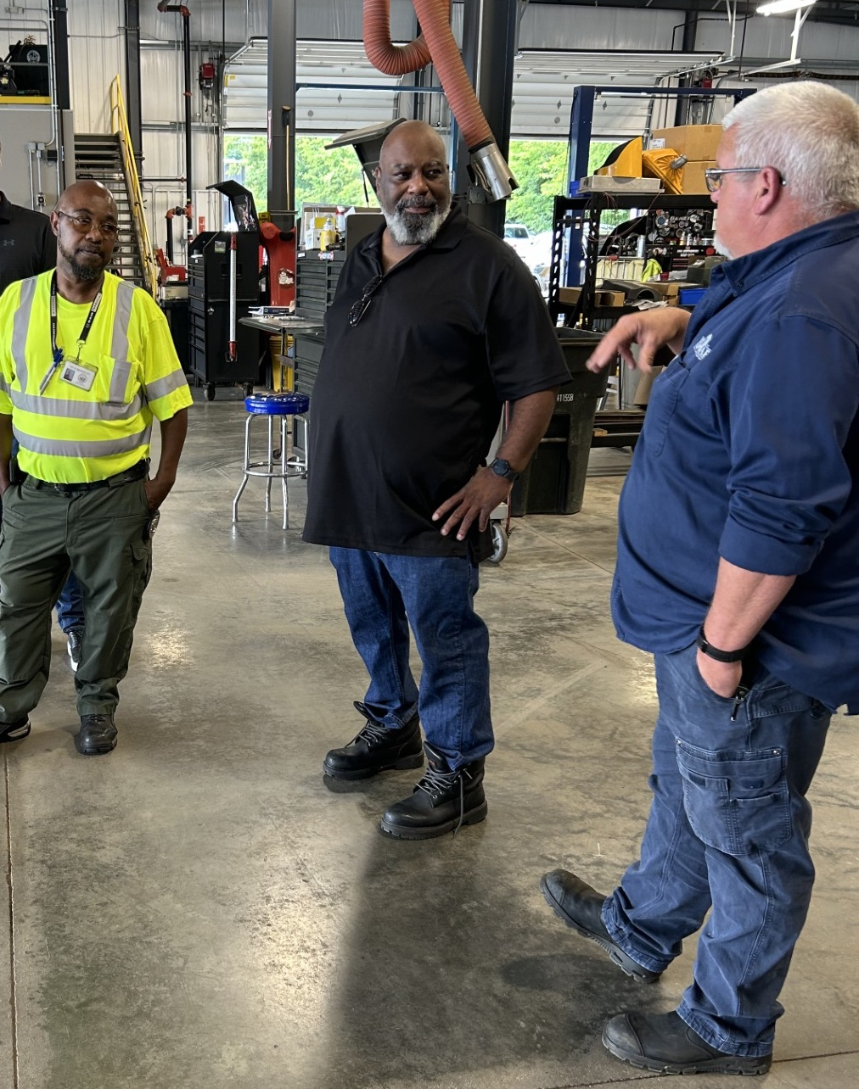
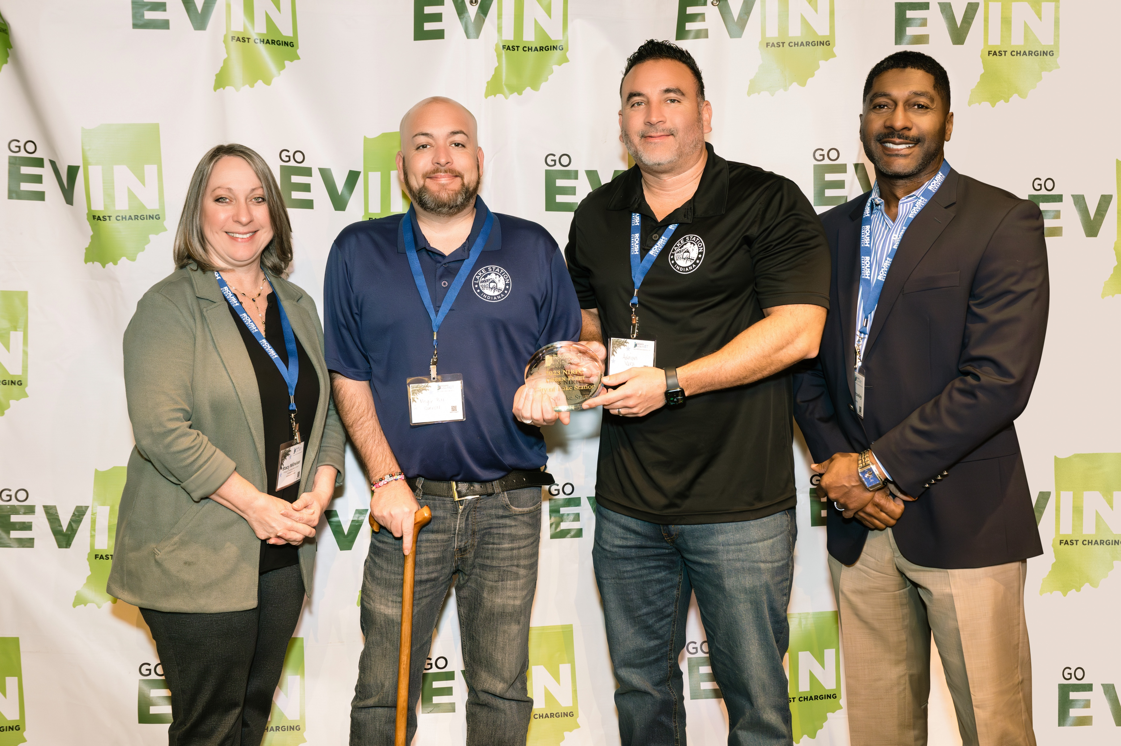
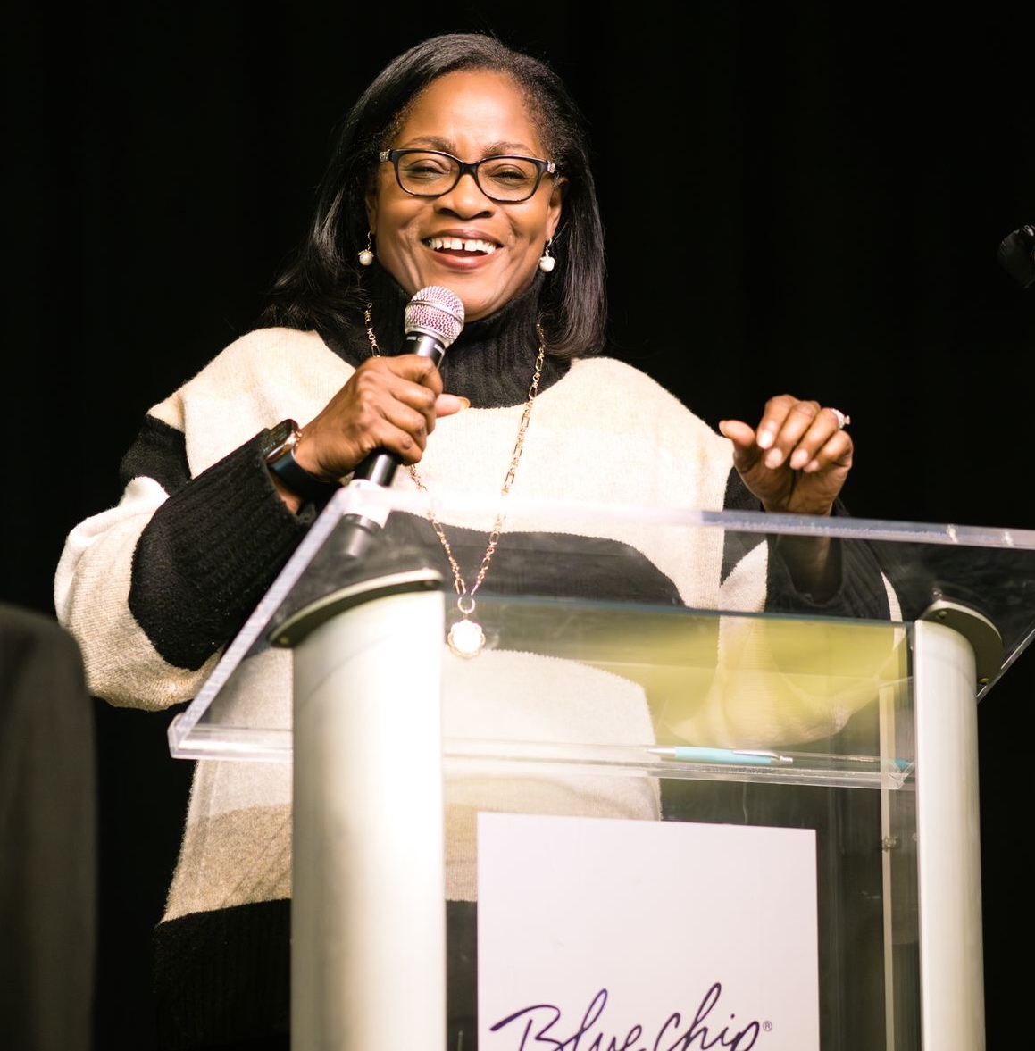
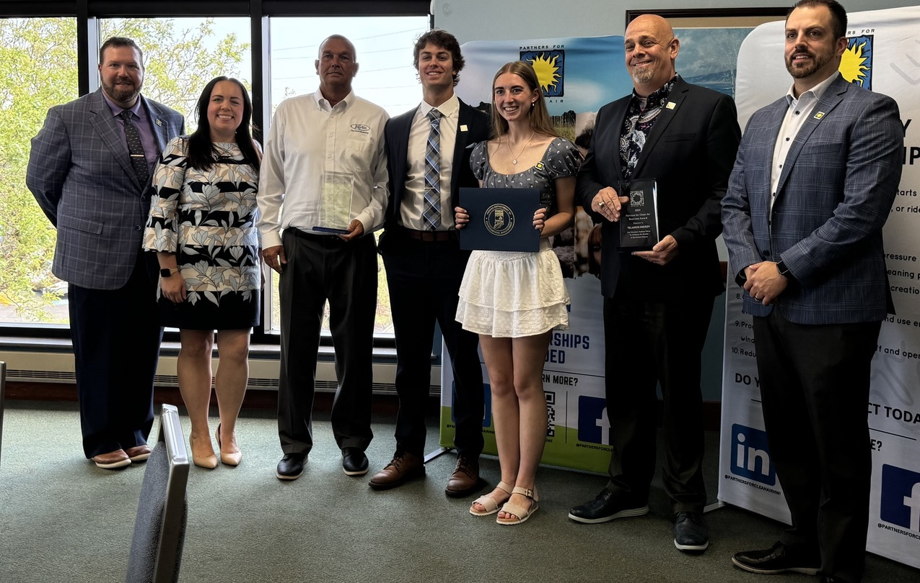
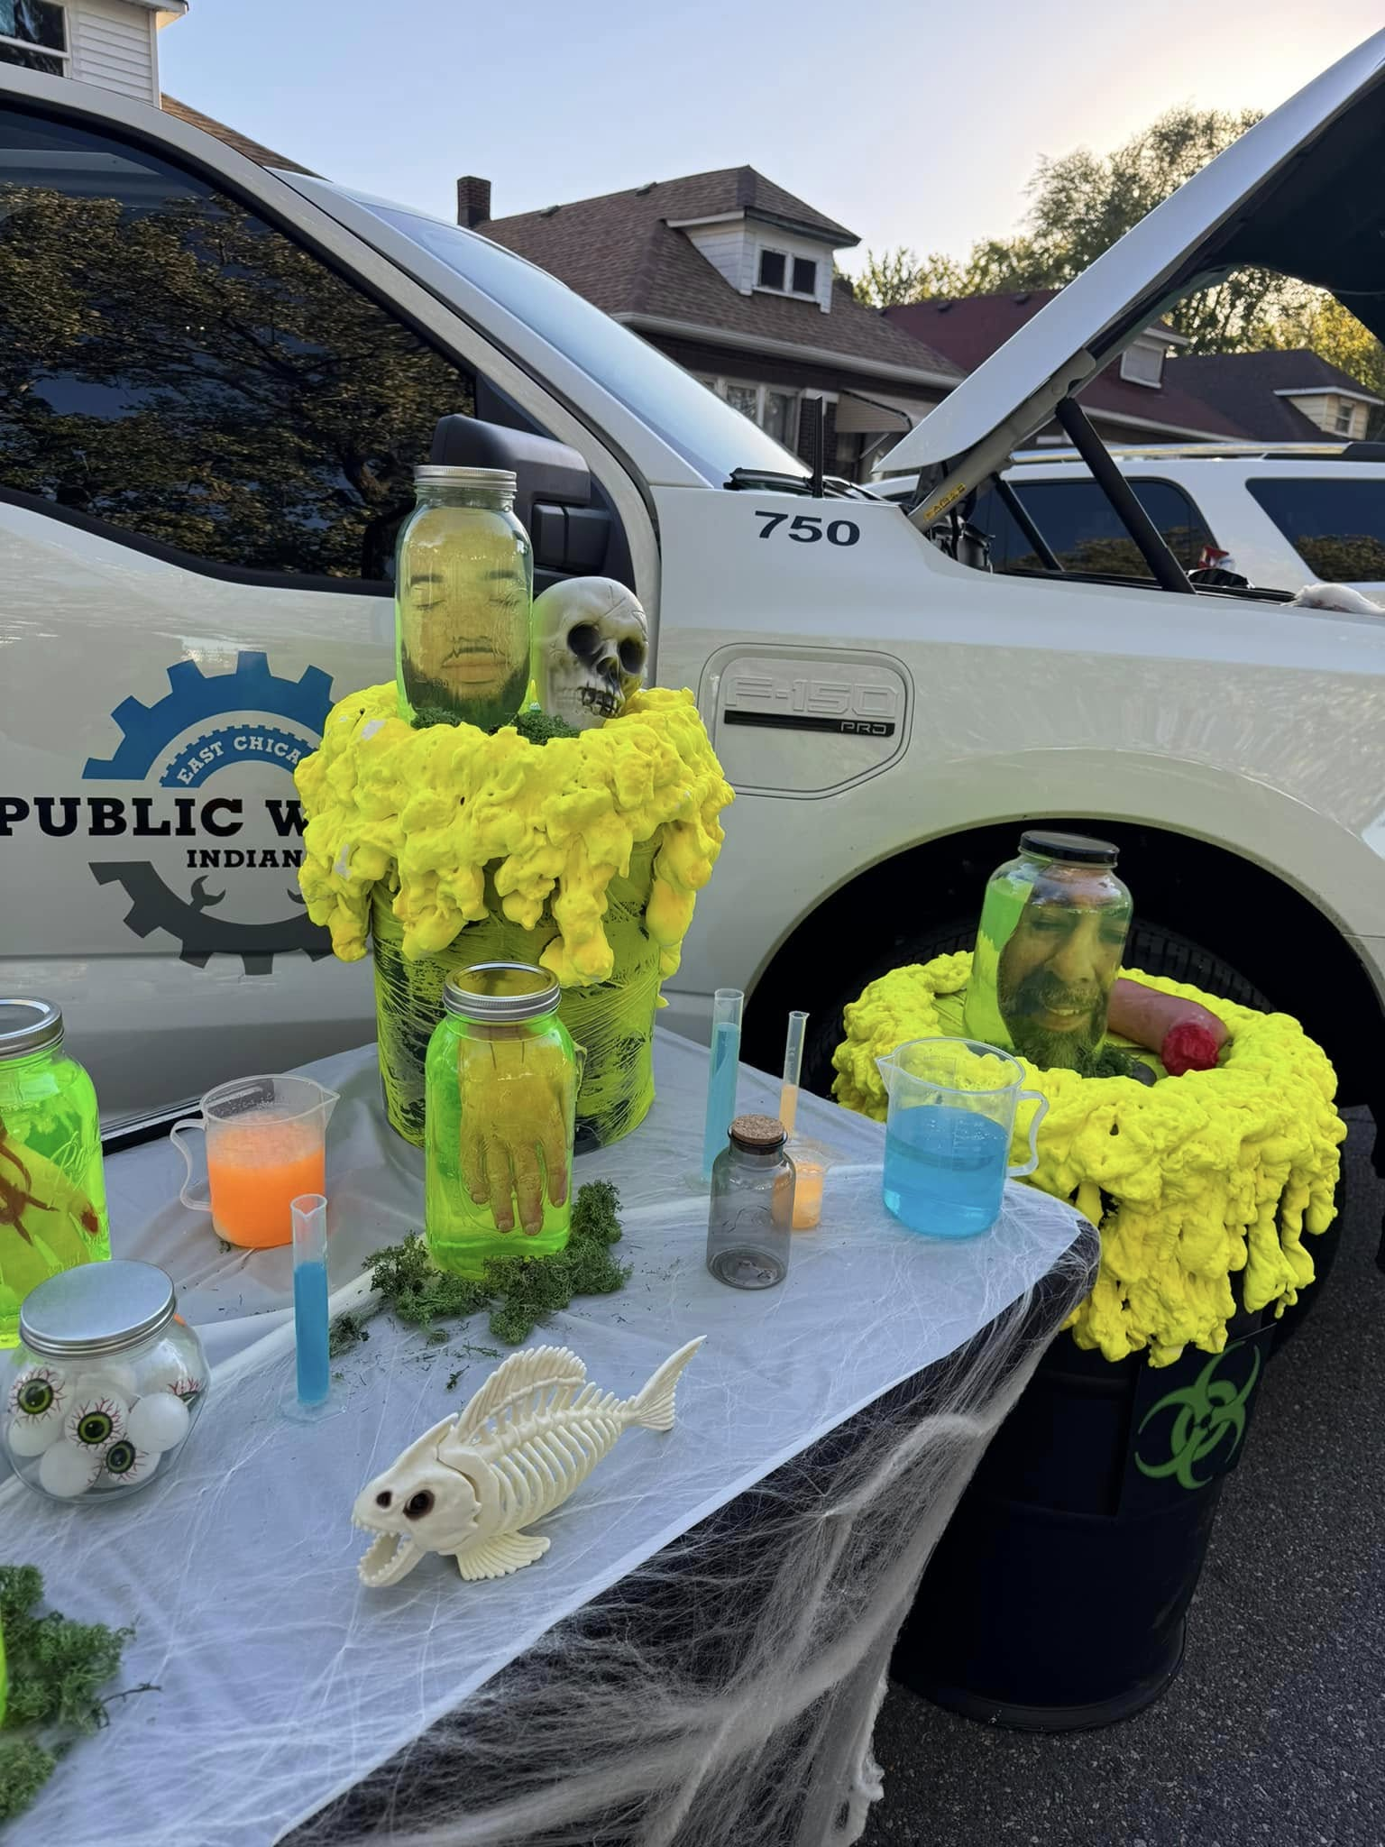
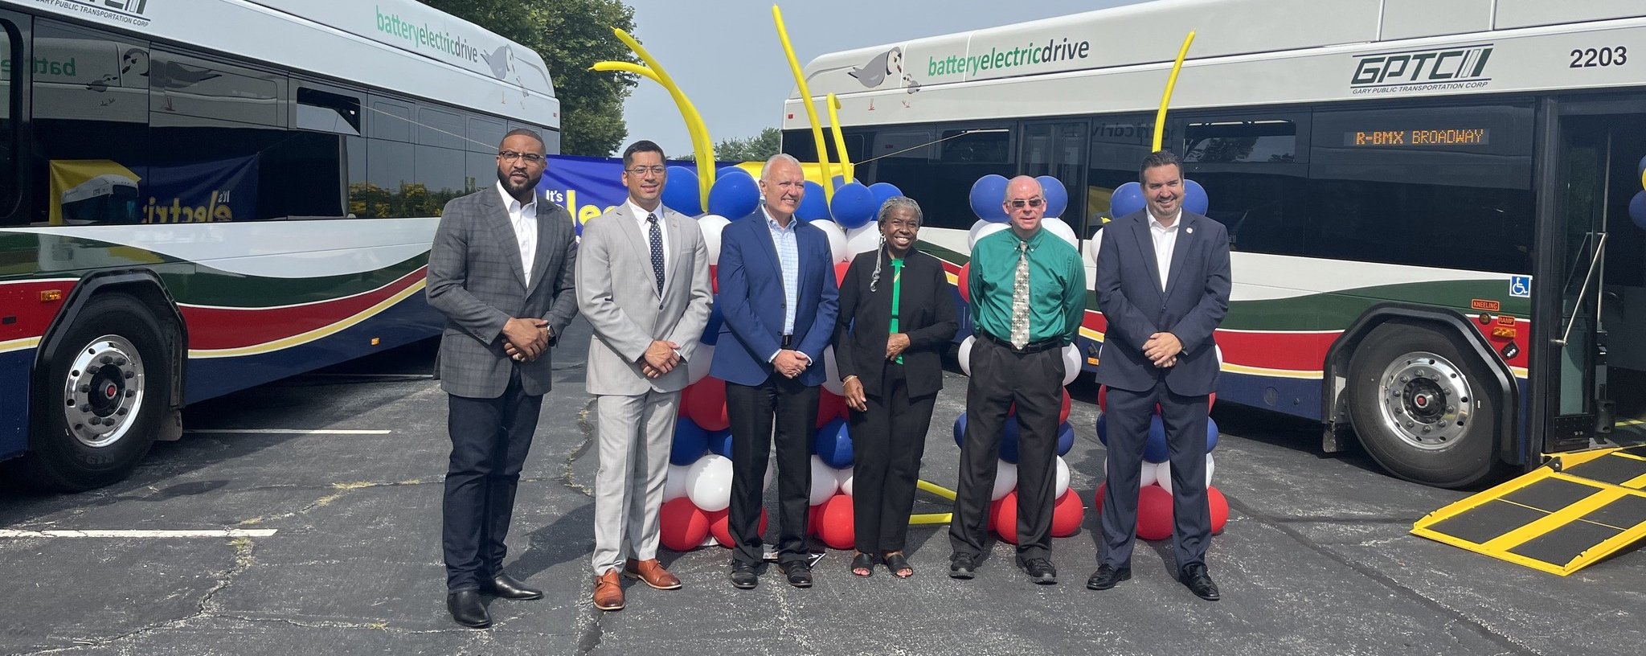
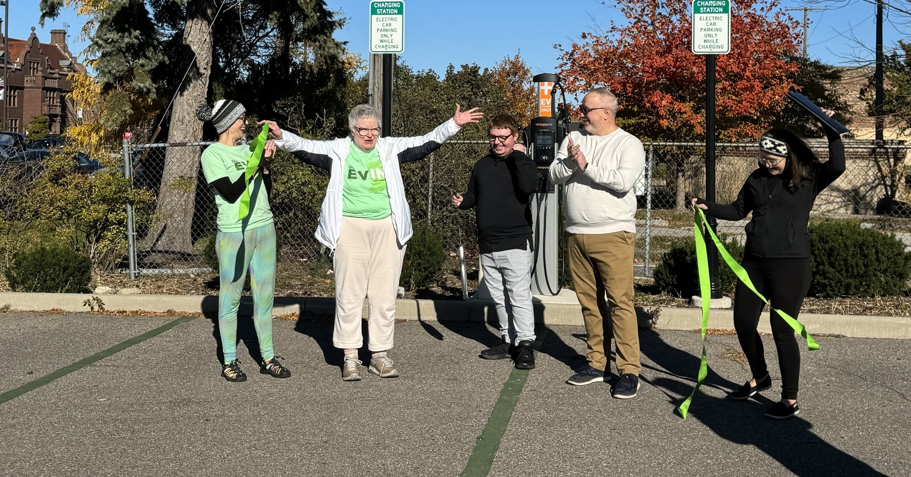
Engagement & Collaboration
Drive Clean Indiana
Notes:
*Must be a DCI member to qualify.

Slide 11
Drive Clean Indiana is a 501(c)(3) nonprofit organization managed by Legacy Environmental Services, Inc., an Indiana Certified Women's Business Enterprise.
With over 25 years of steadfast commitment to the decarbonization of the transportation sector, Drive Clean Indiana lives its mission through:
Education and Outreach
Training
Grant Writing and Funding Acquisition
Project Management
Development of Stakeholder Partnerships.
Drive Clean Indiana is Indiana’s only appointed Clean Cities & Communities Coalition by the U.S. Dept. of Energy
Drive Clean Indiana successfully assisted public, private, and nonprofit members with diesel emissions reduction projects totaling more than $20 million in 2023.
Notes:
Drive Clean Indiana is a nonprofit organization celebrating 25 years of work in the transportation sector. Through our efforts, we help to
Evaluate transportation needs and energy choices to determine the most impactful and cost-effective vehicle options, fuels, technologies, and best practices that make sense for specific stakeholder applications
Shift to domestic energy sources through fuel diversification including natural gas, propane, hydrogen, electric, ethanol, biodiesel & renewable diesel
Improve fuel efficiency through state-of-the-art technologies and strategies
Reduce harmful emissions through idle reduction and other fuel-saving technologies and practices and
Demonstrate and assess new mobility choices that maximize the return on investment in terms of time, cost, energy, and opportunity.
Through these technologies and strategies we can assist communities and businesses and have assisted to secure over $50 million in funding to support these efforts since 2011. The results being improved air quality, economic development, and support of local jobs which all lead to a improved quality of life.

Slide 13
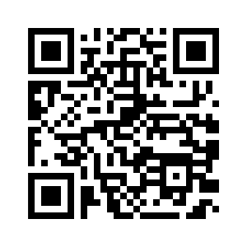
Tire Rack EV Ride and Drive
December 10th, 2024
Work Truck Week
March 5th – 7th, 2025
Indianapolis, IN
DCI Stakeholder Breakfast
March 5th, 2025
Indianapolis, IN
Indiana Clean School Bus Consortium
Monthly, 3rd Tuesday

