Slide 1
2020 Census Data

Slide 2
Northwest Indiana 2020
County | 2010 Population | 2020 Population | Change | % Change
Lake, IN | 496,005 | 498,700 | 2,695 | 0.5%
Porter, IN | 164,343 | 173,215 | 8,872 | 5.4%
LaPorte, IN | 111,467 | 112,417 | 950 | 0.9%
NIRPC Region | 771,815 | 784,332 | 12,517 | 1.6%

Slide 3
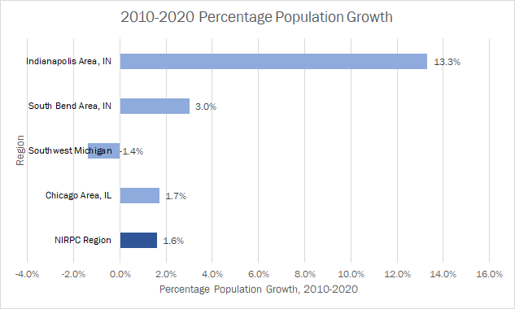
NIRPC Region Population Growth vs. Other Regions

Slide 4
NWI 2020 Population

Slide 5
Population Changes 2000, 2010, 2020

Slide 6
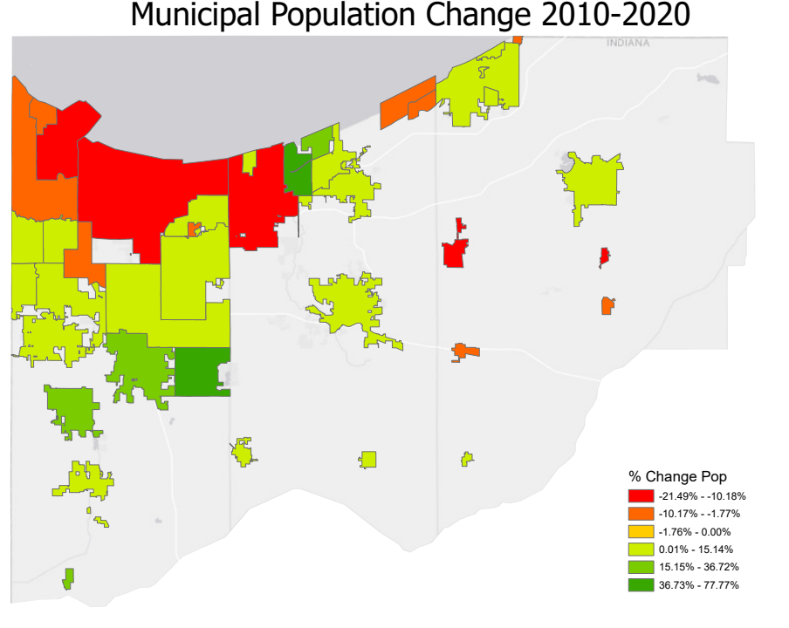
Municipal Population Change

Slide 7
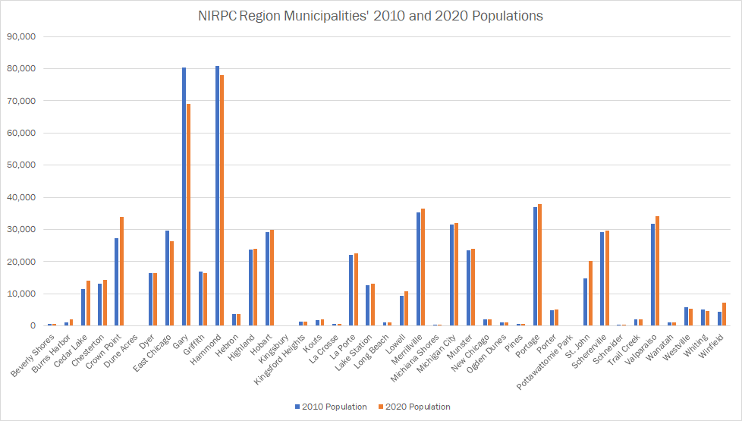
Municipal Population Change

Slide 8
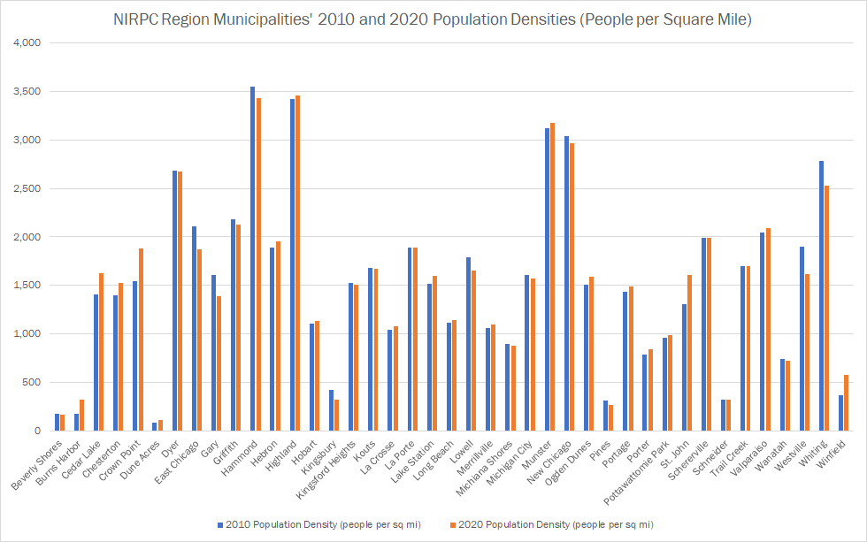
Municipal Population Density Change

Slide 9
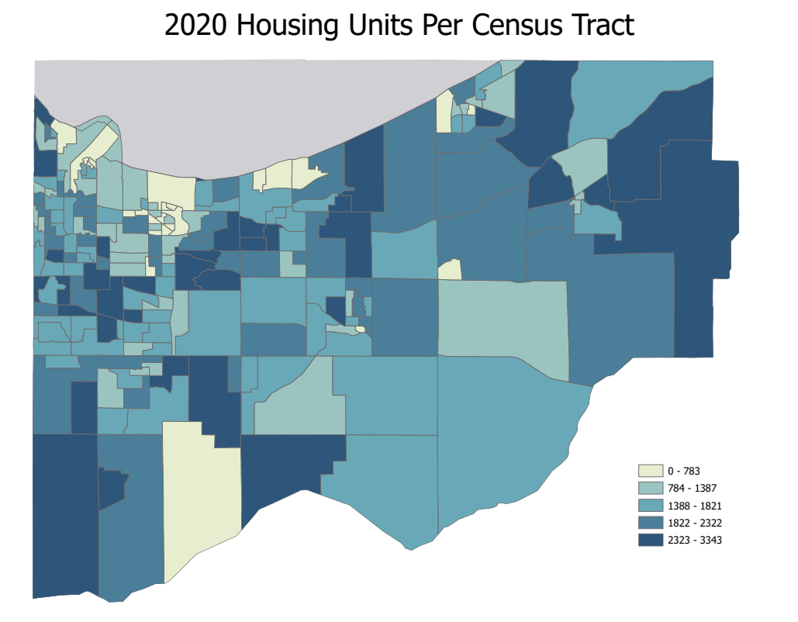
2020 Housing Units

Slide 10
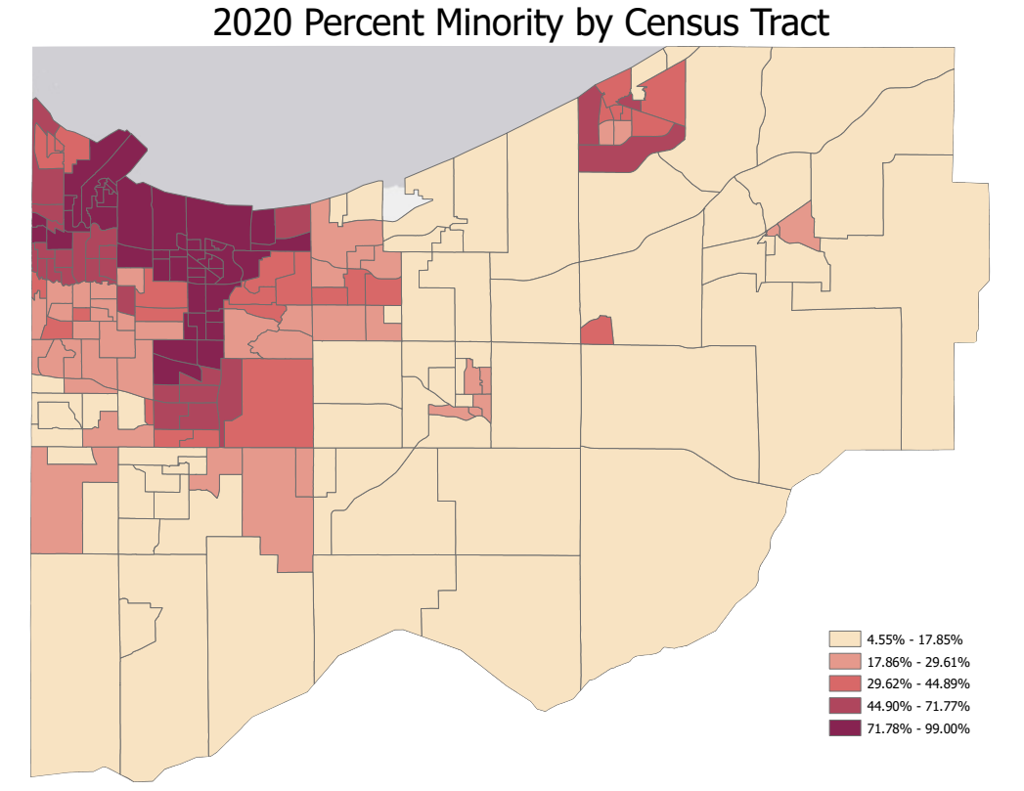
2020 Areas with Minorities

Slide 11
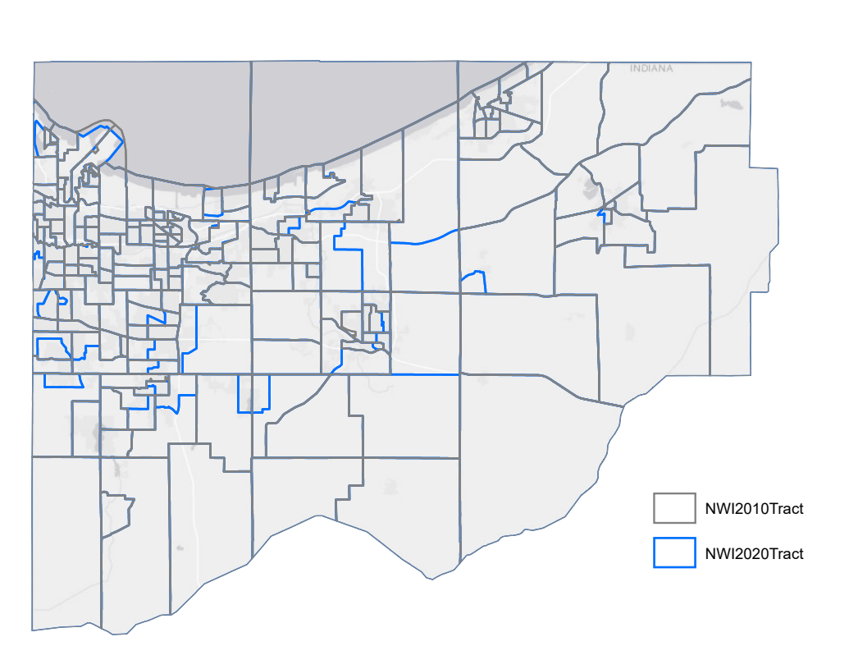
NWI Census Tract Adjustments

Slide 12
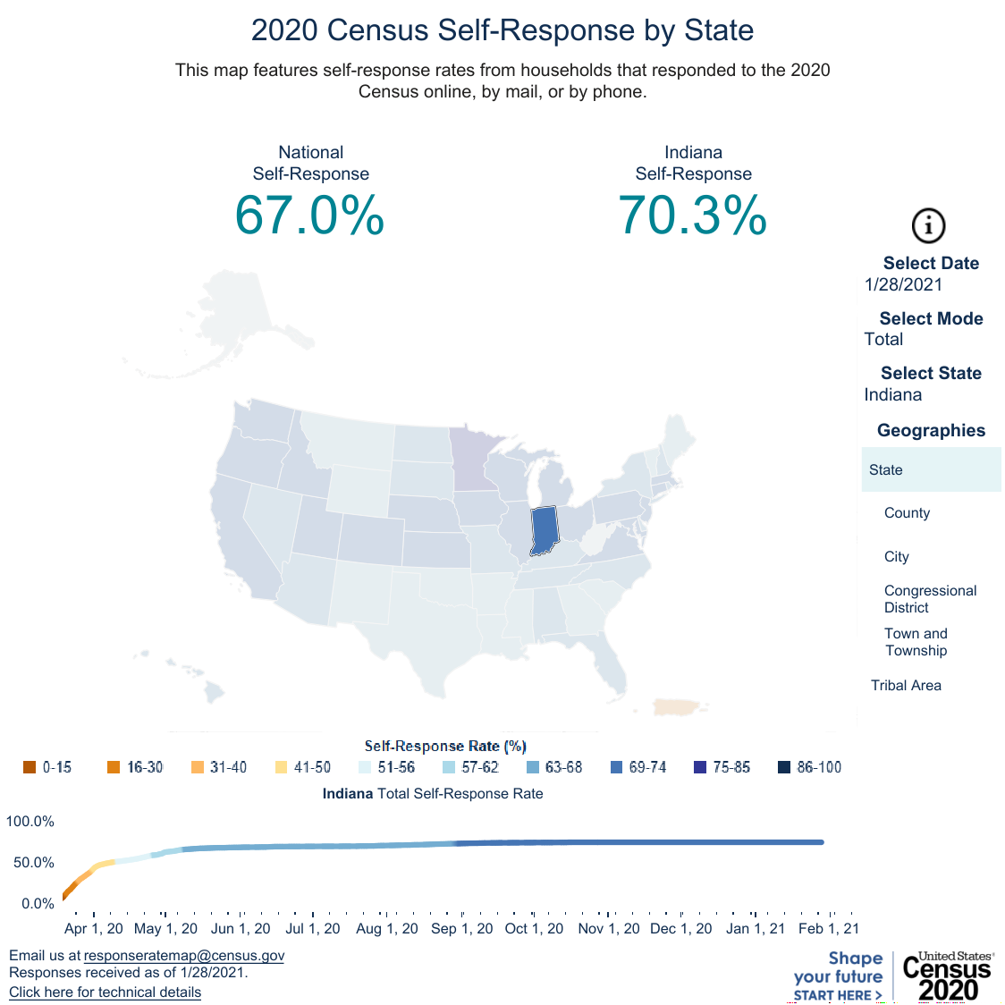
Response Rate
*Compared to 69.6% in 2010

Slide 13
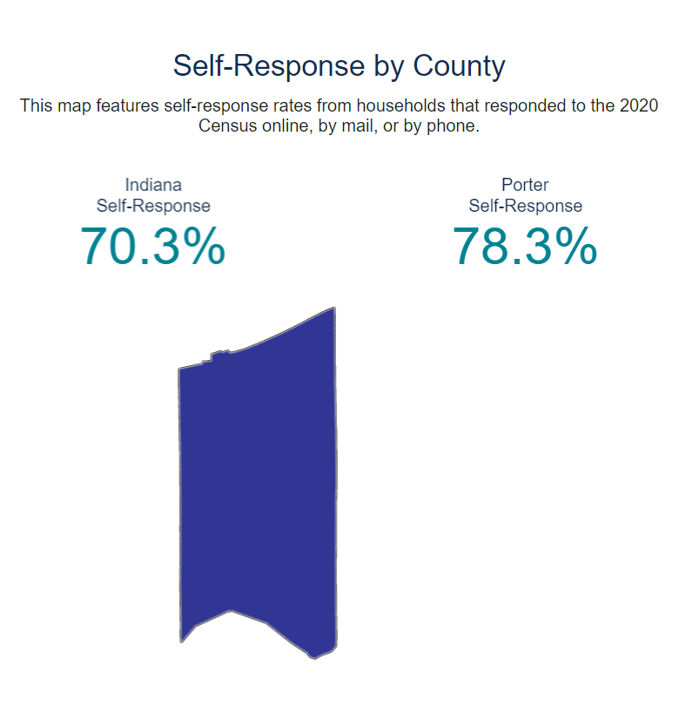
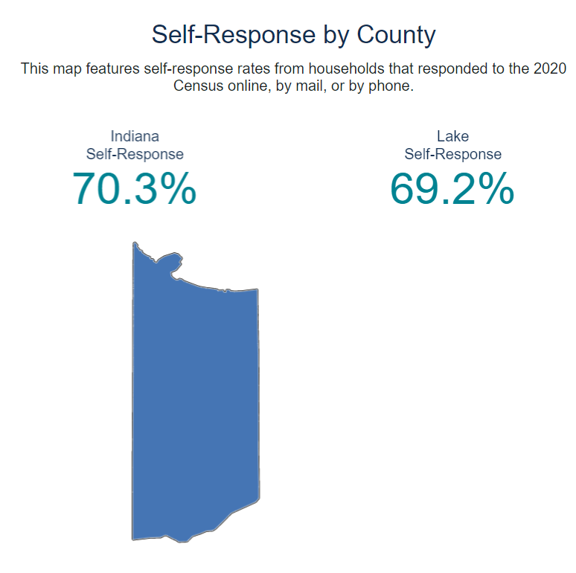
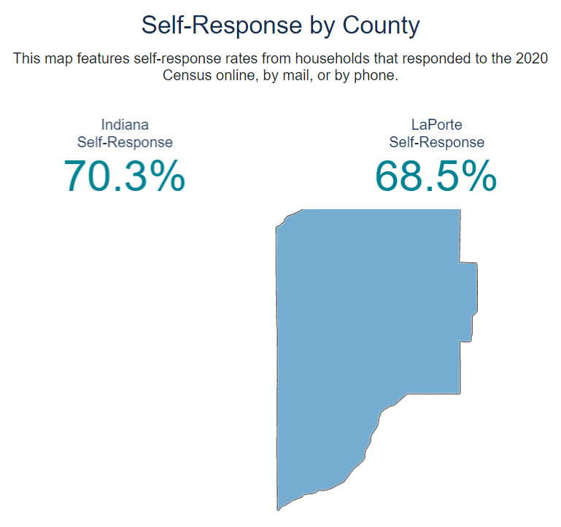
Response Rate by County

Slide 14
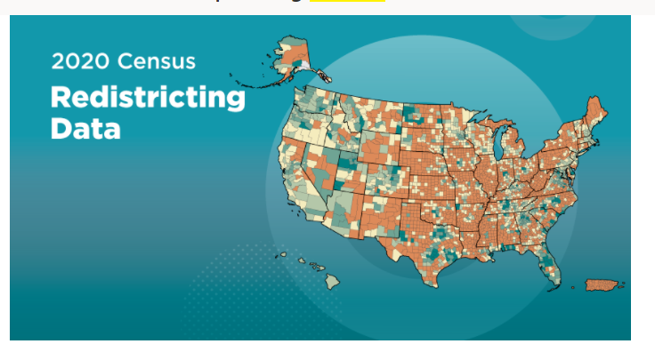
More Info!
https://data.census.gov/cedsci/
Census Data will be available 9/16/2021
Contact Peter Kimball or Scott Weber for more information
https://nirpc.org/2040-plan/economy-and-place/regional-data-maps/request-data/

Slide 15
Peter Kimball | Scott Weber
pkimball@nirpc.org | sweber@nirpc.org
www.nirpc.org

