Slide 1
Porter County Heath Department
Health officer comment

Slide 2
Frequently Asked Questions
Does the COVID19 vaccine cause fetal death?
Will masks be mandated in the future?
Will the updated COVID19 vaccine be offered by the Porter County Health Department?
Does the Porter County Health Department ensure informed consent when vaccines are administered?
What is your position on the UN’s PPPR document and amendments to the WHO International Health Regulations?
COVID19 infection vs vaccination as a cause of myocarditis in youth
Do you read what we send?
Notes:
Over the past 6 months, the public questions and comments have generally revolved around these questions. I’d like to briefly address them

Slide 3
Is the COVID19 vaccine a cause of fetal death?

Slide 4
Number of fetal deaths by year
Notes:
We went through our vital records for fetal deaths. Indiana requires counties to record miscarriages and stillbirths from 20 weeks of gestation and up. My vital records data clerk has gone through the records from 2018 to the present. Our fetal death rate is low compared to other counties in Indiana, but we did see a significant increase in 2020. 16 fetal deaths that year, 3 were before April when covid was circulating here. The vaccine for covid became available for pregnant women in April of 2021, and we then saw a trend in fetal deaths more toward the average of 9. I don’t have specific data on how many pregnant women were vaccinated in 2021, but according to this data the number of fetal deaths is not increasing. I cannot answer to the report from Fresno that they had an increase from a couple to 22 in a month, and I am not finding that data reported on outside of the one news report initiated by a labor and delivery nurse there

Slide 5
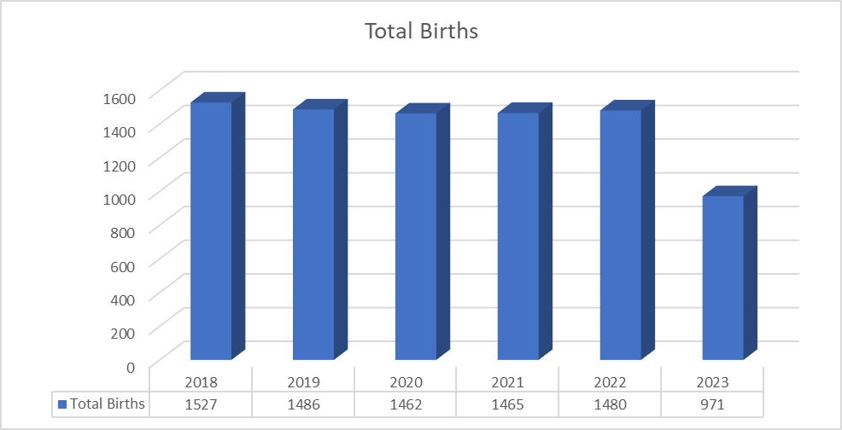
Total births by year

Slide 6
Will masks be mandated in the future?

Slide 7
Masks will not be mandated by the Porter County Health Department for preventing spread of COVID19*
*Recommendations are not mandate, private businesses, healthcare institutions and school systems implement their own policies to protect their employees, patients and students

Slide 8
Will the updated COVID19 vaccine be offered by the Porter County Health Department?

Slide 9
COVID19 Vaccination
Reformulated monovalent mRNA vaccine – only Moderna at this time at health dept
CDC Recommends a dose for all ages 6 mos and older
FDA approved for ages 12 and up, EUA approval for 6 mos – 11 yo
Can be given if no COVID19 vaccination in past 2 months
Strongly recommended for those who have high risk for complications
Notes:
Covid vaccine was modified very similar to the way the seasonal flu shot is modified. The flu vaccine does not go through the human testing studies as a new vaccine would, but is modified slightly to best match the new strain. The components otherwise are the same.
High risks of complications and increased mortality: Age >50, especially >65, residents of LTCF, racial and ethnic minorities, lung disease, kidney disease, cerebrovascular dz and dementia, heart disease, downs syndrome and other developmental disabilities, obesity BMI >30

Slide 10
Does the Porter County Health Department ensure informed consent when giving vaccines?

Slide 11
Consent for all vaccinations
Vaccine Information Sheet (VIS) or Fact Sheet for vaccines with EUA
VAERS (Vaccine Adverse Event Reporting System)
National Vaccine Injury Compensation Program
V-Safe was discontinued in May 2023 after public health emergency ended
Notes:
All clients of the health department who receive vaccinations receive a VIS or Fact Sheet with common side effects listed. On the VIS and Fact Sheet is information on VARES and the Vaccine Injury Compensation Program. V-Safe was another avenue for people experiencing symptoms to report those after covid vaccination. This was discontinued in May

Slide 12
Is myocarditis caused by the COVID19 vaccine?

Slide 13
Research on Myocarditis in Covid19 Vaccination
https://jamanetwork.com/journals/jamanetworkopen/fullarticle/2793555
https://www.acpjournals.org/doi/10.7326/M22-2274
https://pubmed.ncbi.nlm.nih.gov/34185045/
To date in 2023, only 21 doses of covid vaccine have been administered to adolescents at PoCoHD
1.8/100,000 and 9.4/100,000, higher after 2nd dose and when <30 days apart
Incidence higher in males 12-15 and 16-17, highest after 2nd dose, 1/30,000 age 5-39
Military 23 cases in 2.8 million doses, all recovered, higher after 2nd dose
Notes:
Here are some scientific articles regarding myocarditis in young people after covid vaccine. It is rare, generally resulting in full recovery. I don’t know about when Dr Fauci was made aware of these studies, but they were all published in 2022 or earlier. I don’t practice medicine by Fauci, but by guidelines. The demand for covid vaccination in the adolescent age group has been low, with only 21 doses given in 2023 by the HD

Slide 14
Myocarditis in COVID19 Infection
Expert Cardiology Consensus
Contents
https://www.jacc.org/doi/10.1016/j.jacc.2022.02.003
Discusses cardiac syndromes associated with covid19 and covid 19 vaccination, risk/benefit ratio, and screening and treatment recommendations

Slide 15
COVID19 status
Since March 2020
The virus that causes COVID19 has changed and will continue to change
Has not become more virulent or dangerous in 2023
The immune status of the community has changed due to past infection and vaccination
Treatments are available for COVID19 infection
Hospitalizations and deaths still occur, although less frequently
Those at high risk for complication should follow CDC recommendations to prevent infection and be treated if infected
20 covid deaths in Porter County through September 2023

Slide 16
What is your position on the UN’s PPPR document and amendments to the WHO International Health Regulations?

Slide 17
Dr Stamp’s thoughts exclusively:
The WHO and any other organization would do well to evaluate their emergency response plan regularly, especially coming out of a pandemic
The UN and the WHO have called for and received amendment requests from member nations.
The Review Committee appears to give very reasonable Technical Recommendations to the proposed amendments
The UN and WHO appear to be following their rules for order
Does not affect how care is delivered in the United States and Porter County

Slide 18
Do you read what we send?

Slide 19
Emails received from the public
Rumble.com
Theepochtimes.com
Totalityofevidence.com
Petermcculloughmd.substack.com
Sciencedirect.com
Usaspending.gov
Thegatewaypundit.com
Academic.oup.com
Un.org
Stoptheammendments.com
Dailyclout.io
Vigilantnews.com
Thehighwire.com
Covid19criticalcare.com
Thechiefnerd on x.com
theBigLogic.com
Stoptheglobalagenda.com
Exitthewho.com
Congress.gov
Apps.who.int
Notes:
The health department and the BOH has in the past 6 months received requests from <10 people to review 1000s of pages of commentary, data and reports and dozens of hours of video commentary on vaccine concerns, masking and the UN and WHO, so the answer is that we review some. Many of the articles extrapolate causation from associations, most have alarming clickbait titles that are not supported by the data they present. I will continue to read some of articles sent our way, but I think I’ve got the gist of the concerns and it is not changing the way I practice. In the name of medical autonomy, the non-political term for medical liberty, we will continue to offer covid vaccines to those who want to receive them, and allow people to make their own decisions in consultation with their healthcare provider about whether to vaccinate

Slide 20
Recommended reading FROM the HD
https://www.cdc.gov/mmwr/volumes/70/wr/mm7043e2.htm
https://www.sciencedirect.com/science/article/pii/S0264410X22015614?dgcid=raven_sd_aip_email
https://pubmed.ncbi.nlm.nih.gov/35428497/
https://www.cdc.gov/mmwr/volumes/71/wr/mm7107e1.htm
https://www.cdc.gov/mmwr/volumes/71/wr/mm7103a4.htm
https://www.cdc.gov/mmwr/volumes/71/wr/mm7101e1.htm
https://www.cdc.gov/coronavirus/2019-ncov/science/science-briefs/vaccine-induced-immunity.html
https://www.acog.org/clinical/clinical-guidance/practice-advisory/articles/2020/12/covid-19-vaccination-considerations-for-obstetric-gynecologic-care?utm_source=redirect&utm_medium=web&utm_campaign=int
Vaccine Safety and mortality
Vaccine Safety and mortality
VSD dashboard
Booster safety
Decision-making and J&J vaccine
Pregnancy
Vaccine vs infection for immunity
Covid guidelines in pregnancy

Slide 21
Recommended reading FROM the HD
https://www.acc.org/Latest-in-Cardiology/ten-points-to-remember/2022/02/07/15/57/Myocarditis-After-BNT162b2
https://jamanetwork.com/journals/jamapediatrics/fullarticle/2796976
https://sensiblemed.substack.com/p/choosing-a-control-group
https://health.mil/News/Articles/2023/06/01/Hospitalization-Burden
https://www.cdc.gov/vaccines/acip/meetings/downloads/slides-2023-09-12/07-COVID-Klein-508.pdf
Vaccine safety myocarditis
Vaccine safety pregnancy
How a control group affects research
Hospitalization rates in active duty military (98% vaccinated) unchanged in 2022 from prior to pandemic
Vaccine safety

Slide 22
Health First Porter County
Vital records data is a core service for Health First Indiana funding
Vital records data will be presented in coming months and used to direct programming
The health department is investigating ways to obtain and use hospitalization, emergency department and outpatient data to respond quickly to trends in our community, before they become vital statistics

Slide 23
The Mission of the Porter County Health Department is…
Porter County Health Department promotes and protects the health and well-being of our community

