Slide 1
Porter County Heath Department
Health First Indiana updates

Slide 2
Fetal Infant Mortality Review (FIMR)
Fatality Review Teams as Core Service (CFR and SOFR Teams already established)
FIMR: Multi-disciplinary community team to review de-identified infant and fetal death cases
Reviews case summary of medical data and a maternal interview
Cases 20 week gestation to 1 year of age (CFR also reviews 0-1 year deaths)
FIMR team members: LHD, Physicians (OB, Pediatrician, Family Practitioner), Social Services Divisions (Medicaid, WIC, DCS), Nurses, Hospital Grief Counselor, Health Educators, Community Healthcare Workers, etc…
Findings are summarized and used to create recommendations to improve the community’s service delivery systems and resources
Findings are then handed off to a Community Action Team to implement creative way to improve health outcomes for mothers and infants
FIMR is not about assigning blame, but improving systems and resources

Slide 3
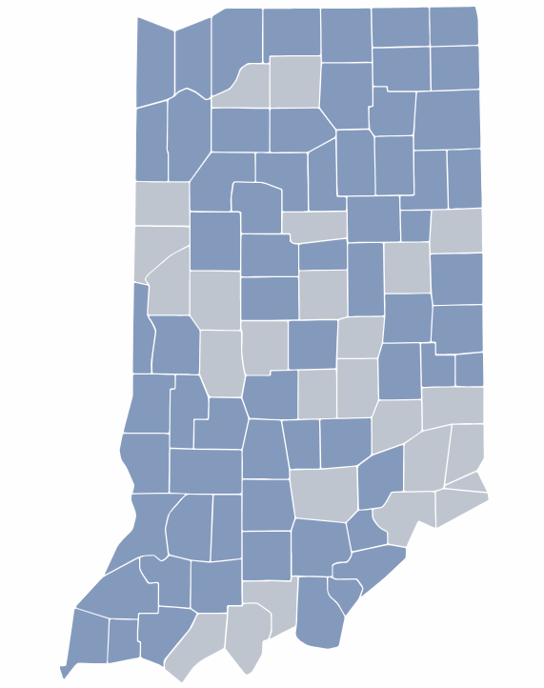
Porter County Infant Mortality Rate 5th Lowest in Indiana (5 year average 3.8 deaths/1000 live births).
PCHD will oversee FIMR team in Porter County.
Have identified FIMR team lead who will train through IDOH for the next few months.
Working to identify the remainder of the team to begin case reviews in 2024.
Through medical review and maternal interviews, goal is to understand how the following issues relate to infant mortality and effect change:
Social
Economic
Environmental
Educational
Health and Safety

Slide 4
Number of fetal deaths by year

Slide 5
Number of prenatal visits

Slide 6
Clinical estimation of gestation at delivery

Slide 7
Fetal attributes – weight in grams

Slide 8
Public Health Needs Assessment Update
Strategy Session 8/09/2023
SWOT analysis with Community Resource Network 08/25/2023
One-on-one interview candidates and stakeholder group participants were identified and Pyrce group intro letter were sent 9/13/2023
As of yesterday afternoon, 9 one-on-one interviews have been scheduled for the upcoming weeks, including:
4 of our large healthcare systems and Porter Starke
5 community partners

Slide 9
Care Coordinator Update
Porter County Council approved new position and pay status on September 19th to be hired in 2023 and paid from Health Fund 1159
Position was posted on September 25th
As of this morning, we have 45 applicants
All current applicant submissions have been reviewed and we have selected 6 candidates that we will invite to interview next week for the first round of interviews.
The hope is to have someone in the position by the first week in November.

