Slide 1
Public Library Budgeting in Indiana for Library Staff
Karen Ainslie
Public Library Consultant
Indiana State Library / Library Development Office
kainslie@library.IN.gov
Notes:
This is an overview of public library budgeting in Indiana. Budget is a planning tool and tells how the library manages the money as it relates to library services Budgeting is a year round exercise. This webinar covers the topics of the budget that includes the Gateway forms, form 1 Budget Estimate and form 2 Miscellaneous Revenue. Understanding expenditures and revenues as laid out on the Gateway forms tells you where the money is coming in and where it is going out. Attention is given to the categories where money is expended. I present expenditure data as percentages, the allocation to the library resources.

Slide 2
Gateway Forms
Form 1 Budget Estimate
Form 2 Estimate of Miscellaneous Revenues
Notes:
Money in the budget is expended in several categories. To plan the budget requires an estimate of expenditures in these categories. There several types of revenue that fund the library. The public library is funded primarily by property tax money; the other money received is from miscellaneous tax such as sales tax and some local income tax and the revenue the library generates itself.

Slide 3
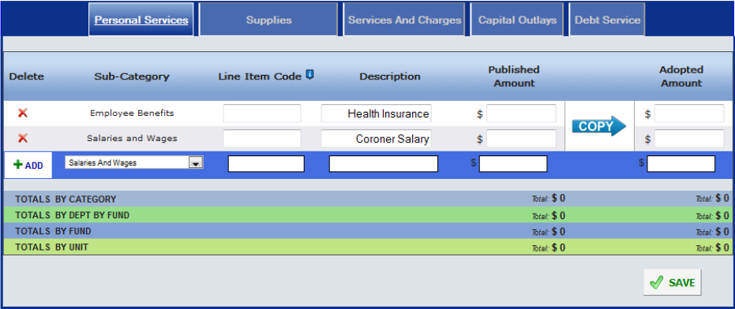
Form 1 Budget Estimate
Notes:
On the Gateway Form 1 are the budget estimate, the library expenditures for personal services, supplies, services and charges and capital outlays. You see the categories on each tab of this form.

Slide 4
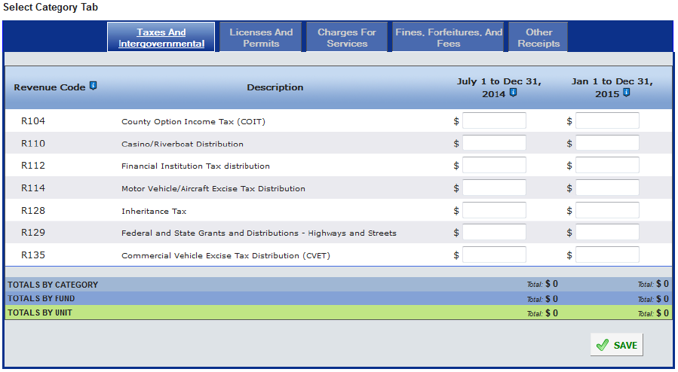
Form 2 Estimate of Miscellaneous Revenues
Notes:
The public library is funded primarily by property tax money; other money received is from miscellaneous tax such as sales tax and some local income tax. You can see some of those taxes on this slide: County Option Income Tax (COIT), Financial Institution Tax, Commercial Vehicle Excise Tax Distribution (CVET). You may hear your director talk about receiving certified shares each month. These are some of the miscellaneous taxes. The property tax money is received twice a year: June tax draw and a December tax draw.

Slide 5
Budget Estimate-Financial Statement-Tax Rate Report
Sometimes referred to as Form 4B
Sample Budget with total budget for incoming year of $876,000
Need to raise tax levy of $616,572
Tax rate is .1521
Notes:
Once you input form Gateway 1 and Gateway form 2, the numbers feed into the form 4B that calculates the tax rate. It's nice that the Gateway does all the math now. The director and fiscal body determine the levy required and the form computes the tax rate.

Slide 6
Gateway: Annual Financial Report
Expenditures or disbursements
https://gateway.ifionline.org/report_builder/Default2.aspx?rptType=afr
Notes:
On the one end you see how the information is inputted to find out your budget, your tax levy and tax rate; on the other end of the Gateway you can see how the public library spends their budget in 2014. Remember this information is reported by March 1 of the following year. So the 2015 data won't be available until March 2016. So what we show here is the data from 2014.

Slide 7
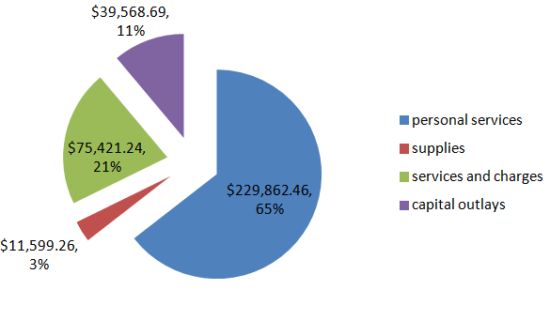
Allocation of Expenditures in 2014
Notes:
A graph can tell a story based on expenditures found in Gateway. This is created from Detailed Disbursements for Funds in 2014 for the Operating Fund for a public library district. The Professional Services includes expenditures for utilities and other consulting services plus communication and transportation as well as health insurance. Those can be large expenditures. The capital expenditures are the material budget and other capital expenses.

Slide 8
Library Budget
Personnel: 60% to 70%
Materials: 15% to 20%
A library expending at least seven and five-tenths percent (7.5%) of its operating fund expenditures for library collections shall meet basic standards for collection expenditures.
Supplies: 2% to 3%
Notes:
Looking at data we can get some idea of what percentage is spent on what category. In general terms the categories break down along these lines for percentages with personnel being the largest expenditures followed by materials and then finally, supplies. On the previous slide, you may have noticed that the largest piece of the pie was spent of personnel services, where it was listed as 65%.

Slide 9
Forecasting: External Factors
Local unemployment
Business growth or recession
Impact of Property Tax Caps 2014
http://www.in.gov/dlgf/9354.htm
Pay 2014 (1782 Notice)
Tax losses
Hoosier Data at www.hoosierdata.in.gov
Notes:
So far I focused on internal factors for calculating the budget. There are a number of external factors that effect the public library budget. It’s the economy as well as assessed value on properties and the property tax cap impact. The recession that began in 2008, the implementation of tax caps resulted in tax losses.

Slide 10
Budget Guess Work
Estimate revenues low even by half
Keep strong operating balance
Policy for fund balance
50% half way through year
Grow your budget by growth quotient
Target Max Levy
Notes:
On the Gateway Form 4B the critical numbers are the tax rate, levy and total budget estimate. It is important to estimate the revenues low even by half. The DLGF cannot give you more than you ask for. So in the guestimate you want to be on the side of getting the levy and tax rate you need. And there are problems knowing actual numbers. Therefore estimate 85% for previous year AV; you do not know what AV to expect and if the number is too high, then your tax rate is too low. Make sure requested levy is high enough; PRTC is assumed to be zero when planning. For example, add 10% to levy. Yes, your tax rate will be determined by the AV and Levy and will be high compared to what you actually receive. This helps you get what you need. This all goes towards getting the max. Once you lose it, that is below the max levy, you never have the ability to get it back. The effect of losing this ground is that some libraries haven't been able to maintain their facility. If you have to bond to fix the building you may end up paying more. And loans cost taxpayers money that is not used for services.

Slide 11
Budget Calendar
18 month plan
July 1 you know the June balance
Early September submit proposed 2016 budgets, tax rates and tax levies to appropriate fiscal body for review
October 23 last possible date to hold public holding 10 days before adoption
November 2 Deadline for taxing unit to adopt 2016 budgets, tax rates and tax levies
Notes:
The budget planning follows a calendar. You begin six months before the following calendar year. Once you know the balance on the June ledger then begin planning the budget. Gather information from the auditor and your records regarding miscellaneous revenues and expenditures. Make adjustments up or down in categories, estimate budget. Target budget estimate, required levy and the target tax rate.
The budget follows a process of advertisement and public hearing during the months of September and October.

Slide 12
Department of Local Government Finance
November 4 last day for library to submit 2016 budgets, tax rates and tax levies.
February 15, 2016 the DLGF certifies 2016 budgets, tax rates and tax levies
Notes:
The public hearing is followed by the budget approval by the library board; and this happens in late October. The budget process ends in November with the submission of the budget documents and certification by the board to the DLGF.

Slide 13
Budget Year 2016
Segregation of Duties
Bonded Treasurer
Safeguard Cash
Monitor cash flow
Notes:
This has been a brief overview of the budget process with the high points. If you have any questions you can direct them to me, Karen Ainslie at the Indiana State Library either at kainslie@library.IN.gov or you can call the 1 800 451-6028 number. But the final message I want to leave with you is that in the following year, budget year 2016, you must pay attention to the segregation of duties, those people handling the money, make sure the treasurer is bonded. Safequard the cash e.g. lock it up in a safe. And monitor your cash flows to make sure you are on target, not running behind or too far ahead. With that being said, thank you for listening.

