Slide 1
Copyright Law for Libraries
A simplified lecture
Mohamed Amin
J.D Candidate, 2023
IU McKinney School of Law
Fall 2022, PLSG Student Extern

Slide 2
Presentation Agenda
Why Librarians should understand copyright law
The Reach of Copyright Law
Understanding Copyright Ownership
The Meaning of Fair Use
Libraries and Section 108
Library Copyright Fool Proof Checklist
Questions

Slide 3
Why Librarians Should Understand Copyright Law

Slide 4
The Reach of Copyright Law
The sources and the scope.

Slide 5
The Sources of Copyright Law
Federal and State Laws
Constitution:
Copyright Clause: U.S Const. Art 1, Section 8
“the Congress shall have power to promote the progress of science and useful arts by securing for limited times to authors and inventors the exclusive right to their respective writings and discoveries.”

Slide 6
The Sources of Copyright Law
U.S Copyright Act of 1976: Covers the entirety of modern-day copyright law.
Balanced the needs of both owners and users of protected works.

Slide 7
The Sources of Copyright Law
Court Decisions
State Law
Regulations

Slide 8
The Scope of Protected Works
Golden Rule: Copyright applies automatically to original works that are fixed in a tangible medium of expression. Section 102(a).
Let’s break this down:
Automatic
Originality and Creativity
Fixed in a Tangible Medium

Slide 9
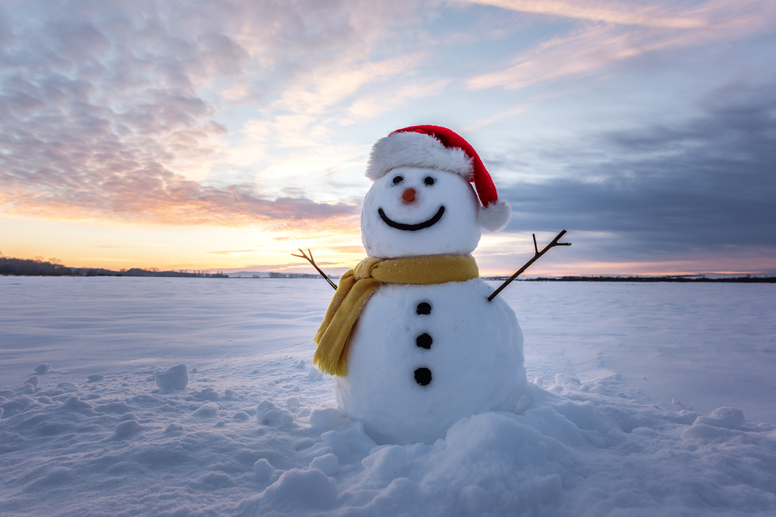
Scenario #1
Mohamed wanted to show his local community how much he loves winter. When it snowed, he built a snowman and made a happy face on it. When his neighbor tried to do the same, Mohamed threatened to sue him for infringement. Is it?

Slide 10
Scenario #2
Mohamed wrote a 12-page short horror story inspired by the Stephen King novels. He made sure he added his own twists and story to it. Stephen King found this out and threatened to sue him. Is this infringement? If not, would Mohamed have to go register this story at the U.S Copyright office?

Slide 11
Scenario #3
Mohamed began rubbing his eyes profusely and was astonished when he spotted these “floaters” in the sky. He wants to claim it as his discovery and receive copyright protection. Can he?

Slide 12
Categories of Protected Works
Section 102A of the Copyright Act → outlines all protected categories of works
What is not protected?
U.S Government works (different rules for state and local governments) https://copyright.lib.harvard.edu/states/indiana/
Ideas, discoveries, and facts
Public domain and Expired Copyrights

Slide 13
Quick note about the Public Domain
No existing copyright protection, belongs to the public.
Safe to use for any reason, nobody can sue you for infringement.

Slide 14
Expired Copyrights
If a work’s protection has expired → enters the public domain.
All protected works go through this cycle.

Slide 15
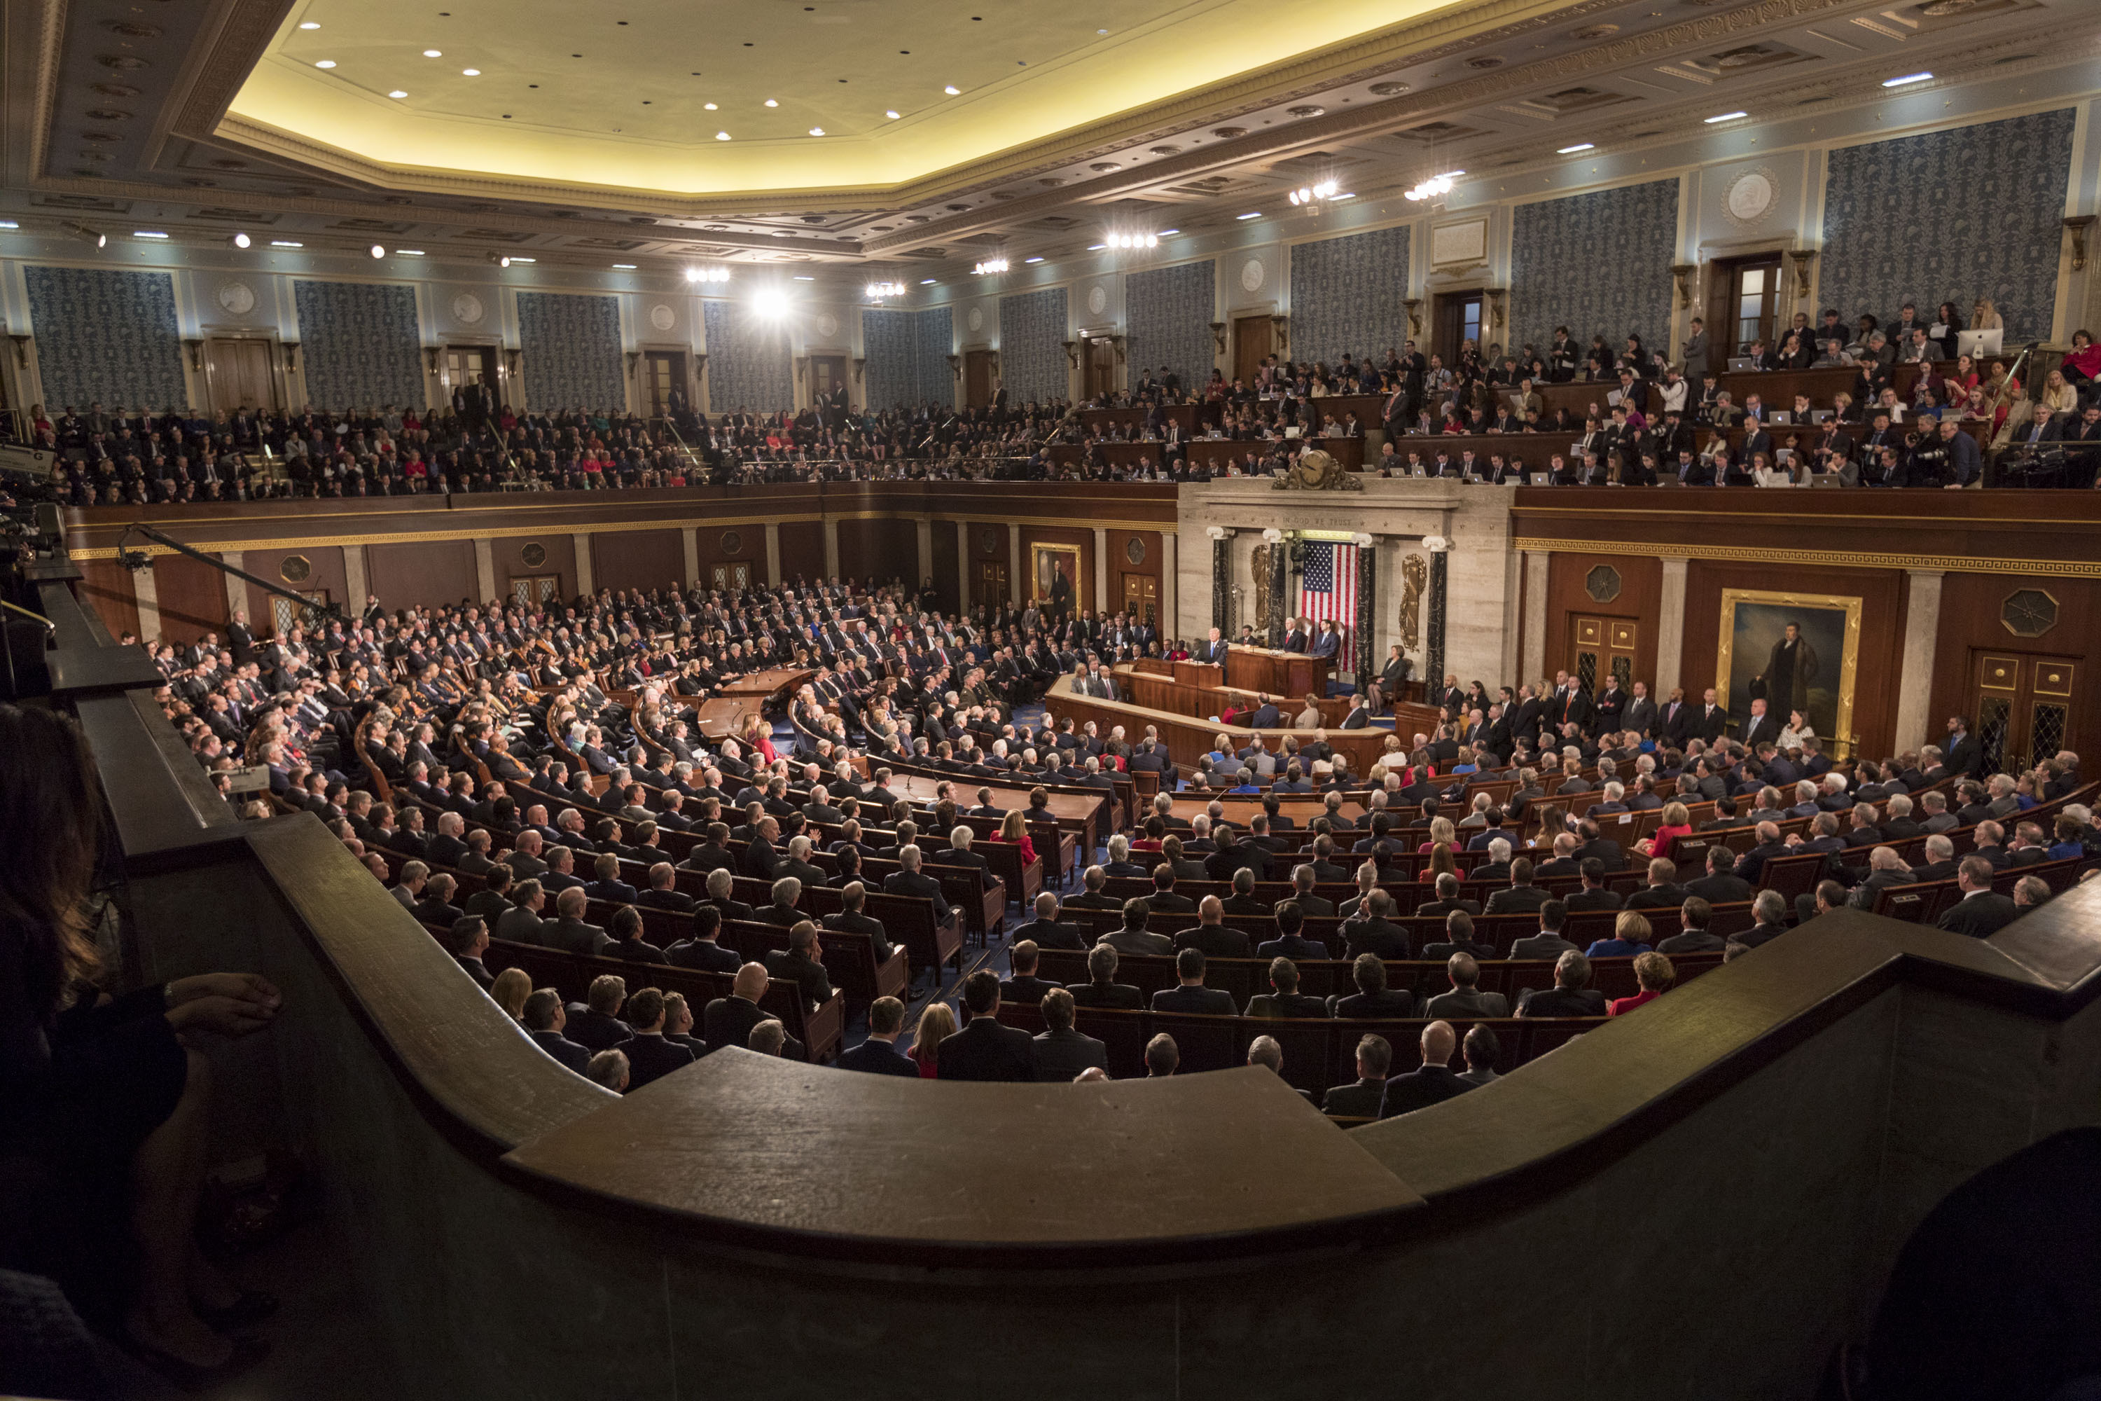
Scenario: #4
Mohamed watched the 1985 State of the Union Address by President Ronald Reagan on YouTube. He decided to write a blogpost that featured the entire transcript of the speech. When Reagan’s estate found out about this, they decided to sue him for infringement. Can they?
This Photo by Unknown Author is licensed under CC BY

Slide 16
Scenario #5
In December 2019, Mohamed found out about the existence of COVID-19 from the news. He decided to make a t-shirt that says, verbatim, “COVID-19 is a virus.” Can he copyright that?

Slide 17
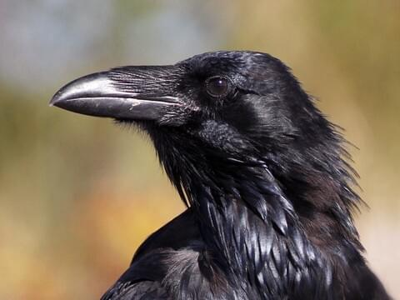
Scenario #6
Mohamed loves Edgar Allen Poe’s poem The Raven. He decided to recite it at a local poetry slam competition. Poe’s estate sued Mohamed for copyright infringement. Did Mohamed infringe?

Slide 18
Rights of Ownership
Duration, Formalities, exceptions to the rights of those owners.

Slide 19
Duration of a Protected Work
Golden Rule: Works are protected for the life of the author plus another 70 years.
Scenario: Mohamed wants to create a theatrical adaption based on the novel “Gone Girl.” The author of Gone Girl is still alive, and she published the novel in 2012. Is the work still protected?

Slide 20
Formalities---No longer required.
The formalities of notice and registration to protect a work are no longer needed.

Slide 21
Transfer of Copyright Ownership
A person can transfer a copyright ownership to another person or entity, but it must be in writing and signed by the copyright owner.

Slide 22
Understanding Open Access, Creative Commons License, and Publication Agreements.
Open Access Publishing: freely available digital information with little restriction.
Publishing Agreements: Contracts between authors of protected works and publishers, in which the latter receives a portion of the ownership rights over the protected work.
Creative Commons License: Public licenses that owners permit in advance to the public indicating specific rights the public has when using the work.

Slide 23
Creative Commons License (CC)
You are free to:
Share — copy and redistribute the material in any medium or format
Adapt — remix, transform, and build upon the material.
However:
You must give attribution
No commercial purposes
Share alike

Slide 24
Rights of Copyright Owners
Owners of protected works have:
Exclusive rights to reproduce the work;
Distribute the work;
Prepare derivative works;
Publicly display the work;
And publicly perform the work.

Slide 25
Exceptions to the Rights of Copyright Owners
The U.S Copyright Act of 1976 has a multitude of exceptions that impede on the rights of copyright owners.
There’s about 16 statutory exemptions to the rights of ownership, most are only relevant to specific industries or entities.

Slide 26
Here are some provisions you should know about
Section 107: Fair Use
Section 108: Library Services
Section 109(a): First Sale Doctrine: Limits distribution rights of the copyright holder, once a particular copy of a work has been authorized for release by the owner, they can no longer control further distribution of the sold copies of the work.
Section 109(c): Exception for Public Displays: allows those who lawfully made a copy of the work to display it publicly.

Slide 27
The Meaning of Fair Use
The Four Factors Balancing Test

Slide 28
What is Fair Use? (Section 107)
Fair use is the right to use a copyrighted work under certain conditions without permission of the copyright owner. The doctrine helps prevent a rigid application of copyright law that would stifle the very creativity the law is designed to foster.
Section 107: https://www.copyright.gov/title17/92chap1.html#107

Slide 29
Basic principle of Fair Use
The statute provides that fair use of a work “for purposes such as criticism, comment, news reporting, teaching (including multiple copies for classroom use, scholarship, or research)” is not an infringement of copyright.

Slide 30
The Four Factors Under Section 107
the purpose and character of the use, including whether such use is of a commercial nature or is for nonprofit educational purposes;
the nature of the copyrighted work;
the amount and substantiality of the portion used in relation to the copyrighted work as a whole; and
the effect of the use upon the potential market for or value of the copyrighted work.

Slide 31
Using the factors, what do they mean?
Purpose of the use: Is your use for nonprofit, educational reasons? Or for commercial reasons? Courts strongly favor the former. A transformative use can also lean towards fair use.
Scenario: Mohamed wants to write a comic book based on the recent Marvel Movies, for his local nonprofit comic book organization. He takes plot points and dialogue from the Spiderman and Hulk movies and combines it with his own “ideas” to the comic. He plans on making no revenue when he publishes the comic book. Is he infringing on Marvel?

Slide 32
Using the factors, what do they mean?
Nature of the work: uses of factual nonfiction works are more likely to be within fair use, while fair use often applies more narrowly to creative works.
Also is the work published or unpublished? The latter is leaning against fair use.
Scenario: Mohamed wrote a comic book based off Disney’s not-yet-released movie Pinocchio 2. Is this fair use?

Slide 33
Using the factors, what do they mean?
Amount of the work used: the less the amount of the work used, the more likely it is for fair use to apply. A basic measurement is not clarified, but courts tend to ask: are you using the “heart” of the work?
Scenario: Mohamed wanted to write a book about his time at law school, and within that book, he added verbatim Neil DeGrasse Tyson’s entire speech on astrophysics from 2008, totaling at around 22 pages. Is this fair use?

Slide 34
Using the factors, what do they mean?
Effect on the market or value: does the use harm the market for the copyrighted work or its value? Uses that compete with the original work’s market will be more likely to be denied fair use.
Scenario: Mohamed loves The Hunger Games franchise. To show his support for the franchise, he created t-shirts featuring the cover-art of The Hunger Games novel; with his luck, the t-shirts became successful and outsold the entire million-dollar HG t-shirt lineup created by the franchise company. Is this fair use?

Slide 35
Fair Use Scenario: Library Edition #1
To honor Native American Heritage Month, your local library decides to host a children’s book “read-aloud” for the local community. The book used for the read aloud was written by famous Native American activist Suzanne Blueriver. Your library did not bother reaching out to Sylvia Watson for help, and instead proceeded with the children’s read-aloud, and even recorded the event. Blueriver got wind of this event and sued your library for copyright infringement. Will she prevail?

Slide 36
Fair Use Scenario: Library Edition #2
A new, scandalous memoir written by the ex-wife of a famous politician was released, and your local library received a generous copy to place on your shelves for the public to use. Your library knows how popular this memoir is and decides to “cash-in” on the popularity by using the cover photo of the book in their promotional poster for the next book club meeting, which charges $20 admission. Is this infringement?

Slide 37
Libraries and Section 108
Libraries’ right to make copies of protected works

Slide 38
Section 108: Another exception to the rights of owners of protected works---but given to libraries.
Provides for libraries & archives to make reproductions of copyrighted works, under certain conditions, without seeking permission from the copyright holder. Two major purposes: preservation and replacement.
The library or archives must be open to the public (or to any specialized researchers, regardless of affiliation)
A copyright notice must be included on each reproduction
Any reproductions in digital form may not be distributed or made available to the public outside of the library or archives
Reproductions are not made for direct or indirect commercial advantage

Slide 39
Scenario: Libraries and Section 108
A strange, closed-off secret library recently opened in the basement of an abandoned Taco restaurant. They specialize in displaying books that are in the fantasy genre. The library’s employees want more copies of Harry Potter and the Goblet of Fire, which doesn’t have any notice on it. Also, bizarrely, the library charges a “rental” fee of the book, $10 per day. Can they make copies?

Slide 40
Libraries can make copies for…
Preservation: Up to 3 copies of an unpublished work may be made for preservation or security purposes, if the work is already part of the library’s or archive’s collection.
Scenario: Your library’s Special Collections owns a small collection of unpublished photographs of buildings by an important local architect. Several have been damaged or have disappeared over the years. The library would like to create viewing copies so that the originals can be preserved.

Slide 41
Libraries can make copies for…
Replacement: Up to 3 copies may be made to replace a published work that has been lost, stolen, damaged, is deteriorating or is manifest in an obsolete format* if an unused replacement is not available at a fair price.
Scenario: Your library owns an out-of-print 1972 documentary on a local historic district on ¾ inch U-matic tape.. You would like to transfer it to DVD, as your ¾ inch tape player is no longer functional, and a new player is unavailable.

Slide 42
Copying and Signs
Libraries have limited liability if a patron uses library equipment (like a scanner, copy machine) to violate copyright law if the library posts a notice on the equipment.
Signs should also be posted wherever librarians take orders for making copies.
The signs on copying equipment must have very precise language.

Slide 43
Library Copyright Fool-Proof Checklist
Step 1: Is your library an owner of copyright? If yes, apply Section 106 and 106a provisions.
Step 2: Is your library wanting to use a copyrighted work? If yes, apply Section 107, Fair Use Balancing Test. If test fails, move onto Step 3.
Step 3: Try to find another exception under the Act, like Section 108 or Section 109. If not, move onto Step 4.
Step 4: Ask the owner of the copyrighted work for permission. If not, start over with another copyrighted work, either your own or a work you want to use.

Slide 44
Questions?

