Slide 1
State Library
Introduction to the 2026 Pay 2027 Budget Cycle
Ryan Burke
May 21, 2026

Slide 2
Disclaimer
This presentation and other Department of Local Government Finance materials are not a substitute for the law. The following is not legal advice, just an informative presentation. The Indiana Code always governs.

Slide 3
Agenda
New Legislation Webinar
Maximum Non-Binding Budgets (Ind. Code § 6-1.1-17-20.3)
Public Library Eligibility for Binding Review by Fiscal Body Resolution (Ind. Code § 6-1.1-17-20.4)
Abridged Budget Calendar
Department Resources
“Budgets 2.0” Demo

Slide 4
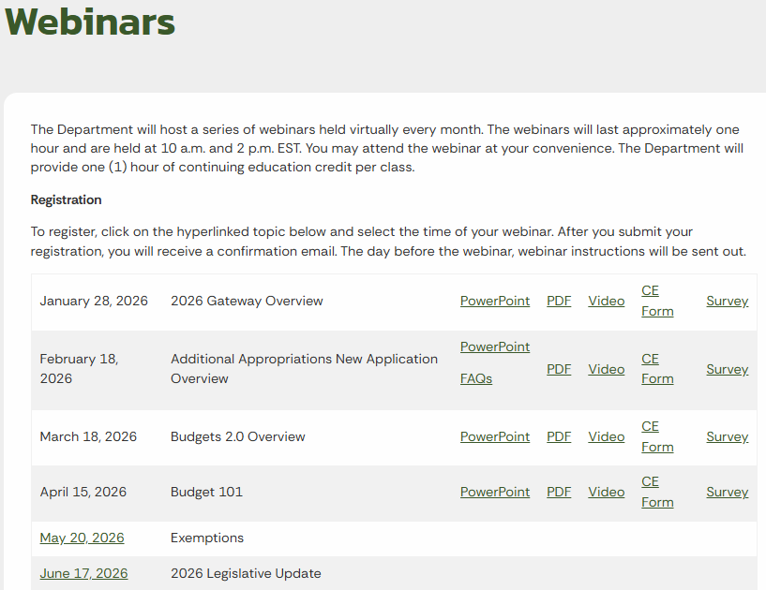
Legislative Overview Webinar
On June 17, the Department will be holding a legislative overview webinar.
Sign up for the webinar at:
  https://www.in.gov/dlgf/continuing-education/webinars/
The webinar will be recorded and posted shortly after.

Slide 5
Maximum Non-Binding Budgets for Libraries

Slide 6
Maximum Non-Binding Budgets for Libraries
Libraries are unique as it relates to determining the appropriate fiscal body that is responsible for adopting their annual budget.
Annually, libraries will determine whether the budget will be adopted by the library board or an appropriate county, city, or town fiscal body.
The determination will be based on the:
  Current year Department certified budget.
  Maximum Levy Growth Quotient (MLGQ)
  Ensuing year advertised budget.

Slide 7
Maximum Non-Binding Budgets for Libraries (Change for Pay 2027)
Ind. Code § 6-1.1-17-20.3 states that a public library is subject to binding review if its proposed upcoming year’s budget is increased by a certain percentage compared to the previous year’s budget. As amended by HEA 1406-2026, the threshold is the percent increase that is the result of:
  the MLGQ, rounded to the nearest thousandth (0.001);
    minus one (1);
    multiplied by five-tenths (0.5).
For example, assume that for the upcoming budget year, the MLGQ is 1.05. Following the order of operations above, the percent increase that would determine whether a public library’s budget is subject to binding review is 0.025 or 2.5%.

Slide 8
Maximum Non-Binding Budgets for Libraries (Change for Pay 2027)
Library boards wanting to advertise and adopt their own budgets and levies, may not increase their budget by half of the MLGQ or more.
In the next two examples for the ensuing year, the library board will have the authority to advertise and adopt any budget less than or equal to the calculated maximum amount.
Any budget advertised for more than this maximum amount, must be adopted by the appropriate county, city, or town fiscal body.

Slide 9
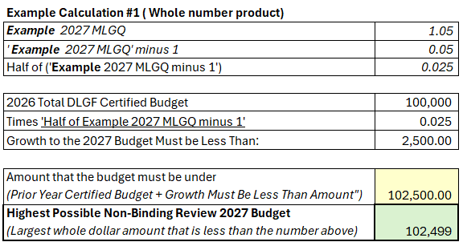
Maximum Non-Binding Budgets for Libraries (Change for Pay 2027)

Slide 10
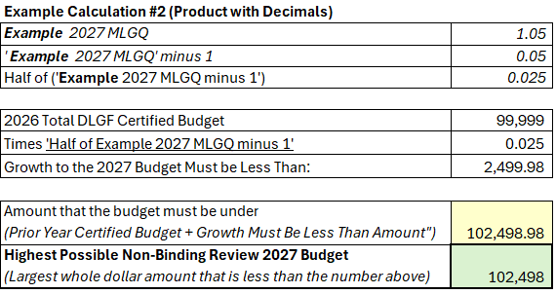
Maximum Non-Binding Budgets for Libraries (Change for Pay 2027)
The Budget application doesn’t accommodate the budgeting/advertising of cents in budget.
In this example, the “Amount that the budget must be under” contains cents.
In these cases, rounding down would be sufficient to not exceed the maximum amount.

Slide 11
Maximum Non-Binding Budgets for Libraries
The Department notes that the library may advertise a budget of any amount, but if the library in this example advertises a budget that is greater than the maximum, then the library becomes subject to a binding budget adoption.
For binding libraries, the appropriate fiscal body of the city, town, or county (whichever applies) shall review and adopt each budget and tax levy for the public library.
The fiscal body may reduce or modify but not increase the proposed budget or tax levy.

Slide 12
Maximum Non-Binding Budgets for Libraries
After the budget adoption by the appropriate fiscal body, the budget will be reviewed and certified by the Department.
If the advertised budget does not exceed maximum non-binding review budget, then the library board will be able to adopt their own budget.
For the following budget cycle, the budget control will default back to the library board.

Slide 13
Maximum Non-Binding Budgets for Libraries
The Department created a report specifically for libraries that will outline the maximum budget amount.
The Pay 2027 Library Report will be posted by July 15, 2026 at:
    https://www.in.gov/dlgf/county-specific-information/
  This excel spreadsheet will display the detailed calculation after you select your county and library.
Budget 2.0’s Unit Questions page will ask libraries if they are pursing a binding or non-binding review. If a library selects that it is pursing a non-binding review, a library will not be able to mark Form 1 as complete if the budget exceeds the maximum non-binding amount.

Slide 14
Maximum Budgets for Libraries – FAQ #1
If I accidently advertise too high, can I just readvertise a lower amount so that I’m not binding?
  Ind. Code § 6-1.1-17-20.3(d) outlines that binding units, including certain libraries, must submit their budget to their appropriate fiscal body no later than September 1*.
  A library may correct their advertised budget to avoid a binding adoption if it is readvertised by September 1. On September 2, the Form 3 can be changed, but the change will not change the appropriate adopting body.
  *If September 1 falls on a weekend or legal holiday, the deadline is extended until the next business day.

Slide 15
Maximum Budgets for Libraries – FAQ #2
Does that mean that a library cannot update any of their budget forms after September 1?
  A library may make updates to any of their budget forms throughout the process but must be aware of the impact that the changes have on their advertised budget on the Form 3.
  If the changes cause the library to advertise over their maximum budget, they will need to work with the appropriate fiscal body to have their budget adopted.
  Libraries advertising a budget over their maximum non-binding amount will have read-only access after September 1.

Slide 16
Maximum Budgets for Libraries – FAQ #3
When calculating the maximum budget for the ensuing year, do I include my home rule or gift funds?
  No, The maximum budget is calculated exclusively using the budgets for funds certified by the Department on the budget order.
  This includes, but is not limited to the General, LIRF, Rainy Day, and/or any debt funds.

Slide 17
Maximum Budgets for Libraries – FAQ #4
Is the Department considering the advertised budget (Form 3), the adopted budget (Form 4), or the certified budget?
  When calculating the maximum budget, the Department is using the certified budget amount found on the budget order.
  The advertised and adopted amounts are not considered for this calculation.

Slide 18
Maximum Budgets for Libraries – FAQ #5
What impact do approved additional appropriations have on the “maximum budget calculation”?
  The maximum budget calculation only considers the total budget amount listed on the Department budget order and the max levy growth quotient.
  If a library had an approved additional appropriation during the budget year, it is not factored into the calculation.

Slide 19
Public Library Eligibility for Binding Review by Fiscal Body Resolution

Slide 20
Binding Review by Fiscal Body Resolution
Libraries are unique as it relates to determining the appropriate fiscal body that is responsible for adopting their annual budget.
In the prior section, we examined how the budgeted amount a library advertises may impact its authority to adopt its own budget.
In this section, we will examine how the fiscal body of a county, city, or town may require a library to become subject to binding review (Ind. Code § 6-1.1-17-20.4).

Slide 21
Binding Review by Fiscal Body Resolution
A library will be subject to a binding adoption if both conditions below are met:
  Based on the Annual Financial Report (AFR), if the library’s cash balance of all funds derived from tax revenue is greater than one hundred fifty percent (150%) of the library’s certified budget for the ensuing year.
  If the appropriate fiscal body for the library advertises a public hearing to make the library subject to binding adoption and adopts the resolution not later than July 1.

Slide 22
Binding Review by Fiscal Body Resolution
The fiscal body of the city, town, or county may not reduce a public library's proposed budget or levy in a budget year by more than ten percent (10%) of the public library's operating levy in the immediately preceding budget year.
The library will be subject to binding review until the December 31 cash balance of all funds of the public library derived from tax revenue, as reported on the AFR, no longer exceeds one hundred fifty percent (150%) of the library's certified budget.

Slide 23
Budget Calendar

Slide 24
Budget Calendar
The Department has posted its 2026 pay 2027 budget calendar. The calendar contains the statutory submission/due dates for some of the key deadlines for the budget certification process.
Units are encouraged to use the budget calendar as a starting point for creating a unit specific calendar.
  https://www.in.gov/dlgf/files/2026-memos/260218-Culy-Memo-2026-Budget-Calendar.pdf

Slide 25
Budget Calendar – June 2026
The Pre-Budget Worksheet has been replaced with the Unit Questions and Debt Worksheet (if applicable) in Budget 2.0.
  The Budget 2.0 application is estimated to launch in early June.
  These pages are to be completed by June 30.
  The Department incorporates this data into their July estimates.

Slide 26
Budget Calendar – June 30
Deadline for State Budget Agency (“SBA”) to provide the MLGQ to civil taxing units, school corporations, and the Department. (Ind. Code § 6-1.1-18.5-2(d))

Slide 27
Budget Calendar – July 15
Department will provide each unit with an:
  Estimate of the maximum amount of property taxes that may be levied in the ensuing budget year.
  Estimate for non-property tax revenues for FIT, CVET, and Excise.
  Estimate for circuit breaker loss for the ensuing year.
Department will provide each library with:
  The “Library Estimated Maximum Budget Report” based on the MLGQ and the certified budget amount.

Slide 28
Budget Calendar – August 1
Last day for county auditor to certify net assessed values (“CNAV”) to the Department.
  The Department will make assessed values (“AV”s) visible to every political subdivision via Gateway.
  All units are encouraged to use Gateway’s public site to validate the AVs certified by the county auditor.
  https://gateway.ifionline.org/report_builder
Notes:
Tax Cap deadline = (Ind. Code § 6-1.1-20.6-11.1)
Tax Cap = The report will be posted on the Department's website and the values will be loaded onto the Form 3 in the Gateway – Budget.

Slide 29
Budget Calendar – September 1
Last day for units with appointed boards, including certain libraries, to have the proposed 2027 budgets, tax rates, and tax levies entered into Budget 2.0 for the appropriate fiscal body to conduct the binding adoption.
Pertains exclusively to units that are subject to binding review, libraries that prepare a budget in excess of the maximum allowable, and libraries whose fiscal body adopted a resolution no later than July 1.

Slide 30
Budget Calendar – Last Action Dates
October 13: Last day to post a notice to taxpayers (“Budget Form 3”) of proposed 2027 budgets, net tax levies, and a public hearing to Gateway.
October 23: Last possible day for most taxing units to hold a public hearing on their 2027 budgets.
November 2: Deadline for all taxing units to adopt 2027 budgets, tax rates, and tax levies.

Slide 31
Budget Calendar – Budget Order Dates
December 31
  Deadline for the Department to certify 2027 budgets, tax rates, and tax levies unless a taxing unit in a county is issuing debt after December 1 in the year preceding the budget year or intends to file a shortfall appeal.
January 15
  Deadline for the Department to certify 2027 budgets, tax rates, and tax levies if a taxing unit in a county is issuing debt after December 1 in the year preceding the budget year or intends to file a shortfall appeal.

Slide 32
Resources

Slide 33
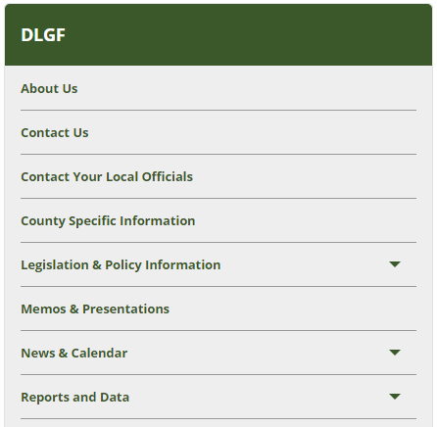
Memos & Presentations
The Department maintains a listing of the communications and legislative guidance from the last 5 years.
This section of the website is where the following memos and more are posted:
  Budget Calendar
  Additional Appropriation
  Various Department presentations
This page can be accessed by going to www.in.gov/dlgf and selecting “Memos and Presentations”.

Slide 34
County Specific Information
In addition to the written guidance, the Department posts various calculations summarized by county.
This includes budget orders, maximum levies, estimated circuit breaker report, and the Library Maximum Budget Report.

Slide 35
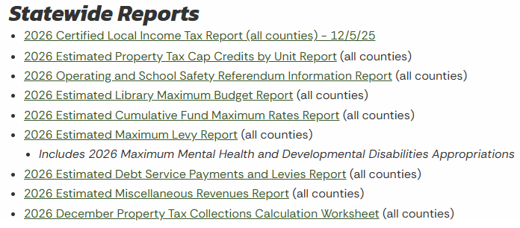
County Specific Information
The Department will issue the following reports on the County Specific Information page.
Not all reports will apply to all unit types.

Slide 36
Budget Workshops
One of the most important resources available are the Budget Workshops held from July 15 through early September.
Many units can:
  Work through a majority of the budget forms with their Budget Field Representative.
  Learn to evaluate their proposed budget to understand if it is fully funded and if not, options to adopting a funded budget.
  Receive a checklist that provides a detailed walkthrough of the remainder of the budgeting process that highlights important deadlines.

Slide 37
Budget Workshops
Be sure to carefully review the list of required documents in the invitation that largely includes:
  June 30 cash balances and expenditures
  Next year’s budget (Form 1) completed in Budgets 2.0
  Public hearing and adoption meeting dates
Preparation is required to get the most from this 45-minute appointment.

Slide 38
Contact the Department
Gateway Support: support@dlgf.in.gov
Telephone: (317) 232-3777
Toll Free: (888) 739-9826
Website: www.in.gov/dlgf
  “Contact Us”: https://www.in.gov/dlgf/contact-us/
  Budget Field Representative Map: https://www.in.gov/dlgf/files/maps/Map-Field-Rep-Map-Budget.pdf

Slide 39
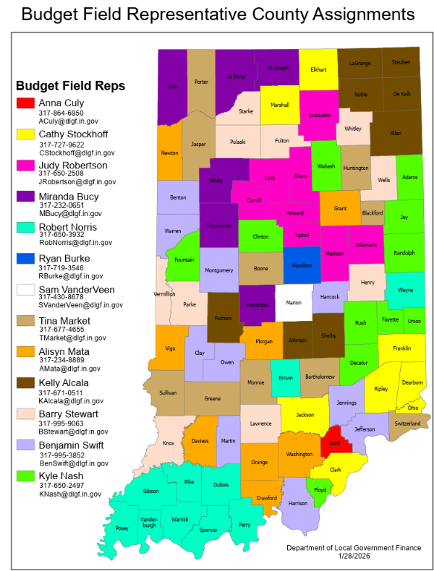
Resources Available 3
Your Budget Field Representative is your primary point of contact for Department budget matters.
While not able to provide legal or financial advice, they can:
  Explain changes in procedures.
  Identify resources available for local officials.
  Help you to avoid common mistakes made during the budget cycle.
Budget Field Rep Assignments Map.

Slide 40
Budget 2.0 Demo

Slide 41
Budget 2.0 Testing
This streamlined budget application is currently launched for testing until May 28, 2026 at Budget2.ifionline.org. Budget 2.0 is currently scheduled to launch in early June for 2026 pay 2027.
Below are some of the notable planned features The budgeting steps presented in a clear linear process.
  It will ask a few questions before certain forms to tailor the data collection process to only those that apply to you.
  Side by side comparisons of the previous year’s amounts will be available in the Form 1: Line-Item Budget Estimates and Form 2: Non-Property Tax Revenue Estimates.
  Incorporation of Department estimates available if desired.

