Slide 1
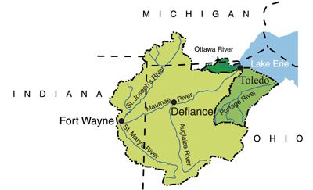
Great Lakes Water Quality Agreement Domestic Action Plan for the Western Lake Erie Basin
Public Meeting Agenda
Welcome
  Meeting purpose
  Introduction of Advisory Committee members and contributors
DAP presentation
Questions and answer session/dialogue
Wrap-up

Slide 2
Indiana’s
GLWQA Domestic Action Plan
Marylou Renshaw on Behalf of the DAP Advisory Committee
Location, Indiana
Date, 2017

Slide 3
Indiana’s Domestic Action Plan (DAP)
Background
Great Lakes Water Quality Agreement
Annex 4, Binational Subcommittee
Commitments
DAP elements
Notes:
To provide context for the DAP

Slide 4
Background
1972 Great Lakes Water Quality Agreement (GLWQA)
GLWQA between the U.S. and Canada to protect, restore, and enhance water quality of the Great Lakes and to prevent further pollution and degradation http://www.ijc.org/en_/Great_Lakes_Water_Quality
Amended 1978, 1983, 1987 and 2012
ANNEXES
Areas of Concern Lakewide Management Chemicals of Mutual Concern Nutrients Vessel Discharges | 6. Aquatic Invasive Species Habitats and Species Groundwater Climate Change Impacts Science

Slide 5
Background
Annex 4, Nutrients Binational Subcommittee
Charged with coordinating binational actions to manage phosphorous (P) concentrations and loadings in the Waters of the Great Lakes.
Start with Lake Erie and apply the lessons learned through DAP development process to the other Great Lakes.
Indiana has been an active member since its establishment in 2013.
Notes:
, and other nutrients if warranted,
Me
Rick Duff
Jeff Frye
Note: Indiana will serve on Lake MI
Cyndi Wagner

Slide 6

Background
ANNEX 4 COMMITMENTS
February 2016: establish binational P objectives, loading targets and allocations for the nearshore and offshore waters.
Assess regulatory and voluntary measures to reduce P.
February 2018: develop a binational P reduction strategy and DAPs to meet P objectives and loading targets for Lake Erie.

Slide 7
Background
DAP ELEMENTS
Identify implementation targets toward meeting Lake Erie Ecosystem objectives.
Provide focus for allocation of resources.
Identify actions and potential policy/program needs.
Outline measures/methods to track progress
Notes:
Each state (Indiana, Michigan, New York, Ohio, and Pennsylvania) and the Province of Ontario agreed to follow a standard outline to develop DAPS by 2018 that at a minimum will

Slide 8
Indiana’s Domestic Action Plan (DAP)
DAP Advisory Committee and development process
WLEB focus and goal
Indiana’s portion of the WLEB- land use and P sources
Watershed prioritization
Guiding Principles
Major actions
Action/Milestone Table
Tracking progress
Future endeavors and resource/research gaps
Outreach and stakeholder engagement

Slide 9
DAP Advisory Committee
CONFIRMED MEMBERS | PARTICIPATING as TIME ALLOWS
Allen County SWCD | Adams Co. SWCD
City of Auburn MS4 | Allen County MS4
City of Fort Wayne Utilities | City of Fort Wayne (other divisions)
DeKalb Co. SWCD | Hoosier Environmental Council
IDEM | NRCS (Steuben Co.)
IDNR LARE Program | Producers
Indiana Farm Bureau | Steuben Co. SWCD
Indiana Pork Producers, Producer | The Andersons Inc. (agribusiness)
IPFW, St. Joseph Watershed Alliance, Tri-State Watershed Alliance
ISDA
NRCS
Purdue University
Sierra Club
The Nature Conservancy
USDA Agricultural Research Service
USGS
Notes:
Invitations sent in February/March, 2016
Introductory meeting in April with scope of work, commitment of time, call for active members (name switched from “steering” to “advisory” committee
Confirmation of participation in May
? advisory committee meetings, 2 conference call calls

Slide 10
DAP Development Process
  Decision-making: strive for consensus, all voices are equal, majority rules with dissenting opinions or positions noted.
  A dynamic document that builds on existing strategies, plans, research and work underway by all sectors in the WLEB.
  Data driven but not deterred or deferred by the inconclusive or unknown.
Notes:
5 advisory committee meetings, 1 conference call
Next meeting scheduled for March 10th
What makes this different- Start with Lake Erie & work upstream; target loads; measuring progress

Slide 11
DAP Development Process
  Evaluation criteria for proposed approaches
    Effect the most change with least cost.
    Prioritize resources to areas with the most P export and reduction potential.
    Seek to engage citizens who are unengaged or not participating in conservation efforts.
    Employ social indicators.
    Employ adaptive management.
Notes:
consider other cost: benefit analyses (research, educational, social); strategic targeting

Slide 12
DAP Goal
Meet the binational phosphorus target loads for the Maumee River as it flows across our border into Ohio.
Focus on meeting the spring-time flow weighted mean concentration of 0.23 mg/L for total phosphorous (TP) and 0.05mg/L for dissolved reactive phosphorous (DRP).
The reduction planned for the Maumee River will address Indiana’s obligation for phosphorous load reductions entering the WLEB and for the Central Basin.
Notes:
The Maumee River drives HABS in the WLEB & contributes to Central Basin hypoxia.
Determined that the most representative site for monitoring Indiana’s progress in meeting its P target loads on the Maumee is at Antwerp, Ohio. The USGS operates a stream-flow gage and an auto-sampler there and follows the recommended Annex 4 protocol collecting the necessary parameters.

Slide 13
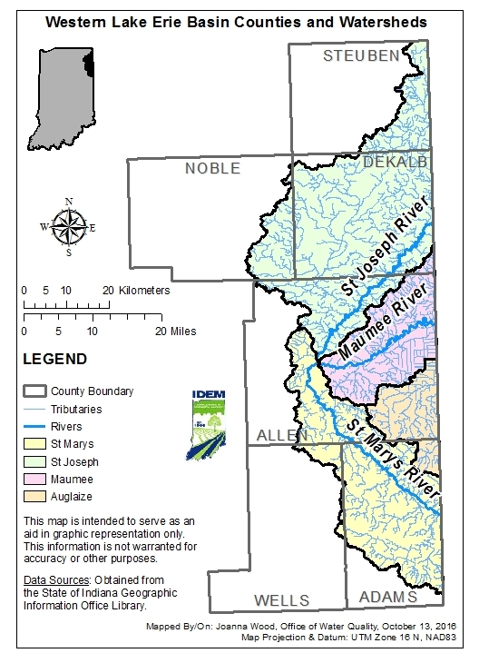
Indiana’s Portion of the WLEB
821,300 acres within 6 counties
  Steuben, DeKalb, Allen, Noble, Adams, Wells
4 watersheds drain roughly 12% of the WLEB
  St. Joseph, Maumee, Auglaize, St. Mary’s
Maumee River
  Confluence of the St. Joseph River and the St. Mary’s River near Fort Wayne
  Flows 29 miles eastward into and through Ohio for 108 miles to its mouth at Maumee Bay in Lake Erie near Toledo
Notes:
Drain to Lake Michigan &
¾ of the rest of the Indiana drains to the Mississippi River & down to the gulf.

Slide 14
Indiana Land Use in the WLEB
Landuse | Total in Acres | Percentage of Total
Agriculture | 436,100.05 | 53.10%
Hay/Pasture Land | 141,174.25 | 17.20%
Developed Land | 123,604.83 | 15.00%
Forested Land | 76,910.81 | 9.40%
Wetlands | 22,168.99 | 2.70%
Scrub/Shrub Land | 11,743.78 | 1.40%
Open Water | 9,594.56 | 1.20%
Total | 821,297.26 | 100.00%
Notes:
USDA 2012
While the distinction is made between Ag & Developed land, from a drainage standpoint, subsurface tiles cause flashiness in streams similar to impervious surfaces

Slide 15
Phosphorus Sources
Point sources account for approximately 15-20%
  Four major municipal wastewater treatment plants (WWTPs)
    TP effluent limit of 1 mg/L
    Average discharge concentration below the 1mg/L limit
  Seven combined sewer overflow communities, each with an approved long-term control plan (LTCP) or consent decree
  Thirteen designated municipal separate storm sewer system (MS4s) with approved storm water management plans (SWMPs)
Notes:
Opportunities exist to reduce P & other nutrient inputs from both urban and rural landscapes including point sources
Major- 1 MG/day
4 major: Fort Wayne, Decatur, Auburn, & Butler
CSO: Auburn, Berne, Butler, Decatur, Fort Wayne, New Haven, & Waterloo
13 MS4s: 1 in Adams Co., 11 in Allen Co., 1 in DeKalb Co. Like NPS pollution, these regulated point sources have thereir pollutant signatures during precipitation events
CFOs defined as 300 cattle, 600 swine or sheep, 30,000 fowl or 500 horses
Adams Co. = 50, Allen Co. = 12, DeKalb Co. =12, Stueben Co. = 1, Wells Co. = 3

Slide 16
Phosphorus Sources
Non-point sources account for approximately 80-85%
Modified hydrology
Land disturbing activities
Septic system failures (also behave as point source)
Agriculture
  Row crops predominated by corn and soybean rotation
  78 Confined feeding operations (CFOs)
    300 cattle
    600 swine or sheep
    30,000 fowl
    500 horses defined as
  36,000 acres are used for application of manure
Notes:
Adams Co. = 50, Allen Co. = 12, DeKalb Co. =12, Stueben Co. = 1, Wells Co. = 3

Slide 17
Watershed Prioritization
First Cut
12 IDEM fixed stations sampled monthly
Time period 2008-2015
10/12 sampling sites co-located with USGS stream flow gages or within 10% drainage area
St. Mary’s at Decatur, drainage area ratio 89%
Notes:
Mention handout
An important aspect of analyzing WQ data is quality assurance.
The USGS Load Estimator (LOADEST) model (both the Purdue Interface and USGS Desktop Application) were used to estimate annual loads and load reductions needed based on a 0.23 mg/L Total Phosphorus concentration.
Given a time series of streamflow, fixed station data and the target concentration (0.23 mg/L) LOADEST develops a regression model for the estimation of loads (calibration). The formulated regression model then is used to estimate loads over a user specified time interval (estimation). Mean load estimates, standard errors, and 95% confidence intervals are developed on a monthly and seasonal basis.
The Adjusted Maximum Likelihood Estimation (AMLE) method was used for these graphs.
The Purdue Web-based Load Calculation using LOADEST interface (https://engineering.purdue.edu/~ldc/LOADEST/) and the USGS LOADEST model were used in this analysis. The Purdue interface is easier to use but we calculated loads using both models to ensure the results were accurate.
Fixed Station data was queried from the IDEM AIMS II database.
Information from the most representative USGS stream gage was used in the LOADEST model.
Mean annual loads were estimated using data from 2008 to 2015.
Precipitation data found on the Indiana State Climate Office webpage (https://climate.agry.purdue.edu/climate/index.asp) from Station Decatur 1 N (IN) along the Saint Mary's River.

Slide 18
Watershed Prioritization at 12-digit HUC
Important for targeting the allocation of resources
Ambient water quality changes occur more quickly at a smaller watershed scale in response to targeted land-based conservation or best management practices (BMPs)
Prioritization process
  Further analysis of water quality monitoring data from:
    Allen County Soil and Water Conservation District (SWCD)
    City of Ft. Wayne
    St. Joseph Watershed Alliance & Tri-State Watershed Alliance
    USGS
  Use P export potential spreadsheet (Natural Resource Conservation Service)
  Critical areas from approved watershed management plans
Notes:
HUCs are a way of identifying all of the drainage basins (watersheds) in the US in a nested arrangement from largest to smallest. The smaller the HUC number, the larger the drainage area. For example a HUC 8 watershed is larger than a HUC 12

Slide 19
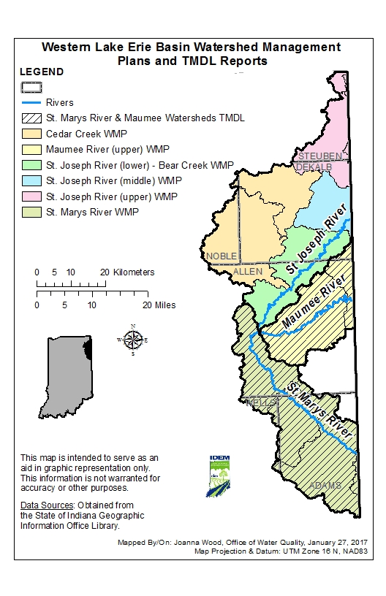
Watershed Management Plans (WMPs) and Total Maximum Daily Load (TMDL) Reports
All sub-watersheds except the Auglaize have a watershed management plan. Most also have a TMDL.
The St. Joseph tri-state TMDL is being finalized.

Slide 20
Guiding Principles for Achieving
Water Quality Improvements
Emphasis is on existing regulatory instruments and implementing voluntary BMPs.
Opportunities exist to reduce nutrient inputs from both urban and rural landscapes, including both point and non-point sources.

Slide 21
Guiding Principles: Point Sources
WWTPs will employ optimization techniques.
CSO communities will implement long-term control plans.
Stormwater Management
  MS4 communities will implement their storm water management plans and track progress.
  Construction site sediment runoff controls will be implemented according to their Notice of Intent (NOI) with stabilization covers that minimizes nutrient inputs.
  Industrial site runoff controls will be implemented according to the NOI.
Septic system installation, operation, maintenance and repair will follow the site specific design regulations.
Notes:
We are not proposing new regulations or rules at this time. We support timely inspections, compliance assistance and rigorous enforcement of existing rules and regulations.

Slide 22
Guiding Principles: Non-point Sources
The overall goals are to enhance nutrient management, promote soil health practices, and restore more natural hydrology and ecological functions
Urban landscapes: create a green infrastructure (GI) paradigm
  Promote infiltration, retention, detention, slow release.
  Support installation of larger, regional or multipurpose GI practices.
  Ensure maintenance of GI practices is included in cost estimates and budgets.
  Provide support to install rain gardens, green roofs, rain barrels, and porous pavement in industrial, commercial and residential settings.
Notes:
by promoting drainage water management and emphasizing the importance of water infiltrating where it falls
Urban: by seeking incentives & opportunities for it
Urban landscapes: seek opportunities for green infrastructure
Infiltration, retention, detention, slow release
Rain gardens, green roofs, rain barrels
Rural and agricultural landscapes
Address subsurface drainage with soil health strategies, saturated buffers
Employ drainage water management techniques with sediment and nutrient removal processes
Restore stream sinuosity and riparian buffers
Restore wetlands and floodplains
Install 2-stage ditches

Slide 23
Guiding Principles: Non-point Sources
Rural landscapes:
Restore stream sinuosity and riparian buffers.
Restore and reconnect riparian wetlands and floodplains.
Install drainage water management BMPs and saturated buffers on working lands.
Install 2-stage ditches where feasible on both regulated and non-regulated drains.
Notes:
by promoting drainage water management and emphasizing the importance of water infiltrating where it falls
Urban: by seeking incentives & opportunities for it
Urban landscapes: seek opportunities for green infrastructure
Infiltration, retention, detention, slow release
Rain gardens, green roofs, rain barrels
Rural and agricultural landscapes
Address subsurface drainage with soil health strategies, saturated buffers
Employ drainage water management techniques with sediment and nutrient removal processes
Restore stream sinuosity and riparian buffers
Restore wetlands and floodplains
Install 2-stage ditches

Slide 24
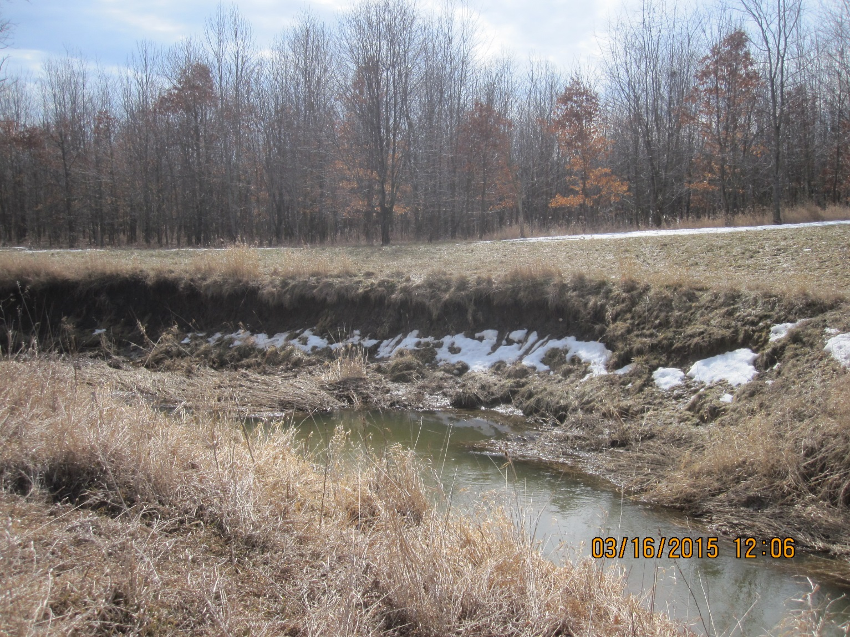
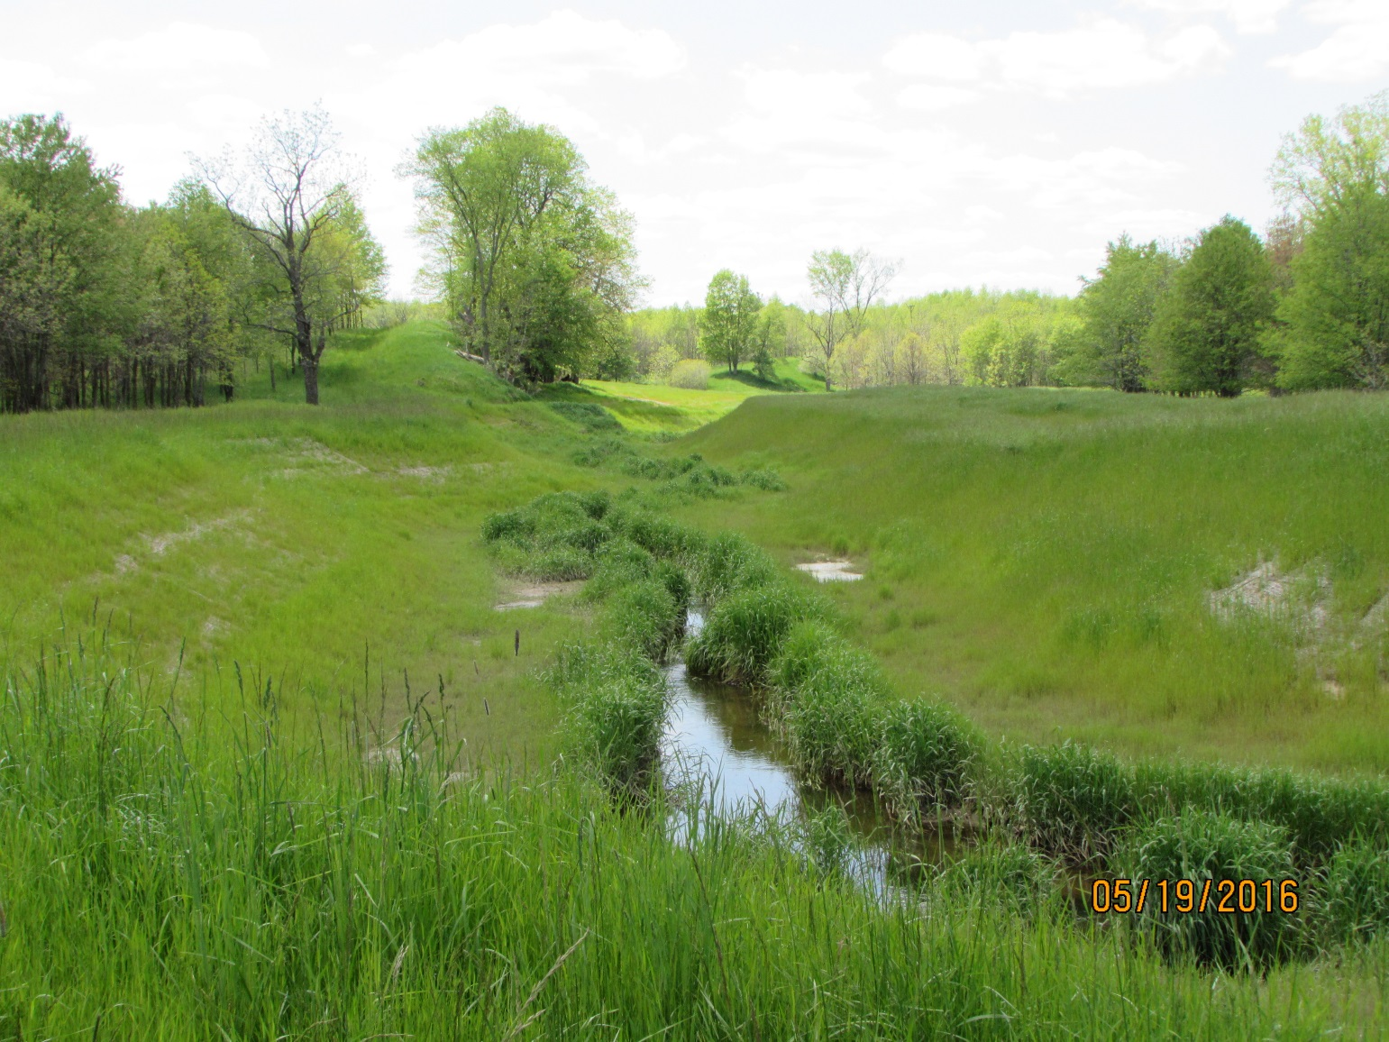
Extension of 2-Stage Ditch, DeKalb County
Notes:
The two-stage ditch in these before and after photos is approximately a 2,600 feet in DeKalb County. This ditch is an extension of a preexisting two-stage ditch, creating approximately 3,800 continuous feet of two-stage ditch.
Farm Bill Program funding (Environmental Quality Incentives Program – EQIP). The preexisting two-stage ditch was put in by The Nature Conservancy in 2010. Holler if you need more information!

Slide 25
Guiding Principles: Non-point Sources
Agricultural landscapes
Emphasize soil health to reduce erosion, minimize nutrient inputs, moderate the effects of flood and drought and to reduce nutrient and sediment loading to streams
  Minimize disturbance through no till or conservation tillage practices
  Maximize soil cover
  Keep living roots growing as long as possible
  Grow a variety of plants
Promote nutrient management to optimize nutrient uptake by crops through the “4 Rs”
  Right Source
  Right Rate
  Right Time
  Right Place
Notes:
by promoting drainage water management and emphasizing the importance of water infiltrating where it falls
Urban: by seeking incentives & opportunities for it
Urban landscapes: seek opportunities for green infrastructure
Infiltration, retention, detention, slow release
Rain gardens, green roofs, rain barrels
Rural and agricultural landscapes
Address subsurface drainage with soil health strategies, saturated buffers
Employ drainage water management techniques with sediment and nutrient removal processes
Restore stream sinuosity and riparian buffers
Restore wetlands and floodplains
Install 2-stage ditches

Slide 26
Major Actions: Regulatory
2012 CFO revised rule
  Design, construction and capacity requirements
  Operation and maintenance requirements
  Land application requirements with setbacks, application at agronomic rates, and avoidance of weather conditions that lead to manure runoff
  Soil P testing and limits
2016 re-adoption of the Certification for Distributors and Users of Fertilizer rule to ensure that fertilizer materials are applied, handled, and transported effectively
All CSO communities have an approved LTCP or other enforceable mechanism (2015)
Notes:
CFO: Design, construction, % capacity requirements
Operation & maintenance requirements
Land application with no application to frozen ground
Tri-State Western Lake Erie Phosphorus Reduction Initiative
Tri-State Western Lake Erie Phosphorus Reduction Initiative

Slide 27
Major Actions: Non-regulatory
State Nutrient Reduction Strategy revised in 2016
Expansion of INField Advantage
Agriculture Commodities Group outreach campaign
Anderson, Inc. became 4 R certified in 2016
Green Project Reserve through State Revolving Fund Loan Program Fort Wayne, Berne and Auburn
Watershed plans at regional and sub-watershed scales

Slide 28
Major Actions: Non-regulatory
Established monitoring priorities and protocol
  Maumee River at Antwerp, OH
    Add a super gage at this site for long-term monitoring and comparison
  St. Mary’s at the IN/OH border
  St. Mary’s before its confluence with the St. Joseph
  St. Joseph at the IN/OH border
Secured lab support for DRP analysis
Notes:
To optimize resources and establish a regional network, IDEM, IN USGS, OH EPA, OH DNR, OH USGS, Ohio USGS and US EPA are collaborating on monitoring activities.

Slide 29
MILESTONE and ACTION TABLE

Slide 30
Tracking Progress
Ambient water quality monitoring data
Edge-of-field monitoring data
Tillage and transect data
BMP load reduction model annual report
Discharge monitoring reports
MS4 site visits and annual reports
LTCP reporting
Cost share program project milestones and updates

Slide 31
Adaptive Management
Notes:
Vital to Indiana’s success in implemting this DAP is an AM strategy that tests the hypothesis put forth in the DAP & applies the lessons learned to future management decisions,
Indiana will continue to participate on the Annex 4 Subcommittee. If new data & information evaluated within the context of the current assumptions and management strategies for the WLEB determine tht P or other targets need to be adjusted, Indiana will take that into account for modifying this DAP.

Slide 32
Future Endeavors & Resource/Research Gaps
Use Erie Stats and assess its utility for guiding Indiana’s actions.
Participate in the P Trading pilot project for the WLEB.
Map wetland and floodplain restoration opportunities.
Develop a response process to examine reports of manure runoff.
Support rigorous enforcement of environmental regulations.
Seek establishment of a federal/binational funding source for a long-term Lake Erie monitoring network.
Support/conduct research on water drainage management.
Install more auto-samplers at the 12-digit HUC scale.
Notes:
including more detail on urban/point source

Slide 33
Outreach and Stakeholder Engagement
Diverse stakeholder representation on DAP advisory committee
Presentations to stakeholder groups
DAP web page on ISDA WLEB website http://www.in.gov/isda/3432.htm
  Public notice posted for public comment August 14th-October 13th
  Survey Monkey
  Public engagement sessions during August and September
Revise and refine DAP after the public comment period ends
Include public comments in an appendix
Final DAP by February 2018
DAP web-based in 2018 with story maps
Notes:
Status update to ICP leaders, SSCB, IASWCD board
Presentation to the Save the Maumee group

Slide 34
Success in the WLEB
Watershed nutrient pollution is a complex, multi-faceted problem caused by point and nonpoint sources across all sectors of our community with the solutions being likewise.
It affects those who live, work, and recreate in the watershed as well as the ecosystem and economics of the region.
Hoosiers are making a positive difference.
Will you be part of the solution?

Slide 35
Let’s Talk!

Slide 37
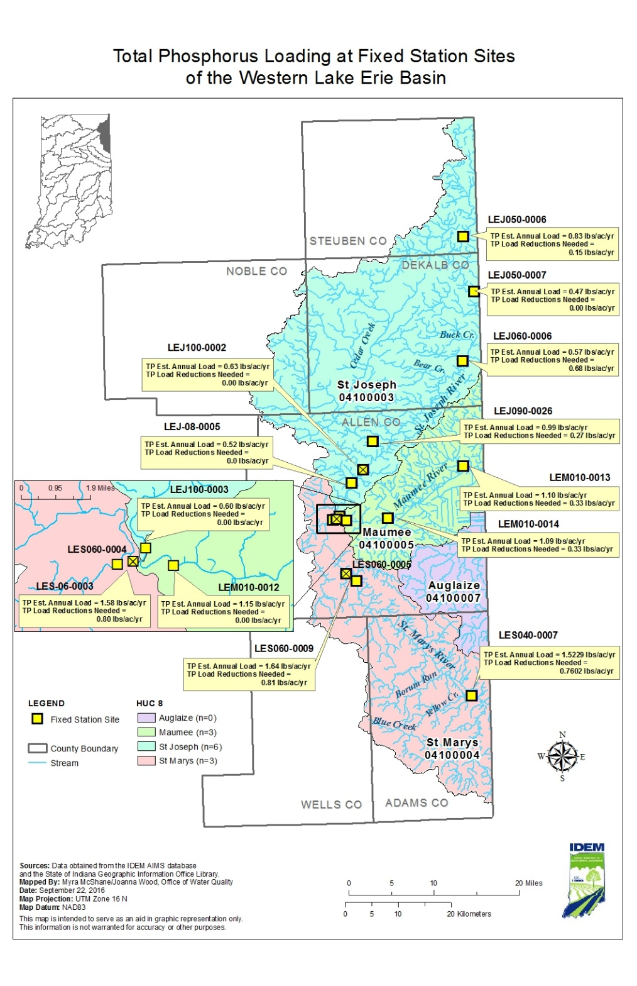
Estimated TP Loads and
Reductions Per Acre Needed
The USGS Load Estimator (LOADEST) model, both the Purdue Interface and USGS Desktop Application, were used to estimate annual loads and load reductions needed based on a 0.23 mg/L Total Phosphorus FWMC.
Notes:
The USGS Load Estimator (LOADEST) model (both the Purdue Interface and USGS Desktop Application) were used to estimate annual loads and load reductions needed based on a 0.23 mg/L Total Phosphorus concentration.
Given a time series of streamflow, fixed station data and the target concentration (0.23 mg/L) LOADEST develops a regression model for the estimation of loads (calibration). The formulated regression model then is used to estimate loads over a user specified time interval (estimation). Mean load estimates, standard errors, and 95% confidence intervals are developed on a monthly and seasonal basis.

