Slide 1
NIST Cybersecurity Framework
February, 2016
Bryan Sacks, Director Risk & Compliance

Slide 2
Agenda
Risk and Compliance Update
NIST Cybersecurity Framework Introduction
Initial Steps and Agency Impact

Slide 3
Risk & Compliance Updates
IOT Governance (Role Update)
ISO to NIST
Three project phases
Governance & Compliance
Risk Management
Vendor/Supplier Risk Management
Archer – Governance, Risk and Compliance
Tool will house policies, standards, assessments and more
Reporting will be made available to each agency
Training documentation will be provided and workshops held (when needed)
Goal: Introduce and improve end-to-end risk management, while reducing compliance burden to the extent possible

Slide 4
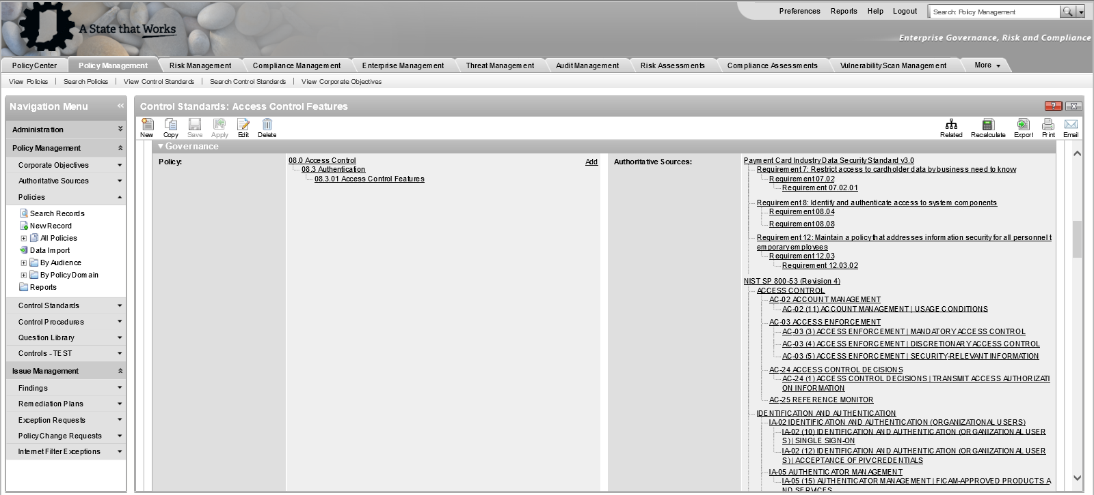
Reducing Compliance Burden with Auth. Source Mapping

Slide 5
Agenda
Risk and Compliance Update
NIST Cybersecurity Framework Introduction
Initial Steps and Agency Impact

Slide 6
NIST Cybersecurity Framework (CSF) Background
President issued Executive Order (EO) 13636, ‘Improving Critical Infrastructure Cybersecurity’, in February 2013
The order directed the National Institute of Standards and Technology (NIST) to work with stakeholders to develop a voluntary framework – based on existing standards, guidelines, and practices – for reducing cyber risks to critical infrastructure
NIST published the Cybersecurity Framework (CSF), in February 2014
CSF provides a ‘common language’ that can be used across agencies to measure risk and understand where control gaps exist
CSF maps to multiple frameworks, including ISO27001, COBIT and more. Therefore, it is not ‘prescriptive’, rather it is a guideline that can be adapted
Many states are now adopting the framework, some known examples:
Virginia
Pennsylvania
Mississippi
Idaho
New York
Texas
Florida
Indiana
IOT will lead the initiative to move to NIST based policy, standards (and controls), using NIST CSF as a baseline

Slide 7
NIST CSF Structure
The Framework was designed to enhance cybersecurity posture, providing a scalable format for executives, management, and staff. Shown are the components of the framework:
Core
Tiers
Profiles
5 ‘Functions’
22 ‘Categories’
98 ‘Subcategories’
Partial
Risk Informed
Repeatable
Adaptive
Current
Target
Identify
T
Adaptive
NIST CSF Core
Repeatable
Recover
Protect
C
Risk Informed
Partial
Respond
Detect

Slide 8
Agenda
Risk and Compliance Update
NIST Cybersecurity Framework Introduction
Initial Steps and Agency Impact

Slide 9
Initial Steps
Build and roll-out Agency Maturity Profile Assessment (March/April, 2016)
Determine assessment context questions
Policy/Standards (Mid-Year)
Update methodology
Understand controls
Build/update policy documents
Compliance Self-Assessments
Develop process
Determine scope
Roll-out
More to come…

Slide 10
Agency Impact
Each agency will be required to complete items, results will be reported to Agency Heads, CIO and possibly the Governor.
Risk & Control Self Assessment
Compliance Self Assessment
5
Agency Maturity Profile
Inherent Risk Profile
Application Risk Questionnaire
Compliance Self-Assessment
Risk & Control Self-Assessment
1
4
Application Risk Questionnaire
2
Inherent Risk Profile
3
2
3
Agency Maturity Profile
1
4
5
Bite sized chunks allow for better consumption and digestion

Slide 11
IOT’s ask…
Be patient
Come along this journey with us
Assist with development, communication, training where you can (contact Tad/Bryan if you have available resources to develop documentation)

Slide 12
Appendix

Slide 13
Additional Resources
Key Links:
NIST Home
NIST Cybersecurity Framework
State of Indiana - NIST RFI Response
NIST Special Publications (Includes 800-53 Rev 4)
Archer Home

Slide 14
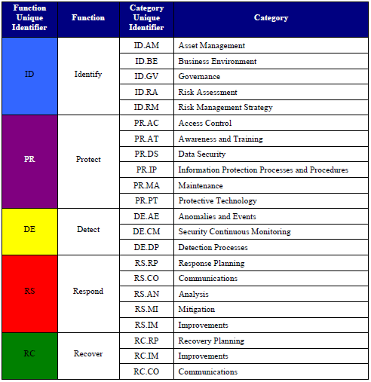
NIST CSF Structure: Core
Core
Tiers
Profile
The Framework was designed to enhance cybersecurity posture, providing a scalable format for executives, management, and staff. Shown are the components of the framework:
Core
Core
5 ‘Functions’
22 ‘Categories’
98 ‘Subcategories’ (not shown)
5 ‘Functions’
22 ‘Categories’
98 ‘Subcategories’ (not shown)

Slide 15
NIST CSF Structure: Tiers
Core
Tiers
Profile
The 4 Tier Definitions span across three areas, detailed definitions are found below:
Tiers | Risk Management Process | Integrated Risk Management Program | External Participation
Tier 1: Partial | Organizational cybersecurity risk management practices are not formalized, and risk is managed in an ad hoc and sometimes reactive manner. Prioritization of cybersecurity activities may not be directly informed by organizational risk objectives, the threat environment, or business/mission requirements | There is limited awareness of cybersecurity risk at the organizational level and an organization-wide approach to managing cybersecurity risk has not been established. The organization implements cybersecurity risk management on an irregular, case-by-case basis due to varied experience or information gained from outside sources. The organization may not have processes that enable cybersecurity information to be shared within the organization | An organization may not have the processes in place to participate in coordination or collaboration with other entities
Tier 2: Risk Informed | Risk management practices are approved by management but may not be established as organizational-wide policy. Prioritization of cybersecurity activities is directly informed by organizational risk objectives, the threat environment, or business/mission requirements | There is an awareness of cybersecurity risk at the organizational level but an organization-wide approach to managing cybersecurity risk has not been established. Risk-informed, management-approved processes and procedures are defined and implemented, and staff has adequate resources to perform their cybersecurity duties. Cybersecurity information is shared within the organization on an informal basis | The organization knows its role in the larger ecosystem, but has not formalized its capabilities to interact and share information externally
Tier 3: Repeatable | The organization’s risk management practices are formally approved and expressed as policy. Organizational cybersecurity practices are regularly updated based on the application of risk management processes to changes in business/mission requirements and a changing threat and technology landscape | There is an organization-wide approach to manage cybersecurity risk. Risk-informed policies, processes, and procedures are defined, implemented as intended, and reviewed. Consistent methods are in place to respond effectively to changes in risk. Personnel possess the knowledge and skills to perform their appointed roles and responsibilities | The organization understands its dependencies and partners and receives information from these partners that enables collaboration and risk-based management decisions within the organization in response to events
Tier 4: Adaptive | The organization adapts its cybersecurity practices based on lessons learned and predictive indicators derived from previous and current cybersecurity activities. Through a process of continuous improvement incorporating advanced cybersecurity technologies and practices, the organization actively adapts to a changing cybersecurity landscape and responds to evolving and sophisticated threats in a timely manner | There is an organization-wide approach to managing cybersecurity risk that uses risk-informed policies, processes, and procedures to address potential cybersecurity events. Cybersecurity risk management is part of the organizational culture and evolves from an awareness of previous activities, information shared by other sources, and continuous awareness of activities on their systems and networks | The organization manages risk and actively shares information with partners to ensure that accurate, current information is being distributed and consumed to improve cybersecurity before a cybersecurity event occurs
CSF Tiers are guidelines, IOT has developed a simpler model

Slide 16
NIST CSF Structure: Tiers
Core
Tiers
Profile
The 4 Tier Definitions span across three areas, detailed definitions are found below:
Maturity Tier | Description
Tier 0: Non-Existent | Appropriate processes and controls do not exist, lack of awareness and knowledge
Tier 1: Initial | Processes and controls are ad-hoc, not documented (informal), poorly controlled and not repeatable
Tier 2: Developing | Processes and controls are managed and documented. Implementation and execution is inconsistent
Tier 3: Defined | Processes and controls are standardized, well established, consistently used, repeatable, periodically reviewed and updated
Tier 4: Advanced | Processes and controls are continuously assessed for improvements. Could be considered best in class or leading practice. Sharable and adopted by others.
CSF Tiers can be used to understand current and target profiles for each category and subcategory

Slide 17
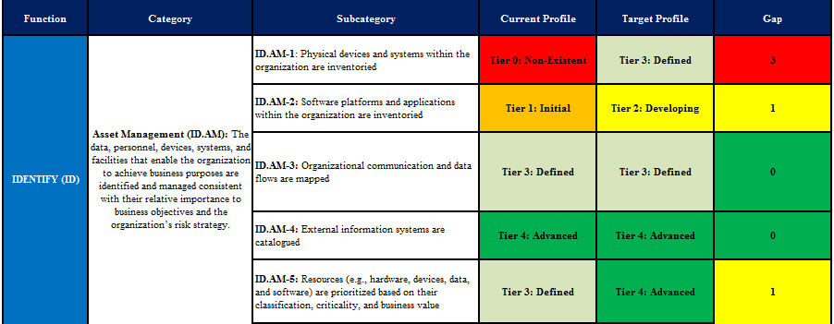
NIST CSF Structure: Profile
Core
Tiers
Profile
How do we know our biggest gaps? Using Current and Target Profiles across Subcategories can help identify and prioritize focus areas
Profiles
Current
Target
Illustrative
T
C

Slide 18
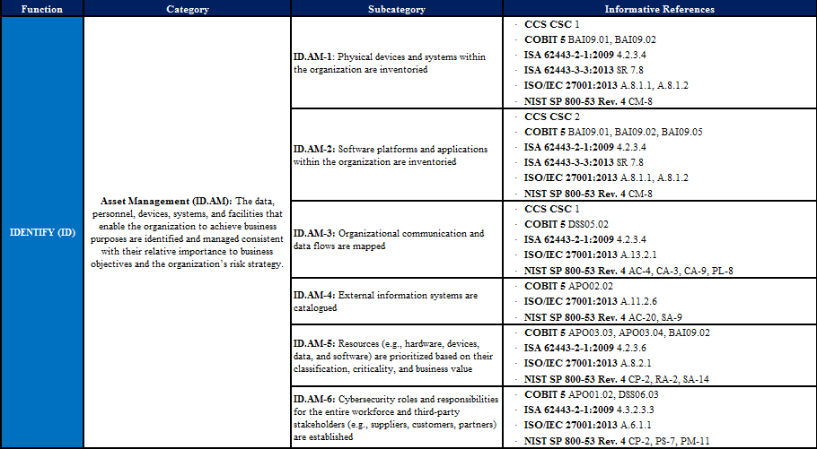
NIST CSF Structure: Core Cont’d
Core
Tiers
Profile
Hierarchy is useful for reporting purposes
Alignment to ‘Informative References’, commonly referred to as Authoritative Sources
NIST SP800-53 Rev. 4 Alignment

Slide 19
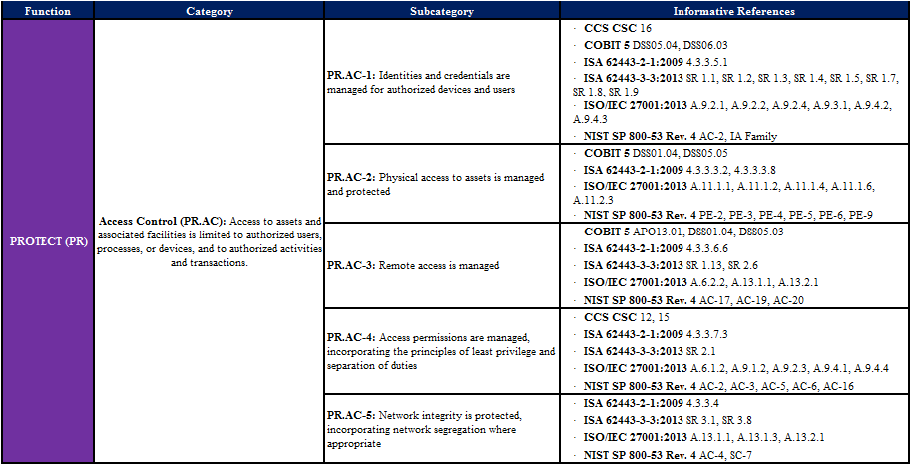
NIST CSF Example (Protect)

Slide 20
NIST CSF Example (Detect)

Slide 21
NIST CSF Example (Respond)

Slide 22
NIST CSF Example (Recover)

