Slide 1
EVOLUTION OF DISASTER RECOVERY
Ram Annamalai
Disaster Recovery Project Manager
Indiana Office of Technology
100 N. Senate Ave.
IGCN Mail Stop N551
Indianapolis, IN 46204
Desk: (317) 232-3206
rannamalai@iot.IN.gov

Slide 2
IOT Infrastructure Update
WAN
Four 10 GB Redundant connectivity for intranet and protected zone supported systems
Network
Upgraded network infrastructure to have the same network redundancy as the primary data center in Indianapolis
Stretched IP Capabilities where Indianapolis IP addresses are now available in Bloomington
Storage
XtremIO – Flash based Storage
VPLEX – Synchronous replication (real time)
RecoverPoint – Asynchronous replication (close to real time with RecoverPoints)
Proxy
NetScaler GSLB (Global Site Load Balancer)
Stretch Clustering
SQL Cluster, Oracle Fail Safe (Windows) and Active DataGuard, VMware ESX MHA Clusters

Slide 3
DR planning and testing
Infrastructure upgrades helped IOT to streamline and improve the DR planning and testing process
Planning
Reduced complexity architecting a system for DR
Minimized technical, administration, and logistics overhead
Improved standards
Testing
Automation reduced the support over head
Improved RTOs translated in to lesser time window
Capability to plan multiple systems

Slide 4
DR Testing Activities 2015
Agency partnership and collaboration with IOT to perform DR testing continues with more enthusiasm than ever, as last year saw agencies actively participating in the testing activities
DOR, DCS, INDOT, BOAH, DFR, FSSA, ISL, ATG, LOT, DHS, ISDH, IFA, IOT

Slide 5
DR meets MHA
IOT is in crossroads between Disaster Recovery (DR) and Multi-site High Availability (MHA)
IOT still in the testing phase
Finalizing planned versus unplanned Recovery Time Objective for MHA systems with improved Recover Point Objective
New Standards are being established

Slide 6
Setting Expectations
IOT to provide MHA as an option only to new systems with a request for a Disaster Recovery Plan
IOT teams will review and identify all the requirements to work out options before any commitment made on Multi-site High Availability or Disaster Recovery Plan
Application supportability
Licensing
Core IOT Infrastructure dependency
Inter-Agency Interface
Protected Zone
Costs
Systems will be initially in a hybrid MHA/DR mode with a roadmap to the possibility of MHA

Slide 7
Goals & Challenges
Goals
Traditional DR plan with critical classification
Continue working on DR testing in some case scheduling multiple systems at the same time
Communicate Milestone when a system is completely supported on MHA end to end
Challenges
Power Expansion delayed a year
Man Power
Protected Zone Requirements

Slide 8
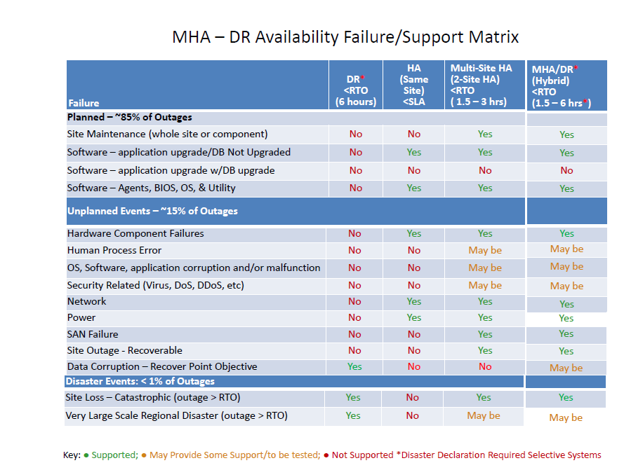
High Level Supported MHA/DR MATRIX

