Slide 1
CERIAS Seminar Presentation
IN-ISAC & SOC Update

Slide 2
Statistics
Incidents Handled YTD
Total | 165
Staffing Levels
SOC FTE | 2
SOC Contractors | 9
IN-ISAC Sec Awareness | 2

Slide 3
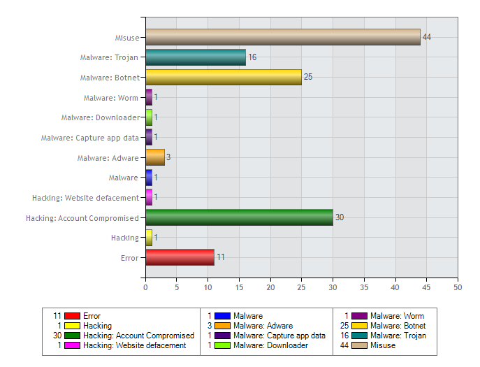
Threats by Category

Slide 4
Incidents by Target

Slide 5
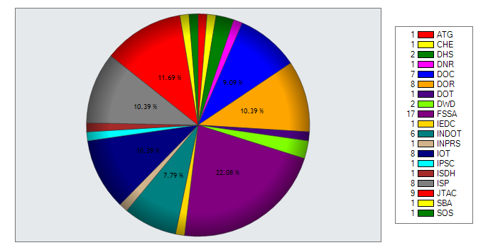
Tickets by Agency

Slide 6
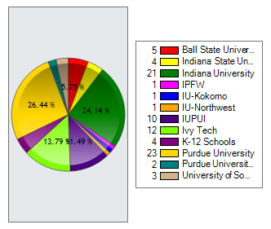
Outside Entities affected

Slide 7
Weekly Bulletins
On February 30th will publish the first joint Weekly Cyber Bulletin with the Indiana Intelligence Fusion Center.
Focusing on the cyber trends and issue for the previous week
To sign up to receive the bulletins please contact me. nsturgeon@iot.in.gov

