Slide 1
IOT Microsoft Power Platform Center of Excellence (CoE) Overview
Created Date: January 2024
Last Revised: November 2024
Version: 1.0.5

Slide 2

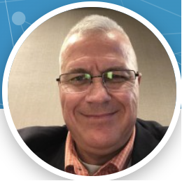

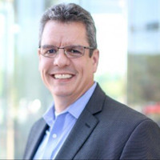
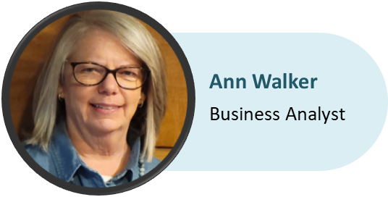

Meet the Microsoft Center of Excellence Team
Larry Jenkins
CoE Project Sponsor Deputy CTO
Jeremy Chenevert
CoE Low/No Code Program Manager
Tony Masopust
MSFT Architect / Sr. Dev
Elyse Caldwell
Business Analyst

Slide 3

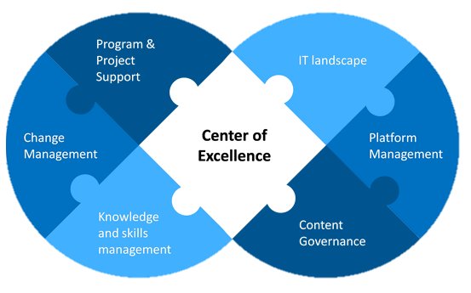
What is a MS Center of Excellence (CoE)?
WHO: A governance committee who ensures that Microsoft Power Platform strategies are aligned with business goals, strategies, and culture.
WHAT: Provides a coordinating function so that change initiatives are delivered consistently and proficiently, through standardized processes.
WHY: Drive innovation and improvement, foster collaboration and support, share knowledge and success.

Slide 4
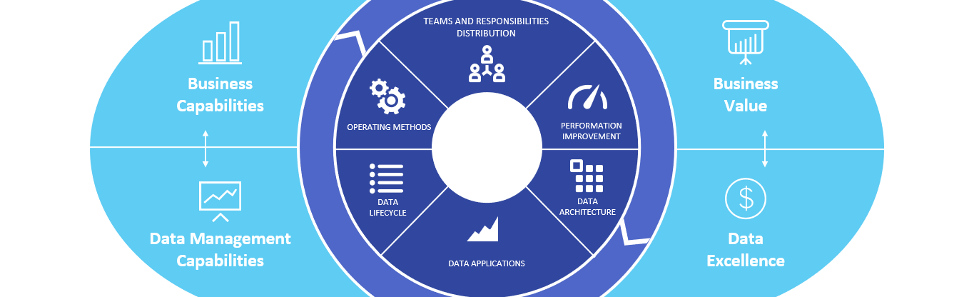
Why have a MS Center of Excellence (CoE)?
PERFORMANCE
The Microsoft Power Platform Center of Excellence (CoE) is a critical principle that helps to drive organizational strategy around the Power Platform and ensures the success of pre-determined business outcomes.
The Power Platform CoE is designed to pull together your community of citizen developers while also sharing knowledge and providing standards, consistency, and governance over the platform. A true CoE cannot succeed without people and collaborative teamwork driving it forward, to manage its success.

Slide 5



What is the function of a
MS Center of Excellence (CoE)?
The LCNC (Low Code No Code) CoE Governance Committee promotes, shares, and collaborates on the MS Power Platform to efficiently and effectively achieve business objectives, with the goals of maximizing return on investment (ROI), accelerating automation, standardizing around best practices, and facilitating knowledge sharing.
Invest in and nurture organic growth while maintaining governance and control.
Drive modernization and improvement, and as a central function, break down geographic and organizational silos.
Provide a powerful way to align around business goals rather than individual department metrics.
Foster greater creativity and innovation across the organization by digitizing and automating business processes.

Slide 6
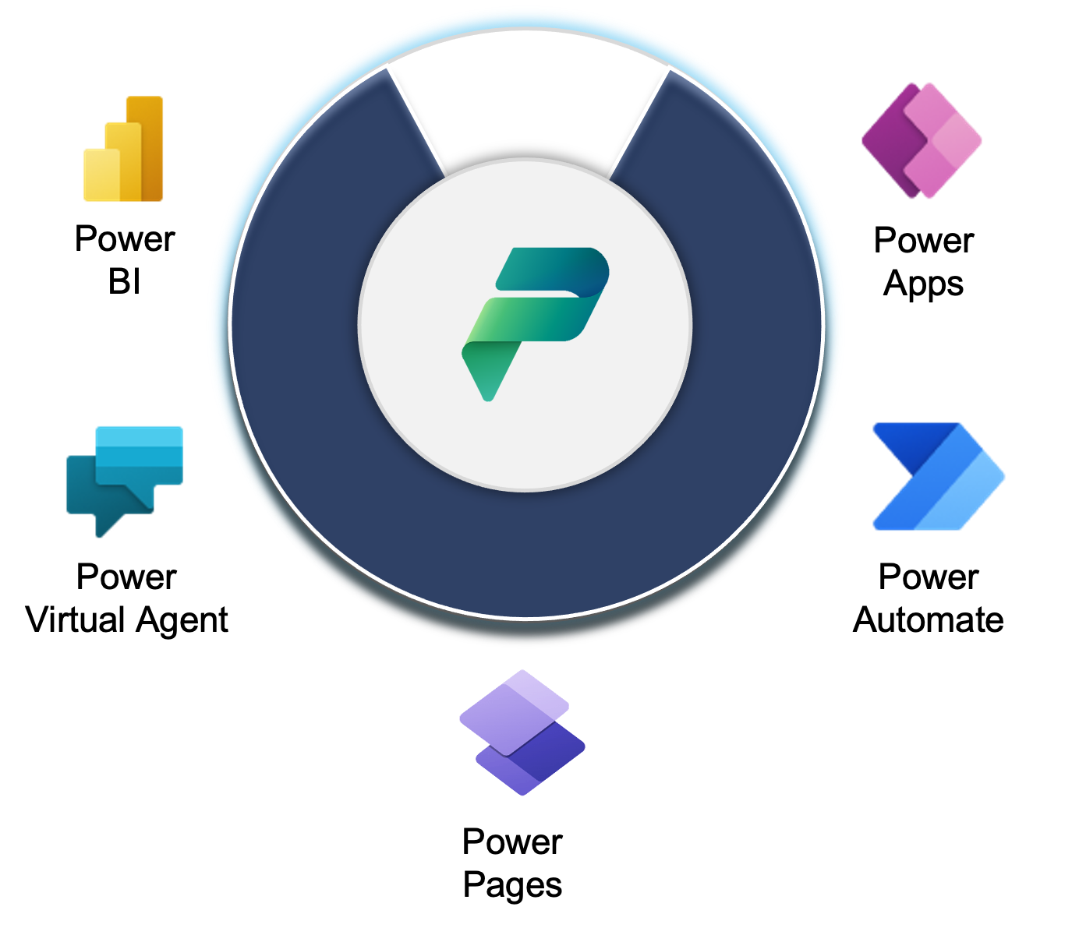
IOT MS Center of Excellence Overview
CoE COMMITTEE
CoE Sponsor: Larry Jenkins
Chairman: Robert Evans
Analysts: Ann Walker & Elyse Caldwell
Architect: Tony Masopust
Partnerships: IOT and Agency Planning, Technology & Citizen Developers
Governance Board Meeting: 2 Hrs / Month
GUIDING PRINCIPLES:
"Start Where You Are" - ITIL
Maximize business value from the use of MSFT LCNC technology
IOT co-create value with Agencies
Empower citizen development
Balance governance & innovation
SCOPE
Primary focus is increased enterprise-wide LCNC adoption, project acceleration & standardization; risk mitigation by providing guidance on proven practices, architecture, training & certification, and reusability.
Deciding vote on significant development and methodology decisions.
OBJECTIVES
Align CoE with overall business & technology strategy and objectives.
Create/maintain a strategic 2–5 yr. plan and enterprise adoption roadmap for future growth.
Incorporate LCNC development into the IOT Enterprise Architecture.
Establish collaborative IOT & Agency technology partnerships to expand LCNC use cases & implement IT enterprise standards.
Establish and mature MS LCNC platform architecture, governance and delivery framework.
Standardize execution paths.
Grow citizen development talent, skills and resources.
Centralize tracking, auditing and reporting to meet CoE objectives.

Slide 7
Why engage with the MS CoE?
WHAT can the CoE do for me?
Assist agencies in achieving business objectives
  (Please see slide 5 for more details)
Conduct health assessment of current environments
Develop Power Platform solutions
Provide technical consultation
Etc.
WHAT do I get in return?
Consultative guidance or full-service development
(*Depending on agency needs)
Proactive alignment with the State of Indiana enterprise application development standards
Assist in development of Power Platform solutions
MS CoE Deliverables
  Analysis provided by qualified analysts and architects
  Assessment and proposed solution provided in a Statement of Work (SOW)
  High-level cost estimate (ROM)
  *All new project intakes are prioritized against the existing legislative and enterprise portfolio

Slide 8
Next Steps
Should you choose a MS Power Platform solution, here are recommended next steps:
Step 1
Formal approval of SOW & estimated cost finalization
Step 2
Procurement Process Begins
Step 3
Procurement Process Completed
Step 4
Project Kick-Off Begins

Slide 9
Thank You!

