Slide 1

State Roads 28 and 213 Roundabout
Public Hearing
June 18, 2026

Slide 2
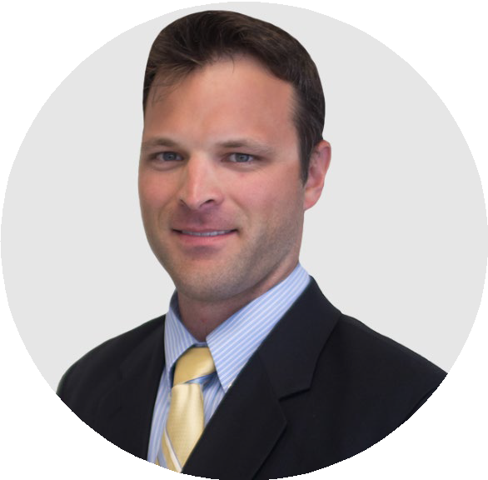


PRESENTERS
John LaBlonde, PE
Project Manager, Parsons
Anna Wainscott
Public Involvement Specialist, Parsons

Slide 3
AGENDA TOPICS
Public Hearing Overview​
Project Overview​
Impacts
Why a Roundabout?
Next Steps​
Public Comments

Slide 4
PUBLIC
HEARING
OVERVIEW

Slide 5
PUBLIC HEARING AND FORMAL COMMENTS
Sign up to share formal comments.​
Verbal comment period follows the presentation.​
Speakers called in the order they signed up. ​
Comments are limited to 3 minutes.​
Time warning will be provided.​

Slide 6
FORMAL COMMENT PERIOD
COMMENT PERIOD ENDS FRIDAY, JULY 3, 2026
There are multiple ways to provide comments.​
Tonight is one of several opportunities to share feedback.
All comments are considered equally; regardless of comment channel. ​
Final environmental document will address all comments received.

Slide 7
FORMAL COMMENT PERIOD
Comment Channels
Verbal comments tonight​
Written comments​ placed in comment box tonight ​
Mail or email after hearing​
Project webpage after hearing​
INDOT customer service
Comments must be submitted by Friday July 3, 2026, to be
included in the formal comment period with responses in the
final environmental document.

Slide 8
PROJECT OVERVIEW

Slide 9
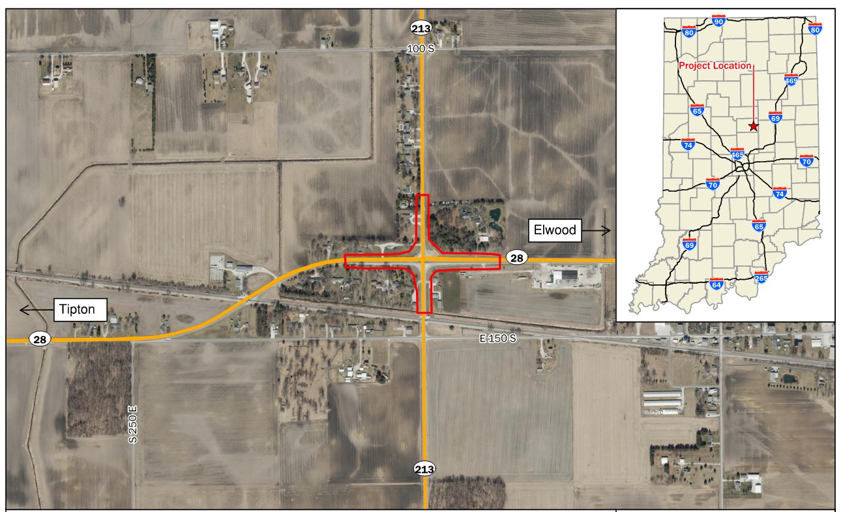
PROJECT AREA
Intersection of State Roads 28 and 213 in Tipton County

Slide 10
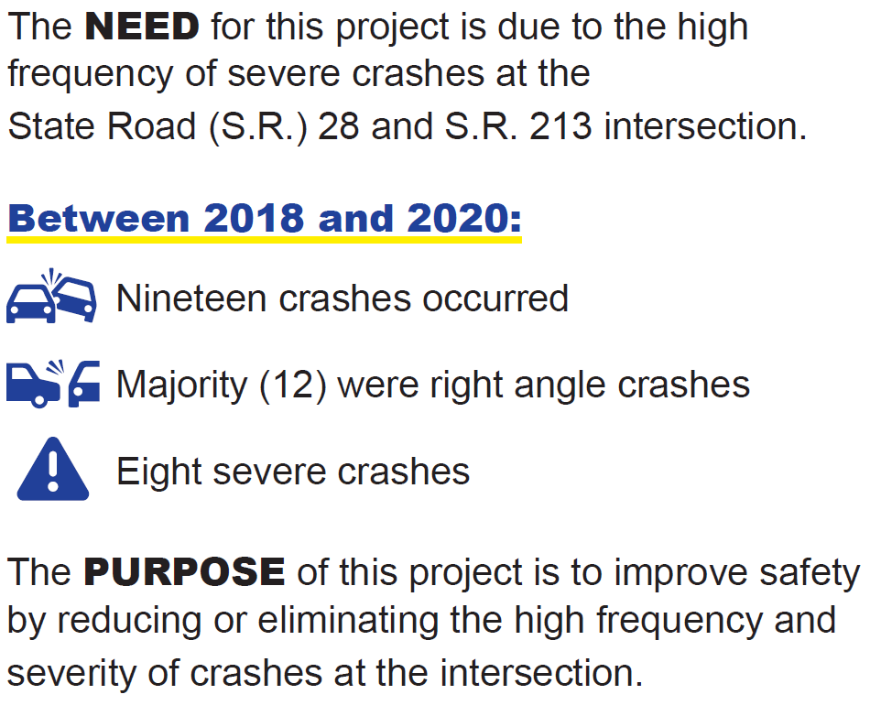
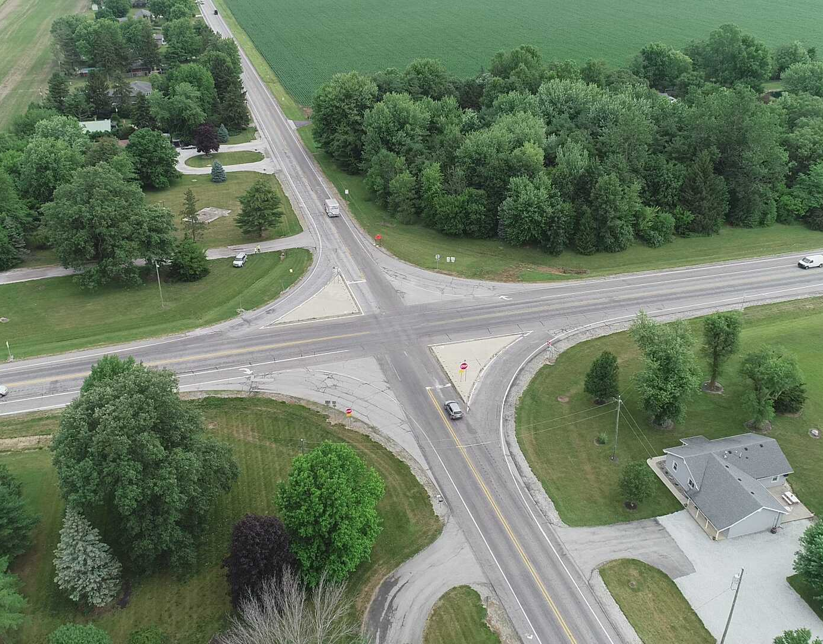
PURPOSE AND NEED

Slide 11
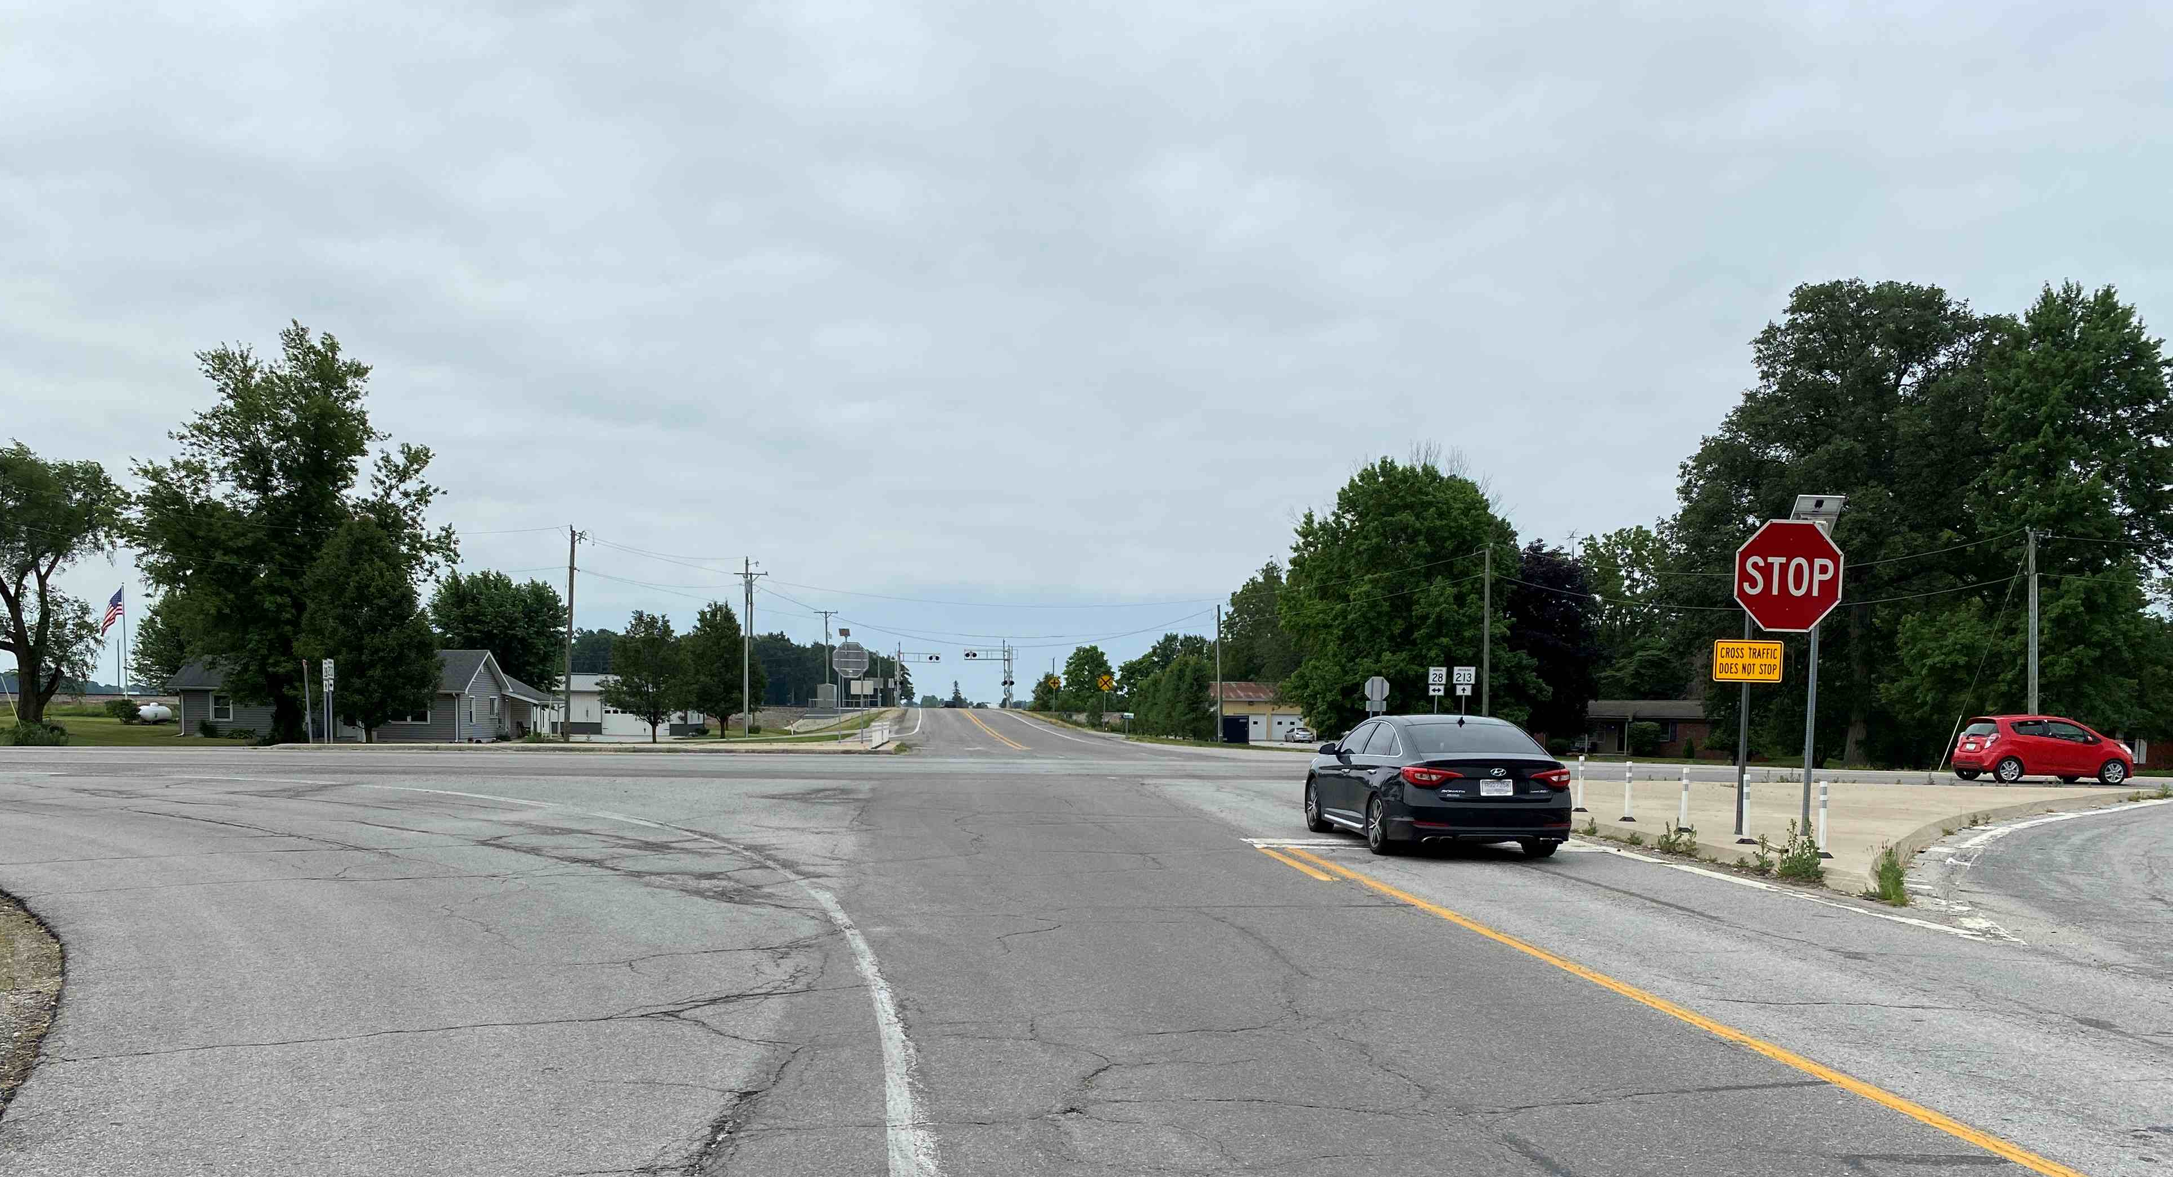
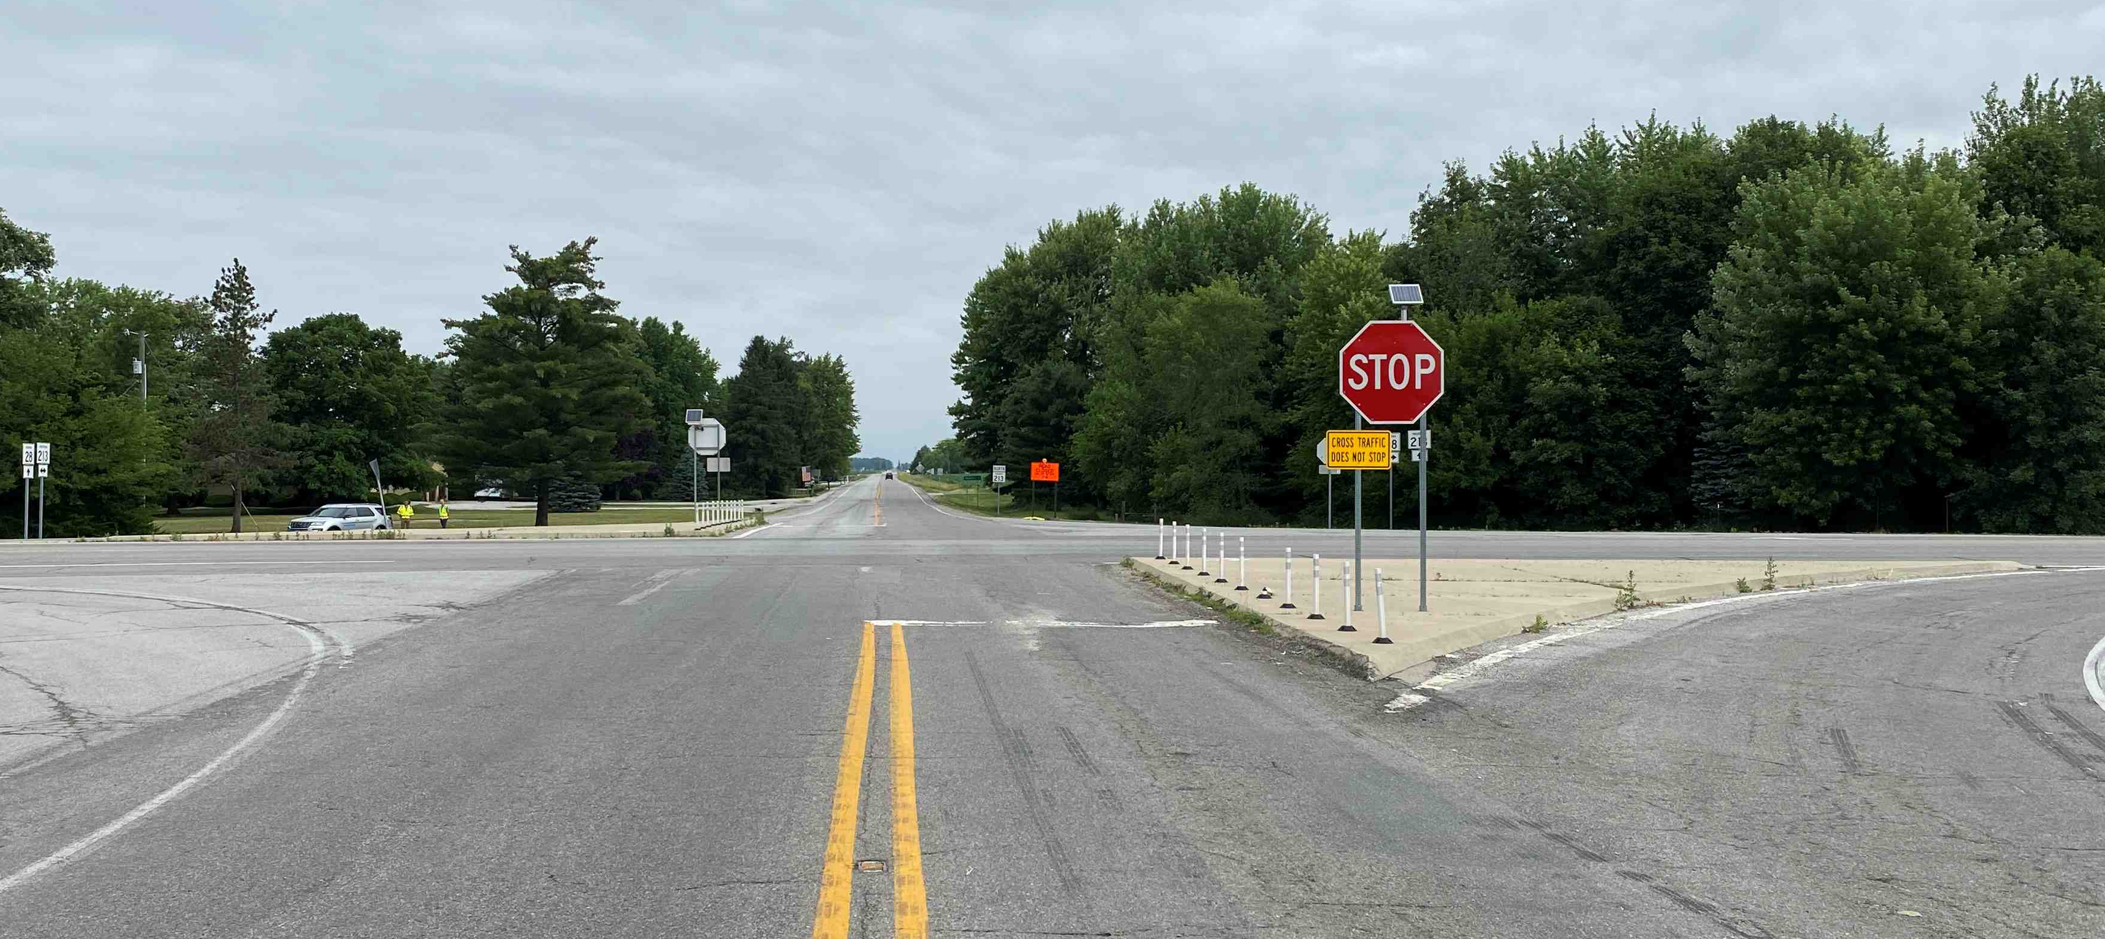
CURRENT STATUS
Stop controlled on S.R. 213
Flashing stop signs for additional warning
S.R. 213 facing south
S.R. 213 facing north

Slide 12
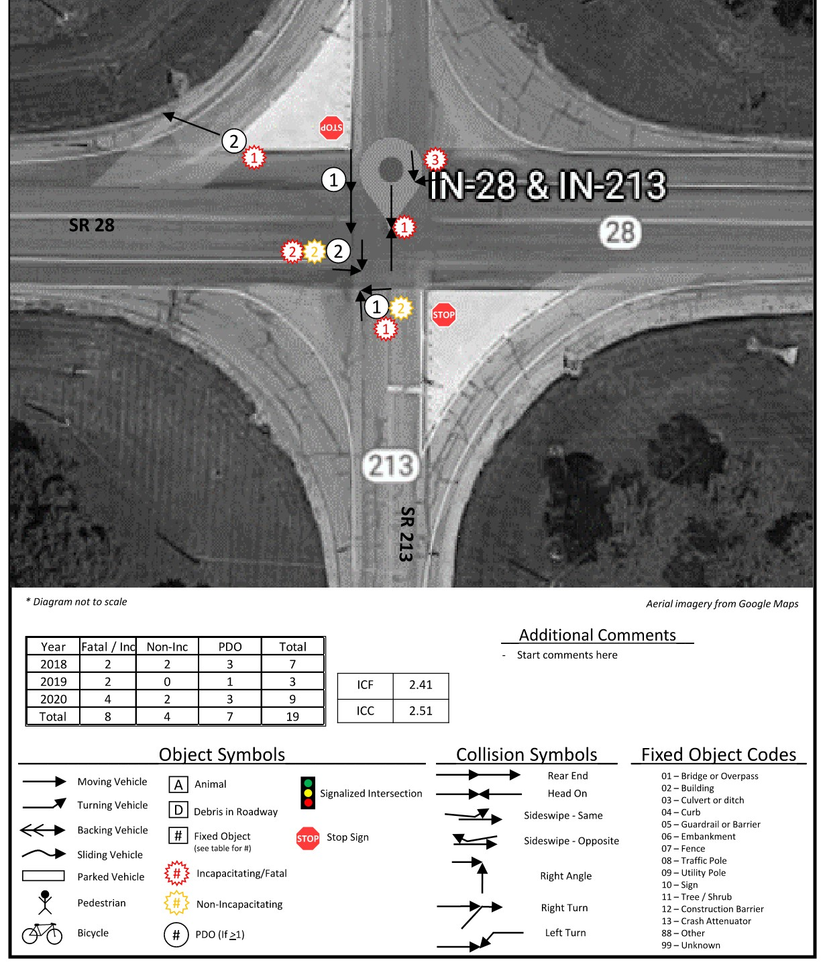
CRASH ANALYSIS
Nineteen crashes
Twelve right angle crashes
Fourteen crashes during daylight hours
Sixteen crashes on dry pavement
Eight severe crashes

Slide 13
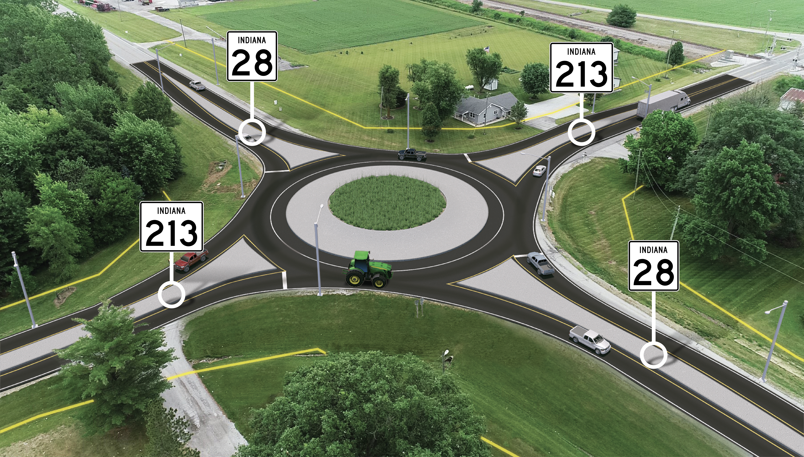
PROPOSED ROUNDABOUT
New single lane roundabout
New raised islands
Four feet of widening along S.R. 28 and S.R. 213
New pavement markings and signage

Slide 14
IMPACTS

Slide 15
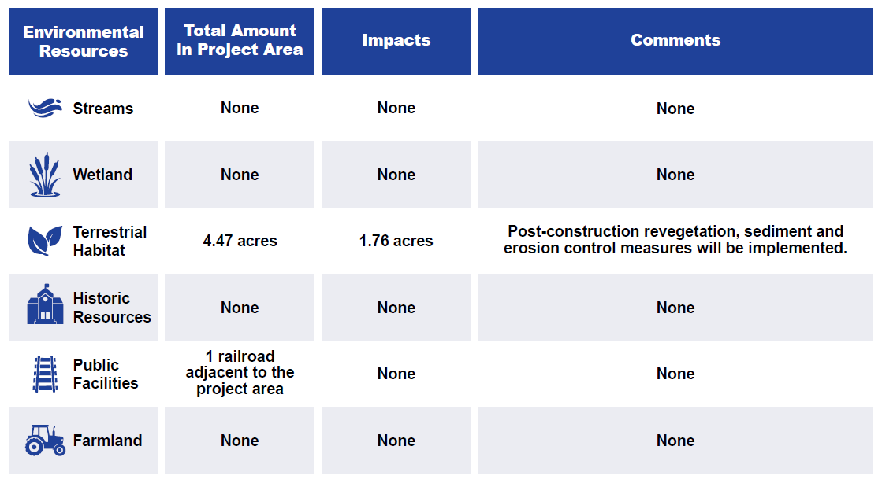
ENVIRONMENTAL IMPACTS SUMMARY

Slide 16


MAINTENANCE OF TRAFFIC
Construction expected to start in spring 2028 and last up to one year.
What to Expect:
  S.R. 28 and S.R. 213 to close for two months
  Outside work and cleanup expected in late 2028
  Signed detours provided
S.R. 213 Closure Detour: Signed detour using state roads 13, 26, and 37.
S.R. 28 Closure Detour: Signed detour using state roads 13, 26, and 19.

Slide 17
Why a Roundabout?

Slide 18
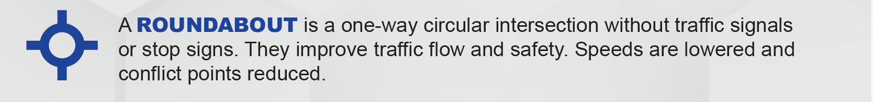
WHY A ROUNDABOUT?
Proven to reduce crashes compared to traffic signals and stop signs
Other alternatives considered:
  Traffic Signal
    Requires additional turn lanes
    Traffic does not warrant a signal
  All-Way Stop
    Anticipated to increase rear-end collisions
    Anticipated that right-angle crashes are likely to be “severe”

Slide 19
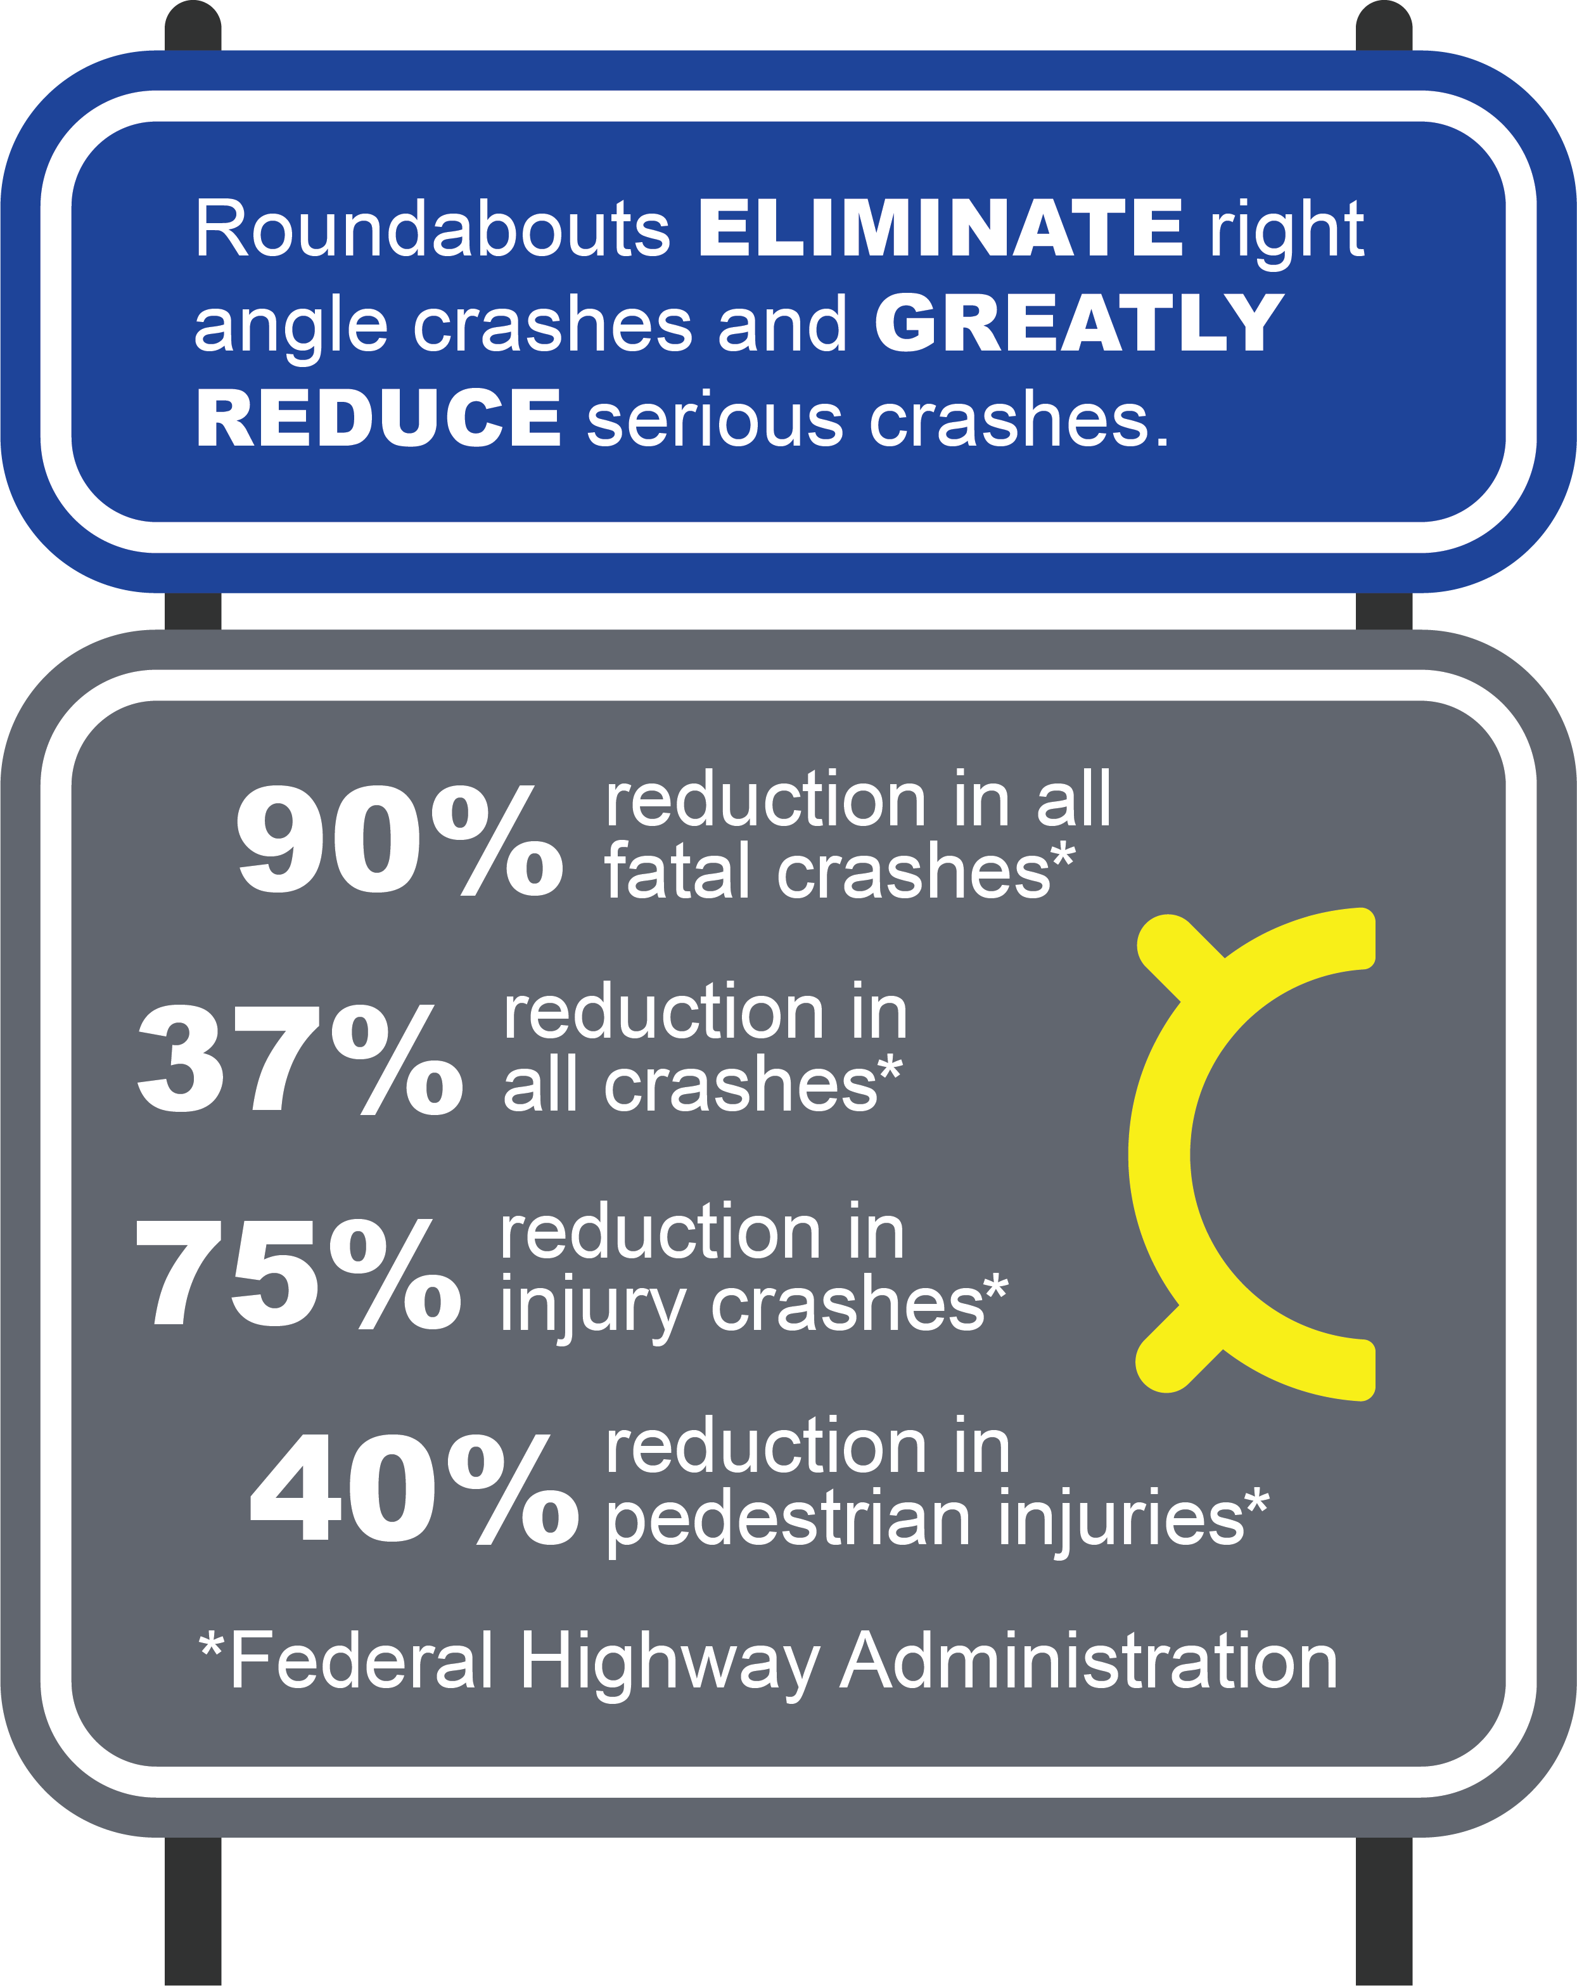
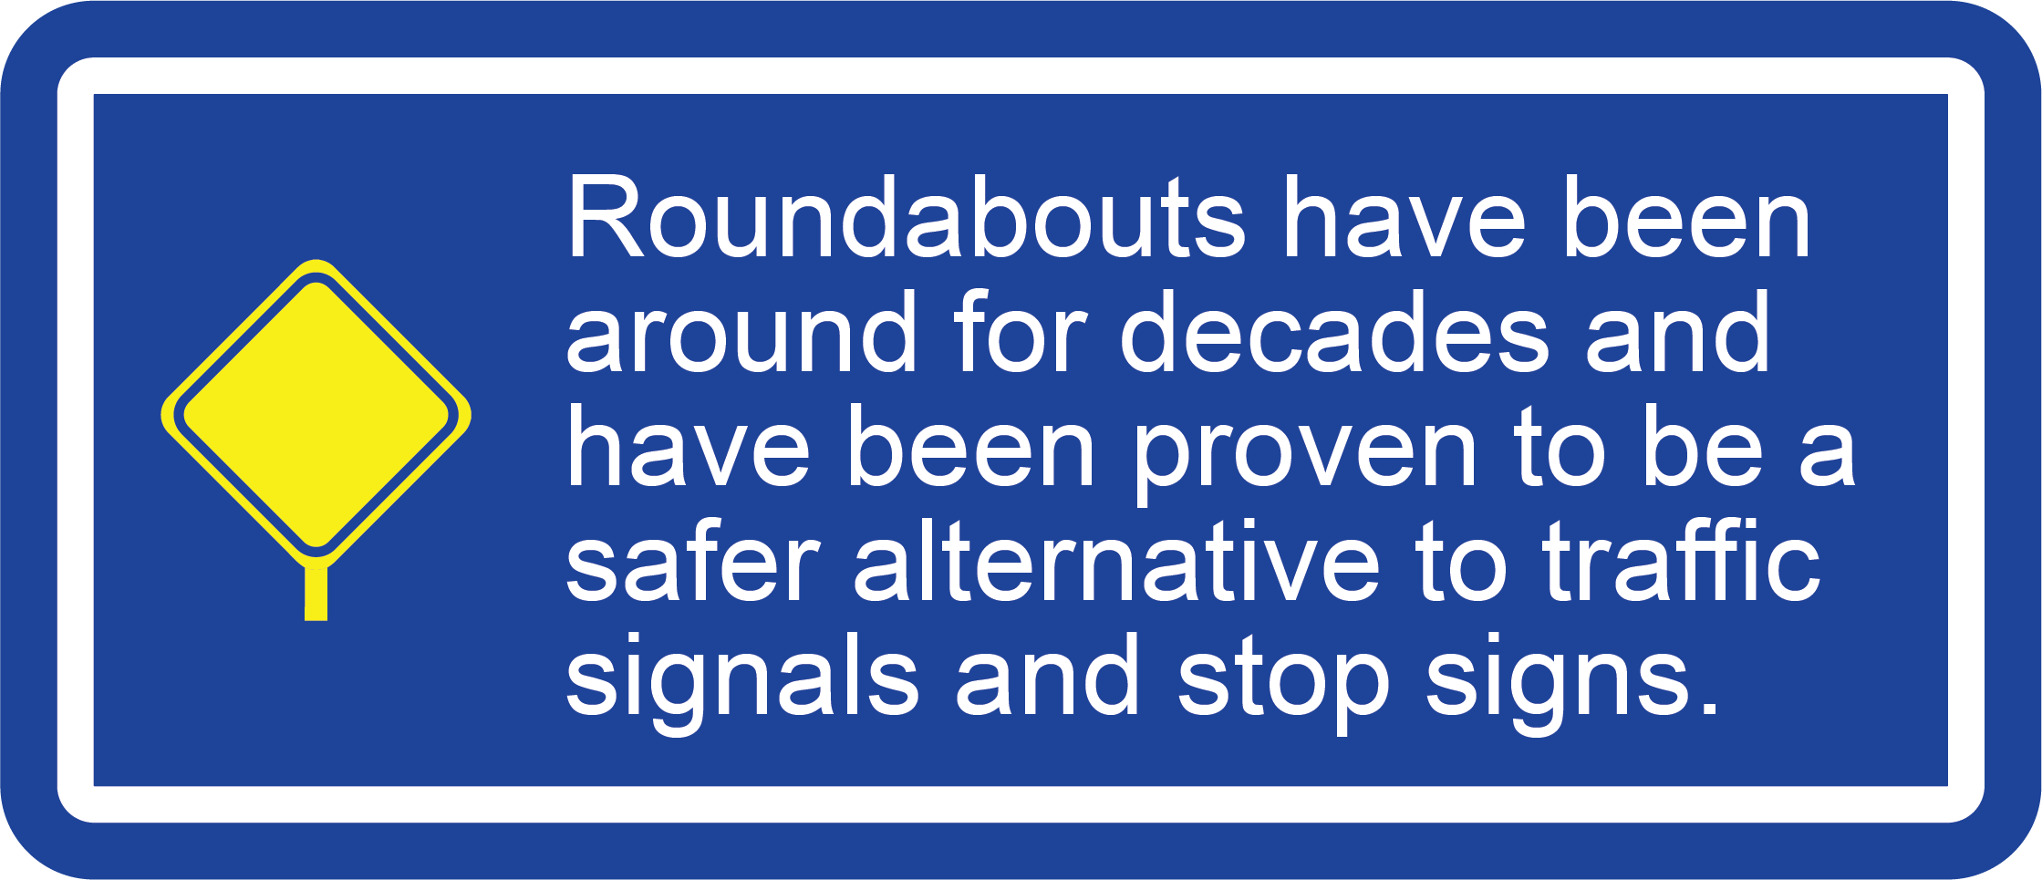

ROUNDABOUT BENEFITS

Slide 20
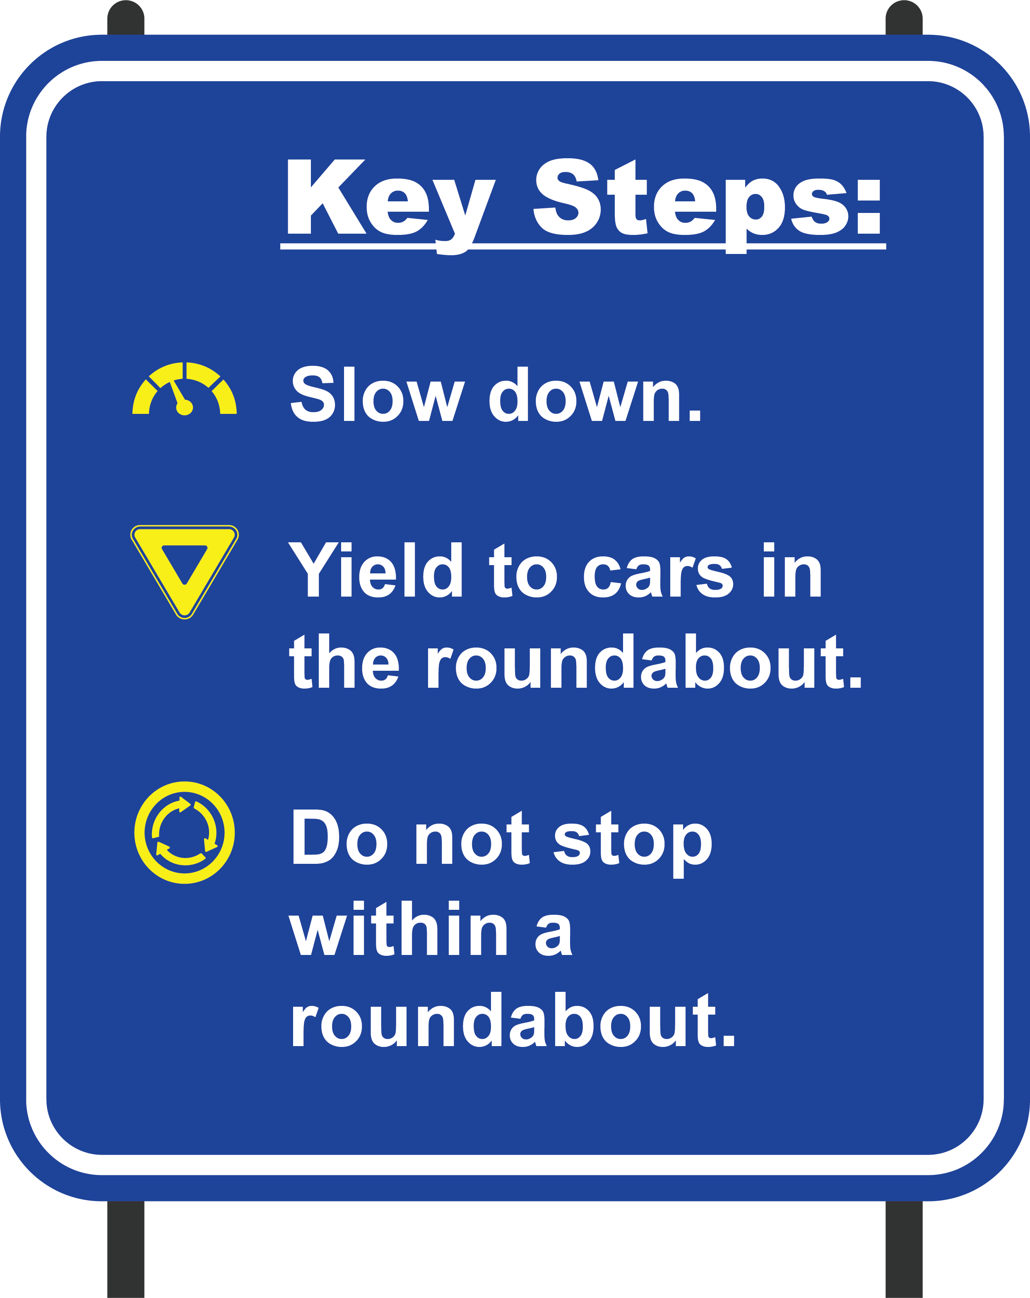
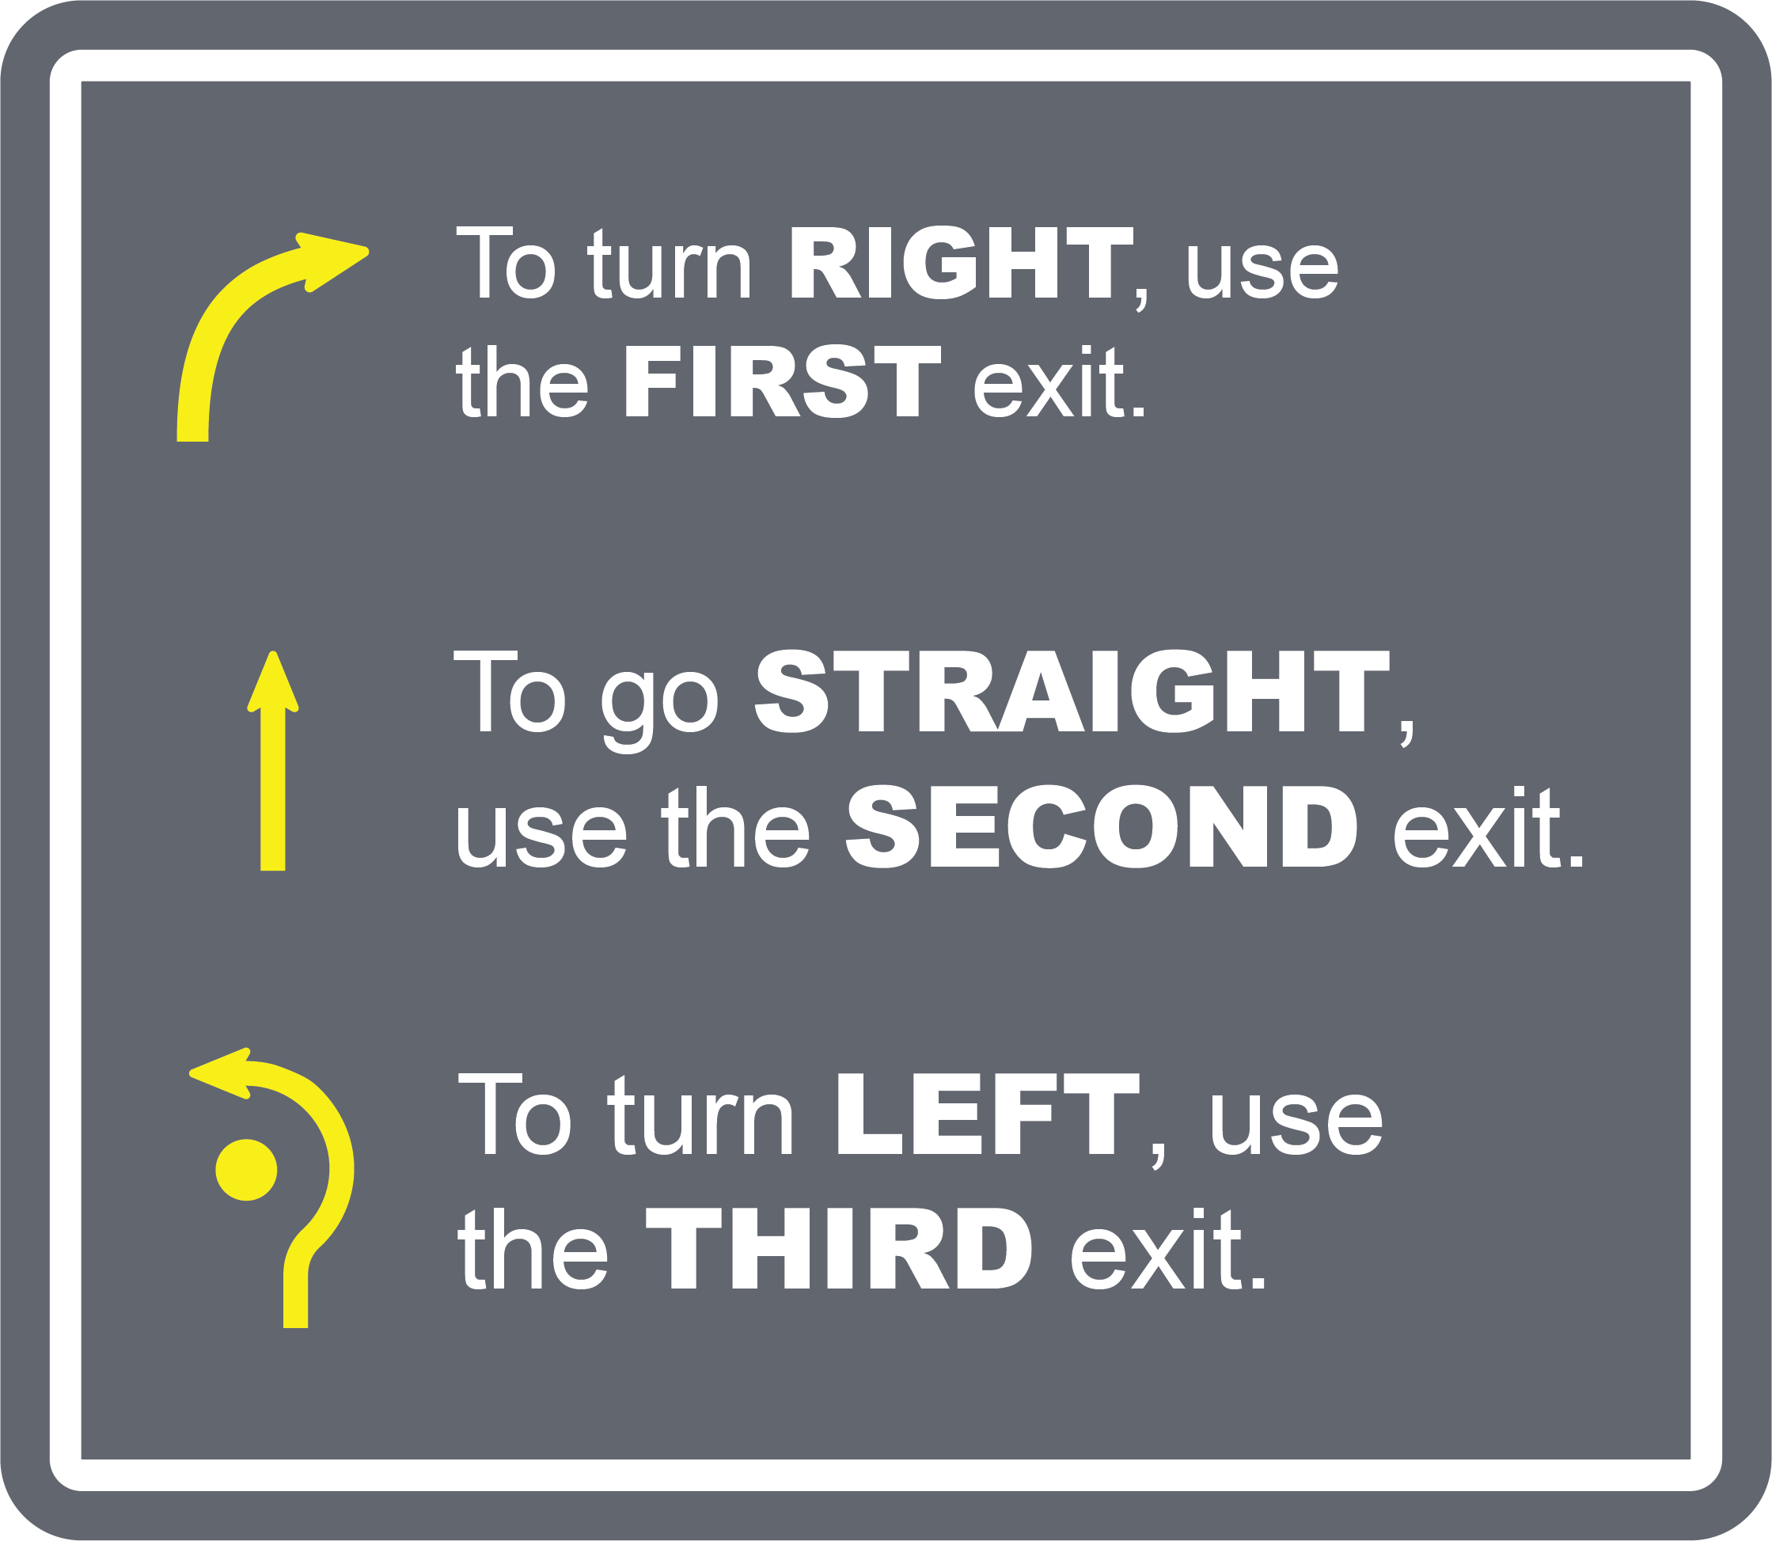
HOW TO USE A ROUNDABOUT

Slide 21
NEXT STEPS

Slide 22
DRAFT DOCUMENT FOR REVIEW
The environmental document is available to view at the following locations:
  Tipton County Foundation | 1020 W Jefferson St., Tipton, IN
  Tipton County Public Library | 127 E Madison St., Tipton, IN
  INDOT Greenfield District Office | 32 S Broadway St., Greenfield, IN
  Online at bit.ly/SR28SR213
Copies of project documents mailed upon request by contacting INDOT Customer Service at 855-INDOT4U (463-6848)

Slide 23
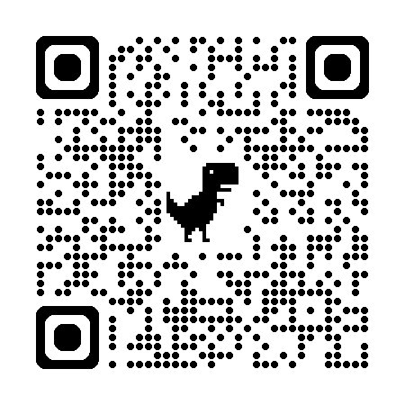


NEXT STEPS
Final environmental document expected later this year
Construction expected to begin in spring 2028 and last one year.
Greenfield District
(East Central Marion County)
INDOT Project Webpage:
bit.ly/SR28SR213
Scan the QR code with your camera phone to sign up for project updates, including dates of closures and detours
Follow @INDOTEast

Slide 24
SHARE YOUR COMMENTS
Share verbal comments tonight
Complete paper comment form tonight
Email scanned copy to anna.wainscott@parsons.com
Mail to Parsons,101 West Ohio St., Ste. 2121, Indianapolis, IN, attn. Anna Wainscott
Online on INDOT webpage
Call INDOT customer service 855-INDOT4U (468-6848)
The formal comment period is June 3 – July 3, 2026.

Slide 25
VERBAL COMMENTS
  Verbal comment period begins now.
  Speakers will be called in the order they signed up.
  Comments are limited to three minutes; time warning provided.

Slide 26
PUBLIC COMMENTS

Slide 27

THANK YOU

