Slide 1
U.S. 41 Roadway Improvement
Indiana Department of Transportation
Thursday, Aug. 2, 2018
6 p.m.
St. John Town Hall

Slide 2
Welcome
Purpose/explanation of public hearing
Public hearing format
Visit our sign-in table
Informational handouts
Participate during public comment session
Submit written public comments
Project display area

Slide 3
U.S. 41 Roadway Improvement
Introduction of INDOT Project Team
  Project Management
  Public Involvement
  LaPorte District – INDOT Regional Office
  Environmental Services
  PARSONS
    Engineering & Design Team
Recognition of elected and local public officials
Sign-in at attendance table to be added to project mailing list
Legal notice of public hearing was published in the Times of Northwest Indiana 7/17 & 7/24
A notice of the public hearing was mailed to known property owners within project area
Announcement of this hearing was posted to INDOT website. A media release was also issued
A copy of presentation and project documentation are available for review on-line via INDOT website

Slide 4
Project Stakeholders
Indiana Department of Transportation
Indiana Division Federal Highway Administration
Lake County
Elected & Local officials
Residents and citizens
Commuters
Businesses
Emergency services
Schools
Churches
Community Organizations

Slide 5
Project Development
Project Selection
Early Coordination
Environmental phase begins
Purpose & Need
Develop alternatives
Preliminary design phase
Release environmental document for public review and comment
HOLD PUBLIC HEARING
Additional work to finalize environmental document and project design
Communicate Project Decision
Real Estate Acquisition
Project Letting
Construction

Slide 6
Environmental Analysis Phase
  National Environmental Policy Act (NEPA)
  Requires INDOT to analyze and evaluate the impacts of a proposed project to the natural
  and socio-economic environments
  NEPA is a decision-making process
    Purpose and Need
    Alternatives Screening
    Preferred Alternative
  Impacts are analyzed, evaluated and described in an environmental document
    What are the impacts this project might have on the community?
    How can impacts be avoided?
    Can impacts be minimized?
    Mitigation for impacts?

Slide 7
Environmental Analysis Phase
  Notice of Entry for Survey – late 2015
    Letters sent to properties within general area
      Describing early project proposal
      Project personnel in area, may need to enter properties
      Gather data for environmental analysis
  Environmental document released for public involvement – June 2018

Slide 8
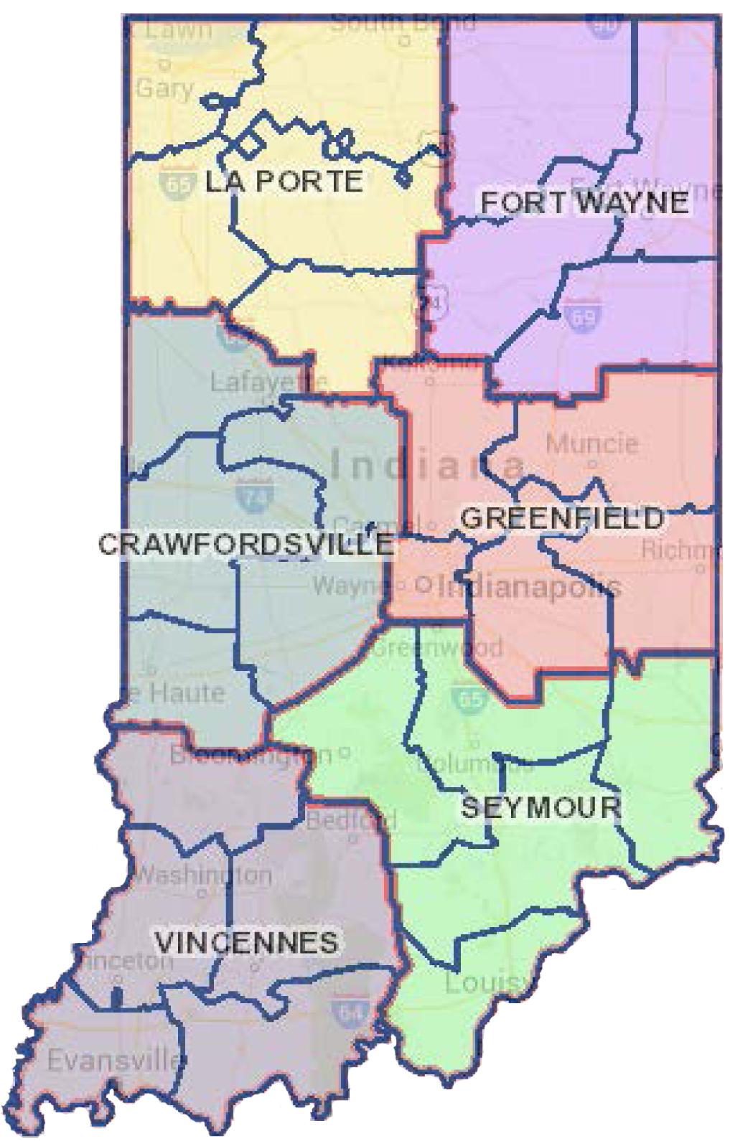

Project Resources
INDOT LaPorte District Office
  315 E. Boyd Boulevard, LaPorte, IN 46350
  LaPorteDistrictCommunications@indot.in.gov
  http://www.in.gov/indot/2705.htm
  Planning, Project Development/Delivery, Construction, Maintenance for Northwest Indiana
St. John Branch of the Lake Co. Public Library
9450 Wicker Avenue, St. John, IN 46373
Phone: (219) 365-5379
INDOT Office of Public Involvement
  100 North Senate Avenue, Room N642, Indianapolis, IN 46204
  Phone: (317) 232-6601
  rclark@indot.in.gov
Transportation Services Call Center
Provides citizen and business customers with
a single point-of-contact to request transportation
services, obtain information, or provide feedback
through multiple channels of communications.
855-463-6848 • INDOT4U.com • INDOT@indot.in.gov

Slide 9
U.S. 41 Roadway Improvement
Purpose
  Enhance mobility on U.S. 41 in Town of St. John
    Provide lane to accommodate left turns
Need
  Allow space for vehicles to stop for left turns without impeding travel
  for through traffic

Slide 10
Alternatives Considered
No Build
  Baseline for comparison for build alternatives
  Does not meet purpose and need, does not enhance mobility
Auxiliary Lanes, Two-Way Left-Turn Lanes
  Widen U.S. 41 to include 14 foot-wide auxiliary center left-turn lane
    Provides safe space for left turns
    Allows through traffic to continue unimpeded
  Exceptions
    Intersections where left turns already exist
    Bridge and/or culverts requiring modification to the existing structure

Slide 11
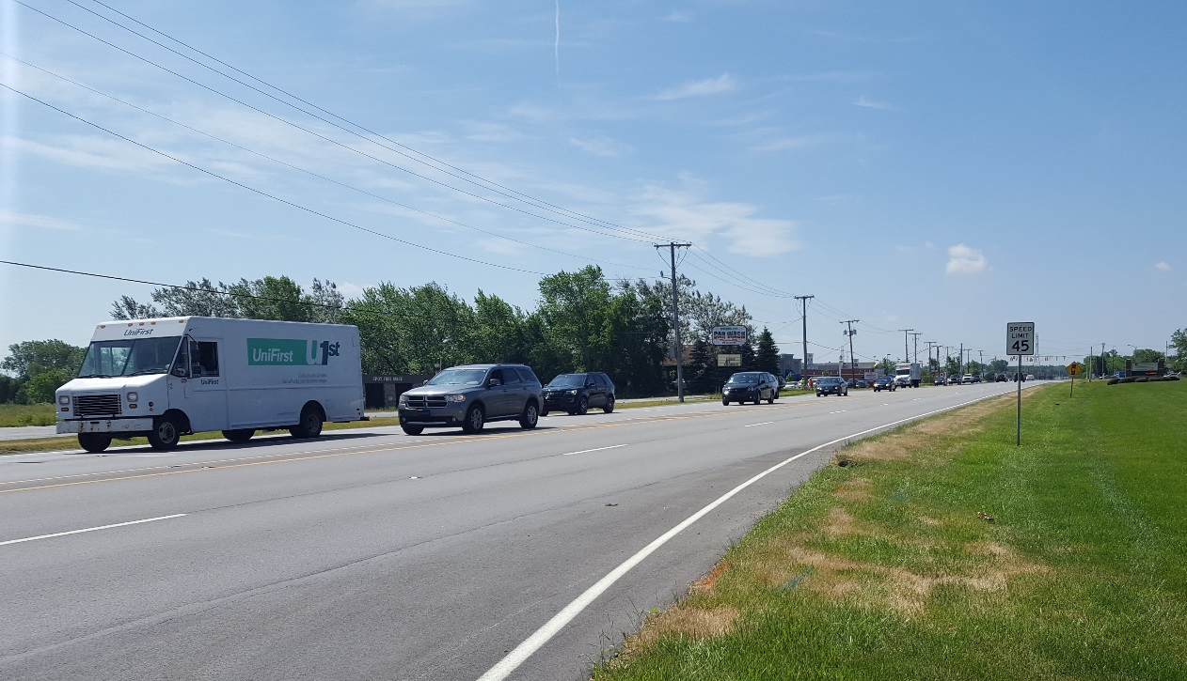
Existing Conditions
Roadway
  4-Lane Highway
  2 Lanes in Each Direction
  Left Turn Lanes only at
  Major Intersections
  Speed Limit Varies from 35 mph
  to 55 mph
Adjacent Area
  Land Use is Mix of Residential
  and Commercial Properties
  Many Businesses Adjacent to the Roadway Do Not Have Left Turn Lanes
  Traffic Flow is Restricted by Left-Turning Traffic

Slide 12
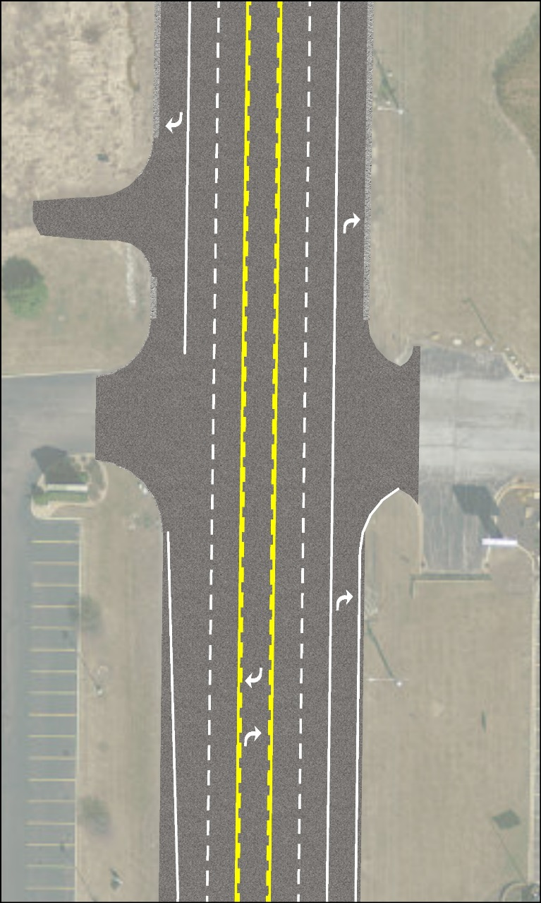
Preferred Alternative
Add Center Turn Lane
  Widen U.S. 41 to Each Side
  Predominately Equal Widening on Each Side
  Majority of Existing Pavement to be Left in Place
  Widening Adjusted As Necessary to Minimize Impacts to Roadside Features
    Streams
    Wetlands
    Utilities
    Parking Lots
  Utilize Curb and Gutter to Minimize Impacts, Where Necessary
  Storm Detention Achieved via In-Ditch and Closed Pipe Detention

Slide 13
Maintenance of Traffic
Phase 1
  Close Northbound Right Lane
  Construct Northbound Outside Widening
Phase 2
  Close Southbound Right Lane
  Construct Southbound Outside Widening
Phase 3
  Mill/Resurface Pavement
  Restripe Lane Lines

Slide 14
Project Schedule
Fall 2018: Completion of Environmental Document
Fall 2018: Begin Right-of-Way Acquisition
Summer 2019: Completion of Right-of-Way Acquisition
Fall 2019: Final Plans Submittal to INDOT
Winter 2020: Letting
Spring 2020: Begin Construction

Slide 15
Submit Public Comments
Submit public comments using the options described in first page of information packet:
  Public Comment Form
  Via e-mail
  Participate during public comment session following formal presentation
INDOT respectfully requests that comments be submitted by Friday, Aug. 17, 2018
All comments submitted will become included in an official public hearings transcript and made part of the public record
Comments will be reviewed, evaluated and given full consideration during decision-making process

Slide 16
Next Steps
Public and project stakeholder input
  Submit comments via options described on page 1 of information packet
INDOT review and evaluation
  All comments given full consideration during decision-making process
  Finalize/approve environmental document, complete project design
Communicate a decision
  INDOT will notify project stakeholders of decision
  Work through local media, social media outlets, paid legal notice
  Make project documents accessible via repositories
Questions? Contact Public Involvement Team

Slide 17
Thank You
Please visit with the design team and INDOT project officials following the presentation and Q & A.
Project Open House
  Project maps, displays, INDOT project team and informal Q & A
  INDOT LaPorte District page: http://www.in.gov/indot/2705.htm
  LaPorteDistrictCommunications@indot.in.gov

Slide 18
Project Resources
INDOT LaPorte District Office
  315 E. Boyd Boulevard, LaPorte, IN 46350
  LaPorteDistrictCommunications@indot.in.gov
  http://www.in.gov/indot/2705.htm
  Planning, Project Development/Delivery, Construction, Maintenance for Northwest Indiana
St. John Branch of the Lake Co. Public Library
9450 Wicker Avenue, St. John, IN 46373
Phone: (219) 365-5379
INDOT Office of Public Involvement
  100 North Senate Avenue, Room N642, Indianapolis, IN 46204
  Phone: (317) 232-6601
  rclark@indot.in.gov
Transportation Services Call Center
Provides citizen and business customers with
a single point-of-contact to request transportation
services, obtain information, or provide feedback
through multiple channels of communications.
855-463-6848 • INDOT4U.com • INDOT@indot.in.gov

