Slide 1
S.R. 2 at Heavilin Road
Indiana Department of Transportation
Monday, 13, 2019
6:00 p.m.

Slide 2
Welcome
Purpose/explanation of public hearing
Public hearing format
Visit our sign-in table
Informational handouts
Participate during public comment session
Submit written public comments
Project display area

Slide 3
S.R. 2 at Heavilin Road
Introduction of INDOT Project Team
Project Management
Public Involvement
LaPorte District – INDOT Regional Office
Environmental Services
Real Estate
Troyer Group
Engineering, Design & Environmental Analysis Team
Recognition of elected and local public officials
Sign-in at attendance table to be added to project mailing list
A public hearing notice was mailed to known property owners within project area
Announcement of this hearing was posted to INDOT website. A media release was also issued
A copy of presentation and project documentation is available on-line via INDOT website
Legal notice publishing:
Times of Northwest Indiana
April 26th & May 8th

Slide 4
Project Stakeholders
Indiana Department of Transportation
Indiana Division Federal Highway Administration
Porter County, City of Valparaiso
Elected & Local officials
Residents and citizens
Commuters
Businesses
Emergency services
Schools
Churches
Community Organizations

Slide 5
Project Development
Project Selection
Early Coordination
Environmental phase begins
Purpose & Need
Develop alternatives
Preliminary design phase
Release environmental document for public review and comment
Additional work to finalize environmental document and project design
Real Estate Acquisition
Construction
Public Hearing
Public Involvement – communicate project decision

Slide 6
Environmental Document
National Environmental Policy Act (NEPA)
Requires INDOT to analyze and evaluate the impacts of a proposed project to the natural and socio-economic environments
NEPA is a decision-making process
Purpose and Need
Alternatives Screening
Preferred Alternative
Impacts are analyzed, evaluated and described in an environmental document
What are the impacts this project might have on the community?
How can impacts be avoided?
Can impacts be minimized?
Mitigation for impacts?
Environmental document released for public involvement
April 2019
Is available for review via public repositories

Slide 7
Environmental Document
Environmental Process
Establish Purpose and Need
Develop possible alternatives
The “Do Nothing” alternative is a baseline for comparison
Evaluate and screen alternatives
Identify a preferred alternative
Solicit public comment on environmental document and preliminary design plan
Address and consider public comment as part of decision making process
Finalize and approve environmental document

Slide 8
Examples of items evaluated
Right-of-way
Streams, Wetlands, and Other Waters
Floodplains
Endangered Species
Farmland
Cultural Resources (Historic/Archaeological)
Parks and Recreational Lands (Trails)
Air Quality
Noise
Community Impacts
Environmental Justice
Hazardous Materials
Permits
Mitigation
Public Involvement
Commercial Development

Slide 9
Environmental Document - Section 106
Section 106 Requires federal agencies to take into account the effects of their undertakings on historic properties
Identified two archaeological sites, associated with the Porter County Farm / Poor Home
These sites are potentially eligible to the National Register of Historic Places.
Section 106 finding of “Adverse Effect”, because sites cannot be avoided
A Memorandum of Agreement (MOA) was developed among FHWA, INDOT, and SHPO to mitigate the impacts
Conduct detailed archaeological investigations.
Investigations will occur at a later date, but before construction commences

Slide 10
Project Resource Locations
INDOT LaPorte District Office
315 East Boyd Boulevard, LaPorte, IN 46350
Planning, Project Development/Delivery, Construction, Maintenance for Northwest Indiana
http://www.in.gov/indot/2705.htm
Valparaiso Public Library
103 Jefferson Street, Valparaiso, IN 46383
Phone: (219) 462-0524
INDOT Office of Public Involvement
100 North Senate Avenue, Room N642, Indianapolis, IN 46204
Phone: (317) 232-6601
rclark@indot.in.gov
Visit Project Web Page https://www.in.gov/indot/3931.htm
Transportation Services Call Center
Provides citizen and business customers with a single point-of-contact to request transportation services, obtain information, or provide feedback through multiple channels of communications.
855-463-6848 • INDOT4U.com • INDOT@indot.in.gov

Slide 11
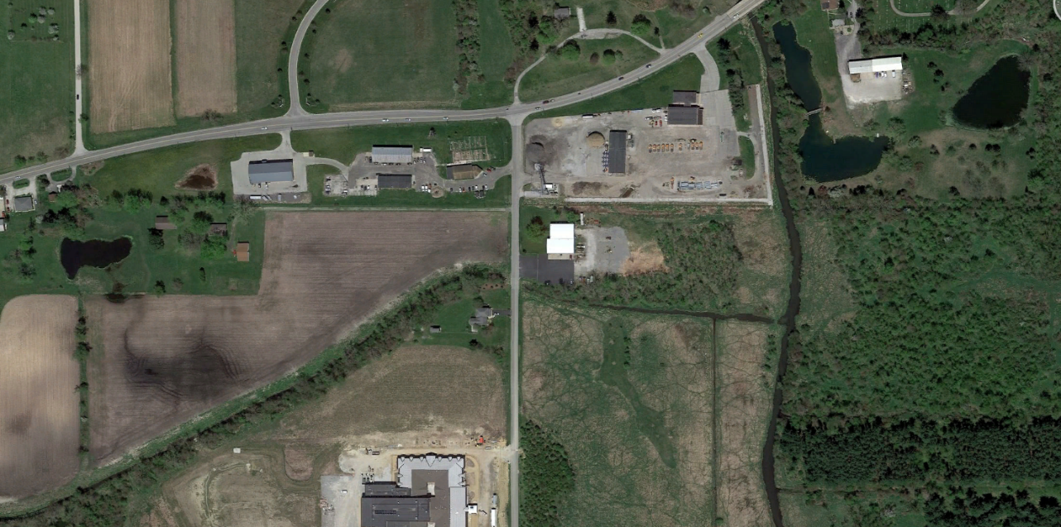
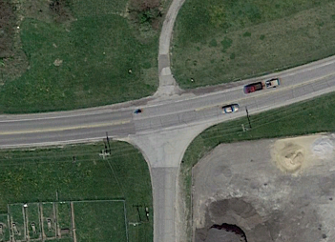
Existing Intersection
Heavilin Road
Heavilin Elementary

Slide 12
S.R. 2 at Heavilin Road – Purpose and Need
Purpose
Increase safety through reduction in operation speed along the SR 2 corridor
Maintain or improve operational efficiency – both in the construction year and the horizon year.
Need
Type of accidents occurring at/near intersection illustrate need for vehicle speed reduction
Speed limit along SR 2 is 45 mph
85th percentile speed: 2015 – 53 mph
2018 – 51 mph
Accident data:
25 total accidents since 2010
Nine (36%) involve SR 2 eastbound cars running off the road east of Heavilin Rd.
Eight (32%) involved SR 2 westbound rear-end collisions
Five (20%) of all accidents have resulted in injury

Slide 13
S.R. 2 at Heavilin Road – Purpose and Need (cont.)
Need (cont.)
Added traffic resulting from the new Heavilin Elementary School has created peak hour intersection congestion
Traffic Impact Study was prepared for school in 2015
An estimated 377 new two-way vehicles trips have been introduced to the intersection
Horizon year (2036) intersection performance was also evaluated
Traffic analysis summary:
Current Intersection (before school opened)
AM LOS: C / PM LOS: C
Current Intersection (added school traffic)
AM LOS: C / PM LOS: D
Horizon year (forecasted traffic)
AM LOS: E / PM LOS: F

Slide 14
Other Alternatives Considered
No Build
Baseline for comparison of build alternatives
Does not meet purpose and need, does not enhance safety at intersection, operational efficiency likely to decline with traffic growth.
Signalized Intersection
Would not help to reduce the operation speed along the SR 2 corridor
Would still permit high-speed crashes
Intersection does not meet signal warrant (according to 2015 TIS)
Does not adequately address the project purpose and need
Passing blisters
Intended to allow westbound SR 2 vehicles to maneuver around vehicles turning left onto Heavilin Rd.
Would still permit high-speed crashes
Would not correct the primary breakdown in intersection efficiency, which is the large number of northbound Heavilin left turns onto SR 2.
Horizon year PM LOS: E

Slide 15
Supplemental Improvements Considered
4th (northern) Intersection leg
Would re-align Danvers Parkway to connect to north side of intersection.
The added construction costs and other project impacts were determined to outweigh the anticipated benefits.
Pedestrian Connection to Heavilin Elementary School
Would provide a pedestrian connection through the intersection to the neighborhoods to the north
Would be funded by Valpo Community Schools
To support this pedestrian link, other pedestrian improvement would have accompanied the roundabout construction, such as a flashing beacon system across SR 2
Eliminated from consideration at the request of Valpo Community Schools

Slide 16
Preferred Alternative – Roundabout Intersection
Meets purpose & need of project
Enhances safety by:
Reducing the operational speed along the SR Corridor
Reducing the number of potential vehicle conflict points
Significantly reducing the severity of traffic accidents
Enhances operational efficiency at the intersection
Existing Configuration:
Construction Year (added school traffic)
AM LOS: C / PM LOS: D
Horizon year (forecasted traffic)
AM LOS: E / PM LOS: F
Roundabout
Construction Year (added school traffic)
AM LOS: A / PM LOS: A
Horizon year (forecasted traffic)
AM LOS: A / PM LOS: A

Slide 17
Roundabout – INDOT Preferred Alternative
One-way circular intersection
Traffic flows counter-clockwise around a center island
Yield at entrance
No Parking
No “activity” in center island

Slide 18
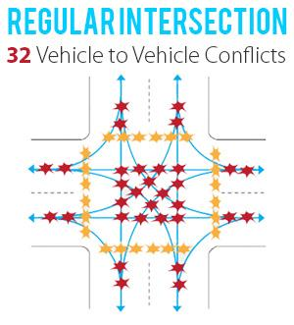
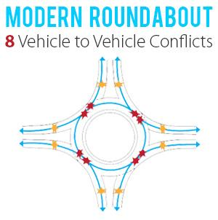
Benefits of Roundabouts
Conflict points are dramatically reduced because all vehicles travel in the same direction.
Enhances Safety
Roundabouts reduce the number of potential accident points within an intersection
75% fewer conflict points than four-way intersections
Slower vehicle speeds
Reduces the severity of crashes
Efficient traffic flow
Reduces need for turn lanes
Improves traffic flow
Community benefits
Reduces congestion
Aesthetic landscaping

Slide 19
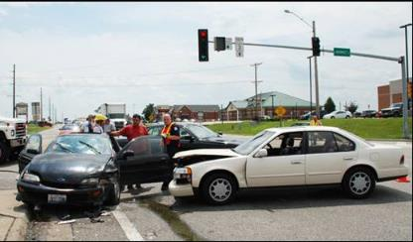
Roundabouts Enhance Safety
US DOT Federal Highway Administration Statistics
Traditional intersections account for:
45% of all crashes - FHWA
33% of all traffic fatalities - FHWA
Compared to traditional intersections roundabouts:
Reduce fatalities and injuries by 82% - FHWA
Reduce total crashes by 44% - FHWA
Require vehicles to travel at lower speeds
For more information: http://safety.fhwa.dot.gov/intersection/innovative/roundabouts/
Collisions at traditional intersections are severe because:
High Speed
Angle of Impact

Slide 20
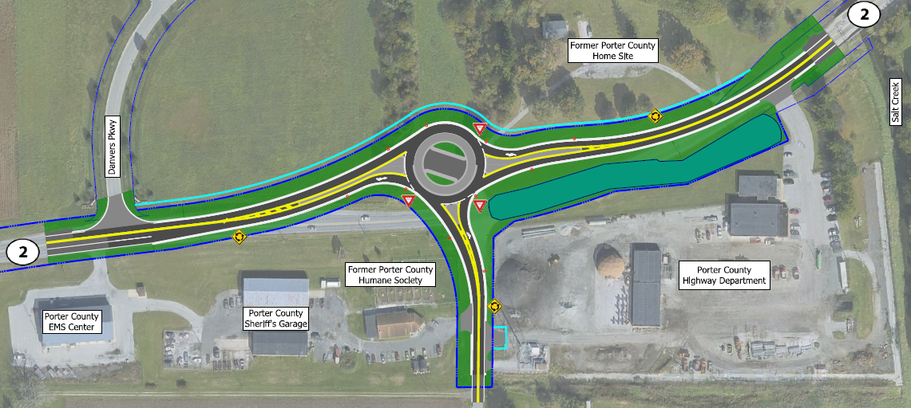
Proposed Roundabout Layout

Slide 21
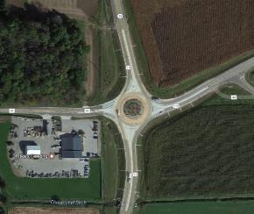
Approaching the Roundabout (example)
X
Images courtesy of Google Maps

Slide 22
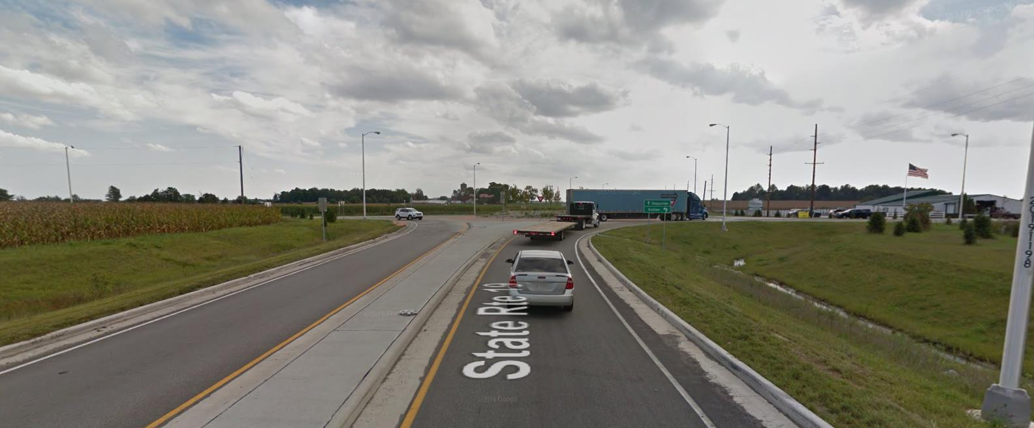
Approaching the Roundabout (example)
X
Images courtesy of Google Maps

Slide 23
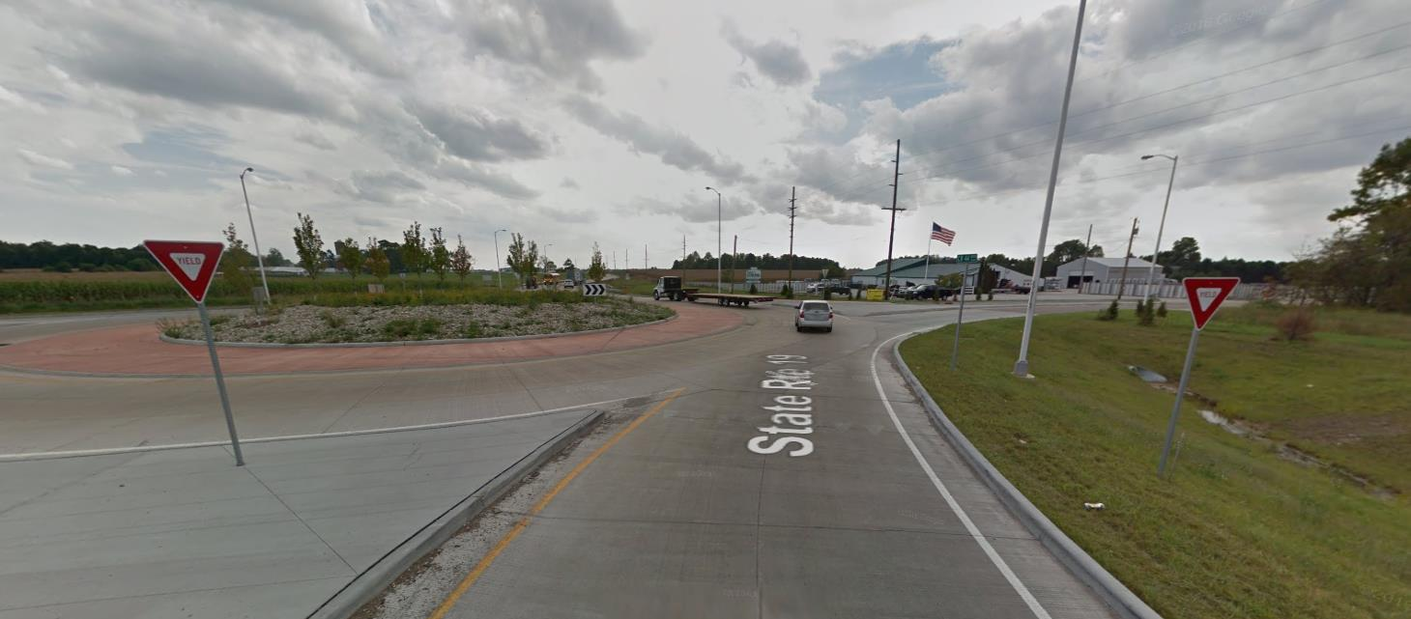
Approaching the Roundabout (example)
X
Images courtesy of Google Maps

Slide 24
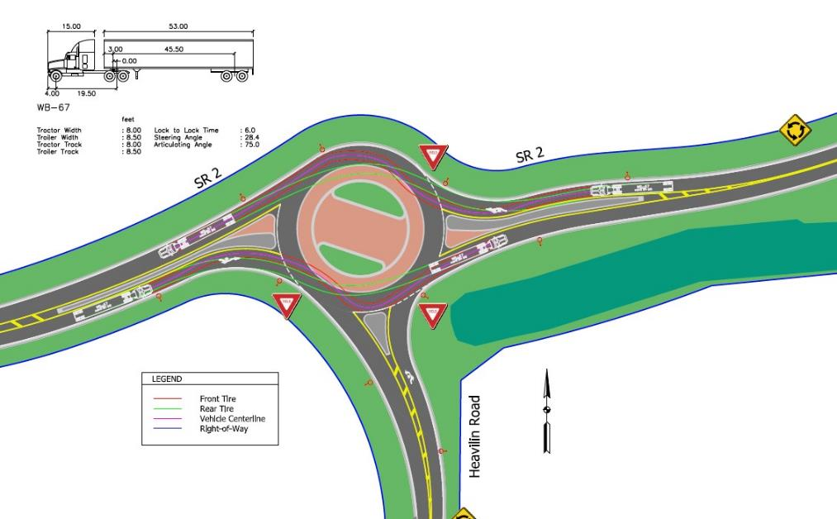
Turning Movement – Semi Truck

Slide 25
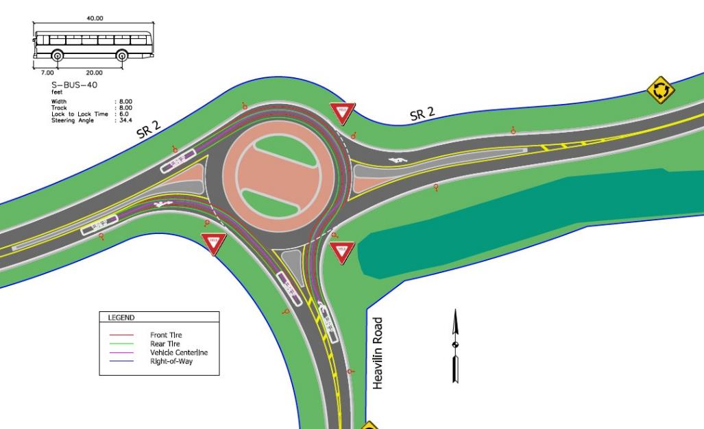
Turning Movement – Bus

Slide 26
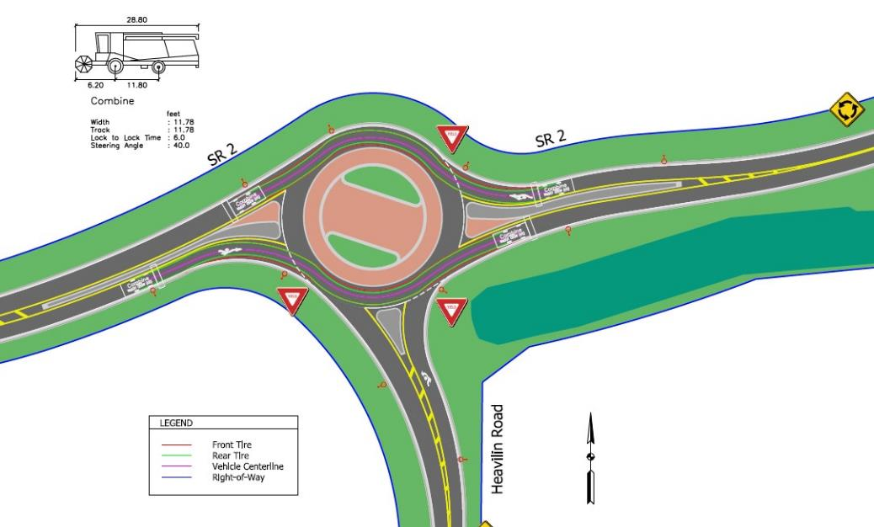
Turning Movement – Combine

Slide 27
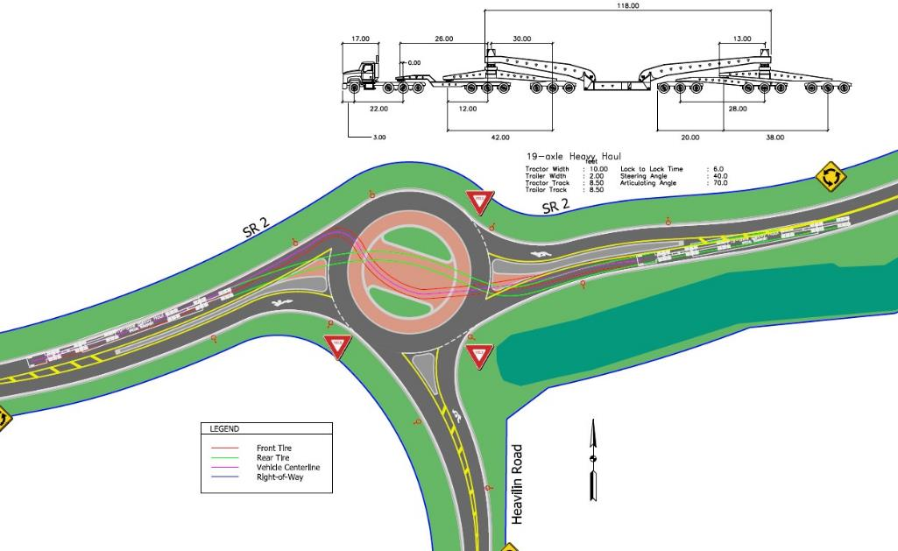
Turning Movement – Oversize / Overweight Vehicle

Slide 28
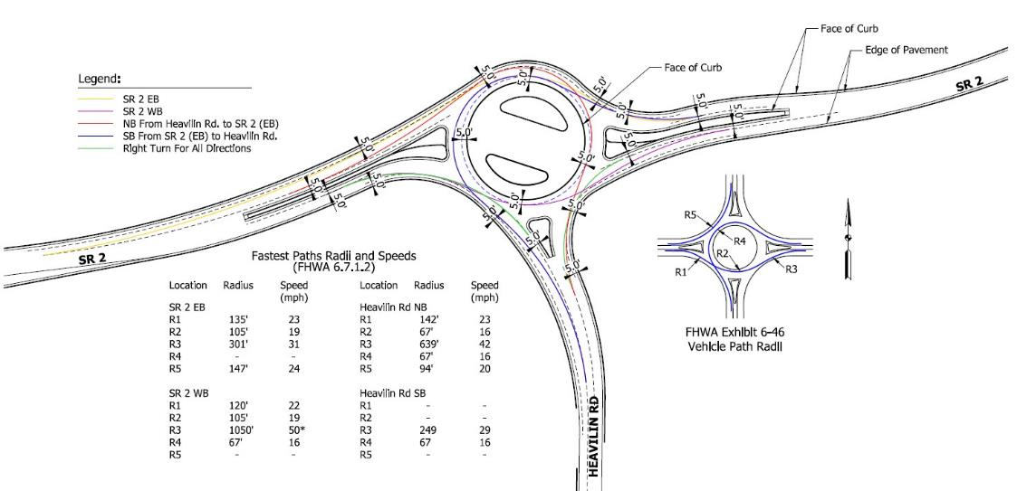
Fastest Path Checks

Slide 29
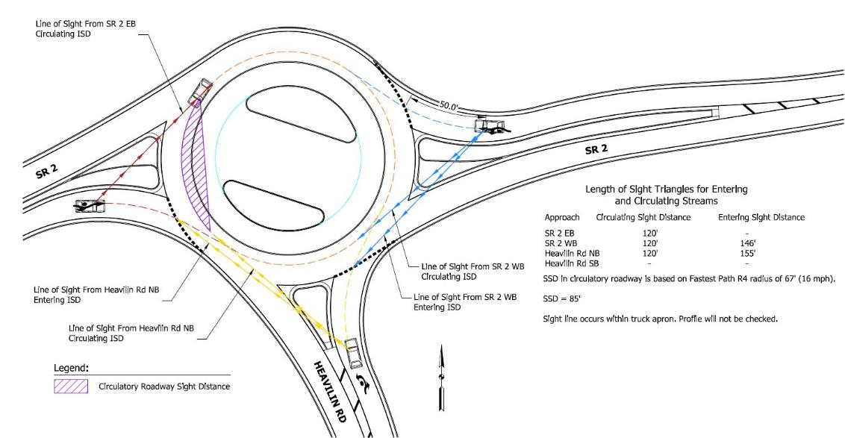
Sight Distance

Slide 30
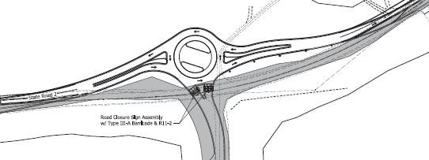
Maintenance of Traffic
Phased MOT – should not require full intersection closure
Phase 1:
Traffic will be maintained on existing SR 2
Heavilin Road will remain open
Work will focus north of SR 2:
Roundabout
East and west approaches
Phase 2:
SR 2 Traffic will be shifted through roundabout
Work will focus on the Heavilin Road approach
Heavilin Road will be closed at the intersection.
Phase 3:
Completion of curb line along the north side of
SR 2
Heavilin Road will reopen
Phase 1
Construction Zone
SR 2 Travel Lanes
Phase 2
SR 2 Travel Lanes
Construction Zone

Slide 31
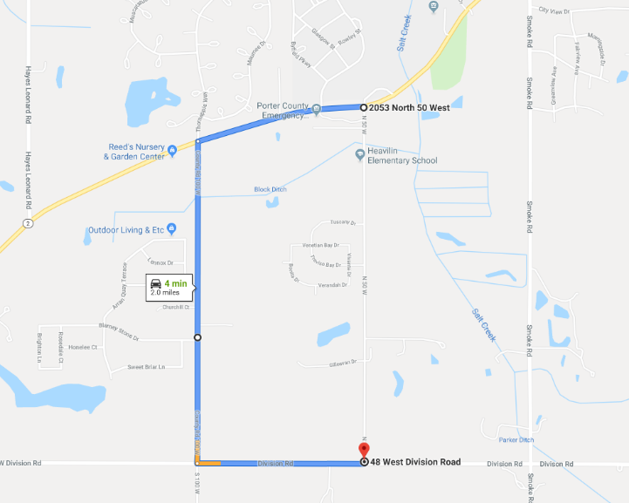
Detour Route

Slide 32
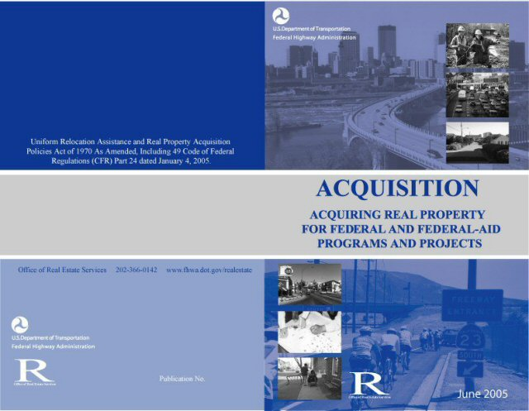
Real Estate Acquisition Process
"Uniform Act of 1970"
All federal, state and local governments must comply
Requires an offer for just compensation
Project proposal requires approximately 5 acres of permanent right-of-way

Slide 33
Submit Public Comments
Submit public comments using the options described in first page of information packet:
Public Comment Form
Via e-mail
Participating during public comment session via microphone
Verbal comments recorded and transcribed for inclusion into public hearings transcript
INDOT respectfully requests comments be submitted by Friday, June 7, 2019
All comments submitted will become part of public record, entered into transcript, reviewed, evaluated and given full consideration during decision making process.

Slide 34
Project Schedule
Public Hearing: May 13, 2019
Public comments requested by COB 6/7/19
INDOT review and consideration of comments – Summer 2019
finalize environmental document
design
project decision
Real estate acquisition phase – 2019
Construction: 2020

Slide 35
Next Steps
Public and project stakeholder input
Submit comments via options described in project handout
INDOT review and evaluation
All comments are given full consideration during decision-making process
Address comments, finalize/approve environmental document, complete project design
Communicate a decision
INDOT will notify project stakeholders of decision
Work through local media, social media outlets; paid legal notice
Make project documents accessible via repositories
Questions? Contact Public Involvement Team

Slide 36
Project Resource Locations
INDOT LaPorte District Office
315 East Boyd Boulevard, LaPorte, IN 46350
Planning, Project Development/Delivery, Construction, Maintenance for Northwest Indiana
http://www.in.gov/indot/2705.htm
Valparaiso Public Library
103 Jefferson Street, Valparaiso, IN 46383
Phone: (219) 462-0524
INDOT Office of Public Involvement
100 North Senate Avenue, Room N642, Indianapolis, IN 46204
Phone: (317) 232-6601
rclark@indot.in.gov
Visit Project Web Page https://www.in.gov/indot/3931.htm
Transportation Services Call Center
Provides citizen and business customers with a single point-of-contact to request transportation services, obtain information, or provide feedback through multiple channels of communications.
855-463-6848 • INDOT4U.com • INDOT@indot.in.gov

Slide 37
Public Comment Session
Please visit with INDOT project officials following the public comment session
Project Open House
Project maps, displays, real estate acquisition table, INDOT project team and informal Q & A
INDOT LaPorte District page http://www.in.gov/indot/2705.htm
LaPorteDistrictCommunications@indot.in.gov

