Slide 1
Public Involvement Process for Project Development
Indiana Department of Transportation
October 2020

Slide 2
INDOT Public Involvement
INDOT and Federal Highway Administration Joint Agreement
Establish a jointly approved public involvement policy for projects receiving federal-aid as part of funding mechanism
Develop criteria to determine which projects require public involvement
Projects that meet criteria undergo public involvement; proactive outreach encouraged for projects not meeting criteria
Determine what the required public involvement activities will be for projects meeting the criteria
Determine the timing of when required public involvement must occur
Perform PI activities, document activities performed, certify via signature when public involvement has been completed
Public Involvement Activities – required if project meets criteria
Level of impact a project may have on a community, the environment, historic properties/structures, residents, businesses
Activities include public hearings, publishing legal notices announcing proposed project, mailing notices directly to property owners, making project documents available for review at public repositories
Proactive Public Involvement
Activities not necessarily required per law or regulation but benefit the public and allow INDOT to serve its customers
Public meetings/Open Houses, website, newsletters, social media, communication to local news media, small group meetings
Planning
Project Selection
Public Involvement
Programming
Preliminary Engineering
Engineer’s Report
Environmental
Design
Public Involvement
Real Estate Acquisition
Utilities Coordination
Project Letting
Public Involvement
Construction

Slide 3
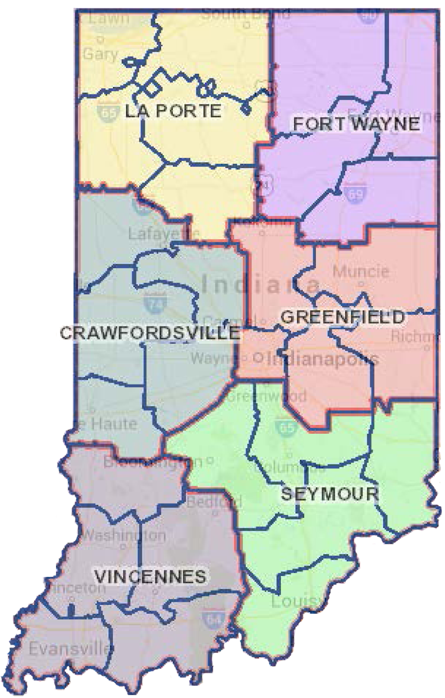
Phases Necessary to Deliver a Project
Planning & Programming (Project Selection)
Call for Projects
Early Consultation Meetings Process
Review & consider project proposals
Public Involvement
Select projects to accept into production
Project Development
Preliminary Engineering
Environmental
Public Involvement
Design
Real Estate
Project Delivery
Letting – accept bids from contractors to construct a project
Public Involvement
Construction
Maintenance
Operation

Slide 4
Provide input critical to transportation decision making
Transportation Stakeholders
Local Officials
MPOs / RPOs
FHWA / FTA
ADA advocates & stakeholders
Bike and Pedestrian planning organizations
Parks and recreational lands (Trails)
Local school corporation
LEP populations
Healthcare industries
Historic preservation groups
Transit (bus, rail)
Traditionally underserved populations
Environmental Justice, minority, Title VI
Freight logistics
Community organizations
Economic development
Emergency Services
Law Enforcement
Resource Agencies
Elected officials
Farming industries

Slide 5
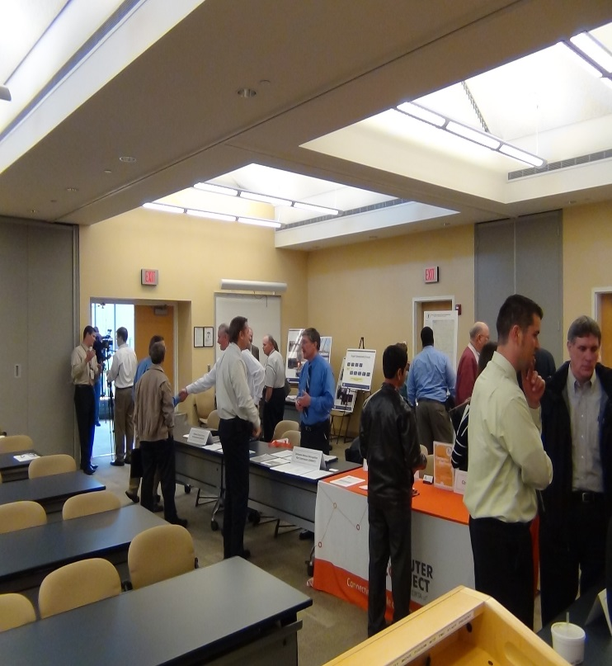
How to Get Plugged In
INDOT Website
Information regarding agency programs
Project specific webpages
Subscription opportunities to receive topic specific notification
GovDelivery – Tool used to send topic-specific messages to stakeholders
Social media engagement
http://www.in.gov/indot
INDOT District Offices
Contact and/or visit the INDOT District Office
Six district office locations throughout the state
Customer Service Center
Toll-Free Telephone Number
Email
Inquiries made to service center are documented and response times are tracked to ensure a timely response
Partners in Transportation Planning
Federal Highway Administration (FHWA), Federal Transit Administration (FTA)
Metropolitan Planning Organizations ̶ MPOs
Rural or Regional Planning Organizations ̶ RPOs

Slide 6
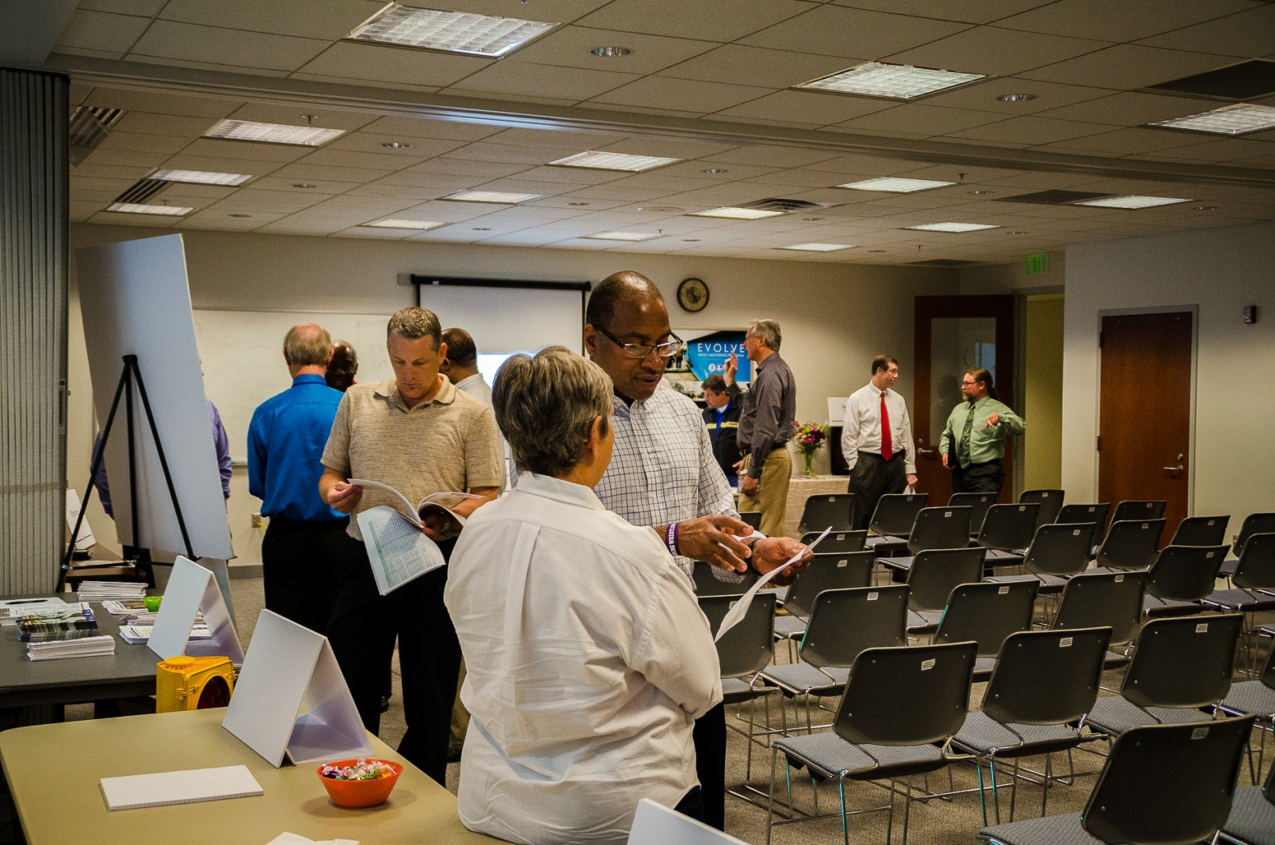
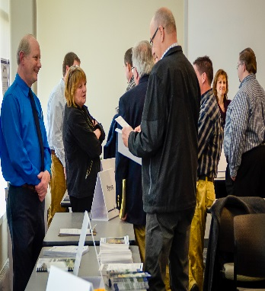
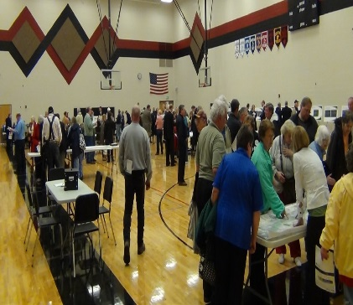
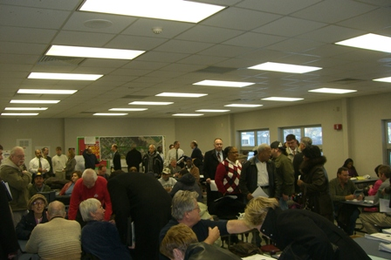
Stakeholder Engagement at INDOT

Slide 7
First Phase Necessary to Deliver a Project
Planning & Programming (Project Selection)
Call for Projects
Early Consultation Meetings Process
Review & consider project proposals
Public Involvement
Select projects to accept into production
Engage Non-MPO Local Officials as part of formal process to determine effectiveness of INDOT consultation process
Project Development
Preliminary Engineering
Environmental
Public Involvement
Design
Real Estate
Project Delivery
Letting – accept bids from contractors to construct the project
Public Involvement
Construction
Maintenance
Operations

Slide 8
Planning – Project Selection for State Projects
Call for Projects
INDOT initiates a formal process where proposals for new projects can be submitted
If approved, these projects are accepted into the INDOT production schedule
Early Consultation Meeting Process
Meetings in each district to discuss proposed projects submitted as a result of the Call for Projects
The District Offices lead the process of establishing stakeholder contacts, arranging meeting logistics and acting as hosts. INDOT and planning partners discuss and consider project proposals; goal is to develop a preliminary list of projects to accept into production schedule.
District Open Houses (when a Statewide Transportation Improvement Program (STIP) document is produced)
Start of process for new project proposals
INDOT Central and District Offices discuss project proposals
Public Open Houses to discuss transportation needs and present list of accepted projects

Slide 9
Planning – Project Selection for State Projects
What is a STIP?
The Statewide Transportation Improvement Plan (STIP) is a four-year planning document that lists all projects expected to be funded during those four years, including pavement and bridge facilities, and projects that address safety, congestion, mobility, and emergency response.
What does a STIP include?
The STIP includes investment in various modes, including highways, transit, pedestrian trails and paths, and bicycle facilities.
Why is a STIP important?
Only projects for which construction and operating funds can reasonably be expected to be available are included. If a project is not included in a STIP, it is not eligible for federal funding.
Must be developed at least once every 4 years
Public involvement is required when a STIP is developed

Slide 10
Project Selection Activity Timeline for State Projects
Aug - Dec
Jan - May
March - May
June - August
DISTRICT AREA/LPA/MPO EARLY CONSULTATION MEETING PROCESS
DISTRICT OPEN HOUSES during STIP years only
ACCEPT PROJECT PROPOSALS WHEN STIP IS DEVELOPED
CALL FOR PROJECTS
During STIP years, the STIP must be finalized and submitted to FHWA for approval. During Non-STIP years, project proposals can be accepted but must be included in the next STIP or be amended into current STIP
INDOT meets with planning partners, local officials and key stakeholders to discuss project proposals submitted in response to Call for Projects
INDOT meets with the public, local officials and key stakeholders to solicit input on transportation needs and/or to present and accept comment on STIP when applicable
INDOT coordinates and/or meets with local officials, key stakeholders and planning partners
STIP AMENDMENT PROCESS
Engage community stakeholders to raise awareness of Consultation Process
Engage local officials, key stakeholders through topical correspondence to raise awareness of STIP process (during STIP years) and to solicit input on transportation needs, various planning documents and INDOT programs
Engage community stakeholders to raise awareness of Call Process
Project proposals not accepted may be resubmitted during next Call For Projects
Notes:
10

Slide 11
INDOT District Open Houses
What
A meeting/open house held in each district to solicit public input on a variety of items including:
Transportation needs both short- and long-term
The Statewide Transportation Improvement Program (STIP)
The effectiveness of the Annual Program Development Process (APDP)
Various INDOT planning and program documents
Other topics related to project selection
Why
INDOT values receiving input from transportation stakeholders; these meetings help us achieve this goal
How Often
Required to be held when a STIP document is produced; may also be held during non-STIP years at INDOT’s discretion
Get Involved
Visit agency website to learn of related processes and to subscribe via GovDelivery to receive INDOT news, updates and topic related information

Slide 12
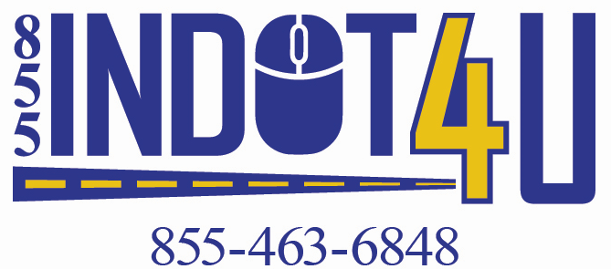
INDOT Regional Offices
When it comes to transportation planning, where you live is important. INDOT District Offices work with communities to identify needs, opportunities and solutions to transportation challenges.
INDOT LaPorte District INDOT Greenfield District INDOT Crawfordsville District
315 E. Boyd Blvd. 32 South Broadway 41 West 300 North
LaPorte, IN 46350 Greenfield, IN 46140 Crawfordsville, IN 47933
https://www.in.gov/indot/2705.htm https://www.in.gov/indot/2704.htm https://www.in.gov/indot/2701.htm
INDOT Fort Wayne District INDOT Seymour District INDOT Vincennes District
5333 Hatfield Road 185 Agrico Lane 3650 South U.S. Highway 41
Fort Wayne, IN 46808 Seymour, IN 47274 Vincennes, IN 47591
https://www.in.gov/indot/2703.htm https://www.in.gov/indot/2706.htm https://www.in.gov/indot/2707.htm
Transportation Services Call Center
Provides citizen and business customers with a single point-of-contact to request transportation services, obtain information, or provide feedback through multiple channels of communications.
855-463-6848 • INDOT4U.com • INDOT@indot.in.gov

Slide 13
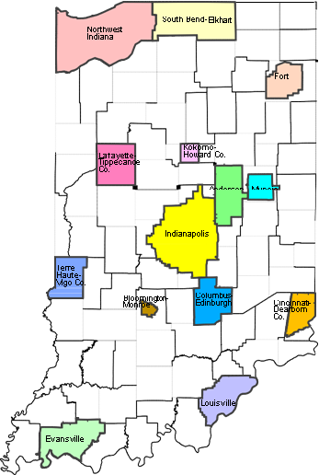
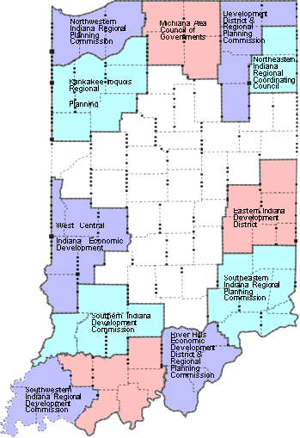
Transportation Planning Where You Live
When it comes to transportation planning, where you live matters. Projects that involve local/city streets or county roads are the responsibility of local city or county governments. INDOT administers funding to local municipalities for transportation improvement projects.
Metropolitan Planning Organizations (MPOs) – MPOs are federally
required transportation planning bodies that represent the local, state and federal
government or agencies. In urbanized areas of 50,000 or more, transportation
planning is done in cooperation with the MPO. Visit www.indianampo.com for
more information. MPOs conduct public involvement activities within their areas of jurisdiction.
Rural or Regional Planning Organizations (RPOs) – RPOs serve
the transportation needs for small urban and rural areas. RPOs support INDOT
planning staff with public outreach, technical assistance, and data collection.
Non-MPO Areas - These include small towns and cities not included in an MPO area.
In non-metropolitan areas, INDOT district offices conduct transportation planning and help
develop lists of projects to be included in the Statewide Transportation Improvement Program.

Slide 14
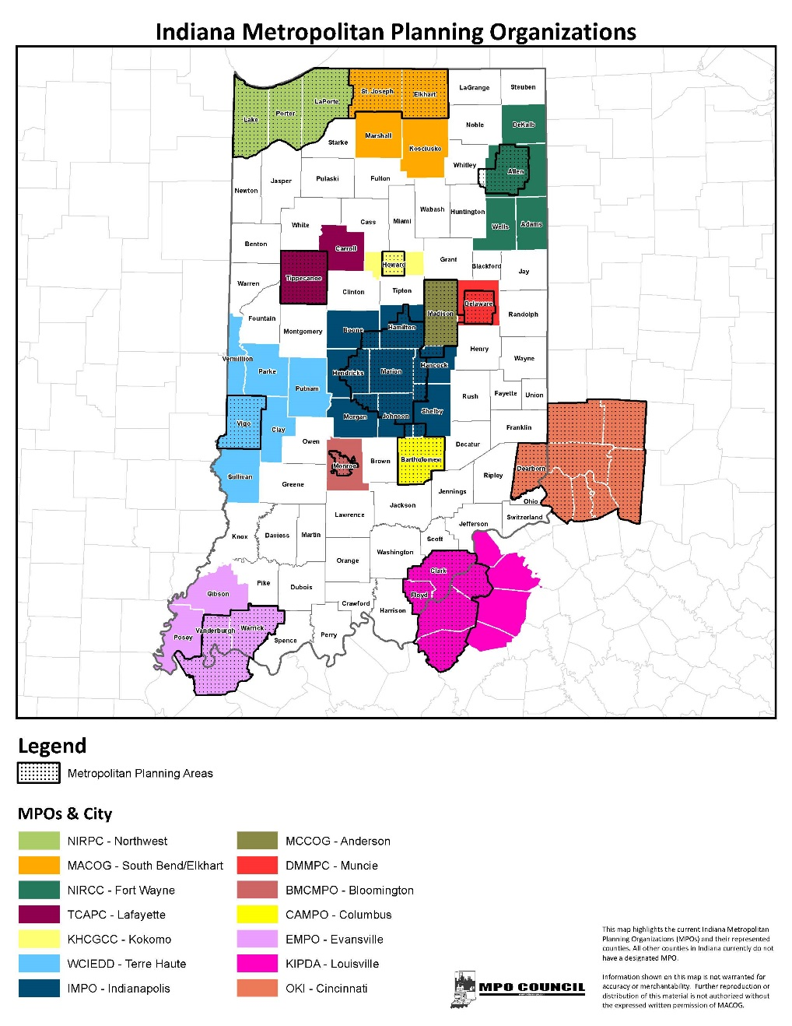
Metropolitan Planning Organizations
Fourteen Metropolitan Planning Organizations (MPOs)
Anderson
Bloomington
Ohio-Kentucky-Indiana (OKI)
Columbus
Evansville
Fort Wayne
Indianapolis
Kokomo
Lafayette
Louisville
Muncie
Northwest Indiana
Terre Haute
South Bend / Elkhart

Slide 15
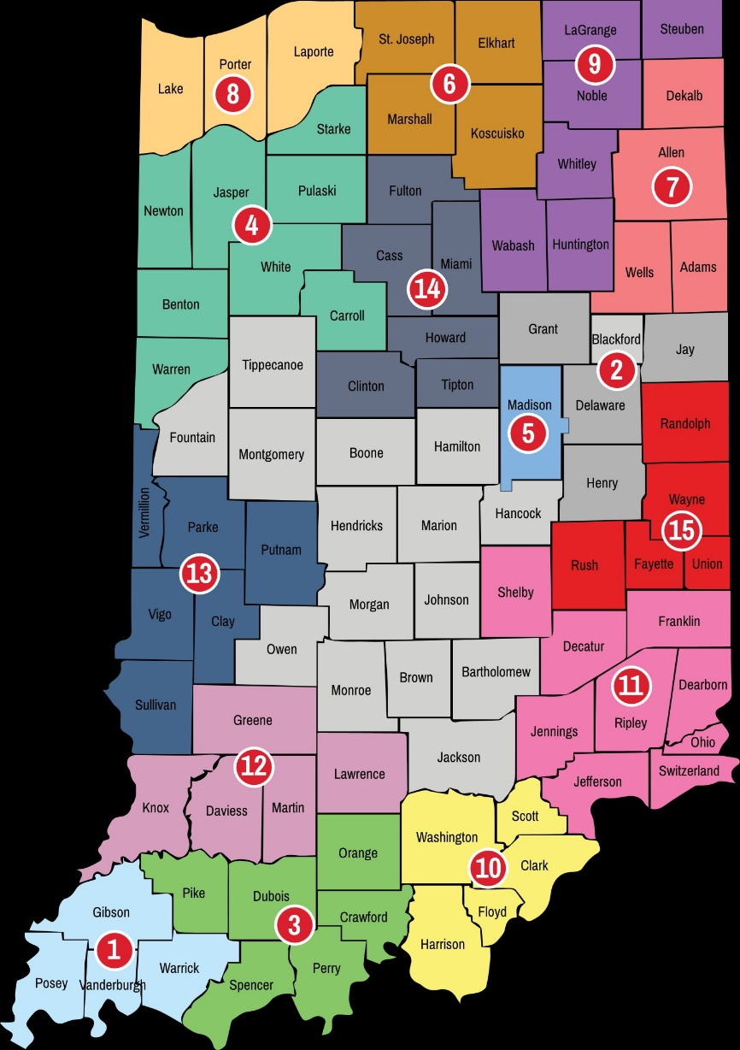
State RPOs and Counties Covered
Indiana Association of Regional Councils
Northwest Indiana Regional Planning Commission (8)
Michiana Area Council of Governments (6)
Region III- A Economic Development District & Regional Planning Commission (9)
Kankakee – Iroquois Regional Planning Commission (4)
North Central Indiana Regional Planning Council (14)
Northeastern Indiana Regional Coordinating Council (7)
Madison County Council of Governments (5)
East Central Indiana Regional Planning District (2)
West Central Indiana Economic Development District (13)
Eastern Indiana Regional Planning Commission (15)
Southern Indiana Development Commission (12)
Southeastern Indiana Regional Planning Commission (11)
Economic Development Coalition of Southwest Indiana (1)
Indiana 15 Regional Planning Commission (3)
River Hills Economic Development District & Regional Planning Commission (10)

Slide 16
INDOT Regional Offices
When it comes to transportation planning, where you live is important. INDOT District Offices work with communities to identify needs, opportunities and solutions to transportation challenges.
INDOT LaPorte District INDOT Greenfield District INDOT Crawfordsville District
315 E. Boyd Blvd. 32 South Broadway 41 West 300 North
LaPorte, IN 46350 Greenfield, IN 46140 Crawfordsville, IN 47933
https://www.in.gov/indot/2705.htm https://www.in.gov/indot/2704.htm https://www.in.gov/indot/2701.htm
INDOT Fort Wayne District INDOT Seymour District INDOT Vincennes District
5333 Hatfield Road 185 Agrico Lane 3650 South U.S. Highway 41
Fort Wayne, IN 46808 Seymour, IN 47274 Vincennes, IN 47591
https://www.in.gov/indot/2703.htm https://www.in.gov/indot/2706.htm https://www.in.gov/indot/2707.htm
Transportation Services Call Center
Provides citizen and business customers with a single point-of-contact to request transportation services, obtain information, or provide feedback through multiple channels of communications.
855-463-6848 • INDOT4U.com • INDOT@indot.in.gov

Slide 17
Second Phase Necessary to Deliver a Project
Planning & Programming (Project Selection)
Call for Projects
Early Consultation Meetings Process
Review & consider project proposals
Public Involvement
Select projects to accept into production
Project Development
Preliminary Engineering
Environmental
Public Involvement
Design
Real Estate
Project Delivery
Letting – accept bids from contractors to construct project
Public Outreach
Construction
Maintenance
Operations

Slide 18
Project Development – When a Project is Added to INDOT Schedule
Develop a Public Involvement Plan
Assess level of project impact to local community; discuss/determine appropriate level of public involvement
Level of Public Involvement determined by scope of project and environmental impact
Three categories of projects in terms of impact
Categorical Exclusion – lower level of environmental impact
Environmental Assessment – moderate level of environmental impact
Environmental Impact Statement – high level of environmental impact
Required Public Involvement
Per federal law (National Environmental Policy Act) and with oversight from the Federal Highway Administration (FHWA), state departments of transportation are required to have a public involvement program
Identify public outreach opportunities, implement activities
Legal notices, website, media/social media, public meetings, open houses, hearings, small group/local official’s meetings
Planning
Programming
Project Selection
Preliminary Engineering
Engineer’s Report
Environmental
Design
Public Involvement
Phase
Real Estate Acquisition
Utilities Coordination
Project Letting
Construction

Slide 19
INDOT Public Involvement
INDOT and Federal Highway Administration Joint Agreement
Public Involvement Activities – Required if project meets criteria
Level of impact a project may have on a community, the environment, historic properties/structures, residents, businesses
Activities include public hearings, publishing legal notices announcing proposed project, mailing notices directly to property owners, making project documents available for review at public repositories
Proactive Public Outreach
Activities not necessarily required per law or regulation but benefit the public and allow INDOT to serve its customers
Public meetings/Open Houses, website, newsletters, social media, communication to local news media, and small group meetings
Planning
Project Selection
Public Involvement
Programming
Preliminary Engineering
Engineer’s Report
Environmental
Design
Public Involvement
Real Estate Acquisition
Utilities Coordination
Project Letting
Public Outreach
Construction

Slide 20
PI Criteria – Projects Require Public Involvement If…
Proposal requires a one-half acre (0.5) or more of permanent right-of-way
Land purchased by INDOT for transportation improvement purposes
Proposal substantially changes layout or functions of connecting roadways
Example: An intersection conversion from a traditional intersection to a roundabout or median U-Turn may warrant public involvement
Proposal has substantial adverse impact on abutting property
Example: A multi-use trail project within close proximity of a residential area may pose an impact warranting public involvement
Proposal has significant social, economic, environmental or other effects
Examples: a noise wall project, new interchange, projects impacting low income and minority populations, projects on new alignment
Proposal is determined by the Federal Highway Administration to warrant a public hearing
Partnership agreement with INDOT as a majority of transportation improvement projects receive federal funding
Proposal is a Federal-aid highway project involving the bypassing of, or going through any city, town, community or proposal is for an interstate system
Proposal involves impact to a historic structure and/or a cultural resource
INDOT has partnership agreements with FHWA and various resources agencies (including historic preservation) which requires public involvement for projects when a historic bridge, property or structure is involved
Proposals involving potential impact to recreational properties (parks, school athletic fields) and areas of cultural, historical, archeological significance

Slide 21
INDOT Public Involvement
For projects meeting PI criteria, requirements can be satisfied by:
Publishing a Planned Improvement Notice – Offering the opportunity to request a public hearing
Ensuring an environment document has been released for public involvement
Publishing legal notice two times in most widely circulated paper(s); minority paper(s) in project area, when applicable
Performing stakeholder notification activities as notification should be sent to project stakeholders; mail to property owners within project area
Ensuring copies of environment document and preliminary design plans are available for public review at local repositories
Minimum 15-day notice offers the public the opportunity to request hearing and/or express concerns regarding a proposed project
If no hearing is held – Concerns and comments must be addressed prior to hearings certification
INDOT project management teams work with impacted stakeholders to address concerns; stakeholder coordination is documented as part of public involvement process
Environmental document released for public involvement
Notice of Planned Improvement to solicit input (offering of public hearing)
Publish notice twice in local newspaper(s), approximately a week apart, make environmental document available at public repositories
Public review of environmental document and design plans
Allow a minimum of 15 days from the date of 1st publishing to receive public comments
Public comment period
Public comments received are documented & addressed
Project receives public involvement certification

Slide 22
INDOT Public Involvement
For projects meeting PI criteria, requirements can be satisfied by:
Holding a public hearing
Publishing a Notice of Public Hearing – Announcement of public hearing (date, time, location, purpose)
Ensuring an environment document has been released for public involvement
Publishing legal notice two times in most widely circulated paper(s); minority paper(s) in project area, when applicable
Performing stakeholder notification as notification should be sent to project stakeholders (via mail and/or email); mail to property owners within project area
Ensuring copies of environment document and preliminary design plans are available for public review at local repositories
Minimum 15-day notice offers the public the opportunity to request hearing and/or express concerns regarding a proposed project
If hearing is held – A hearing transcript is prepared, public involvement requirements certified THEN comments must be addressed as part of final environmental document. Project stakeholders are notified of project decision.
Environmental document released for public involvement
Notice of Public Hearing
Publish notice twice in local newspaper(s), approximately a week apart, make document available at local repositories
Public review of environmental document
Allow a minimum of 15 days from the date of 1st publishing to receive public comment
Hold Public Hearing
Public comment period
Public Hearings transcript
Hearing Certification
Address public comments
Approve Environmental Document
Additional public involvement after approved document

Slide 23
Third Phase Necessary to Deliver a Project
Planning & Programming (Project Selection)
Call for Projects
Early Consultation Meetings Process
Review & consider project proposals
Public Involvement
Select projects to accept into production
Project Development
Preliminary Engineering
Environmental
Public Involvement
Design
Real Estate
Project Delivery
Letting – accept bids from contractors to construct project
Public Outreach
Construction
Maintenance
Operations

Slide 24
Public Involvement at INDOT

Slide 25
Public Involvement at INDOT

Slide 26
Public Involvement at INDOT

Slide 27
Public Involvement at INDOT

Slide 28
INDOT Public Involvement
INDOT Website: http://www.in.gov/indot
Metropolitan Planning Organizations: www.indianampo.com
Rural/Regional Planning Organizations:
Indiana Association of Regional Councils: http://www.iarc.cc

