Slide 1
PUBLIC MEETING
US 33 Roadway Project
(Des. No. 2000027)
Goshen, Elkhart County, Indiana
Wednesday, March 4, 2026
6:30 PM
Goshen High School, 401 Lincolnway E, Goshen, IN

Slide 2
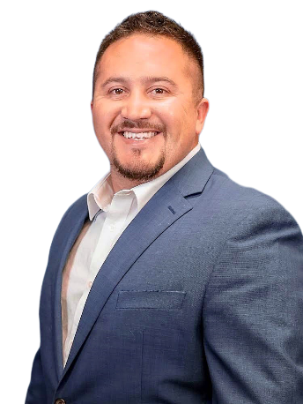

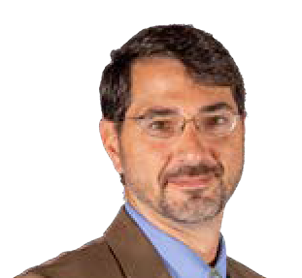

Project Team
MIGUEL
SETH
JEFF
ALYSSA
Indiana Department of Transportation (INDOT)
Miguel Tucker Project Manager
American Structurepoint, Inc.
Scott Crites, PE Project Development Director
Seth Boyd, PE Project Manager
Jeff Byrd, PE Senior Engineer
Shashad Gujaran, PE Traffic Project Manager
Bri Hope Environmental Project Manager
Alyssa Kern Senior Environmental Specialist

Slide 3
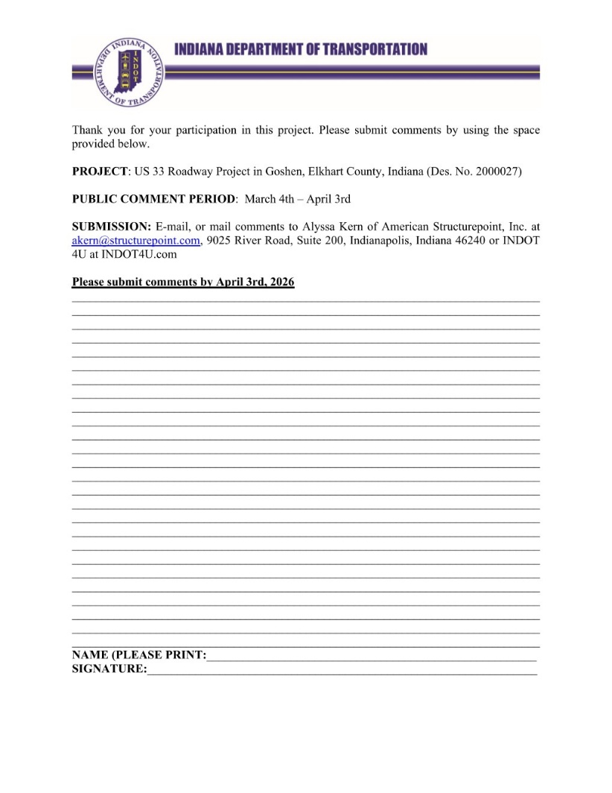

Meeting Format
In-person or live stream
  Short presentation
  Live Stream Link: https://bit.ly/US33AddedTravelLanes
  Followed by an open house for a closer look at project exhibits and discussion with the project team
    Virtual attendees can view exhibits and handouts at the website
Online via website
  Project website: on.in.gov/US33TravelLanes
  Presentation slides, exhibits, and handouts available
Questions and comments can be sent by
  Mail: Alyssa Kern, American Structurepoint, Inc.
    9025 River Road, Suite 200
    Indianapolis, IN 46240
  Email: akern@structurepoint.com

Slide 4



Presentation Agenda
Project Location
Purpose & Need Overview
Project Alternatives
Proposed Project Improvements
Maintenance of Traffic
Environmental Process
Anticipated Project Schedule
Next Steps
Meeting Intent
Project Location
Purpose & Need Overview
Project Alternatives
Proposed Project Improvements
Environmental Process
Anticipated Project Schedule
Next Steps

Slide 5
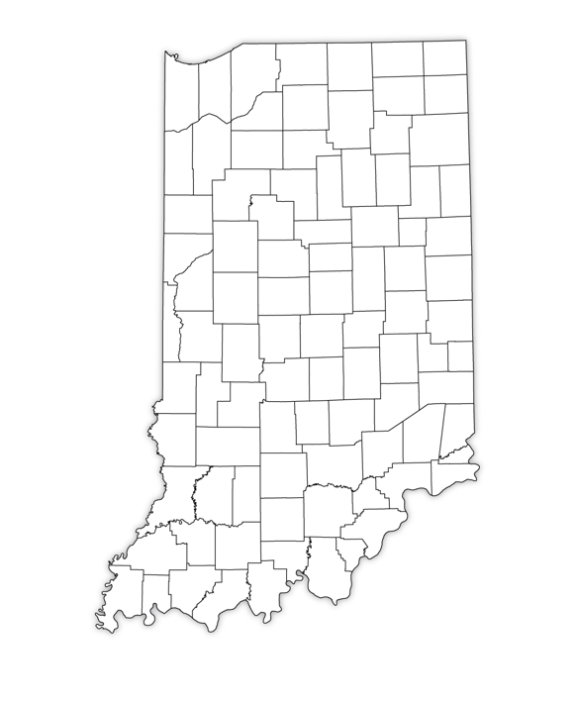
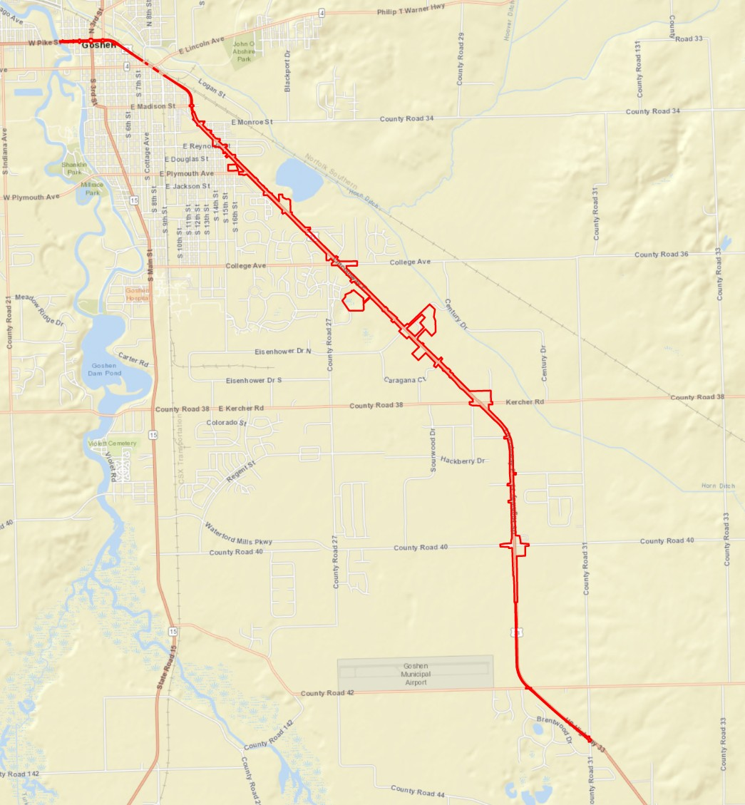
Project Location
N
Goshen, Elkhart County, Indiana

Slide 6
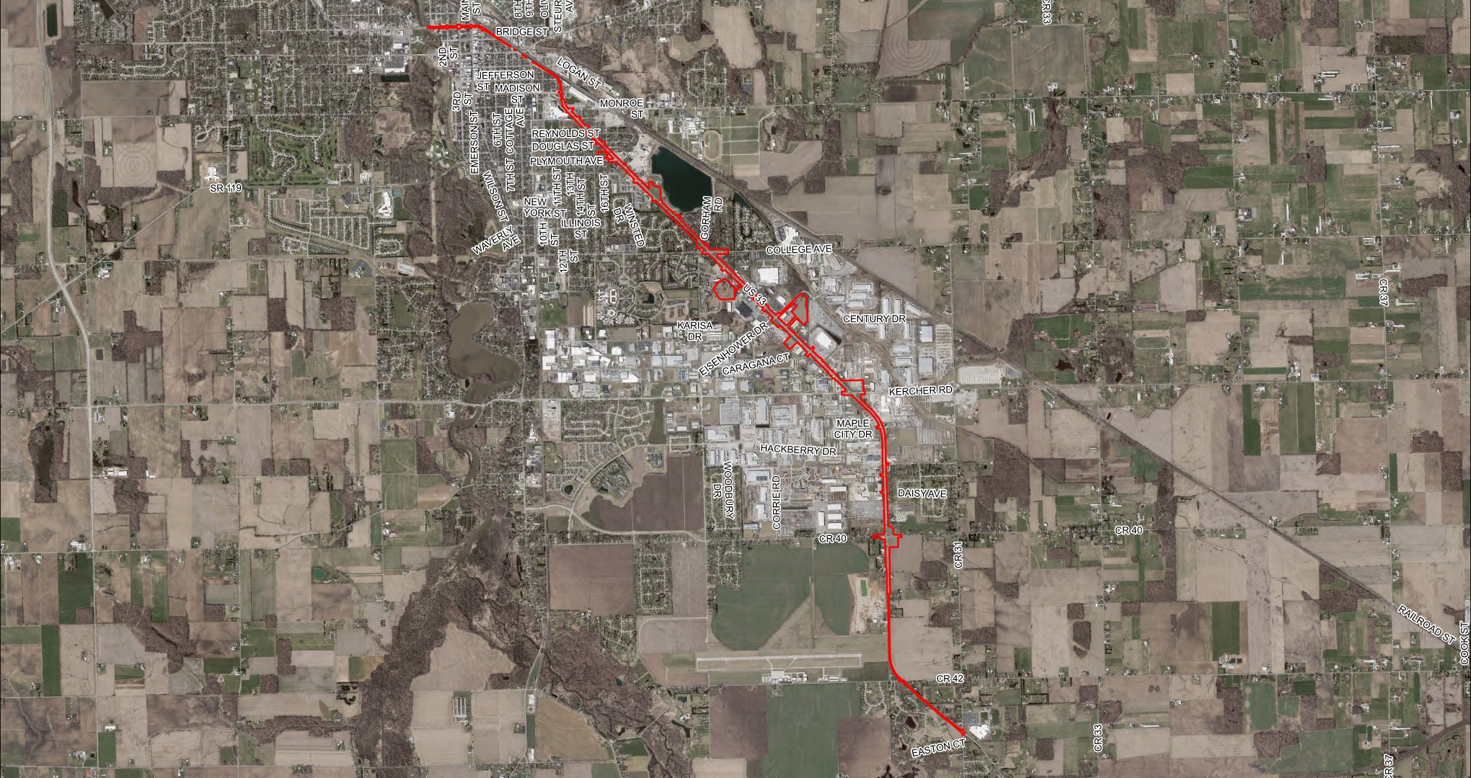
Project Area
N
End Project
Begin Project

Slide 7
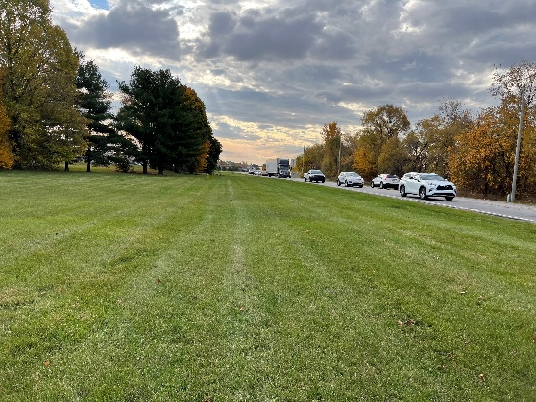
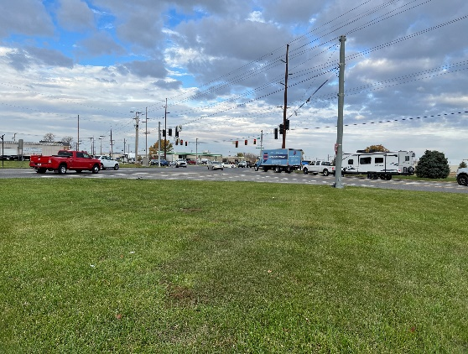
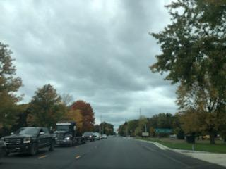
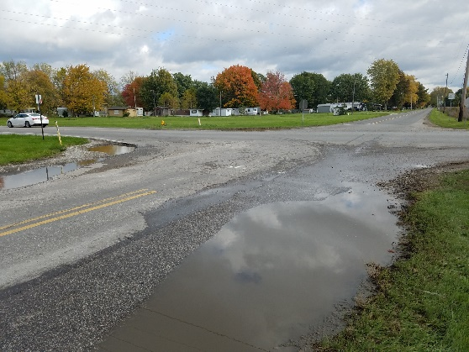
Need of the Project
Significant Traffic Congestion
  Occurs along US 33 during peak travel times
  Results in long vehicle queues impacting adjacent properties
Crashes
  564 crashes occurred from 2022 to 2024
  367 crashes (65%) were rear-end crashes
Drainage
  No defined drainage system

Slide 8
Purpose of the Project
Decrease traffic congestion and queuing
  Increase the level of service along this section of US 33
  Reduces long vehicle queue lengths
Improve safety
  Reduce the number of crashes along this section of US 33
Improve stormwater drainage
  Provide a defined storm sewer system

Slide 9
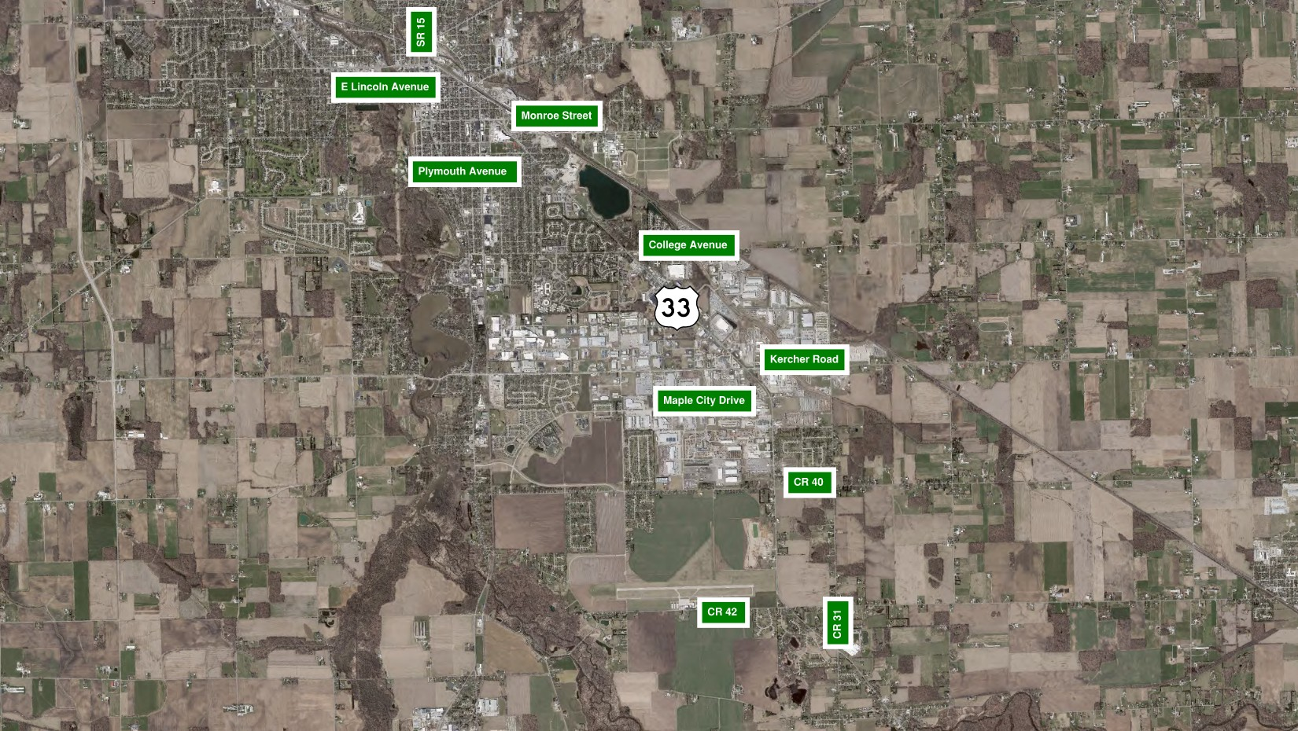
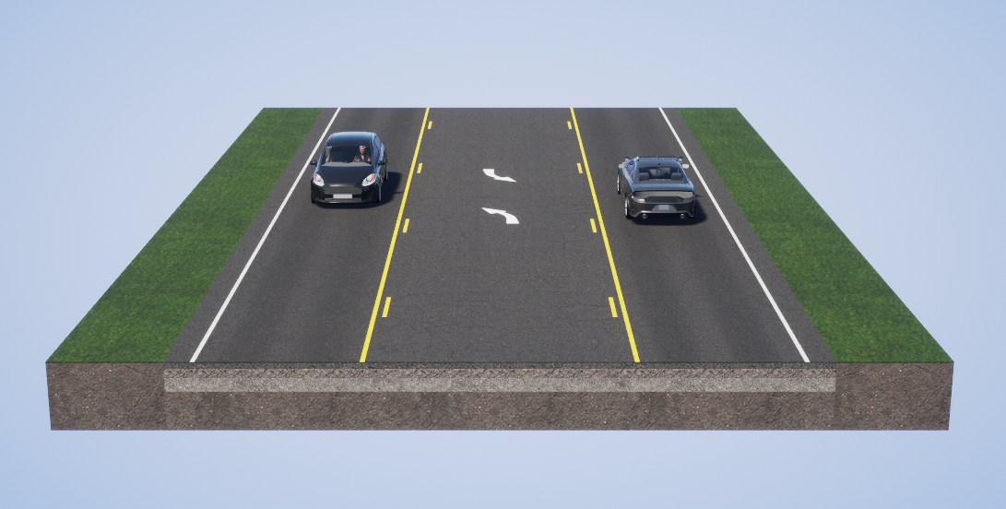
Existing Conditions
N
End Project
Stop controlled
Signalized
Signalized
Stop controlled
Begin Project

Slide 10
Project Alternatives
Alternative 1
  No build
Alternative 2 (Three-lane Section)
  Three-lane section (one travel lane in each direction and two-way left turn lane)
  Left turn lanes to US 33 at CR 40
  Mill and resurface from CR 31 to the Elkhart River Bridge
Alternative 3 (Four-lane Section)
  Four-lane section (two travel lanes in each direction)
  Left turn lanes to US 33 at CR 40
  Mill and resurface from CR 31 to the Elkhart River Bridge
Alternative 4 (Five-lane/ Four-lane Section)
  Five-lane section (from Kercher Road to Plymouth Avenue)
  Four-lane section (from Plymouth Avenue to Monroe Street)
    Left turn lanes would be provided at key intersections
  Left turn lanes to US 33 at CR 40
  Mill and resurface from CR 31 to the Elkhart River Bridge

Slide 11
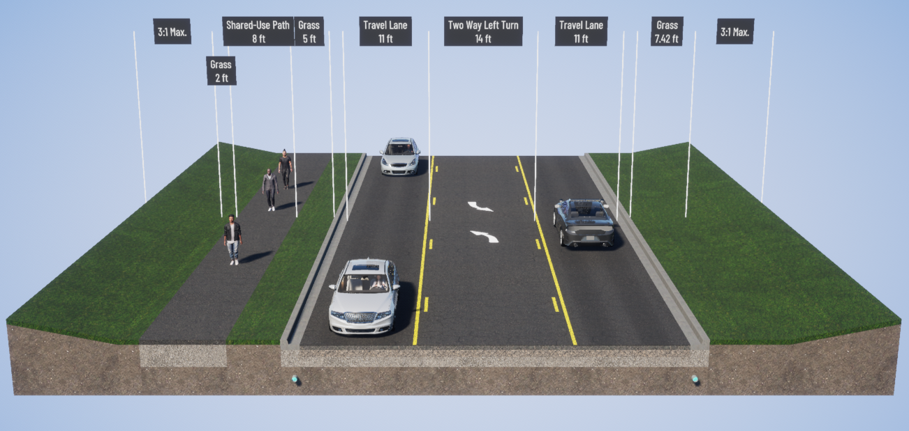
Alternative 2 – Three Lane Section
One travel lane in each direction
Two-way center left turn lane
Curb and gutter
Storm sewer
Shared-use path

Slide 12
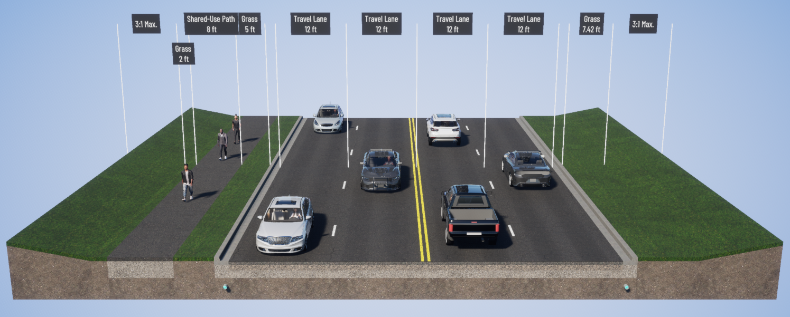
Alternative 3 – Four Lane Section
Two travel lanes in each direction
Curb and gutter
Storm sewer
Shared-use path

Slide 13
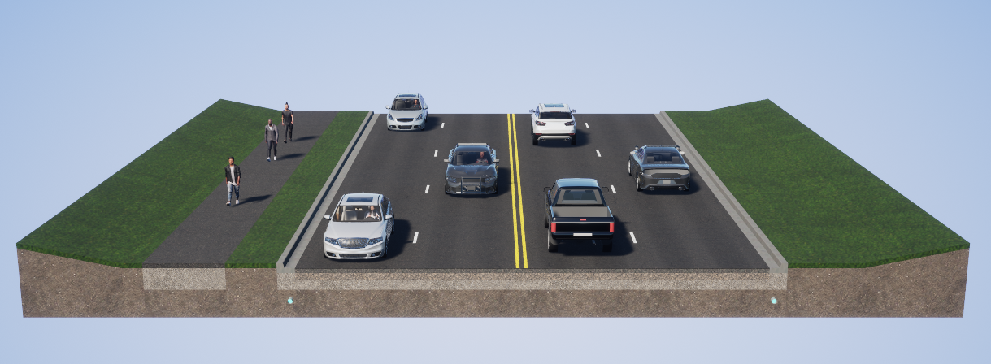
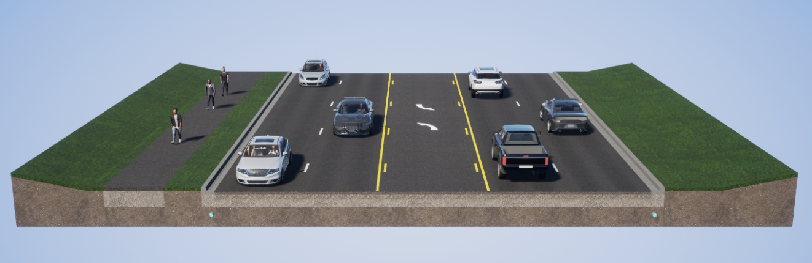
Alternative 4 – Four Lane and Five Lane Section
N

Slide 14
Evaluation of Alternatives
Alternatives are first evaluated to determine if they meet the purpose and need of the project
  Improve level of service
  Improve safety
  Improve drainage
Any alternative that does not meet the purpose and need were eliminated from further consideration

Slide 15
Evaluation of Alternatives
Alternative 1 (No Build)
  Would not improve level of service
  Would not improve safety
  Would not improve drainage
Alternative 2 (Three-lane section)
  Would not improve level of service
  Would not improve safety
  Improve drainage
Alternative 3 (Four-lane section)
  Improves level of service
  Would not improve safety
  Improve drainage
Alternative 4 (Four-lane and Five-lane section)
  Improves level of service
  Improves safety
  Improves drainage

Slide 16
Preliminary Recommended Alternative 4
Pavement Replacement
N
Pedestrian crossing at Fidler Pond Park
Full Depth Reconstruction and Widening
Updated pavement markings, signage, and signal modifications
Multi-use Path with a Grass Buffer
Mill and Resurfacing
Full Depth Reconstruction, Turn Lanes, and new signal

Slide 17
Maintenance of Traffic (MOT)
MOT Segment V
N
MOT Segment III
MOT Segment II
MOT Segment I
Mill and Resurfacing
MOT Segment IV

Slide 18
Environmental Process
Requirement of the National Environmental Policy Act (NEPA)
  Requires evaluation of the environmental impacts of the project on the natural and social environment
    Waterways, wetlands, endangered species, etc.
    Historic Resources
  Environmental document
    Prepared in accordance with state and federal guidelines
    Evaluates impacts of proposed project
    Evaluates several possible alternatives including a “Do Nothing” or “No Build” alternative to serve as a baseline comparison
  The goal is to Avoid, Minimize, and Mitigate impacts

Slide 19
Environmental Process
NEPA Status
  Gathering information and identifying resources
    Water resources
      Various wetlands
    Noise
    Section 4(f)
      Fidler Pond Park
      Fidler Pond Trail Head
    Historic resources
  Evaluating alternatives
  Coordinating with local, state, and federal agencies
  Gathering community/public input

Slide 20
Environmental Process
Historic Resources
Section 106 of the National Historic Preservation Act (NHPA)
  Evaluate all above ground structures 50 years old or older for eligibility for the National Register of Historic Places (NRHP or National Register)
  Requires below ground, or archaeological investigation, to look for things that people may have made, used, or left behind

Slide 21
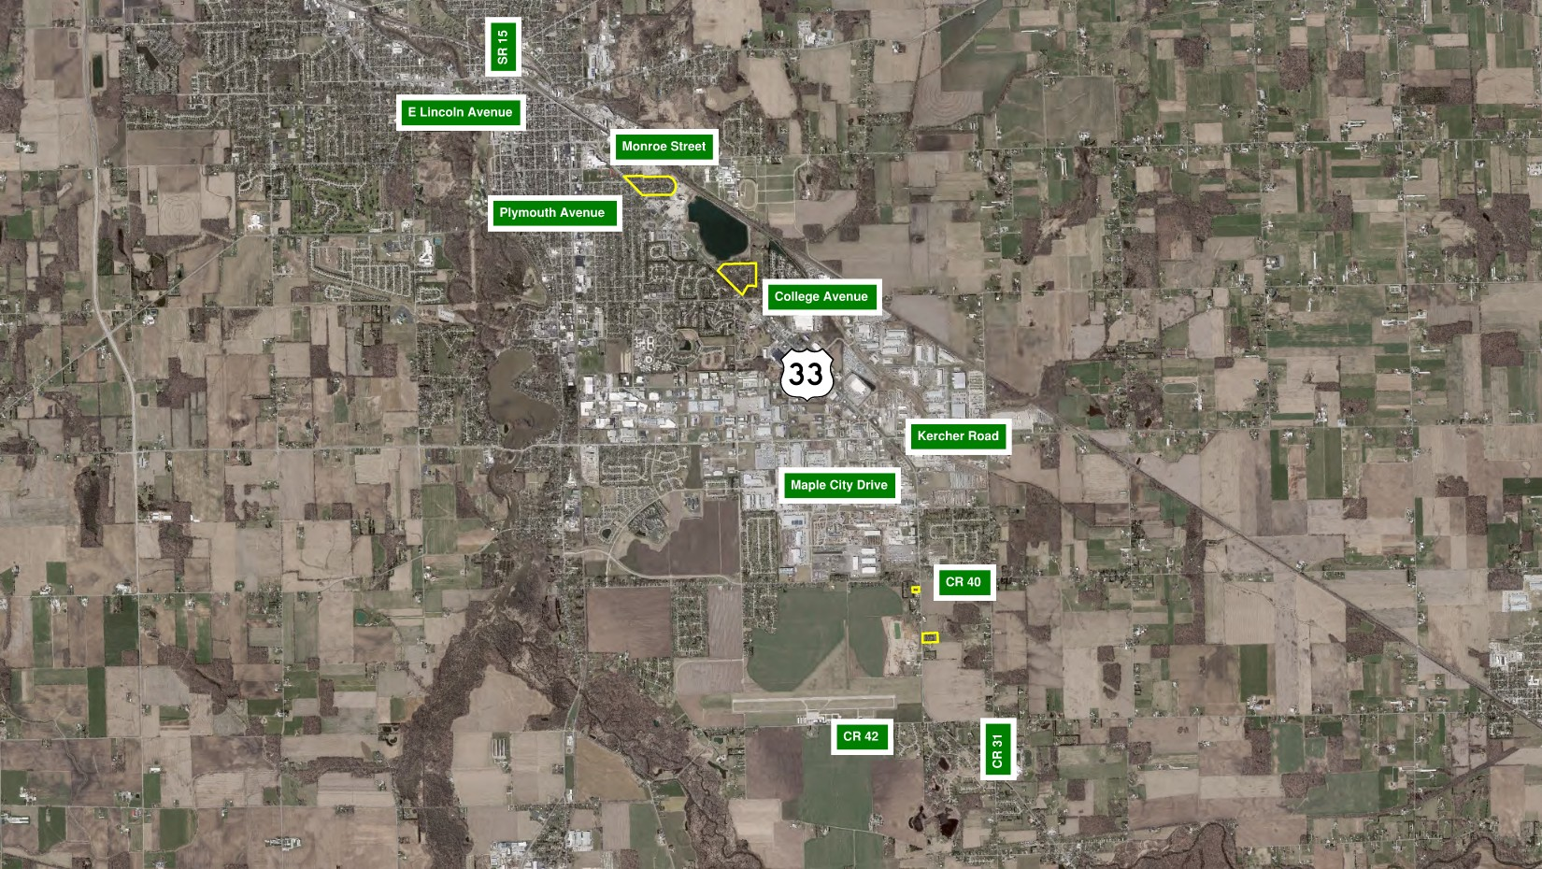
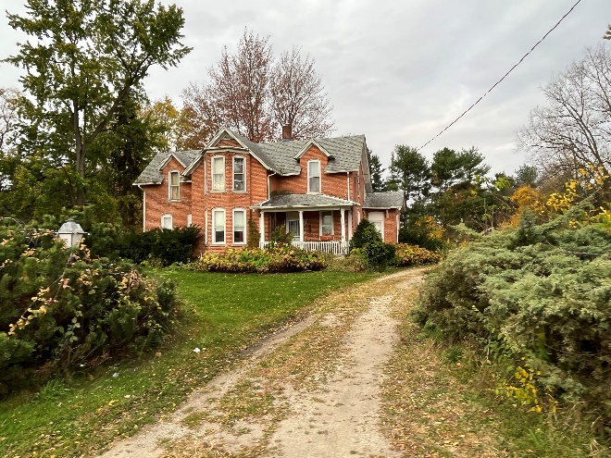
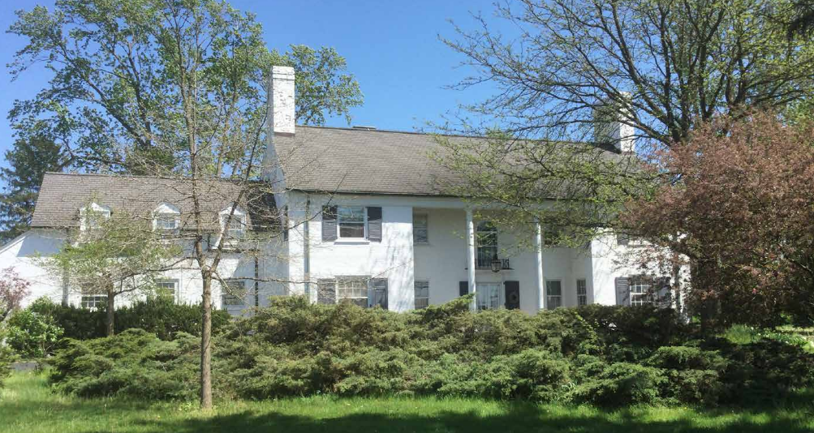
N
Fidler Estates Historic District
Gorham Woods Historic District
Israel Hess House
Nymeyer House

Slide 22


Community Involvement
Notice of Survey
Public Information Meeting

Slide 23
Anticipated Project Schedule
ESTIMATED TIMELINE
Spring
2026
Fall
2026
Winter
2026
Spring
2027
Spring
2027
Spring
2028
Public Information Meeting
Draft Env. Document
Public Hearing
Env. Doc. Approved
Land Acquisition
Begin Utility Relocation/ Construction*
*Construction is anticipated to last for three seasons

Slide 24
Submitting Public Comments
Online, mail, or email:
INDOT 4U Website: INDOT4U.com
Mail: Alyssa Kern, American Structurepoint, Inc.
    9025 River Road, Suite 200
    Indianapolis, IN 46240
Email: akern@structurepoint.com
In-person at meeting:
  Public comment forms available at sign-in
  Submit complete forms to a Project Team member
  Please submit comments by April 3rd, 2026

Slide 25
THANK YOU!
Please feel free to view the exhibits and ask questions of the project team
Additional information, the presentation, and the project exhibits can also be found on the project website at on.in.gov/US33TravelLanes
Comments and/or questions after the meeting can be directed to:
American Structurepoint, Inc
Attn. Alyssa Kern
9025 River Road, Suite 200
Indianapolis, IN 46240
Email: akern@structurepoint.com
Phone: (317)547-5580
Fax: 317-543-0270
855-463-6848 • INDOT4U.com • INDOT@indot.in.gov

