Slide 1
Welcome!
Presentation will begin at 6 p.m.
Large aerial illustration along wall
56th Street intersection displays in back
Talk with project team members and ask questions
Notes:
Presenter: C2

Slide 2
Public Information Meeting
January 19, 2023
Notes:
Presenter: C2

Slide 3
Agenda
Project team introductions
Purpose and need
Proposed solution and benefits
Environmental review
Ways to contact us
Open house with project team
Notes:
Presenter: C2

Slide 4
Project Team
INDOT Greenfield District
Luis Laracuente, Traffic Engineer
Christine Williams, Project Manager
Mark Muenz, Traffic Planning Engineer
CHA Consulting Team
Darrik Yetzer, Design Manager
Ben Ankrom, Design Lead
Summer Elmore, Environmental Manager
LaMar Holliday, Communications
Notes:
Presenter: C2
Prompt project team members to raise their hands so crowd can identify them

Slide 5
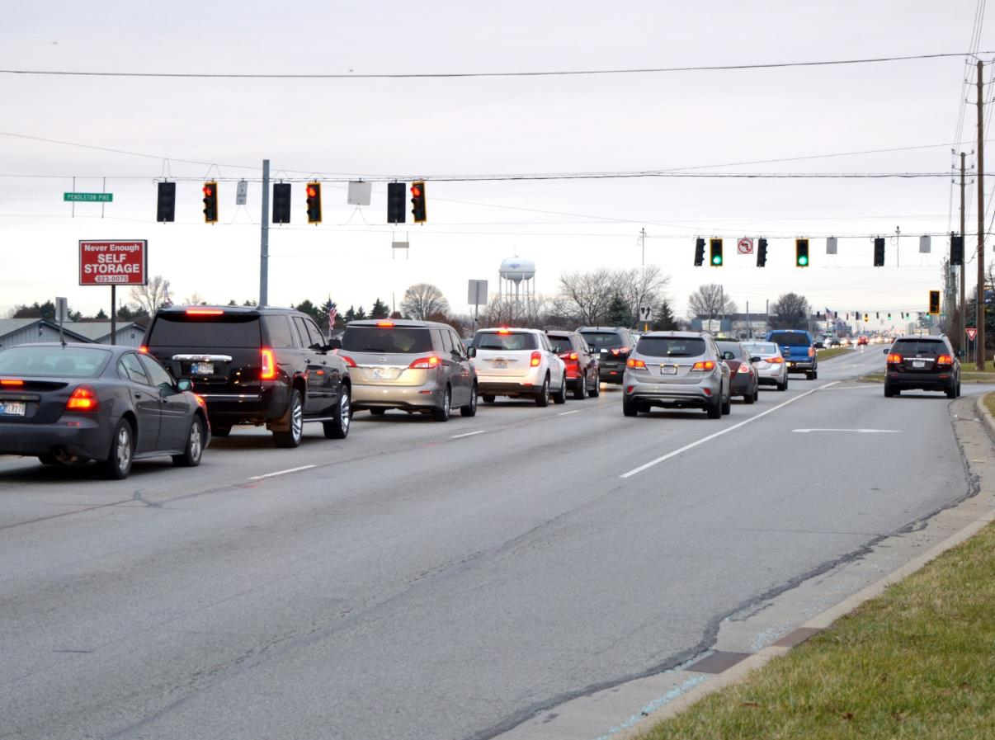
Purpose and Need
High frequency of injury crashes
Reduce congestion at 56th Street intersection
Pedestrian connectivity near 56th Street
Notes:
Presenter: INDOT

Slide 6
Crash Frequency and Severity
45% of segment crashes are angle crashes
Half of angle crashes result in injuries
Notes:
Presenter: INDOT

Slide 7
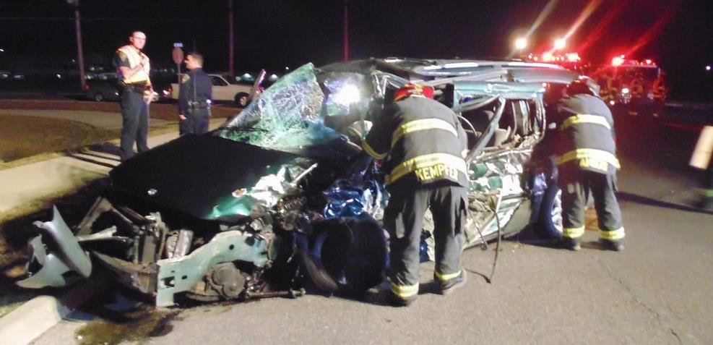
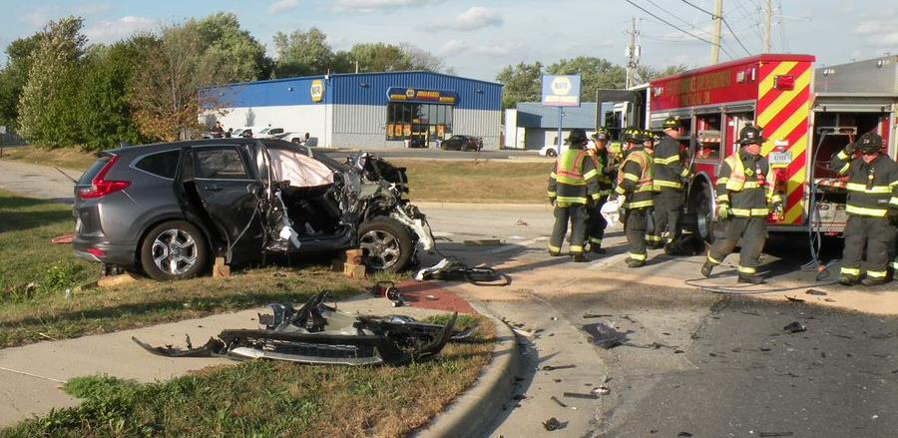
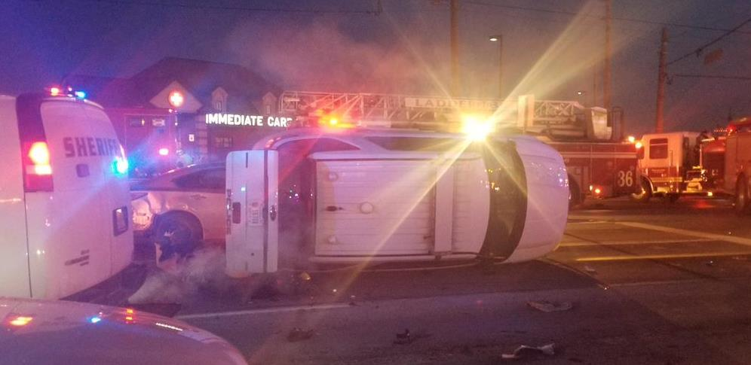
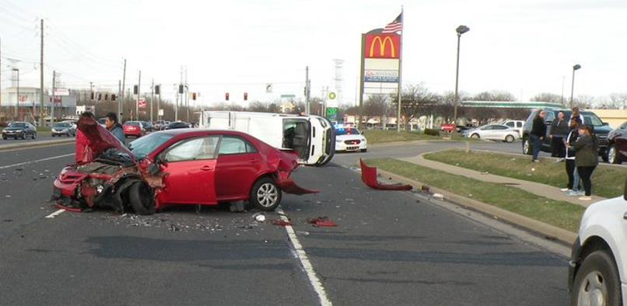
Crashes – City of Lawrence
Notes:
Presenter: Lawrence Deputy Mayor Hofmann

Slide 8
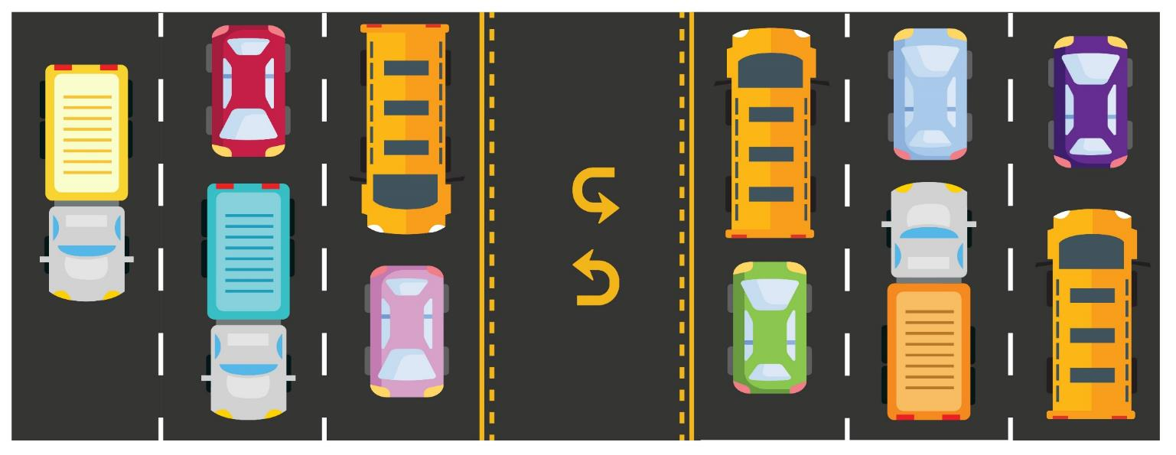
What’s Causing Crashes?
Pendleton Pike carries 45,000 vehicles per day
Few gaps for left turns
Driveways must cross 3+ lanes to turn left
Aggressive driving
Notes:
Presenter: Luis Laracuente, INDOT

Slide 9
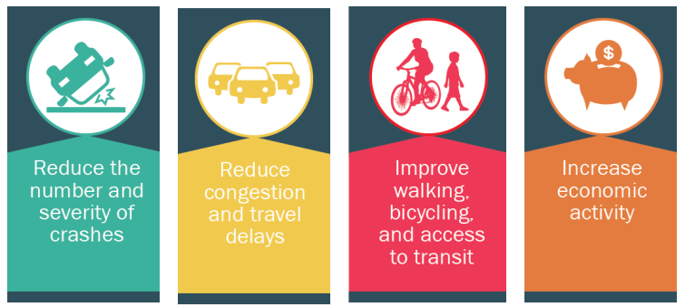
Access Management
Access management seeks balance between the safety and mobility of a roadway with the access needs of neighboring properties.
Source: Access Management Toolbox - TXDOT
Notes:
Presenter: Luis Laracuente, INDOT

Slide 10
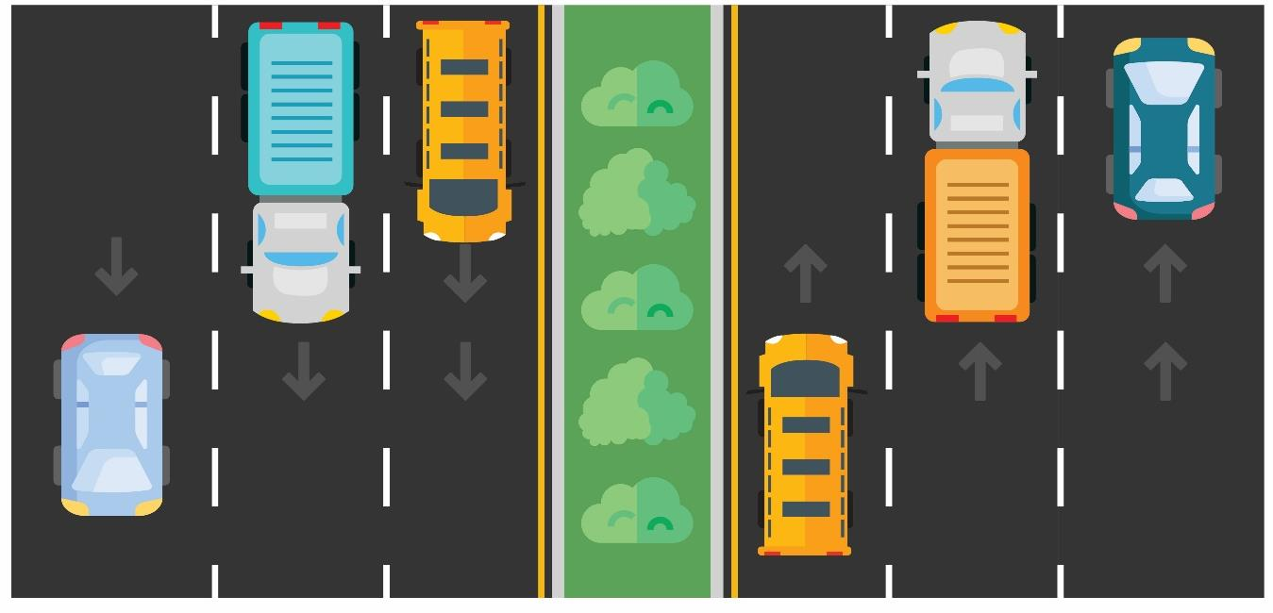
Proposed Solution
Eliminate angle crashes between major intersections
Coordinating with City on landscaping raised medians
Notes:
Presenter: Luis Laracuente, INDOT

Slide 11
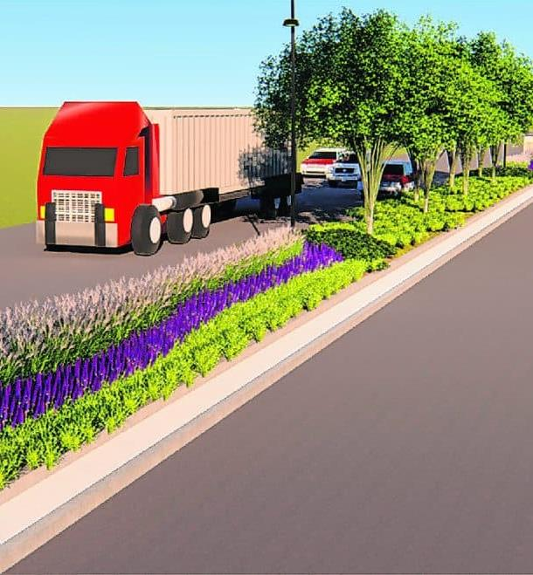
Median Benefits
Eliminate angle crashes between major intersections
Improves traffic flow
More consistent speeds
Promotes safer driving
Notes:
Presenter: Luis Laracuente, INDOT
Where left turn movements are removed, angle crashes will be completely eliminated
As you add to the built environment, it has the effect of calming traffic
Traffic calming measures promotes slower and safer driving
The left, inside lane will be able to drive at a consistent speed because traffic will not be slowing down to enter the center lane for turning left

Slide 12
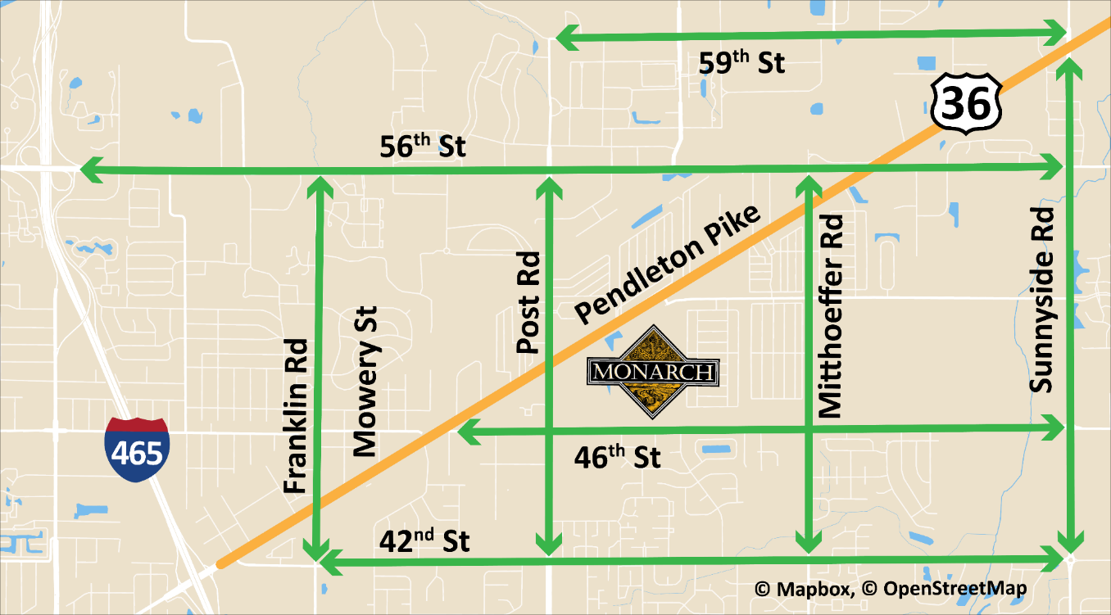
Left Turns for Cross Traffic
Legal U-turns at the next intersection are 25% safer
Twelve signals in the project area
Large trucks can use the road network as shown
Notes:
Presenter: Luis Laracuente, INDOT
There are 10 traffic signals in the project area: 42nd Street, Franklin Road, Post Road, Monarch Beverage, Mitthoeffer Road, 56th Street, Walmart, Sunnyside Road, Oaklandon Road and 65th Street
Addition of second signal at 56th Street and Thunderbird Road makes it 12 – plenty of safe spots to turn
Change will direct traffic to major intersections and local road network.
Left turns and U-turns will increase if there’s not direct access to a specific driveway
Large trucks who need to perform a U-turn and cannot, use local road network to get where they’re going.

Slide 13
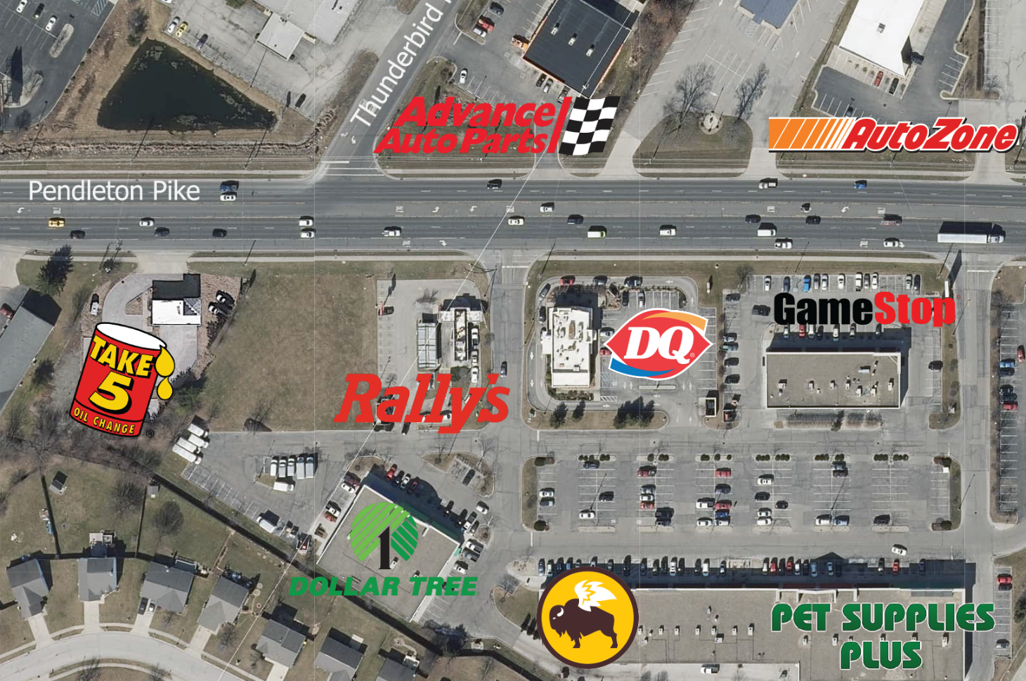
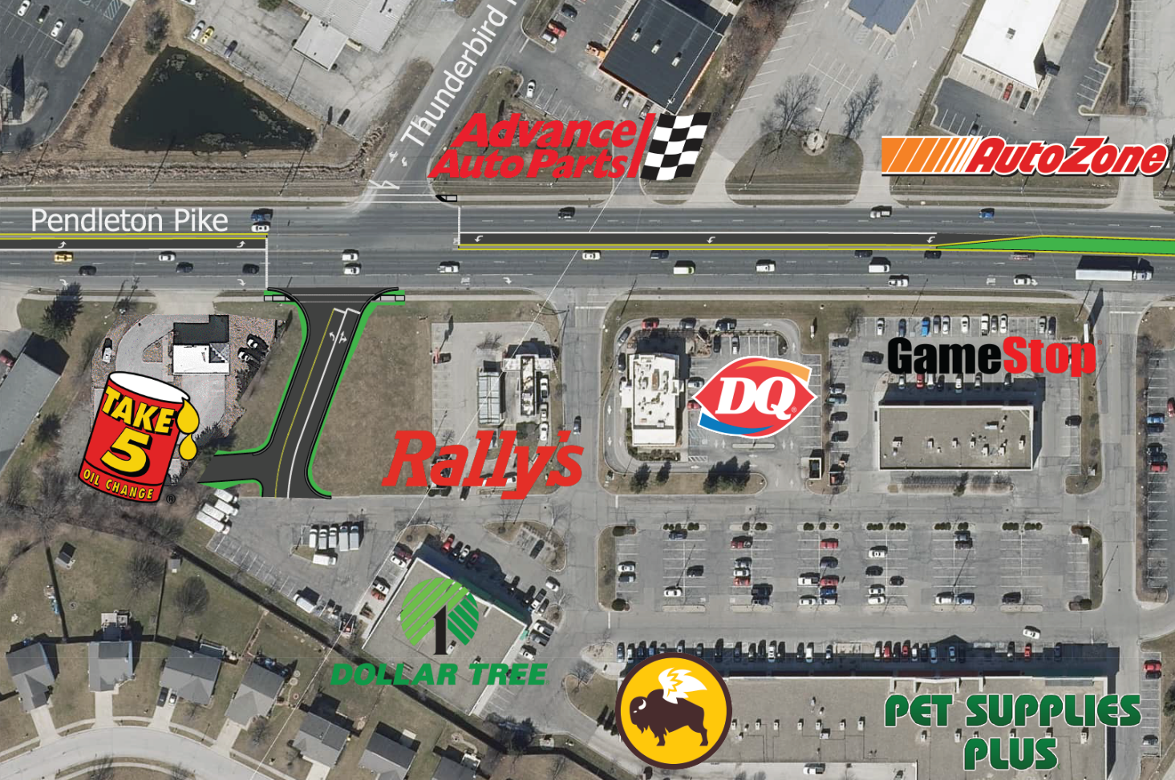
Thunderbird Road Intersection
New traffic signal and connector road to the south
Notes:
Presenter: Luis Laracuente, INDOT

Slide 14
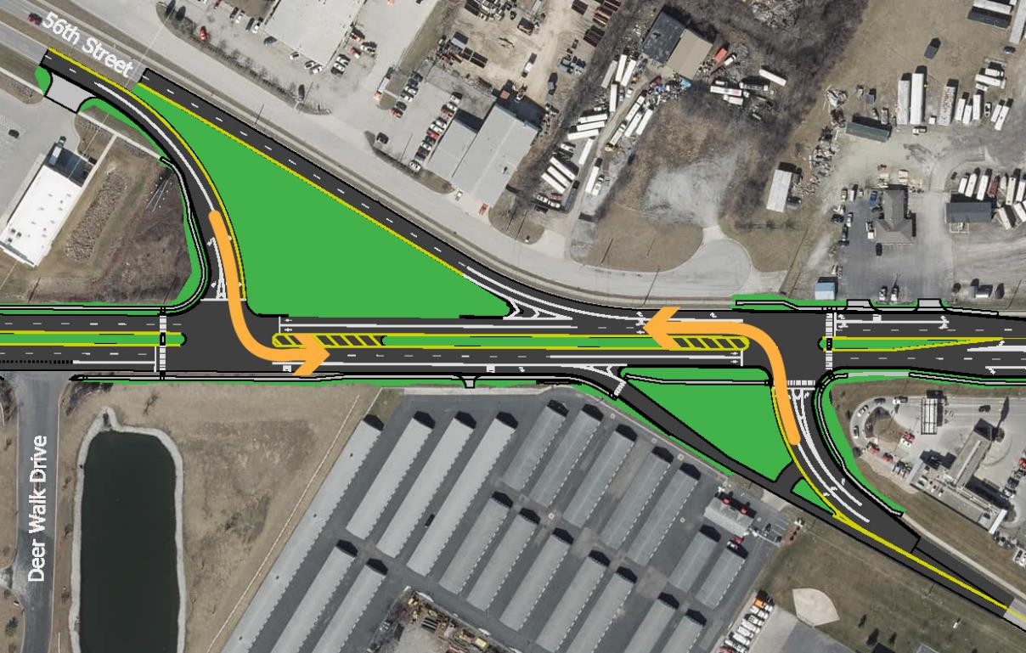
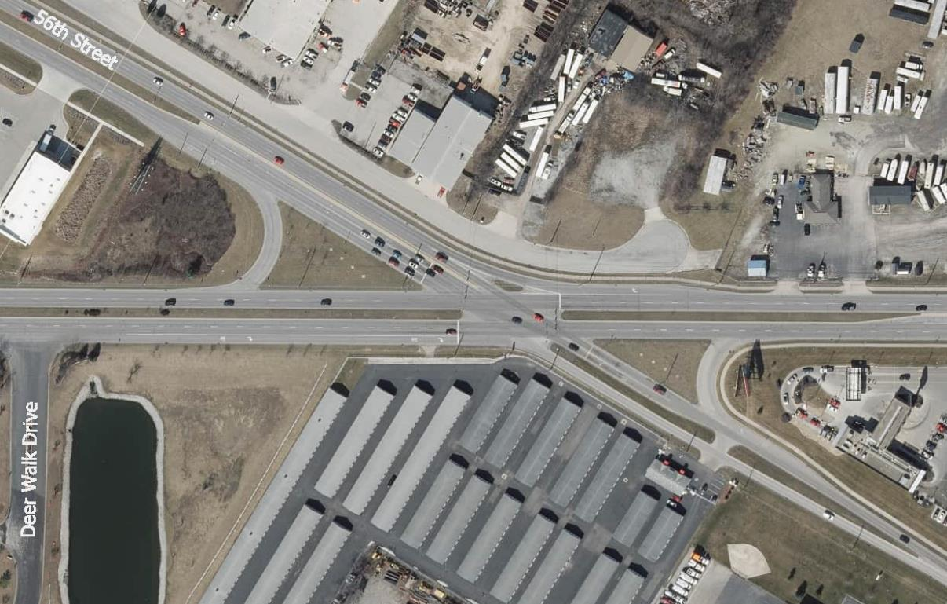
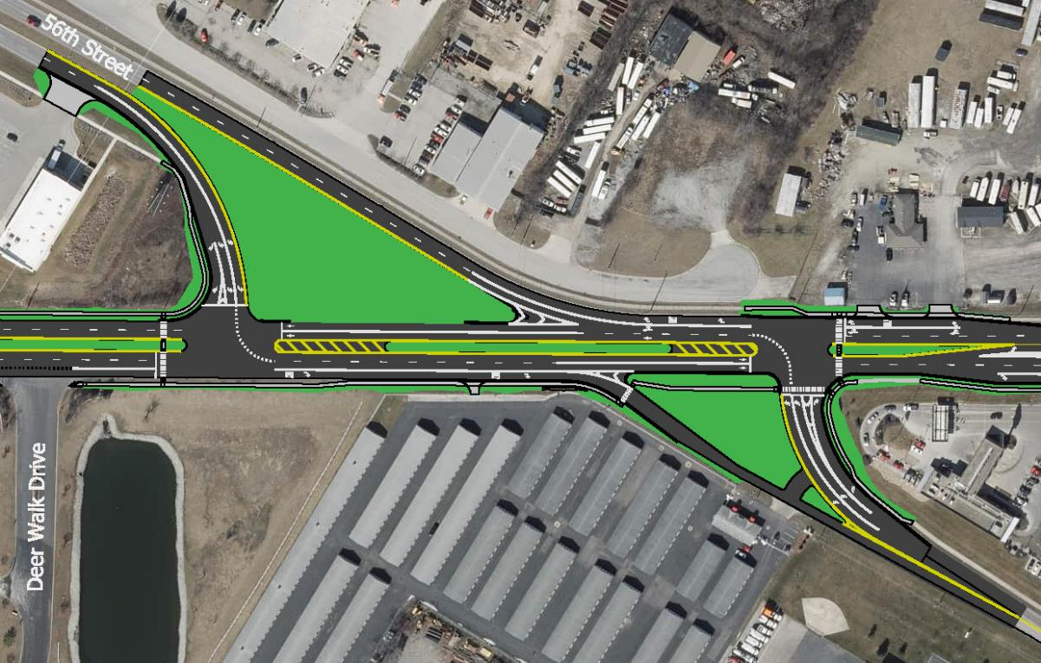
56th Street Intersection
Realign into two “offset T” signals
Turns get green at same time
Less time stopped at red lights, less congestion
Improved sight distance
Reduces rear-end crashes
See display in back
Notes:
Presenter: Cory Lamb, CHA
Turn movements are separated into intersections
Current intersection cannot allow dual left turns
Two signal phases for Pendleton Pike instead of three
Better turn radius angle for “north-south” turns

Slide 15
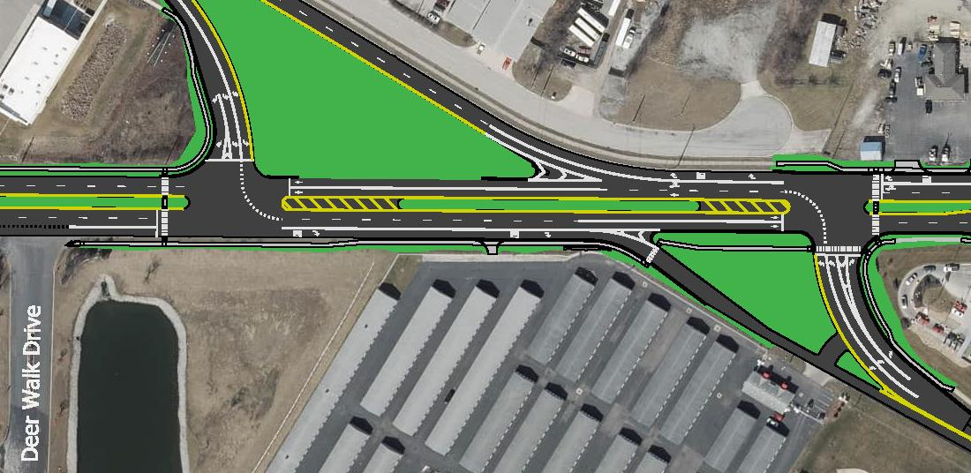
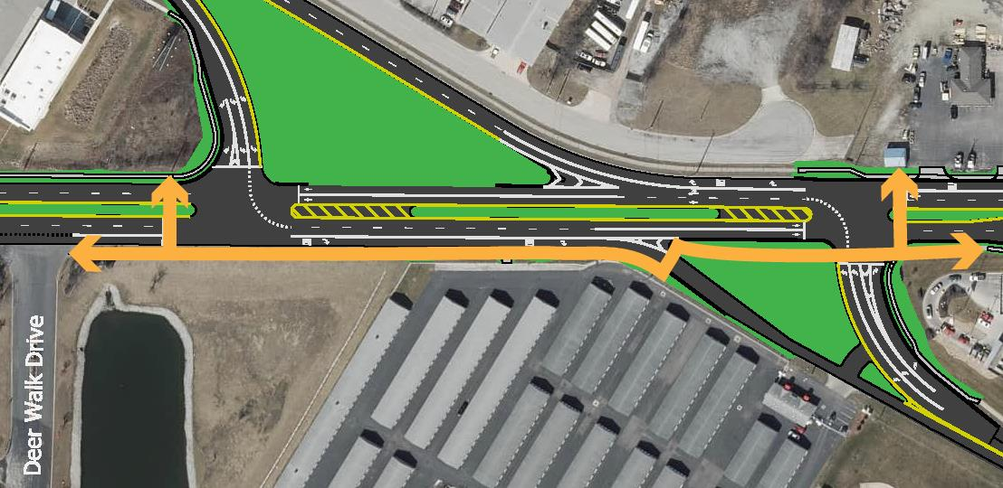
Pedestrian Connections
Connect sidewalks with crosswalks at 56th Street intersection
Notes:
Presenter: Cory Lamb, CHA

Slide 16
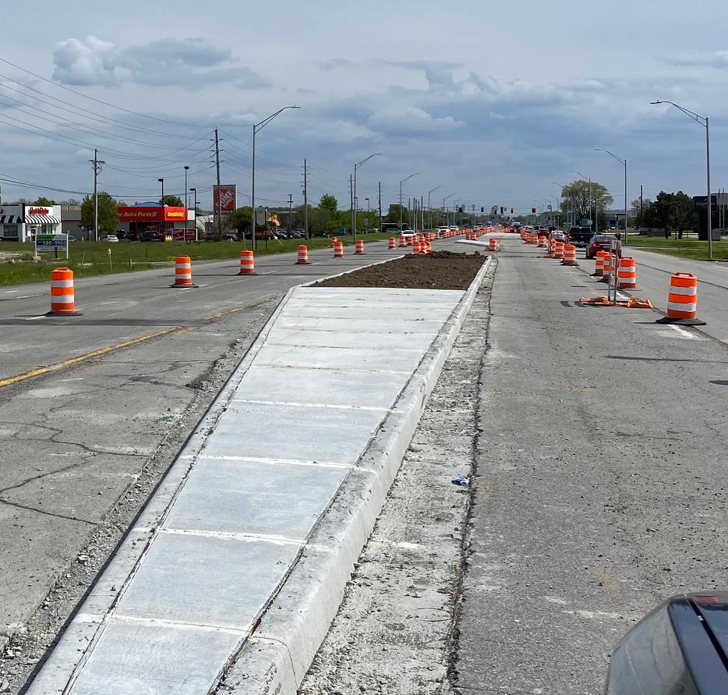
Traffic During Construction
Built in segments
Expected combination of day and night work
Coordination with emergency responders, schools
Notes:
Presenter: Cory Lamb, CHA
Pendleton Pike currently has five and seven lane sections.
We’re working to minimize lane closures, with more construction occurring during off-peak times.
We will work to maintain traffic capacity during peak times, such as weekday commutes.

Slide 17
National Environmental Policy Act (NEPA)
Environmental analysis and documentation is required for all federally-funded projects
Evaluates alternatives, including “no build”
Considers and addresses public comments
Incorporates socio-economic and ecological considerations in the decision-making process
What are the impacts?
How can they be avoided or mitigated?
Notes:
Presenter: Cory Lamb, CHA
Environmental analysis and documentation is required for all federally-funded projects and actions
Different levels of review. CE is the least amount of impacts.
What makes this a CE 4? Increased access at Thunderbird Road.
Summarize examples of items in the environmental analysis
Threatened species, including the Indiana Bat – Lighting restrictions during construction
Hazardous Materials – Identifying contaminated soils and proper handling and disposal

Slide 18
Anticipated Timeline
Early 2023: Draft environmental document for public review and comment
Mid 2023: Finalize environmental document
Late 2023: Finalize project design
Summer 2024: Start construction
Notes:
Presenter: Cory Lamb, CHA

Slide 19
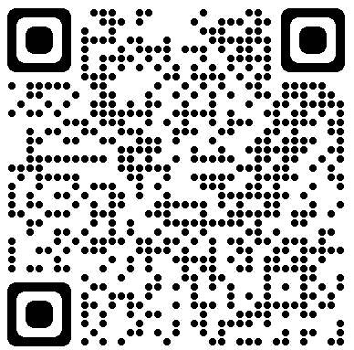
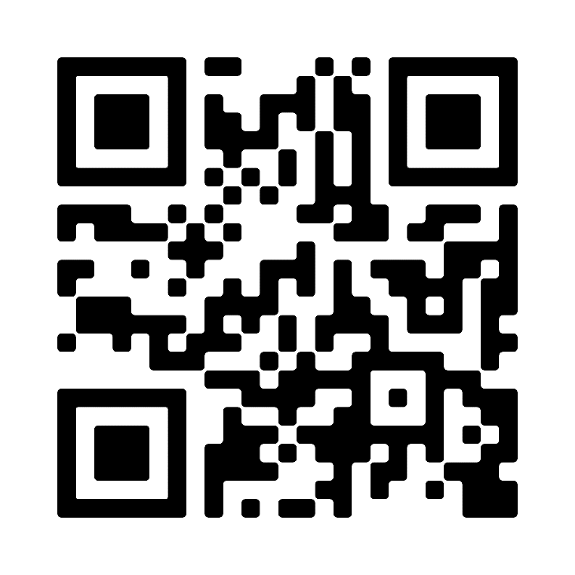
Posted After the Meeting
Presentation slides
Presentation recording
Aerial illustrations
Handouts
Notes:
Presenter: C2
Greenfield.indot.in.gov
Find link for “U.S. 36 Pendleton Pike”

Slide 20
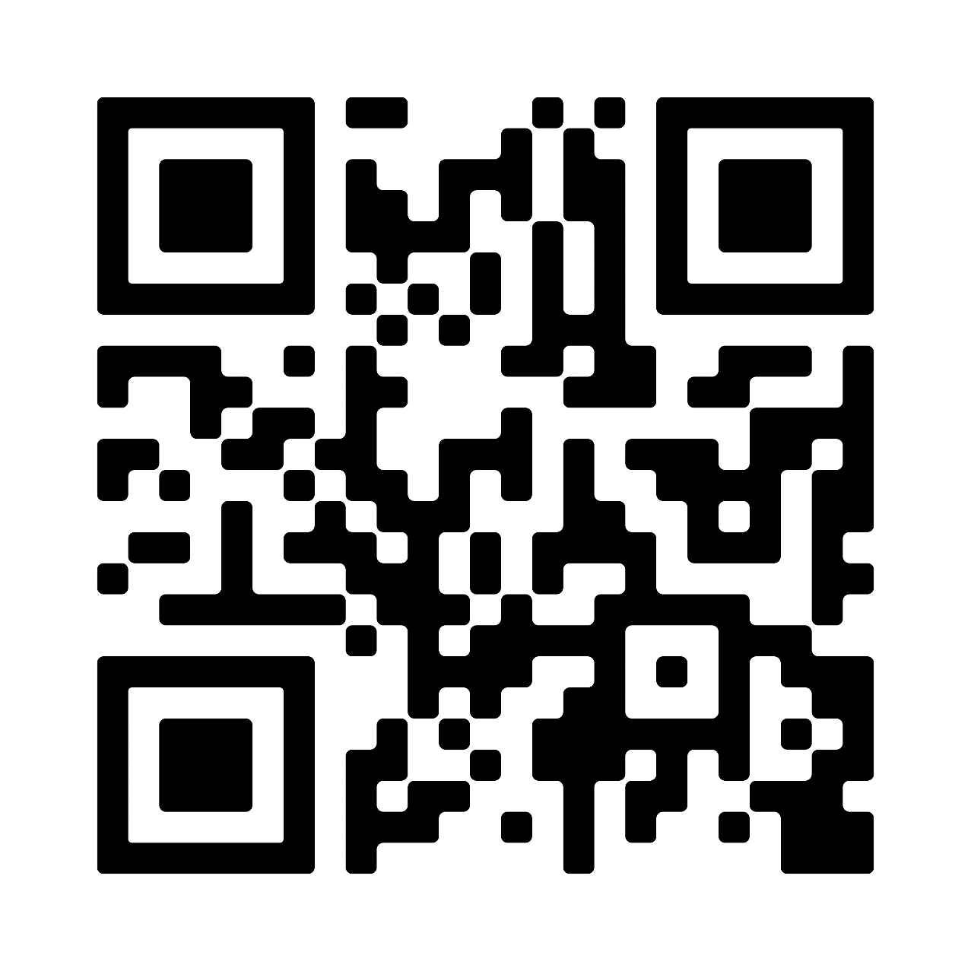
Ways to Provide Public Input
Paper and Online
Comment Form
Call or Email INDOT4U
INDOT@indot.in.gov
855-INDOT-4U
Email Darrik Yetzer
CHA Design Manager
DYetzer@chacompanies.com
Scan to leave a comment
Notes:
Presenter: C2

Slide 21
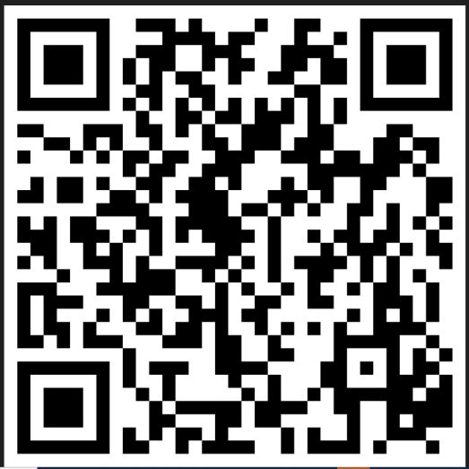
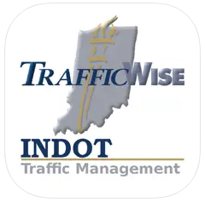
Stay Informed
@INDOTEast on Facebook & Twitter
GovDelivery Email & Text Alerts
511in.org
Notes:
Presenter: C2

Slide 22
Open House
Large aerial illustration along wall
56th Street intersection displays in back
Talk with project team members and ask questions
Provide comments using paper forms
Notes:
Presenter: C2

