Slide 1
New Airport Road/CR 300 South in Orange County
Indiana Department of Transportation
Thursday, November 7, 2019
6 p.m.

Slide 2
Welcome
Purpose/explanation of public hearing
Public hearing format
Visit our sign-in table
Informational handouts
Participate during public comment session
Submit written public comments
Project display area

Slide 3
New Airport Road/CR 300 South in Orange County
Introduction of INDOT Project Team
Vincennes District – INDOT Regional Office
Project Management
Public Involvement
Environmental Services
Michael Baker Inc.
Engineering, Design & Environmental Analysis Team
Recognition of elected and local public officials
Sign-in at attendance table to be added to project mailing list
Legal notice of public hearing was published in the Spring Valley Herald 10/16, 10/23 & 10/30
A notice of the public hearing was mailed to known property owners within project area
Announcement of this hearing was posted to INDOT website. A media release was also issued
A copy of presentation and project documentation are available for review on-line via INDOT website

Slide 4
Project Stakeholders
Indiana Department of Transportation
Indiana Division Federal Highway Administration
Orange County
Elected & local officials
Residents and citizens
French Lick Municipal Airport
Commuters
Visitors
Businesses
Area attractions

Slide 5
Project Development
Project Selection
Early Coordination
Environmental phase begins
Purpose & Need
Develop alternatives
Preliminary design phase
Release environmental document for public review and comment
HOLD PUBLIC HEARING
Additional work to finalize environmental document and project design
Communicate Project Decision
Real Estate Acquisition
Project Letting
Construction

Slide 6
Environmental Analysis Phase
National Environmental Policy Act (NEPA)
Requires INDOT to analyze and evaluate the impacts of a proposed project to the natural and socio-economic environments
NEPA is a decision-making process
Purpose and Need
Alternatives Screening
Preferred Alternative
Impacts are analyzed, evaluated and described in an environmental document
What are the impacts this project might have on the community?
How can impacts be avoided?
Can impacts be minimized?
Mitigation for impacts?

Slide 7
Environmental Analysis Phase
Notice of Entry for Survey – 2017
Letters mailed to properties within general area
Describing early project proposal
Project personnel in area, may need to enter properties
Gather data for environmental analysis
Section 106 of National Historic Preservation Act – 2019
Take into account proposal’s impact to historic & archaeological properties
Consulting Parties Process – 2019
Groups invited to participate
Public notice issued with 30 day comment period
Herald Times and Herald Times Online
“No Adverse Effect” finding issued by INDOT on behalf of the Federal Highway Administration
Draft environmental document released for public involvement – October 2019
Available for public review

Slide 8
Project Resource Locations
INDOT Vincennes District Office
3650 South U.S. Highway 41
Vincennes, IN 47591
Toll Free 1-855-463-6848
Planning, Project Development/Delivery, Construction, Maintenance for Southwest Indiana http://www.in.gov/indot/2707.htm
Melton Public Library
8496 West College Street, French Lick, IN 47432
INDOT Office of Public Involvement
100 North Senate Avenue, Room N642, Indianapolis, IN 46204
Phone: (317) 232-6601
rclark@indot.in.gov
Transportation Services Call Center
Provides citizen and business customers with a single point-of-contact to request transportation services, obtain information, or provide feedback through multiple channels of communications.
855-463-6848 • INDOT4U.com • INDOT@indot.in.gov

Slide 9
New Airport Road/CR 300 South in Orange County
Purpose
The purpose of the project is to provide a safe roadway that meets current roadway design standards for air travelers to reach area attractions in Orange County from the Orange County (French Lick Municipal) Airport
Need
The need for this project is recognized by the deficient roadway and underlying unstable embankment material left incomplete for public use of the original June 12, 2012 construction of New Airport Road following embankment slide and roadway failures during construction in 2014 and 2015; the need for the original Des. No. 0901872 safety, airport operations, and economic development considerations (next slide) remain valid for this project

Slide 10
New Airport Road/CR 300 South -Need Elements
Safety Considerations
The current access road is deficient in roadway geometrics
Lane widths and cross slope are inadequate.
Vertical alignment does not meet the required Level 1 design criteria for stopping sight distance or maximum grade
Horizontal alignment does not meet the required Level 1 design criteria for horizontal curvature, superelevation, and stopping sight distance
Six accidents from 2004-2007 (INDOT District supplied crash data)
Airport Operations
French Lick Municipal Airport has experienced a significant increase in aircraft landings and takeoffs
Airport flights in 2010 increased by 30% from 2009
Economic Development
The French Lick area has seen significant economic development
French Lick Resort and Casino
Pete Dye Golf Course and Big Splash Water Park
Tourist destination with PGA & LPGA Golf Tournaments
Safer access to the French Lick area from the French Lick Municipal Airport will enhance the attractiveness of the area

Slide 11
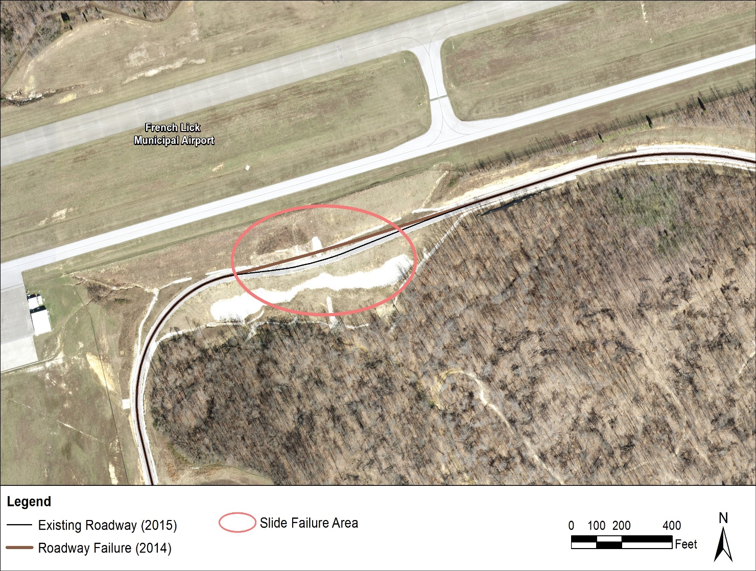
Existing Roadway
New Airport Road
Originally constructed in 2014 to provide access from the Airport to SR 145
2014 & 2015 slide failures
Two-lane roadway
1.96 miles long from W CR 375 S to SR 145
Rural Major Collector
Bridge over French Lick Creek
Left incomplete – no final asphalt layer, no guardrail, no signing or pavement markings

Slide 12
Alternatives Considered- Agency Coordination
No Build
Baseline for comparison for build alternatives
Does not meet purpose and need, does not enhance safety of roadway
Alternative 1
Discarded after topographical survey and geotechnical analysis
Alternative 2-6
Participating agencies preferred minimizing impacts and agreed that Alternatives 2 through 6 should be removed from consideration due to impacts and cost.
Alternative 7 (Original Alignment)
Includes new construction of retaining walls, anchors, drainage, and erosion control elements to shore up existing road bed adjacent to French Lick Airport taxiway. Meets purpose and need but has high costs.
Alternative 8 (Preferred Alternative)
The proposed realignment will provide a structurally sufficient road, updated to current safety standards to provide safe passage to and from the French Lick Municipal Airport, effectively satisfying the purpose and need.
Alternatives reviewed as part of an Agency Coordination Meeting held December 12, 2017, with representatives from USACE, USFWS, FAA, FHWA, IDNR, IDEM, INDOT, and the Orange County Commissioners Office.

Slide 13
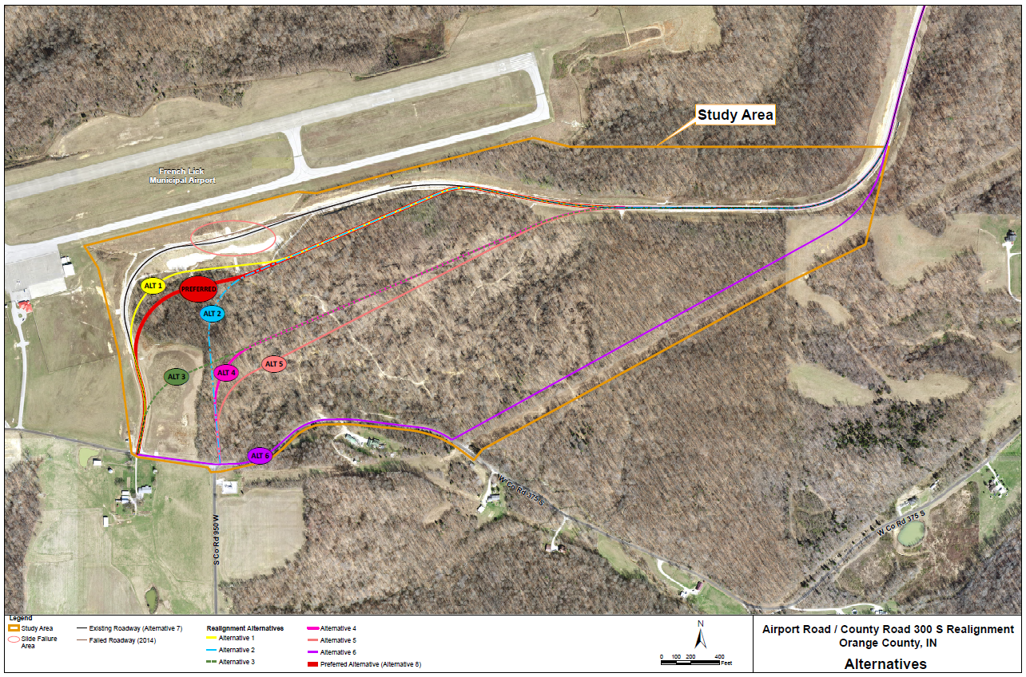
Alternatives Considered

Slide 14
Preferred Alternative
New Roadway Section/ Finish Existing Roadway
Realigned to the south to avoid slide area
Add final pavement layer, guardrail, signs and pavement markings
Environmental and Community Considerations
Addresses Complex Drainage Issues
Minimizes Stream and Wetland Impacts
Avoids Impacts to Core Forest (and Hoosier National Forest Property) and Private Property Impacts
Compatible with Airport Operations
Design Features
Dry detention feature with weir structure
Robust geotechnical slope stability measures consisting of 2.5 ft dia. cored holes in bedrock filled with I-beam encased in concrete
Horizontal drains to relieve water pressure

Slide 15
Preferred Alternative

Slide 16
Real Estate
Uniform Act of 1970"
All federal, state and local governments must comply
Requires an offer for just compensation
Acquisition Process
Appraisals
Review Appraisals
Negotiations
22 acres r/w required for project
R/W will be follow FAA land transfer process

Slide 17
Project Schedule
PUBLIC HEARING
Public comment period
Prepare Public Hearing Transcript
2019
Review public comments
Continue work on preliminary design and environmental document
2019
Finalize environmental document
Complete project design
2019/2020
Communicate Project Decision
2019/2020
Project Letting
Tree Clearing (2020)
Construction (2020)

Slide 18
Submit Public Comments
Submit public comments using the options described in first page of information packet:
Public Comment Form
Via e-mail
Participate during public comment session following formal presentation
INDOT respectfully requests that comments be submitted by Friday, November 15, 2019
All comments submitted will become included in an official public hearings transcript and made part of the public record
Comments will be reviewed, evaluated and given full consideration during decision-making process

Slide 19
Next Steps
Public and project stakeholder input
Submit comments via options described on page 1 of information packet
INDOT review and evaluation
All comments given full consideration during decision-making process
Finalize/approve environmental document, complete project design
Communicate a decision
INDOT will notify project stakeholders of decision
Work through local media, social media outlets, paid legal notice
Make project documents accessible via repositories
Questions? Contact Public Involvement Team

Slide 20
Project Resource Locations
INDOT Vincennes District Office
3650 South U.S. Highway 41
Vincennes, IN 47591
Toll Free 1-855-463-6848
Planning, Project Development/Delivery, Construction, Maintenance for Southwest Indiana http://www.in.gov/indot/2707.htm
Melton Public Library
8496 West College Street, French Lick, IN 47432
INDOT Office of Public Involvement
100 North Senate Avenue, Room N642, Indianapolis, IN 46204
Phone: (317) 232-6601
rclark@indot.in.gov
Transportation Services Call Center
Provides citizen and business customers with a single point-of-contact to request transportation services, obtain information, or provide feedback through multiple channels of communications.
855-463-6848 • INDOT4U.com • INDOT@indot.in.gov

Slide 21
Thank You
Please visit with the design team and INDOT project officials following the presentation and Q & A.
Project Open House
Project maps, displays, INDOT project team and informal Q & A
INDOT Vincennes District page: http://www.in.gov/indot/2707.htm

