Slide 1
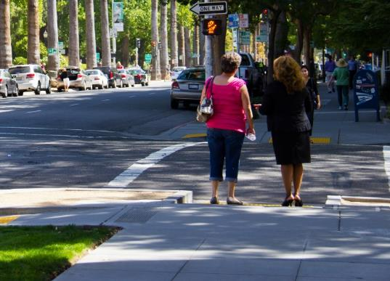
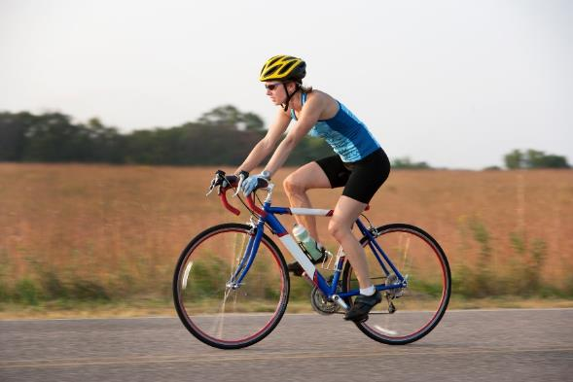
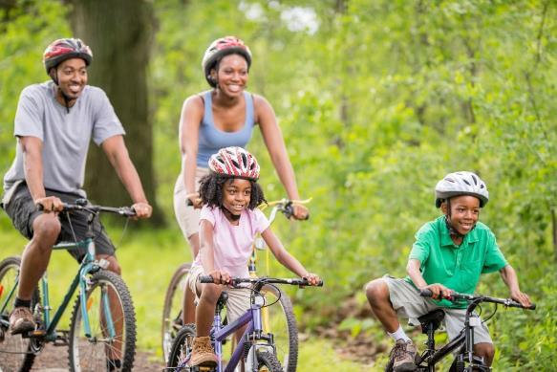
Toward an Active Indiana: Walking and Bicycling in the Hoosier State
2018 Indiana mpo conference | September 26, 2018

Slide 2
The Indiana Department of Transportation (INDOT) is committed to advancing and promoting multimodal and active transportation planning; working with planning agencies to ensure multimodal solutions are identified and implemented; and supporting healthy Indiana lifestyles.

Slide 3
Why active transportation?

Slide 4
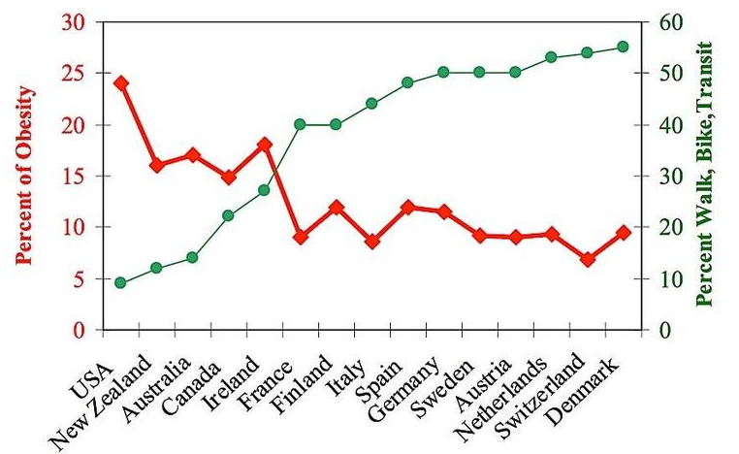
Health benefits
+6%
each hour spent in a car
-4.8%
each kilometer walked
Frank, L., et. al. (2004). Obesity Relationships with Community Design, Physical Activity, and Time Spent in Cars. American Journal of Preventative Medicine 27(2).
Pucher, et al. (2010). Walking and Cycling to Health: A Comparative Analysis of City, State, and International Data, American Journal of Public Health.

Slide 5
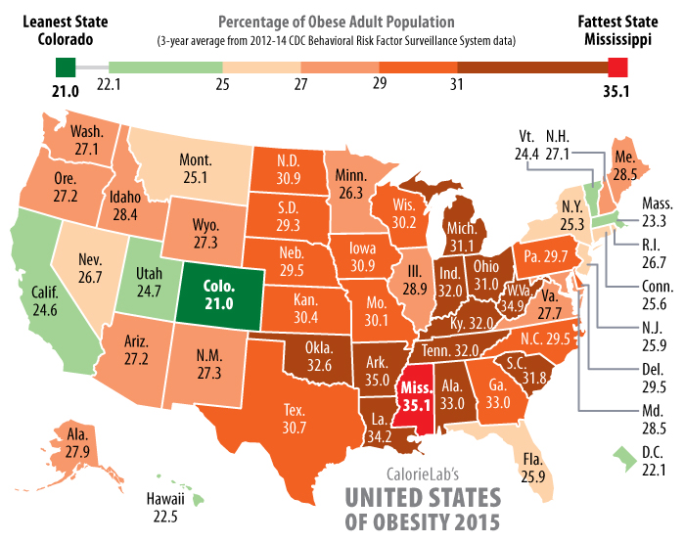
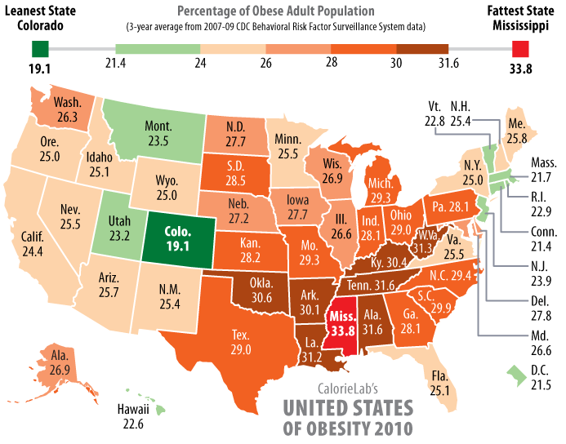
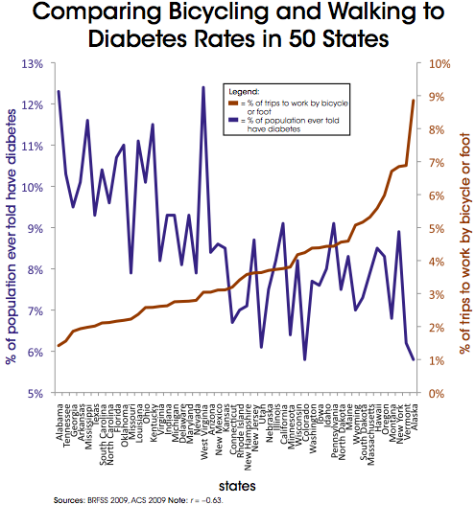
Health benefits

Slide 6
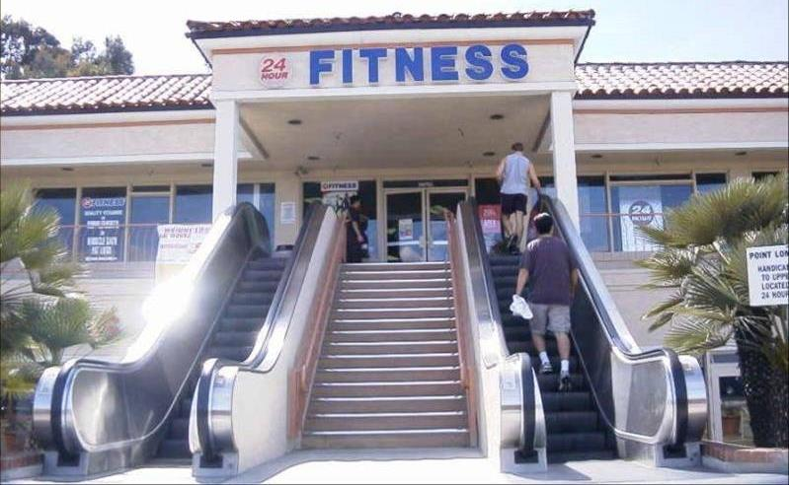
We have “outsourced” physical activity!

Slide 7
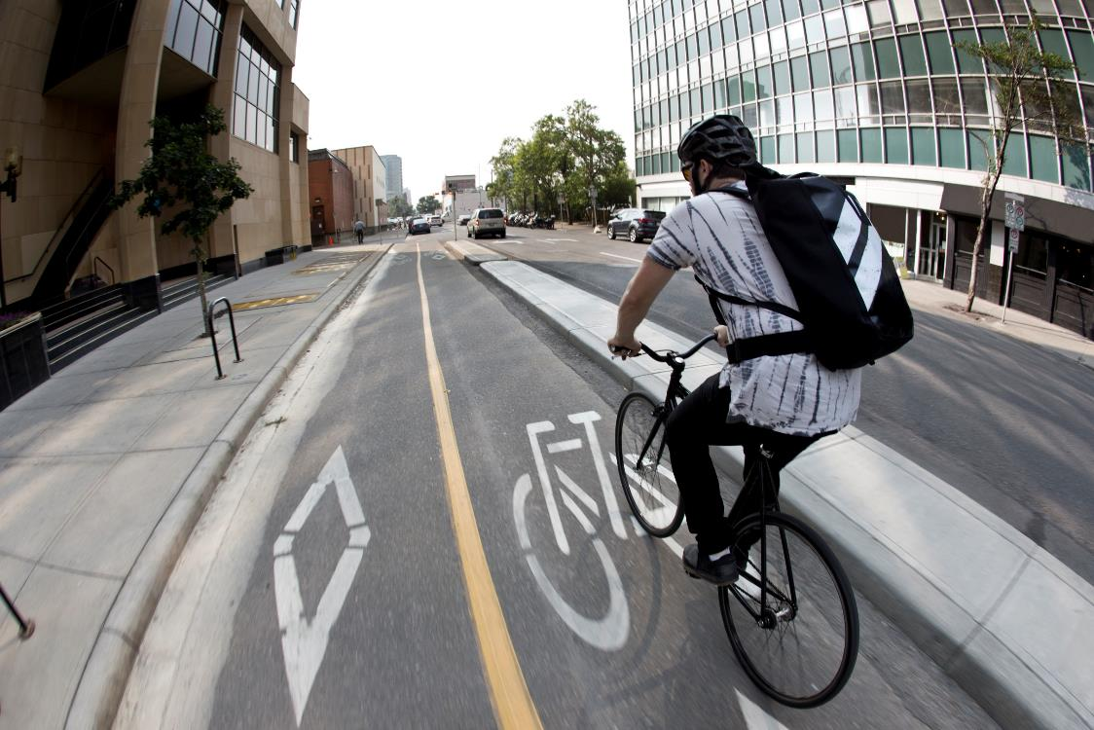
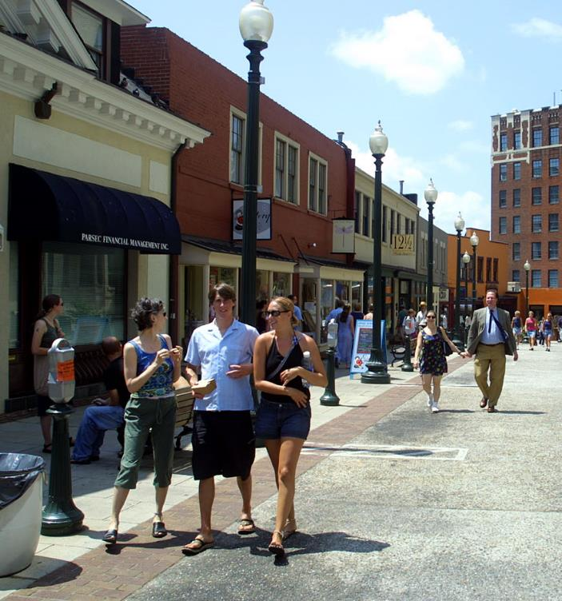
Livability and choice
66%
of Americans want more transportation options so they have the freedom to choose how to get where they need to go.
Millennials are driving less and looking for other transportation options.
73%
currently feel they have no choice but to drive as much as they do.
57%
would like to spend less time in the car.
Future of Transportation National Survey (2010)
Future of Transportation National Survey (2010)

Slide 8
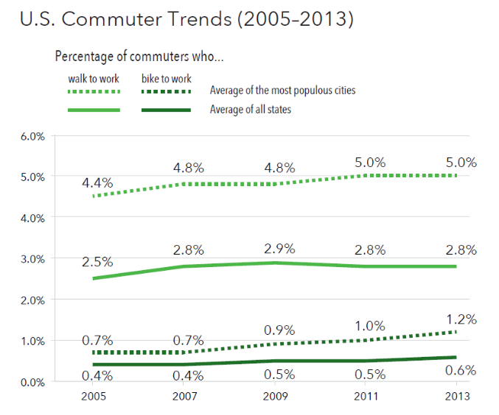
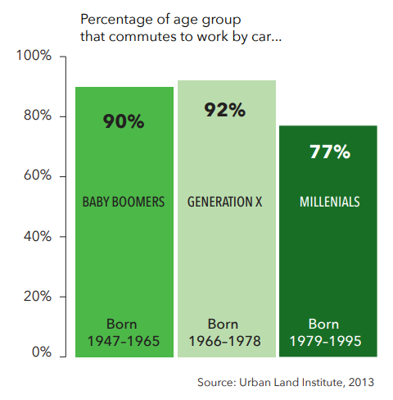
Livability and choice

Slide 9
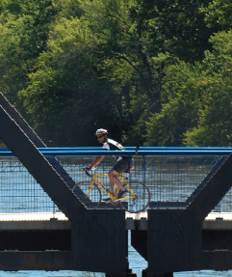
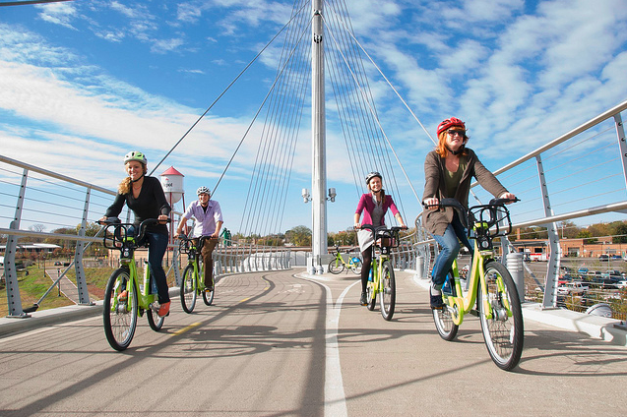
Tourism, recreation and economic benefits
In 2016:
$12.2 billion in spending
242,000 jobs
$2.9 billion in tax revenue
Source: Indiana Office of Tourism Development
“Our employees are healthier, happier, and more productive. We’re attracting some of the best talent in the industry. And, most important, we’re attracting new and exciting clients to fuel the bottom line.”
–Christine Fruechte, President and CEO, Cole + McVoy
National Complete Streets Coalition

Slide 10
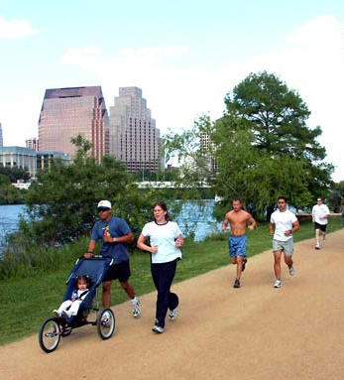
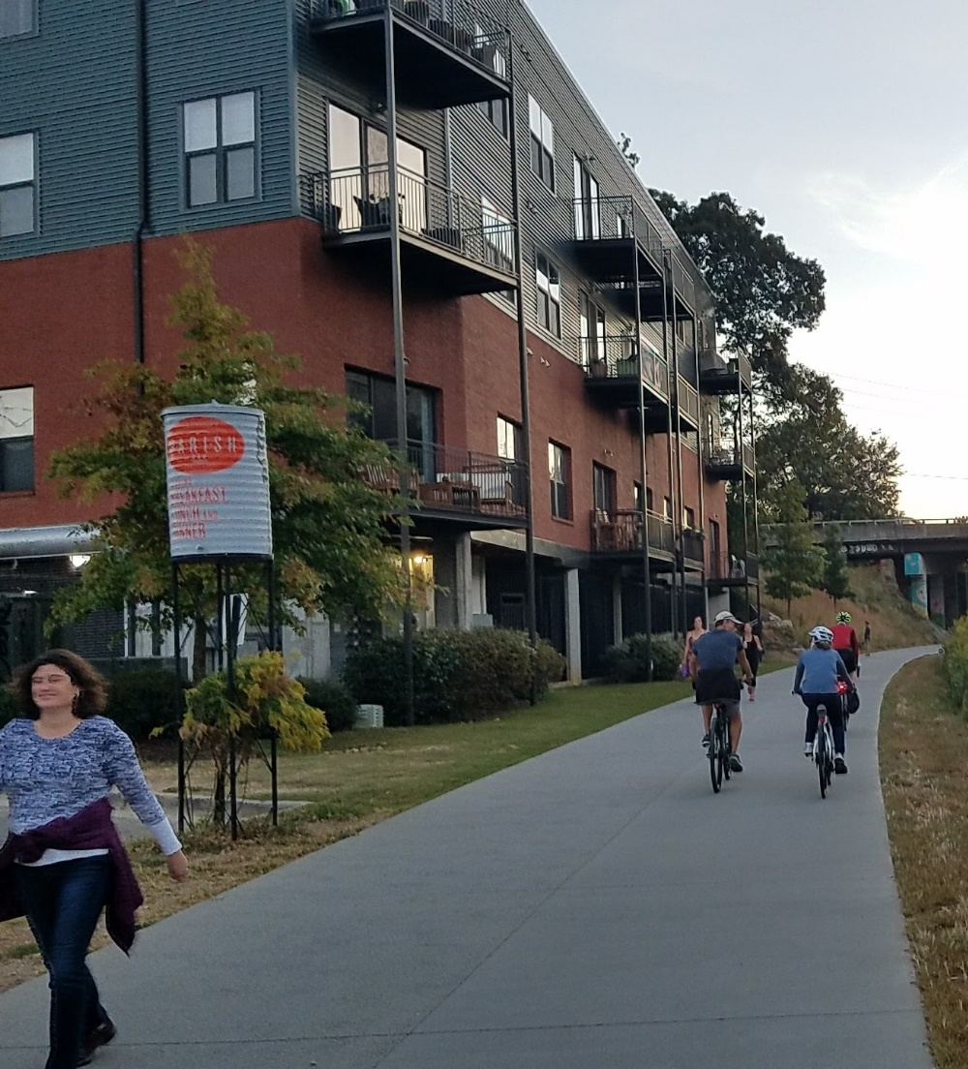
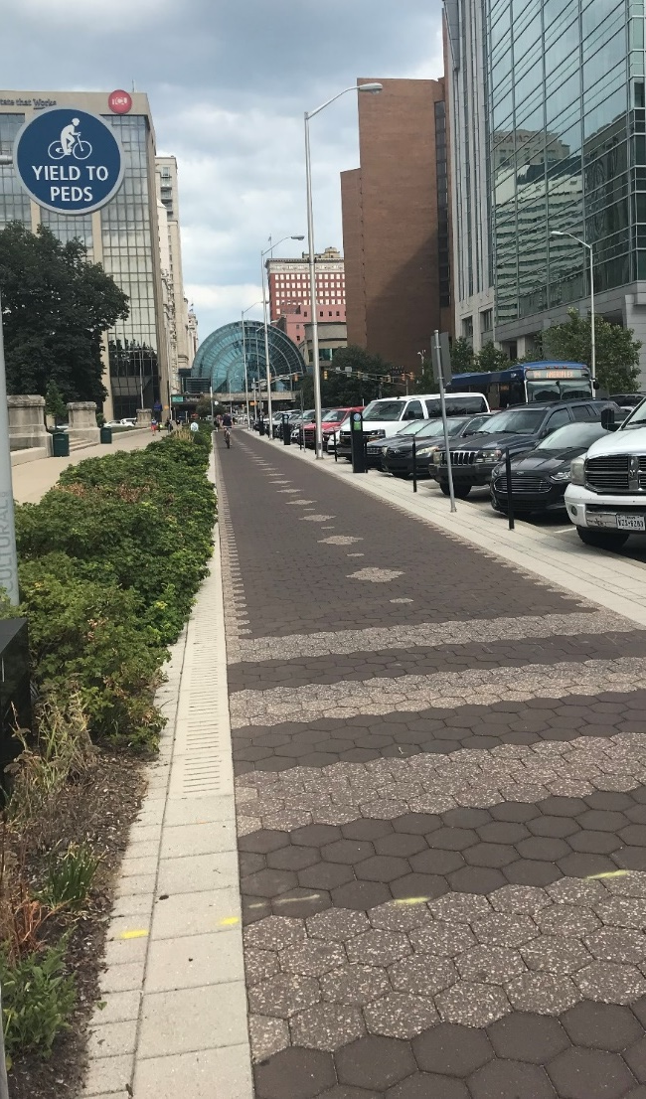
Tourism, recreation and economic benefits
Community/Quality of Life – The Project requires a significant number of employees. We want to invest in a community where our employees will enjoy living, recreational opportunities, educational opportunities, and an overall high quality of life. Tell us what is unique about your community.

Slide 11
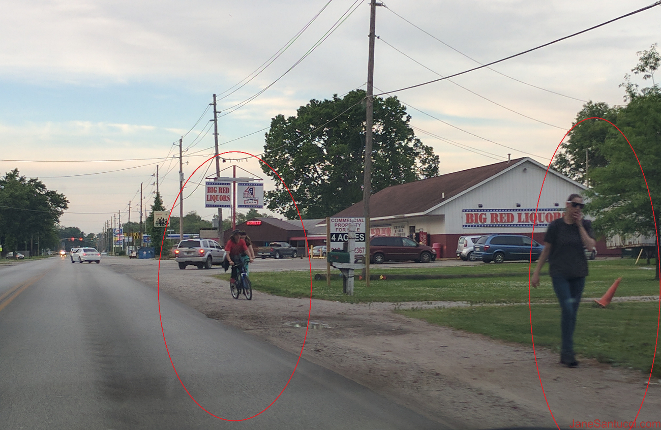
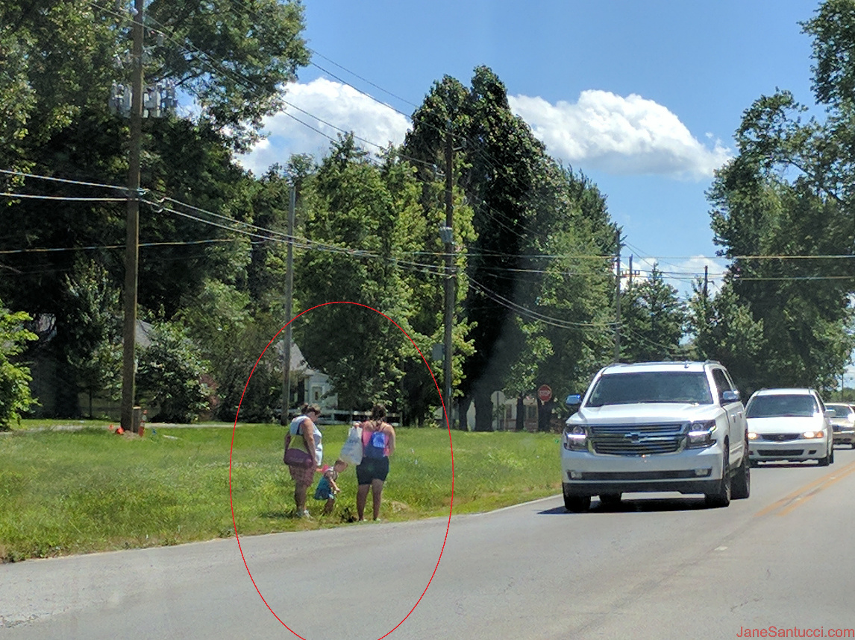
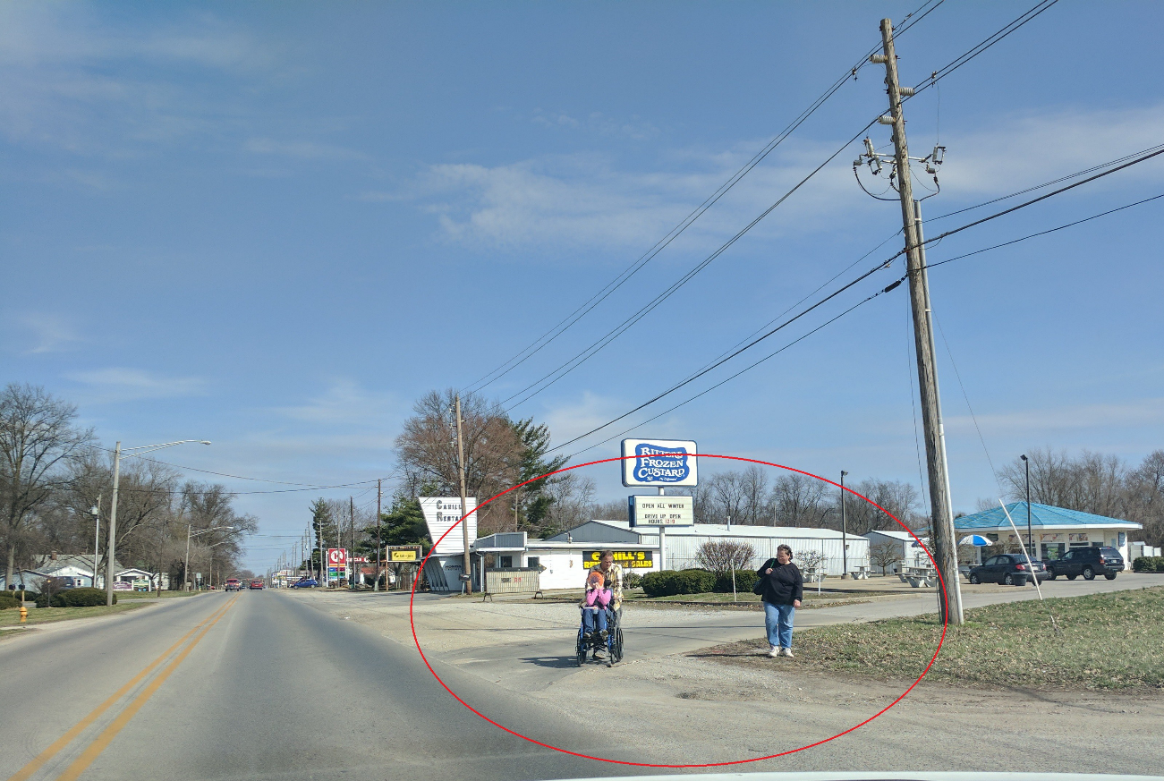
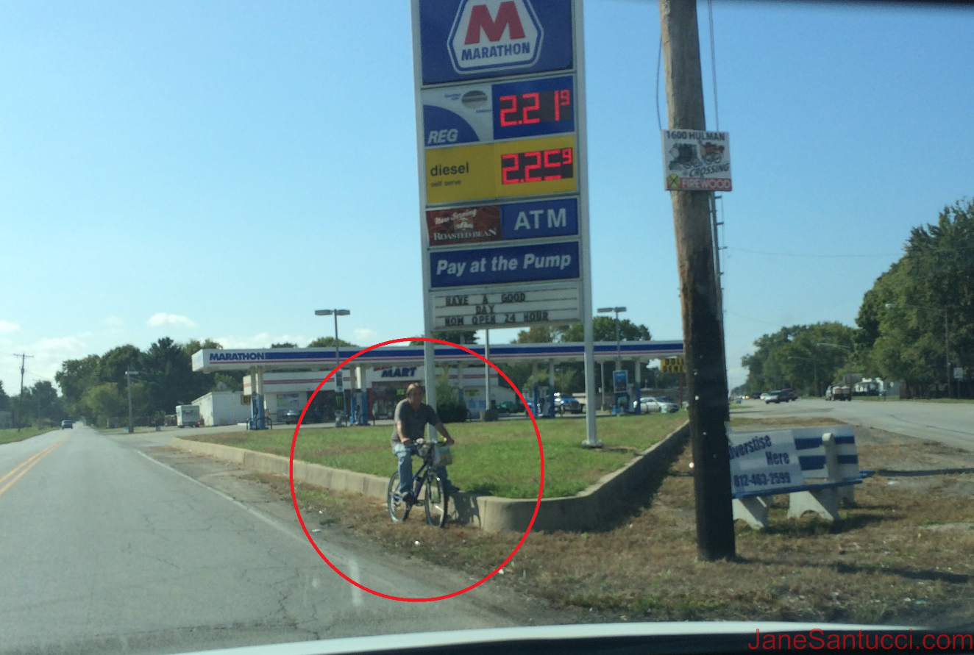
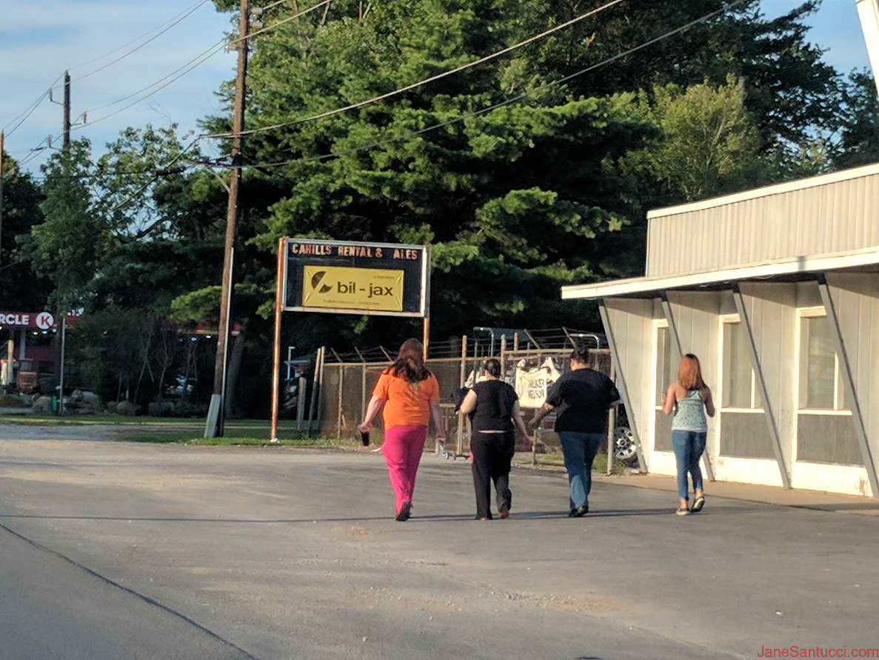
“just enough” isn’t good enough
Lafayette Avenue in North Terre Haute/Terre Haute
Credit: Jane Santucci

Slide 12
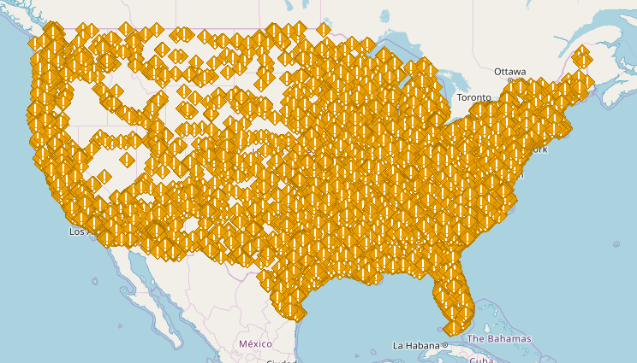
What does this map represent?

Slide 13
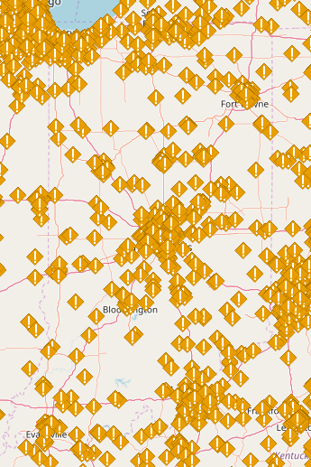
Pedestrian fatalities (2005-14)
Source: National Complete Streets Coalition, via the Fatality Analysis Reporting System provided by the National Highway Transportation Safety Administration.

Slide 14
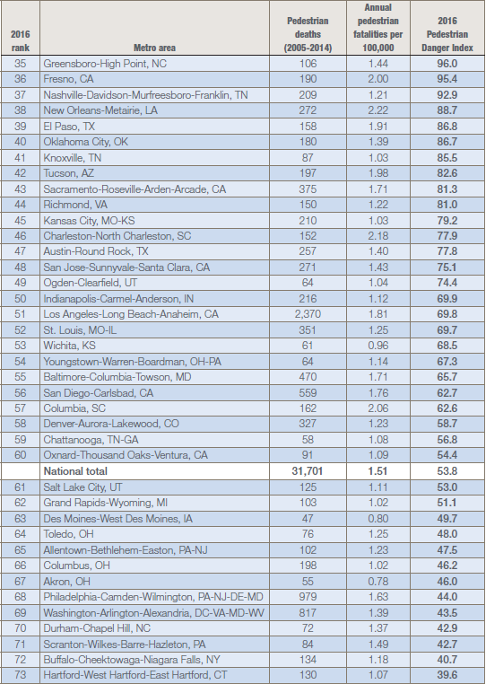
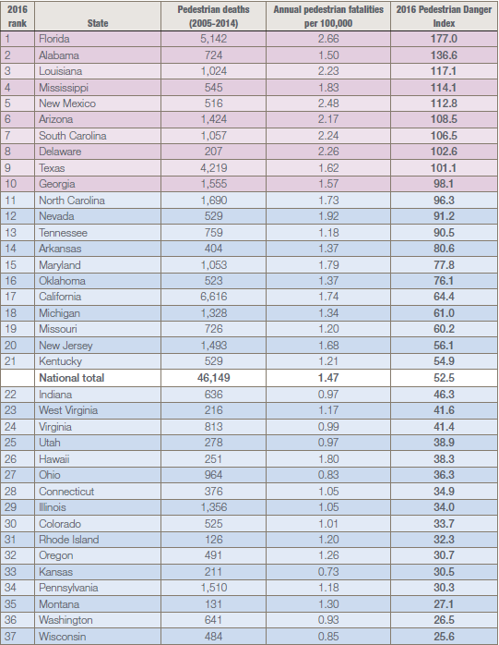
Safety, safety, safety

Slide 15
Project overview
Connect
People to parks, hubs, places, opportunities through a statewide network of bicycle and pedestrian facilities.
Guide
INDOT policy on plans and programs that impact active transportation.
Recommend
Priorities, funding sources and strategies to implement active transportation.
Advance
Active transportation, including walking and cycling, in the state of Indiana.

Slide 16
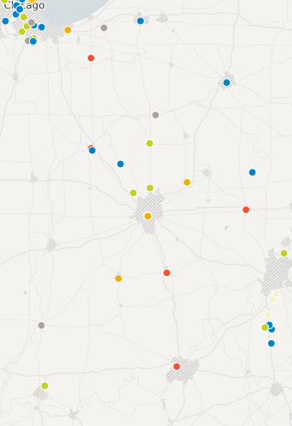
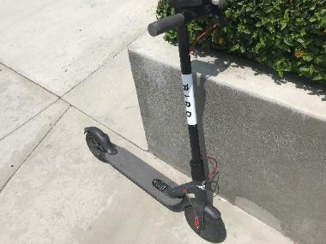
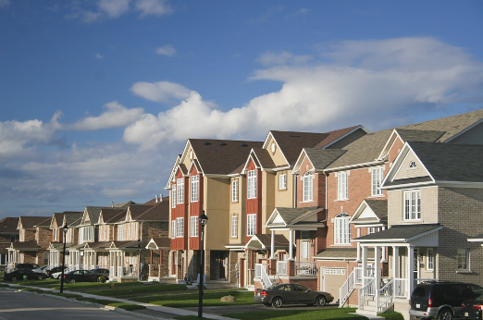
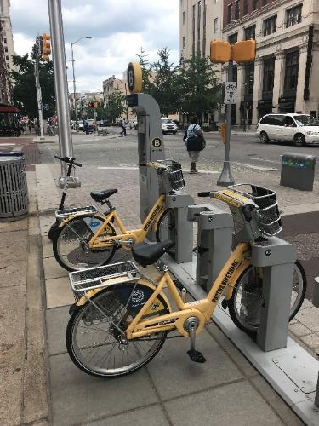
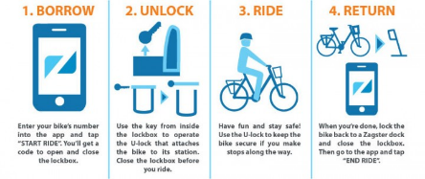
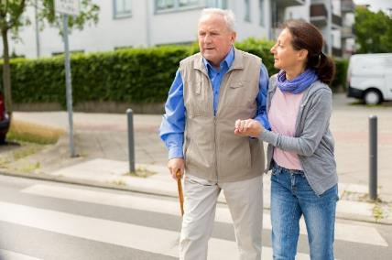
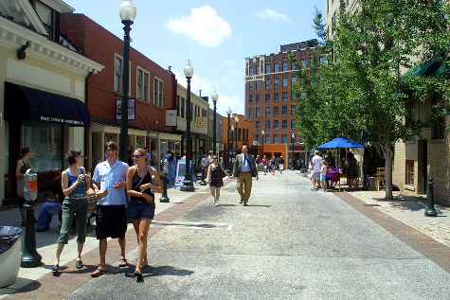
Understanding major trends
Policies
New and emerging technologies
Growth and development
Demographic shifts

Slide 17
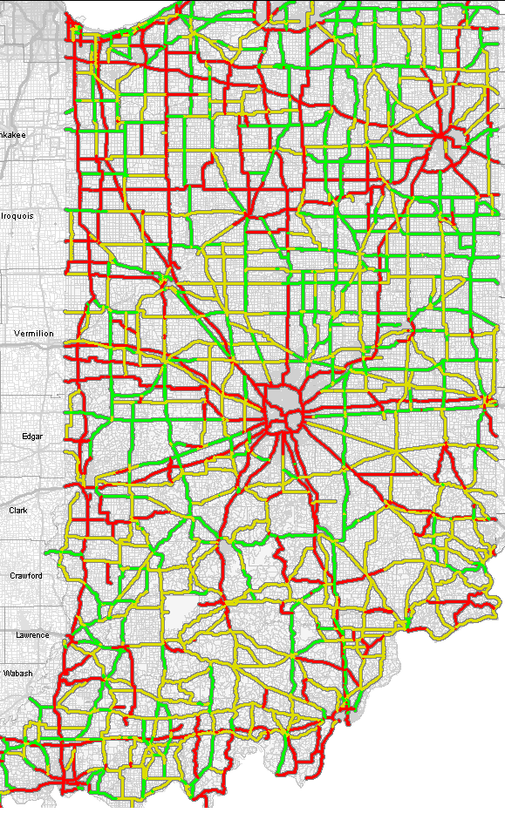
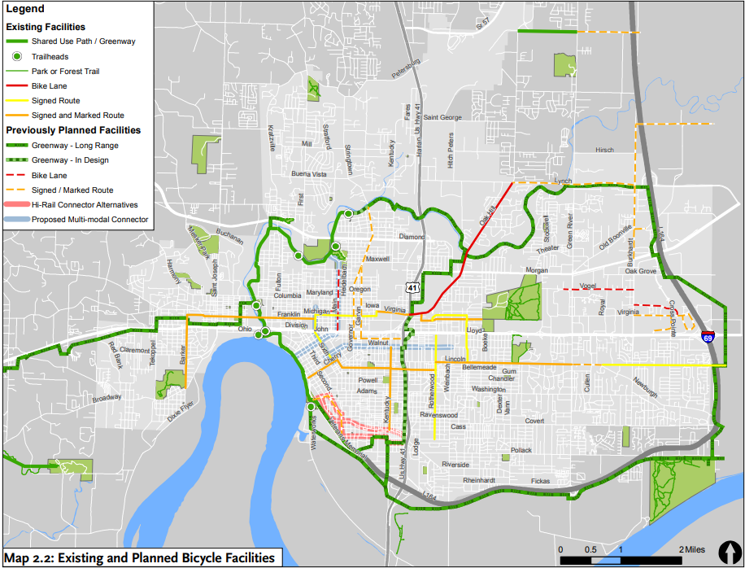
developing a statewide network
Agency partner data
Existing bicycle suitability
Trail recommendations
Evansville Bicycle & Pedestrian Connectivity Master Plan

Slide 18
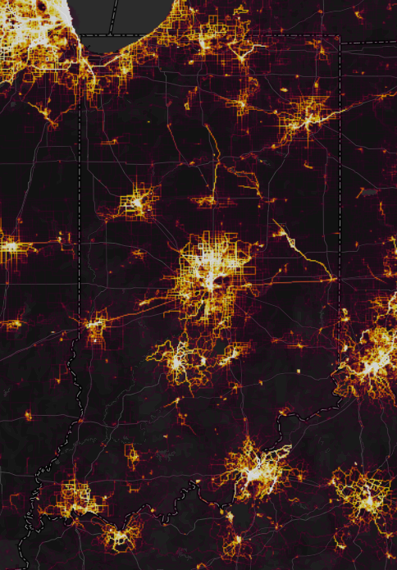
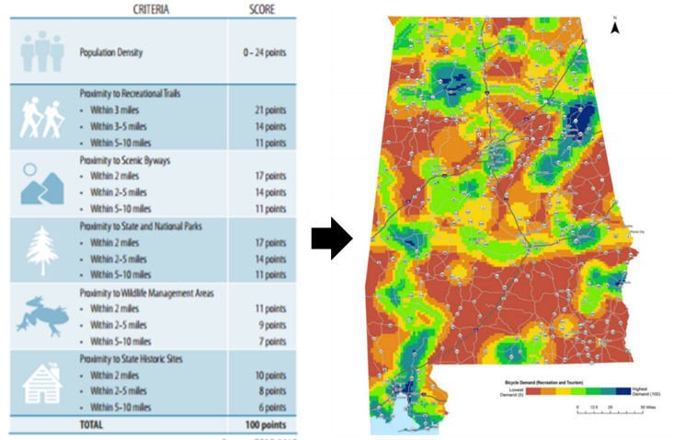
developing a statewide network
Example demand analysis from Alabama.
Strava activity heatmap

Slide 19
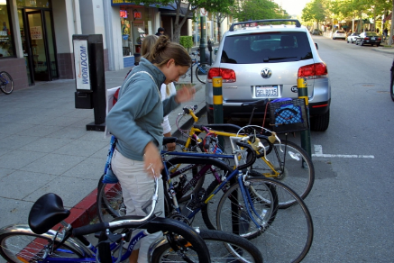
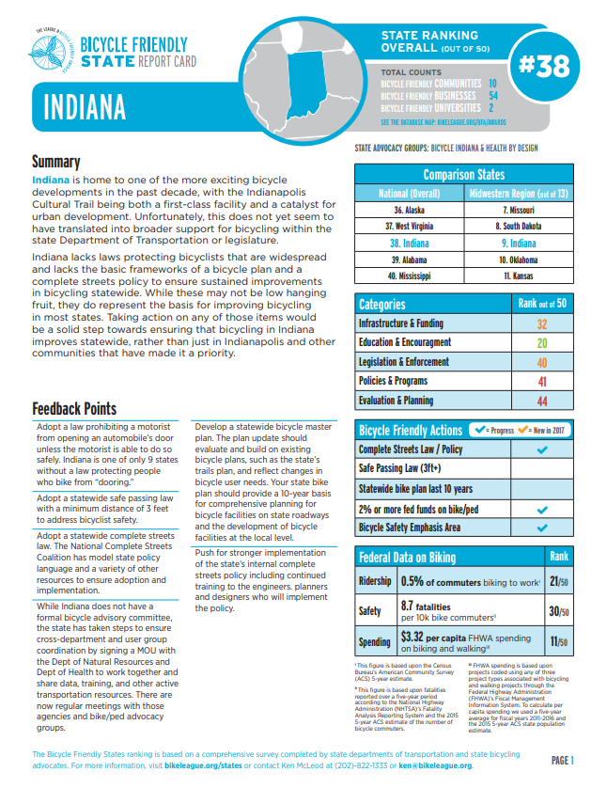
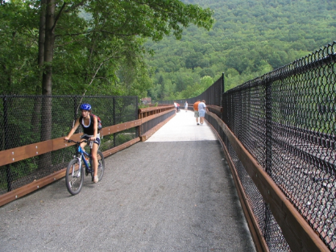
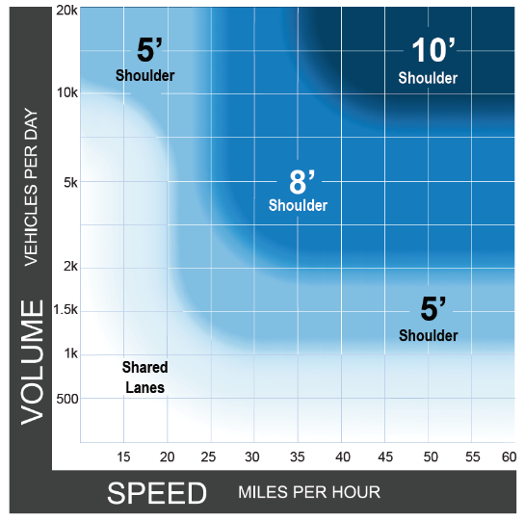
Moving Indiana forward
$
Innovative funding strategies.
www.pedbikeimages.org / Dan Burden
Economic and health impacts.
Iowa State Bike & Pedestrian Plan/ Tolle Design Group
Priority connections and networks.
Improved rating and ranking.
Best practices.

Slide 20
Bicycle trails task force

Slide 21
Bicycle trails task force
Funding Source | New or Reallocation | Notes
Tipping Fees | Reallocation | Reallocate underutilized funds from waste management fees for trails & recycling
Public Private Partnerships |  | Develop ways to better incentivize private and corporate donations for trail projects
Waste Tire Fee | Reallocation | Reallocate excess funds from waste tire fees for trails
Sporting Good Sales Tax | Reallocation | Dedicate a % of the existing state sales tax on certain sporting goods items (ex. bikes) for their infrastructure (ex. trails)
State Gas Tax | Reallocation | Utilize amount of state gas tax coming from ORVs and snowmobiles for all trails or flat 1 or 2% for bike/ped
General Appropriations | New | General appropriation from Legislature or Governor
Real Estate Transfer Tax | New | New minute tax on real estate transfers that would go to quality of life amenities, such as trails & parks

Slide 22
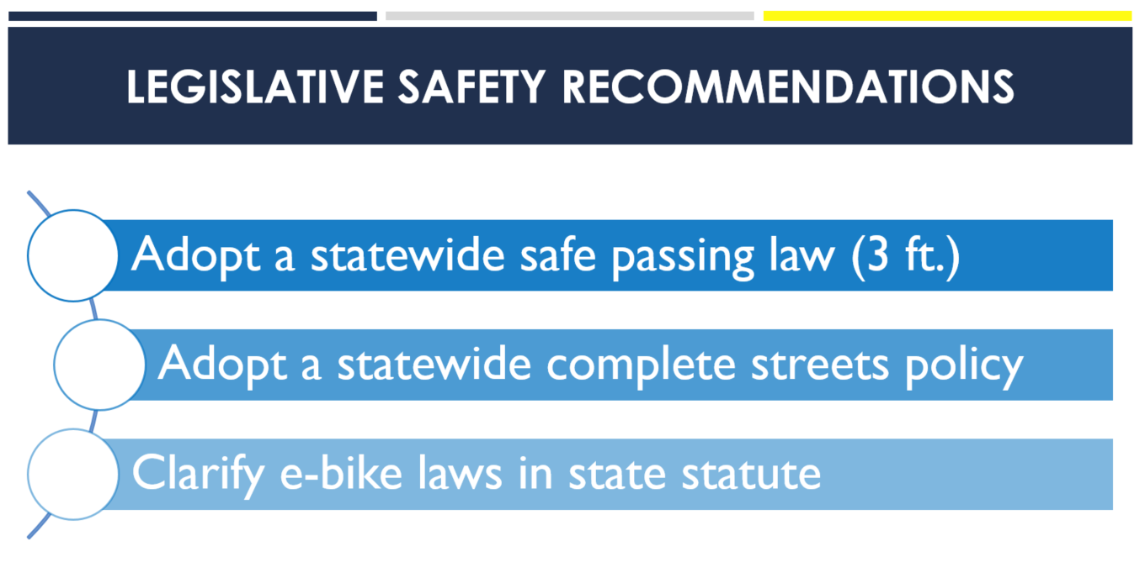
Bicycle trails task force

Slide 23
Project timeline
2018
2019
JUL
OCT
JAN
APR
JUL
Stakeholder Coordination
Online survey
Stakeholder outreach meetings
Project Development
Existing trends
Inventory and tracking system
Recommendations
Statewide network
Plan implementation guidance
Final report

Slide 24
Take our survey!
https://www.surveymonkey.com/r/ActiveIndiana

