Slide 1


Slide 2

WELCOME TO THE PUBLIC HEARING MEETING
State Route 9 and Northport Road Intersection Reconstruction Project
Des. No. 1601984/2000041
Rome City, Noble County, Indiana
September 16, 2021
Notes:
Hello, everyone; my name is Brady Hagerty, public involvement specialist with Burgess & Niple. Welcome to INDOT’s public hearing for the SR 9 and Northport Road intersection reconstruction project in Noble County. Thank you for being interested in the project, and we appreciate your attendance.

Slide 3

Agenda Overview
Welcome
Project Overview
Project Team Introductions
Project Development and Timeline
Environmental Overview
Project Purpose and Need
Alternatives Considered
Preferred Alternative
Public Comments Due by September 30, 2021
Next Steps
Notes:
Before we discuss the specific components of the project, here is a brief overview of tonight’s presentation. First off, welcome, and thanks again for being part of this process.
Tonight, you will hear the term National Environmental Policy Act or NEPA process quite a bit. NEPA is a federal law that establishes a decision-making process state agencies must follow. The process allows INDOT to use Federal dollars for the design and construction of state projects. One NEPA requirement is that a public hearing be held for certain types of projects. Since this project proposes a permanent traffic alteration, INDOT is hosting this public hearing to show you the revised traffic pattern and how it will work.
More importantly, this process allows INDOT and Burgess and Niple to hear your feedback regarding the proposed project. This project will impact anyone who regularly uses the SR 9 and Northport Road intersection.
If you’d like to comment on the project, you can do so during the comment period following this presentation. Or, to submit written comments, you may also email, call or write to the project team. Contact information will be shown at the end of the presentation. Members of the project team will also be around after the hearing portion and will be available for informal discussions and questions.

Slide 4
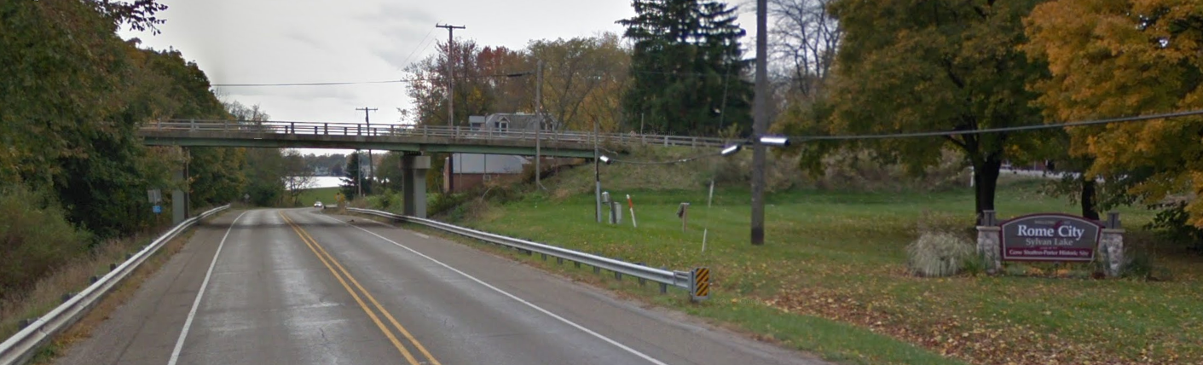
Project Overview
The project is located at the Northport Road and SR 9 intersection in Noble County, Indiana; north of Rome City in the Fort Wayne District. A bridge currently carries Northport Road over SR 9 and is located at RP 208+53 on SR 9. The Structure Number is 009-57-02086 C.
The purpose of this project is to provide an at grade intersection in place of the existing bridge for Northport Road over SR 9. The bridge was built to bridge an existing parallel railroad to SR 9, which is no longer in use. The bridge is in need of major repair, and no longer serves its intended function. An at grade intersection of Northport Road and SR 9 has been proposed to maintain connectivity of the two roads.
Notes:
A quick overview of the project itself. It’s located on SR 9 at Northport Road in Nobel County, north of Rome City. Currently, there is a bridge carrying Northport Road over SR 9; our proposed project will replace the bridge with an at-grade intersection. SR 9 will remain a free-flowing roadway, with Northport Road meeting SR 9 with a two-way stop. SR 9 will retain two through lanes in each direction and gain a protected left-turn lane. Northport Road will remain as a two-lane roadway, one lane in each direction.

Slide 5


Project Team
Indiana Department of Transportation (INDOT)
Miguel Tucker, INDOT Project Manager
Burgess & Niple
Jeff Andrews, Project Manager
Robert Milligan, Lead Project Engineer
Brady Hagerty, Public Involvement Specialist
SJCA, Inc
Karen Wood, Environmental/ Historic Properties
Erin Mulryan, Environmental Document
Notes:
The team for this project includes. The owner, the Indiana Department of Transportation, represented by Miguel Tucker, Project Manager. The project design is being performed by Burgess and Niple, represented by Jeff Andrews, Project Manager; Robert Milligan, Lead Designer; and Brady Hagerty, Public Involvement Specialist. Our environmental consultant, Steven J. Christian, and Associates represented by Karen Wood and Erin Mulryan.
After the presentation is complete, we will be available for informal discussions and questions. Please feel free to engage any of the staff with questions or comments or look over the project exhibits.

Slide 6
Project Development and Timeline
Public Hearing
September 16, 2021
Project
Kick-Off
April 2018
Engineer Report Approved
January 2019
Construction Bids
Spring 2022
Finish Right-of-Way
Spring 2022
2018
2019
2020
2021
2022
Draft Environmental Document Released
August 2021
Construction Begins
Summer 2022
Project
Open House
June 26, 2018
Environmental Document Finalized
October
2021
Begin Right-of-Way Acquisition
Fall 2021
Develop Purpose & Need, Alternative Analysis, Refine Preferred Alternative, Finalize Design
Notes:
Here is an overview of the project timeline; where we have been, where we are, and where we are going. Burgess and Niple, and SJCA joined INDOT’s project team in April 2018.
Once on the project team, we worked to develop a project purpose and need, analyze project alternatives, refine the preferred alternative, develop the NEPA document and move toward a design.
Tonight, is the public hearing phase of the project timeline, which is an opportunity for us to hear from you – your questions, comments, and concerns.
Right-of-way acquisition will begin this fall and completed in the spring of 2022.
We anticipate construction starting in the summer of 2022 and completing it in the fall of 2022.

Slide 7

Environmental Overview
NEPA
National Environmental Policy Act (NEPA)
SR 9 and Northport Road
  Safety/Mobility
  Cultural Resources
  Historic Properties
  Property Impacts
  Community Impacts
State and Local Laws
Safety
Environmental Justice
Protected and Endangered Species
Air Quality
Cultural Resources
Wetlands
Parks
Historic Properties
Civil Rights
Federal Laws
Notes:
Because this project will utilize Federal Funds for construction, it falls under the National Environmental Policy Act (NEPA), as previously mentioned.
NEPA is like an umbrella of protection - requiring specific criteria to be reviewed and addressed as part of the project to ensure protections are afforded during the development. The NEPA document provides protections to the public like ensuring property rights and fair compensation for land acquisition or protection of historic properties and structures. NEPA also offers protections to air quality; protects land, wetlands, and endangered species.

Slide 8
Environmental Document
Categorical Exclusion Level 4
  Requires concurrence from the Federal Highway Administration
Published Legal Notice
  The News Sun – September 2, 2021 and September 9, 2021
  Mailed to homeowners and stakeholders
Available for viewing and comment.
  INDOT Fort Wayne District Website
    https://www.in.gov/indot/about-indot/central-office/welcome-to-the-fort-wayne-district/s.r.-9-and-northport-intersection-improvement-in-noble-county/
  INDOT Fort Wayne District Office
  Limberlost Branch Public Library, 164 Kelly Street, Rome City, IN 46784
  Copy on display tonight
Notes:
The final NEPA document showing the environmental studies is available on the INDOT website, which can be found on the slide. It can also be viewed at the Limberlost Branch Public Library through September 30, 2021.
A copy of the NEPA document is also available this evening, as part of the exhibits.
As you will see in the document, this project is classified as a Categorical Exclusion Level 4, which means it does not have a significant environmental impact.

Slide 9
Project Purpose and Need
The need of this project is to address safety concerns in the existing configuration of the SR 9, Northport Road, and Kelly Street intersections.
The current configuration has led to an above average number of crashes.
A secondary need for the project is to address the deteriorating bridge carrying Northport Road over SR 9.
The bridge was built to span SR 9 and a railroad corridor; which is now out of service and the tracks removed. The bridge will be removed as part of the project.
The purpose of this project is to provide connectivity between SR 9 and Northport Rd that improves motorists’ safety at the intersection of SR 9 and Kelly St, as well as meets current roadway requirements.
Notes:
The need for the project is to address safety concerns in the existing configuration of the SR 9, Northport Road, and Kelly Street intersections. The current configuration has led to an above-average number of crashes – from 2017-2020, 17 crashes involving 22 vehicles on SR 9 near the Northport Road Bridge or the adjacent Kelly Street intersection with SR 9.
A secondary need for the project is to address the deteriorating bridge carrying Northport Road over SR 9. The bridge was built to span SR 9 and a railroad corridor, which is now out of service, and the tracks removed. The bridge will be removed due to its low condition and insufficient load ratings and it’s geometrically deficient due to its age.
The purpose of this project is to provide connectivity between SR 9 and Northport Rd that improves motorists’ safety at the intersection of SR 9 and Kelly St, as well as meets current roadway standards.

Slide 10
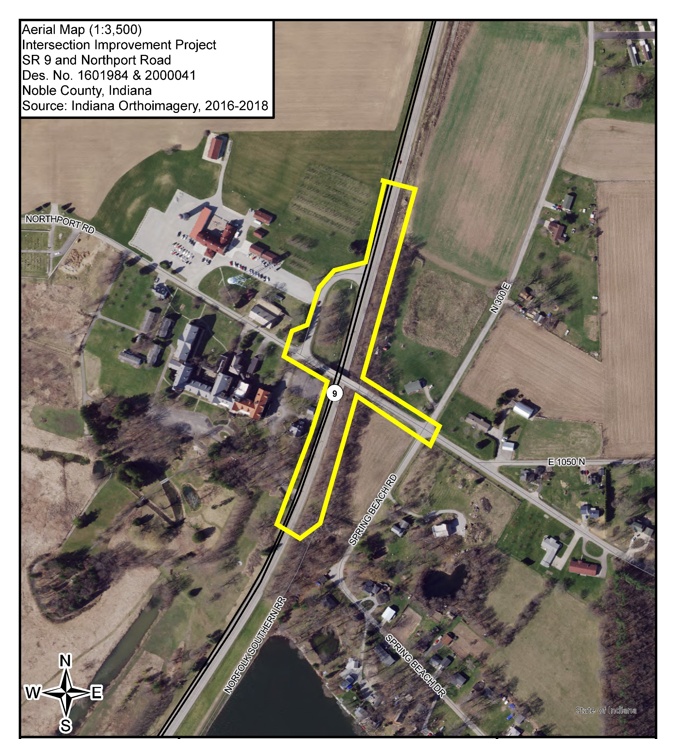
Project Study Area
SR 9 and Northport Road
  Northport and CR N 300 E
  Kelly Street
  Sylvan Cellars Event Center
  Our Lady Mother of Mercy Center
Notes:
This is the project study area, which is taken from the NEPA document. Our study limits encompass the entire project area, which includes SR 9 just north and south of the project, along Northport Road just east and west of the project, along Kelly Street, and into the Sylvan Cellars and Lady Mother of Mercy properties.

Slide 11
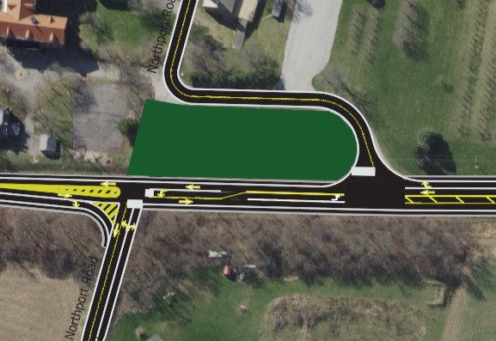
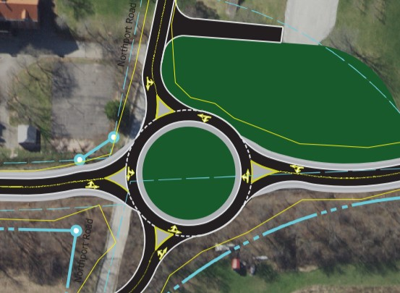
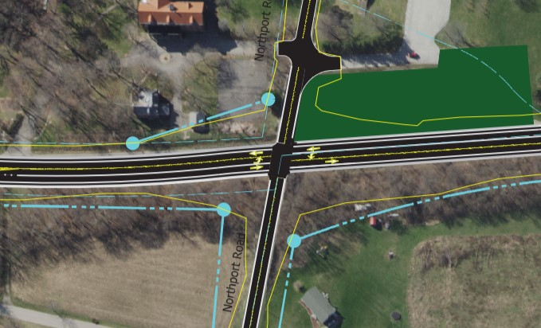
Project Alternatives
Staggered Intersection
Roundabout Intersection
At-grade Intersection
Notes:
Several options have been studied for the SR 9 and Northport Road intersection. In October 2017, INDOT put together an Engineering Report examining the replacement of the bridge carrying Northport Road over SR 9. That report concluded the bridge is no longer needed; and that creating an intersection would be the most practical alternative to explore.
Using the INDOT report as a starting point, Burgess and Niple studied three intersection layouts and a “no-build” alternative. The “no-build” alternative wasn’t feasible as the bridge required replacement, and removal of the bridge would sever the connectivity of Northport Road.

Slide 12
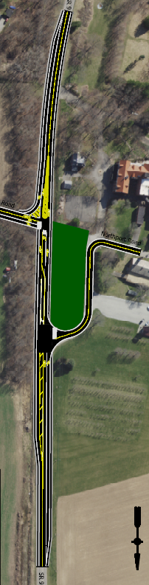
Staggered Intersection Alternative
Notes:
The first intersection alternative was a staggered intersection. This would utilize the existing Kelly Street intersection with SR 9 for the east approach, and a new west Northport Road approach to SR 9 would be created in place of the bridge. This alternative had too many roadway geometric issues and could not provide adequate space for a left turn lane. Due to those reasons, this alternative was not selected as the preferred option.

Slide 13
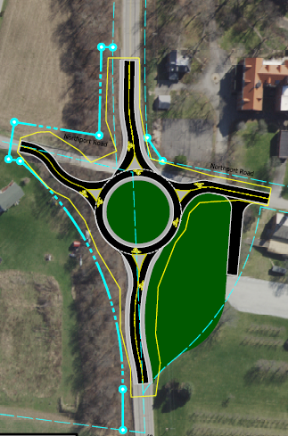
Roundabout Intersection Alternative
Notes:
The second alternative was a roundabout. This alternative would replace the bridge with a roundabout between SR 9 and Kelly Street in the infield area. This alternative would introduce a yielding condition on SR 9, which was otherwise free-flow, creating an increased risk of high-speed rear-end crashes on SR 9. Due to the increased risk, this alternative was not selected as the preferred option.

Slide 14
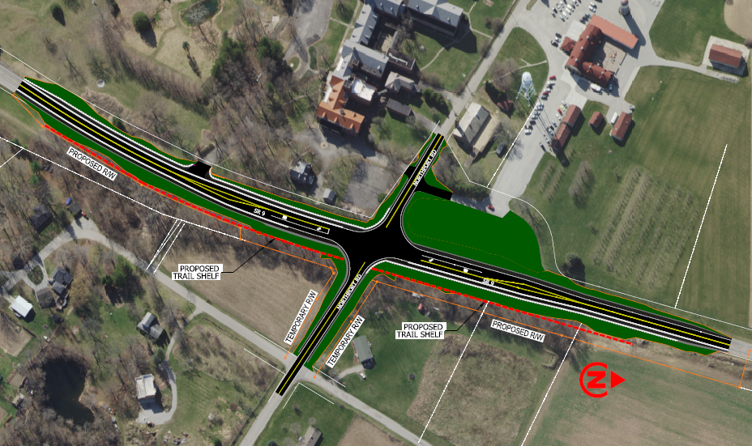
Preferred Alternative
4-legged At-Grade Intersection
  Dedicated left turn lane improves safety
  SR 9 remains free-flowing
  Removes sight obstructions
    Kelly Street
    Overhead Bridge
  No adverse impacts to Historic Resources
  No wetland or stream impacts, hazardous material, or regulated substance concerns
  Meets Purpose and Need
Notes:
The third and preferred alternative is a four-legged, at-grade intersection, which meets the purpose and needs of the project.
This option will provide dedicated left-turn lanes on SR 9, giving vehicles a protected space to stop and wait to make left turns, outside the free-flowing travel lanes.
The intersection will be two-way stop-controlled, with Northport Road stopping at a stop sign and SR 9 remaining free flow. This – along with removing turning vehicles from the traffic stream – will reduce rear-end crashes.
The removal of the bridge and regrading the intersection will improve the sightlines of the intersection. The bridge piers, which were a sight obstruction, will be removed. SR 9 will be raised, and Northport Road will be lowered, flattening the intersection and increasing the available sightlines for vehicles entering and exiting Northport Road. Kelly Street will no longer intersect with SR 9; traffic will access Kelly Street from Northport Road.
As you can see in red, we will also cut into the hillside and level an area which can be paved into a future trail.
The intersection layout has been configured to create no adverse impact to the Historic Properties and Historic District adjacent to the project.
This alternative also has no impacts to wetlands, streams, or regulated or hazardous material concerns.

Slide 15

Next Steps- Property Acquisition and Construction
https://www.in.gov/indot/2698.htm
If any portion of your property needs to be acquired, the property owner, will be notified as soon as possible.
  The agency’s interest in acquiring your property
  The agency’s obligation to secure any necessary appraisals
  Any other useful and pertinent information
When the agency beings the acquisition process, the property owner, will be personally contacted no later than during the appraisal process
Notes:
The next steps of the project will involve the certifying of the NEPA document and right-of-way acquisition. This project will require a right-of-way acquisition of approximately 3.37 acres of permanent new right-of-way, needed during construction.
The process will follow the Federal Acquisition process; if any portion of your property needs to be acquired, the property owner will be notified as soon as possible. You will be notified of INDOT’s interest in acquiring your property and INDOT’s obligation to secure any necessary appraisals. An appraiser will contact you to make an appointment to inspect your property. The appraiser is responsible for determining the initial fair market value of the property. INDOT will then have a review appraiser study and recommend approval of the appraisal report used to establish the just compensation to be offered to you for the property. You, or a representative that you designate, will be invited to accompany the appraiser during the inspection. There are copies of the Federal Acquisition process at the sign in table.

Slide 16
Addressing Comments
All comments received will be addressed in the Final Environmental Document as a result of:
  The public statements recorded at the public hearing
  All written comments, concerns, and suggestions such as letters, faxes, and emails received during the comments period.
  Informal comments are always welcome, however, please note the general conversations are not part of the official record.
Notes:
Let’s discuss how your comments will be incorporated into the NEPA document.
All verbal comments received tonight and any written or emailed comments received before September 30, 2021, will receive responses from the project team within the final NEPA document.
Informal comments are always welcome; however, please note, the general conversations are not part of the official record.

Slide 17
Submit Public Comments
Fill out a comment sheet, provide a formal comment during the meeting, or submit written comments via mail or email by September 30, 2021.
Mail: Burgess & Niple
251 N. Illinois Street, Suite 920
Indianapolis, IN 46204
Email: jeff.andrews@burgessniple.com
Phone: 317-237-2760
Documents are available for public viewing at:
Limberlost Branch Public Library
164 Kelly Street
Rome City, IN 46542
Indiana Department of Transportation
Fort Wayne District Office
5333 Hatfield Road
Fort Wayne, IN 46808
Notes:
The presentation portion of the hearing is complete; we will start accepting formal, verbal comments in a few minutes. If you signed up to speak on the speaker’s list at the sign-in table, you will be invited to come up and speak in the order you signed up. If you have not yet signed up to speak, you will have an opportunity to do so after we have completed the list.
If you would like to make verbal comments but are not interested in speaking in front of an audience, please see us after the presentation, and we can record your comments off to the side.
The second method of delivering your comments is on the comment sheets included within the information packet. You may fill this comment sheet out this evening and hand it to one of us.
Your third option is to send us your comments via mail or email. If you send your comments via email, you will receive a brief confirmation response letting you know that your comments were received.
Representatives will be available after the presentation to answer any questions one on one at the exhibits; however, please note, that these general conversations are not part of the official record.
Formal statements from one of the three mentioned options are the only way to make statements that will appear on the record.

