Slide 1
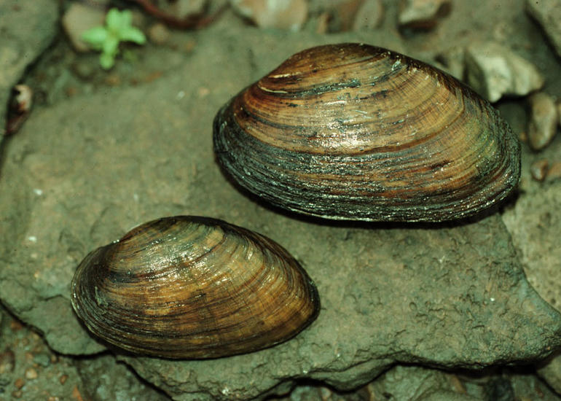
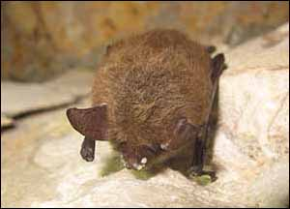
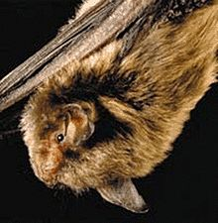
Terrestrial Habitat and Endangered Species
Project Area Land Use
Riparian Forest
Agricultural
IDNR Natural Heritage Database
State Species of Special Concern in Area:
Kidney Shell Mussel (Ptychobranchus fasciolaris)
No impacts expected to State Species of Special Concern
USFWS
2013 Interim Policy
Potential for impacts assumed to be minimal
Range-Wide Programmatic Informal Consultation for the Indiana Bat and Northern Long Eared Bat
“Not Likely to Adversely Affect”
Avoidance, Minimization, & Mitigation Measures to be implemented
[ 1 ]

Slide 2
Cultural Resources
Archaeological
Records Check and Phase Ia Field Reconnaissance
No Archaeological deposits in project area
Historic Properties
Two resources 50 years or older within the Area of Potential Effects (APE)
Bridge No. (421)39-12-01792B, which is the focus of this project
St. Luke Church and Cemetery
Historic Bridge Programmatic Agreement
Alternatives Analysis:
Feasible and Prudent Alternative
Secretary of Interior’s Standards for Rehabilitation
Effect Finding:
“No Adverse Effect” published November 14, 2019 in The Times
State Historic Preservation Officer concurred with Finding on December 09, 2019

Slide 3
Section 4(f)
Historic Properties:
Bridge No. (421)39-12-01792B
Programmatic Use Determination
Will not impair the historic integrity of the bridge
Currently used for transportation purposes
No Section 4(f) conversion will take place
St. Luke Church and Cemetery
Will not convert property to a transportation use
Section 106 finding of “No Adverse Effect”
No Section 4(f) analysis required

Slide 4
Purpose and Need
Need:
Advanced deterioration of structure
Sufficiency Rating of 46.7 out of 100
Current deficiencies
Bridge Deck: Exhibiting sings of spalling, transverse and longitudinal cracking, and efflorescence
Superstructure: Minor section loss, spalling with exposed rebar, and longitudinal cracking with efflorescence. Metal trusses have widespread rust with severe rusting and section loss at four corner connections
Substructure: Minor section loss, interior piers are exhibiting sings of cracking and have exposed rebar
Purpose:
Correct the listed deficiencies of the structure
Provide continued safe vehicular crossing over South Fork Wildcat Creek
Increase the service life of the structure

Slide 5
Alternatives
Do Nothing
No expenditure of capital funds – utilize existing facility
Result in road closure
Does not meet Purpose and Need of project
Not prudent
Preferred Alternative
Rehabilitation for Continued Vehicular Use
Meets Secretary of Interior’s Standards for Rehabilitation
Meets Purpose and Need
Feasible and prudent

Slide 6
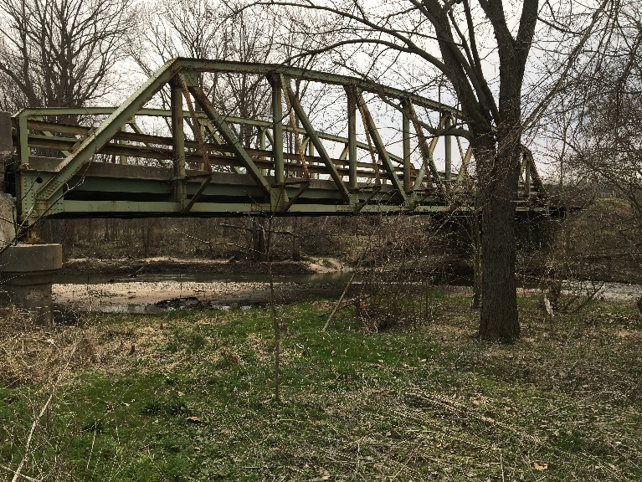
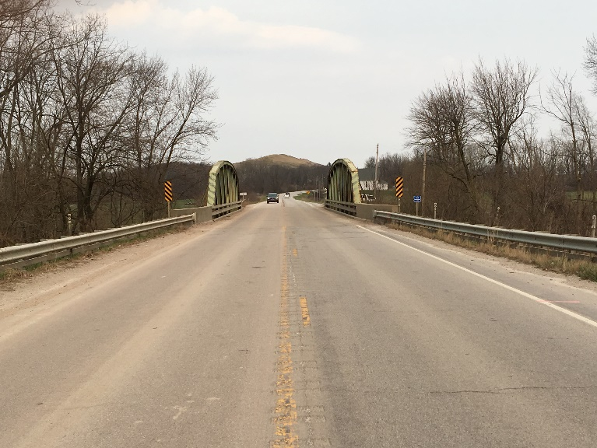
Preferred Alternative
Replacing reinforced concrete pier pedestals for Spans A and C
Replacing end abutment caps
Replacing the end spans A and C, with new prestressed concrete box beam superstructures, a new reinforced concrete deck and new type FC concrete railing
Abutments 1 & 4 would become semi-integral. New joints would be installed at Pier 2 and Pier 3 where superstructure type changes
Replacing the existing reinforced concrete deck on the steel pony truss main span
Repairing the existing steel pony truss by:
Replacing steel elements in-kind
Replacing deteriorated rivets with round-headed bolts
Repairing deteriorated members by attaching additional steel plates to restore member’s original cross-sectional area Installing new bridge deck drains
Cleaning and painting the existing steel pony truss and attached existing metal bridge railing
Constructing new reinforced concrete bridge approaches
Replacing existing guardrail at all four bridge corners
Wedge and level and/or replacing existing asphalt pavement as necessary
Installing riprap turnouts at the ends of the concrete bridge railing transitions
Adding scour protection

Slide 7
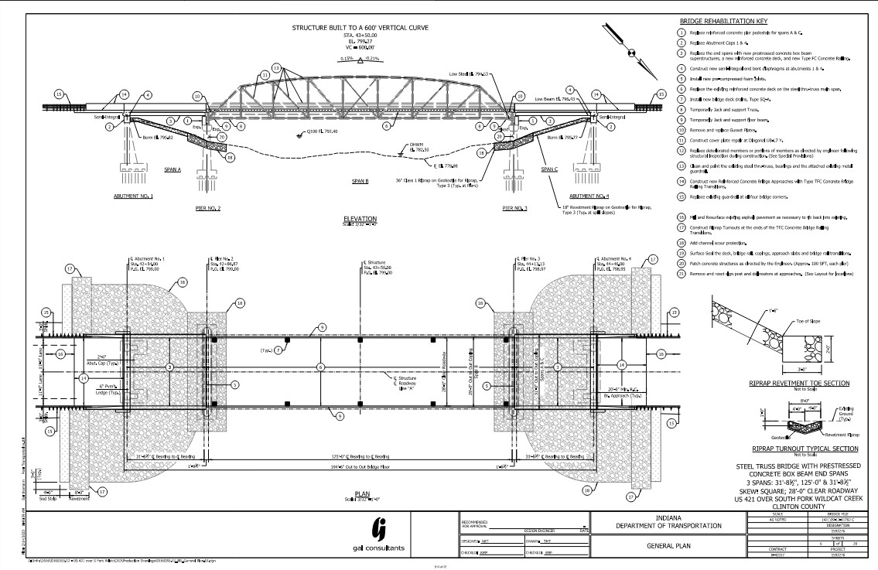
Preferred Alternative – Plan and Profile View

Slide 8
Detour

Slide 9
Right-of-Way
This project will not require the acquisition of any permanent or temporary right-of-way

Slide 10
Project Schedule
The anticipated schedule is…
Public Hearing – September 04, 2020
Environmental Document Completion – October 2020
Completion of the Design Phase – December 2020
Project Letting – March 10, 2021
Construction to Begin – Summer 2021
Note – Construction completed by Spring 2022

Slide 11
Public Comment Reminders
Mail to Harlan Ford at GAI Consultants, Inc., 201 N. Illinois Street, Suite 1700, Indianapolis, IN 46204
Fax to: 317-570-6810
Email to h.ford@gaiconsultants.com
Please ensure that comments are postmarked no later than September 19, 2020
All comments will be reviewed, evaluated, and given due consideration during the decision-making process

