Slide 1

U.S. 31 & S.R. 28 Interchange Project
Tipton County Foundation
Wednesday, February 11, 2015

Slide 2
Welcome
Rickie Clark, INDOT Office of Public Involvement
Purpose/explanation of public hearing
Public hearing format
Visit our sign-in table
Informational handouts
Submitting public comments for hearings transcript
Project display area

Slide 3
Welcome
Introduction of INDOT project officials
Project Management
Design
Real Estate
Public Involvement
URS
Design & Environmental Team
Recognition of elected and local public officials

Slide 4
Public Hearing
Sign-in at attendance table to be added to project mailing list.
A public hearing notice was mailed to known property owners within project area.
Announcement of this hearing was posted to INDOT website. A media release was also issued.
Legal notice publishing:
Tipton County Tribune
Tuesday, January 27, 2015
Tuesday, February 3, 2015

Slide 5
Project Stakeholders
Indiana Department of Transportation
Indiana Division Federal Highway Administration
Tipton County
City of Tipton
Local communities
Elected public officials
Community residents and citizens
Commuters
Chrysler Corporation
Emergency services

Slide 6
Project Development Process
Engineering Assessment
Environmental phase begins
Purpose & need
Develop alternatives
Preliminary design phase
Release environmental document for public review and comment
Right-of-Way acquisition phase
Construction
Public Hearing
Notes:
6

Slide 7
Environmental Document
Requirement of the National Environmental Policy Act (NEPA)
Requires INDOT to analyze and evaluate the impacts of a proposed project to the natural and socio-economic environments
Impacts are described in environmental document
Categorical Exclusion (CE), Level 3
Environmental document was released for public involvement in January 2015

Slide 8
Environmental Document
Purpose and need
Develop a number of possible alternatives
The “Do Nothing” alternative is a baseline for comparison
Screen alternatives to identify a preferred alternative
Solicit public comment on environmental document and preliminary design plan
Solicit, address and fully consider public comment as part of decision making process

Slide 9
Elements of the Environmental Documentation
Environmental Documentation
Real Estate
Community Impacts
Air Quality
Wetlands and Waterways
Noise
Floodplains
Farmland
Endangered Species
Hazardous Materials
Environmental Justice
Historic/Archaeological
Cultural Resources
Public Involvement

Slide 10
Environmental Documentation
Noteworthy Environmental Document findings
0.39 acre of Wetland Impacts
0.044 acre will require mitigation on site.
No impacts to Jurisdictional Streams (Waters of the U.S.)
No impacts to Tucker Cemetery
Adverse impact to one potentially eligible Archaeological site in NW Quadrant
Memorandum of Agreement with INDOT/FHWA/SHPO dated 1/9/15.

Slide 11
Environmental Documentation
Noteworthy Environmental Document findings (Cont.)
Low levels of soil and groundwater contamination will be encountered during excavation at 4 sites
Minimal Impacts to the Floodplain of Dixon Creek
8 Relocations (3 Residential, 5 Businesses)

Slide 12
Environmental Documentation
Categorical Exclusion Level 1 – Advanced Acquisitions
Allowed by MAP-21, the Moving Ahead for Progress in the 21st Century Act
Approved December 2013 for 6 Properties
Amended September 2014 for 5 Additional Properties

Slide 13
Environmental Documentation
INDOT Greenfield District Office
Planning & Programming Department
32 South Broadway
Greenfield, IN 46140
(855) 463-6848; eastcentralin@indot.in.gov
INDOT Office of Public Involvement
Indiana Government Center North, Room N642
100 North Senate Avenue, Indianapolis, IN 46204
(317) 232-6601; rclark@indot.in.gov
Tipton County Public Library
127 East Madison Street
Tipton, Indiana 46072
Phone (765) 675-8761

Slide 14
U.S. 31 / S.R. 28 Interchange Project
Purpose
To improve the safety and mobility on US 31 as a high-speed commerce corridor between Indianapolis and South Bend.
Need
Reduce the number and severity of crashes
Reduce travel times for expected traffic growth
Notes:
Deteriorating pavement conditions
Substandard roadway geometry
Average Annual Daily Traffic (AADT)

Slide 15
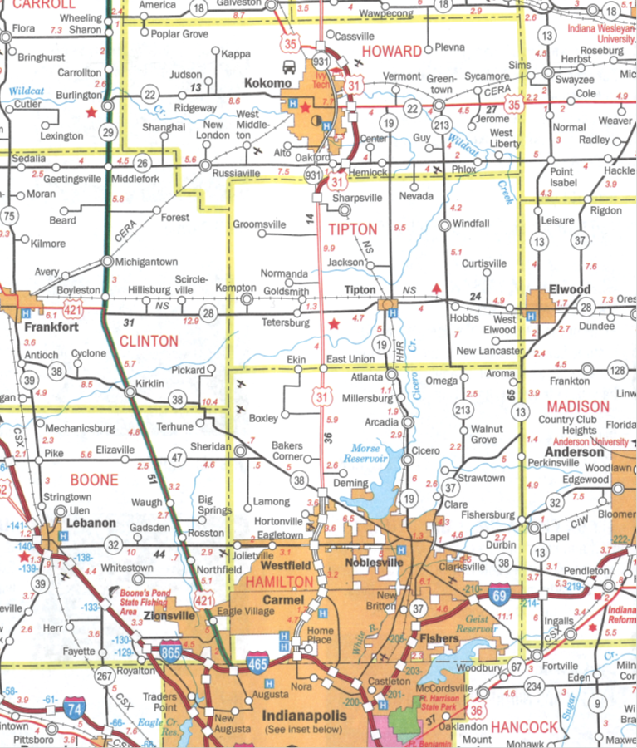
U.S. 31 / S.R. 28 Interchange Project
▲
N
PROJECT
LOCATION

Slide 16
U.S. 31 / S.R. 28 Interchange Project
Alternatives considered:
#1 - Modified Diamond with SE Loop
#2 - Tight Diamond with roundabout terminals
#3 - Modified Diamond with NW Loop
#4 - Two Quadrant Diamond with roundabout ramp terminals and direct Chrysler Transmission Plant connection
#5 - Modified Diamond with roundabout terminals and direct Chrysler Transmission Plant connection
#6 - Do-Nothing Alternative

Slide 17
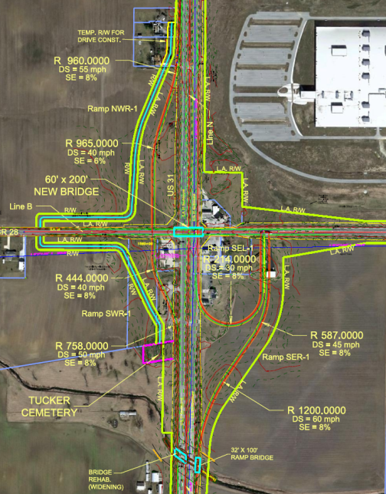
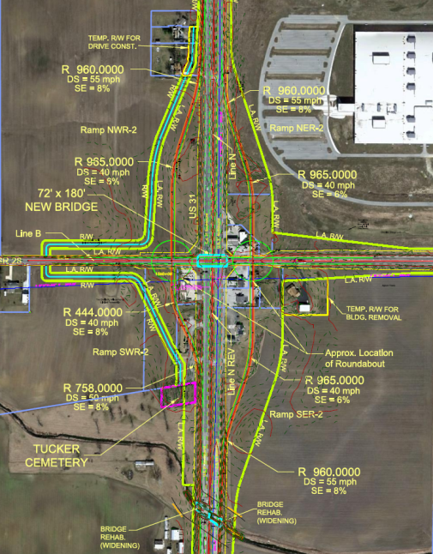
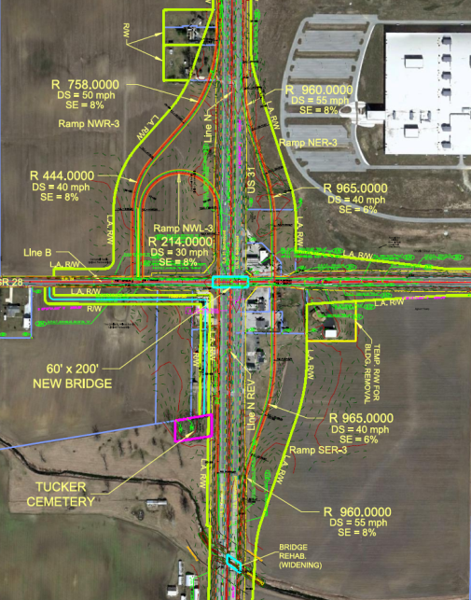
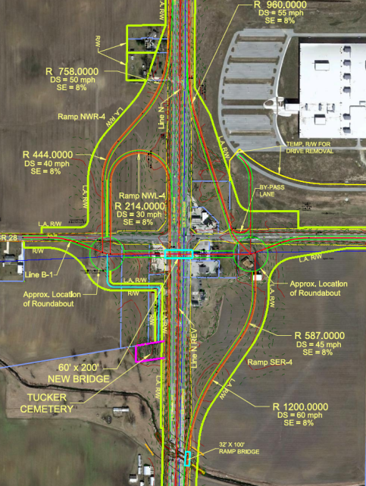
U.S. 31 / S.R. 28 Interchange Project
Alternatives considered:
▲
N
Alternative #1
Alternative #2
Alternative #3
Alternative #4

Slide 18
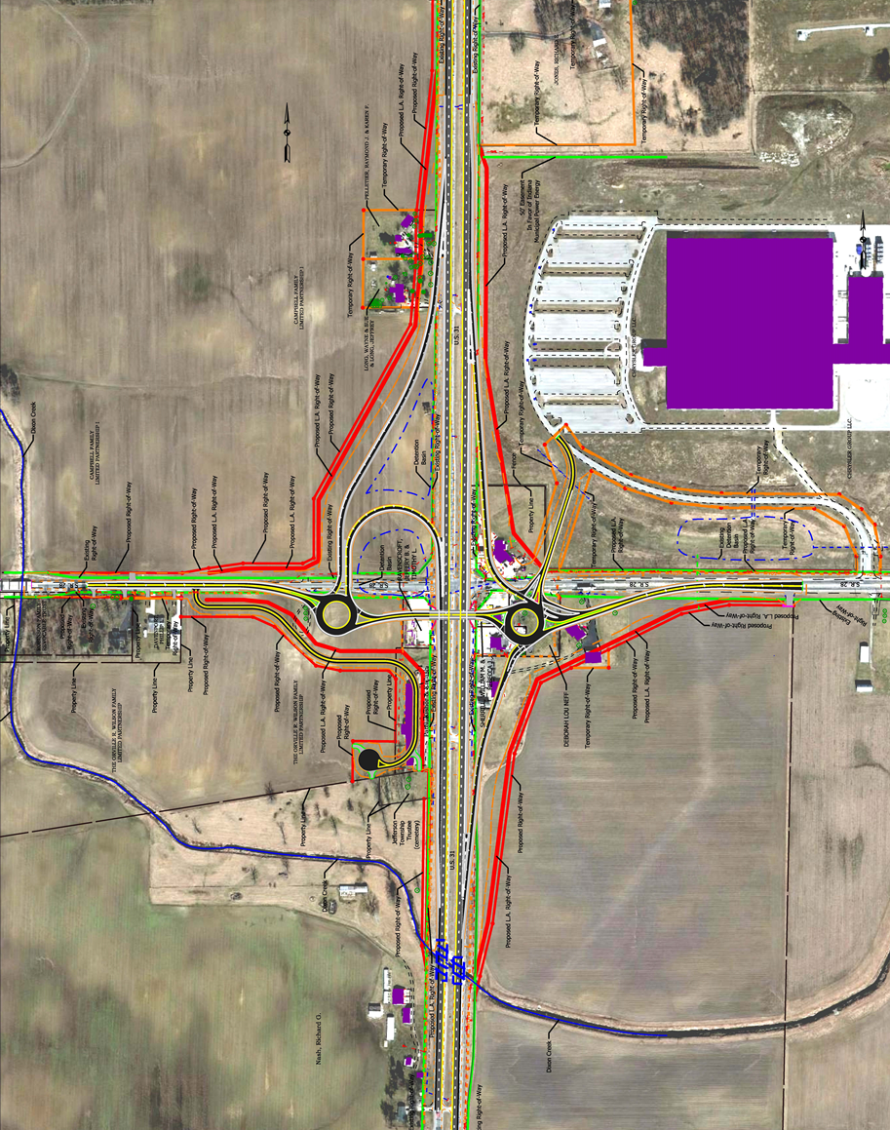
U.S. 31 / S.R. 28 Interchange Project
Preferred Alternative:
Alternative 5
▲
N

Slide 19
U.S. 31 / S.R. 28 Interchange Project
Preferred Alternative: Alternative #5
Supports local economic vision for the interchange as endorsed by the local public agencies.
Meets current and forecast travel demand.
Provides the most efficient means of travel along SR 28 & from the Chrysler Plant.
Provides a high level of safety with the installation of roundabouts.
Minimizes impacts to Tucker Cemetery in the southwest quadrant.
Provides the most efficient and cost-effective means of maintaining traffic during construction.

Slide 20
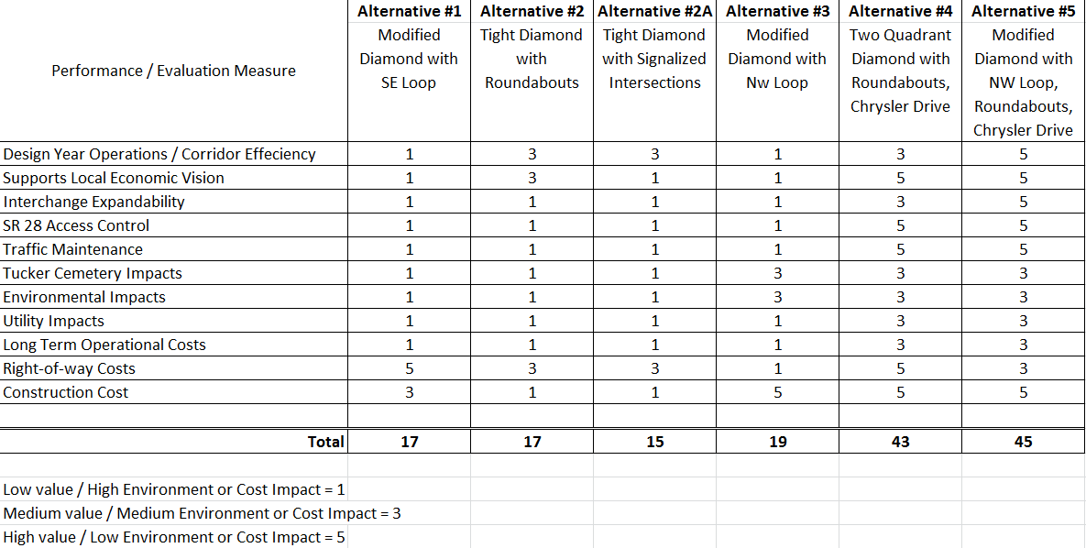
U.S. 31 / S.R. 28 Interchange Project
Preferred Alternative:
Alternative 5: Scored equal to or better than all other alternatives in all categories.

Slide 21


U.S. 31 / S.R. 28 Interchange Project
Project Features
S.R. 28 over U.S. 31
New Concrete/Steel Bridge
Roundabout Intersections
New Chrysler Access
Limited Access ROW
SW Local Access Road
Utility Relocations
On-site Detention Storage

Slide 22
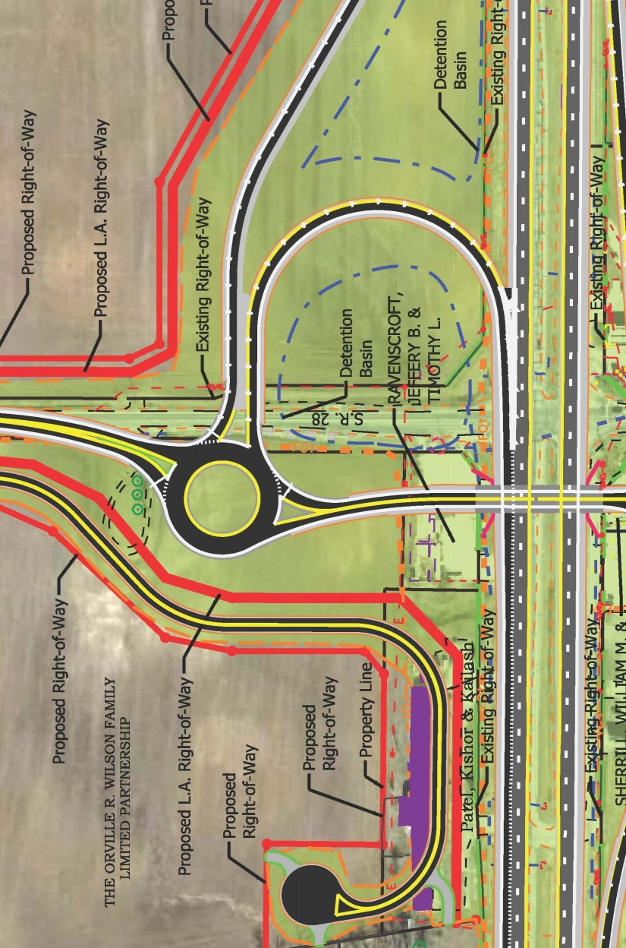
U.S. 31 / S.R. 28 Interchange Project
West Roundabout
Operations
Single Lane with Future Expansion
Design to Accommodate Commercial Trucks / Ag Equipment
Overhead Lighting
▲
N

Slide 23
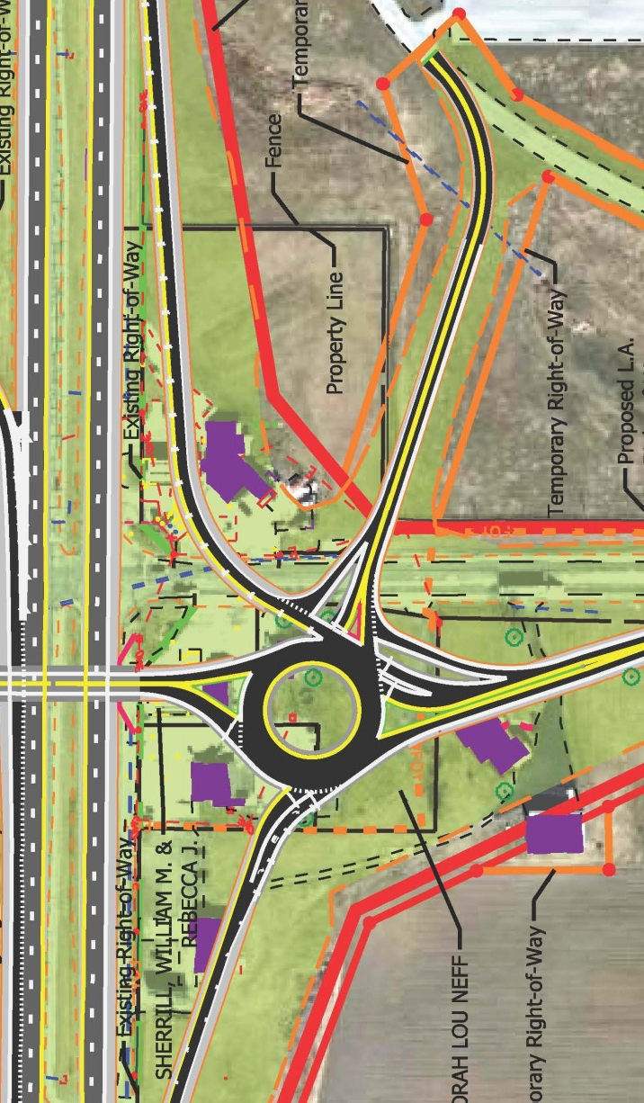
U.S. 31 / S.R. 28 Interchange Project
East Roundabout
Operations
Single Lane with Future Expansion
Design to Accommodate Commercial Trucks / Ag Equipment
Overhead Lighting
▲
N

Slide 24
U.S. 31 / S.R. 28 Interchange Project
Traffic Maintenance
A lot of work with short term lane / shoulder restrictions
≈120 day S.R. 28 Closure
Signed State Detour
Local Traffic CR 560E North to Division Rd.

Slide 25
U.S. 31 / S.R. 28 Interchange Project
Estimated Cost
$1.4 Million Engineering
$5.0 Million ROW
$8.4 Million Construction
$14.8 Million Project

Slide 26

Real Estate Acquisition Process

Slide 27
Real Estate Acquisition Process
"Uniform Act of 1970"
All federal, state and local governments must comply
Requires an offer for just compensation
Acquisition Process
Appraisals
Review Appraisals
Negotiations
INDOT Real Estate Team to work with impacted property owners

Slide 28
U.S. 31 / S.R. 28 Interchange Project
Right-of-way
Permanent R/W: 40.1 acres
Residential
Commercial
Agricultural
Temporary R/W: 9.3 acres
Grading
Driveway reconstruction
8 Relocations

Slide 29
Project Schedule
Public Hearing: February 2015
Environmental Document finalized: March 2015
Real Estate Acquisition activities: 2015 - 2016
Appraising
Negotiations/Buying
Utilities coordination/Relocation
Construction: 2015-2016

Slide 30
Feedback
INDOT would like to hear from you
Talk with INDOT project team members
Comment sheet in information packet
E-mail or mail comments to INDOT
Sign-in list to be added to project mailing list
Visit INDOT Greenfield District page at http://www.in.gov/indot/2704.htm
All comments are very much appreciated and will be given full consideration by project team

Slide 31
Submit Public Comments
Submit public comments using the options described in first page of information packet:
Public Comment Form
Via e-mail
Participating during public comment session via microphone
Verbal comments recorded and transcribed for inclusion into public hearings transcript
INDOT respectfully requests comments be submitted by Friday, February 27, 2015.
All comments submitted will become part of public record, entered into transcript, reviewed, evaluated and given full consideration during decision making process.

Slide 32
Next Steps
Public and project stakeholder input
Submit comments via options described on page 1 of information packet
INDOT review and evaluation
All comments are given full consideration during decision-making process
Address comments, finalize/approve environmental document, complete project design
Communicate a decision
INDOT will notify persons on mailing list of decision
Work through local media outlets and paid legal notice
Make project documents accessible via repositories
Questions? Contact Public Involvement Team

Slide 33
Public Involvement Team
Rickie Clark
INDOT Office of Public Involvement
(317) 232-6601
rclark@indot.in.gov
Nathan Riggs
INDOT Greenfield District Office (855) 463-6848
eastcentralin@indot.in.gov

Slide 34
Thank You
Please visit with INDOT project officials following the public comment session
Project Open House
Project maps, displays, real estate acquisition table, INDOT project officials and informal Q & A

Slide 35

Public Comment Session

