Slide 1
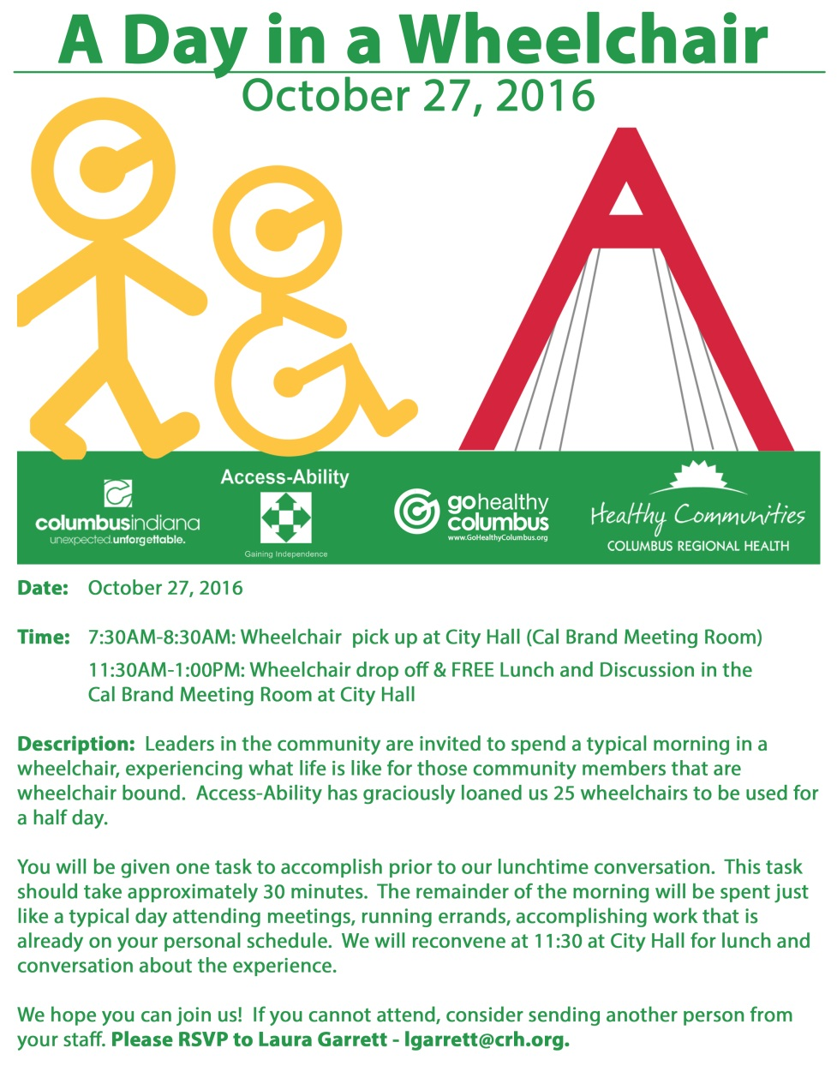
AN ADA EDUCATION EXPERIENCE
A Day in a Wheelchair
David Hayward, PE
City Engineer
Columbus, IN
Notes:
This was not my first time participating in such an event. The previous time was about 20 years ago. I found that I am not as strong as I used to be.
Let’s break this invitation into 2 parts for our discussion.

Slide 2
PARTNERSHIPS
Columbus Regional Health
City of Columbus
Columbus Human Rights Commission
Bartholomew County
Notes:
This was a great cooperative effort of several agencies. I especially want to mention Healthy Communities (always a great partner for the City) and The Republic, our local newspaper. Most of the photos and quotes in this presentation are from The Republic.
An estimated 17 percent of Bartholomew County residents (about 13,500) have some form of disability.

Slide 3
AGENDA
Notes:
The organizers selected 25 key people to participate and were told what they would be doing.

Slide 4
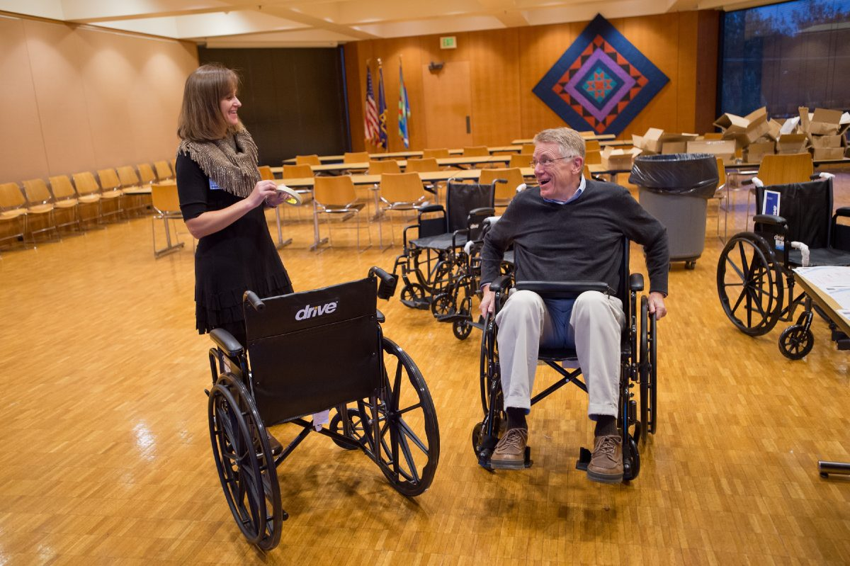
FITTING & INSTRUCTIONS
Brand new wheelchairs courtesy of Access-Ability
Notes:
Access-Ability brought 25 brand new wheelchairs for our use. Each worth about $1,000.
Each person was fitted and was given instructions for the exercise.
People: Laura Garrett, Healthy Communities
Jim Lienhoop, Mayor
Dennis Baute, City Plan Commission President

Slide 5
ROUTES
Notes:
Each person was allowed to choose his/her route.

Slide 6
ROUTES
Notes:
Each instruction contained a task to accomplish at our destinations/

Slide 7
HEADING OUT
“As much as we try, our environment is just not set up for wheelchairs,” Mayor Jim Lienhoop said after participating in the event.
Notes:
This is our Mayor. Notice that he is looking up and to his left. He is looking at the traffic signal and wondering if he is going to make it across before the light changes.
Other participants noticed an approaching vehicle driving too fast who blew thru the red light. Fortunately they were able to get out of the way.

Slide 8
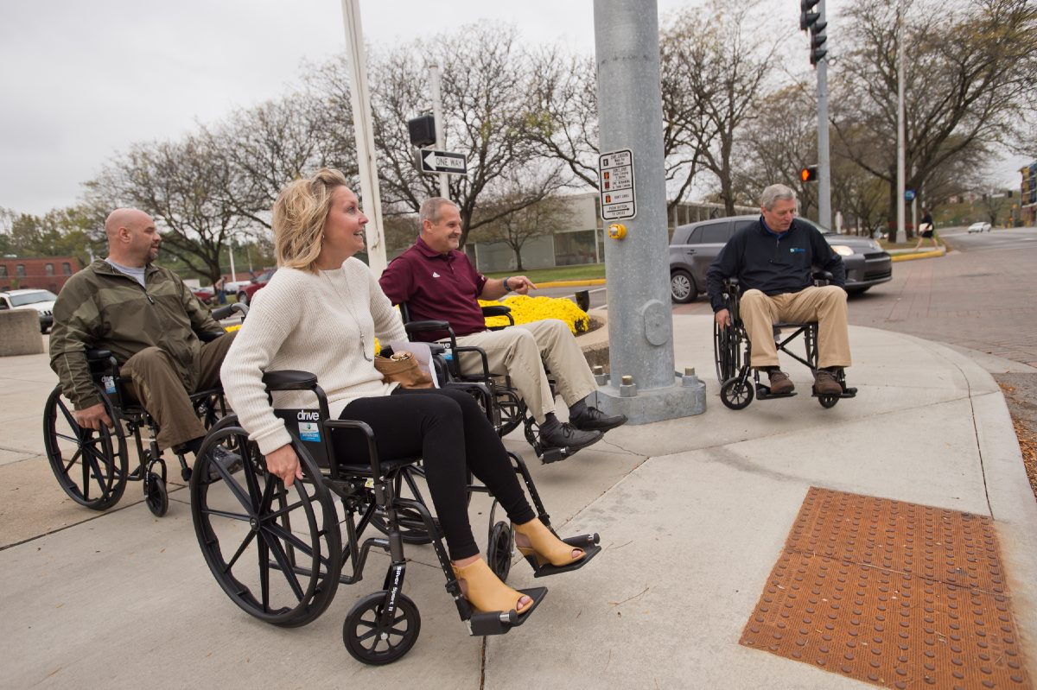
HEADING OUT
“Columbus strives to be a welcoming community, and that must extend to residents and visitors who have disabilities.”
Notes:
Redevelopment Director, Transit mechanic, Public Works Director, and me.
Notice the compliant curb ramp and pedestrian push button.

Slide 9
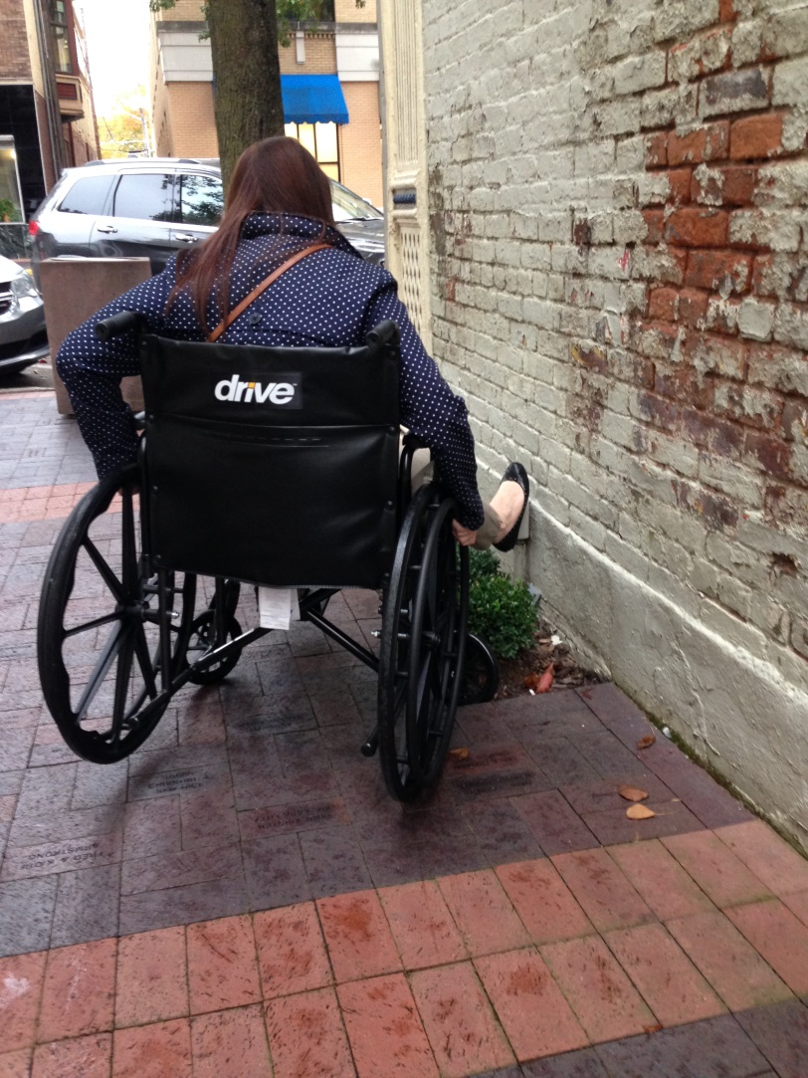
ISSUES
Tree grate in sidewalk
Planter in sidewalk
Notes:
Senior Planner Allie found a few trouble spots.
Note right rear wheel is off the pavement in the right photo. When that happens, it is very difficult to move.

Slide 10
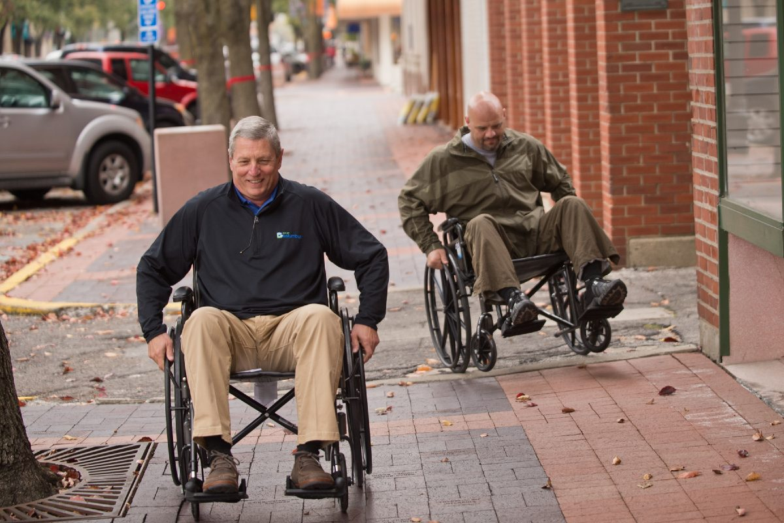
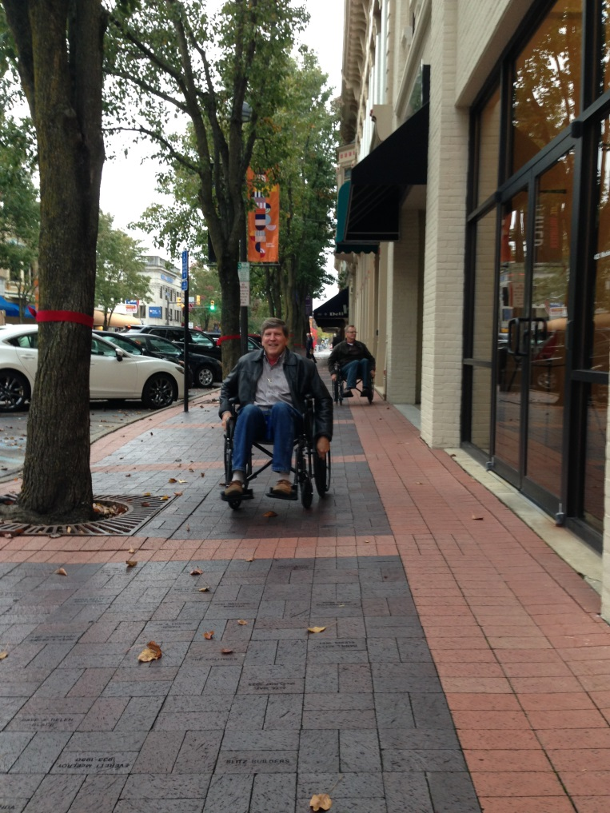
ISSUES
Pavement surface irregularities
Cross slope issues
Notes:
We have a great transit system. Drivers are very well trained and helpful.
This “Call-A-Bus” driver is helping a transit staff person into the bus.

Slide 11
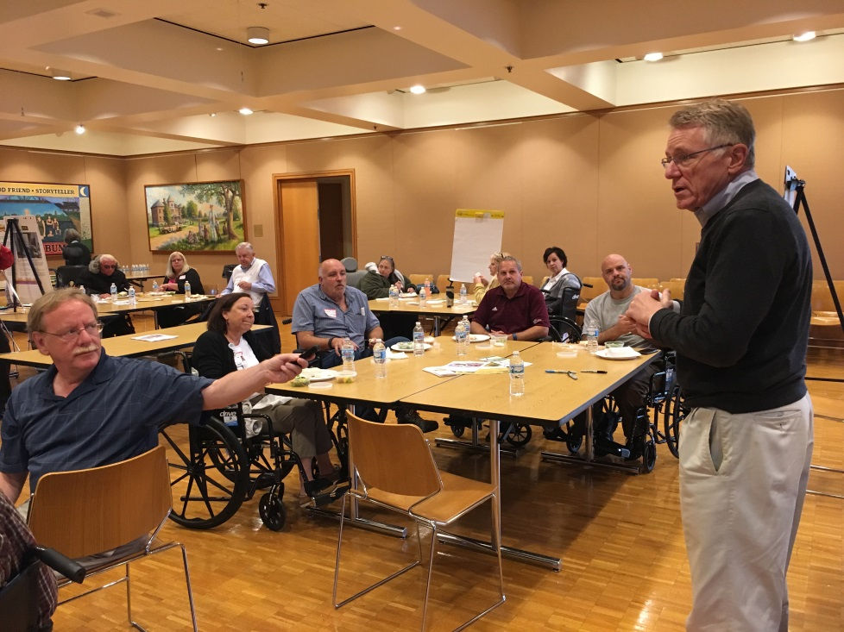
WRAP-UP
News media also invited
Notes:
Wrap-up lunch was an eye opener. We’ll share some of the participants’ comments in the next couple of slides.
People:
Zach Ellison, County Plan Commission President and CRH Board member
Bill Pumphry, “accessibility watchdog”
County Highway Engineer
News media (radio and newspaper)
School Corporation officials
Several mobility challenged individuals

Slide 12
LESSONS LEARNED
I wish this sidewalk was smoother.
The cross slope keeps steering me toward the street.
Curb ramps require a lot more effort than I thought.
I hope that car sees us and stops for us.
Where’s the drink holder?
More people should experience this.
Restrooms and elevators are challenging.
Loose leaves and sand hamper a wheelchair’s traction.

Slide 13
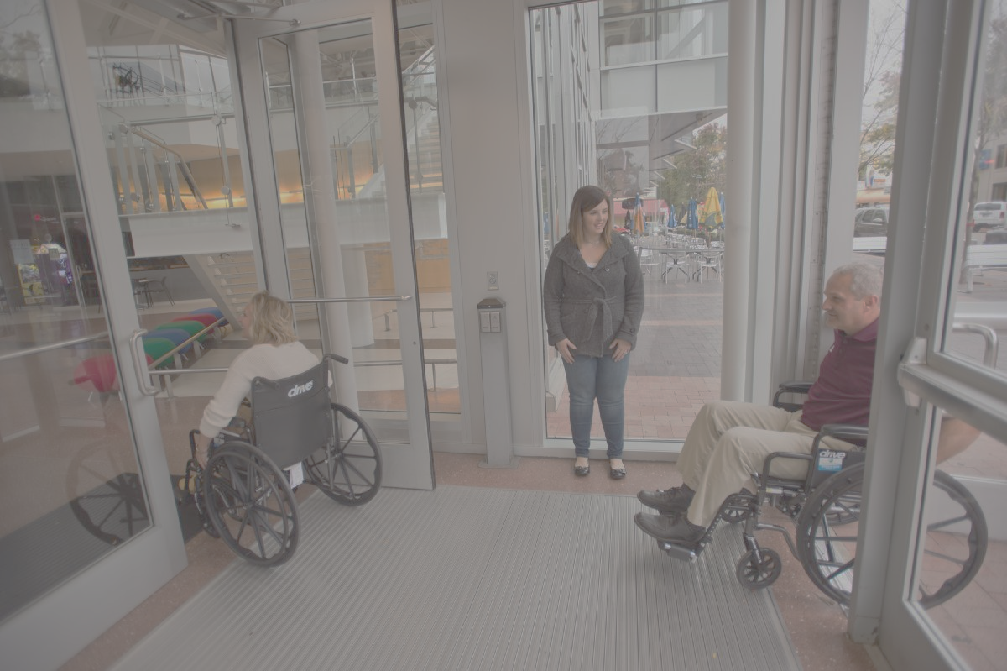
COMMENTS
“This took an emotional toll. I’m my wife’s primary caregiver, but I kept thinking that if I were in this wheelchair for good, I wouldn’t be able to take care of her.”
“I felt a sense of guilt, because I knew that in a couple of hours, I’ll be able to get up. … I’m going to be listening to their voices a lot more.”
Notes:
1st quote – wife has Crohn’s disease.
2nd quote – BCSC Asst. Superintendent

Slide 14
PRESS
“Those who organized A Day in a Wheelchair are to be commended for the valuable learning experience, and participants deserve kudos for stepping out of their comfort zone and seeing life in a different way.”
“The Columbus community will benefit from this.”
The Republic
Notes:
Editorial in local newspaper
Many thanks to our sponsors.
We aren’t perfect, but we’re always striving to improve. I think this is a great example of working together to make Columbus a better place.

Slide 15
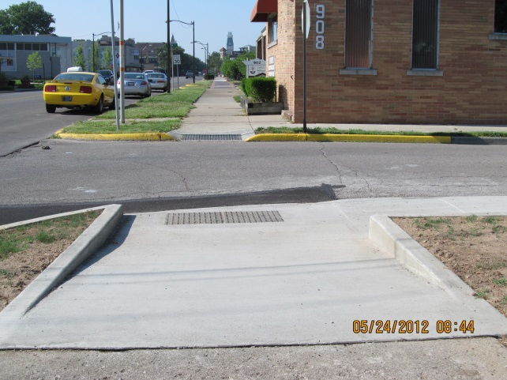
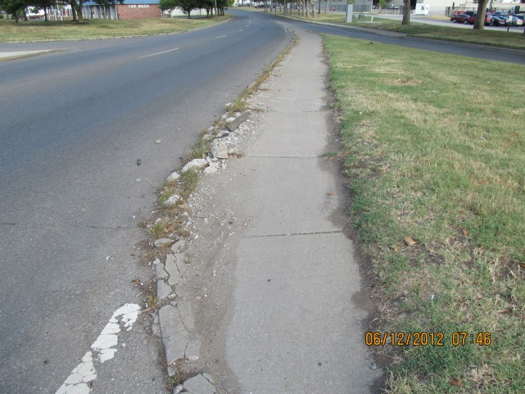
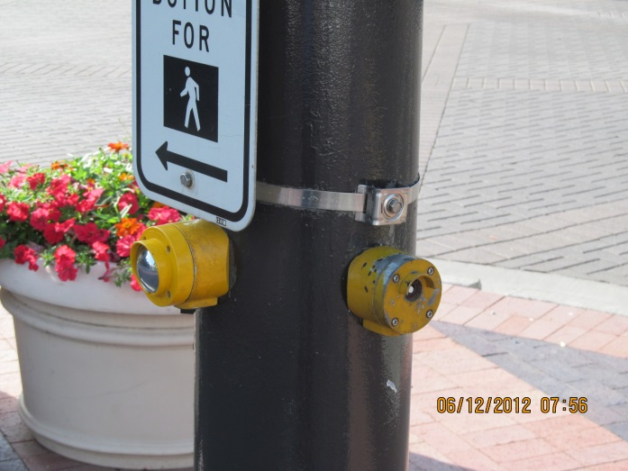
What are we doing with this experience?
Transition Plan update
Contract signed with consultant – R/W only
Curb ramps and sidewalks
Pedestrian signals and pushbuttons
Site furnishings (Downtown only)

Slide 16
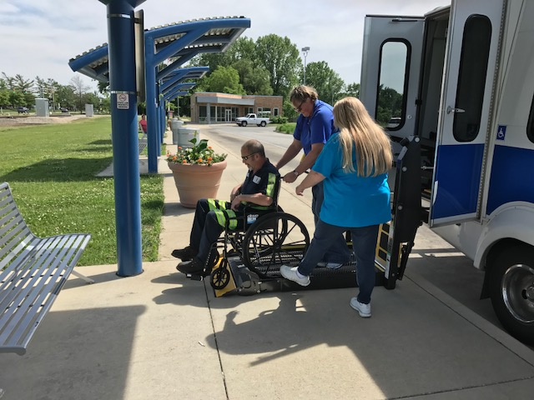
What are we doing with this experience?
Reviewing our current standards
Bus stops / Curb ramps
Notes:
Standards and functional needs are different for bust stops vs. curb ramps.

Slide 17
What are we doing with this experience?
Reviewing our maintenance operations
Pavement conditions, especially alleys
Notes:
This alley approach has just been reconstructed by our Public Works Dept.

Slide 18
THANKS
Contact Information:
David L. Hayward, PE
City Engineer
Executive Director of Public Works
City of Columbus
812-376-2540
dhayward@columbus.in.gov

