Slide 1
River Bridges Rehabilitation
Evansville to Henderson
Evansville MPO Presentation
September 2016

Slide 2
Project Design and Planning
Purpose and Need
Realization of the overall scope of the projects and impacts to the community
Decision to coordinate with Kentucky
How to bring the public onboard?
Public Involvement
Traffic Patterns
Restrictions
Timeframes
Future information updates
Notes:
COST – 25-30 million
Project Need
Heavy vehicular use resulting in wearing down of bridge decks and roadway pavement
Purpose
Address the ongoing deterioration of the bridge decks and cracking pavement
Extend the lifespan of each bridge before major reconstruction is required.

Slide 3
Project Area
3.8 total miles in length
2.5 miles in KY
7 bridges OHIO RIVER
$25 Million
KENTUCKY
INDIANA

Slide 4
Deciding Factors for Construction and MOT
Type of work to be done.
Deck replacements
Pavement replacement
Keep two lanes open in each direction.
Lessen impacts to the traveling public.
Increase the service life of the bridges and pavement by 20 – 25 years
Work zone safety

Slide 5
Extensive Planning
Safe and efficient project
Coordination with other projects located in the greater Evansville area.
Kentucky – Ohio River Bridges
Numerous meetings with local, federal, and state agencies in Indiana and Kentucky
Emergency services
Local commerce
Utilities
Notes:
Extensive over the last year
Shared costs all 8 bridges…but not the pavement
News in Aug 2015
Emergency Mgmt Sept 2015
PODI FHWA Spring 2015

Slide 6
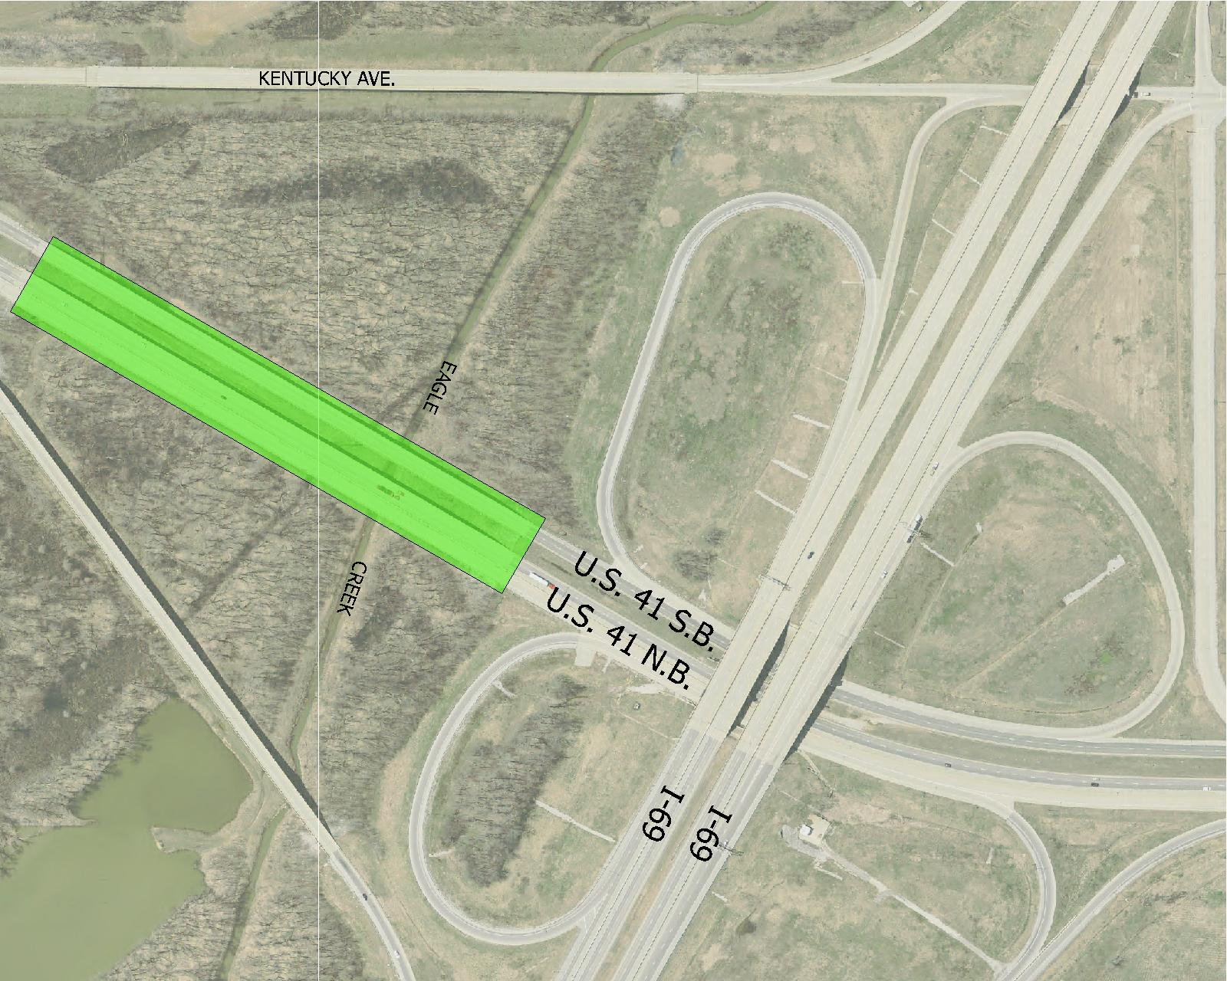
Locations
Eagle Creek Bridges located south of the US 41 and I-69 interchange
Project starts at the I-69 interchange
Bridge decks rehabilitated
Kentucky Avenue closed only while constructing the southbound lanes
Kentucky Ave
Notes:
Picture needs to reflect all of Kentucky Ave

Slide 7
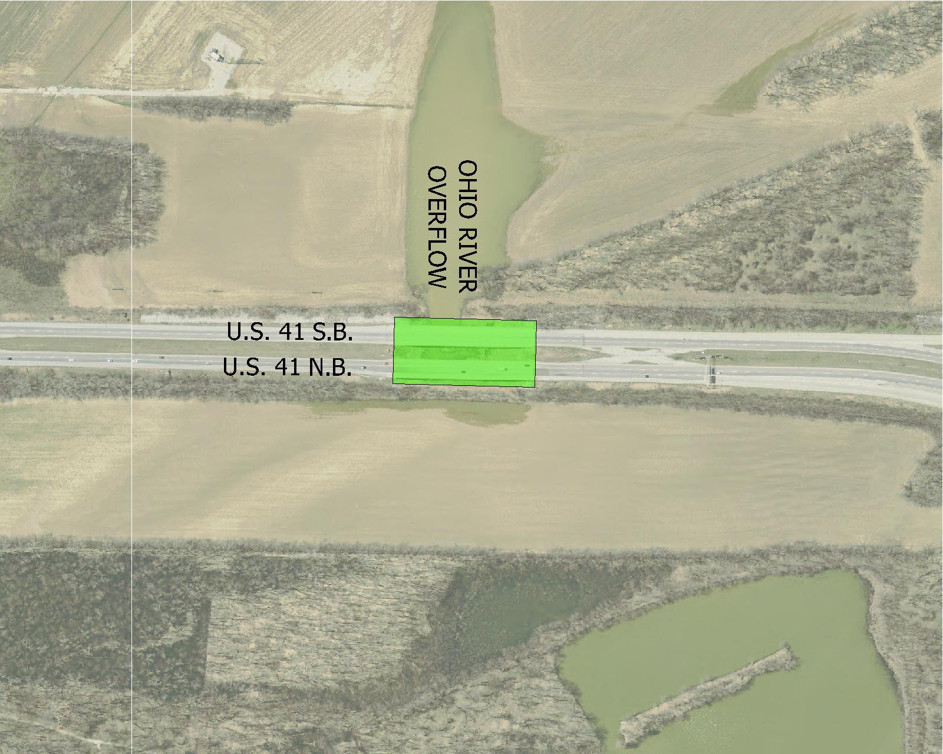
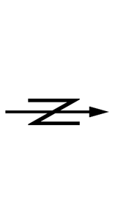
Locations
Ohio River Overflow
Bridge decks replaced
Notes:
Most drivers don’t even realize that there is a bridge here…

Slide 8
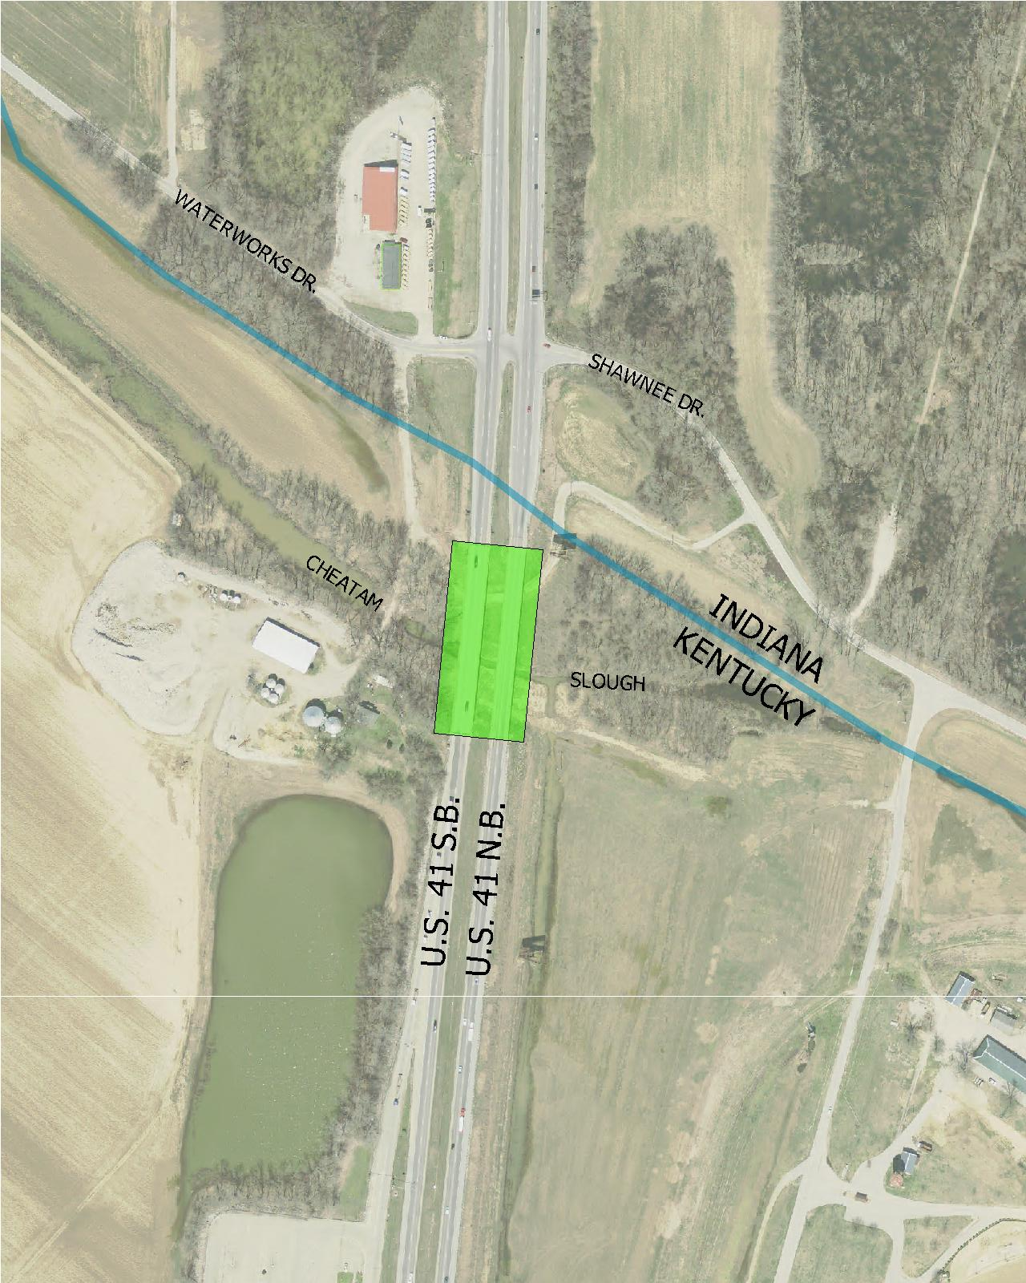
Locations
Cheatam Slough
Bridge decks replaced
Temporary bridge for crossover
Turning Restrictions
No left turns between Waterworks Road and Shawnee Drive, both north and southbound lanes
Notes:
Needs to reflect Waterworks Road

Slide 9
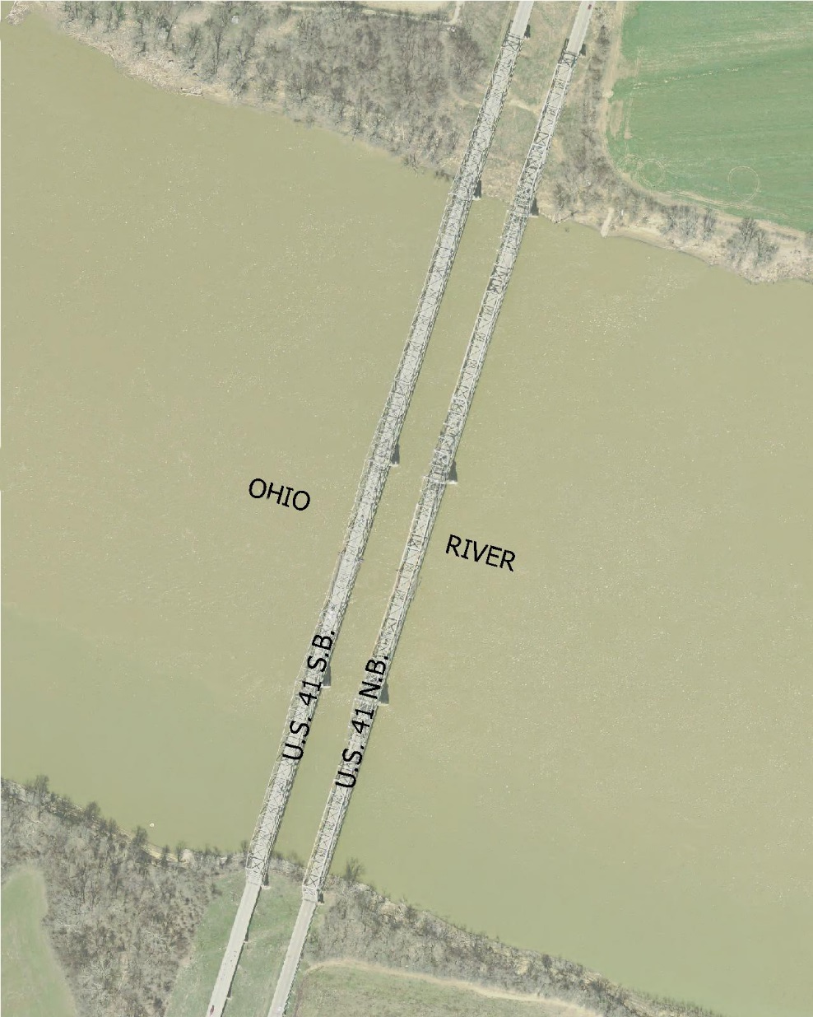
Locations
Kentucky Ohio River Bridges
Only southbound bridge
Deck overlay
Joint repair
90 to 120 days construction period
Notes:
Absorbing KY bridge into IN project

Slide 10
Phasing and Maintenance of Traffic
Phase 1
Primary Goals
Southbound Main Span over the Ohio River 3,000 foot bridge deck overlay with the expectation to be completed before Phase 2
Secondary Goals
Minor utility relocation starting 2016
Shoulder widening and crossovers
Temporary bridge at Cheatam Slough
Notes:
Utilities
Intention to keep weigh station open during construction

Slide 11
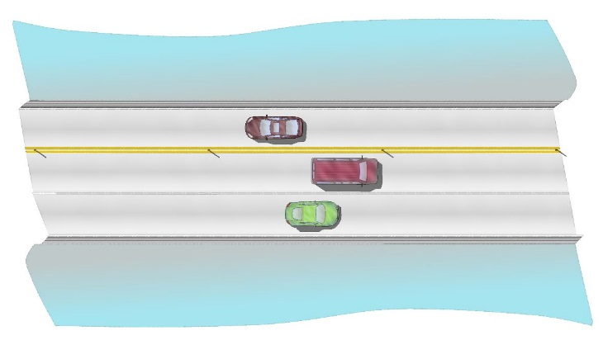
Phase 1 - Kentucky Ohio River Bridge
Reconstruct SB structure
With 1 lane open
Truck traffic directed onto the open southbound lane
MOT on NB structure 35 MPH
1 lane SB
2 lanes NB

Slide 12
Phase 1 Multiple Activities
Shoulder widening
Entire length of the project in order to accommodate 4 lanes during Phase 2 and Phase 3.
Lane restrictions and night work
Construct crossovers located in roadway median
Increase worker safety
Increase speed of construction

Slide 13
Phase 1 Multiple Activities
Temporary Bridge and crossover located at Cheatam Slough

Slide 14
Phase 2
Work complete and re-open the KY Ohio River Bridge southbound structure
All traffic to be shifted onto southbound lanes
Construct northbound bridges and roadway
MOT illustrated by flyover

Slide 15
Phase 3
All traffic to be shifted onto northbound lanes
Construct southbound bridges and roadway
Kentucky Avenue will be closed
MOT illustrated by flyover

Slide 16
MOT – Detour Route
Wide loads and heavy haul
Detour east to Maceo, Kentucky using US 231 bridge.
Required during Phase 1
Encouraged throughout
Coordination with Motor Truck Assc.

Slide 17
For Public Safety
Reduced speed limit
Tow trucks on site and on call
Rush Hours during Phase 1 on site
24/7 on call
Monitored by law enforcement
Additional patrols
INDOT MOU with ISP
Permanent Cameras
Aid in emergency response

Slide 18
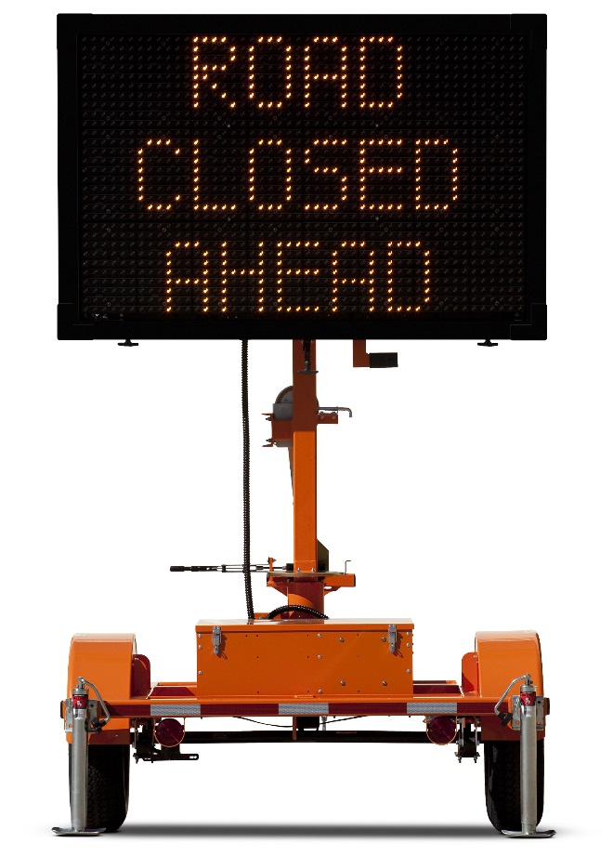
MOT – Public Awareness
Highway message boards
Located on I-69, US 41, Lloyd Expressway and Kentucky State Routes
Website
Partner with local news media with updates
Lane Changes
Ahead

Slide 19
Community
River Run
No conflict May 6, 2017

Slide 20
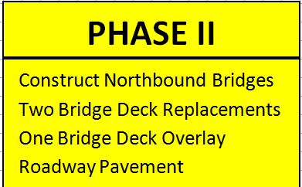
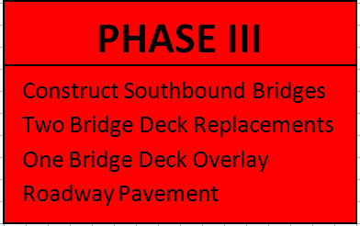
Conclusion: Schedule
Spring and Summer 2017
Fall 2017 through
Fall 2018
Fall 2018 through
Summer 2019

Slide 21
Contact Information
Kate Francis
Border Bridge Project Manager
100 North Senate Avenue
IGCN 642
Indianapolis, IN 46204
kfrancis@indot.IN.gov
317-234-5289
INDOT Vincennes Customer Service swincommunications@indot.in.gov 1-800-279-5758

