Slide 1
U.S. 20 Road Improvement State Road 15 to County Road 35 DES# 1600517
Thursday, July 18, 2019
Northridge High School 6 p.m.
Please silence electronic devices at the start of the hearing.

Slide 2
Agenda
Welcome & Introductions
Formal Public Hearing
Presentations
Public Statements for the Record
Adjourn Formal Hearing
Invited to the display area for Q & A with the project team

Slide 3

Why a Public Hearing?
Conducted as a requirement to the National Environmental Policy Act (NEPA)
NEPA requires evaluation of potential impacts to surrounding natural, cultural, and social environments.
Impacts are to be described in an environmental document.
Requires opportunity for the public to be involved and comment in the project decision-making process.
Notes:
NEPA is a federal law enacted in 1970 that establishes a decision-making process that agencies must follow prior to design and construction of projects using federal money or requiring federal approval.

Slide 4
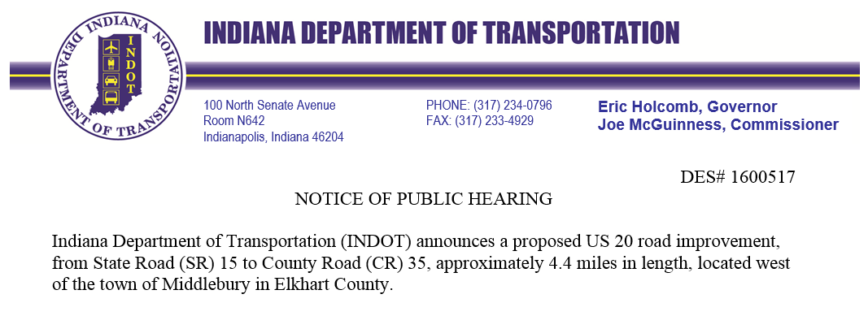
Environmental Document
Released for Public Involvement on May 31, 2019
Published Legal Notice
Goshen News
July 3rd & July 10th, 2019
Announcing the public hearing and the documents are available for viewing and comment
Notes:
THE ENVIRONMENTAL DOC FOR THIS PROJECT IS A LEVEL 2 –CLASSIFICATION MEANS THE ACTIONS DO NOT HAVE A SIGNIFICANT EFFECT ON THE ENVIRONMENT
RELEASED FOR PI AND PUBLISHED AND AVAILABLE FOR VIEWING AND COMMENT
Legal Notice Also sent to as many property owners as possible – unfortunately the mailing information is not always up to date.

Slide 5
How Can You Participate?
Verbally as a Public Statement
Statements are recorded
Comment Form
Submit via mail, fax, or drop box
Email ‒ mwright@indot.in.gov
Comment Period ends
Thursday, August 1, 2019
Please feel free to use any and all methods.
Notes:
FIRST YOU MAY VERBALLY EXPRESS (Public Comment Session) YOUR CONCERNS HERE THIS EVENING BY SIGNING ON TO THE SPEAKERS LIST ON THE TABLE AS YOU ENTERED…. AS SOME OF YOU MAY ALREADY HAVE….IF YOU DID NOT SIGN UP YOU WILL STILL HAVE AN OPPORTUNITY TO COME UP AND SPEAK AFTER WE HAVE COMPLETED THE NAMES ON THE LIST. I WILL OPEN THE FLOOR FOR COMMENTS AT THAT TIME.
ALL SPEAKERS COMMENTS ARE RECORDED. IF YOU WOULD LIKE TO MAKE VERBAL COMMENTS BUT YOU ARE NOT INTERESTED IN SPEAKING IN FRONT OF SUCH A LARGE GROUP OF PEOPLE, PLEASE SEE ME AFTER THE PRESENTATION AND WE CAN RECORD YOUR COMMENTS OFF TO THE SIDE.
SECOND, WE HAVE PROVIDED FOR YOUR CONVENIENCE A COMMENT SHEET ON THE BACK PAGE OF YOUR INFORMATION PACKET SO THAT YOU MAY RECORD YOUR WRITTEN COMMENTS. YOU MAY FILL THIS OUT THIS EVENING AND HAND YOUR REMARKS TO ME OR
THE THIRD OPTION IS TO MAIL OR FAX YOUR COMMENTS TO US. NOT NECESSARILY ON THIS FORM.
THE ADDRESS FOR TRADITIONAL MAIL AND THE FAX NUMBER CAN BE FOUND ON THESE PAGES IN THE INFORMATION PACKET…
….AND THE LAST OPTION WOULD BE TO E-MAIL. MY ADDRESS IS ALSO ON THIS PAGE >>>>>>>>Please note that I will respond to all email with a quick reply telling you that I have received your comment.>>>>>>>>So as to assure you that it has been received.
REPRESENTATIVES WILL BE AVAILABLE AFTER THIS SESSION TO ANSWER QUESTIONS ONE ON ONE. HOWEVER PLEASE NOTE THAT GENERAL CONVERSATIONS ARE NOT PART OF THE OFFICIAL RECORD.
WE STRONGLY ADVISE FORMAL STATEMENTS FOR THE RECORD.

Slide 6
How Will Comments be Addressed?
All comments will be addressed in the Final Environmental Document as a result of:
The public statements recorded at a public hearing.
All written comments, concerns, and suggestions such as letters, faxes, and emails received during the comment period.
Informal comments are always welcome, however, please note general conversations are not part of the official record.

Slide 7
Environmental Studies
Areas of environmental impacts
Right-of-Way
Hazardous Materials
Threatened & Endangered Species
Historic & Archaeological
Community Impacts
Floodplains
Land Use
Wetlands & Waterways
Noise
Air Quality
Public Involvement
Public Information Meeting
Public Hearing

Slide 8
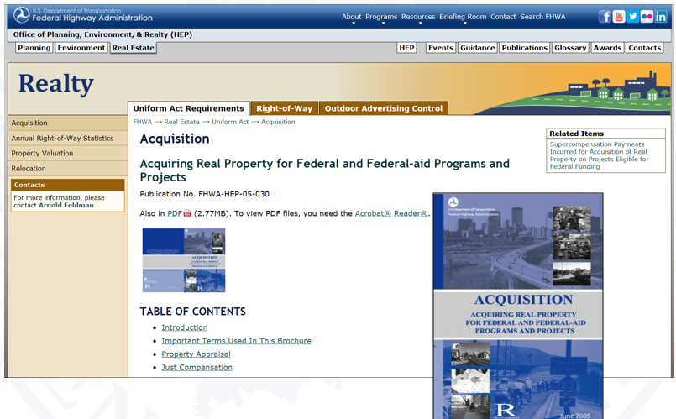
Right-of-Way
Proposed 90.8 acres of permanent new right-of-way (ROW)
Generally 40 feet each side of the centerline of the roadway
Residential 39.4 Acres
Commercial 7.5 Acres
Agricultural 29.9 Acres
Forest 5.5 Acres
Wetlands 5.1 Acres
Other 1.8 Acres
Utility 1.6 Acres
https://www.fhwa.dot.gov/real_estate/uniform_act/acquisition/real_property.cfm

Slide 9
Right-of-Way
Currently being acquired through the Moving Ahead for Progress in the 21st Century Act (MAP-21)
When evident there is a need for an improvement
Allows acquisition during early stages of project development to lessen the project timeline.

Slide 10
Real Estate Acquisition Process
“Uniform Act” of 1970
All federal, state, and local governments must comply by requiring just compensation.
Acquisition Process
Appraisals
Review appraisals
Amount of compensation cannot be less than fair market value
Offer will be made in writing
No agreement
Mediation
Condemnation

Slide 11

Right-of-Way
Proposed Relocations
19 Residential
2 Business
4 Farms
https://www.fhwa.dot.gov/real_estate/publications/your_rights/

Slide 12
Right-of-Way
Temporary right-of-way (4.0 acres) for drive construction and grading
One driveway on each parcel will be replaced in-kind
Contractor to coordinate access with homeowner during construction
Temporary right-of-way restored via seeding/sodding

Slide 13
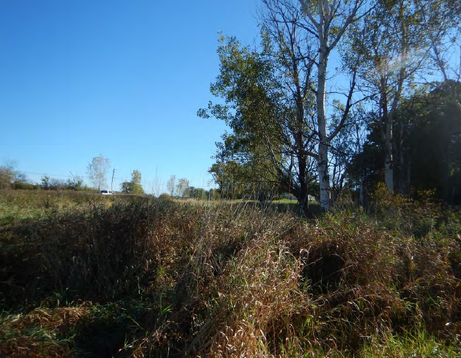
Wetlands
Isolated wetlands located throughout project corridor
5.1 acres impacted
Specific Mitigation is unknown at this time
Determined by U.S. Army Corp of Engineers and Indiana Department of Environmental Management (IDEM)

Slide 14
Environmental Impacts
Indiana Bat and Northern Long-Eared Bat
Tree clearing activities
Mitigated via The Conservation Fund (TCF)
Range-wide In-Lieu Fee Program
The amount determined by the Habitat Block Method
Calculated by a compensatory price per acre

Slide 15
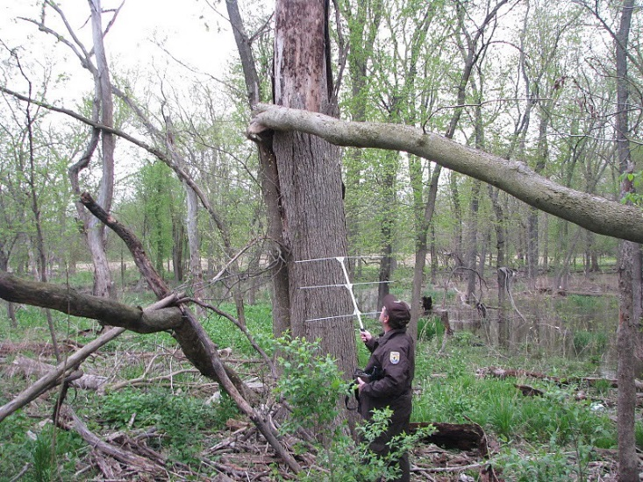
Forest
5.5 acres of tree clearing impacted
Mitigation coordination with U.S. Fish and Wildlife Service (USFWS)
Requested for the loss of trees for migratory birds and other wildlife, including bats
Tree clearing accomplished under a separate contract and performed approximately one year prior to the roadway construction project.

Slide 16
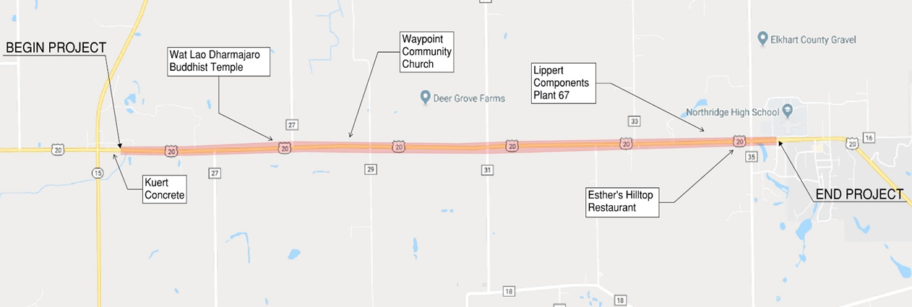
Project Location
U.S. 20 from State Road 15 to East of County Road 35
4.29 miles
Originally constructed in 1925

Slide 17
Purpose & Need
Need
High accident rate
Traffic congestion
Visibility constraints
Inadequate separation between vehicular and non-motorized traffic
Purpose
Improve safety
Reduce congestion
Enhance sight distance
Upgrade the driving surface
Provide uniform separation for the non-vehicular transports

Slide 18
Within the Project Limits
Miami Snowmobile Trail
Public easement on private land
Note that during construction activities a suitable path for use will be provided.

Slide 19
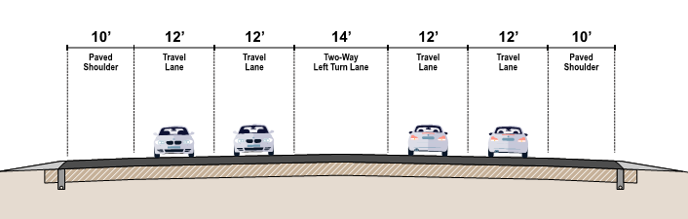
Preferred Alternative
5-lanes with Two-Way Left Turn Lane (TWLTL)
Widening primarily to the south of the existing alignment
Includes 10-foot paved shoulders to accommodate non-motorized traffic
Rumble strips – to be determined
Pavement type – to be determined

Slide 20
Project Description
Pavement Replacement
Replace legal drains within INDOT right-of-way
Ditches, retention basins, and detention basins
Add mailbox approaches to each driveway
Adjust grade of roadway in areas to improve sight distance

Slide 21
Within the Project Limits
To remain: 12’ x 8’ metal pipe arch
5 Culverts to replaced under U.S. 20
18” pipe to be replaced with 36” pipe
24” pipe to be replaced with 36” pipe
18” pipe to be replaced with 36” pipe
24” pipe to be replaced with 132” pipe
Twin 60” culverts to be replaced with 8’ x 5’ box culvert

Slide 22
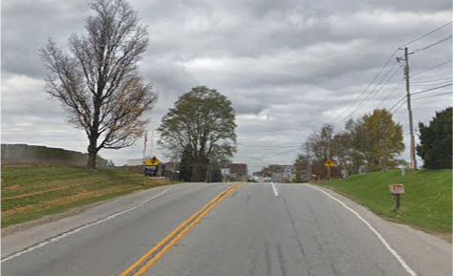
Project Description
Reduce or flatten the tops of small hills
The area east of the U.S. 20/C.R. 15 intersection will be flattened to improve sight distance

Slide 23
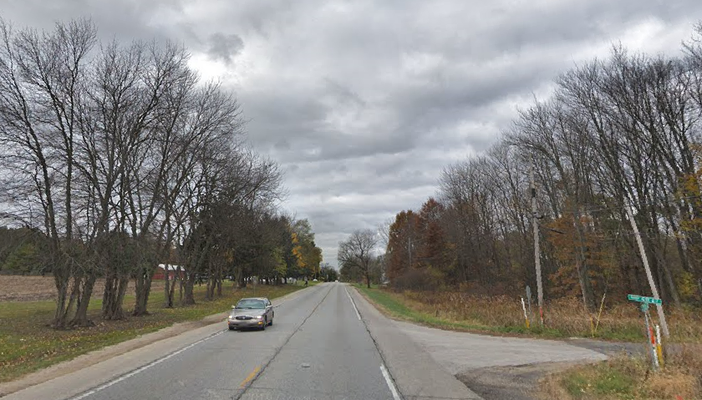
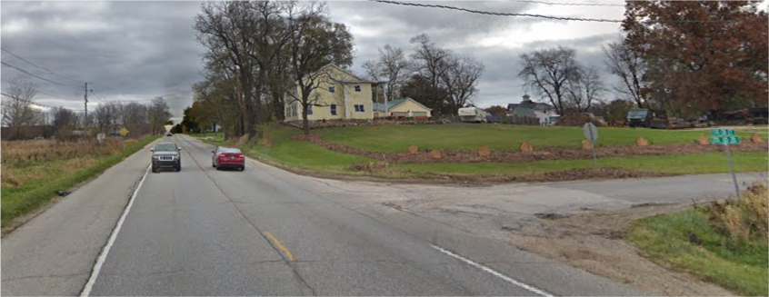
Project Description
Adjust the road grade
Between C.R. 27 South of U.S. 20 and C.R. 27 North of U.S. 20 to improve sight distance

Slide 24
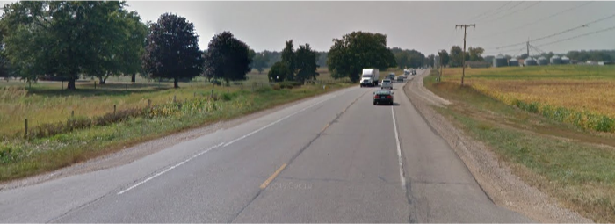
Project Description
Realign the bend on U.S. 20 at C.R. 31

Slide 25
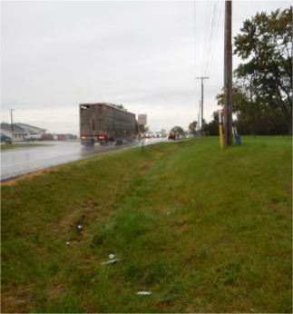
Project Description
Side ditches will be improved by re-grading and designing to direct surface drainage to open channels and basins along the project corridor
Includes in-ditch detention, detention basins, and retention basins

Slide 26
Design Features
Design Speed – 55 mph (same as today)
Project Example:
Notes:
Sodding will be used to return yards back to mowable grass.

Slide 27
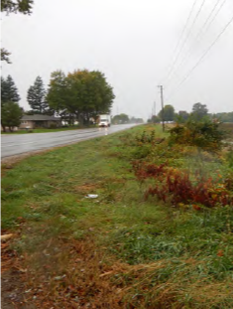
Utilities
Completed Subsurface Utility Exploration
Relocations expected:
Electric
Telephone
Fiber Optics
Cable
Gas
Notes:
Poles will be moved ahead of time. Fiber optics will be moved ahead of time.

Slide 28

Maintenance of Traffic – 2 Phases
Phase 1
Construct entire southern portion of U.S. 20 while maintaining current traffic patterns on U.S. 20
Two lanes – one in each direction
Phase 2
Switch traffic over to newly constructed half
Northern half constructed

Slide 29

Maintenance of Traffic (MOT)
Access to be maintained to all properties, homes and businesses along the project
Short term closure of county road intersections with U.S. 20 may occur
During the Fall Festival and Hometown Holidays Annual Festival, one lane of traffic in each direction will be maintained.

Slide 30
Project Timeline
After Public Hearing and Public Comments
Environmental Document Approval, including responses to all comments
Right-of-way acquisition on-going
Tree clearing and building demolition to begin approximately one year prior to construction
Road construction is anticipated to begin in Spring 2022
Timelines will be set at the time of the final design
Anticipate construction to be two construction seasons

Slide 31
Comment Session
No responses at this time.
Statements are for the official public hearing transcript.
First speakers are from the sign-in sheet.
Open for additional public statements from the floor.
Please come forward to the podium so that we may accurately record your statements.
We encourage and appreciate your comments.
Notes:
TURN ON RECORDER
THIS COMMENT SESSION IS THE OPPORTUNITY FOR THE COMMUNITY TO MAKE STATEMENTS FOR THE PUBLIC RECORD. WE KNOW YOU MAY HAVE QUESTIONS THAT YOU WOULD LIKE TO DISCUSS BUT WE ASK YOU TO HOLD ON TO THESE UNTIL AFTER THE HEARING IS ADJOURNED WHEN YOU CAN CONVERSE ONE ON ONE WITH THE REPRESENTATIVES.
DURING THE COMMENT SESSION IT IS IMPORTANT THAT WE RECORD YOUR STATEMENTS AS ACCURATELY AS WE CAN FOR THE RECORD SO WE ASK THAT YOU PLEASE COME FORWARD TO THE PODIUM AND MICROPHONE.
AT THIS TIME WE WILL MOVE FORWARD TO THE SPEAKER LIST. IF YOU DID NOT SIGN UP TO SPEAK YOU STILL MAY DO SO AFTER WE HAVE COMPELTED THE NAMES ON THE LIST. I WILL OPEN COMMENTS TO THE FLOOR.
AT THIS TIME I WOULD LIKE TO OPEN THE PODIUM TO THE FLOOR. IS THERE ANYONE WHO WOULD LIKE TO COME FORWARD TO SPEAK???
PLEASE STATE YOUR NAME

Slide 32
Public Comments
Statements recorded at public hearing.
Written Statements
Mary Wright IGCN Room N642 100 North Senate Avenue Indianapolis, IN 46204
E-Mail ‒ mwright@indot.in.gov
Respectfully request comments to be postmarked by Thursday, August 1, 2019
All comments will be reviewed and evaluated and given full consideration before final design decisions.
Notes:
Example

Slide 33
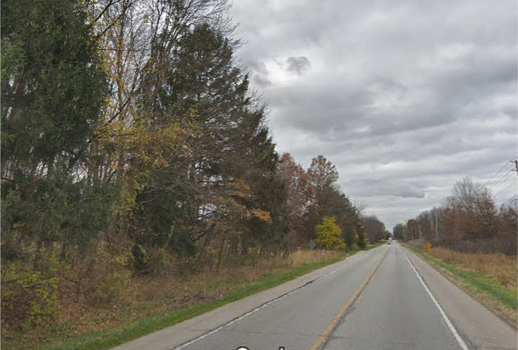
Thank You
Please visit with project representatives following the public comment session
View displays and preliminary plans
Informal questions and answers
Informal comments are always welcome, however, please note general conversations are not part of the official record.
Thank you for your attendance this evening.
Formal public hearing is adjourned.
Notes:
THANK YOU FOR COMING OUT TO THE PUBLIC HEARING TONIGHT. PLEASE STAY AFTER SO REPRESENTATIVES CAN ANSWER YOUR QUESTIONS AND CAN DISCUSS ANY OF YOUR CONCERNS….
THANK LOCATION
THANKS AGAIN AND HAVE A GOOD EVENING.
THIS SESSION IS ADJOURNED.

