Slide 1
State Road 28 Road Rehabilitation DES# 1592968
Tuesday, July 9, 2019
James Cole Elementary School 6 p.m.
Please silence electronic devices at the start of the hearing.

Slide 2
Agenda
Welcome & Introductions
Formal Public Hearing
Presentations
Public Statements for the Record
Adjourn Formal Hearing
Invited to the display area for Q & A with the project team

Slide 3
Why a Public Hearing?
Conducted as a requirement to the National Environmental Policy Act (NEPA)
NEPA requires evaluation of potential impacts to surrounding natural, cultural, and social environments.
Impacts are described in an environmental document.
Requires opportunity for the public to be involved and comment in the decision-making process of said impacts.
Notes:
NEPA is a federal law enacted in 1970 that establishes a decision-making process that agencies must follow prior to design and construction of projects using federal money or requiring federal approval.

Slide 4
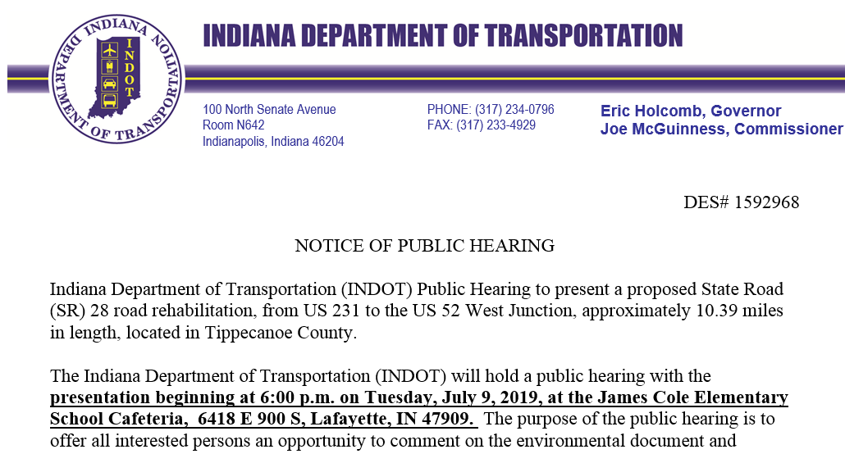
Environmental Document
Released for Public Involvement on May 20, 2019
Published Legal Notice
Journal Courier
June 24th & July 2nd, 2019
Announcing the public hearing and the document is available for viewing
Notes:
THE ENVIRONMENTAL DOC FOR THIS PROJECT IS A LEVEL 2 –CLASSIFICATION MEANS THE ACTIONS DO NOT HAVE A SIGNIFICANT EFFECT ON THE ENVIRONMENT
RELEASED FOR PI AND PUBLISHED AND AVAILABLE FOR VIEWING AND COMMENT
Legal Notice Also sent to as many property owners as possible – unfortunately the mailing information is not always up to date.

Slide 5
How Can You Participate?
Verbally as a Public Statement
Statements are recorded
Comment Form
Submit via mail, fax, or drop box
Email ‒ mwright@indot.in.gov
Comment Period ends
Wednesday, July 24, 2019
Please feel free to use any and all methods.
Notes:
FIRST YOU MAY VERBALLY EXPRESS (Public Comment Session) YOUR CONCERNS HERE THIS EVENING BY SIGNING ON TO THE SPEAKERS LIST ON THE TABLE AS YOU ENTERED…. AS SOME OF YOU MAY ALREADY HAVE….IF YOU DID NOT SIGN UP YOU WILL STILL HAVE AN OPPORTUNITY TO COME UP AND SPEAK AFTER WE HAVE COMPLETED THE NAMES ON THE LIST. I WILL OPEN THE FLOOR FOR COMMENTS AT THAT TIME.
ALL SPEAKERS COMMENTS ARE RECORDED. IF YOU WOULD LIKE TO MAKE VERBAL COMMENTS BUT YOU ARE NOT INTERESTED IN SPEAKING IN FRONT OF SUCH A LARGE GROUP OF PEOPLE, PLEASE SEE ME AFTER THE PRESENTATION AND WE CAN RECORD YOUR COMMENTS OFF TO THE SIDE.
SECOND, WE HAVE PROVIDED FOR YOUR CONVENIENCE A COMMENT SHEET ON THE BACK PAGE OF YOUR INFORMATION PACKET SO THAT YOU MAY RECORD YOUR WRITTEN COMMENTS. YOU MAY FILL THIS OUT THIS EVENING AND HAND YOUR REMARKS TO ME OR
THE THIRD OPTION IS TO MAIL OR FAX YOUR COMMENTS TO US. NOT NECESSARILY ON THIS FORM.
THE ADDRESS FOR TRADITIONAL MAIL AND THE FAX NUMBER CAN BE FOUND ON THESE PAGES IN THE INFORMATION PACKET…
….AND THE LAST OPTION WOULD BE TO E-MAIL. MY ADDRESS IS ALSO ON THIS PAGE >>>>>>>>Please note that I will respond to all email with a quick reply telling you that I have received your comment.>>>>>>>>So as to assure you that it has been received.
REPRESENTATIVES WILL BE AVAILABLE AFTER THIS SESSION TO ANSWER QUESTIONS ONE ON ONE. HOWEVER PLEASE NOTE THAT GENERAL CONVERSATIONS ARE NOT PART OF THE OFFICIAL RECORD.
WE STRONGLY ADVISE FORMAL STATEMENTS FOR THE RECORD.

Slide 6
How Will Comments be Addressed?
All comments will be addressed in the Final Environmental Documents as a result of:
The public statements recorded at a public hearing.
All written comments, concerns, and suggestions such as letters, faxes, and emails received during the comment period.
Informal comments are always welcome, however, please note general conversations are not part of the official record.

Slide 7
Environmental Studies
Areas of environmental impacts
Right-of-Way
Hazardous Materials
Threatened & Endangered Species
Historic & Archaeological
Community Impacts
Floodplains
Land Use
Wetlands & Waterways
Noise
Air Quality
Public Involvement
Public Hearing

Slide 8
Right-of-Way
Proposed 50.0 acres of permanent new right-of-way (ROW)
Generally 40 feet each side of the centerline of the roadway
Residential 5.45 Acres
Commercial 1.15 Acres
Agricultural 41.09 Acres
Forest 1.75 Acres
Wetlands .56 Acre

Slide 9
Right-of-Way
Temporary right-of-way (1.0 acre) for drive construction and grading.
Driveways are replaced in-kind.
Contractor to coordinate with homeowner.
Access during construction.
Temporary right-of-way for seeding/sodding.

Slide 10
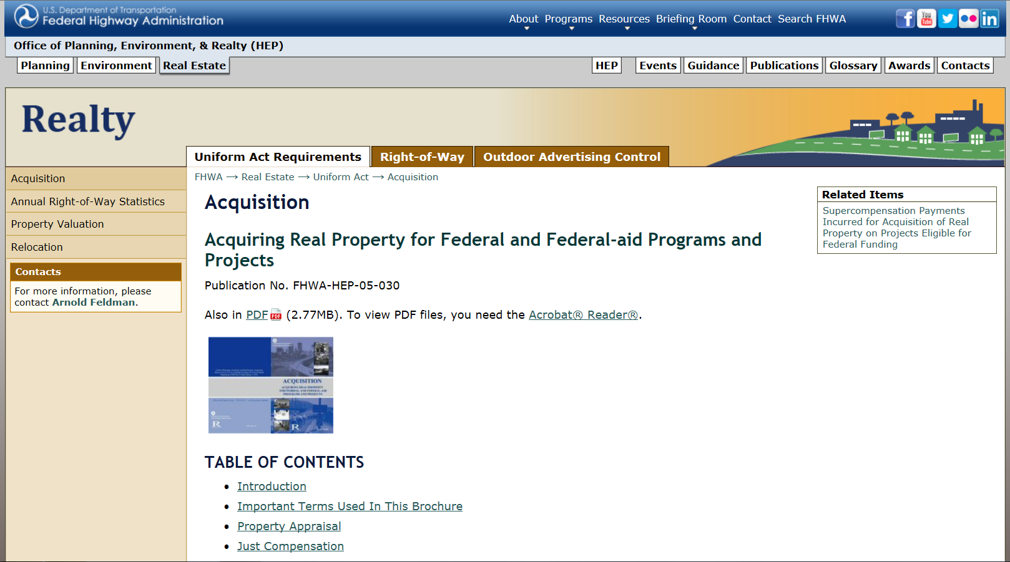

Real Estate Acquisition Process
https://www.fhwa.dot.gov/real_estate/uniform_act/acquisition/real_property.cfm

Slide 11
Real Estate Acquisition Process
“Uniform Act” of 1970
All federal, state, and local governments must comply by requiring just compensation.
Acquisition Process
Appraisals
Review appraisals
Amount of compensation cannot be less than fair market value
Offer will be made in writing
No agreement
Mediation
Condemnation

Slide 12
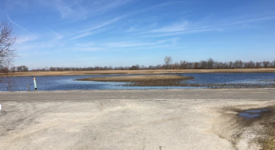
Wetlands
Isolated wetlands located throughout project corridor
0.56 impacted
Mitigation is unknown at this time
Determined by Indiana Department of Environmental Management (IDEM)

Slide 13
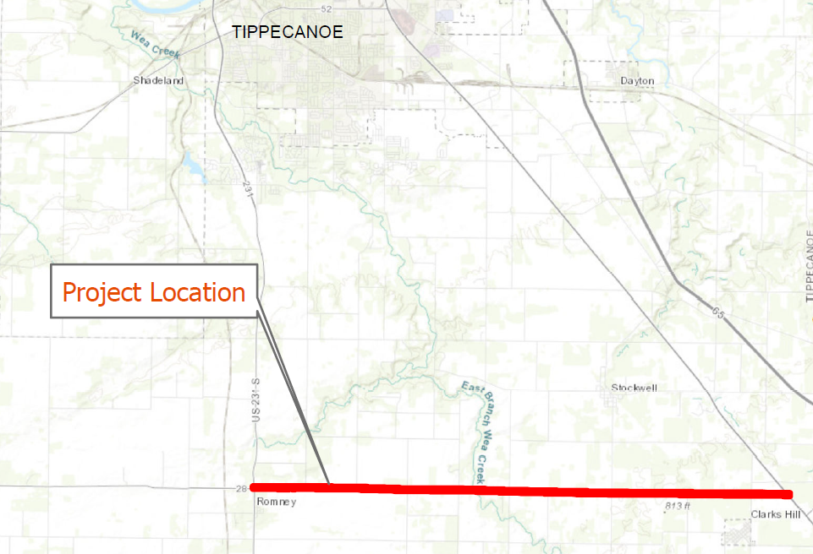
SR 28 Project Location
From US 231 to the West Junction of US 52

Slide 14
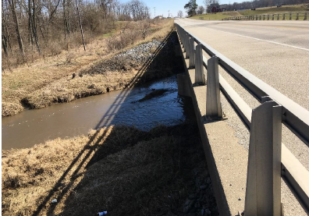
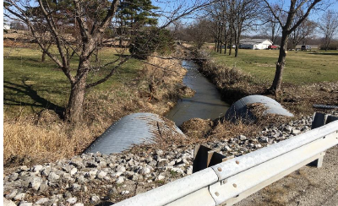
Within the Project Limits
Not included is the existing bridge at Big Wea Creek
In 2015, INDOT completed an overlay of the approach pavement to the bridge.
Dual pipes at ??

Slide 15
Purpose & Need
Need
Deterioration of pavement
Culvert pipes have moderate to severe sediment build up impeding the flow of water
Increase motorist safety
Purpose
Improve and extend the driving surface for continued vehicular use
Improve safety
Improve sight distance

Slide 16
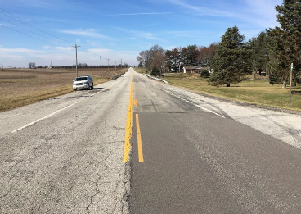
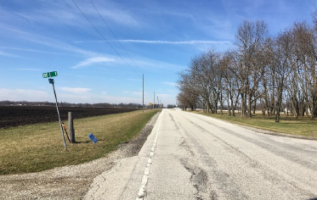
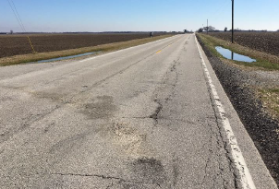
Existing Conditions
Pavement
Original construction in 1928
Last resurfacing of the corridor
occurred in 1984
Existing roadway rated 4 out of 10
Notes:
Wet soils eat away at the pavement. Nowhere for water to go in existing condition. This has been resurfaced however, the main pavement and subgrade still persist, and the resurfacing is kind of a band-aid fix.

Slide 17
Project Description
Full depth reclamation of pavement
Replace legal drains within INDOT right-of-way
Maintain existing drainage patterns
Add mailbox approaches to each driveway
Adjust grade of roadway in areas to improve sight distance

Slide 18
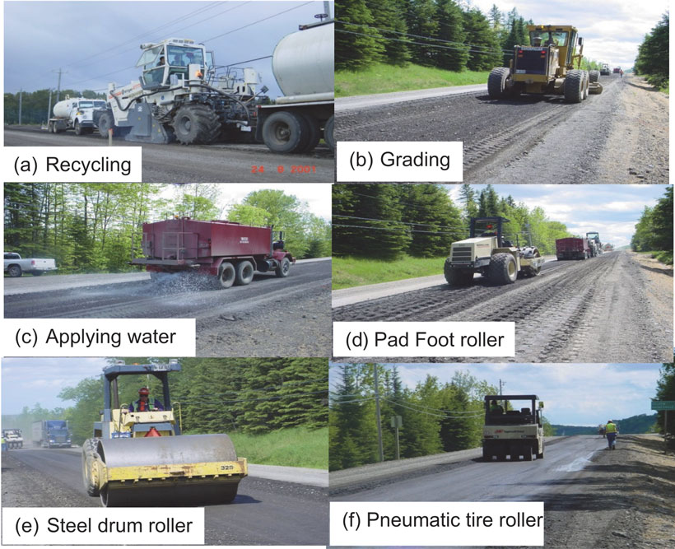
Full Depth Reclamation Process
Recycling the existing roadway
Following FDR Process, roadway will receive two layers of asphalt

Slide 19
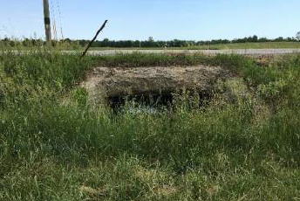
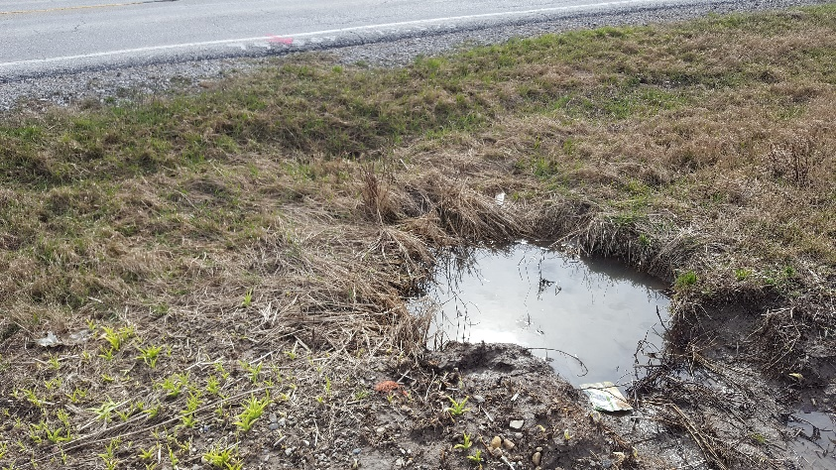
Within the Project Limits
Majority of culverts under SR 28 will be replaced with the same size of pipe
Where the roadway floods during heavy rain, the culverts will be sized to eliminate the roadway flooding

Slide 20
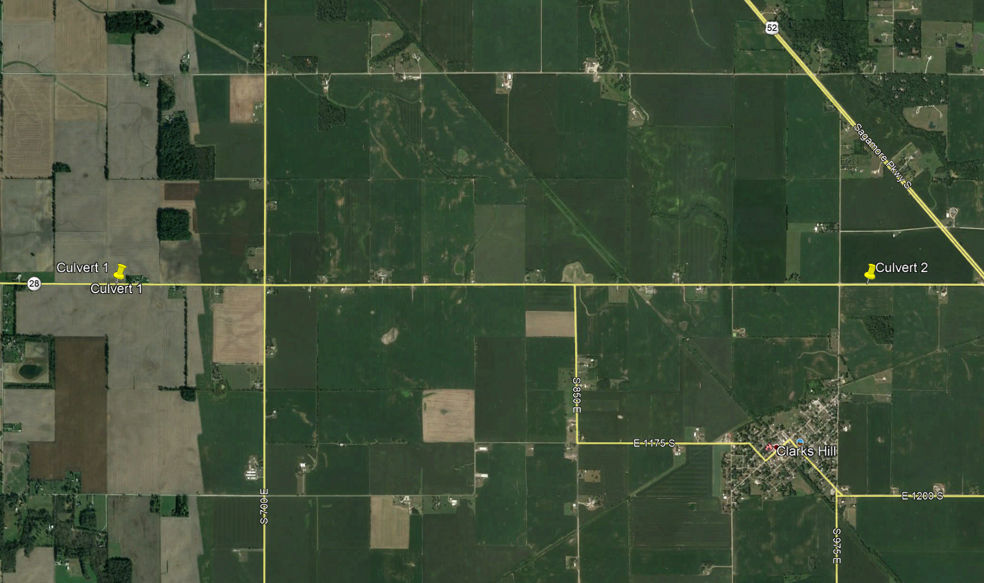
Project Description
Locations of culverts to be upsized as part of the project

Slide 21
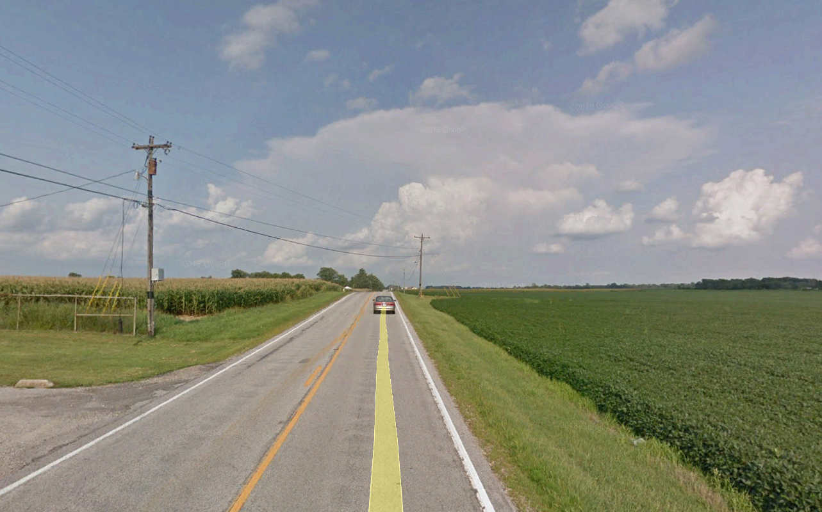
Project Description
Reduce or flatten the tops of small hills
Currently 14 locations identified along the corridor that will be flattened out to improve sight distance
Seven of the 14 locations have crash history within or adjacent to them

Slide 22
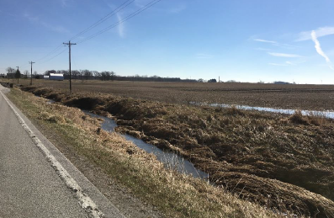
Project Description
Side ditch locations will remain in the same areas as they currently exist
Side ditches will be regraded and designed to direct surface drainage to open channels along the project corridor
Trees that are located within the proposed construction limits will be removed.

Slide 23
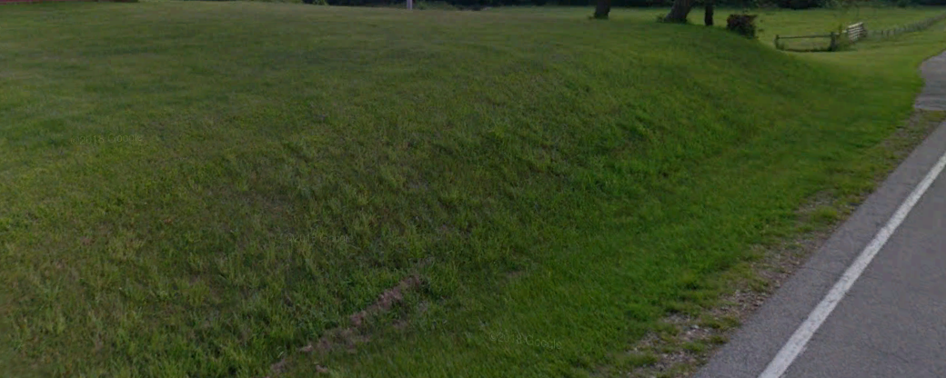
Curb and Gutter adjacent to shoulder
In areas where the adjacent ground is higher than the existing roadway, a curb and gutter section will be constructed next to the shoulder and a pipe will be constructed beneath the new fill grade.

Slide 24
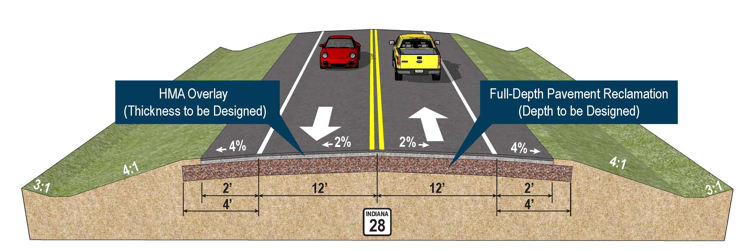
Design Features
Design Speed – 55 mph
Project Example:
Notes:
Sodding will be used to return yards back to mowable grass.

Slide 25
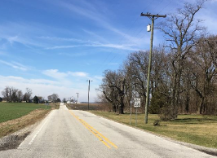
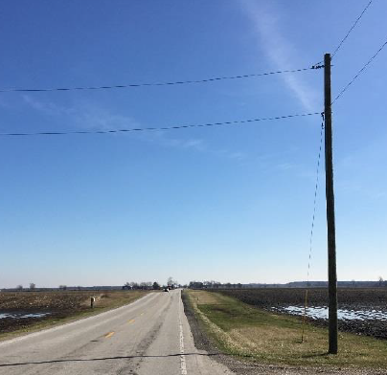
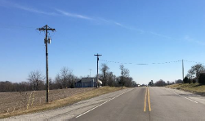
Utilities
Completed Subsurface Utility Exploration
Electric
Poles to be relocated
Communications
Telephone
Electric
Fiber Optics
Notes:
Poles will be moved ahead of time. Fiber optics will be moved ahead of time.

Slide 26

Maintenance of Traffic (MOT)
Three phases of construction for safety and timeliness
Short term closure of 3 months per phase
Official state maintained route
U.S. 231, S.R. 25 and U.S. 52
Access to be maintained to all properties, homes and businesses.

Slide 27
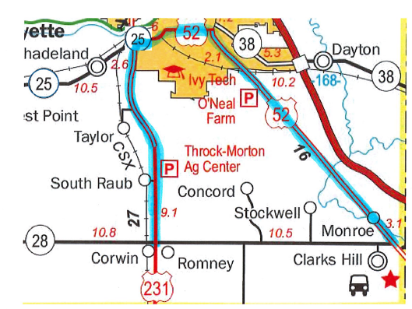
Official State Maintained Detour Route
U.S. 231, S.R. 25, & U.S. 52
Notes:
Refer to exhibit for further details about MOT and detours

Slide 28

MOT – 3 Phases
Project will be broken out into 3-5 mile segments for construction.
Contractor will determine limits based on completed utility relocations.
Notes:
Coordinating with the city about detours.

Slide 29
Project Timeline
After Public Hearing and Public Comments
Environmental Document Approval including all comments addressed.
Right-of-way acquisition 2019 -2020
Construction is anticipated in Spring 2021
Exact timelines will be set at the time of the final design.
Anticipate Construction to be within one construction season with most likely a 9 month timeline.
Notes:
Current schedule is:
Land Ac complete by 6/18/2020
Final Plans 8/2/2020
Letting 11/2/2020
Spring Construction

Slide 30
Comment Session
No responses at this time.
Statements are for the official public hearing transcript.
First speakers are from the sign-in sheet.
Open for additional public statements from the floor.
Please come forward to the podium so that we may accurately record your statements.
We encourage and appreciate your comments.
Notes:
TURN ON RECORDER
THIS COMMENT SESSION IS THE OPPORTUNITY FOR THE COMMUNITY TO MAKE STATEMENTS FOR THE PUBLIC RECORD. WE KNOW YOU MAY HAVE QUESTIONS THAT YOU WOULD LIKE TO DISCUSS BUT WE ASK YOU TO HOLD ON TO THESE UNTIL AFTER THE HEARING IS ADJOURNED WHEN YOU CAN CONVERSE ONE ON ONE WITH THE REPRESENTATIVES.
DURING THE COMMENT SESSION IT IS IMPORTANT THAT WE RECORD YOUR STATEMENTS AS ACCURATELY AS WE CAN FOR THE RECORD SO WE ASK THAT YOU PLEASE COME FORWARD TO THE PODIUM AND MICROPHONE.
AT THIS TIME WE WILL MOVE FORWARD TO THE SPEAKER LIST. IF YOU DID NOT SIGN UP TO SPEAK YOU STILL MAY DO SO AFTER WE HAVE COMPELTED THE NAMES ON THE LIST. I WILL OPEN COMMENTS TO THE FLOOR.
AT THIS TIME I WOULD LIKE TO OPEN THE PODIUM TO THE FLOOR. IS THERE ANYONE WHO WOULD LIKE TO COME FORWARD TO SPEAK???
PLEASE STATE YOUR NAME

Slide 31
Public Comments
Statements recorded at public hearing.
Written Statements
Mary Wright IGCN Room N642 100 North Senate Avenue Indianapolis, IN 46204
E-Mail ‒ mwright@indot.in.gov
Respectfully request comments to be postmarked by Wednesday, July 24, 2019
All comments will be reviewed and evaluated and given full consideration before final design decisions.
Notes:
Example

Slide 32
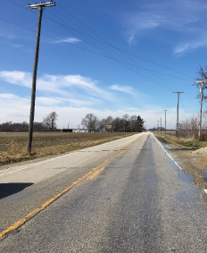
Thank You
Please visit with project officials following the public comment session
View displays and preliminary plans
Informal questions and answers
Informal comments are always welcome, however, please note general conversations are not part of the official record.
Thank you for your attendance this evening.
Formal public hearing is adjourned.
Notes:
THANK YOU FOR COMING OUT TO THE PUBLIC HEARING TONIGHT. PLEASE STAY AFTER SO REPRESENTATIVES CAN ANSWER YOUR QUESTIONS AND CAN DISCUSS ANY OF YOUR CONCERNS….
THANK LOCATION
THANKS AGAIN AND HAVE A GOOD EVENING.
THIS SESSION IS ADJOURNED.

