Slide 1
INDOT LPA Parcel Packet
Review Training
LPA & Real Estate Divisions, INDOT
August 28, 2014

Slide 2
Facilitators
Britni Saunders
LPA Training Program Director, INDOT
100 North Senate Avenue, N955
Indianapolis, IN 46204
317-234-7930
bsaunders@indot.in.gov
Trevor Mills
LPA Project Manager Supervisor, INDOT
100 North Senate Avenue, N955
Indianapolis, IN 46204
317-232-5121
tmills@indot.in.gov
Don Ballard
LPA Right of Way Supervisor, INDOT
100 North Senate Avenue, N642
Indianapolis, IN 46204
317-233-3055
doballard@indot.in.gov
Todd Clift
Acquisitions Manager, INDOT
100 North Senate Avenue, N642
Indianapolis, IN 46204
317-232-5060
wclift@indot.in.gov

Slide 3
Purpose & Objective
Purpose
To share information regarding the new process of parcel review on LPA projects
Objective
To understand the new LPA parcel review process and offer an opportunity for open Q&A

Slide 4
Organizational Chart
Todd Clift
Acquisitions Manager
All questions/calls should go through Don at this time
Don Ballard
LPA Right of Way Supervisor
317-233-2055
doballard@indot.in.gov
Mary Loy
LPA Right of Way Specialist
Suzi Wagner
LPA Right of Way Specialist
Julie Foreman
LPA Right of Way Specialist

Slide 5
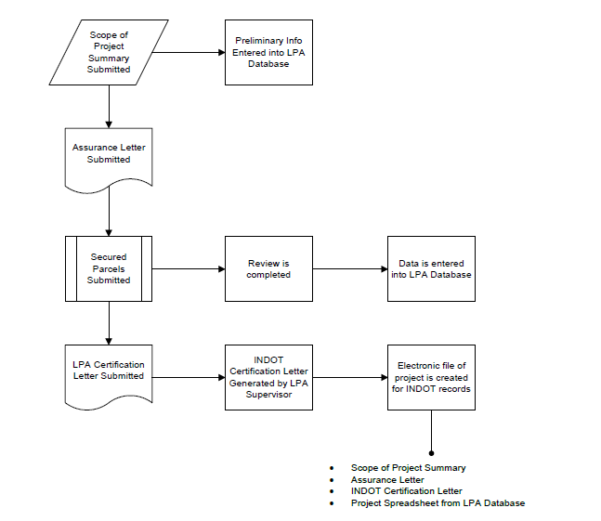
Local Project Acquisition Review

Slide 6
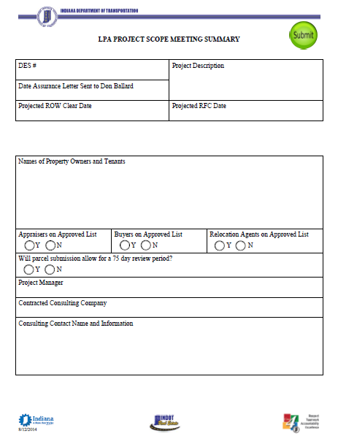
LPA Project Scope Meeting Form

Slide 7
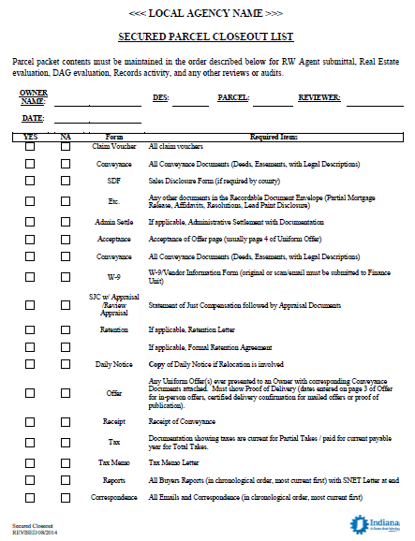
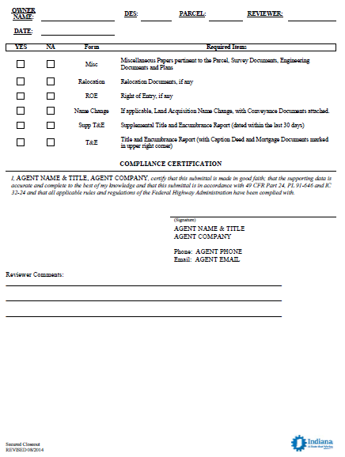
Secured Parcel Close-Out Form

Slide 8
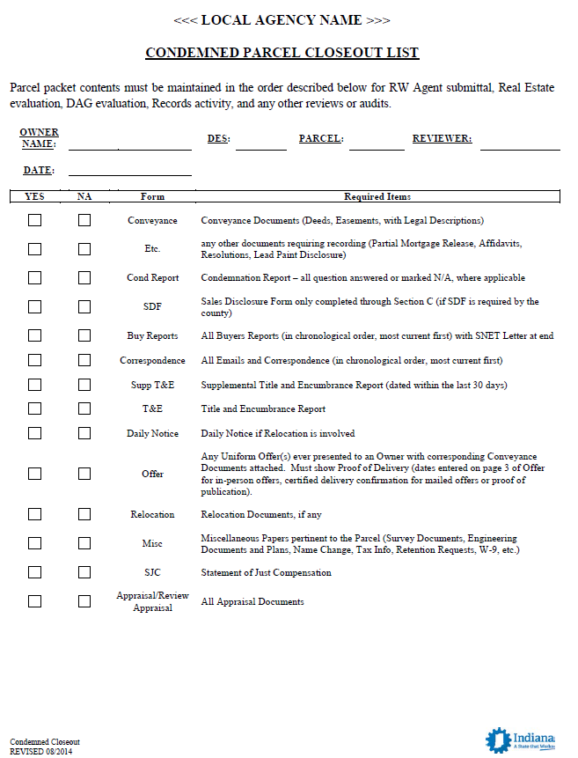
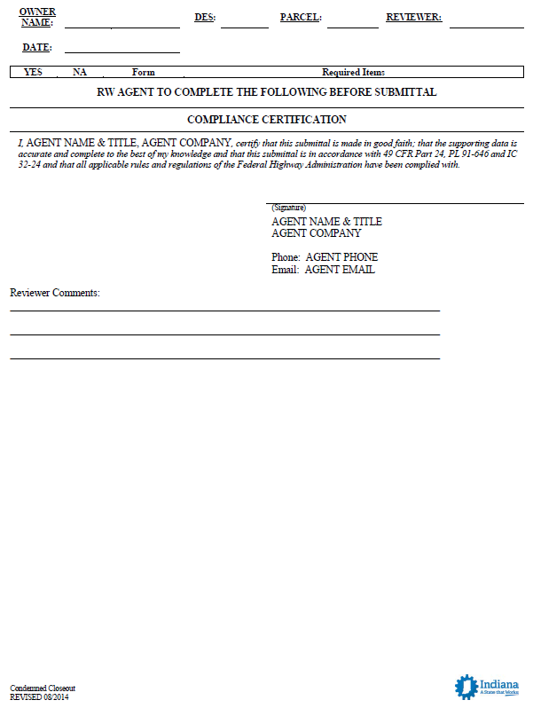
Condemned Parcel Close-Out Form

Slide 9
Frequently Asked Questions
Q: What should be submitted to ERMS?
A: Just Right-of-Way (ROW) plans. Parcels are sent to Don.
Q: Do appraisals need to be sent in to be approved?
A: No, not unless you have a unique situation and would like it to be reviewed. Otherwise, we will go with what you have given us.
Q: How does this process change impact ROW contracts?
A: It doesn’t. Contracts will still go through the District Local Program Directors. As a reminder, if you want to use federal funds on ROW acquisition, you need to make sure you have received FMIS approval. 2 other notes: 1. The Uniform Act must be followed explicitly even if just one penny of federal money touches the project during any phase. 2. If the LPA acquires ROW with federal money and then later sells it, the proceeds shall go toward another Title 23 eligible project.
Q: I have a ROW project with construction limits within existing ROW. How will this work?
A: The LPA will certify that there is no ROW needed but that is your call- when submitting plans, submit any documents on this you may have. The LPA must provide supporting documentation that they own the existing ROW.

Slide 10
Frequently Asked Questions
Q: The parcels that I have already submitted to the district, will those be reviewed again by CO?
A: No, but your next project’s parcels should come to us at CO.
Q: Do I need to still submit a Scope Meeting form for parcels that are ready to be sent somewhere?
A: No, just go ahead and send them to us and we would like to see the Scope Meeting form on the next project’s parcels.
Q: How will PMR waivers and SDFs work?
A: PMR Waivers are ok within reason. The LPA will assume the risk on all PMR Waivers. SDFs are not a federal regulation actually. If the County doesn’t require it, then that’s ok. If you can provide the SDF, we would like it.
Q: INDOT's Partial Mortgage Release (PMR) Waiver amount is currently $10k. Will this be the same for the LPA program?
A: We are looking at that. Right now we will evaluate this on a parcel-by-parcel basis. Any documentation you can provide will help. The waiver increase decision needs to come from the Attorney General’s office, so it may be awhile on that.

Slide 11
Frequently Asked Questions
Q: What about administrative settlements?
A: We do not need to approve your administrative settlements prior to submission, however, we are willing to review them and give you guidance if you desire. We just need the LPA to ‘tell the story’ effectively. We will ensure compliance at the end. All Administrative Settlements will require detailed supporting documentation to include; appraisal data, comps, project delay cost, condemnation cost etc. to support any increase to the appraised FMV acquisition offer amount.
Q: The LPAs asked what percentage INDOT will review? We’ve heard INDOT looks at 10%.
A: INDOT will review most, if not all, of the parcels.
Q: Can we expect delays in the reviewing process if parcels are not sent in all at the same time?
A: Technically, we have 75 days to review. That clock starts when the last parcel is received. Keep this in mind. Also, the sooner we get that Scope Meeting information, the better.
Q: Do you plan to issue a naming convention for the PDF files we will have?
A: We will accept FTP sites and/or DVD/CDs as a form of electronic submittal of parcel packets. This will cut down on Outlook storage issues that may occur with sending and receiving large files. All emails to the LPA group should include the DES # and Parcel # in the subject line for easier reference later.
Q: Can we use share file sites to submit parcels?
A: No.

Slide 12
Frequently Asked Questions
Q: How should we deal with Right of Entry?
A: Right of Entry can only be used on bare land parcels. If there is a unique situation, get with Don to discuss. Also there was a memo regarding Right of Entry that was issued recently. It will be reissued through the LPA GovDelivery subscription service once it is available. It is now more usable because it can be used when the offer’s made not when it’s accepted.
Q: Where will these forms be available online to use?
A: They will be posted shortly. We will communicate their location through the LPA division’s GovDelivery subscription service once they are available.
Q: How can I edit the document if it’s locked?
A: Click ‘Stop Protection’ in the Review tab. There should be no required password.
Q: If an LPA wants to change a conveyance document, is that ok?
A: Yes. We will require the LPA attorney to review it and submit a memo to file approving the change.

Slide 13
Frequently Asked Questions
Q: Who completes the LPA Project Scope Meeting form to submit it?
A: The LPA Consultant’s Project Manager or Right-of-Way Services Manager will submit the form to Don Ballard and carbon copy the INDOT LPA Project Manager.
Q: Can we use DropBox for submittals?
A: Yes, if INDOT’s security systems will allow us.
Q: Will the districts each still have a contact for general ROW coordination?
A: Contact Don Ballard with any Right-of-Way questions.
Q: Who do we invite to field checks? Don?
A: The LPA Review Unit will not be attending field checks.
Q: What role, if any, will Don West have in LPA projects?
A: At this time, none. Only the people identified as part of Don Ballard’s team will be involved in the LPA parcel review process.

Slide 14
Frequently Asked Questions
Q: On LPA projects, what is the role of the relocation reviewer?
A: Our role is to provide guidance when needed or requested and to review to ensure the parcel is compliant with state and federal regulations.
Q: There was discussion that presently existing ROW may go away. Can you discuss this?
A: The LPA and their consultant are to verify the ROW belongs to the LPA and that it is “clear” prior to letting.
Q: Is a W-9 required on every parcel?
A: You do not need to provide a copy of the W-9.

Slide 15
QUESTIONS?

Slide 16
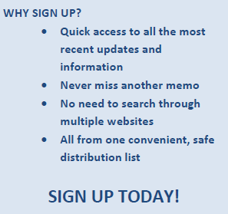
Future Updates & Communication
August Newsletter Topics:
LPA Pre-Award Annual Survey Reminder
NEW: LPA Parcel Packet Review Process
Follow Up: Reimbursement & Invoicing Procedures
Reminder of LPA Training Requirements
Indiana State Budget Agency Travel Policy Change
FHWA and FTA Open Call for 2015 Transportation Planning Excellence Award Nominations
UPDATE: Progress Towards Online LPA Training in 2015

