Slide 1
INDOT UTILITIES AND RAILROAD DIVISION
BUY AMERICA
FOR
UTILITY WORK

Slide 2
BUY AMERICA REGULATIONS
Federal Codes
23 U.S. Code 313
https://www.fhwa.dot.gov/map21/docs/title23usc.pdf
23CFR 635.410
https://www.ecfr.gov/cgi-bin/text-idx?rgn=div5;node=49%3A7.1.2.1.18#se49.7.661_16
49 US Code 5323j
https://www.gpo.gov/fdsys/pkg/USCODE-2011-title49/pdf/USCODE-2011-title49-subtitleIII-chap53-sec5323.pdf

Slide 3
WHAT IS BUY AMERICA?
Buy America comprises the requirements to utility work accomplished as part of a Federal-aid highway program(FAHP) funded project as defined by the National Environmental Protection Act (NEPA).

Slide 4
BUY AMERICA

Slide 5
BUY AMERICA—WHAT IS COVERED
Iron, steel or manufactured items
Permanent structures
Recycled steel is NOT covered

Slide 6
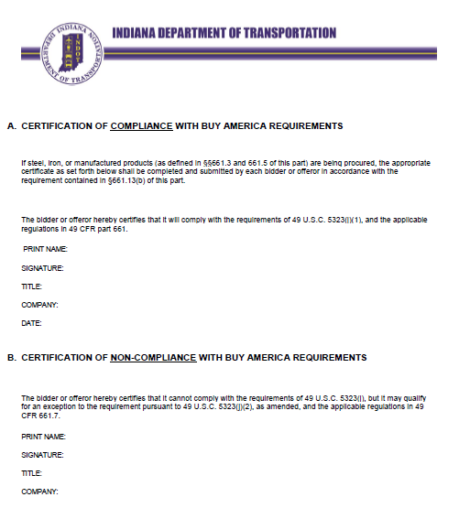
BUY AMERICA –CERTIFICATION OF COMPLIANCE
The certification can be found in the UTA library template.

Slide 7
BUY AMERICA—CERTIFICATION REQUIREMENTS
The certification form is Per 23CFR 635.410. The certification form of compliance/non-compliance form is required if Iron, steel or manufactured products are being procured.

Slide 8
BUY AMERICA
UTILITY COORDINATOR’S RESPONSIBILITIES
Evaluate material on a case by case to determine if Buy America applies.
Ensure that Certification of Compliance is completed by manufacturer, signed by utility and manufacturer and delivered appropriately.
Although the italicized language is in all Utility agreements, the Utility Coordinator must still follow the Buy America Certification requirements as well.
The Utility agrees that all steel and cast iron materials and products to be used under this agreement will be produced and manufactured in the United States of America pursuant to the requirements of Indiana Code 5-16-8-1, et al, and 23 CFR 635.410.

Slide 9
BUY AMERICA
CERTIFICATION OF COMPLIANCE
The Certification document can be found in the UTA template library
Utility Oversite Coordinator is responsible for turning the completed and signed form in to the Project Manager to ensure it is properly given to Project Engineer

Slide 10
BUY AMERICA
CERTIFICATION PROCESS CHECKS AND BALANCES
Mark the appropriate box on the Utility Agreement Routing form if Buy America Applies
The Administrator will confirm that the certification has been turned in to the PM
Copies of the Buy America Certificates should be uploaded by the Utility Oversight/Coordinator to the UTA for document retention

Slide 11
BUY AMERICA
ADDITIONAL RESOURCES
Construction Memorandum 17.04
FHWA Buy America Issues to Consider for Utility

