Slide 1
Process for requesting a Mileage Certification Change through INDOT Road Inventory
Kathy Eaton-McKalip

Slide 2
Road Inventory Mileage Change Request
Verify current INDOT Inventory of your roads
INDOT’s Inventory of Roads is limited to what has been reported to the Office of Road Inventory in the past.
If a segment of roadway is not shown in INDOT’s Inventory it is not getting reported to the Auditor of the State of Indiana and no MVH funding is being distributed for that mileage.
It is equally important to remove segments that appear in INDOT’s Inventory that are not actually a county roads or a city or a town street.
There could be certain maintenance and liability issues associated with these types of roads.
New property owners along a “Private” street or drive may expect the Jurisdiction (County, City, or Town) to maintain the drive.
An injury accident occurs on a “Private” drive that is in the official Inventory and the Jurisdiction (County, City, or Town) could be named in litigation as a defendant.
INDOT Road Inventory recently audited many Counties to remove roads that were not actually in the Counties Inventory.
Inventory Summary tables and Map viewer are available online

Slide 3

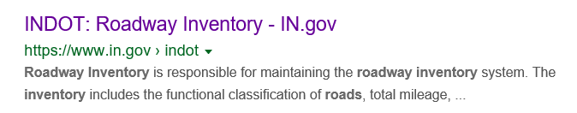

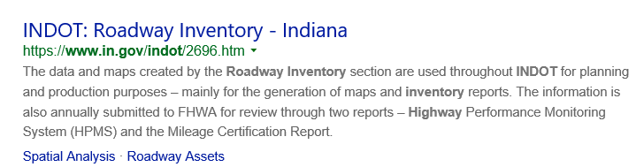
Road Inventory Mileage Change Request
From any web browser search window search for INDOT Road Inventory:

Slide 4
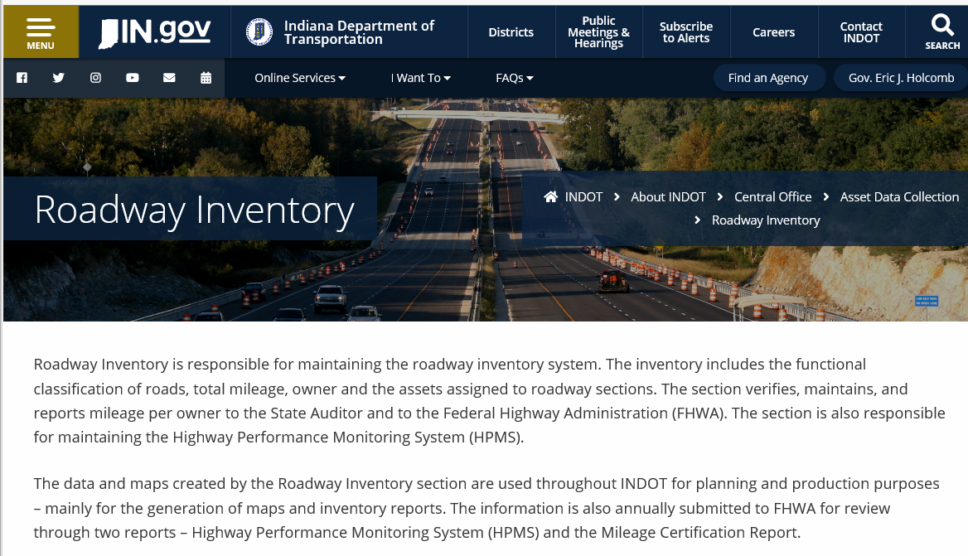
Road Inventory Mileage Change Request
Either Link should take you to the following page:

Slide 5
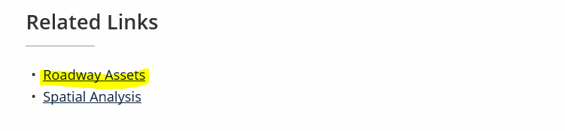
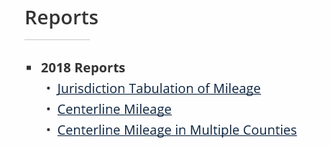
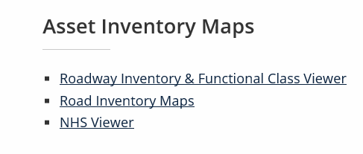
Road Inventory Mileage Change Request
Scroll down to the Related Links Section:
The Roadway Assets Link will direct you to the Summary Tables and Online Map Viewers

Slide 6
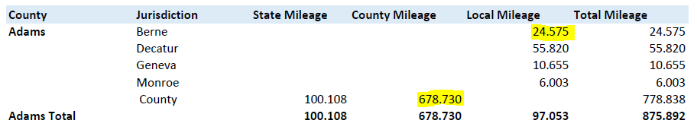
Road Inventory Mileage Change Request
The Centerline Mileage Report will show the Summary of Mileage for each Jurisdiction.
This is what gets reported to FHWA and the Auditor for the State of Indiana.
Sample: in the sample below, Adams County has 678.730 miles of County Roads, While the Town of Berne has 24.575 miles of town Streets.

Slide 7
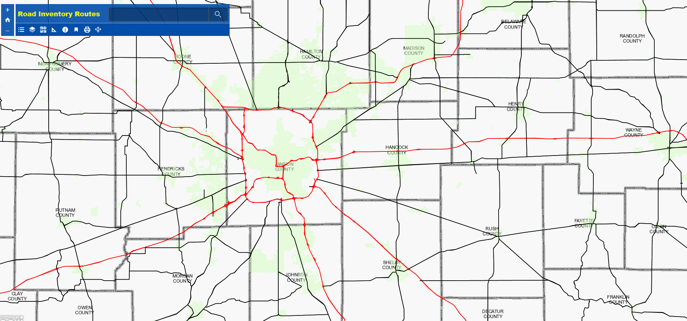
Road Inventory Mileage Change Request
The Roadway Inventory Maps Link will open up a Webmap Viewer.

Slide 8
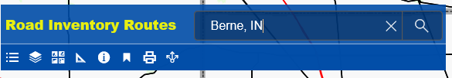
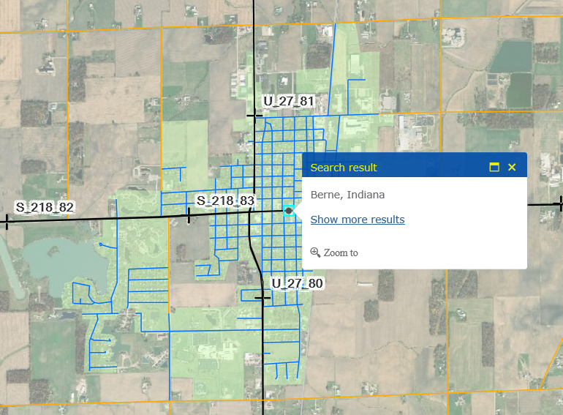
Road Inventory Mileage Change Request
Type the name of your County, City or Town into the search pane and click on the Magnifying glass icon.
The map should then zoom to the location of interest.

Slide 9
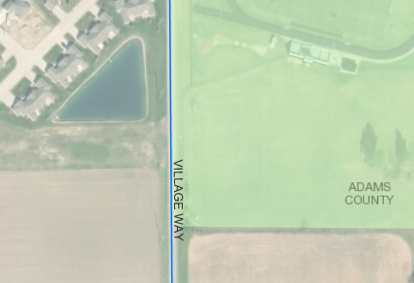
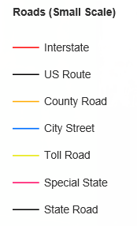
Road Inventory Mileage Change Request
The Line Colors Indicate the Jurisdiction of the Roadway (i.e. State, County, or City).
Areas with a greenish overlay are the Corporate Boundaries of Towns and Cities.
City
County

Slide 10











Road Inventory Mileage Change Request
About the Map
The “+” zooms into the map. The “-” zooms out. The “Home” icon pans the map back to the
opening screen location. The Legend will open the legend. The Layer will allow you to select additional
layers to show or turn layers off to show less. The Basemap icon will allow you to change the basemap to a
variety of available maps. The Measure icon opens up the measuring tool which can be used to measure
distance, area or determine location ( Lat. and Long.). The details icon is used to select a line or area of the map
and will yield specific information about that feature, such as Road Name, Route ID, Jurisdiction and City Name.
The Bookmark icon will pull up several preset location bookmarks. The Print icon will allow you to set up
and print a map that you have displayed. The Share icon allows you to share the map with others (maybe).

Slide 11
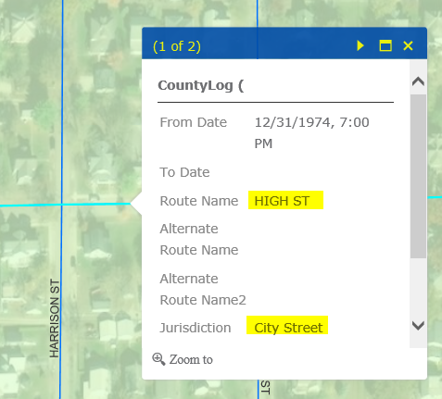
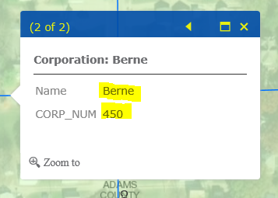
Road Inventory Mileage Change Request
Example of Details tool:
Notice the Street Name is High St
and the Jurisdiction is City Street
Also the (1 of 2) indicates that there
Is another feature that has been selected
Click the > arrow and you will see that
Corp Boundary name and Corp Number
are shown.

Slide 12
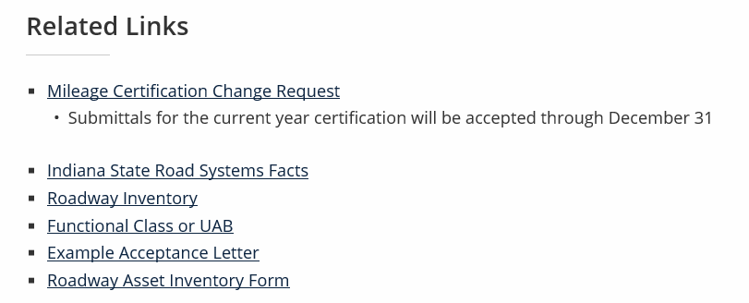
Road Inventory Mileage Change Request
Back to the Road Inventory Links and locate the Related Links section under Asset Inventory Maps:
This is where you will find the Mileage Certification Change Request form, Example Acceptance Letter and the Roadway Asset Inventory form.

Slide 13
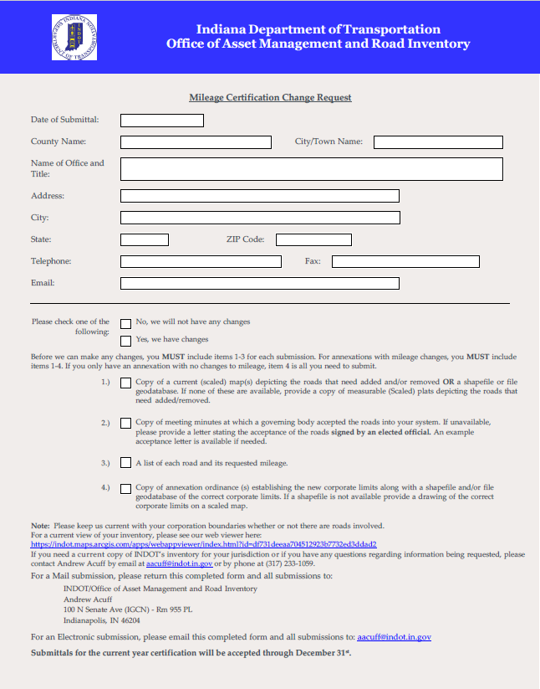
Road Inventory Mileage Change Request
The Mileage Change Request form can be exported, printed, or filled in online and then sent to the Road Inventory Manager or Route Network Coordinator.
The top portion is mostly contact information
for the agency requesting the change.
The middle portion is describing the information
needed to properly process and complete the
request.
The bottom portion is information on who
to submit the form to and contact information
for the Road Inventory Group.

Slide 14
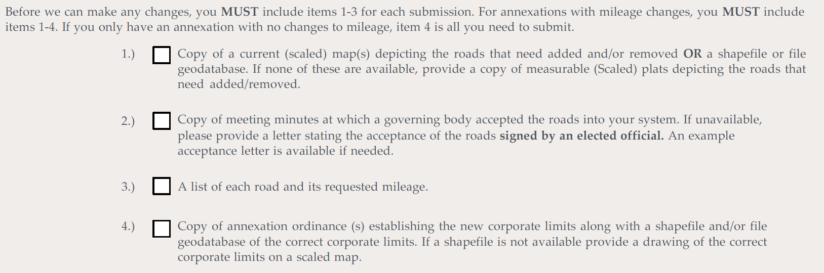
Road Inventory Mileage Change Request
Required Items for Mileage Change Request

Slide 15
Road Inventory Mileage Change Request
Requests can be submitted in multiple formats.
Sent via USPS, FedEx, UPS or hand delivered.
If sent via mail, please retain a copy of all documents sent and follow up with a phone call 2 weeks after mailing.
Transmitted via email
When submitting by email please send to both the Road Inventory Manager and the Route Network Coordinator.
Follow up with a phone call shortly after sending the email.
Maps.
INDOT online web map screen shot with mark-ups.
Jurisdiction GIS Map screen shot with mark-ups.
Google maps or other online mapping source with mark-ups.
GIS files
Geodatabase/Shapefile/ArcGIS Map Package

Slide 16
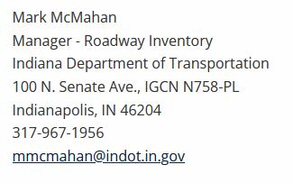
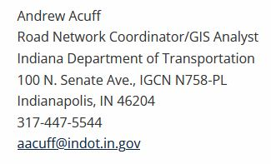
Road Inventory Mileage Change Request
Contact Information:

