Slide 1

DocuSign
Kathy Eaton-McKalip
Director LPA Programs, INDOT

Slide 2
DocuSign
All parties will use DocuSign to electronically sign INDOT LPA Contracts and Local Roads and Bridges Matching Grant Agreements.
The Employee in Responsible Charge (ERC) must give INDOT contact information for the person(s), with Legal Binding Authority, to sign contracts for a local agency.

Slide 3
DocuSign ‒ Legal Binding Authority
What is Legal Binding Authority?
Definition of Legal Binding Authority:
Mayor; or
Designee with one of the following to demonstrate signatory has legal authority to bind the agency:
  Ordinance showing one official signatory is sufficient to legally bind the agency.
  Resolution which shows the individual who signed has the legal authority to bind the agency.
  Meeting Minutes which delegates legal authority to one individual to sign on behalf of the agency, or
Multiple signatures from a quorum of County Commissioners, Board of Public Works, or Town Council.

Slide 4
DocuSign ‒ Legal Binding Authority
INDOT only requires one (1) legal signature per contract.
However, unless it is signed by a Mayor, the agency must send in a copy of an ordinance, resolution, or meeting minutes stating that the agency agrees to only one (1) legal signer (i.e., Board President, Council President). Otherwise, more than one (1) legal signature will be required.

Slide 5
DocuSign ‒ Legal Binding Authority
LPAs will receive instructions requesting the following information is returned to INDOT prior to a contract being routed to a local agency for execution:
Signer Name: = First and last name of legal signer.
Signer Email: = An email address that will mail directly to the legal signer.
Signer Cell Phone Number: = A phone number that can receive a text message. This text message will be sent with the authorization code needed for the legal signer to enter into DocuSign as a verification of identity. This is the preferred method of signature verification.
Alternative Means of Signature Verification: = If the legal signer does not have a cell number, or does not want to provide their cell number, they will receive an email with an authorization code, located within the body of the email, to enter into DocuSign as verification of identity.

Slide 6
DocuSign ‒ Legal Binding Authority
Below is an example of the form the agency’s ERC will be required to complete for Legal Binding Authority signer's information.
ONLY LIST LEGAL SIGNERS WHO WILL BE / ARE ABLE TO SIGN. The contract will be routed to legal signer(s) in the order you provide and assign.
All listed signatories you provide must sign using DocuSign.
A Member cannot be marked absent.
If you know an ‘assigned’ legal signer will not be available, notify your District Program Director immediately so that person can be removed as a legal signer from that contract.
The contract will not move to the next legal signer until the previous signer has signed and submitted the signed contract using DocuSign.
Electronic signatures cannot be attested.
LPA Name: | Town in Indiana
1 – Signer Name: 1 – Signer Email: 1 – Signer Cell Phone Number: | Dan Doe ddoe@email.com 317-555-1234
2 – Signer Name: 2 – Signer Email: 2 – Signer Cell Phone Number: | Jane Doe jdoe@email.com 317-555-9999
3 – Signer Name: 3 – Signer Email: 3 – Signer Cell Phone Number:
4 – Signer Name: 4 – Signer Email: 4 – Signer Cell Phone Number:

Slide 7
DocuSign ‒ Legal Binding Authority
Important:
If a legal signer is unable to sign, please contact your District Program Director immediately so the contract can be re-sent to the revised legal signer(s).
Re-sending a contract, for any reason, will re-start the legal signature process for that contract. Those who had previously signed the contract will be required to sign again.

Slide 8
DocuSign ‒ Routing for Signatures
It is INDOT’s process to e-mail a draft copy of the contract to the local agencies ERC each time a contract is routed to the legal signer(s).
This is only a draft copy and not to be signed but may be used for any public meeting and votes.
The ERC should notify legal signer(s) this contract has been routed to them via DocuSign for their signature.
This draft copy can be routed and viewed by all persons required to review the contract prior to it being signed by the legal signers for the local agency.

Slide 9
DocuSign ‒ DocuSign Emails
Examples:
The email a legal signer will receive will be from DocuSign NA3 System < dse_NA3@docusign.net >
  FYI – email may go to their SPAM or Junk email folder.
Subject of email will be your agency name, phase of the project, SCM# (tracking # for DocuSign), project DES #, EDS #.
Legal Signers can view the document prior to signing by clicking REVIEW DOCUMENT.
See email examples on the next slides.

Slide 10
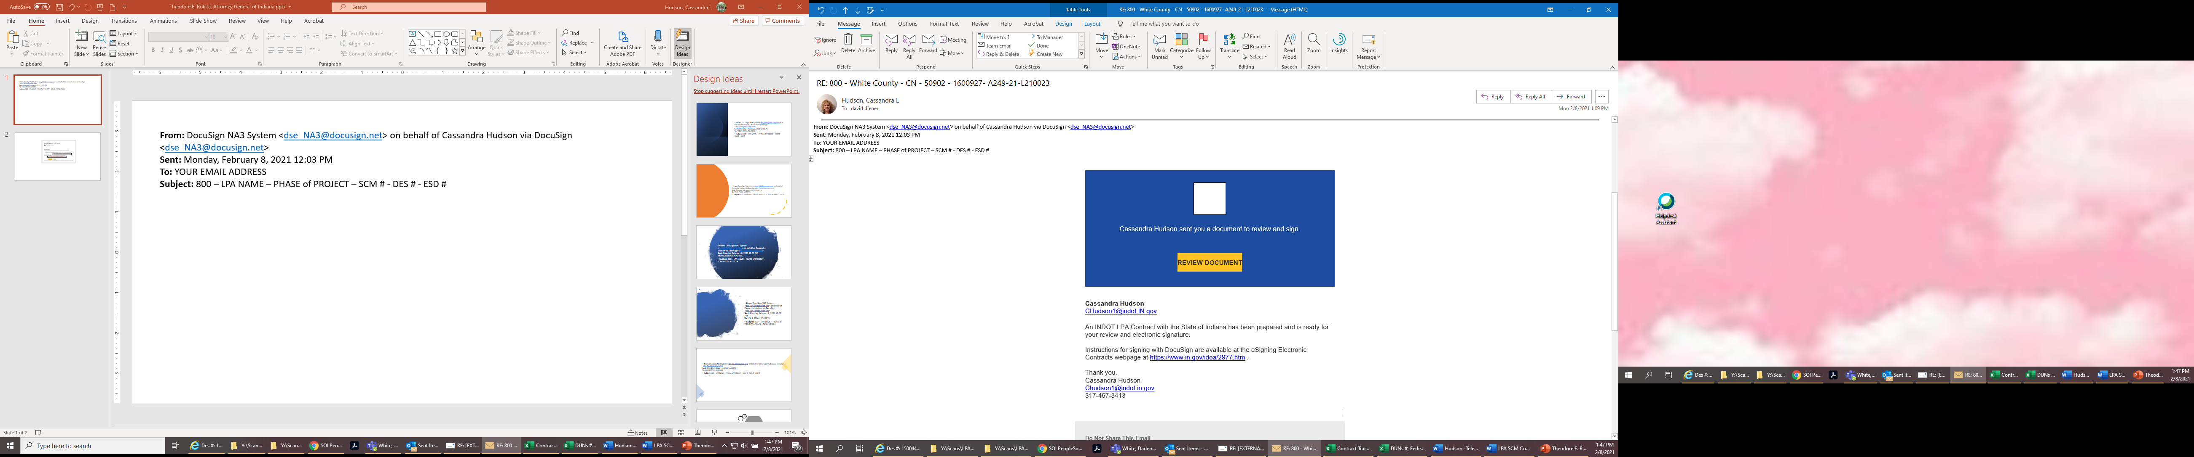
DocuSign ‒ DocuSign Emails
You will receive an email from dse_NA3@docusign.net
Subject will be your agency name, phase of the project, SCM# (tracking # for DocuSign), project DES #, EDS #.
Click ‘REVIEW DOCUMENT’ to view the contract.
The legal signer will then start the signature process by requesting the Authorization Code be texted to their cell.

Slide 11
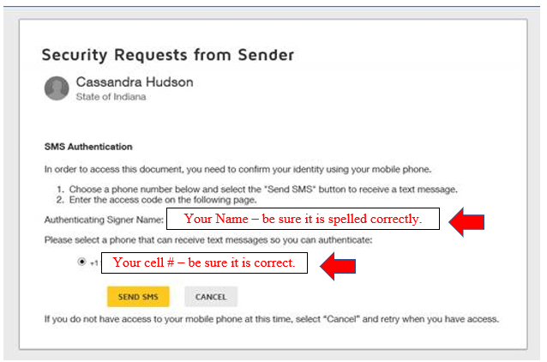
DocuSign ‒ DocuSign Emails
Click ‘SEND SMS’ to request the Authorization Code texted to your cell number.

Slide 12
DocuSign ‒ Authorization Code
Important: Once legal signer has viewed the contract, they will be prompted to click ‘SEND SMS’ and an Authorization Code will be texted to their cell number.
The Authorization Code texted is only valid for 48-hours from receipt. If a legal signer does not sign within a 48-hour period, a new Authorization Code will be required.
A New Authorization Code can be generated by the legal signer simply opening the original email and clicking the ‘SEND SMS’ link again, and a new Authorization Code will be texted to their cell number.

Slide 13
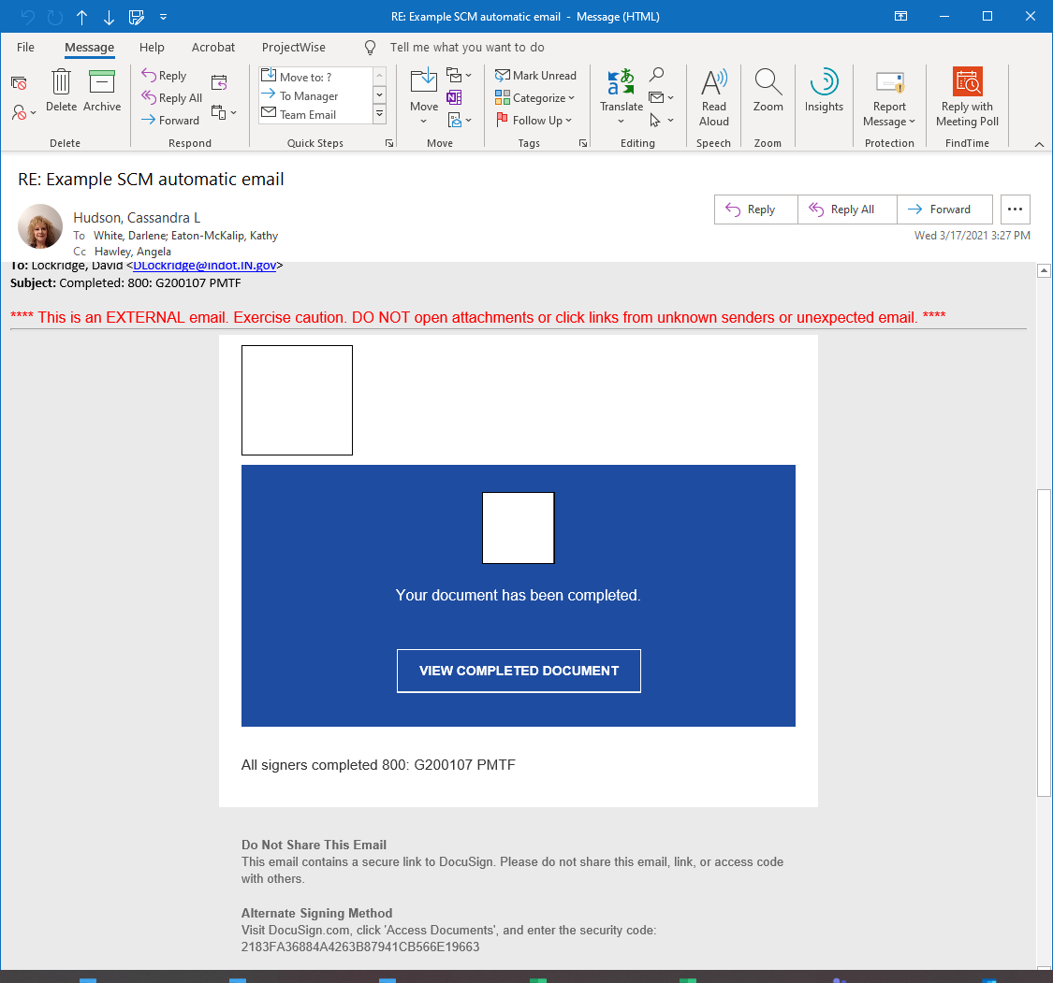
DocuSign ‒ DocuSign Emails
Important: Once all legal signers for your LPA has signed and the LPA/MPO Grant Administrator has signed for INDOT, all signers will receive an email from dse_NA3@docusign.net, as pictured here.
This e-mail is automatically generated by DocuSign and DOES NOT mean this INDOT Contract is now a fully executed, legally binding contract.

Slide 14

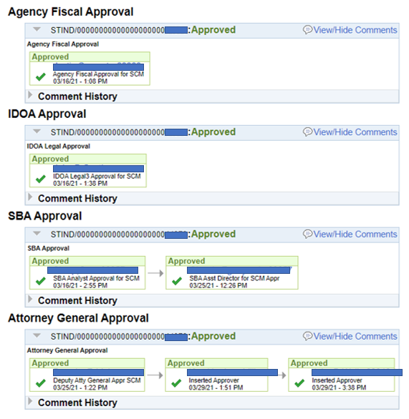
DocuSign ‒ DocuSign Emails
Important: For the contract to be a fully executed, legally binding contract, the contract will still require signatures from The Indiana Department of Administration (IDOA) and State Budget Agency (SBA). Furthermore, if the contract is an Amendment, it will also require the signature of The Office of the Attorney General (AG). These signatures will appear on the fully executed, legally binding contract as pictured here.
Once the contract is fully executed by INDOT, the District Program Director will e-mail a pdf file of the fully executed, legally binding contract to the local’s ERC for their records.

Slide 15
DocuSign ‒ Lifecycle of the Contract
In preparation for using DocuSign, the Employee in Responsible Charge (ERC) must give INDOT contact information for the person(s), with Legal Binding Authority, to sign contracts for a local agency.
  INDOT will require the name, email, and cell number of the legally binding signer(s).
  The time taken for this step is dependent on the LPA.
A contract is requested by the District Program Director, created, and routed via DocuSign to the legal signer(s).
  Draft copy of the contract is emailed to the LPA’s ERC to be routed and viewed by all persons required to review the contract prior to it being signed by the legal signers for the local.
  The time taken for this step in the signature process depends on the local’s board or council meeting dates.
All legal signers have signed the contract, and the contract is routed to the LPA/MPO Grant Administrator for signature.

Slide 16
DocuSign ‒ Lifecycle of the Contract - continued
Department of Workforce Development (DWD) and Department of Revenue (DOR) clearances are run for the local by INDOT.
  If there are outstanding issues with a clearance, this may delay the routing of the contract until the issues are resolved by the LPA.
  If DOR/DWD issues delay the contract routing more than 30 days, the contract will have to be resigned by the LPA.
Contract is routed for INDOT approval.
  The Department of Admiration (DOA)
  State Budget Agency (SBA)
  The Office of the Attorney General (AG)
A fully executed, legally binding contract is e-mailed to the local’s ERC for their records.

Slide 17
DocuSign ‒ Helpful Links
Local Public Agency Program https://www.in.gov/indot/doing-business-with-indot/local-public-agency-programs/
How to Electronically Sign a Contract Training Materials https://www.in.gov/indot/doing-business-with-indot/local-public-agency-programs/
DocuSign Process for Signing a State Contract https://www.in.gov/idoa/wbt/DocuSign_IdentityAuth/index.html
DocuSign Process to Decline to Sign a State Contract https://www.in.gov/idoa/wbt/DocuSign_DeclineSigning/index.html
Instructions for signing with DocuSign are available at the eSigning Electronic Contracts webpage at https://www.in.gov/idoa/2977.htm

Slide 18
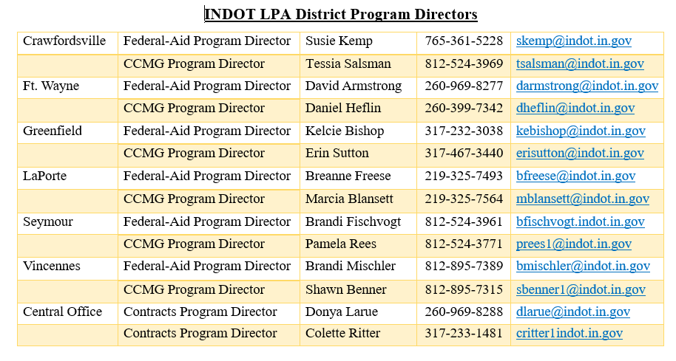
District LPA Program Directors

